Slide 1

BIBO STABILITY OF NONLINEAR
FUZZY PI CONTROL SYSTEMS
- Guanrong Chen, Hao Ying, 1997
Presented to,
Prof. Murali Mohan Bosukonda
Department of Electrical Engineering
IIT Kharagpur
Presented by
Sai Joshitha Annareddy
21EE62R10
MTech
Control Systems Engineering
IIT Kharagpur
Seminar 2
Total Slides-30

Slide 2

CONTENTS
Introduction
The Fuzzy PI Controller
Stability of Non Linear Fuzzy PI Control System
Theorems
Linear Process-Explicit Results
Conclusions
References

Slide 3
When was the First
Fuzzy controller introduced?
1974, Mamdani
Due to important and challenging issues such as stability, controllability, observability, identifiability for Fuzzy control systems.
Can a stable conventional linear PI controller be replaced by the Non linear Fuzzy PI controller ?
How one should choose the parameters of the fuzzy PI controller to ensure its BIBO stability?

Slide 4
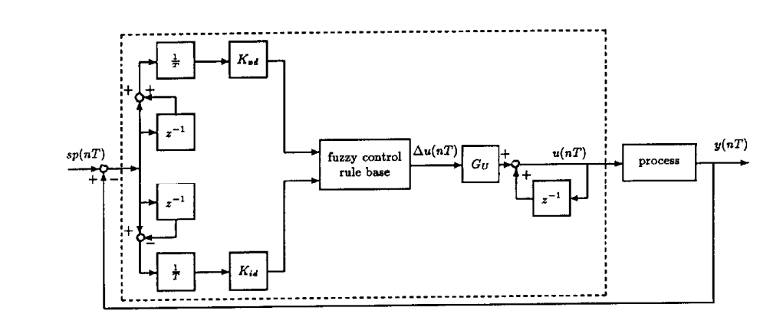
The Fuzzy PI controller
Fuzzy PI controller is a rule based digital controller
Figure 1: Fuzzy PI control system

Slide 5

From Figure 1 u(nT) = u(nT-T) + $G_{U}∆u\left(nT\right)$ …(1)
where…
$G_{U}$ is fuzzy control gain
$∇u\left(nT\right)$ is incremental control output of fuzzy controller
In general u(0) = 0
1. Fuzzification 2. Fuzzy control rules 3. Defuzzification

Slide 6
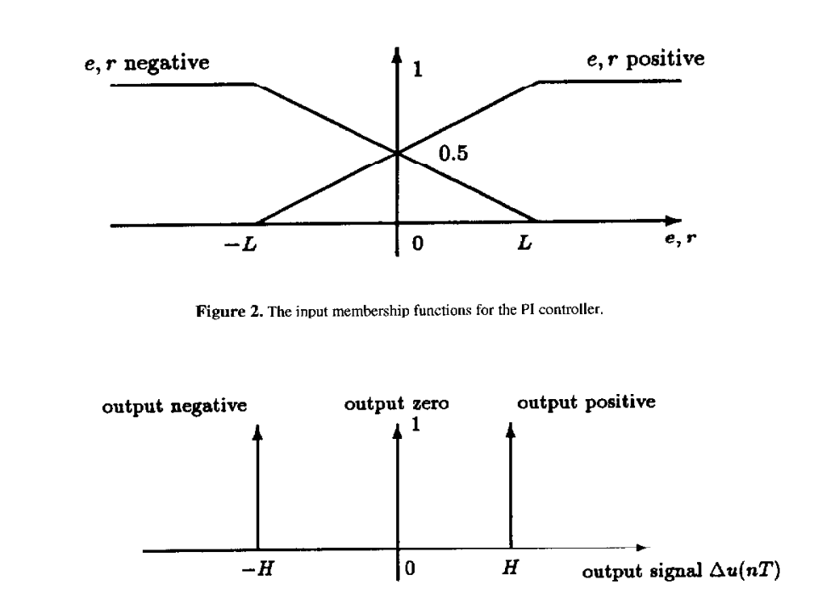
Figure 2: Input membership functions for the PI controller
The Fuzzy controller here employs two inputs: 1. Error signal, e(nT) 2. Rate of change of error signal, r(nT)

Slide 7
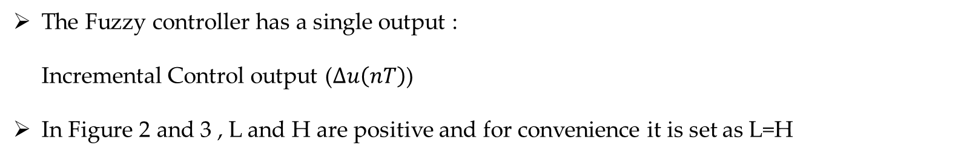
Figure 3: The output membership functions for the PI controller
The Fuzzy controller has a single output : Incremental Control output ($∆u\left(nT\right)$)
In Figure 2 and 3 , L and H are positive and for convenience it is set as L=H

Slide 8
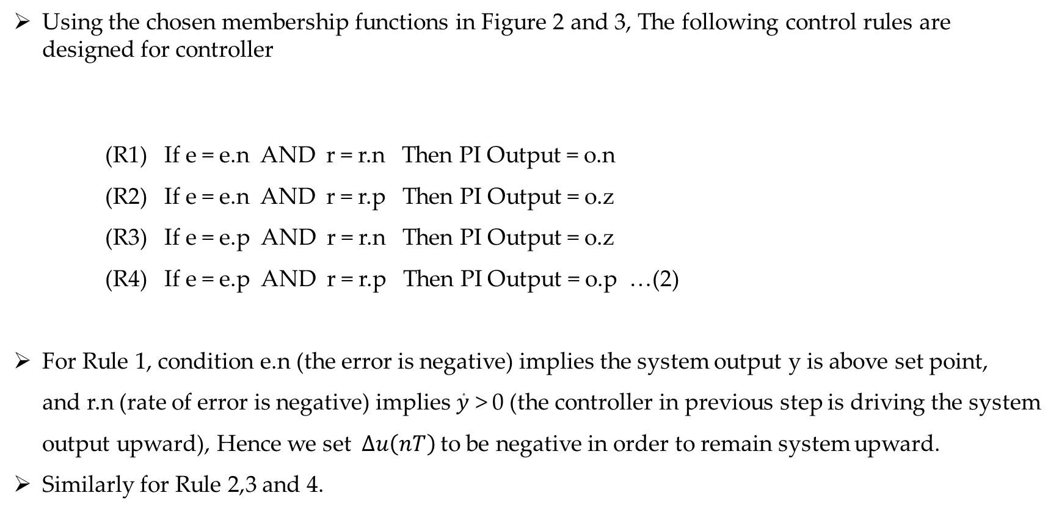
Using the chosen membership functions in Figure 2 and 3, The following control rules are designed for controller
(R1) If e = e.n AND r = r.n Then PI Output = o.n (R2) If e = e.n AND r = r.p Then PI Output = o.z (R3) If e = e.p AND r = r.n Then PI Output = o.z (R4) If e = e.p AND r = r.p Then PI Output = o.p …(2)
For Rule 1, condition e.n (the error is negative) implies the system output y is above set point, and r.n (rate of error is negative) implies $\dot{y}$ > 0 (the controller in previous step is driving the system output upward), Hence we set$∆u\left(nT\right)$ to be negative in order to remain system upward.
Similarly for Rule 2,3 and 4.

Slide 9
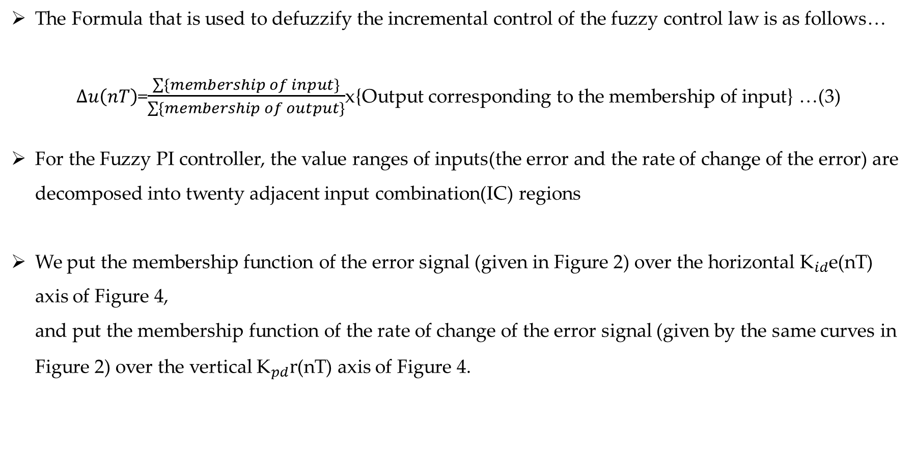
The Formula that is used to defuzzify the incremental control of the fuzzy control law is as follows…
$∆u\left(nT\right)$=$\frac{\sum{\{membership of input\}}}{\sum{\{membership of output\}}}$x{Output corresponding to the membership of input} …(3)
For the Fuzzy PI controller, the value ranges of inputs(the error and the rate of change of the error) are decomposed into twenty adjacent input combination(IC) regions
We put the membership function of the error signal (given in Figure 2) over the horizontal ${\text{K}}_{id}$e(nT) axis of Figure 4, and put the membership function of the rate of change of the error signal (given by the same curves in Figure 2) over the vertical ${\text{K}}_{pd}r$(nT) axis of Figure 4.

Slide 10
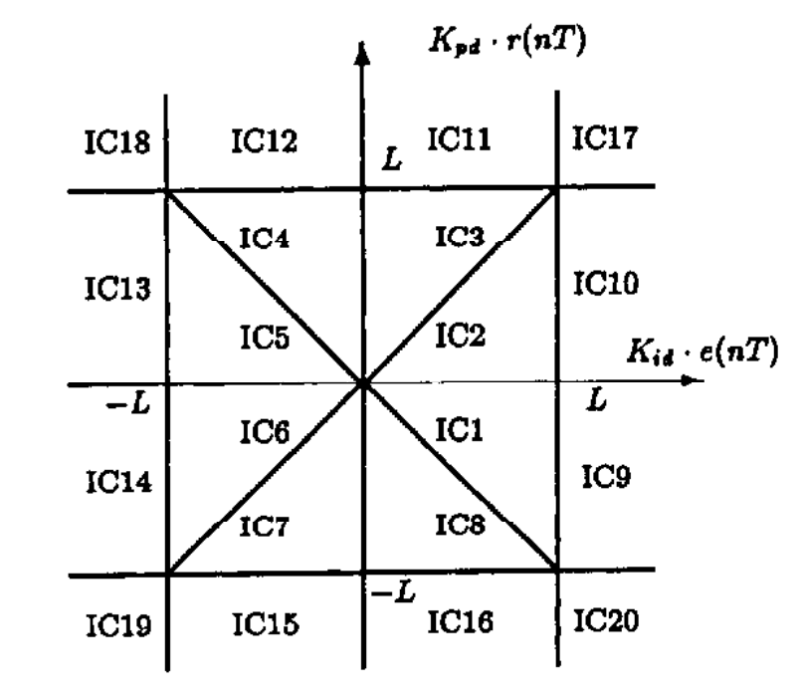
{error = e.n AND rate = r.n} = min{ e.n , r.n } = e.n
Therefore, Rule 1 (R1) yields
The selected input membership value is e.n
corresponding output membership value is o.n
(R1)
Figure 4: Regions of Fuzzy PI controller input-combination values

Slide 11
Similarly in IC1 Rules 2-4 and logical “AND” used to yield as
The selected input membership value is e.n
corresponding output membership value is o.z
The selected input membership value is r.n
corresponding output membership value is o.z
The selected input membership value is r.p
corresponding output membership value is o.p
(R2)
(R3)
(R4)
The above are True for IC1 and IC2, Thus the defuzzification formula is as follows
$∆u\left(nT\right)$ = $\frac{e.n ×o.n + e.n ×o.z + r.n ×o.z + r.p × o.p }{e.n+e.n+r.n+r.p}$ …(4)

Slide 12
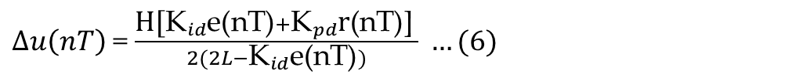
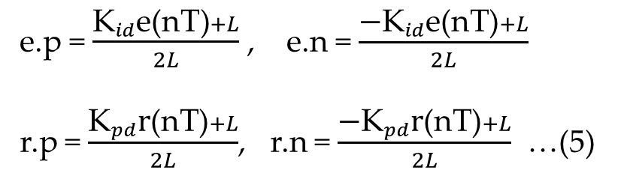
From Figure 4 we get o.p=H, o.n=-H, o.z=0 . The following are the straight line formulas from the geometry of membership functions.
e.p = $\frac{{\text{K}}_{id}\text{e}\text{(}\text{nT}\text{)}+L}{2L}$ , e.n = $\frac{{\text{−}\text{K}}_{id}\text{e}\text{(}\text{nT}\text{)}+L}{2L}$
r.p = $\frac{{\text{K}}_{pd}\text{r}\text{(}\text{nT}\text{)}+L}{2L}$, r.n = $\frac{{\text{−}\text{K}}_{pd}\text{r}\text{(}\text{nT}\text{)}+L}{2L}$ …(5)
And the rate of change of input is given as….
$∆u\left(nT\right)$= $\frac{{\text{H}\text{[}\text{K}}_{id}\text{e}\text{(}\text{nT}\text{)}+{\text{K}}_{pd}\text{r}\text{(}\text{nT}\text{)]} }{2(2L−{\text{K}}_{id}\text{e}\text{(}\text{nT}\text{)})} …(6)$

Slide 13
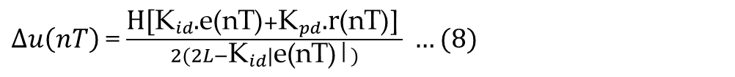
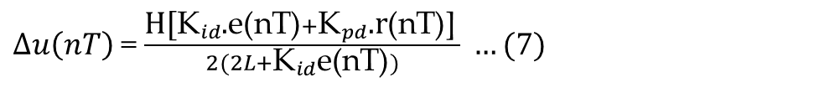
Similarly for IC5 and IC6 regions, we obtain...
$∆u\left(nT\right)$= $\frac{{\text{H}\text{[}\text{K}}_{id}\text{.}\text{e}\text{(}\text{nT}\text{)}+{\text{K}}_{pd}\text{.}\text{r}\text{(}\text{nT}\text{)]} }{2(2L+{\text{K}}_{id}\text{e}\text{(}\text{nT}\text{)})} …(7)$
By combining above two formulas. The following is the generalized result for IC1,IC2,IC5 and IC6.
$∆u\left(nT\right)$= $\frac{{\text{H}\text{[}\text{K}}_{id}\text{.}\text{e}\text{(}\text{nT}\text{)}+{\text{K}}_{pd}\text{.}\text{r}\text{(}\text{nT}\text{)]} }{2(2L−{\text{K}}_{id}|\text{e}\text{(}\text{nT}\text{)|})} …(8)$
Let the incremental gain formula scale by ${\text{G}}_{u}$

Slide 14


${\text{G}}_{u}∆u\left(nT\right)$= ${\text{−}\text{K}}_{I}\text{.}\text{e}\text{(}\text{nT}\text{)}+{\text{K}}_{P}\text{.}\text{r}\text{(}\text{nT}\text{) }…(9)$
${\text{−}\text{K}}_{I} \text{and}{ \text{K}}_{P}$ are given as below…
${\text{K}}_{I}$= $\frac{{\text{G}}_{E}{\text{G}}_{U}H}{2(2L−{\text{G}}_{E}|\text{e}\text{(}\text{nT}\text{)|})}$
${\text{K}}_{P}$= $\frac{{\text{G}}_{R}{\text{G}}_{U} H}{2(2L−{\text{G}}_{E}|\text{e}\text{(}\text{nT}\text{)|})}$ …(10)
${\text{G}}_{R}={\text{K}}_{pd} and{ \text{G}}_{E}={\text{K}}_{id}$ are Fuzzy control gains which are related to the conventional linear PI control gains ${\text{K}}_{p} and {\text{K}}_{i}$.
${\text{K}}_{i}$= $\frac{{\text{G}}_{E}{\text{G}}_{U} H}{4L}$
${\text{K}}_{p}$= $\frac{{\text{G}}_{R}{\text{G}}_{U} H}{4L}$ …(11)
We call a conventional PI controller as Nonlinear fuzzy PI controller if e(nT) = r(nT) = 0

Slide 15
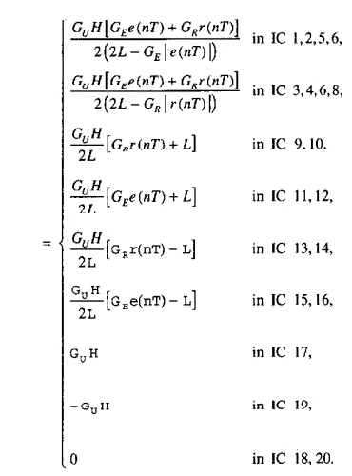
Working through all regions in same way, we obtain for the twenty IC regions
$${\text{G}}_{u}∆u\left(nT\right)$$
…(12)

Slide 16
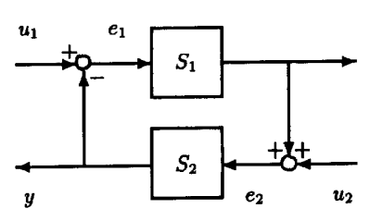
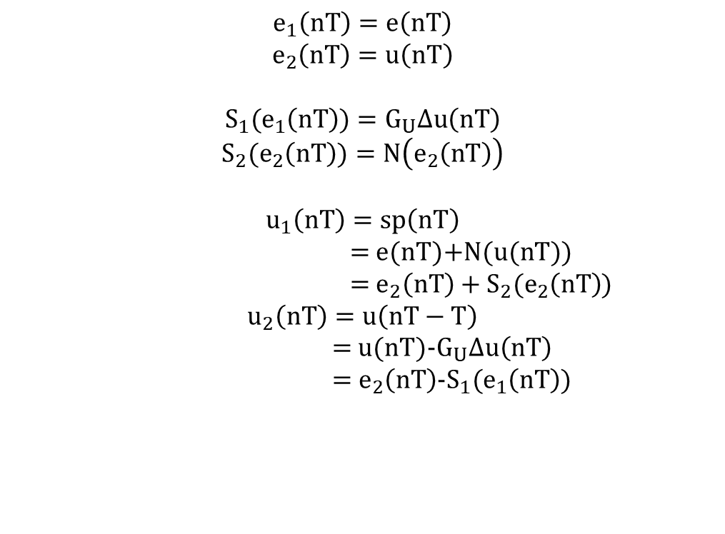
Stability of Nonlinear Fuzzy PI Control System
Let us consider the process under control is nonlinear and denoted by N.
$$e_{1}\left(nT\right)=e\left(nT\right)$$
$$e_{2}\left(nT\right)=u\left(nT\right)$$
$${S_{1}(e}_{1}\left(nT\right))=G_{U}∆u\left(nT\right)$$
$${S_{2}(e}_{2}\left(nT\right))=N\left(e_{2}\left(nT\right)\right)$$
$$u_{1}\left(nT\right)=sp\left(nT\right)$$
= e(nT)+N(u(nT))
= $e_{2}\left(nT\right)+{S_{2}(e}_{2}\left(nT\right)$)
$$u_{2}\left(nT\right)=u\left(nT−T\right)$$
= u(nT)-$G_{U}∆u\left(nT\right)$
= $e_{2}\left(nT\right)$-${S_{1}(e}_{1}\left(nT\right))$
Figure 5: an Equivalent closed loop control system
…(13)

Slide 17
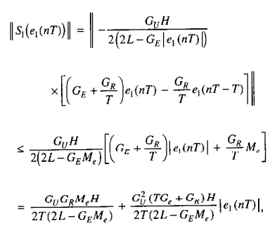

…(14)
Where ||N|| is the operator norm of the given N(.) or the gain of non linear system
Over the set of admissible control signals that have any meaningful function norms and Me is the maximum of magnitude of the error signal.

Slide 18
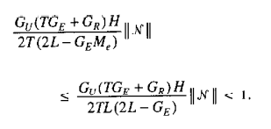
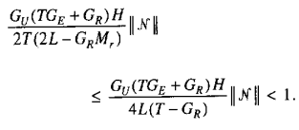
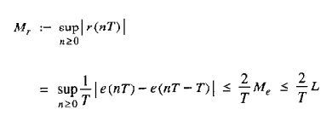
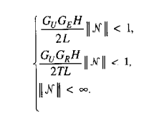
To this end ,An application of small gain theorem is done and the following is the sufficient condition for the BIBO stability of the closed loop non linear fuzzy control system
…(15)
When e(nT) and r(nT) are in different IC regions, we can observe different stability conditions…
…(16)

Slide 19

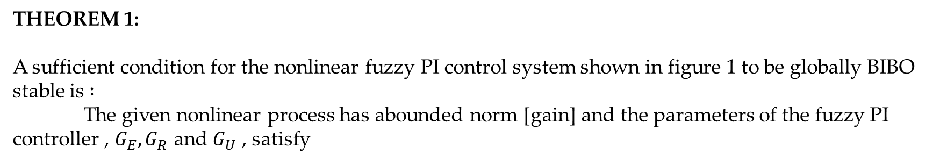
THEOREMS
THEOREM 1:
A sufficient condition for the nonlinear fuzzy PI control system shown in figure 1 to be globally BIBO stable is $:$
The given nonlinear process has abounded norm [gain] and the parameters of the fuzzy PI controller , $G_{E},G_{R}$ and $G_{U}$ , satisfy
…(17)
Where…
and

Slide 20
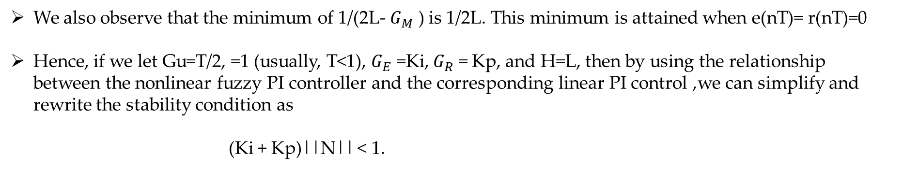
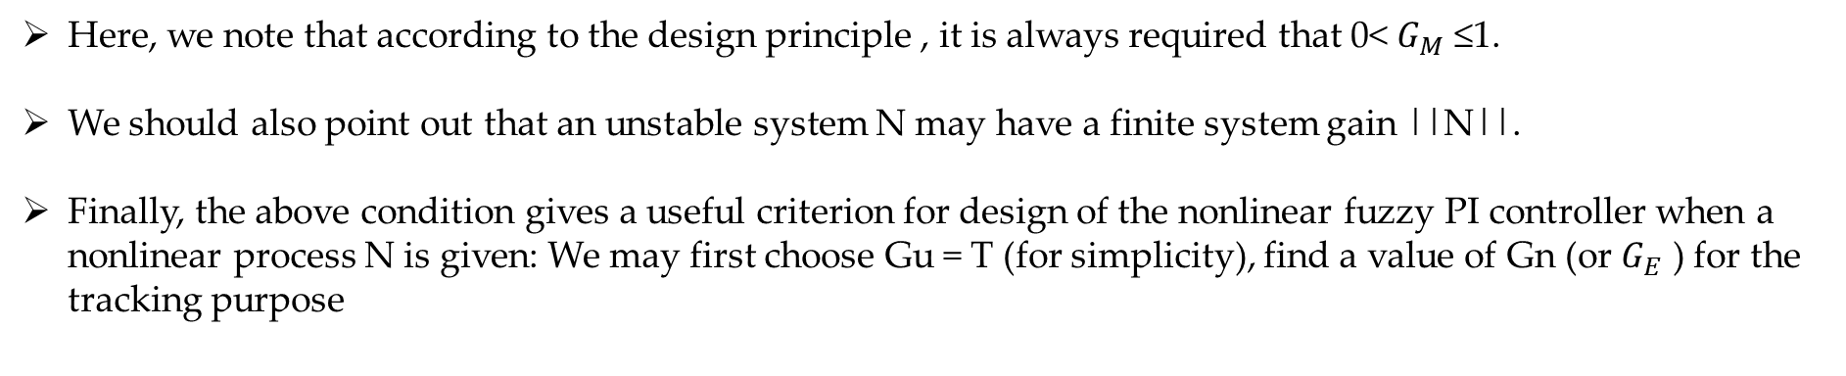
Here, we note that according to the design principle , it is always required that 0< $G_{M}$ ≤1.
We should also point out that an unstable system N may have a finite system gain ||N||.
Finally, the above condition gives a useful criterion for design of the nonlinear fuzzy PI controller when a nonlinear process N is given: We may first choose Gu = T (for simplicity), find a value of Gn (or $G_{E}$ ) for the tracking purpose
e(nT) = y(nT) - sp(nT) →0
…(18)
We also observe that the minimum of 1/(2L- $G_{M}$ ) is 1/2L. This minimum is attained when e(nT)= r(nT)=0
Hence, if we let Gu=T/2, =1 (usually, T<1), $G_{E}$ =Ki, $G_{R}$ = Kp, and H=L, then by using the relationship between the nonlinear fuzzy PI controller and the corresponding linear PI control ,we can simplify and rewrite the stability condition as
(Ki + Kp)||N|| < 1.
…(19)

Slide 21
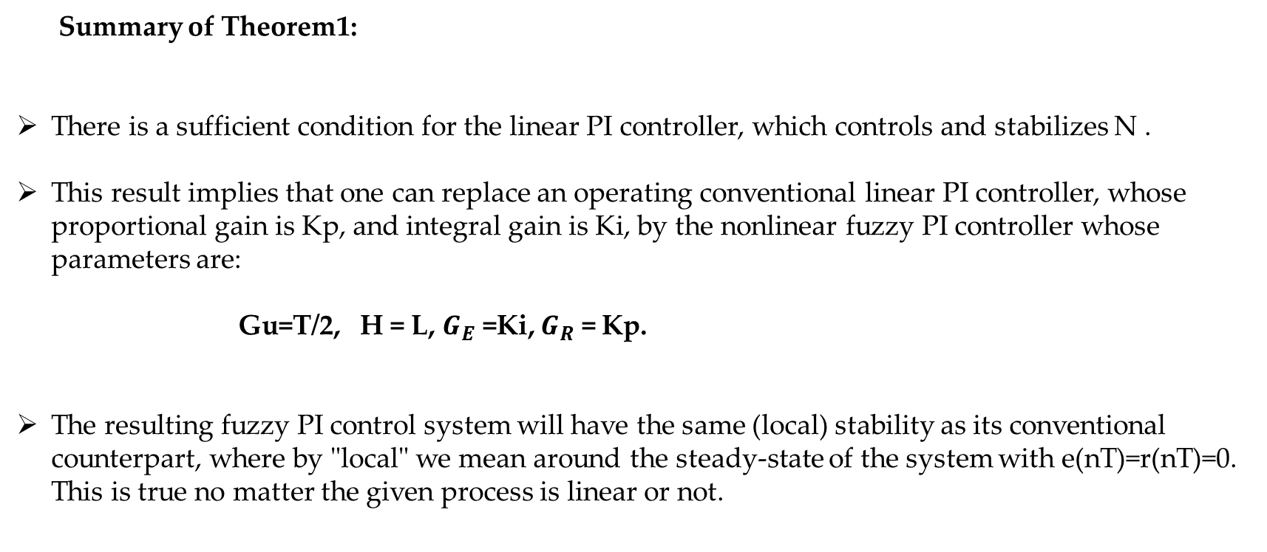
Summary of Theorem1:
There is a sufficient condition for the linear PI controller, which controls and stabilizes N .
This result implies that one can replace an operating conventional linear PI controller, whose proportional gain is Kp, and integral gain is Ki, by the nonlinear fuzzy PI controller whose parameters are:
Gu=T/2, H = L, $G_{E}$ =Ki, $G_{R}$ = Kp.
The resulting fuzzy PI control system will have the same (local) stability as its conventional counterpart, where by "local" we mean around the steady-state of the system with e(nT)=r(nT)=0. This is true no matter the given process is linear or not.
…(20)

Slide 22
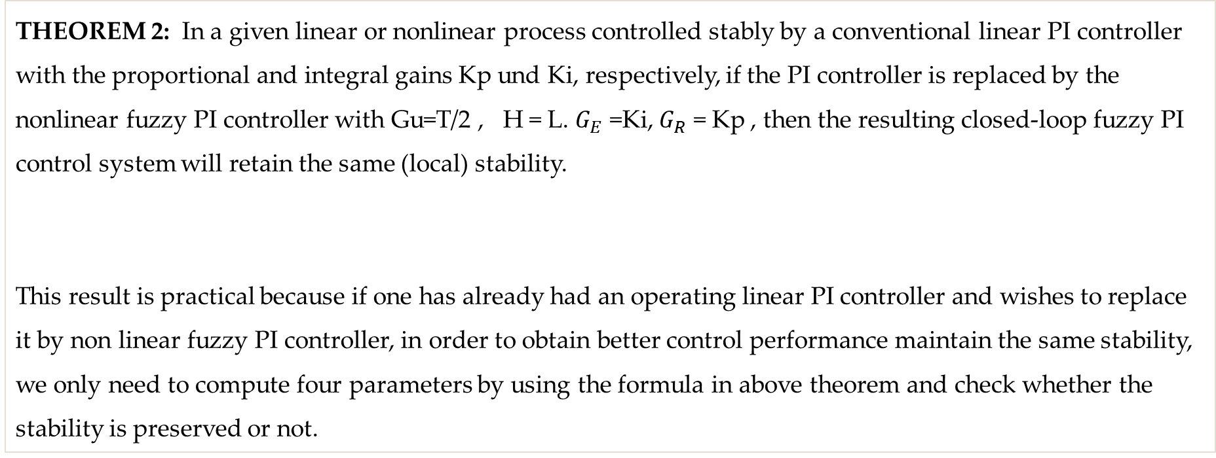
THEOREM 2: In a given linear or nonlinear process controlled stably by a conventional linear PI controller with the proportional and integral gains Kp und Ki, respectively, if the PI controller is replaced by the nonlinear fuzzy PI controller with Gu=T/2 , H = L. $G_{E}$ =Ki, $G_{R}$ = Kp , then the resulting closed-loop fuzzy PI control system will retain the same (local) stability.
This result is practical because if one has already had an operating linear PI controller and wishes to replace it by non linear fuzzy PI controller, in order to obtain better control performance maintain the same stability, we only need to compute four parameters by using the formula in above theorem and check whether the stability is preserved or not.

Slide 23


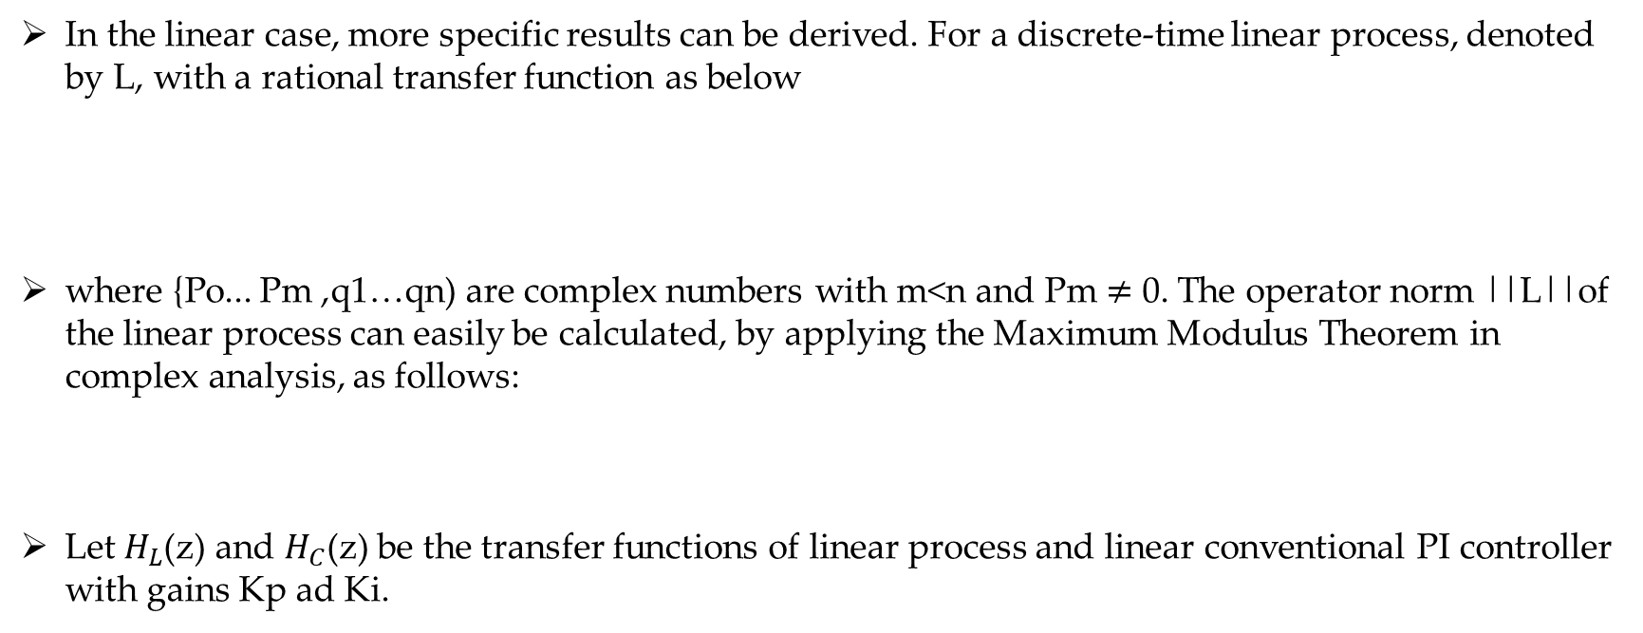
Linear processes – Explicit results
In the linear case, more specific results can be derived. For a discrete-time linear process, denoted by L, with a rational transfer function as below
where {Po... Pm ,q1…qn) are complex numbers with m<n and Pm $≠$ 0. The operator norm ||L||of the linear process can easily be calculated, by applying the Maximum Modulus Theorem in complex analysis, as follows:
Let $H_{L}$(z) and $H_{C}$(z) be the transfer functions of linear process and linear conventional PI controller with gains Kp ad Ki.
…(21)
…(22)

Slide 24




The transfer function of closed loop control system is given by…
Where Hc(z) is as below
Substituting $H_{L}$(z) and $H_{C}$(z) We obtain H(z) as
…(23)
…(24)
…(25)

Slide 25
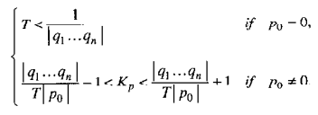
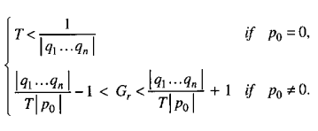
THEOREM 3:
A necessary condition for the stability of the conventional linear PI control system involving a linear process and satisfies the condition…
Kp is replaced by Gr to get non linear fuzzy PI controller
Proposition1:
A necessary condition for the non linear fuzzy PI control system to be locally stable is
…(26)
…(27)

Slide 26
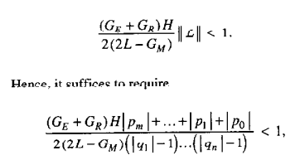
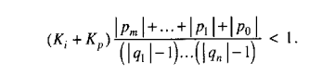
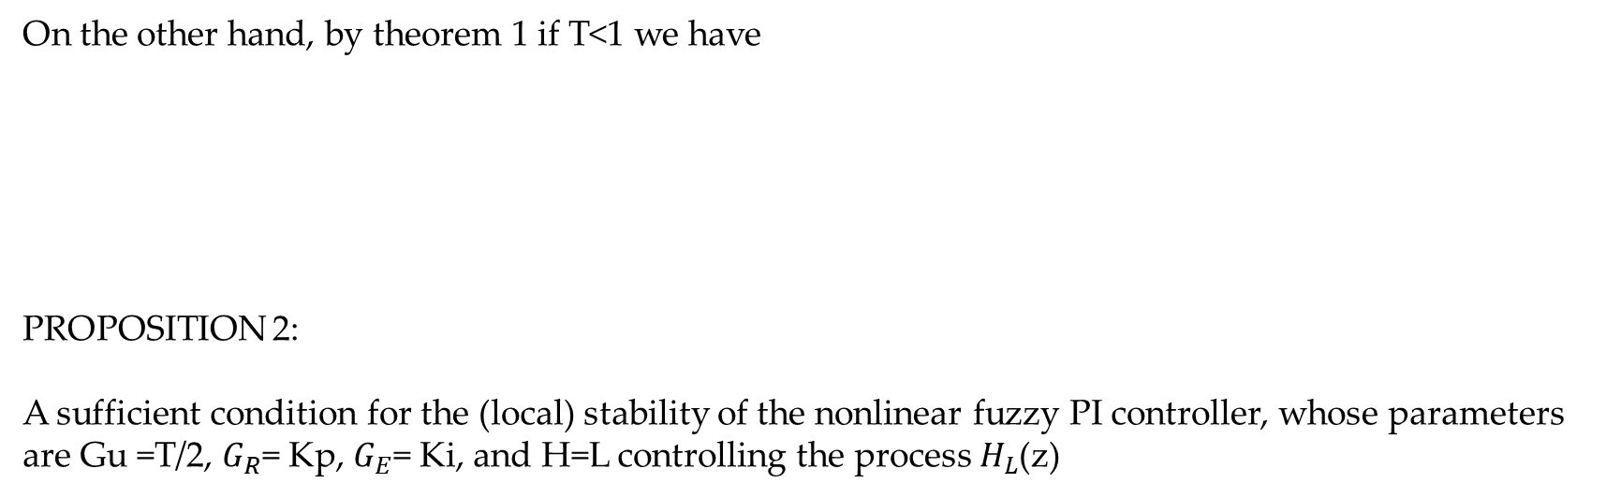
On the other hand, by theorem 1 if T<1 we have
PROPOSITION 2:
A sufficient condition for the (local) stability of the nonlinear fuzzy PI controller, whose parameters are Gu =T/2, $G_{R}$= Kp, $G_{E}$= Ki, and H=L controlling the process $H_{L}$(z)
…(28)
…(29)
…(30)

Slide 27
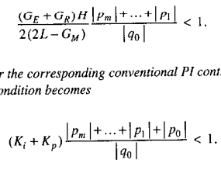
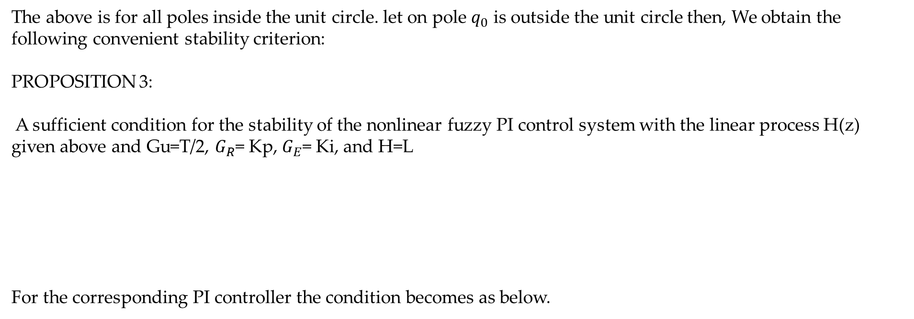
The above is for all poles inside the unit circle. let on pole $q_{0}$ is outside the unit circle then, We obtain the following convenient stability criterion:
PROPOSITION 3:
A sufficient condition for the stability of the nonlinear fuzzy PI control system with the linear process H(z) given above and Gu=T/2, $G_{R}$= Kp, $G_{E}$= Ki, and H=L
For the corresponding PI controller the condition becomes as below.
…(31)
…(32)

Slide 28
Conclusions
‘Small Gain Theorem’ is used to obtain a simple sufficient condition on the global BIBO stability.
Proof of unchanged stability of control system if Linear PI controller is replaced by Non linear Fuzzy PI controller.
Analysis of the BIBO stability of a class of non linear fuzzy PI control systems, where fuzzy PI controllers have linear structure in both proportional and integral parts similar to conventional linear PI controllers
Some Formulas for computing the fuzzy PI controller parameters such as proportional and integral gains using the proportional and integral gains of corresponding linear PI controller

Slide 29
References
Chen, Guanrong and Ying, Hao. ‘BIBO Stability of Nonlinear Fuzzy PI Control Systems’. 1 Jan. 1997 : 245 – 256.

Slide 30

THANK YOU
- Sai Joshitha Annareddy

