Slide 1

An improved PID-type fuzzy controller employing individual fuzzy P, fuzzy I and fuzzy D controllers
- S. Bhattacharya, A. Chatterjee and S. Munshi
Presented to,
Prof. Murali Mohan Bosukonda
Department of Electrical Engineering
IIT Kharagpur
Presented by,
Sai Joshitha Annareddy
21EE62R10
MTech
Control Systems Engineering
IIT Kharagpur
Seminar 2
Total Slides-24

Slide 2
Contents
Introduction
Proposed Controller structure
Equations and Membership function
Construction of Fuzzy rule base
Simulation studies that are provided in the paper
Conclusions
References

Slide 3
Introduction
Fuzzy logic controllers (FLCs) incorporate human expertise in control strategy for controlling processes.
Development of PID-type FLCs was not that popular earlier because they usually needed the construction of a three-dimensional rule base.
The present paper describes the development of a simple, model-free improved fuzzy PID-type structure as an effective combination of three independent fuzzy controllers.
Here an incremental fuzzy P controller, an incremental fuzzy I controller and a fuzzy D controller are connected in parallel to give the resultant controller structure.

Slide 4
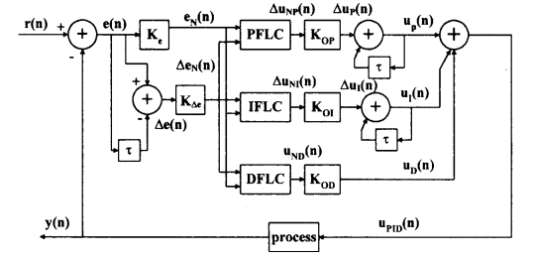
Proposed controller structure
The proposed fuzzy PID controller is comprised of fuzzy P, fuzzy I and fuzzy D controllers in parallel form.
While the fuzzy P controller (denoted PFLC) and fuzzy I controller (denoted IFLC) are implemented in incremental form, the fuzzy D controller (denoted DFLC) is implemented in position form.
Figure 1 : Proposed (fuzzy P + fuzzy I + fuzzy D) controller architecture in schematic representation

Slide 5
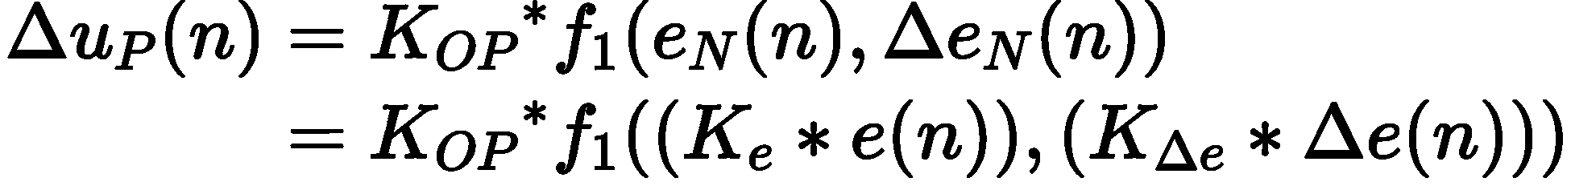
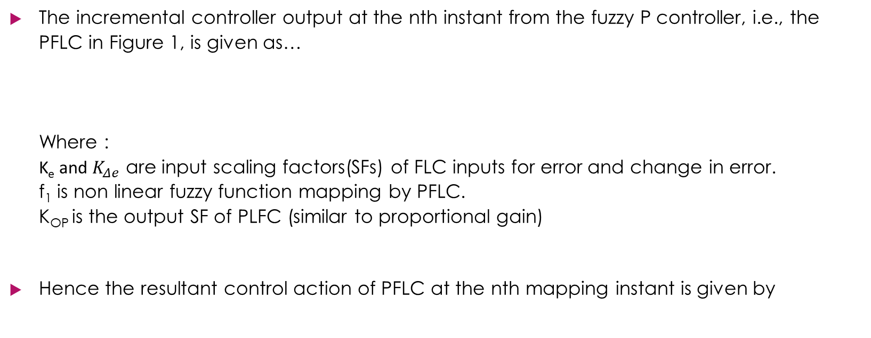
Equations
The incremental controller output at the nth instant from the fuzzy P controller, i.e., the PFLC in Figure 1, is given as… Where : K_{e} and $K_{Δe}$ are input scaling factors(SFs) of FLC inputs for error and change in error. f₁ is non linear fuzzy function mapping by PFLC. K_{OP} is the output SF of PLFC (similar to proportional gain)
Hence the resultant control action of PFLC at the nth mapping instant is given by

Slide 6
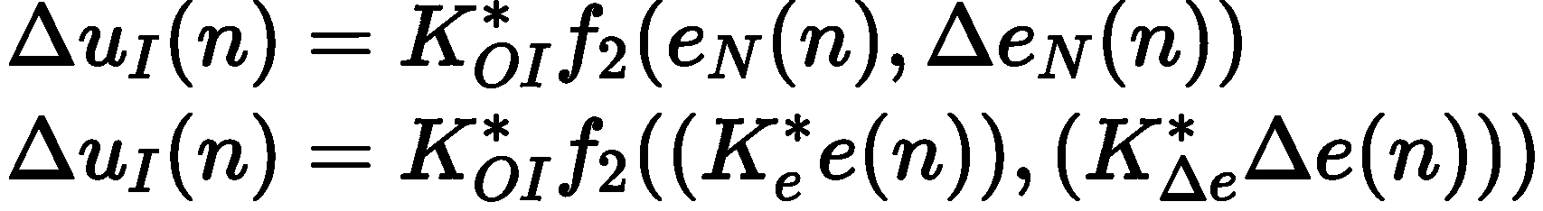
Cont.
The incremental controller output at the nth sampling instant of the fuzzy I controller, i.e., the IFLC in Figure 1 is given by… Where : f₂ is non linear fuzzy function mapping by IFLC. K_{OI} is the output SF of ILFC (similar to Integral gain)
The resultant control force by IFLC is

Slide 7
Cont.
The control action produced by the fuzzy D controller, i.e., DFLC in Figure 1, at the nth instant is… Where : f₃ is non linear fuzzy function mapping by DFLC. K_{OD} is the output SF of DLFC (similar to Derivative gain)
The final resultant control action produced by the proposed PID-type FLC structure is given by…

Slide 8
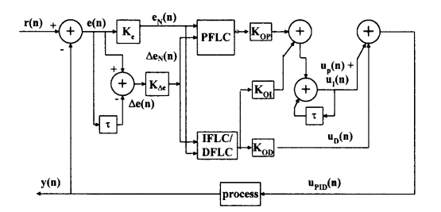
Figure 2 : Proposed (fuzzy P + fuzzy I + fuzzy D) controller architecture in simplified form for practical realization

Slide 9
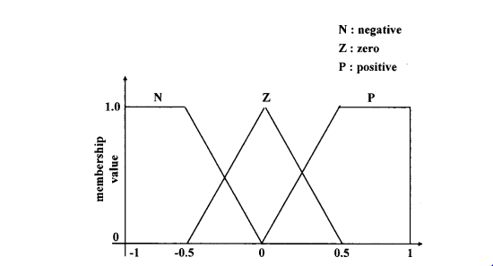

Membership Function
Each of these input and output variables are fuzzed using three fuzzy sets.
The shape of the fuzzy MFs are so chosen that the middle MF is a triangle and at the two extreme ends the two MFs are chosen to be trapezoidal.
The linguistic terms associated with the three MFs are negative (N), positive (P) and zero (Z)
Figure 3 Input and output MF (For e_{N}, $Δ$u_{NP} $, Δ$e_{N}, $Δ$u_{NI,} u_{ND})
variations for each of the PFLC, IFLC and DFLC in Figure

Slide 10
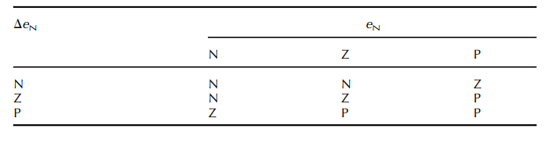
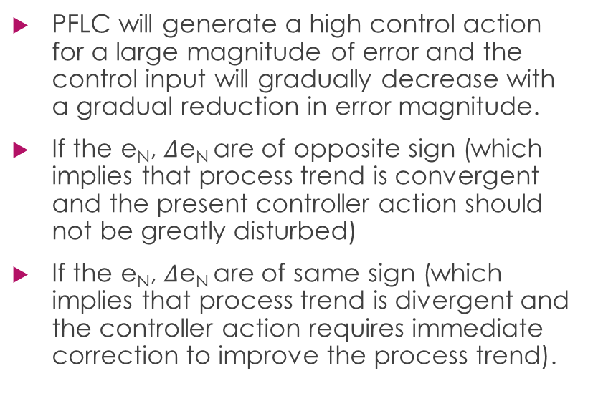
Construction of fuzzy rule bases
PFLC will generate a high control action for a large magnitude of error and the control input will gradually decrease with a gradual reduction in error magnitude.
If the e_{N}, $Δ$e_{N} are of opposite sign (which implies that process trend is convergent and the present controller action should not be greatly disturbed)
If the e_{N}, $Δ$e_{N} are of same sign (which implies that process trend is divergent and the controller action requires immediate correction to improve the process trend).
Table 1 Rule base for incremental P action (PFLC)

Slide 11
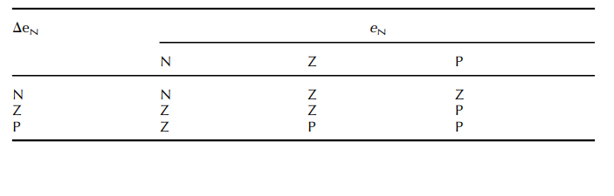
Cont.
The common rule base for IFLC and DFLC is formed after an in-depth analysis of different situations of the transient and steady state responses of different processes.
Table 2 Rule base for incremental I/direct D action (IFLC/DFLC)

Slide 12
Each of the PFLC, IFLC and DFLC is implemented independently so, each of them employs a fuzzy rule base where rule activation in any one FLC is not dependent on the working of the other two FLCs.
Hence one can conclude that each of the fuzzy P, fuzzy I and fuzzy D actions can be controlled separately by the use of three decoupled fuzzy systems.
A proper choice of K_{OP ,} K_{OD ,} K_{OI} will determine the suitable relative amount of proportional, integral and derivative actions to be applied to control a process.
The proposed DPIDFLC employs Mamdani-type inferencing and centroid method of defuzzification for each individual FLC.
In practical cases:
The problem of determining six input SFs for three FLCs ultimately gets reduced to the problem of determining two input SFs.
So they proposed empirical rules to determine K_{OP} and K_{OD} in terms of K_{OP} in order to further reduce the computation load.
Once an optimum value of K_{OP} is determined, we can employ K_{OI}, which is one-tenth of K_{OP} and K_{OD} is 30 times KOP .

Slide 13
Simulation studies
The performance of the proposed DPIDFLC is compared with two other controllers,
A conventional PID controller whose parameters Kp , Ti, Td are tuned by the well known Z-N method (denoted the ZNPIDC)
A static fuzzy PID controller whose structure is obtained from Li and Gatland (1996) (denoted the PIDSFLC).
Performance measures used are peak overshoot/undershoot (%OS/US), rise time (tr), settling time (ts), integral absolute error (IAE) and integral time multiplied absolute error (ITAE).
Simulation studies are carried out for three different type of process that is a. Second order linear process with dead time b. Marginally stable system with dead time c. Second-order linear process without dead time

Slide 14
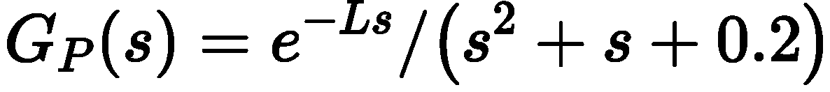
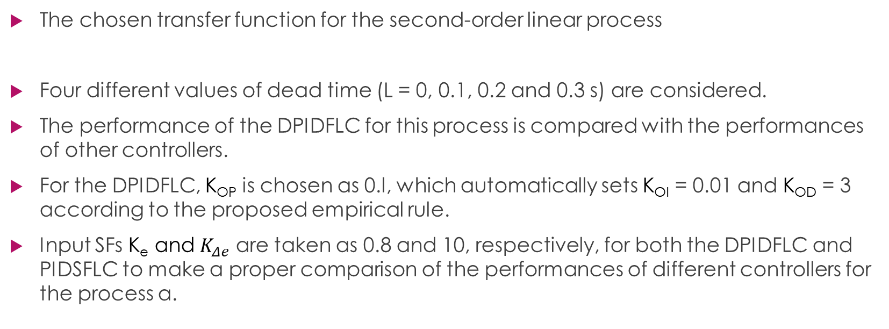
a. Second-order linear process with dead time
The chosen transfer function for the second-order linear process
Four different values of dead time (L = 0, 0.1, 0.2 and 0.3 s) are considered.
The performance of the DPIDFLC for this process is compared with the performances of other controllers.
For the DPIDFLC, K_{OP} is chosen as 0.l, which automatically sets K_{OI} = 0.01 and K_{OD} = 3 according to the proposed empirical rule.
Input SFs K_{e} and $K_{Δe}$ are taken as 0.8 and 10, respectively, for both the DPIDFLC and PIDSFLC to make a proper comparison of the performances of different controllers for the process a.

Slide 15
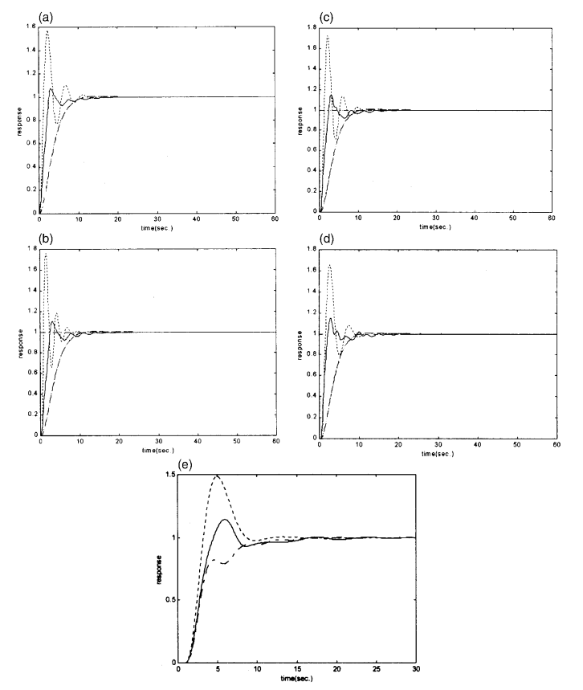
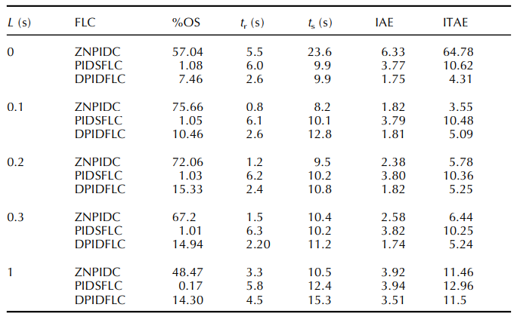
Table 3 Performance comparison of the DPIDFLC vis-a`-vis other controllers for the second order linear process.
Figure 4 Unit step responses of second-order process in (7) employing ZNPIDC (- - -), PIDSFLC (— – —) and DPIDFLC (——) with (a) L = 0 s, (b) L = 0.1 s, (c) L = 0.2 s, (d) L = 0.3 s and (e) L = 1 s.

Slide 16
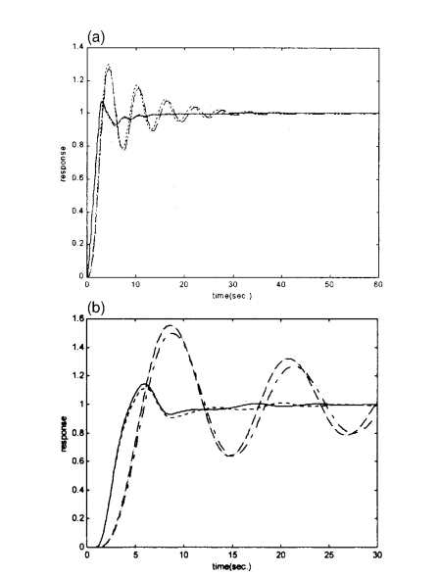
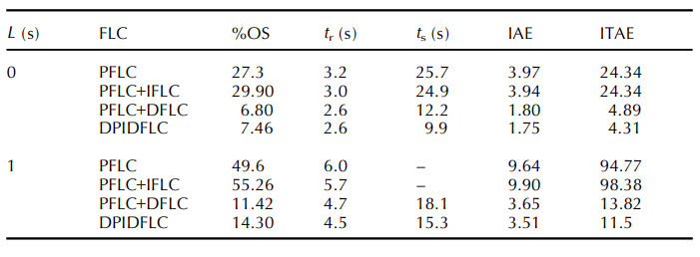
Table 4 Performance analysis of the DPIDFLC, when activated to produce different control actions, for the process in a
Figure 5 Unit step responses of second-order process in (7) with (a) L = 0 s and (b) L = 1 s employing only PFLC (— – —), PFLC and DFLC (- - -), PFLC and IFLC (— —) and DPIDFLC (——)

Slide 17
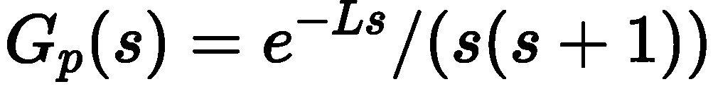
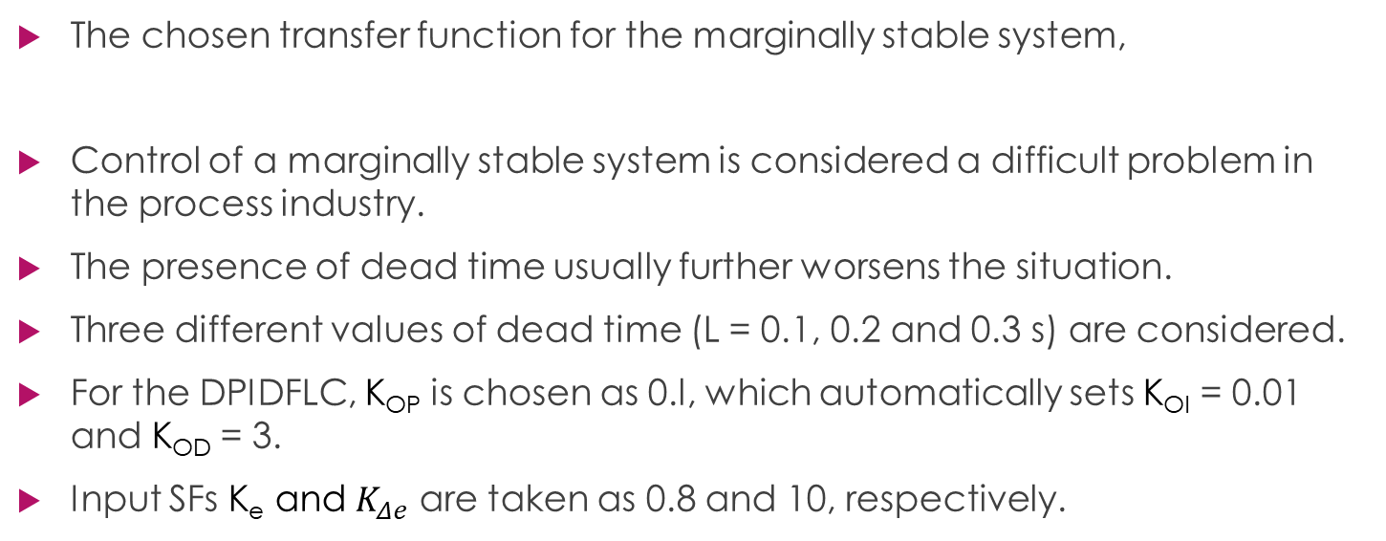
b. Marginally stable system with dead time
The chosen transfer function for the marginally stable system,
Control of a marginally stable system is considered a difficult problem in the process industry.
The presence of dead time usually further worsens the situation.
Three different values of dead time (L = 0.1, 0.2 and 0.3 s) are considered.
For the DPIDFLC, K_{OP} is chosen as 0.l, which automatically sets K_{OI} = 0.01 and K_{OD} = 3.
Input SFs K_{e} and $K_{Δe}$ are taken as 0.8 and 10, respectively.

Slide 18
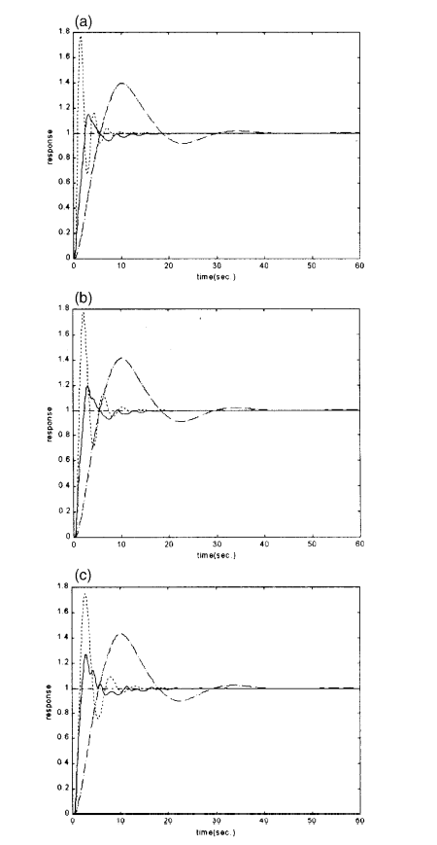
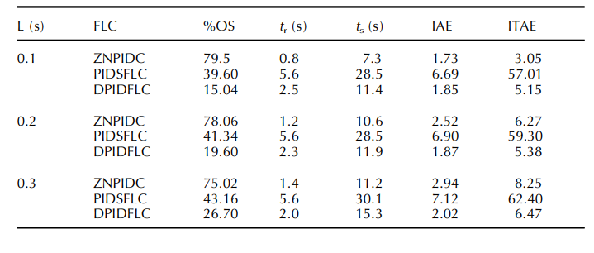
Table 5 Performance comparison of the DPIDFLC vis-a-vis other controllers for the process b.
Figure 6 Unit step responses of the second-order process in (8) employing ZNPIDC (. . . .), PIDSFLC (–·–·–) and DPIDFLC (——) with (a) L = 0.1 s, (b) L = 0.2 s and (c) L = 0.3 s.

Slide 19
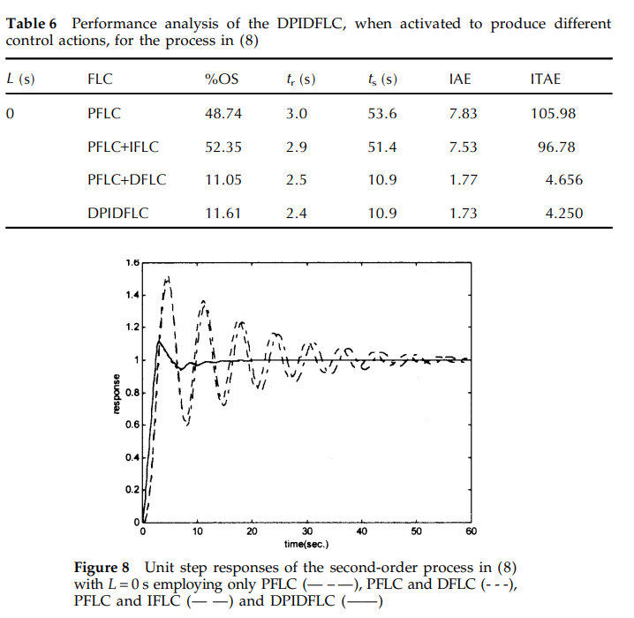
Table 6 Performance analysis of the DPIDFLC, when activated to produce different control actions, for the process b.
Figure 7 Unit step responses of the second-order process in (b) with L = 0 s employing only PFLC (— – —), PFLC and DFLC (- - -), PFLC and IFLC (— —) and DPIDFLC (——).

Slide 20
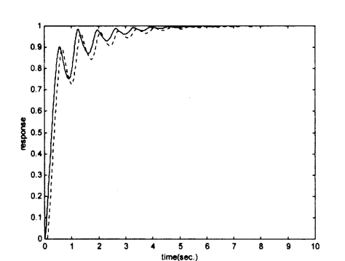
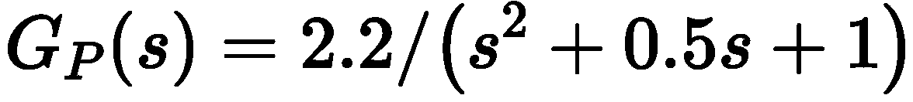
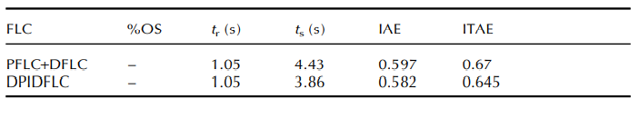
c. Second-order linear process without dead time
A second-order linear process, which was considered
Table 7 Performance analysis of the DPIDFLC, when activated to produce different control actions, for the above process c.
Figure 8 Unit step responses of the second-order process in (c) employing PFLC and DFLC (- - -) and DPIDFLC (——).

Slide 21
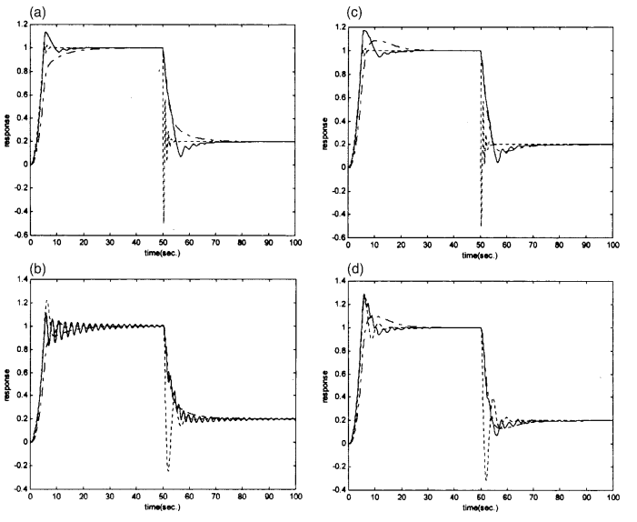
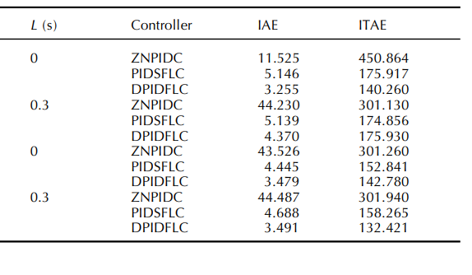
Table 8 Dynamic performance comparison of the DPIDFLC vis-a`-vis other controllers for varying input combination
Figure 9 Dynamic performance comparison for the varying input combination with ZNPIDC (- - -), PIDSFLC (— – —) and DPIDFLC (——) with (a) process in (a), L = 0, (b) process in (a), L = 0.3 s, (c) process in (b), L = 0 s and (d) process in (b), L = 0.3 s

Slide 22
Conclusions
Simulation studies have been carried out on second-order linear processes with and without dead time, and on a marginally stable system with dead time.
The proposed fuzzy control scheme shows a superior performance for all processes under consideration when compared to a conventional Z-N tuned PID controller and static PID-type FLC.
For stable second-order systems with dead time, where the PIDSFLC results in an overdamped closed-loop step response, the proposed controller yields a fast underdamped response, but with a not-too-large overshoot.
In particular, for marginally stable processes with dead time, for which the ZN-tuned three-term PID controllers fail to provide good control action, and the PIDSFLC also does not work satisfactorily, but proposed controller gives satisfactory response.
For each of the three sample processes considered, we have shown the effectiveness of our proposed DPIDFLC with each input and output variable of PFLC, IFLC and DFLC fuzzified using three MFs.

Slide 23
References
An improved PID type fuzzy controller employing individual fuzzy P, fuzzy I and fuzzy D controllers, Bhattacharya, S; Chatterjee, A and Munshi, S, 2003 | TRANSACTIONS OF THE INSTITUTE OF MEASUREMENT AND CONTROL 25 (4), pp.352-372

Slide 24
Thank you
-Sai Joshitha Annareddy

