Slide 1
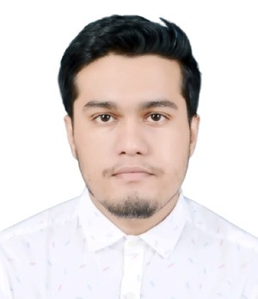

Saikat Ghosh
Associate Consultant
Base Location | : Mumbai
Email Id | : saikat.a.ghosh@capgemini.com
Ph. No. | : +91 9144510804
Grade | : B1
Java
Microservices
Spring Boot
Spring WebFlux (Reactive Spring)
Apache Kafka
Strengths
My Industry Experience
Hands-on experience in:
Cassandra DB, Maria DB, Mongo DB
Java 8, Spring Boot, Spring WebFlux, REST API, Microservices
IntelliJ, Postman, GitHub, Hazelcast
Ready to learn new technologies and Frameworks and implement them to further improve my knowledge.
A team player with good communication skill always ready to work for the enrichment of knowledge.
BY Luminate Commerce: -Trained and Certified Functional consultant in BY luminate commerce for its Microservices like -
Inventory and Availability:- This Microservice deals in getting information such as ATP , Reservation, Transaction Types, Demand & supply Matrices, feeds inventory supply and its information for the selected products
Commits:- This Microservice helps in optimizing sourcing Location & shipment dates, provides flexibility to business to manage delivery Commitments, it also provides calculated dates for delivery based on event configurations
Capacity planning:- This Microservice helps by avoiding overselling and underselling with help of pre-set parameters
Common Services:- This Microservices helps in getting and defining the org level data related to product, selling channel, fulfilment type and service etc.
Case Study:-
Developed several microservices using different tech stacks which includes –
Spring boot, Spring WebFlux, CassandraDB, MariaDB, MongoDB, Hazelcast, Apache Kafka, Spring Web client etc.
Check out my work on GitHub: https://github.com/SaikGhos
Completed B.Tech. from NIT Durgapur, West Bengal, India (2018 – 2022)
BY Commerce Decisioning Functional Consultant

