Slide 1

Hack2Ignite · Problem Statement AI-04
SamajSevak
AI-powered public grievance analysis, resolution recommendation and accountability platform
One real problem, one issue — prioritised, resolved, confirmed by the citizen, escalated if not.
Team Viper

Slide 2






The problem
Citizens complain. Systems file. Problems repeat.
Manual triage
Wrong routing
No real prioritisation
Thousands of free-text complaints, in several languages, read and sorted by hand.
Complaints bounce between departments before reaching the right team.
A live wire near a school waits in the same queue as a broken bench.
Duplicates
No root-cause insight
No accountability
The same pothole reported 20 times means 20 tickets and wasted field visits.
Clusters and spikes (e.g. a dengue outbreak) go unnoticed until too late.
"Resolved" is declared by the department, and an ignored complaint simply goes quiet.
SamajSevak · AI-04 | 2

Slide 3




Our solution: SamajSevak
An AI co-pilot for grievance cells — for citizens, officers and administrators.
Understand
Prioritise
Resolve
Hold accountable
Reads English, Hindi, Marathi and Hinglish. Classifies category and department, extracts ward, landmark, duration, risk words and vulnerable groups.
Explainable 0–100 urgency score. Reports of the same real-world problem are gathered into one master issue using text, GPS and photo evidence.
Step-by-step action plan from SOPs plus what fixed similar past cases, an ETA, a drafted reply and photo proof of the fix.
The citizen confirms the fix. Unresolved issues move through Complaint, Warning and three strikes, every step in an audit trail.
Works fully offline with local ML; plugs into Gemini / OpenAI when a key is available.
SamajSevak · AI-04 | 3

Slide 4
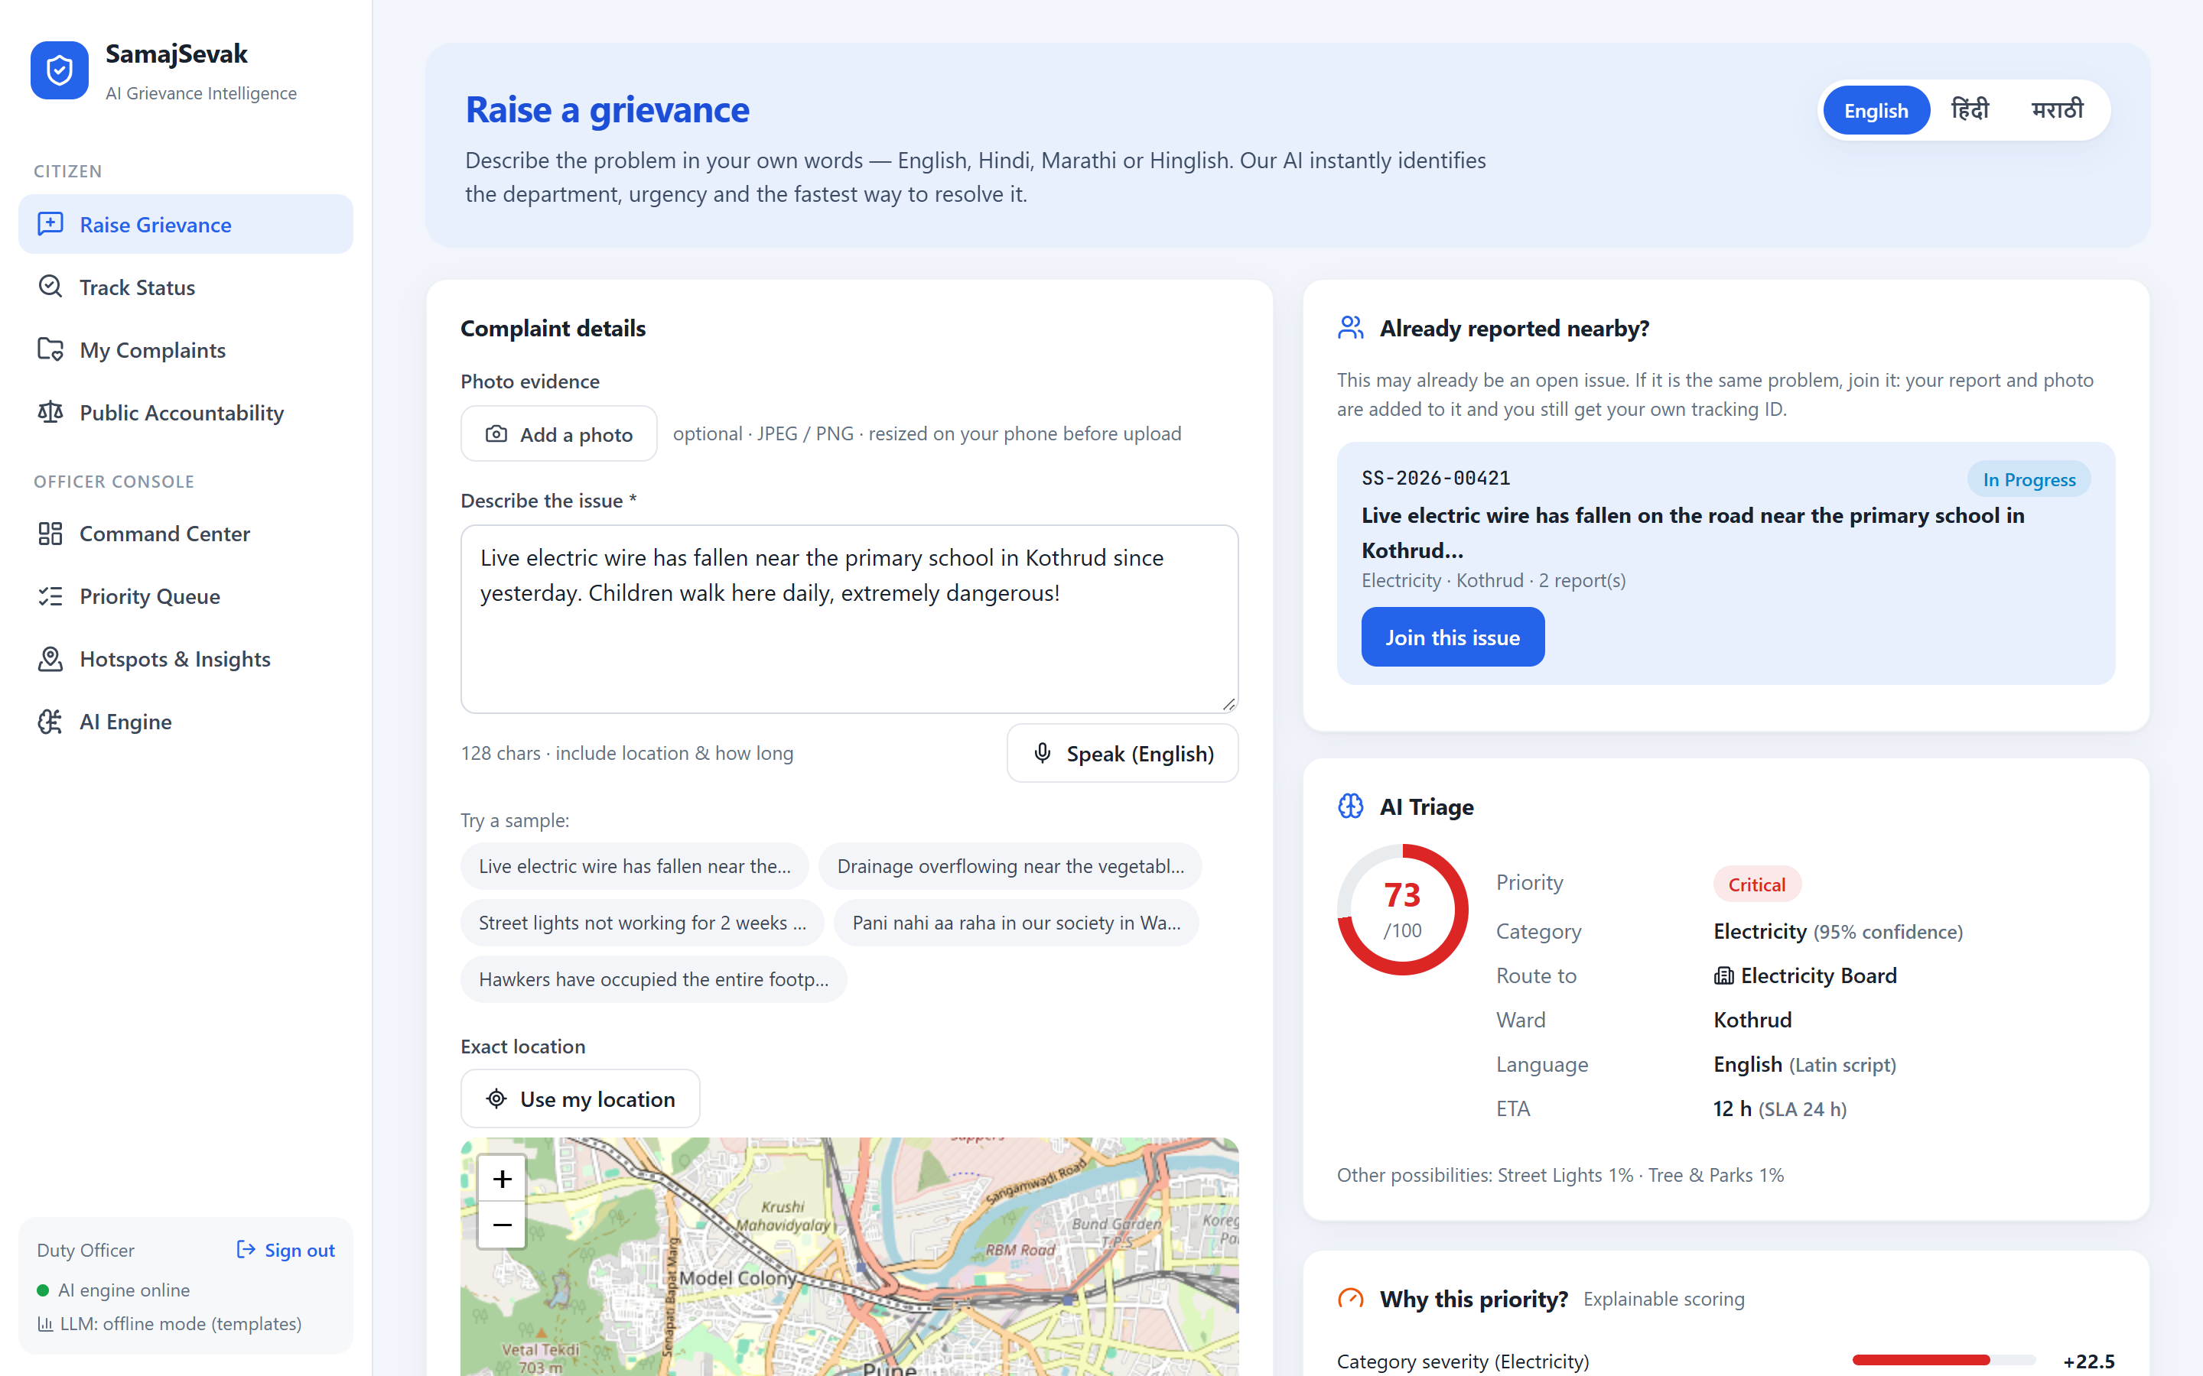
Citizen portal: evidence first, live AI while you type
1
Photo, GPS or map pin
The photo is evidence; the location tells one pothole from another.
2
Type or speak, in your language
English, हिंदी, मराठी or Hinglish. The page and the Speak button switch language.
3
"Already reported nearby?"
Open issues that match are shown before submitting; one tap joins the existing issue.
4
Instant, explained triage
Department, priority, ETA and the reasons, shown before the complaint is filed.
5
Name + mobile is the account
Officers only ever see an internal citizen ID.
SamajSevak · AI-04 | 4

Slide 5
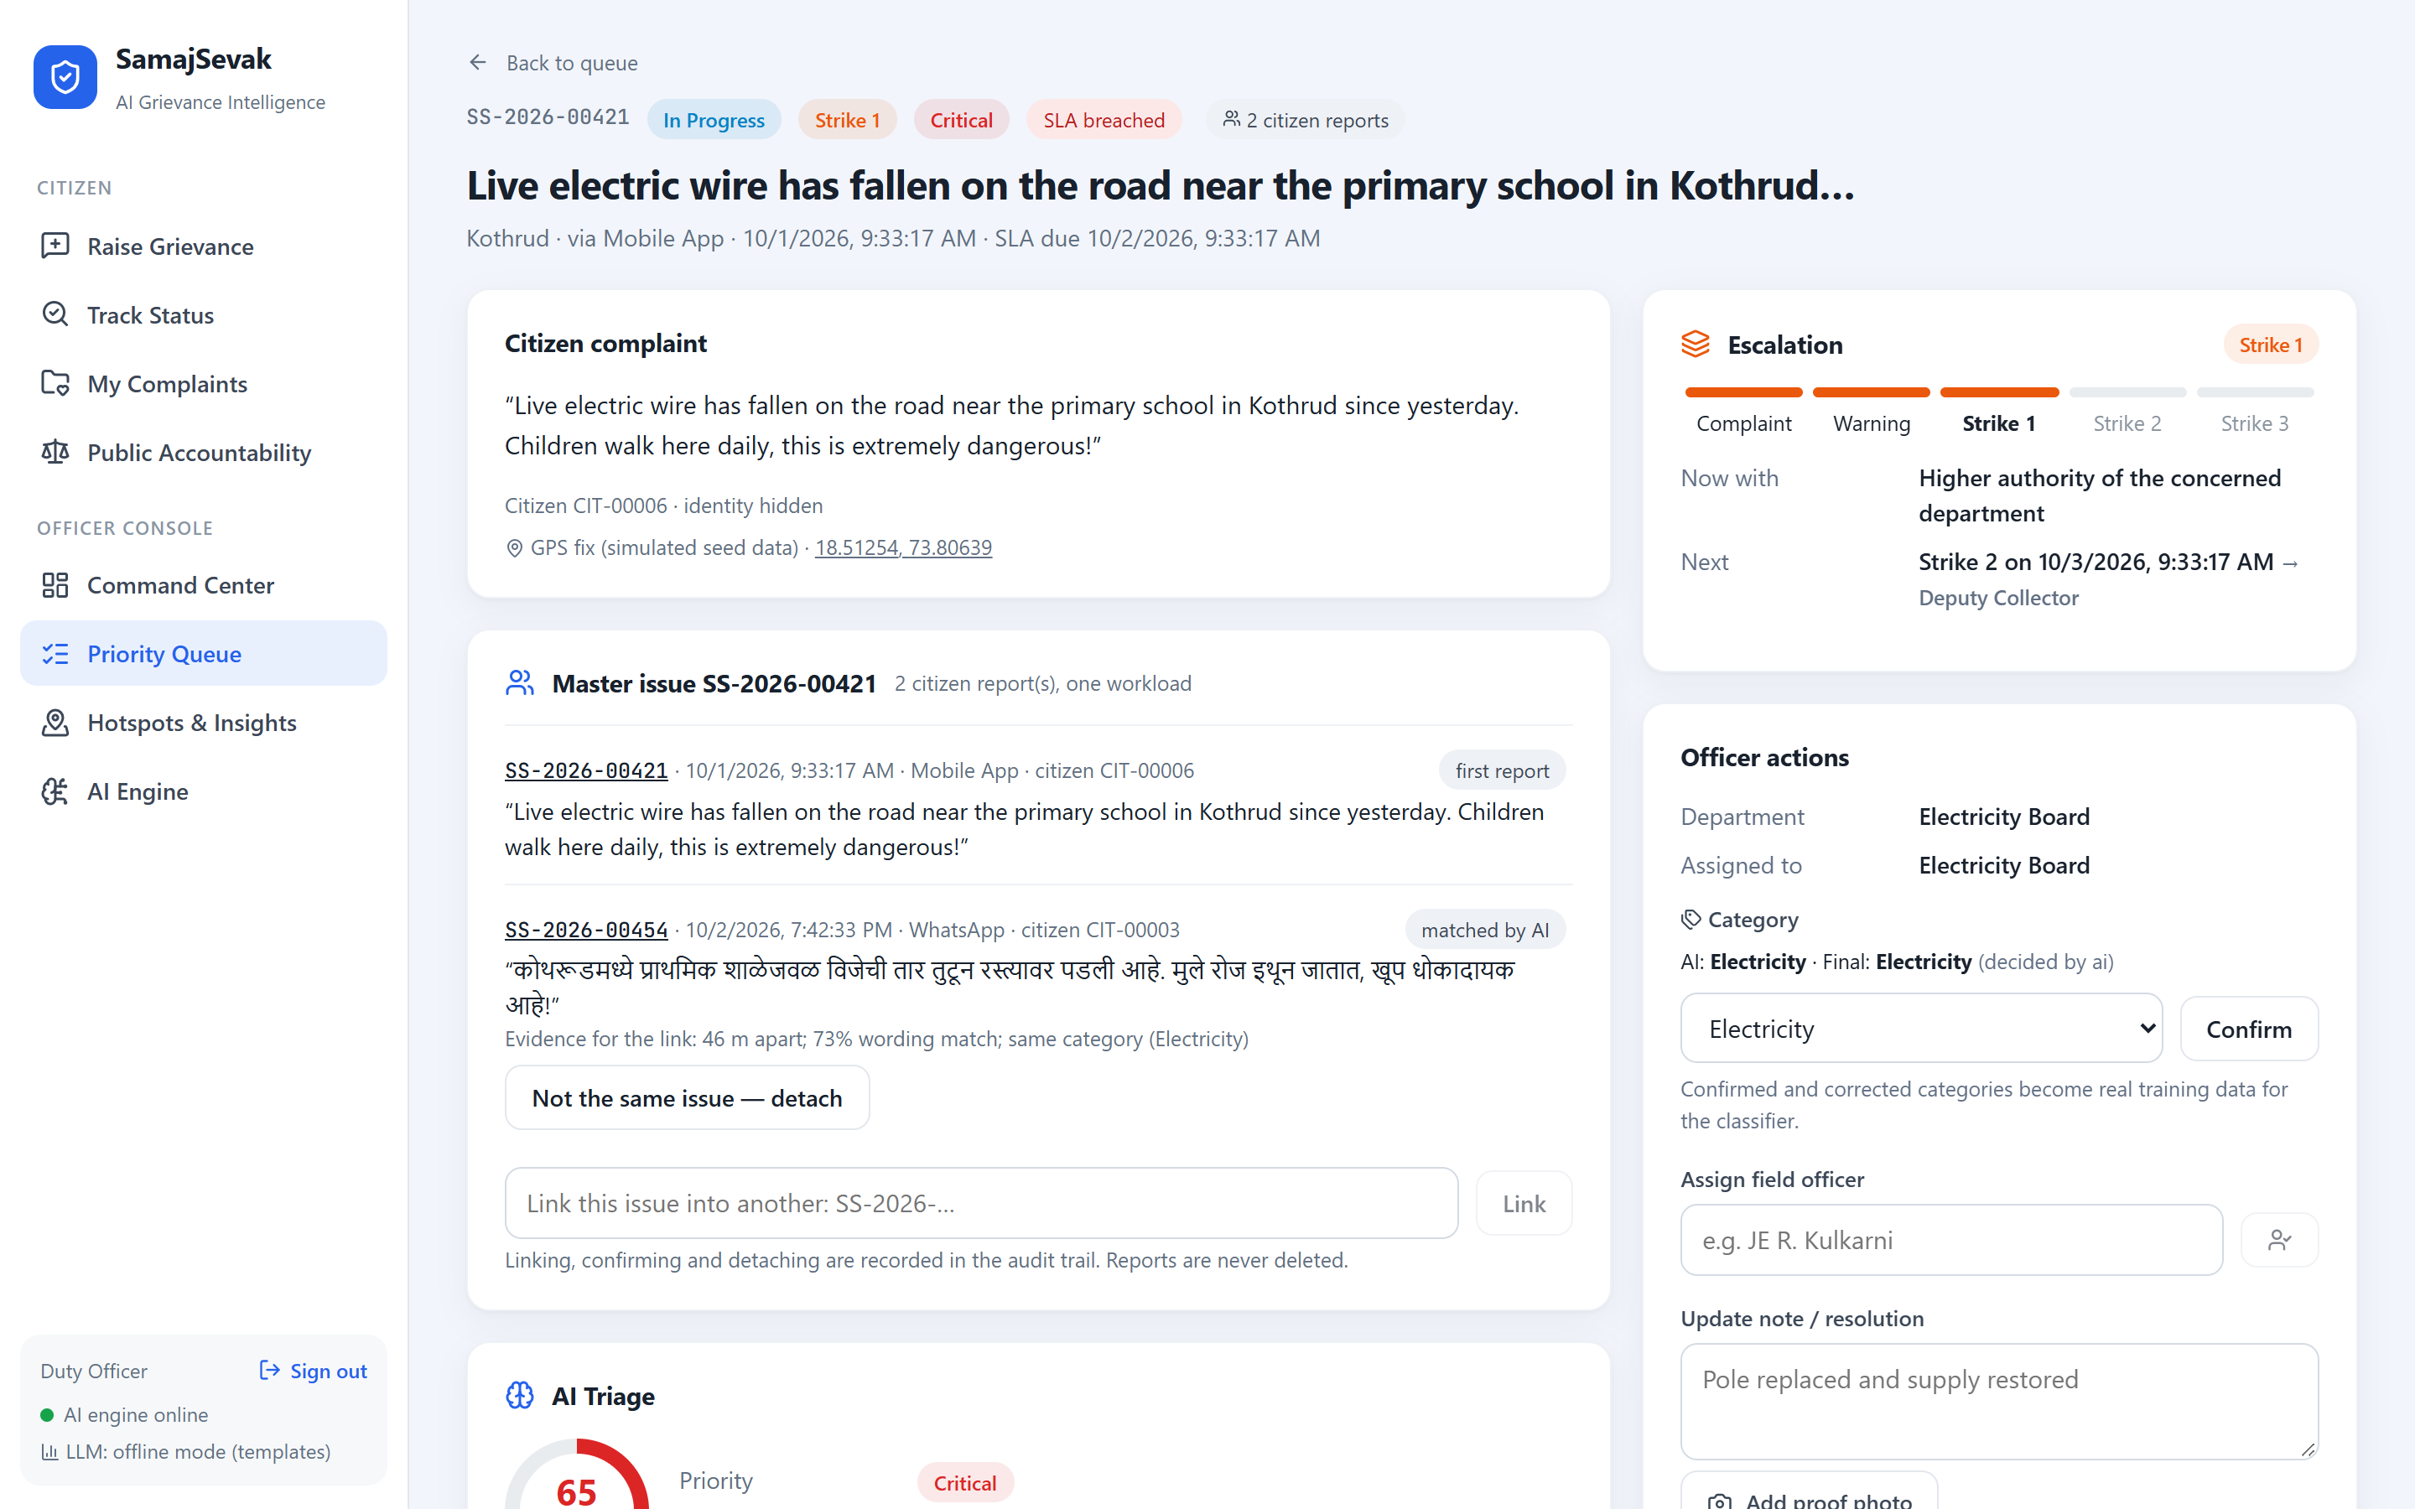
One real problem = one master issue
Many citizens can report it; the department works on it once. No report is ever deleted.
Citizen joins first
Shown the open issue while typing and taps "Join". Recorded as CITIZEN; the AI makes no merge decision for that report.
1
AI fallback after submission
Only if nothing was joined. Links on combined evidence: within 300 m + matching wording or photo; without GPS, same ward + strong wording + same landmark.
2
Never on a weak signal
Same ward, same category or the same keyword alone does not merge. The same words 2 km away stay a separate issue.
3
Officer has the last word
Sees the evidence for every link and can confirm, detach or re-link. Each action is in the audit trail.
4
Photo reuse is detected with a file hash and a perceptual hash: it compares pictures, it does not understand them. The example above is an English report and a Marathi report of the same fallen wire, 46 m apart.
SamajSevak · AI-04 | 5

Slide 6
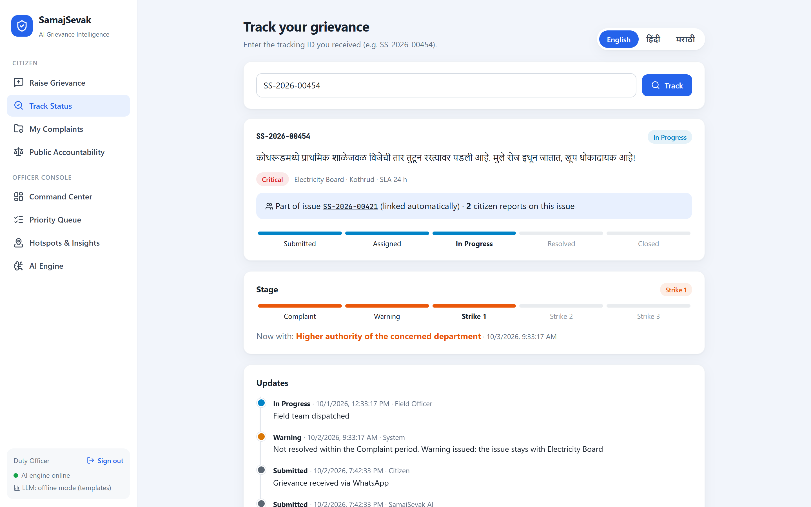
Accountability: the citizen confirms, the issue escalates
Resolved means "awaiting citizen confirmation". Silence is never read as satisfied.
Complaint
Warning
Strike 1
Strike 2
Strike 3
›
›
›
›
Concerned department
Still the concerned department
Higher authority of the department
Deputy Collector
Final escalation body: IAS officers + opposition party leaders
A warning never leaves the department. Only the strikes go upward. A strike marks how long an issue has gone unresolved; it is not a score of any officer, department or party.
Satisfied closes. Not satisfied reopens. The issue reopens for every citizen on it and the escalation clock continues where it stopped.
One escalation per master issue. Three citizens reporting one wire means one ladder, not three.
Timers live in one place. By default the Complaint period is the category SLA and each later stage half of it. They are placeholders, not legal deadlines.
This ladder is the prototype’s own workflow, not a verified legal or government procedure. Escalation updates records and screens; nothing is sent to a real authority yet.
SamajSevak · AI-04 | 6

Slide 7
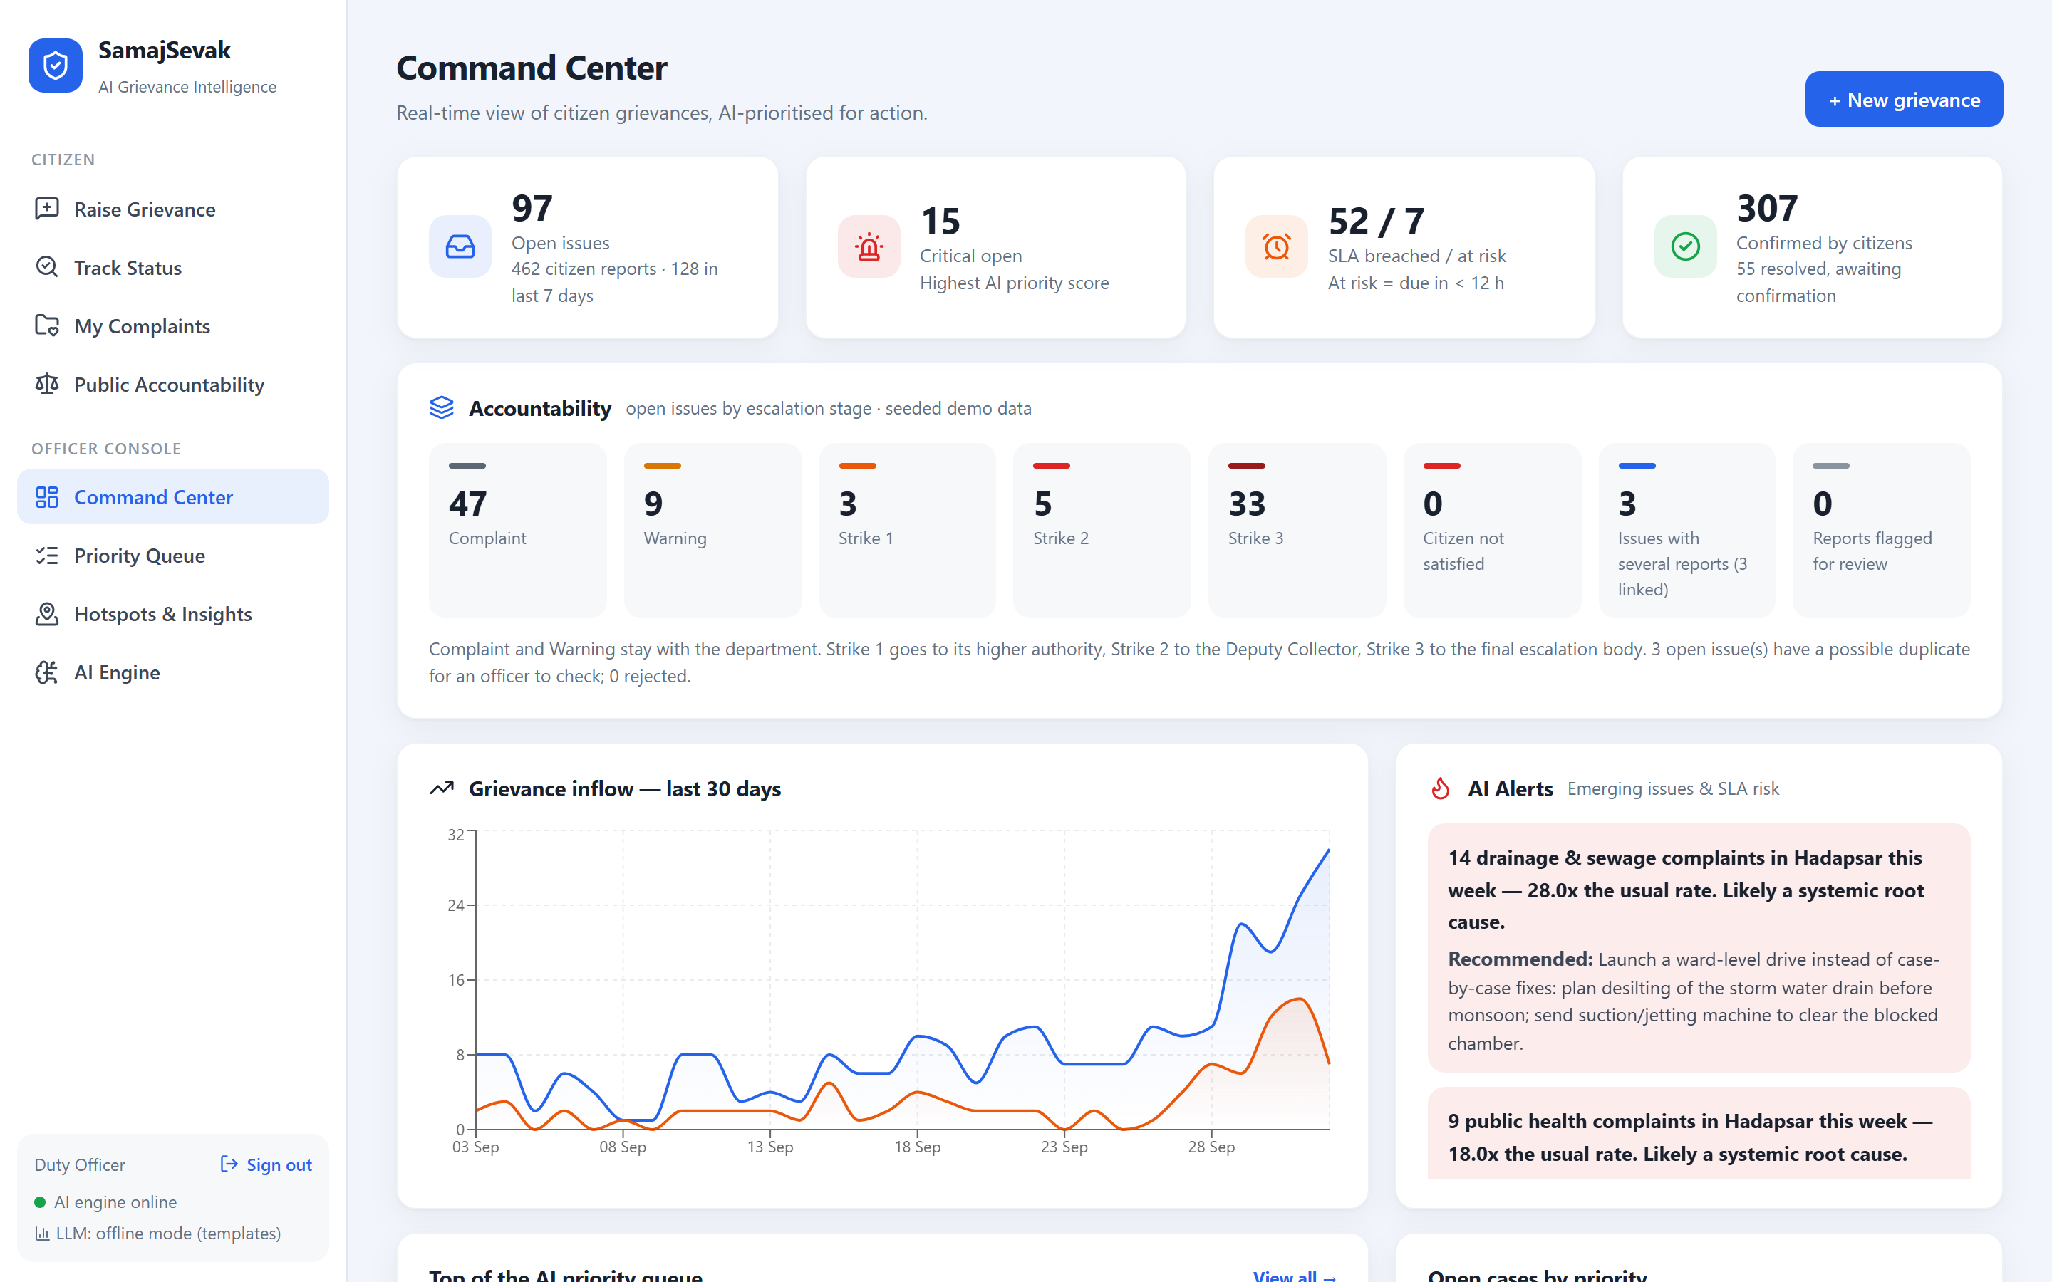
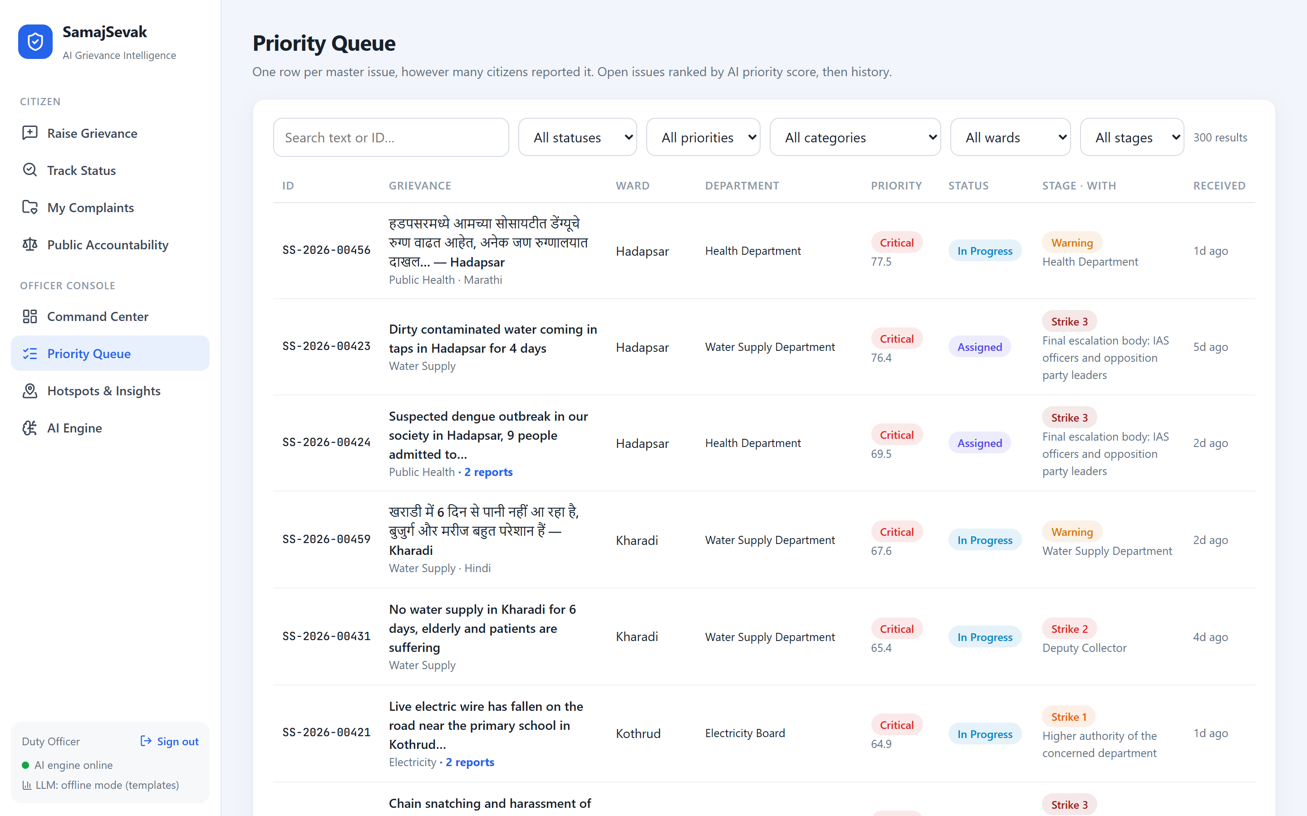
Officer console: decide faster, act smarter
Command Center — KPIs, open issues by escalation stage, AI alerts
Priority queue — one row per master issue, with stage and who holds it
Login required
Auto-routing
Master issues
Confirm / correct AI
Photo proof on resolve
Full audit trail
SamajSevak · AI-04 | 7

Slide 8







The AI pipeline
Every complaint passes through 8 stages in about 30 ms on a laptop CPU.
1. Detect language
2. Classify & route
3. Extract entities
4. Sentiment
›
›
›
English, Hinglish, Hindi, Marathi fully; other scripts flagged for human review
TF-IDF + multilingual sentence embeddings, averaged → 11 categories
Ward, landmark, duration, risk words, vulnerable groups, in all four languages
Lexicon + intensifiers + !/CAPS → distress score
5. Find the same issue
6. Score priority
7. Recommend
8. Detect spikes
›
›
›
Meaning-level similarity across languages + GPS distance + photo hash
Explainable 0–100 from 7 weighted factors, a rule engine not a black box
SOP playbook + proven past fixes + median ETA
Ward × category vs 3-week baseline → alerts
+ optional GenAI (Gemini / OpenAI) drafts replies and checks the photo against the complaint. Advisory only: it never decides category, priority or routing.
SamajSevak · AI-04 | 8

Slide 9
Explainable priority, not a black box
Officers see exactly why a case is urgent — and can defend the decision.
Example complaint
73
Routed to Electricity Board · ETA 12 h · SLA 24 h
“Live electric wire has fallen near the primary school in Kothrud since yesterday. Children walk here daily, extremely dangerous!”
/100 CRITICAL
Category severity (Electricity)
+22.5
Risk keywords: live electric wire, dangerous
+26
Vulnerable groups: children, school
+12
Critical ≥ 60 · High ≥ 42 · Medium ≥ 25 · Low
The same Hindi or Marathi complaint produces the same factors: local-language risk words map to one shared vocabulary.
Low confidence (< 40%), an unsupported language, or the citizen and AI disagreeing on category sends the case to human triage.
2 similar open complaints nearby
+8
Issue persisting ~1 day
+3.2
Citizen distress
+1.2
SamajSevak · AI-04 | 9

Slide 10






Privacy and trust by design
What each side can and cannot see.
Citizen identity stays hidden
Officer console behind a login
Public page shows counts only
Login is name + mobile. Officers see an internal ID such as CIT-00013: never the name or the number, on any screen or API.
Salted password hash and signed 8-hour tokens. The audit trail records who did what.
Received, resolved, pending, by stage, department and ward. No complaint text, people or locations. No rankings or scores.
Abuse signals, not verdicts
The LLM never decides
Everything is auditable
A reused photo, a burst from one account or network, identical text. Two signals raise a review flag; nothing is rejected automatically.
Category, priority, routing and escalation stay deterministic and explainable. GenAI only drafts and advises.
Every join, link, correction, resolution, citizen answer and escalation is an event with actor, time, previous and new state.
SamajSevak · AI-04 | 10

Slide 11
System architecture
Channels
React UI (Vite)
FastAPI backend
AI Engine
Web portal (3 languages)
Voice · photo · GPS / map pin
WhatsApp / IVR (planned)
Raise grievance + join issue
Track, confirm, rate
My complaints
Public accountability
Command Center
Priority queue
Case workspace
Hotspot map · AI Engine
REST API + OpenAPI docs
Citizen + officer auth
Master-issue service
Satisfaction workflow
Escalation engine
Abuse signals
Analytics & alerts
Audit trail
TF-IDF + multilingual
embeddings (ONNX, CPU)
Entities · sentiment
Similarity + GPS + photo hash
Priority scorer
Recommender · spike detector
Users
Citizens (name + mobile)
Officers (login)
Public (aggregate page)
Higher authorities (stages)
Data
Knowledge
SQLite: reports, events, citizens, officers
SOPs, SLAs, lexicons, stage config
Flow: report → join or AI-link to a master issue → route & prioritise → officer resolves with proof → citizen confirms → closed, or reopened and escalated
Optional: Gemini 2.0 Flash / GPT-4o-mini — reply drafting and photo check, template fallback offline

Slide 12



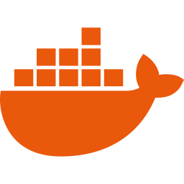
Tech stack
Lightweight, open-source and deployable on a single government server.
Frontend
Backend
AI / ML
Deploy
React 19 + Vite
React Router
Recharts
Leaflet + OpenStreetMap
Web Speech API (voice)
Python 3.11
FastAPI + Uvicorn
SQLite (PostgreSQL-ready)
PBKDF2 + HMAC tokens (stdlib)
pytest: 17 tests
scikit-learn: TF-IDF, LogReg
fastembed + ONNX Runtime
Multilingual MiniLM, CPU only
Pillow: photo hashes
Gemini / OpenAI (optional)
Docker single container
Render / any VM
OpenAPI docs at /docs
Env-based keys and timers
Runs offline, no GPU
SamajSevak · AI-04 | 12

Slide 13
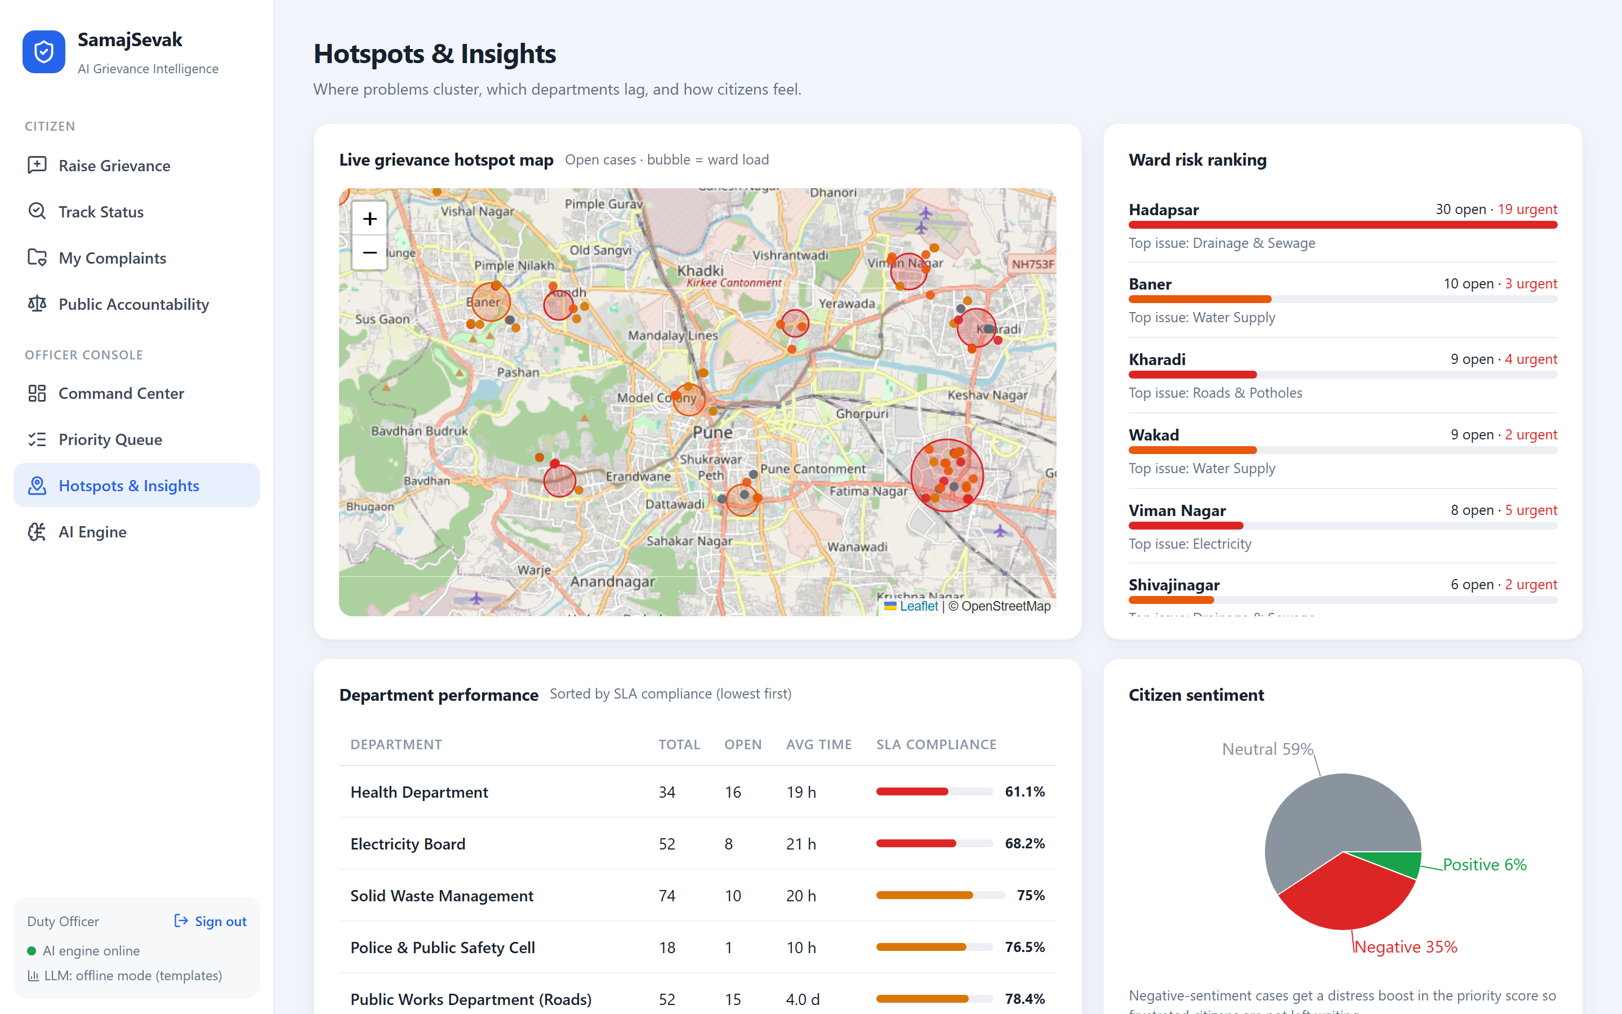
From complaints to prevention
Hotspots, emerging-issue alerts and department accountability.
Emerging hotspot detected
Drainage and public-health complaints in Hadapsar this week — far above the 3-week baseline (planted in the demo data).
Recommendation: a ward-level drive instead of case-by-case fixes.
Ward risk ranking Open & urgent load per ward, top issue
SLA compliance by department Lowest performers surface first
Public accountability page Aggregate counts by stage, department and ward
SamajSevak · AI-04 | 13

Slide 14
Prototype results
Measured on the working prototype (backend/models/metrics.json, 17 automated tests)
87.9%
90.9% · 84.8%
~30 ms
4 + 5
category accuracy on 66 hand-written English + Hinglish complaints kept unseen until the templates were frozen (58/66). TF-IDF alone: 80.3%
Hindi · Marathi (Devanagari, 33 each) before any training text in those languages existed. 100% · 97.0% after, which is optimistic
full AI analysis per complaint on a laptop CPU, no GPU
languages with the full pipeline, and five escalation stages with every transition tested
What the demo shows
About 460 seeded reports across 12 Pune wards forming master issues · an English and a Marathi report of the same fallen wire linked automatically · open issues spread over all five stages · citizen "not satisfied" reopening an issue · hotspot spike alert in Hadapsar.
Honest notes: all data is synthetic, so no real-world accuracy is claimed; no real complaints have been collected yet. The officer-verification loop that retrains on real corrections is built. Citizen login has no OTP. Escalation changes records and screens only. The photo check needs an LLM key.

Slide 15

Impact & roadmap
Accounts and notifications for each escalation authority; OTP for citizens
Impact
Next
Life-safety issues reach the right team first
One workload per real problem, not one per complaint
Officers get a proven action plan, not a blank page
An issue is closed by the citizen, not by the department
Ignored issues escalate on a visible, audited ladder
Citizens report in their own language and stay anonymous to officers
Real complaint data through the officer-verification loop; more Indian languages
Next
WhatsApp chatbot & IVR intake; CPGRAMS / municipal ERP integration
Scale
Offline image model for photo evidence; PostgreSQL + PostGIS
Scale
Predictive maintenance: forecast issues before complaints arrive
Future
SamajSevak · AI-04 | 15

Slide 16
Thank you
SamajSevak — every voice heard, every issue followed through.
GitHub: github.com/<your-username>/samajsevak
Run: docker build -t samajsevak . && docker run -p 8000:8000 samajsevak
Team Viper · Hack2Ignite · AI-04

