Slide 1

MediAssist
LLM + Agentic AI Healthcare Conversational Assistant
Deep Learning Course Project · MedQuAD dataset
Notes:
Introduce MediAssist: a virtual healthcare assistant that combines a large language model with an agent that plans and executes tasks. It is trained and evaluated on the MedQuAD medical question answering dataset.

Slide 2




One assistant handles four patient tasks
Patients wait on phone lines for simple answers, bookings and report explanations. MediAssist automates these routine requests so staff can focus on care.
Medical Q&A
Appointments
Answers grounded in NIH-sourced MedQuAD passages
Check slots, book, list and cancel visits
Goal: plan and execute multi-step requests autonomously, grounded in trusted medical data.
Report summary
Preventive care
Parse lab values and flag abnormal results
Lifestyle tips and age-based screenings
Notes:
The organization wants one assistant for four tasks: medical questions, appointment scheduling, summarizing health reports, and preventive recommendations. A single message can combine several of them.

Slide 3
MedQuAD: 14,978 expert medical Q&A pairs
16,407
raw Q&A pairs from 12 NIH websites
14,978
unique pairs after de-duplication
15
question types (symptoms, treatment, ...)
Notes:
MedQuAD contains question-answer pairs from trusted NIH sources such as MedlinePlus and GARD. After removing duplicate questions and one class with a single example, 14,978 pairs across 15 question types remain. Classes are imbalanced, so the split is stratified.

Slide 4
System architecture
Patient
Streamlit chat UI
Healthcare Agent
Safety check → Plan → Act → Observe → Respond
Gemini LLM
function calling
Medical
knowledge search
Check
availability
Book / list /
cancel
Summarize
report
Preventive
tips
MedQuAD models
TF-IDF retriever + question-type classifier
Appointment store
JSON, 10 specialties
Offline fallback
rule planner when no API key
Notes:
The patient talks to a Streamlit UI. The agent first runs a safety check, then plans. In LLM mode, Gemini chooses tools through function calling. Tools wrap the trained MedQuAD models, the appointment store, the report analyzer and the prevention engine. Without an API key, a rule-based planner drives the same tools.

Slide 5




The agent plans, acts, observes and responds
1. Plan
2. Act
3. Observe
4. Respond
Split the request into sub-tasks and order them
Call the right tool with extracted arguments
Use tool output to decide the next step
Merge results into one grounded, safe reply
Example
“Summarize my report and book the right doctor”
summarize_health_report → sugar & HbA1c high → reason: specialty = Endocrinology → book_appointment → reply with summary + booking ID
Notes:
This loop is what makes the system agentic. In the example, the user never names a specialty. The agent reads the report output, sees high blood sugar, and books Endocrinology on its own.

Slide 6



Three models work together
Hybrid TF-IDF retriever
Question-type classifier
Gemini LLM agent
Word 1-2-grams + character 3-5-grams
Cosine similarity over 14,978 questions
Returns top-k passages for RAG
TF-IDF + Logistic Regression
15 classes, balanced class weights
Compared with Naive Bayes and SVM
Function calling over 7 tools
Answers only from retrieved passages
Offline rule planner as fallback
Notes:
The retriever finds the most similar MedQuAD questions. The classifier predicts the question type, which helps interpret the query. Gemini orchestrates the tools and writes the final answer from the retrieved passages, which reduces hallucination.

Slide 7
Classifier aces MedQuAD's fixed templates
Reality check
43.3%
accuracy on re-worded questions. MedQuAD questions follow templates, so the split is easy. Real patients phrase questions freely, which is why the LLM handles the final answer.
Notes:
Logistic Regression reaches 99.9% accuracy and SVM 100%, but that is because the questions are templated, like 'What are the symptoms of X'. When we paraphrase test questions, accuracy drops to about 43%. That honest result motivated using the LLM for understanding free-form language.

Slide 8
Retrieval finds the right disease 95% of the time
95.2%
top answer is about the correct disease
89.2%
exact answer in the top 5 passages
55.4%
answer token-F1 vs. gold answer
Notes:
To test robustness, we paraphrase test questions. Exact Hit@1 is about 41% because each disease has many similar questions. But the retriever lands on the right disease 95% of the time, and the exact answer is in the top five 89% of the time. That is why we pass the top passages to the LLM. The hybrid model beats word-only TF-IDF on every metric.

Slide 9
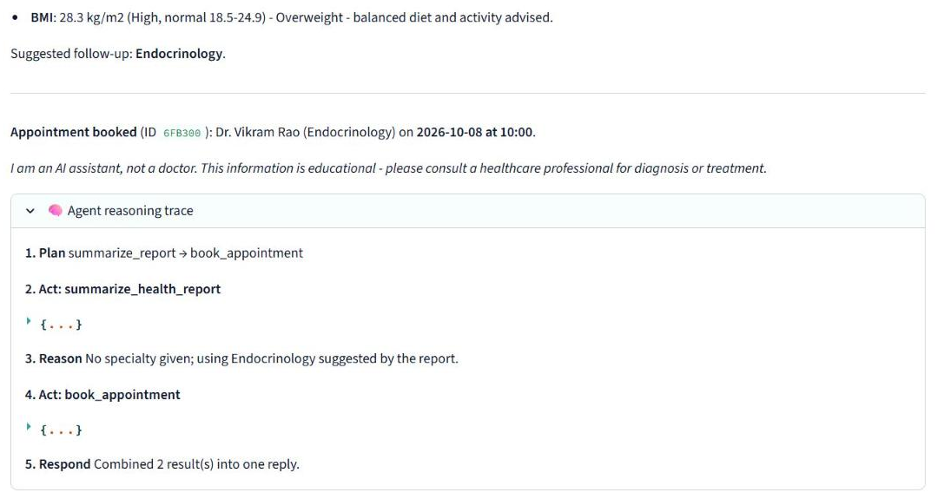
Demo: one request, several autonomous steps
20 / 20
multi-intent test requests planned correctly
Agent reasoning trace shows every step
Specialty inferred from the report
Booking saved with an appointment ID
Notes:
Live demo: tick 'Attach report', then ask to summarize the report and book the right doctor. Expand the reasoning trace to show plan, act, reason and respond.

Slide 10
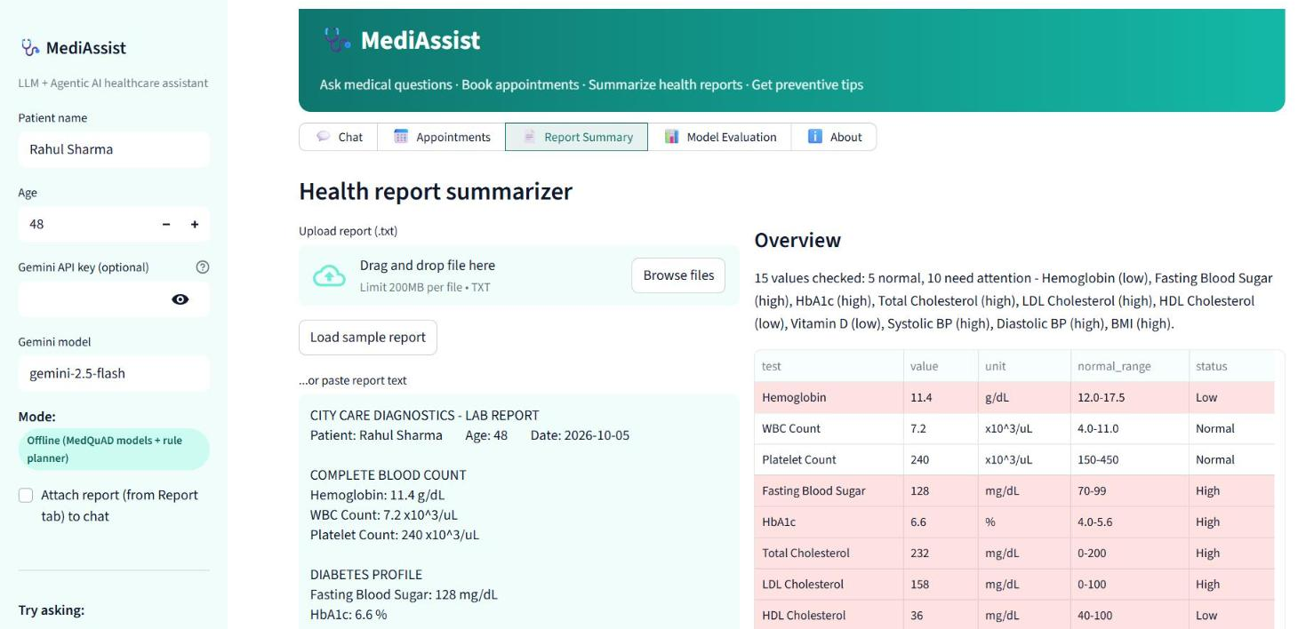
Demo: abnormal lab values flagged instantly
19
lab tests with reference ranges
10 / 15
values flagged in the sample report
Abnormal results map to a follow-up specialty, ready to book in one click.
Notes:
Load the sample report. The parser extracts each value, compares it with the normal range, highlights abnormal rows, gives advice, and suggests Endocrinology because of high sugar and HbA1c.

Slide 11




Safety is built into every reply
Emergency detection
Grounded answers
Chest pain, breathing trouble or self-harm phrases skip the agent and show emergency numbers.
Medical answers come from NIH-sourced MedQuAD passages, never invented.
No diagnosis or dosing
Works offline
The assistant informs and refers; every reply carries a disclaimer.
Without an API key, all features run locally on the trained models.
Notes:
Healthcare needs guardrails. Emergency keywords bypass the agent entirely. Answers are grounded in trusted data. The assistant never diagnoses or prescribes. An offline mode keeps the demo, and patient data, local.

Slide 12
Limitations and next steps
Limitations
Next steps
Classifier overfits MedQuAD templates
TF-IDF misses synonyms (signs ≈ symptoms)
Report parser needs text, not scanned PDFs
Scheduler is a local demo store
Dense embeddings (BioBERT / sentence transformers)
Paraphrase augmentation for the classifier
OCR for PDF and image reports
Connect to a real hospital calendar (FHIR)
Notes:
Each limitation maps to a concrete next step. The biggest gain would come from dense medical embeddings, which understand that 'signs' and 'symptoms' mean the same thing.

Slide 13

Thank you
Questions?
Run it: python train_evaluate.py → streamlit run app.py
Notes:
Summary: MediAssist combines trained retrieval and classification models on MedQuAD with an LLM agent that plans and executes healthcare tasks. Invite questions.

