Slide 1
Title
Security & Compliance in Algonquin Pet Store
Sai Karthick Kalidoss • 041185264 • CST8919

Slide 2
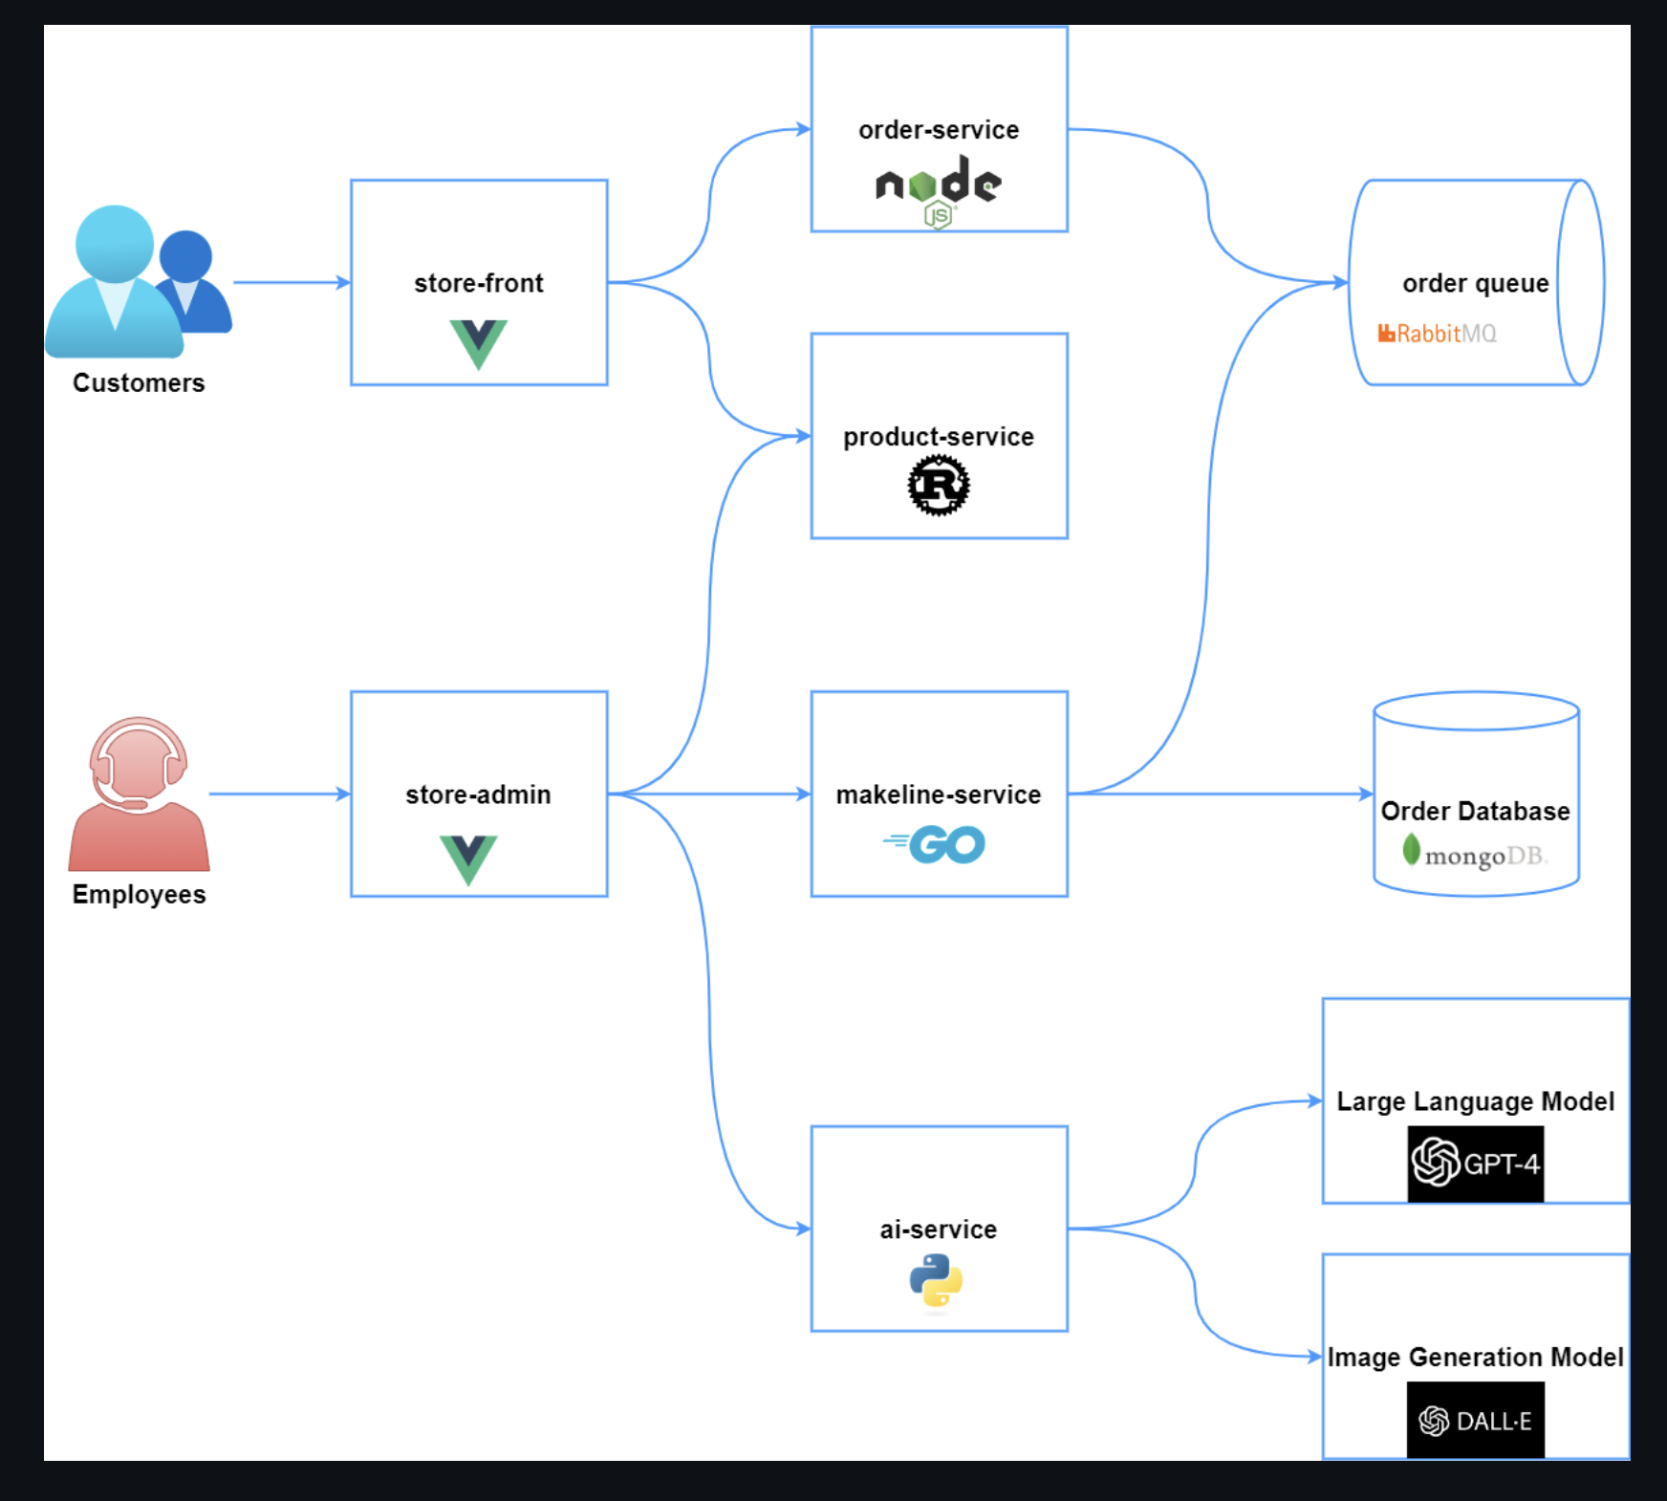
Architecture Overview
The Pet Store app uses microservices with Vue.js frontends, Rust/Go backends, RabbitMQ for messaging, and MongoDB for persistence.

Slide 3
SSO & Federated Identity Management
Implement SSO in store-front and store-admin for seamless access.
Use OAuth2, OpenID Connect, and SAML for authentication.
Explanation: Centralized authentication improves security while simplifying user access.

Slide 4
Audit Logs & Event Analysis
Log user logins, order changes, product updates, and admin actions.
Use Azure Monitor, ELK Stack, or Splunk for log analysis.
Explanation: Capturing and analyzing events helps detect anomalies and supports compliance reporting.

Slide 5
Threat Detection in Audit Logs
Configure alerts for: Multiple failed login attempts, Suspicious admin activities, Unauthorized data access
Explanation: Automated alerts enable quick responses to potential security breaches.

Slide 6
Cloud-Native Security Tools
Integrate tools such as: Azure Security Center, AWS GuardDuty, GCP Security Command Center
Explanation: Native cloud tools provide real-time insights and proactive protection.

Slide 7
Organizational Policy Enforcement
Use RBAC to control employee privileges.
Apply policies for data retention, encryption, and quota limits.
Explanation: Ensures compliance with business and regulatory standards.

Slide 8
Security Automation
Automate with Azure Sentinel Playbooks for incident response.
CI/CD security scans for vulnerabilities.
Explanation: Automation reduces human error and speeds up security responses.

Slide 9

Best Practices & Summary
Strong Authentication & SSO
Continuous Monitoring & Threat Detection
Automated Security Enforcement
Cloud-Native Security Integration
Explanation: These practices ensure end-to-end security and compliance for the Pet Store app.

