Slide 1
Title
Serverless Architecture for Algonquin Pet Store
Sai Karthick kalidoss • 041185264 • CST8917

Slide 2
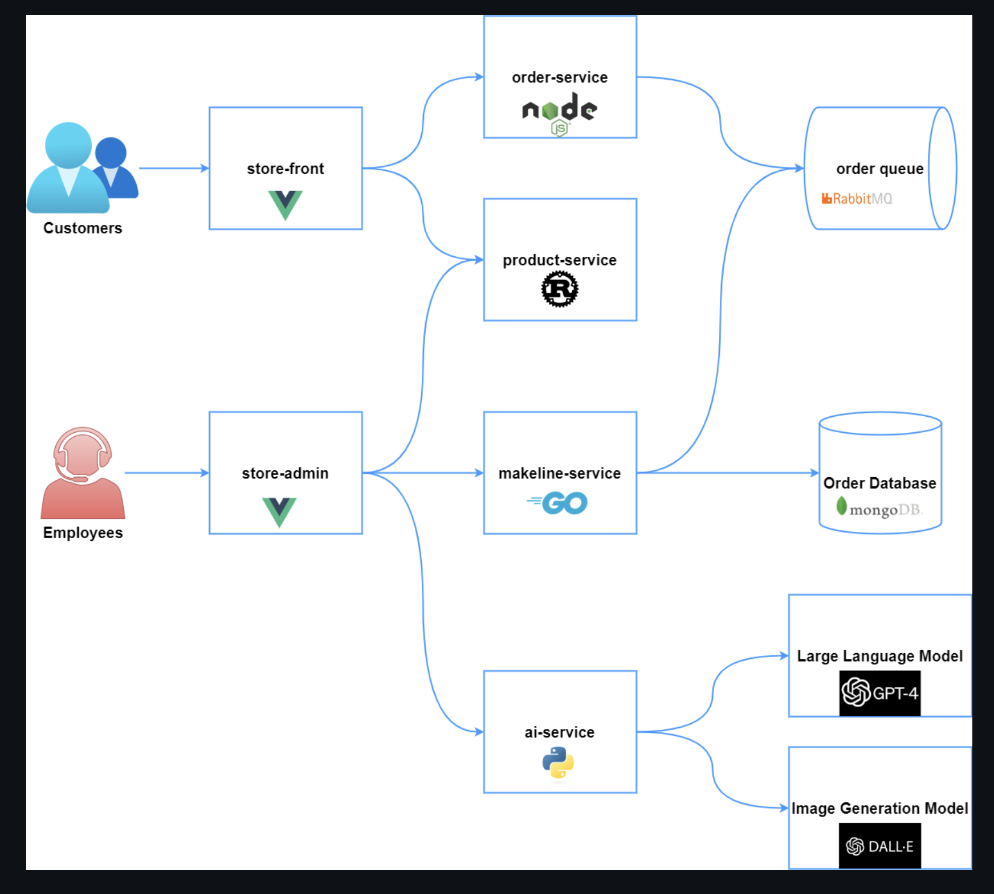
Overview of Algonquin Pet Store Architecture
Microservices: store-front, store-admin, order-service, product-service, makeline-service, ai-service
Data flow: Customers → Orders → Queue → Processing → Database
Explanation: The microservices architecture supports modular and scalable operations.

Slide 3
Serverless Opportunities
Move order-service, ai-service, and virtual-customer/worker to Azure Functions.
Offload cron-based tasks to serverless timers.
Explanation: Serverless reduces infrastructure overhead and improves scalability.

Slide 4
Triggers & Bindings Design
HTTP Trigger: customer orders
Queue Trigger: RabbitMQ replacement with Azure Service Bus
Timer Trigger: virtual-customer order creation
Explanation: Functions can be triggered by events, queues, or timers to automate workflows.

Slide 5
Function Chaining & Orchestration
Use Durable Functions for Order placement → Payment → Fulfillment → Notification.
Handle AI-service calls sequentially.
Explanation: Durable Functions provide reliable stateful orchestration of multi-step workflows.

Slide 6
Handling Long-Running Processes
Implement retries, timeouts, and compensation logic in Durable Functions.
Explanation: Ensures resilience for tasks like AI image generation and large batch orders.

Slide 7
CI/CD & Deployment Pipelines
Use GitHub Actions or Azure DevOps Pipelines.
Automate build, test, and deployment of functions.
Explanation: Automated pipelines ensure reliable and repeatable deployments.

Slide 8
Security, Monitoring & Observability
Apply Managed Identities for service access.
Monitor with Azure App Insights & Log Analytics.
Use RBAC for access control.
Explanation: Provides secure, traceable, and observable operations.

Slide 9
Logic Apps vs Azure Functions
Logic Apps: best for workflow automation (e.g., order confirmations).
Azure Functions: best for compute-heavy operations (e.g., AI-service).
Explanation: Logic Apps simplify integrations, while Functions provide flexible compute.

Slide 10
Messaging & Event Routing
Replace RabbitMQ with Azure Service Bus or Event Grid.
Pros: Scalability, cloud-native management
Cons: Vendor lock-in, migration complexity
Explanation: Cloud-native messaging simplifies scaling and management.

Slide 11
Serverless Best Practices & Summary
Use Event-Driven Design
Secure with Managed Identities & RBAC
Automate Deployments with CI/CD
Monitor with Cloud-Native Tools
Explanation: Serverless architecture improves efficiency, scalability, and reliability.

