Slide 1


TEEGALA KRISHNA REDDY ENGINEERING COLLEGE
(UGC-Autonomous)
Approved by AICTE, Affiliated by JNTUH, Accredited by NAAC- ‘A’ Grade
Medbowli, Meerpet, Balapur, Hyderabad, Telangana- 500097
Mob: 9393959597. Email: info@tkrec.ac.in, deanacademics@tkrec.ac.in
DEPARTMENT OF ELECTRONICS AND COMMUNICATION ENGINEERING
Batch No.03
DESIGN AND IMPLEMENTATION OF HIGH SPEED
32-BIT VEDIC MULTIPLIER USING VERILOG HDL
TEAM MEMBERS :-
22R91A04D7 SAI KARTHIK REDDY.K
22R91A04H6 SAIKIRAN.N
22R91A04G1 PRAVALIKA.M
22R91A04E8 CHANDRAMOHAN REDDY.M
.
GUIDED BY:-
Mr M.V.V.SATYA CHOWDARY
(ASSISTANT PROFESSOR)

Slide 2
Table of Contents
1. OBJECTIVE
2. ABSTRACT
3. EXISTING SYSTEM
4. PROBLEM IDENTIFICATION
5. PROPOSED SYSTEM
6. BLOCK DIAGRAM
7. WORKING PRINCIPLE
8. SCHEMATIC DIAGRAM
9. EXPLANATION
10. ADVANTAGES
11. APPLICATIONS
12. EXPECTED RESULT
13. CONCLUSION
14. FUTURE SCOPE
15. REFERENCES

Slide 3
OBJECTIVES
Design a digital circuit that can perform multiplication of two 32-bit numbers using the Vedic multiplication algorithm.
Implement the designed Vedic multiplier using Verilog HDL, a hardware description language.
Optimize the design to achieve high-speed operation, minimizing the delay and maximizing the throughput..

Slide 4
ABSTRACT
The increasing demand for high-speed digital arithmetic operations in modern computing systems necessitates the development of efficient multiplication techniques.
This work presents the design of a high- speed 32-bit binary Vedic multiplier based on the principles of ancient Vedic mathematics, particularly the Vedic Sutras. Vedic multiplication, renowned for its parallel processing capabilities, offers significant advantages over conventional multiplication techniques.
The proposed design optimizes the addition and carry management stages, which are crucial for reducing the overall delay in the multiplication process, making it suitable for modern digital systems requiring high-speed arithmetic operations.
The architecture of the 32-bit Vedic multiplier is implemented using Verilog Hardware Description Language (HDL), ensuring flexibility and scalability. The multiplier was simulated and synthesized using AMD Vivado to validate its performance in a simulated environment.
Simulation results show that the 32-bit Vedic multiplier significantly reduces time delay compared to conventional multiplier designs. Additionally, optimized resource utilization further enhances its performance.
The design is scalable, allowing it to be extended to larger bit-widths for higher-order multiplications, which is particularly advantageous for applications in Digital Signal Processing (DSP), cryptography, and other computationally intensive tasks.

Slide 5
Existing System
Traditional Vedic multipliers use Ripple Carry Adders (RCA) for partial product addition.
Limitations include:
- High propagation delay
- Inefficient hardware utilization
- Difficulty in scaling for higher bit-widths

Slide 6
Problem Identification
RCA-based Vedic multipliers suffer from:
- Increased critical path delay
- Inefficiency at larger data widths
- Unsuitability for high-speed real-time applications like DSP and encryption

Slide 7
Proposed System
Replace RCAs with CSAs to reduce carry propagation delay.
Modular design from 4-bit → 8-bit → 16-bit → 32-bit using hierarchical Vedic structure.
OR operation replaces higher-bit RCA in final stage to reduce adder size.
Uses 16-bit final adder for output stage.

Slide 8
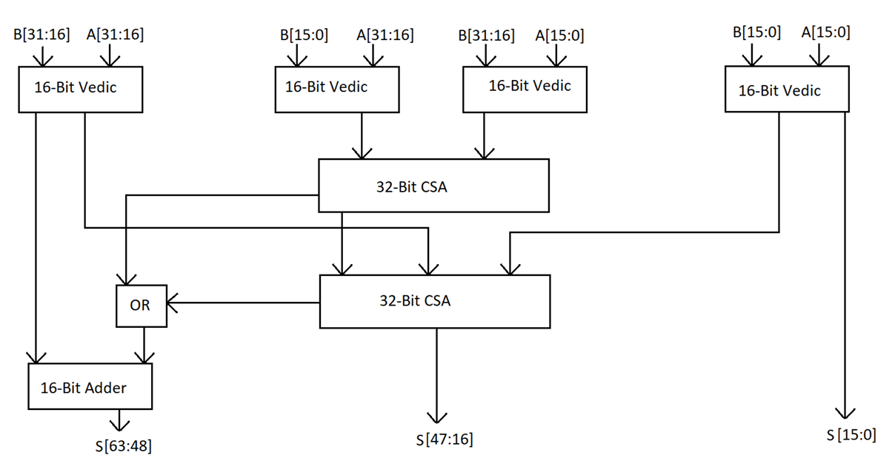
BLOCK DIAGRAM

Slide 9
Working Principle
1. Split inputs A[31:0] and B[31:0] into halves.
2. Compute 16-bit multiplications: m0, m1, m2, m3.
3. Use CSA to combine m1, m2, and high part of m0.
4. Use second CSA to combine output with m3 and carry.
5. Final result = m0 lower + CSA result + OR + 16-bit adder.

Slide 10
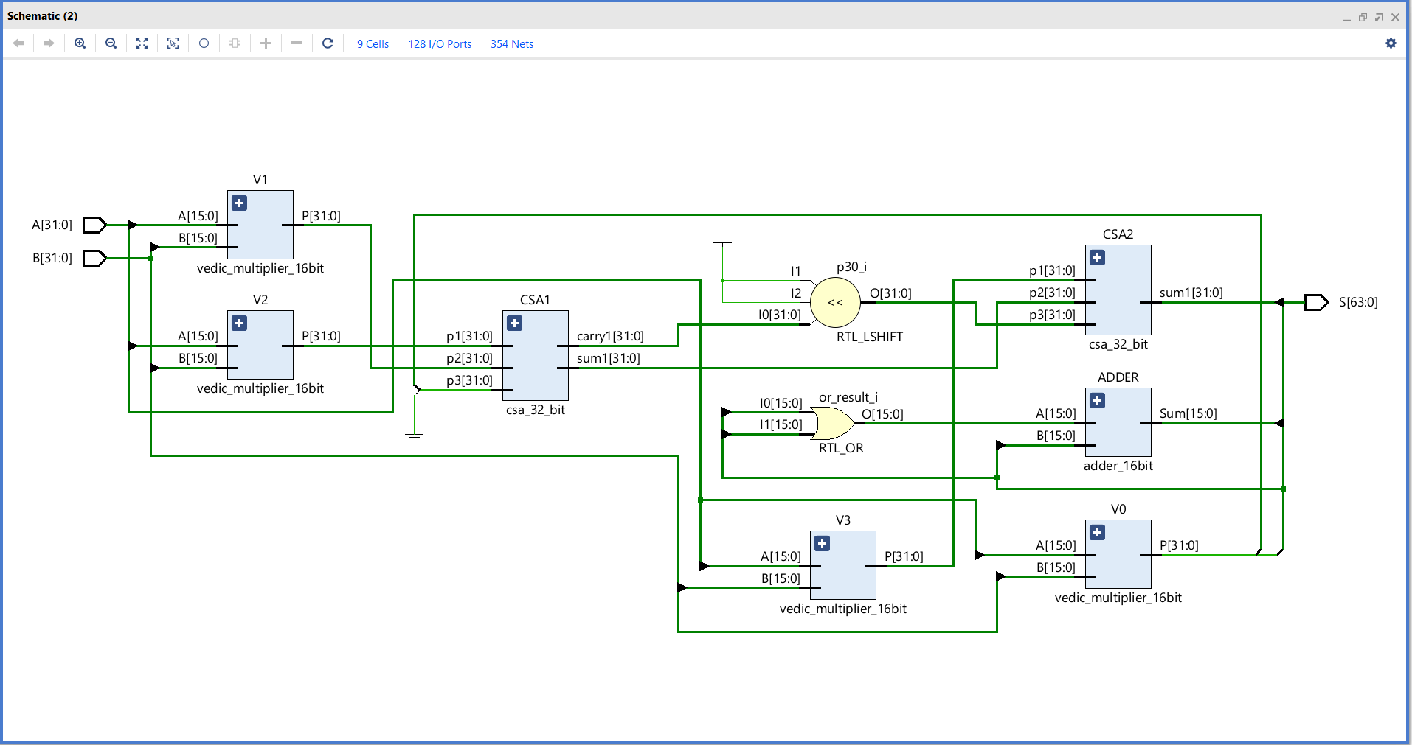
Schematic Diagram

Slide 11
Explanation of Each Block
Vedic Multiplier Blocks (V1, V2, V3, V0) : These blocks perform multiplication of 16-bit inputs to produce 32-bit outputs. Each block is labeled with its specific input and output connections.
Carry-Save Adder Blocks (CSA1, CSA2) : CSA1 and CSA2 are responsible for addition. They take multiple 32-bit inputs and produce outputs in the form of sum and carry, which streamline the computation process by avoiding ripple carry delays.
RTL_LSHIFT Block : This block carries out a left-shift operation on input data, adjusting the bits to a new position and effectively scaling the values.
RTL_OR Block : A bitwise OR operation is performed here. It combines inputs, retaining any bit that is set in at least one input.
ADDER Block : This block adds two 16-bit numbers together, producing a 16-bit result. Simple but crucial in smaller computation steps.
Output Block : It delivers the final result—a 64-bit outcome combining the processing of all prior blocks.

Slide 12
Advantages
Faster due to reduced carry propagation.
Scalable for higher-bit multipliers.
Efficient partial product combination.
Lower delay

Slide 13
Applications
Digital Signal Processing (DSP)
Cryptography and Encryption Engines
Scientific Computing and Simulation
Communication Systems and Protocols

Slide 14
EXPECTED RESULT
The Carry Save Adders (CSAs) combine the intermediate results reduce carry propagation delay.
The final carry is added using a 16-bit adder.
The 64-bit product is divided into three parts:
S[63:48]
S[47:16]
S[15:0]

Slide 15
Conclusion
The modified Vedic multiplier achieves:
  Reduced time delay
  Better performance for 32-bit inputs
  Suitable for real-time embedded and DSP systems
  Increase in area is acceptable trade-off

Slide 16
Future Scope
Extend design to 64-bit or floating-point multiplication
Implement on ASIC for better area optimization
Explore hybrid adder structures like Carry Lookahead
Integrate into SoC multipliers and MAC units

Slide 17
References
A. Khanam and S. Singarapu, “Modified High-Speed 32-Bit Vedic Multiplier Design and Implementation,” Dept. of ECE, Chaitanya (Deemed to be University), Warangal, India.
K. Radha, S. Anuradha, R. Meghana, P. R. T. Reddy, and P. Hemanth, “FPGA Implementation of 32-Bit Vedic Multiplier Using Verilog HDL,” Dept. of ECE, Sir C R Reddy College of Engineering, Vatluru, Eluru, Andhra Pradesh – 534007, India.
M. B. Murugesh and G. V. K. Reddy, “Modified High-Speed 32-bit Vedic Multiplier: Design and Implementation,” Dept. of ECE, SVCET, RVS Nagar, Chittoor, AP, India.
N. K. Mishra and S. Wairya, “Low Power 32×32 Bit Multiplier Architecture Based on Vedic Mathematics Using Virtex 7 Low Power Device,” Dept. of Electronics and Communication Engineering.

Slide 18
Thank you...

