Slide 1
PROJECTION OF POINT
PES

Slide 2
INTRODUCTION
POINT HAS SIMPLY POSITION BUT NO MAGNITUDE
GENERALLY REPRESENTED BY A VERY SMALL CIRCLE OR A DOT

Slide 3
POSITION OF POINT
IN ORTHOGRAPHIC PROJECTIONS SPACE IS DIVIDED INTO FOUR QUADRANTS
BY TWO REFERENCE PLANES : H.P. AND V.P.
POINT MAY BE SITUATED IN ANY ONE OF THESE QUADRANTS
IT MAY ALSO BE ON ANY ONE OF THE REFERENCE PLANES

Slide 4
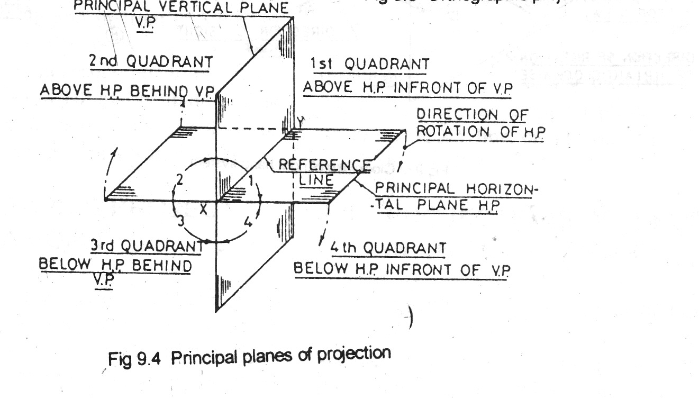
PRINCIPAL PLANES OF PROJECTION
PES

Slide 5
Position of point
Point situated above HP and in front of VP is in 1Q
Point situated above HP and behind VP is in 2Q.
Point situated below HP and behind VP is in 3Q.
Point situated below HP and in front of VP is in 2Q.
PES

Slide 6
POSITION OF POINT
IN FRONT OF VP AND ABOVE HP
IN FRONT OF VP AND IN THE HP
IN THE VP AND ABOVE HP
BEHIND VP AND ABOVE HP
BEHIND VP AND IN HP
BEHIND VP BELOW HP
IN VP BELOW HP
IN FRONT OF VP AND BELOW HP
IN VP AND HP

Slide 7
POSITION OF POINT
AFTER KNOWING DISTANCES OF POINT FROM BOTH THE REFERENCE PLANES, IT IS POSSIBLE TO FIND OUT ITS PROJECTIONS ON HP AND VP
BY EXTENDING PROJECTORS PERPENDICULAR TO BOTH THE PLANES
PROJECTION ON HP IS CALLED TOP VIEW
PROJECTION ON VP IS CALLED FRONT VIEW

Slide 8
Position of point
The original point is represented by capital letters e.g A, B, P & Q
The top view or top plan or plan is represented by lower case letters for example a b p & q.
The front view or front elevation or elevation is represented by a lower case letter with dash for example a’ b’ p’ & q’
PES

Slide 9
Position of point
THE LINE OF INTERSECTION OF HP & VP IS KNOWN AS THE HINGE LINE OR GROUND LINE OR REFERENCE LINE. IT IS GENERALLY NAMED THE XY LINE
FOR DRAWING THE PROJECTIONS ON A 2D PIECE OF PAPER THE HP IS IMAGINED TO HAVE BEEN ROTATED ABOUT THE HINGE LINE XY IN SUCH A WAY THAT THE 1Q OPENS OUT AND THE HP IS BROUGHT IN TO THE PLANE OF THE VP.
PES

Slide 10
TWO QUADRANT SYSTEM FOR TWO DIRECTION OF SIGHT
ANTI CLOCKWISE OR LEFT HAND SYSTEM
CLOCKWISE OR RIGHT HAND SYSTEM
PES

Slide 11
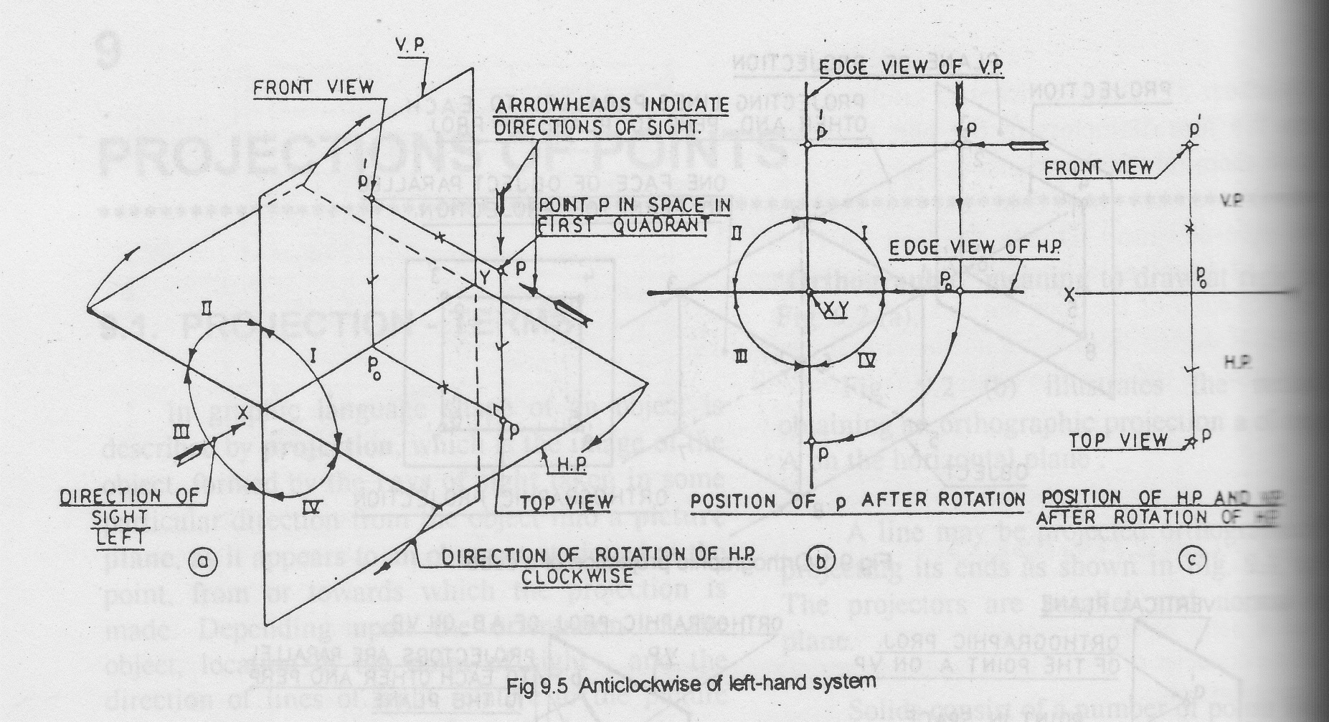
ANTICLOCKWISE LEFT HAND SYSTEM
PES

Slide 12
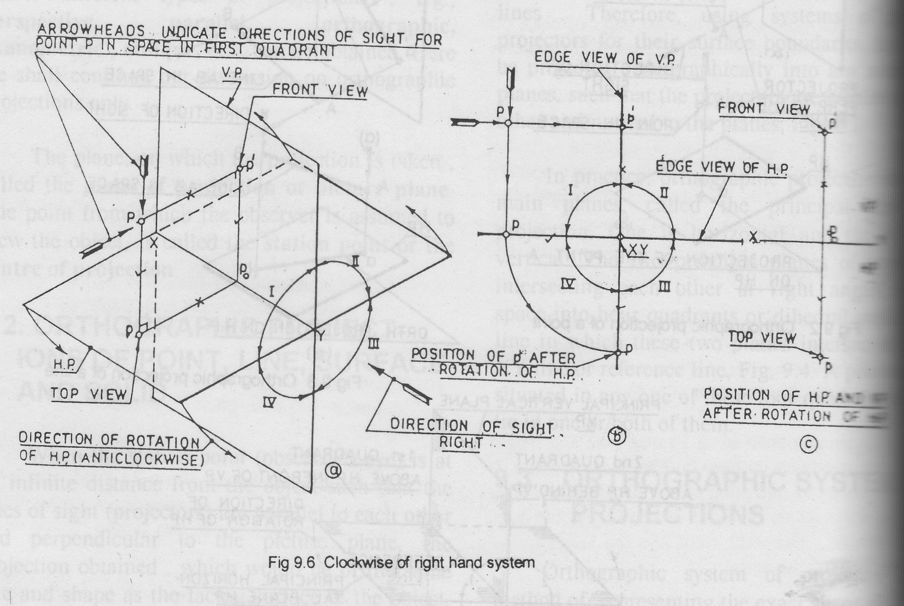
CLOCKWISE RIGHT HAND SYSTEM
PES

