Slide 1
PROJECTION OF A POINT IN 1Q
THE POINT P IN 1Q IS HAVING P’ AS FRONT VIEW AND P AS THE TOP VIEW.
HOLD VP AND REVOLVE HP IN CLOCKWISE DIRECTION THROUGH 90 DEG.
THE PROJECTIONS P’ AND P LIE ON A PROJECTOR PERPENDICULAR TO THE XY LINE AND THE FRONT VIEW P’ AFTER RABATMENT, LIES ABOVE THE XY LINE AND THE PLAN P BELOW IT.
PES

Slide 2
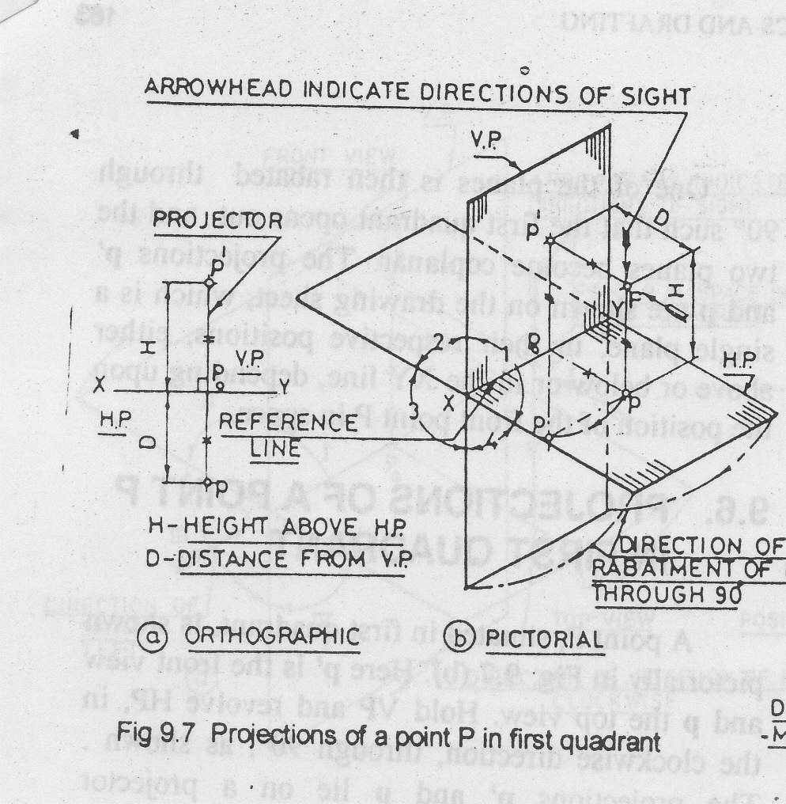
PROJECTION OF POINT ‘P’ IN 1ST QUADRANT
PES

Slide 3
PROJECTION OF POINT ‘P’ IN 2nd QUADRANT
HOLD VP AND REVOLVE HP THROUGH 90 DEG IN CLOCKWISE DIRECTION.
AFTER RABATMENT THE ELEVATION P’ AND PLAN P BOTH LIE ABOVE XY LINE, ON A PROJECTOR PERPENDICULAR TO XY.
PES

Slide 4
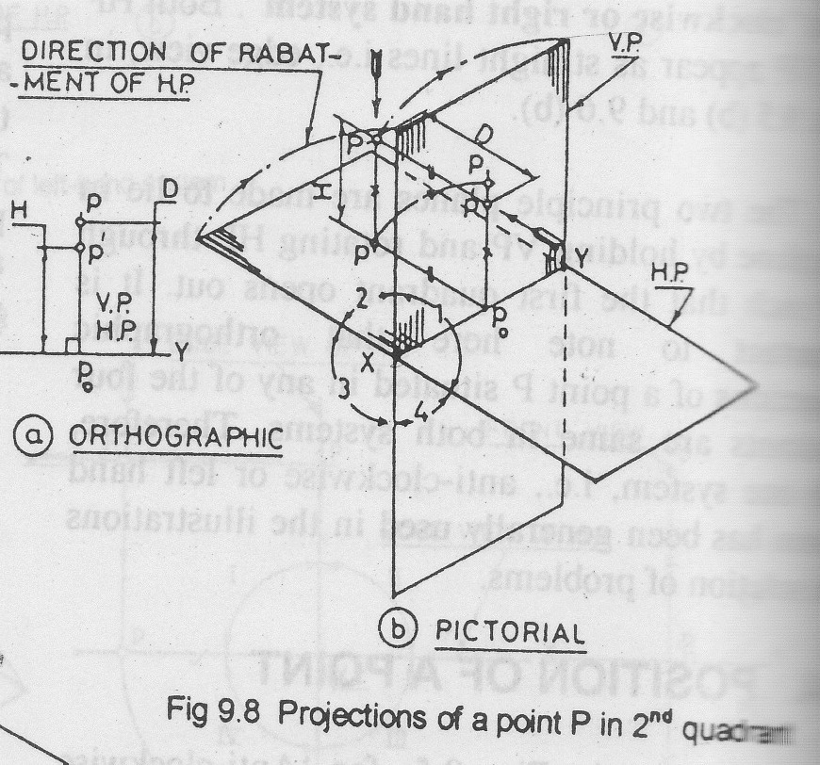
PROJECTION OF POINT ‘P’ IN 2ND QUADRANT
PES

Slide 5
PROJECTION OF POINT ‘P’ IN 3rd QUADRANT
HOLD VP AND REVOLVE HP THROUGH 90 DEG IN CLOCKWISE DIRECTION SO THAT 1Q OPENS OUT.
AFTER RABATMENT THE ELEVATION P’ LIES BELOW AND PLAN P LIES ABOVE THE XY LINE ON A COMMON PROJECTOR PERPENDICULAR TO XY.
THE DISTANCE OF P’ BELOW XY IS EQUAL TO THE DISTANCE OF P BELOW HP AND THE DISTANCE OF TOP VIEW ABOVE THE XY IS EQUAL TO THE DISTANCE OF THE POINT P BEHIND VP
PES

Slide 6
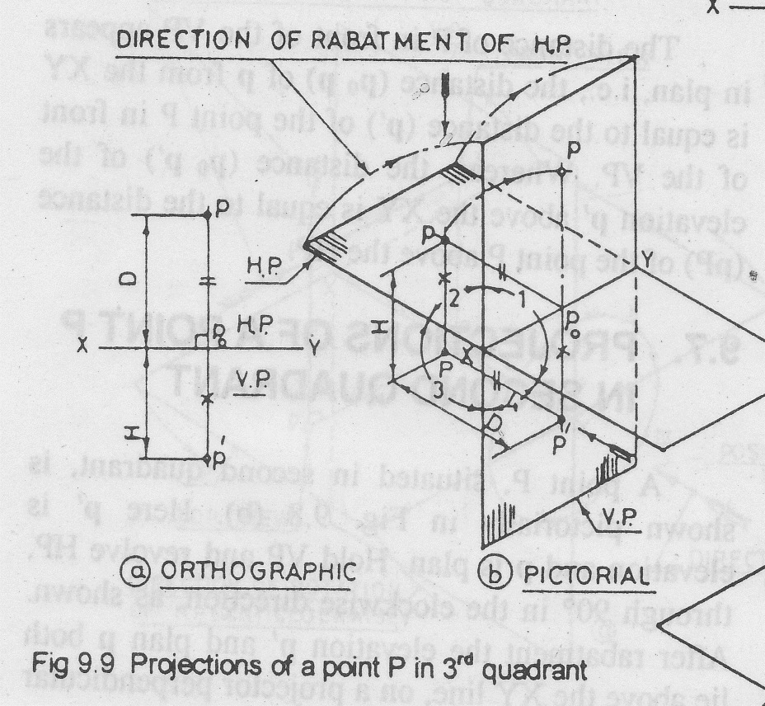
PROJECTION OF POINT IN 3RD QUADRANT
PES

Slide 7
PROJECTION OF POINT IN 4th QUADRANT
HOLD VP AND REVOLVE HP THROUGH 90 DEG IN CLOCKWISE DIRECTION.
AFTER RABATMENT THE ELEVATION P’ AND PLAN P LIES BELOW THE XY LINE ON A COMMON PROJECTOR PERPENDICULAR TO XY.
THE DISTANCE OF P’ BELOW XY IS EQUAL TO THE DISTANCE OF THE POINT P BELOW HP AND THE DISTANCE OF TOP VIEW P BELOW THE XY IS EQUAL TO THE DISTANCE OF THE POINT P IN-FRONT OF VP
PES

Slide 8
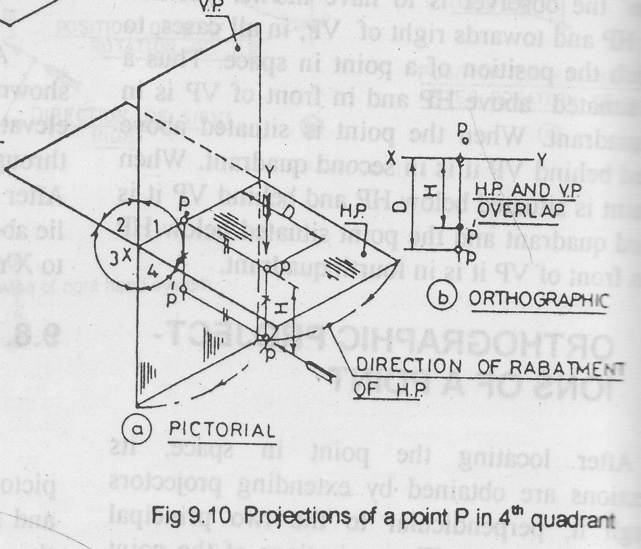
PROJECTION OF POINT IN 4TH QUADRANT
PES

Slide 9
Points to Remember
THE FRONT VIEW AND TOP VIEW OF A POINT ARE ALWAYS ON THE SAME VERTICAL LINE.
IF THE POINT IS ABOVE HP ,ITS FRONT VIEW IS ABOVE XY LINE ,IF THE GIVEN POINT IS BELOW THE HP ,ITS FRONT VIEW IS BELOW THE XY LINE.
IF THE POINT IS IN FRONT OF VP ,ITS TOP VIEW IS BELOW THE XY LINE. IF THE GIVEN POINT IS BEHIND VP, ITS TOP VIEW IS ABOVE THE XY LINE
PES

Slide 10
Important observations
IN FIRST AND THIRD QUADRANT THE PROJECTION OF THE POINT P LIE ON THE OPPOSITE SIDES OF THE XY LINE.
WHERE AS, BOTH THE PROJECTIONS LIE ON THE SAME SIDE OF IT WHEN THE POINT P LIES IN 2ND Q OR 4TH Q
THE PROJECTIONS OF GEOMETRICAL SHAPES IN 2Q OR 4Q MAY OVERLAP EACH OTHER AND WILL NOT AFFORD A CLEAR VISUALIZATION AND INTERPRETATION OF THE OBJECT DRAWN.
THEREFORE PROJECTIONS OF AN OBJECT EITHER IN 1Q OR IN 3Q IS USED
PES

Slide 11
PROBLEMS
DRAW PROJECTIONS OF FOLLOWING POINTS IN DIFFERENT QUADRANTS:
POINT A,25 IN FRONT OF VP AND 30 MM ABOVE HP
POINT B , 22MM BEHIND VP AND 28 MM ABOVE HP
POINT C, 28MM BEHIND VP AND 30MM BELOW HP
POINT D, 40MM IN FRONT OF VP AND 25MM BELOW HP

Slide 12
PROBLEMS
POINT E, 32MM IN FRONT OF VP AND IN HP
POINT F, 35MM BEHIND VP AND IN HP
POINT G, IN VP AND 40MM BELOW HP
POINT H, IN VP AND HP

Slide 13
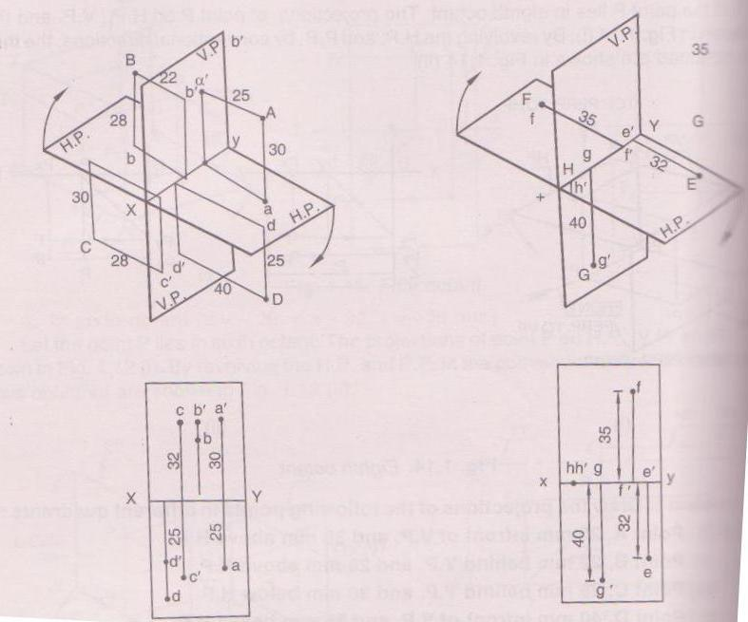
PROBLEMS

Slide 14
PROBLEMS
APOINT P IS 25MM IN FRONT OF VP AND 40MM ABOVE HP. ANOTHER POINT Q IS 40MM IN FRONT OF VP AND 25MM ABOVE HP. THE DISTANCE MEASURED BETWEEN PROJECTORS IS 40MM. DRAW THE PROJECTIONS AND FIND THE DISTANCE BETWEEN P AND Q.
SOLUTION:BOTH THE POINTS LIE IN THE FIRST QUADRANT

Slide 15
PROBLEMS
TAKE A DISTANCE OF 40MM BETWEEN THE PROJECTORS OF TWO POINTS P AND Q ON xy LINE
DRAW PROJECTIONS OF POINT P ON LEFT END OF PROJECTOR WHICH IS 25MM BELOW xy LINE AND 40MM ABOVE xy LINE
SIMILARLY DRAW PROJECTIONS OF POINT Q ON RIGHT END OF PROJECTOR WHICH IS 40MM BELOW xy LINE AND 25MM ABOVE xy LINE

Slide 16
PROBLEMS
JOIN p’q’ AND pq WHICH ARE FRONT VIEW AND TOP VIEW OF LINE PQ RESPECTIVELY
AT p AND q DRAW PERPENDICULARS Pp AND Qq EQUAL TO 40MM AND 25MM RESPECTIVELY
JOIN P AND Q
THEN PQ IS REQUIRED DISTANCE BETWEEN P AND Q

Slide 17
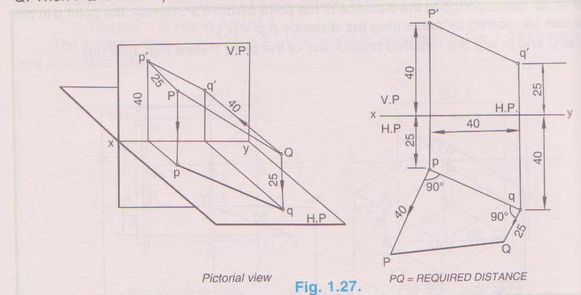
PROBLEMS

