Slide 1
ORTHOGRAPHIC PROJECTION
AN
INTRODUCTION

Slide 2
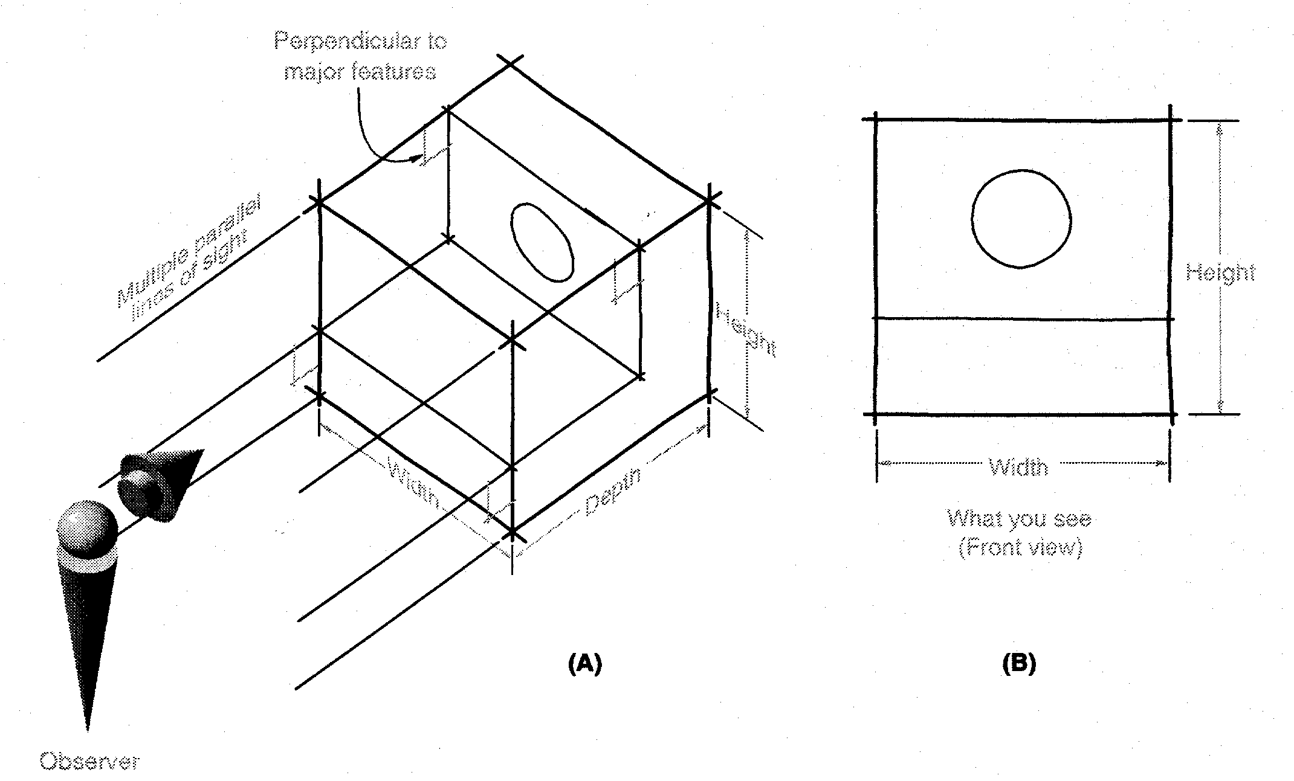
Orthographic Projections
Orthographic Projections are a collection of 2-D drawings that work together to give an accurate overall representation of an object.
Notes:
By definition for each element of a orthographic projection drawing you only present 2 of the three dimensions. Think of it as an observer look at one face, what do they see.
Any orthographic projection drawing normal has three views… Front view, Top view and side view (Right or left side view)

Slide 3
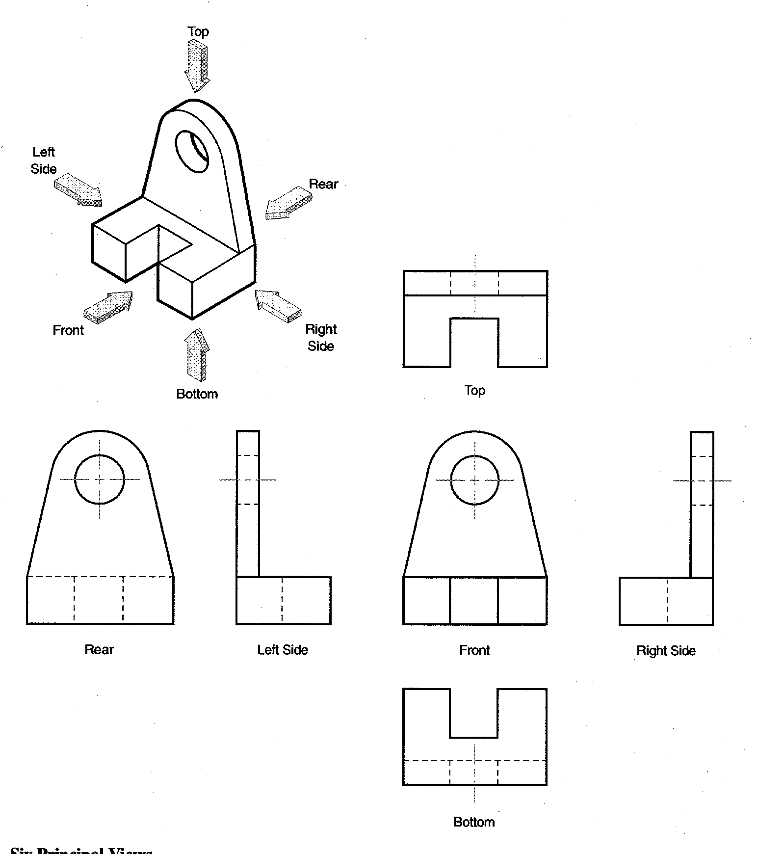
Defining the Six Principal Views or Orthographic Views
Notes:
Although any face could be chosen to be the front, once front and two other face are selected all are determined. There are really SIX PRINICPAL VIEWS as defined in the diagram.
Generally do not need all six to fully describe the object. A conventional Engineering Drawing will normally have 2 to 3 views unless it required more views to describe the geometry/ profile.
We know which ones they are on the drawing, because we always present them in the same relationship to each other. I.e. Top above front, right to right of front, etc. This convention is called as the Third angle method.. The other method in which the views can be placed is the First angle method in which the Top view is below front view, Right side view is on left side of front view. For this class we will be following the Third angle convention.
These are often called orthographic projections – because the line of sight is perpendicular to the principal view

Slide 4
Which Views to Present?
General Guidelines
Pick a Front View that is most descriptive of object
Normally the longest dimension is chosen as the width (or depth)
Most common combination of views is to use:
  Front, Top, and Side View
Notes:
Pick the views which will help in describing the object with highest clarity.
Explain what is an auxiliary view. Explain that they are drawn to show specific features that are not clear in the Principal views.

Slide 5
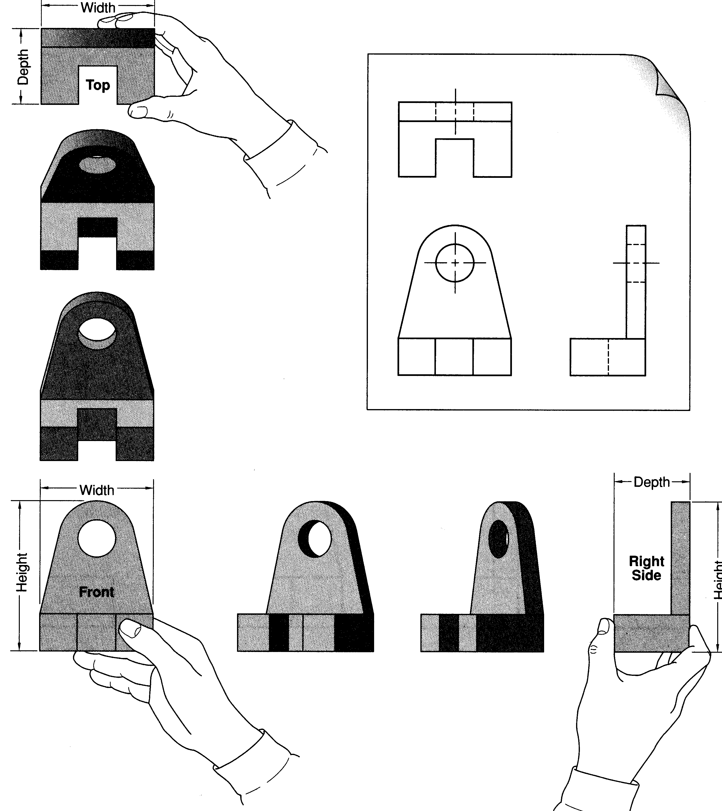
Notes:
The Idea is to have them take an object from the table.
Declare front. FRONT View is the MOST DESCRIPTIVE VIEW OF THE OBJECT. The view that gives MORE INFORMATION ABOUT THE OBJECT.
Rotate 90 degrees “up” to get top view.
Rotate Back.
Rotate 90 degrees clockwise to get right side.
This give three principal views commonly used.

Slide 6
Glass Box Approach
Place the object in a glass box
Freeze the view from each direction (each of the six sides of the box) and unfold the box
Notes:
At this point, give an introduction to Glass-box approach for developing orthographic projection drawings.
Student slides contain snapshots of the animation

Slide 7
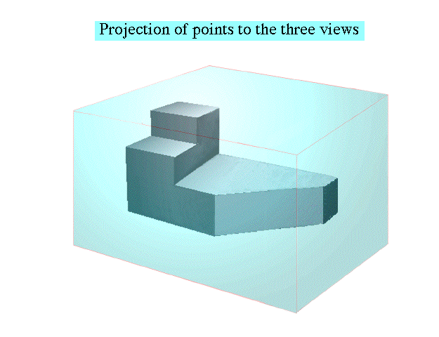
Glass Box Approach
Notes:
The object, whose orthographic projection needs to be drawn, is enclosed in a glass-box

Slide 8
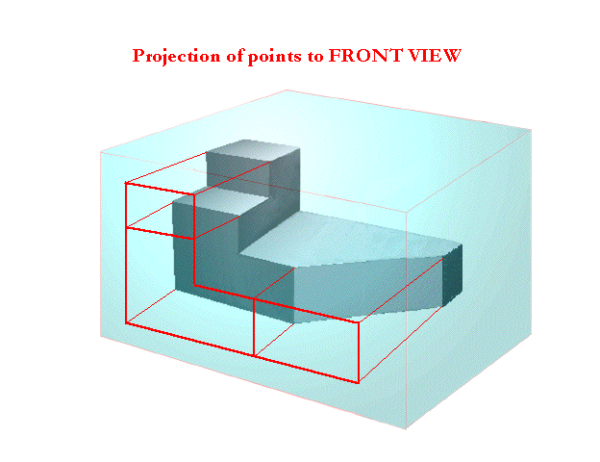
Glass Box Approach
Notes:
Project points on the front view of the glass-box

Slide 9
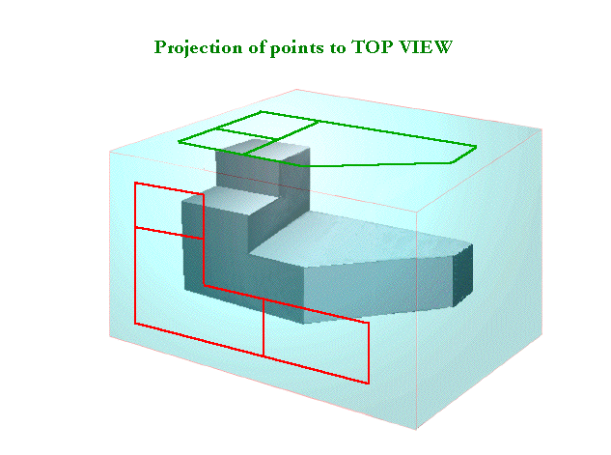
Glass Box Approach
Notes:
Project points on the the top view of the glass-box, just as done for front

Slide 10
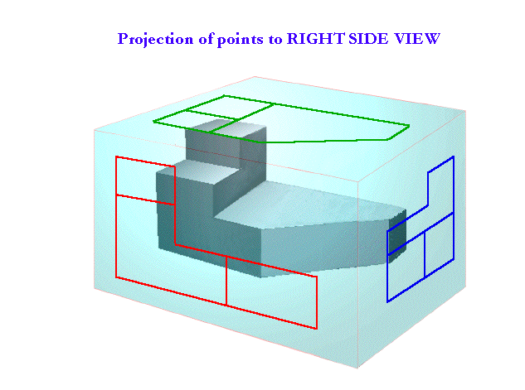
Glass Box Approach
Notes:
Project points on the right view of the glass-box, just as done for front and top

Slide 11
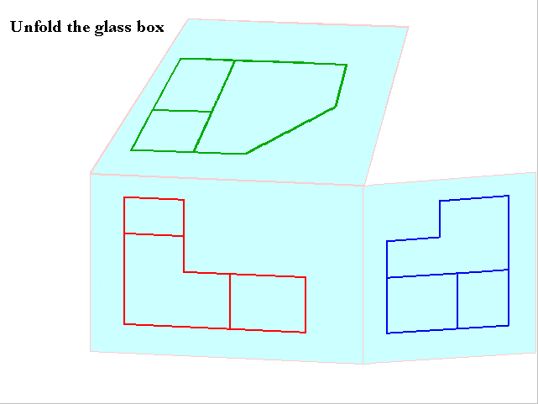
Glass Box Approach
Notes:
Unfold the glass box, see how the views align

Slide 12
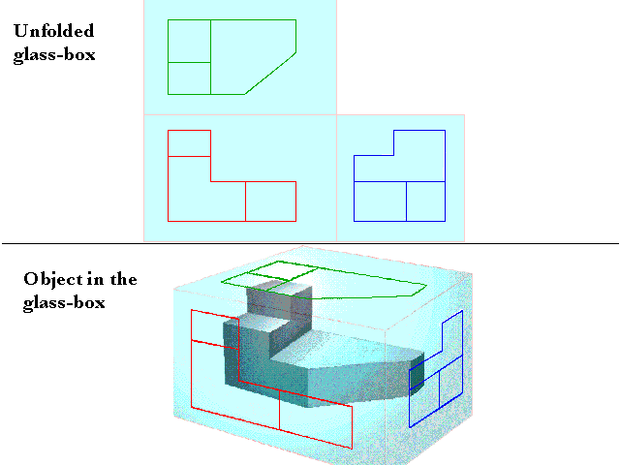
Glass Box Approach
Notes:
Unfold the glass box, see how the views align

Slide 13
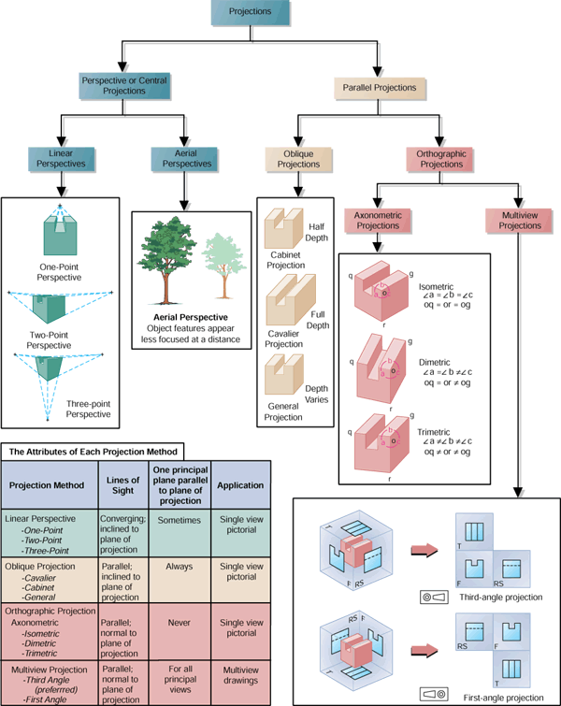
First and Third Angle Projections
Third-angle Projection
First-angle Projection
First Angle
Third Angle
Notes:
Instructor:
Third angle projection is normally used in the US while Europe uses the First Angle projection. Note the symbols at the bottom of each one which tell you which projection that you are viewing.
These can be confusing to students. We are only highlighting the fact that there are different ways to represent projections. It is not expected for students to fully understand the differences.
From Fundamentals of Graphic Communications by Bertoline, McGraw-Hill

Slide 14
Conventional Orthographic Views
Width
Top View/Plan
Depth
Right Side View
Front View
Height
Notes:
Note that the views are placed and aligned in the manner shown in the diagram. Remind the students that they have to follow the above convention for all their home work problems and exam problems.
It is very important to maintain the alignment and correct placement relative to each other.
Means line for top (and bottom) is straight across for both front view and right side view for example.
Same thing between front and top for sides.
Note : The following can be seen from the slide:
Top View and front view have the same width
Front View and Right / Left side view have the same height.
The depth of Top view is same as the width of right/ left side view.

