Slide 1




1
PLANES
PRINCIPAL PLANES
HP AND VP
AUXILIARY PLANES
Auxiliary Vertical Plane
(A.V.P.)
Auxiliary Inclined Plane
(A.I.P.)
Profile Plane
( P.P.)
Øº
A.V.P.
A.I.P.
⊥ to Hp & ∠ to Vp
⊥ to Vp
&
∠ to Hp
θº

Slide 2
2
PATTERN OF PLANES & VIEWS (First Angle Method)
THIS IS A PICTORIAL SET-UP OF ALL THREE PLANES.
ARROW DIRECTION IS A NORMAL WAY OF OBSERVING THE OBJECT.
BUT IN THIS DIRECTION ONLY VP AND A VIEW ON IT (FV) CAN BE SEEN.
THE OTHER PLANES AND VIEWS ON THOSE CAN NOT BE SEEN.
Y
PROCEDURE TO SOLVE ABOVE PROBLEM:-
TO MAKE THOSE PLANES ALSO VISIBLE FROM THE ARROW DIRECTION,
A) HP IS ROTATED 90⁰ DOUNWARD
B) PP, 90⁰ IN RIGHT SIDE DIRECTION.
THIS WAY BOTH PLANES ARE BROUGHT IN THE SAME PLANE CONTAINING VP.
X
Click to view Animation
On clicking the button if a warning comes please click YES to continue, this program is
safe for your pc.
Y
VP
PP
FV
LSV
X
Y
X
TV
HP
ACTUAL PATTERN OF PLANES & VIEWS
OF ORTHOGRAPHIC PROJECTIONS
DRAWN IN
FIRST ANGLE METHOD OF PROJECTIONS
HP IS ROTATED DOWNWARD 90⁰
AND
BROUGHT IN THE PLANE OF VP.
PP IS ROTATED IN RIGHT SIDE 90⁰
AND
BROUGHT IN THE PLANE OF VP.

Slide 3
3
Methods of Drawing Orthographic Projections
First Angle Projections Method
Here views are drawn
by placing object
in 1st Quadrant
( Fv above X-y, Tv below X-y )
Third Angle Projections Method
Here views are drawn
by placing object
in 3rd Quadrant.
( Tv above X-y, Fv below X-y )
SYMBOLIC
PRESENTATION
OF BOTH METHODS
WITH AN OBJECT
STANDING ON HP ( GROUND)
ON IT’S BASE.
FV
TV
X
Y
NOTE:-
HP term is used in 1st Angle method
&
For the same
Ground term is used
in 3rd Angle method of projections
X
Y
TV
FV
G
L

Slide 4
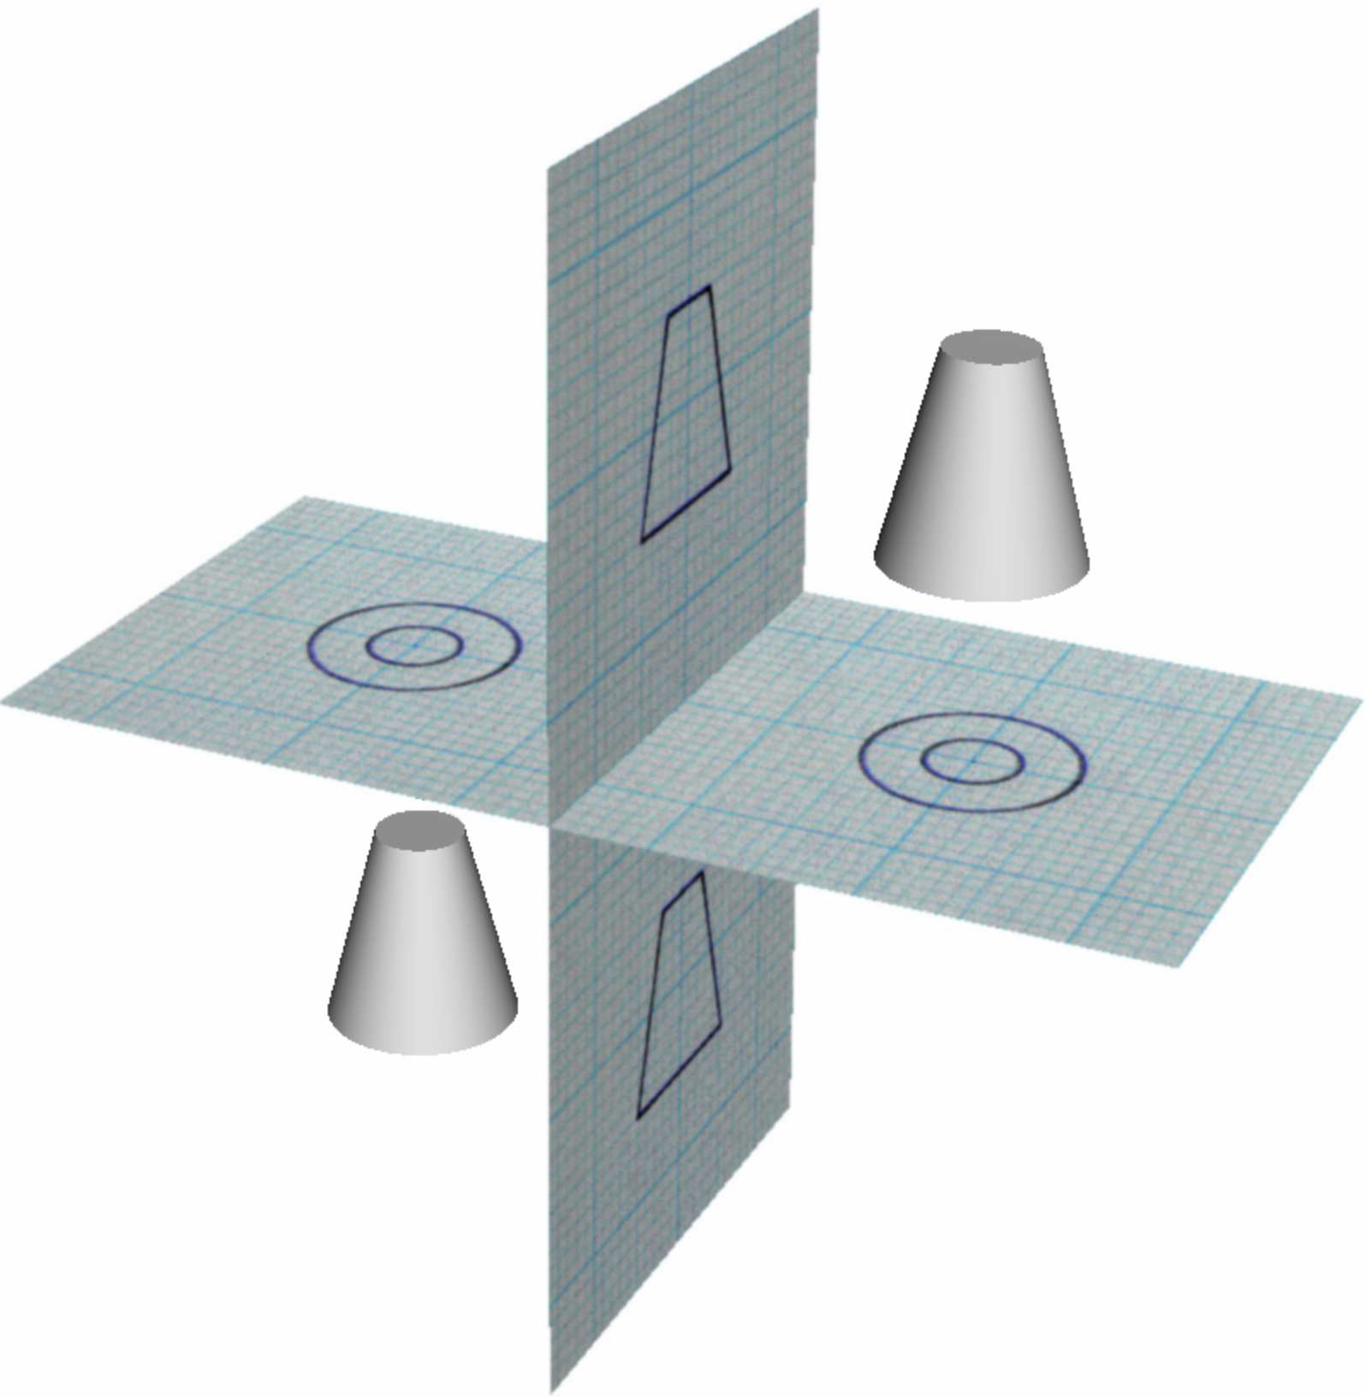

Slide 5
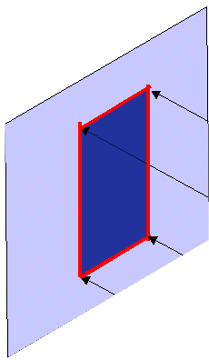
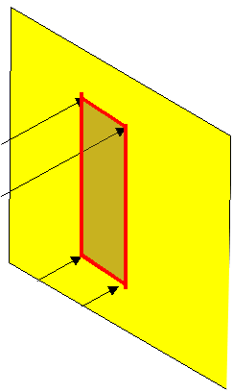
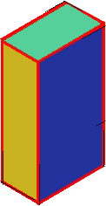
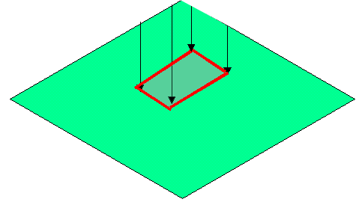


FIRST ANGLE
PROJECTION
FOR T.V.
IN THIS METHOD,
THE OBJECT IS ASSUMED TO BE
SITUATED IN FIRST QUADRANT
MEANS
ABOVE HP & INFRONT OF VP.
V.P.
P.P.
F.V.
S.V.
OBJECT IS INBETWEEN
OBSERVER & PLANE.
OBJECT
VP
PP
FV
LSV
X
Y
FOR S.V.
FOR F.V.
TV
HP
ACTUAL PATTERN OF
PLANES & VIEWS
IN
FIRST ANGLE METHOD
OF PROJECTIONS

Slide 6


THIRD ANGLE
PROJECTION
FOR T.V.
IN THIS METHOD,
THE OBJECT IS ASSUMED TO BE
SITUATED IN THIRD QUADRANT
( BELOW HP & BEHIND OF VP. )
PLANES BEING TRANSPERENT
AND INBETWEEN
OBSERVER & OBJECT.
P.P.
V.P.
OBJECT
TV
X
Y
S.V.
F.V.
LSV
FV
ACTUAL PATTERN OF
PLANES & VIEWS
OF
THIRD ANGLE PROJECTIONS
FOR S.V.
FOR F.V.

