Slide 1



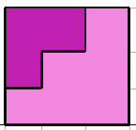

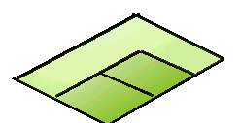
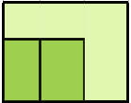

FOR T.V.
1
S.V.
F.V.
ORTHOGRAPHIC PROJECTIONS
FRONT VIEW
L.H.SIDE VIEW
FOR F.V.
FOR S.V.
x
y
PICTORIAL PRESENTATION IS GIVEN
DRAW THREE VIEWS OF THIS OBJECT
BY FIRST ANGLE PROJECTION METHOD
TOP VIEW

Slide 2



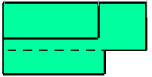
FOR T.V.
2
S.V.
F.V.
ORTHOGRAPHIC PROJECTIONS
FRONT VIEW
L.H.SIDE VIEW
X
Y
FOR S.V.
FOR F.V.
TOP VIEW
PICTORIAL PRESENTATION IS GIVEN
DRAW THREE VIEWS OF THIS OBJECT
BY FIRST ANGLE PROJECTION METHOD

Slide 3

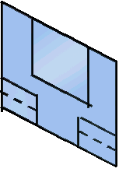
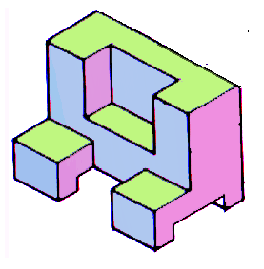
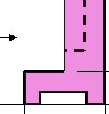
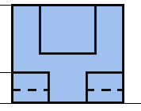
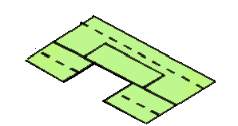

FOR T.V.
S.V.
3
F.V.
ORTHOGRAPHIC PROJECTIONS
FRONT VIEW
L.H.SIDE VIEW
FOR S.V.
FOR F.V.
X
Y
TOP VIEW
PICTORIAL PRESENTATION IS GIVEN
DRAW THREE VIEWS OF THIS OBJECT
BY FIRST ANGLE PROJECTION METHOD

Slide 4
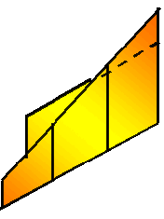
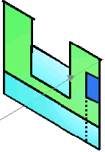

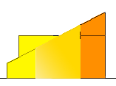



4
FOR T.V.
S.V.
F.V.
ORTHOGRAPHIC PROJECTIONS
FRONT VIEW
L.H.SIDE VIEW
X
Y
FOR S.V.
FOR F.V.
TOP VIEW
PICTORIAL PRESENTATION IS GIVEN
DRAW THREE VIEWS OF THIS OBJECT
BY FIRST ANGLE PROJECTION METHOD

Slide 5


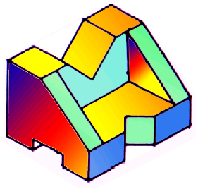




FOR T.V.
5
F.V.
S.V.
ORTHOGRAPHIC PROJECTIONS
FRONT VIEW
L.H.SIDE VIEW
FOR S.V.
FOR F.V.
X
Y
PICTORIAL PRESENTATION IS GIVEN
DRAW THREE VIEWS OF THIS OBJECT
BY FIRST ANGLE PROJECTION METHOD
TOP VIEW

Slide 6
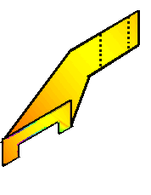
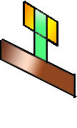
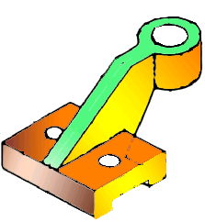
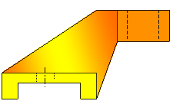
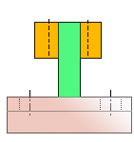
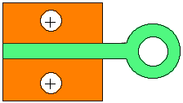
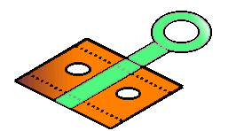
6
FOR T.V.
F.V.
S.V.
ORTHOGRAPHIC PROJECTIONS
FRONT VIEW
L.H.SIDE VIEW
X
Y
FOR S.V.
FOR F.V.
TOP VIEW
PICTORIAL PRESENTATION IS GIVEN
DRAW THREE VIEWS OF THIS OBJECT
BY FIRST ANGLE PROJECTION METHOD

Slide 7
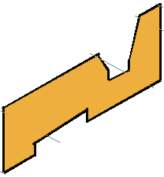

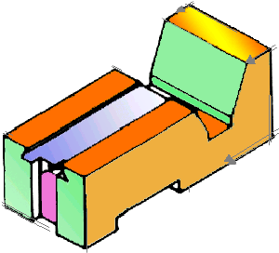
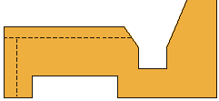
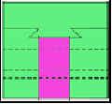
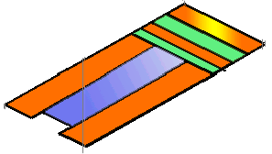
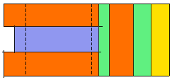
7
FOR T.V.
S.V.
F.V.
ORTHOGRAPHIC PROJECTIONS
FRONT VIEW
L.H.SIDE VIEW
FOR F.V.
FOR S.V.
X
Y
PICTORIAL PRESENTATION IS GIVEN
DRAW THREE VIEWS OF THIS OBJECT
BY FIRST ANGLE PROJECTION METHOD
TOP VIEW

Slide 8
Z
8
STUDY
ILLUSTRATIONS
FOR T.V.
ORTHOGRAPHIC PROJECTIONS
FRONT VIEW
50
X
Y
20
25
FOR F.V.
25
20
TOP VIEW
PICTORIAL PRESENTATION IS GIVEN
DRAW THREE VIEWS OF THIS OBJECT
BY FIRST ANGLE PROJECTION METHOD

Slide 9
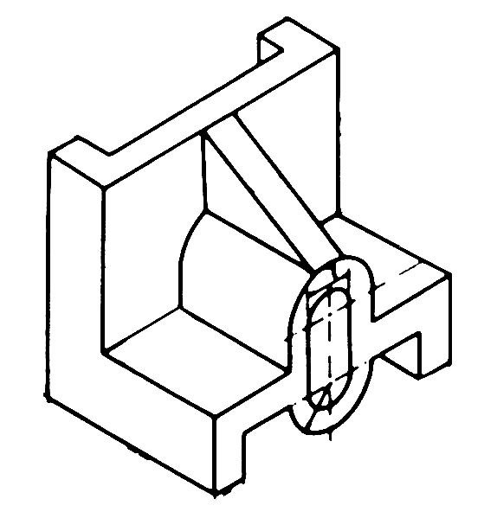
9
FOR T.V.
ORTHOGRAPHIC PROJECTIONS
FRONT VIEW
L.H.SIDE VIEW
X
Y
FOR F.V.
FOR S.V.
PICTORIAL PRESENTATION IS GIVEN
DRAW THREE VIEWS OF THIS OBJECT
BY FIRST ANGLE PROJECTION METHOD
TOP VIEW

Slide 10
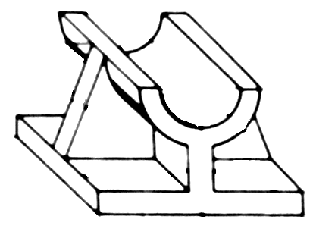
10
FOR T.V.
ORTHOGRAPHIC PROJECTIONS
FRONT VIEW
L.H.SIDE VIEW
X
Y
FOR S.V.
FOR F.V.
PICTORIAL PRESENTATION IS GIVEN
DRAW THREE VIEWS OF THIS OBJECT
BY FIRST ANGLE PROJECTION METHOD
TOP VIEW

