Slide 1

Tic Tac Toe Game Implementation
A Java Swing-based GUI application that allows users to play the classic Tic Tac Toe game. Includes features like player turns, win detection, and game reset.

Slide 2

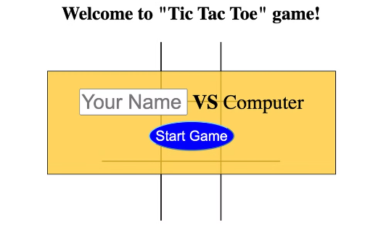
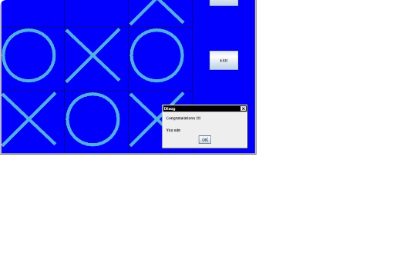
Introduction
Simple Tic Tac Toe Game
Human vs. Computer
Implemented in Java Swing
This Java Swing application allows users to play the classic Tic Tac Toe game with an intuitive graphical interface.
Players compete against an intelligent computer AI that strategically places its moves to challenge the human player.
The game's user interface is built using the powerful Java Swing library, providing a responsive and visually appealing experience.

Slide 3
Class Structure
1
Main Class: TicTacToe
2
Inner Class: ButtonListener
3
Modular and Organized
The TicTacToe class serves as the central hub, handling the game setup and core logic.
By separating concerns into distinct classes, the code remains modular, organized, and easy to maintain.
The ButtonListener class is responsible for responding to button click events during the game.

Slide 4
GUI Setup
Frame Initialization
1
Set up a JFrame with a 3x3 GridLayout.
Button Placement
2
Add the game buttons to the frame.
Visibility and Size
3
Make the frame visible and set its size.
The game's graphical user interface is built using the Java Swing library. The main JFrame is initialized with a 3x3 grid layout to accommodate the tic tac toe board. The game buttons are then added to the frame, and the window is made visible with a set size to provide an intuitive and responsive playing experience.

Slide 5



Button Initialization
Font Size
1
Increased to 50 for visibility
ActionListener
2
Added to handle button clicks
Button Properties
3
Set for an intuitive user experience
To create the tic tac toe board, the game implements a series of customized JButtons. The font size is increased to 50 to ensure the button text is clearly visible to players. Additionally, an ActionListener is attached to each button to capture and respond to user clicks during gameplay.
These button properties are carefully configured to provide an intuitive and engaging user interface, setting the stage for the strategic tic tac toe gameplay to come.

Slide 6
Button Listener
Action Handling
1
The ButtonListener class updates the button text based on the current player, checks for a win or draw, and triggers the computer's move.
2
Update Button Text
When a button is clicked, the listener sets the text to the current player's symbol (X or O).
Check Game Status
3
After the button is updated, the listener checks if the current player has won the game or if the board is full, resulting in a draw.
4
Trigger Computer Move
If the game is not over, the listener calls the makeComputerMove() method, allowing the computer player to strategically place its symbol on the board.

Slide 7




Computer Move Logic
Random Move Generation
Check for Availability
Update Board State
Evaluate Game Status
The computer selects a random empty spot on the board to place its move.
The code checks if the selected position is currently empty before placing the computer's symbol.
Once a valid move is found, the corresponding button's text is updated with the computer's symbol (O).
After the move, the program checks if the computer has won the game or if the board is full, resulting in a draw.

Slide 8
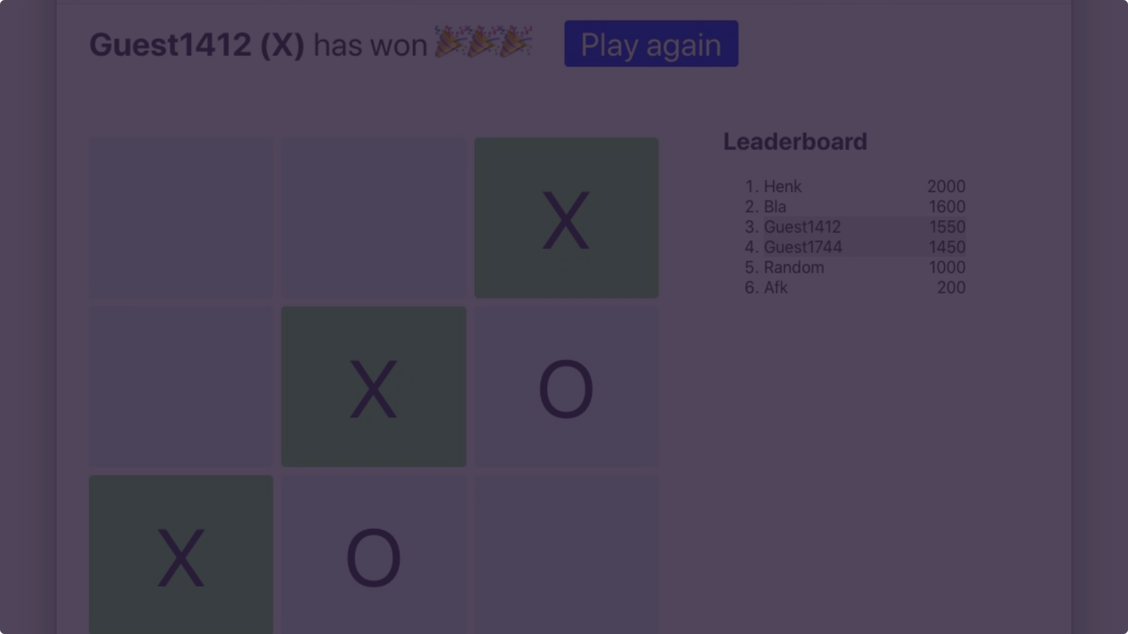
Winning Condition Check
Diagonals Inspected
Rows Checked
Additionally, the method checks the two main diagonals of the board to uncover any three-in-a-row wins.
The code scans each row of the tic tac toe board to detect three consecutive marks of the same player.
1
2
3
Columns Verified
The program also examines each column to identify potential winning patterns of the same player's symbols.

Slide 9



Board Full Check
Scan the Board
Detect Empty Spots
Determine Draw Condition
The program iterates through each cell on the 3x3 tic tac toe board, checking if any of the buttons have the default "-" text.
If any button is found with the "-" text, it means the board is not yet full, and the game is still in progress.
If no empty spots are detected, and no player has won the game, the function returns true, indicating a draw condition has been reached.

Slide 10
Game Flow
1
Start Game
Initialize the frame and buttons.
2
Player Move
Player clicks a button to make a move.
3
Check Status
Evaluate for a win or draw condition.
4
Computer Move
Computer selects and places its mark.
5
Check Status
Evaluate for a win or draw condition.
The Tic Tac Toe game flow begins by setting up the initial game state, including the frame and buttons. Players then take turns making moves by clicking on the board. After each move, the game logic checks if the current player has won or if the board is full, resulting in a draw. If the game is not over, the computer player strategically places its mark on the board, and the status is checked again.

Slide 11
Demo:
Live Demonstration:
Show the game in action.
Expalin the flow as the game process.

Slide 12
Demo:
Conclusion:
Live Demonstration:
Summary:
Simple and interactive Tic Tac Toe game.
Demonstrates GUI development with JAVA Swing.
Basic AI for the computer player.

