Slide 1

BIG MART SALES PREDICTION

Slide 2










Table Of Creators
DRIPTA MAJUMDAR
ROUNAK PRAMANIK
SAIKAT PAUL
CHHATON MODAK
BIPASHA SINHA
ROHAN NAYEK

Slide 3
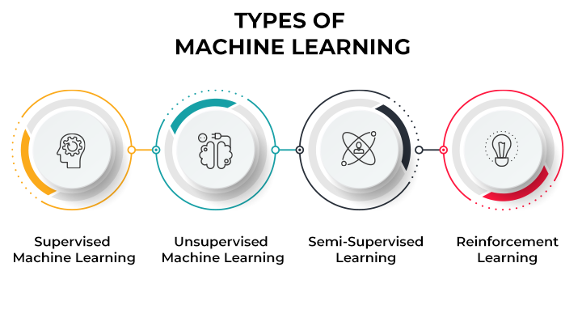
MACHINE LEARNING
Machine learning (ML) is a type of artificial intelligence (AI) that allows software applications to become more accurate at predicting outcomes without being explicitly programmed to do so. Machine learning algorithms use historical data as input to predict new output values.
Machine learning is important because it gives enterprises a view of trends in customer behavior and business operational patterns, as well as supports the development of new products. Many of today's leading companies, such as Facebook, Google and Uber, make machine learning a central part of their operations. Machine learning has become a significant competitive differentiator for many companies.

Slide 4
INTRODUCTION
Every item is tracked for its shopping centers and BigMarts in order to anticipate a future demand of the customer and also improve the management of its inventory. Big Mart is an immense network of shops virtually all over the world. Trends in Big Mart are very relevant and data scientists evaluate those trends per product and store in order to create potential centres. Using the machine to forecast the transactions of Big Mart helps data scientists to test the various patterns by store and product to achieve the correct results. Many companies rely heavily on the knowledge base and need market patterns to be forecasted. Each shopping center or store endeavors to give the individual and present moment proprietor to draw in more clients relying upon the day, with the goal that the business volume for everything can be evaluated for organization stock administration, logistics and transportation administration, and so forth. To address the issue of deals expectation of things dependent on client’s future requests in various BigMarts across different areas diverse Machine Learning algorithms like Linear Regression, Random Forest, Decision Tree, Ridge Regression, XGBoost are utilized for gauging of deals volume. Deals foresee the outcome as deals rely upon the sort of store, populace around the store, a city wherein the store is located. it is possible that it is in an urban zone or country. Population statistics around the store also affect sales, and the capacity of the store and many more things should be considered. Because every business has strong demand, sales forecasts play a significant part in a retail center. A stronger prediction is always helpful in developing and enhancing corporate market strategies, which also help to increase awareness of the market.

Slide 5

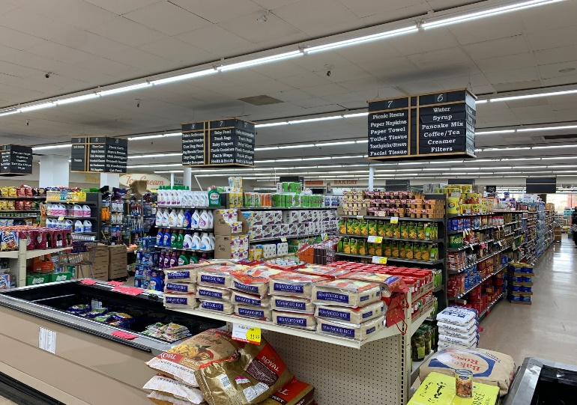
PROBLEM STATEMENT
The problem statement of on the website is as follows: We have tried to built our own Big Mart and we have put our own data set. The aim is to build a predictive model and find out the sales of each product at a particular store and to do the data visualization.

Slide 6
CHALLENGES
“To find out what role certain properties of an item play and how they affect their sales by understanding Big Mart sales.” In order to help Big Mart achieve this goal, a predictive model can be built to find out for every store, the key factors that can increase their sales and what changes could be made to the product or store’s characteristics

Slide 7
LIBRARIES USED
Pandas: This library helps to load the data frame in a 2D array format and has multiple functions to perform analysis tasks in one go.
Sckitlearn/ Sklearn : Scikit-Learn is a free machine learning library for Python. It supports both supervised and unsupervised machine learning, providing diverse algorithms for classification, regression, clustering, and dimensionality reduction.
Matplotlib: Matplotlib is a low level graph plotting library in python that serves as a visualization utility. Matplotlib is open source and we can use it freely. Matplotlib is mostly written in python, a few segments are written in C, Objective-C and Javascript for Platform compatibility.
Tensorflow: Tensorflow is an open-source end-to-end platform for creating Machine Learning applications. It is a symbolic math library that uses dataflow and differentiable programming to perform various tasks focused on training and inference of deep neural networks.

Slide 8
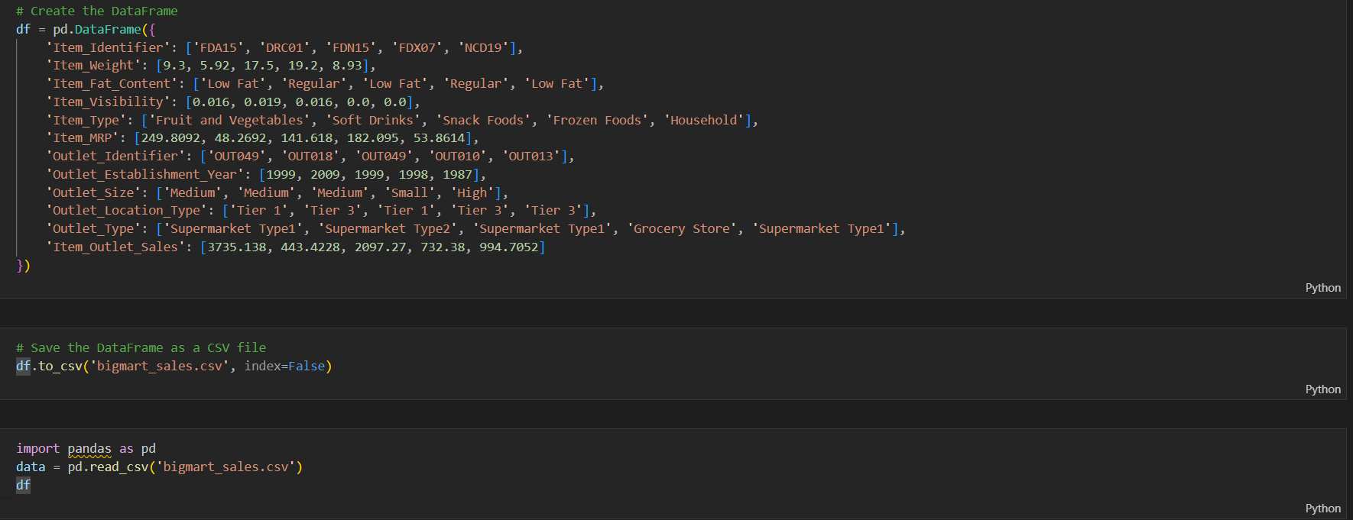
DATASET

Slide 9
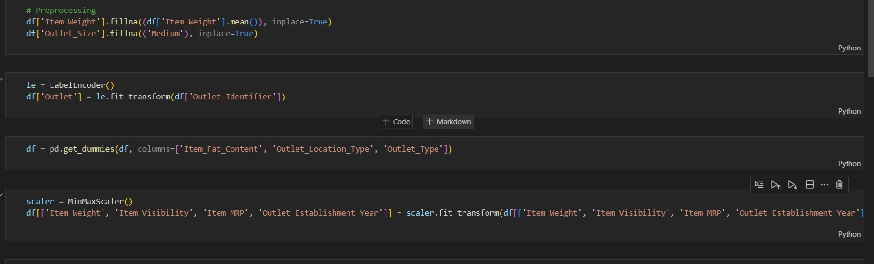
DATA PROCESSING
Data pre-processing is a process of preparing the raw data and making it suitable for a machine learning model. It is the first and crucial step while creating a machine learning model.
When creating a machine learning project, it is not always a case that we come across the clean and formatted data. And while doing any operation with data, it is mandatory to clean it and put in a formatted way. So for this, we use data pre-processing task.

Slide 10
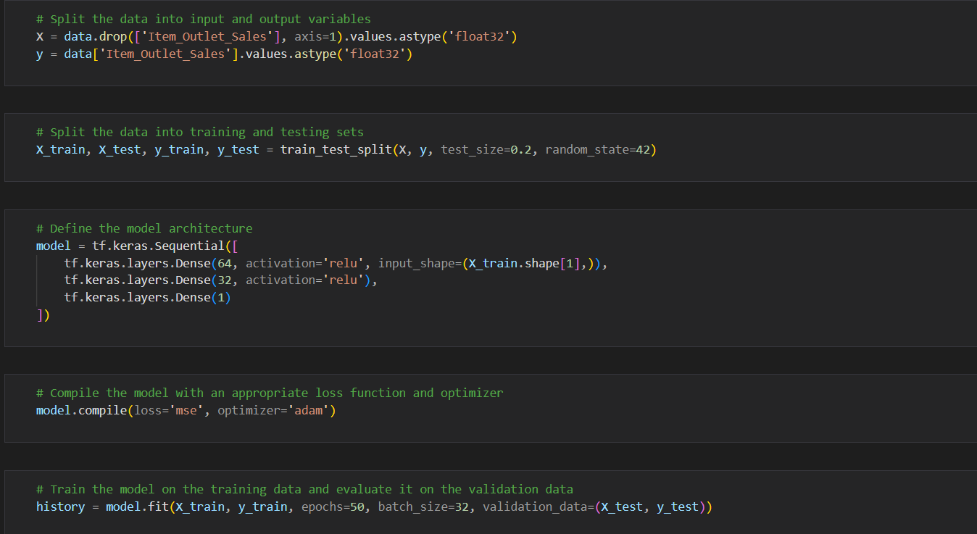
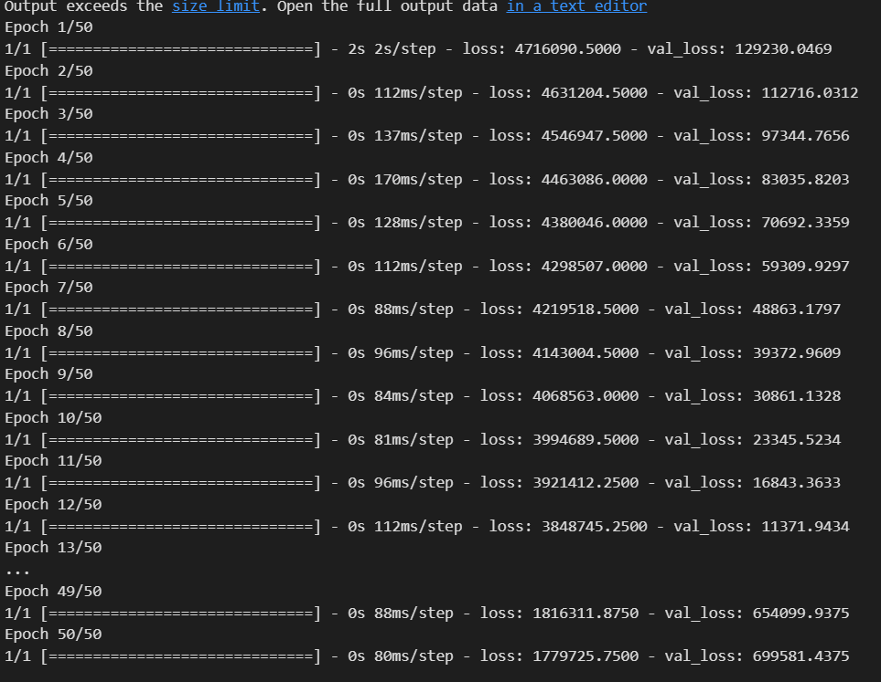
CREATING MODEL USONG TENSOR FLOW AND FINDING VALIDATION LOSS
Here we Splited the data into input and output variables and then Splited the data into training and testing sets then we defined the model architecture using Tensor flow. We then Compiled the model with an appropriate loss function and optimizer then we Trained the model on the training data and evaluate it on the validation data to get the validation loss.

Slide 11
DATA VISUALIZATION
Plot training & validation loss values
Plot predicted V/S true sales values
DATA VISUALIZATION
Data visualization is a graphical representation of quantitative information and data by using visual elements like graphs, charts, and maps.

Slide 12
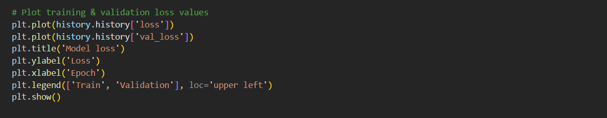
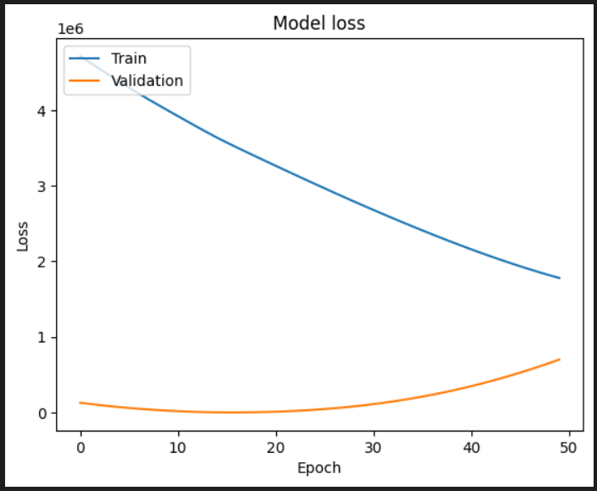
PLOT TRAINING & VALIDATION LOSS VALUES
The training and validation loss values provide important information because they give us a better insight into how the learning performance changes over the number of epochs and help us diagnose any problems with learning that can lead to an underfit or an overfit model.

Slide 13
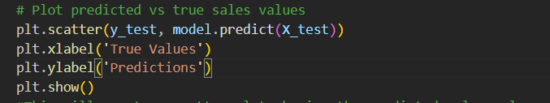
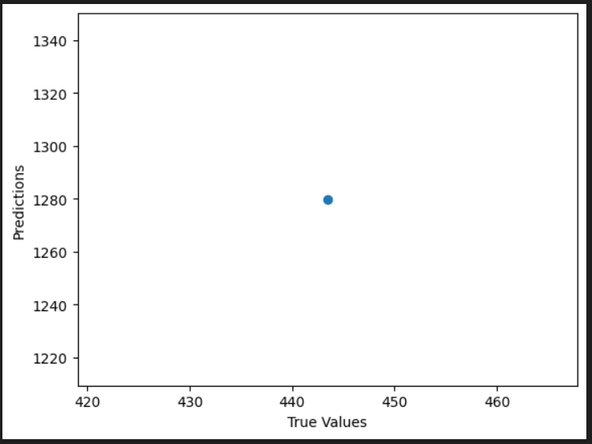
PLOT PREDICTED V/S TRUE SALES VALUES
This will create a scatter plot showing the predicted sales values on the y-axis and the true sales values on the x-axis. The y_test array contains the true sales values for the test set, while model.predict(X_test) contains the predicted sales values for the test set.

Slide 14
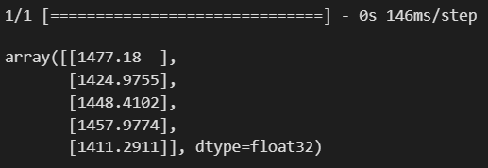
PREDICT THE SALES OF THE ITEMS OF THE BIGMART
Here we are predicting the sales of the five items of the data set using model.predict method of python:

Slide 15
CONCLUSION
In this projects, basics of machine learning and the associated data processing and modeling algorithms have been described, followed by their application for the task of sales prediction in Big Mart Shopping centers at different locations. On implementation, the prediction results show the correlation among different attributes considered and how a particular location of medium size recorded the highest sales, suggesting that other shopping location should follow similar patterns for improved sales.

Slide 16


CREDITS: This presentation template was created by Slidesgo, including icons by Flaticon, and infographics & images by Freepik and illustrations by Stories

