Slide 1
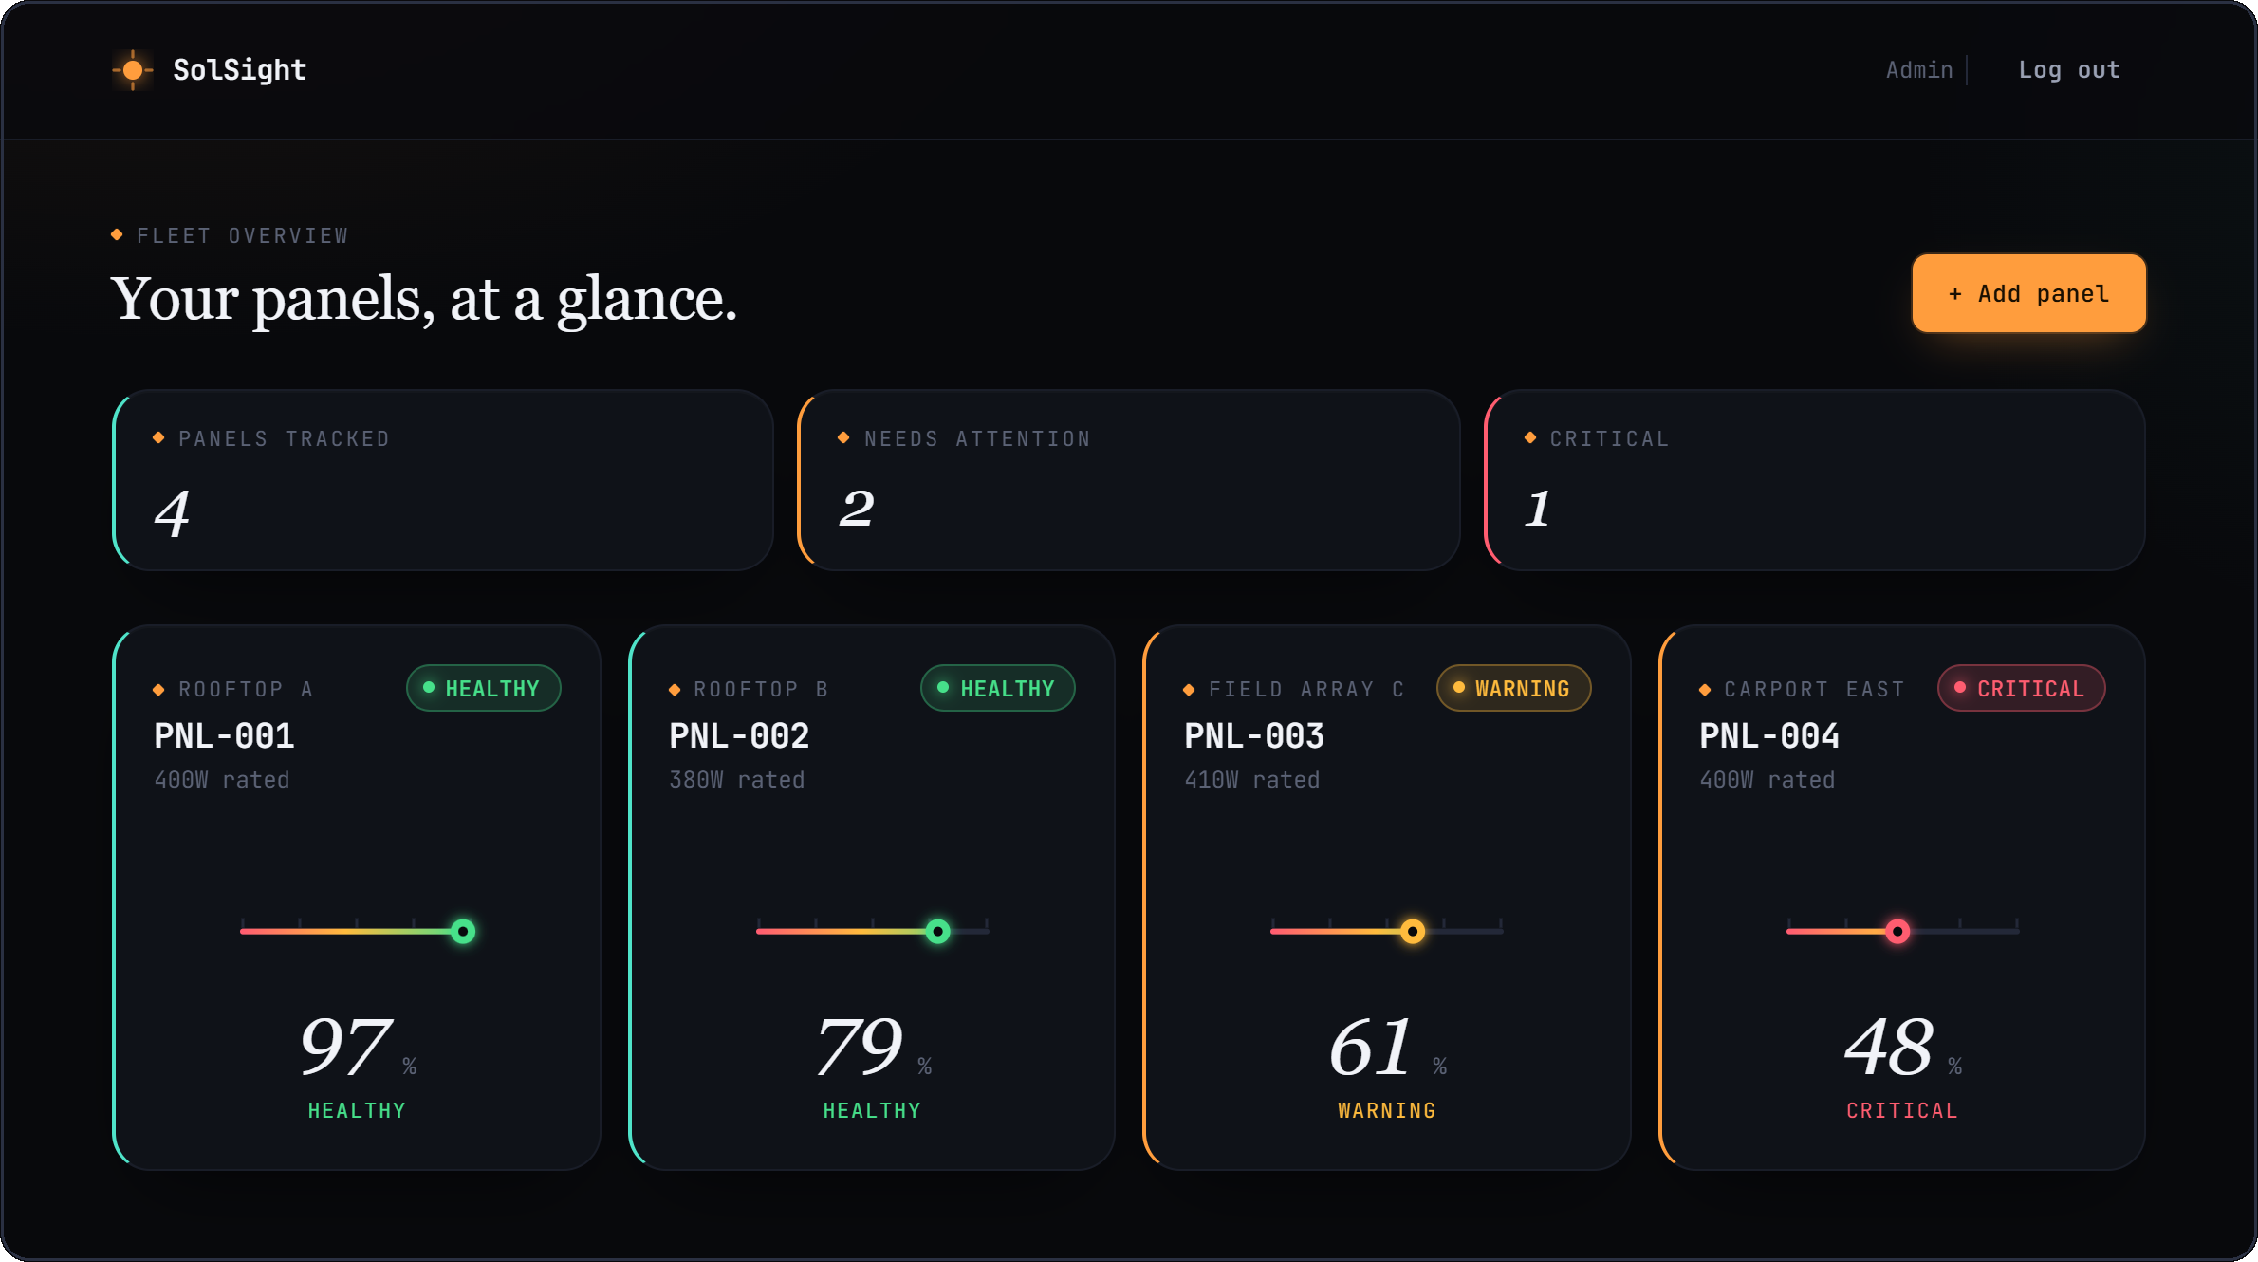
SolSight
◆ PROJECT PRESENTATION
Catching failing solar panels from their own readings
4 defect classes 90d forecast CNN → MLP → Bi-LSTM
Presented by [team names] · Guide [name] · [institution]
Notes:
SolSight is a monitoring tool for solar panels. You log a panel's electrical readings, and optionally a photo, and it tells you whether something is wrong, how healthy the panel is, and where it's heading over the next three months. What you see on the right is the actual dashboard, running with a sample fleet of four panels.

Slide 2
A panel can lose a third of its output and nobody notices
◆ THE PROBLEM
01
Losses build slowly or hide inside a whole string's total, so the monthly yield barely moves.
−0.4%
output lost per °C of cell temperature above 25 °C, for typical crystalline silicon
02
Inspection is manual and periodic: someone walks the roof with a thermal camera once or twice a year.
1 in 3
of a panel's output gone when one cracked cell trips one of its three bypass diodes
03
By the time anyone looks, a hotspot has had weeks to cook the cells around it.
~0.5%
a year is normal ageing (NREL field-data median), so anything faster is a fault
Notes:
Solar panels don't usually fail loudly. A dirty panel, a cracked cell or a hotspot just quietly produces less. On a big array that loss disappears into the total. Inspections are manual, so problems sit for months. These three numbers are the physics the whole project is built on: heat reduces output by about 0.4 percent per degree, one cracked cell can take out a third of a panel through its bypass diode, and normal ageing is only about half a percent a year. So if a panel is dropping faster than that, something is wrong with it.

Slide 3
Log a reading, get a diagnosis and a forecast
◆ THE IDEA
01
02
03
Log a reading
Diagnose
Forecast and act
Voltage, current and cell temperature from the panel, plus an optional thermal or visual photo.
The most likely defect (normal, soiling, crack or hotspot) and a health score from 0 to 100: Healthy, Warning or Critical.
Projected health at 30, 60 and 90 days, and a specific action for the technician to take.
Every result is stored against the panel, so each new reading is judged against that panel's own history rather than a fleet average.
Notes:
The workflow is three steps. You enter what the panel is doing right now. SolSight works out what's likely wrong and gives it a score. Then it looks at that panel's history to project where it's going and says what to do about it. The key point is the last line: every panel is compared with its own past, not with some average.

Slide 4
The whole fleet on one screen
◆ PRODUCT
TOP ROW
How many panels are tracked, how many need attention, and how many are critical.
PANEL CARDS
Each panel's latest health on a 0–100 gauge, coloured by status.
CLICK THROUGH
Opens that panel's forecast, recommendation and full inspection log.
Notes:
This is the main screen. At the top: four panels tracked, two needing attention, one critical. Each card shows the latest health score on a gauge. Green is healthy, amber is warning, red is critical. This is a sample fleet of four panels with ten weeks of readings, and every score you see was produced by the real analysis code.

Slide 5
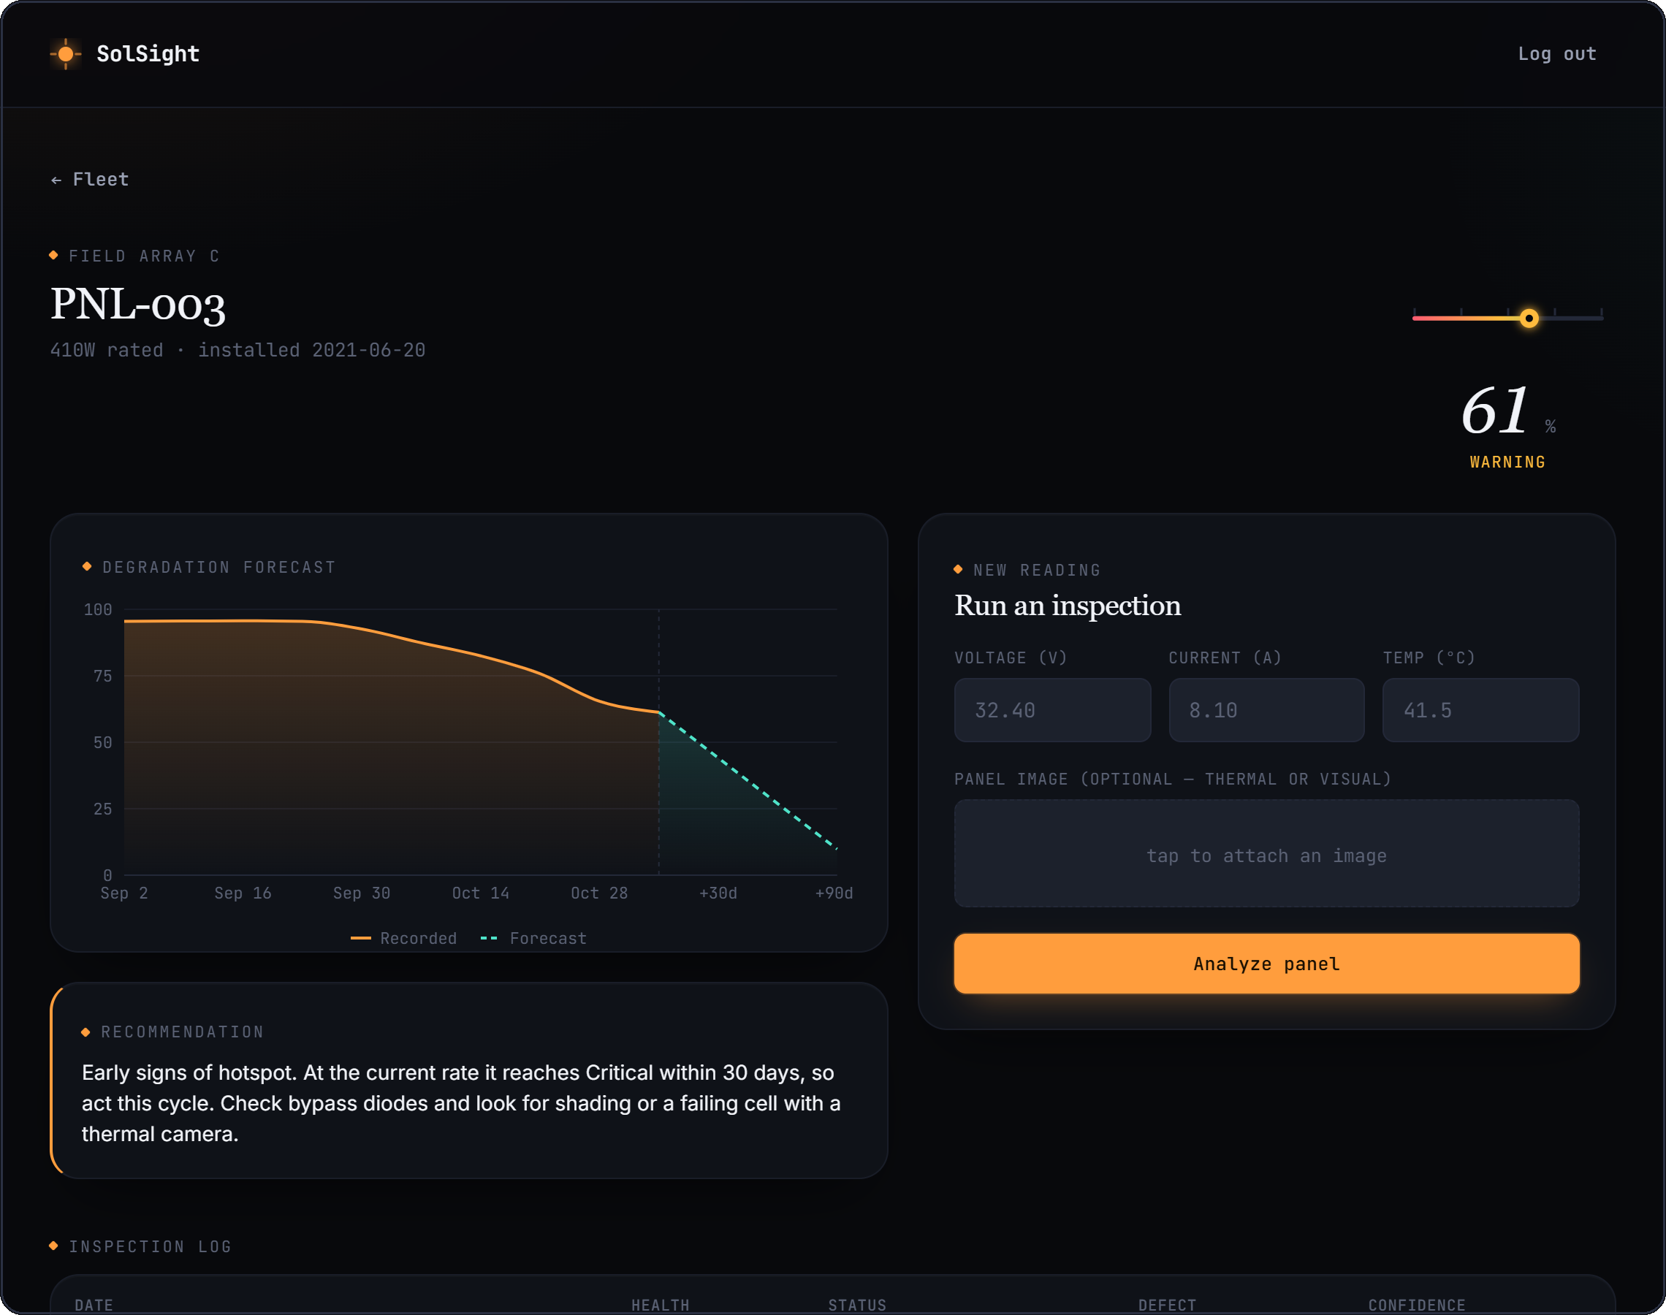
Watching a hotspot develop
◆ PRODUCT
WEEKS 1–5
Healthy, scores 93–96. Output within a few percent of what's expected.
WEEKS 6–8
Output slips 10–20% while temperature stays normal, so SolSight reads it as soiling.
WEEKS 9–10
Cell temperature passes 70 °C and output keeps falling. The diagnosis switches to hotspot and the status drops to Warning.
Forecast: Critical within 30 days. Check bypass diodes and look for shading or a failing cell with a thermal camera.
Notes:
Clicking into panel three, Field Array C. This one tells a story. For the first five weeks it's fine. Then output starts slipping but the temperature is normal, so the system calls it soiling, which is the right first guess. In weeks nine and ten the temperature climbs past 70 degrees while output keeps falling. Heat plus loss together is the signature of a hotspot, so the diagnosis changes. The amber line is the recorded history, the dashed cyan line is the forecast.

Slide 6
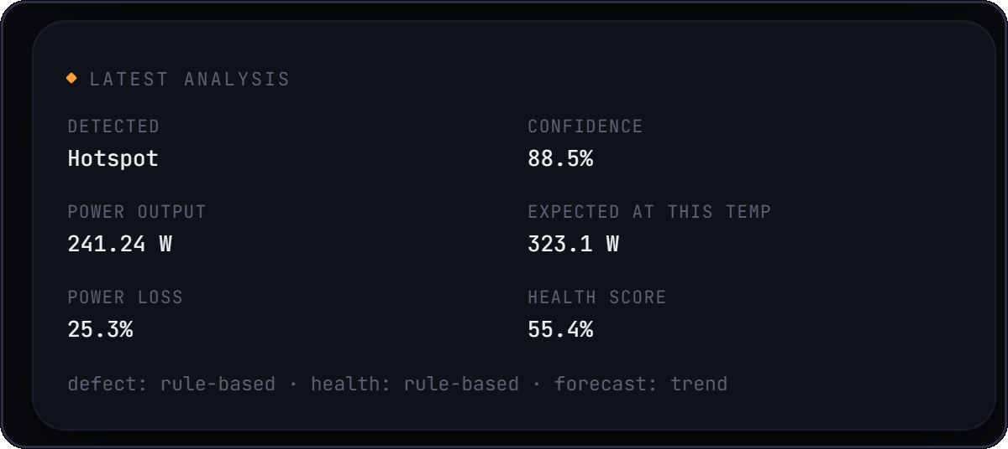
One reading, worked through
◆ PRODUCT
MEASURED
32.6 V × 7.4 A = 241 W
EXPECTED AT 78 °C
410 W × (1 − 0.004 × 53) = 323 W
SHORTFALL
25% below expected, while running hot
Result as shown in the app after submitting the reading for PNL-003
VERDICT
Hotspot (88.5%), health 55, Warning
Notes:
Here's a single reading worked through, live from the app. The panel puts out 32.6 volts at 7.4 amps, so 241 watts. It's rated 410 watts, but at 78 degrees we'd only expect about 323, because hot panels make less power. So it's 25 percent short of even the heat-adjusted figure, and it's running very hot. That combination points to a hotspot, the health score comes out at 55, which is in the Warning band.

Slide 7
Three stages, each with a fallback
◆ HOW IT WORKS
1 Defect
2 Health
3 Forecast
IN
OUT
Voltage
Current
Cell temp
Photo (optional)
MODEL
MODEL
MODEL
Status
Forecast
Action
ResNet18 CNN
MLP on image + readings
Bi-LSTM on history
FALLBACK
FALLBACK
FALLBACK
Electrical + thermal rules
Temperature-corrected performance ratio
Trend over real inspection dates
A stage only uses its network when trained weights are on disk. Without them it switches to the physics-based method and labels the result, so an estimate is never passed off as a model output.
Notes:
Under the hood there are three stages. A CNN built on ResNet18 looks at the image for defects. An MLP combines those image features with the electrical readings to classify health. And a bidirectional LSTM looks at the panel's history to forecast. Every stage has a fallback. Deep models need labelled training data, and until those weights exist we'd rather give a reasoned physics-based answer than a random one. The app always shows which method produced the result.

Slide 8
What each defect looks like in the data
◆ HOW IT WORKS
DEFECT | SIGNATURE IN THE READINGS | WHAT THE TECHNICIAN IS TOLD
Normal | Output within about 10% of expected, normal cell temperature | Keep the standard schedule
Soiling | Moderate, even loss of roughly 10–25% at normal temperature | Clean the surface, then re-measure
Crack | Heavy loss of 30% or more at normal temperature, often a sudden step | Inspect for micro-cracks, plan replacement
Hotspot | Loss together with high cell temperature or a bright spot in the thermal image | Check bypass diodes and shading
HEALTH BANDS
Healthy ≥ 75
Warning 50–75
Critical < 50
Notes:
This is how the rule-based stage tells defects apart. The core measure is the performance ratio: what the panel produces divided by what it should produce at its current temperature. A small even loss looks like dirt. A big loss at normal temperature looks like a crack, because a cracked cell trips a bypass diode and takes a third of the panel offline. Loss plus heat looks like a hotspot. Each one maps to a different action, which is what a technician actually needs. The health score then puts the panel in one of three bands.

Slide 9
A sudden drop is an event, not a trend
◆ HOW IT WORKS
In the sample data, PNL-004 cracks in week 7 and loses a third of its output between two inspections.
A straight line through all ten readings says the panel is dead within 60 days.
SolSight treats any drop of 15 points or more as an event and fits only the readings after it: 37% at 30 days, 15% at 90.
Notes:
One design decision worth showing. Panel four had a crack in week seven, its score fell from 96 to 55 overnight. If you naively draw a straight line through all the readings, the red line, you'd predict the panel hits zero in two months, which isn't realistic. A crack is an event, not a rate of decline. So SolSight detects big step drops and only uses the readings after the event to estimate the trend. That's the cyan line, a steady decline that a technician can plan around.

Slide 10
How it's built
◆ HOW IT WORKS
BROWSER
API
DATABASE
React 18 + Vite
FastAPI (Python)
MongoDB
JSON + JWT
Motor
Dashboard, panel pages and upload form. Charts with Recharts.
Auth, panels and inspections. Models load once at startup and run off the request thread.
Users, panels and every inspection with its full result.
MAIN ENDPOINTS
POST /auth/login GET /panels POST /predict-defect
GET /panels/{id}/history GET /panels/{id}/prediction DELETE /panels/{id}
Runs with Docker Compose, or with MONGO_URI=memory for a demo that needs no database at all.
Notes:
The stack is a React front end, a FastAPI back end in Python, and MongoDB. Users log in and get a JWT token, and every request after that carries it. Each user only sees their own panels. The three PyTorch models are loaded once when the server starts, and inference runs on a worker thread so one slow analysis doesn't block other users. Everything is documented automatically at /docs.

Slide 11
What we fixed while testing it
◆ ENGINEERING
PROBLEM FOUND | FIX
Login crashed on the current bcrypt release | Password hashing rewritten on bcrypt directly
Untrained models gave random answers: a panel 70% down at 70 °C came back Healthy | Physics-based fallback, and every result says which method produced it
A saved but unanalysed reading broke the fleet page | All reads filter on analysed inspections only
A corrupt image upload caused a server error | Clear error message, and images capped at 5 MB
The forecast model was trained on a different target than it was read with | Training and inference now use the same target
22
automated tests, all passing: login, panel ownership, the full inspection flow, upload validation and the diagnostics logic.
Notes:
While testing the system end to end we found and fixed several real problems. The most serious: the model weights hadn't been trained yet, so the networks were giving random output. A panel losing 70 percent of its power at 70 degrees came back as Healthy. That's why the physics-based fallback exists. We also fixed a login crash caused by a library incompatibility, and several cases where bad input caused server errors instead of clear messages. There are now 22 automated tests that run in a few seconds.

Slide 12
What comes next
◆ NEXT STEPS
01
Train the image model
02
Add irradiance
Labelled crack and hotspot images, such as the public ELPV electroluminescence set, let the CNN take over stage 1 with no code change.
We assume readings are taken near peak sun. A pyranometer value would make the expected-power baseline exact.
03
Read from the inverter
04
Alert on change
Pull voltage and current automatically on a schedule instead of typing them in.
Notify the site owner when a panel crosses into Warning, or when its forecast does.
Notes:
Where this goes next. First, train the image model on a labelled dataset. Because of how the pipeline is built, the moment trained weights are saved, the app uses them. Second, add an irradiance sensor, because right now we assume readings near peak sun. Third, read data straight from the inverter so nobody types numbers in. And finally, alerts, so the owner hears about a problem without having to open the dashboard.

Slide 13
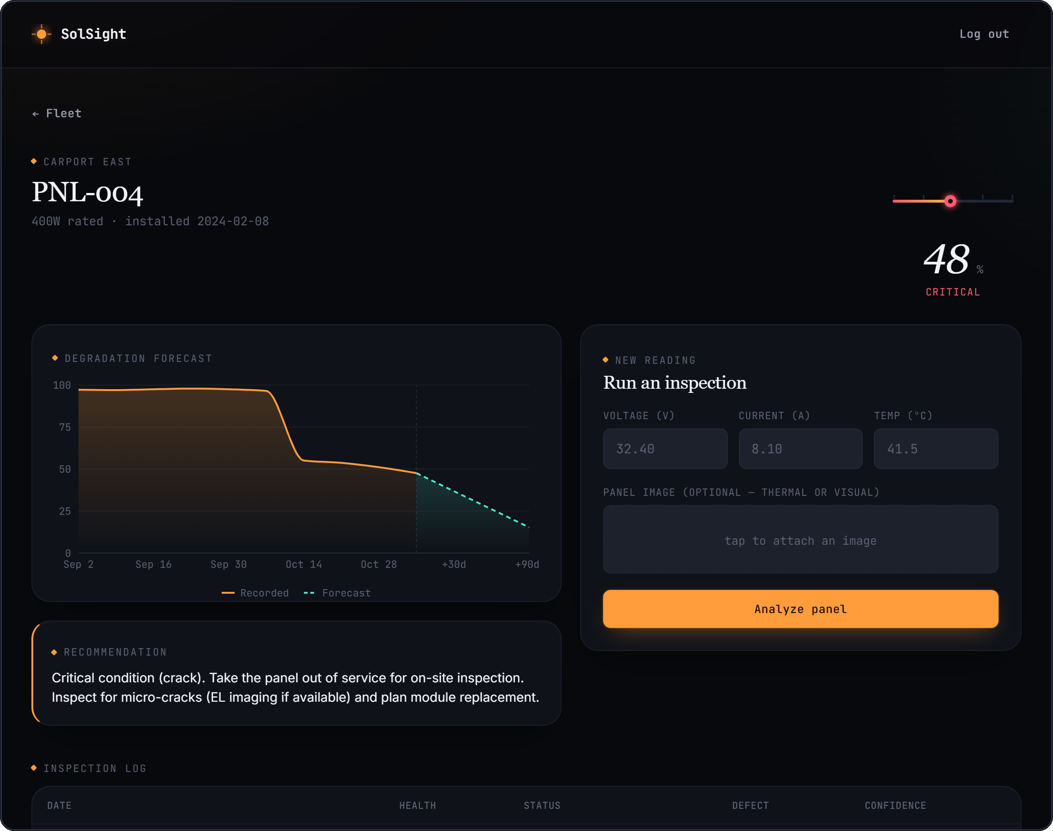
Questions?
◆ THANK YOU
github.com/SaikatxAlpha/Sol-Sight
Presented by [team names] · Guide [name] · [institution]
Notes:
Thanks for listening. The code is on GitHub at the link shown. Happy to take questions, or to run a live inspection in the app.

