Slide 1
JANATAHACK
CROSS-SELL PREDICTION
HACKATHON - Nov 30 2024 -
Analytics Vidhya

Slide 2
Links:
Github Link: https://github.com/Saikeerthanakumar/Nov30Hackathon2024
Docker hub link: Repositories | Docker Hub
GCP Model app: https://api-model-nov30-lr-902968606805.us-central1.run.app
GCP WebView: https://api-test-nov30-lr-902968606805.us-central1.run.app/
AWS Model app: https://container-service-2.a2296rx7zn6mt.ap-south-1.cs.amazonlightsail.com/docs#/default/predict_predict_post
AWS Webview: https://container-service-3-streamlitnov302024.a2296rx7zn6mt.ap-south-1.cs.amazonlightsail.com/

Slide 3
Problem Overview
((381109, 12), (127037, 11), (127037, 2))
Problem Statement
Insurance company wants to identify whether a customer claims for the insurance or not.
Analysis of different risk factors that helps predict the likelihood and cost of insurance claims.
Data set provided
train.shape, test.shape, sub.shape
Train.csv = 381109 rows with 12 columns
Test.csv = 127037 rows with 11 columns

Slide 4
Observations
12 columns are found with non null values in train dataset and out of 12 columns 11 columns had values in test dataset
All the columns had values.
Train dataset is highly imbalanced
Reponse column Is the target variable and observed vehicle age between 1 to 2 are in majority
In Response target column 87% are not interested and 12% are interested for vehicle Loan

Slide 5
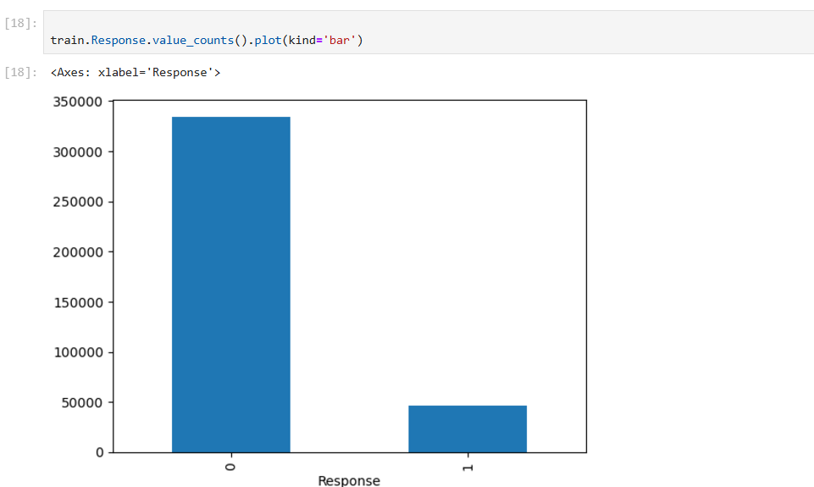
Data Analysis

Slide 6
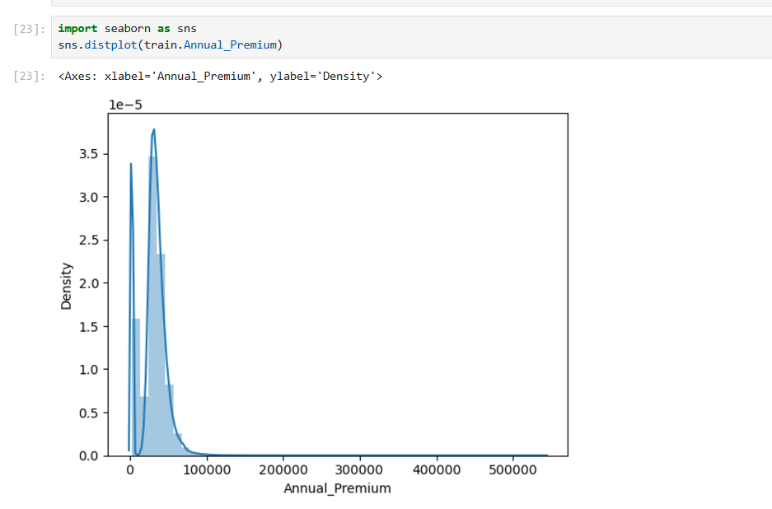
Annual Premium column

Slide 7
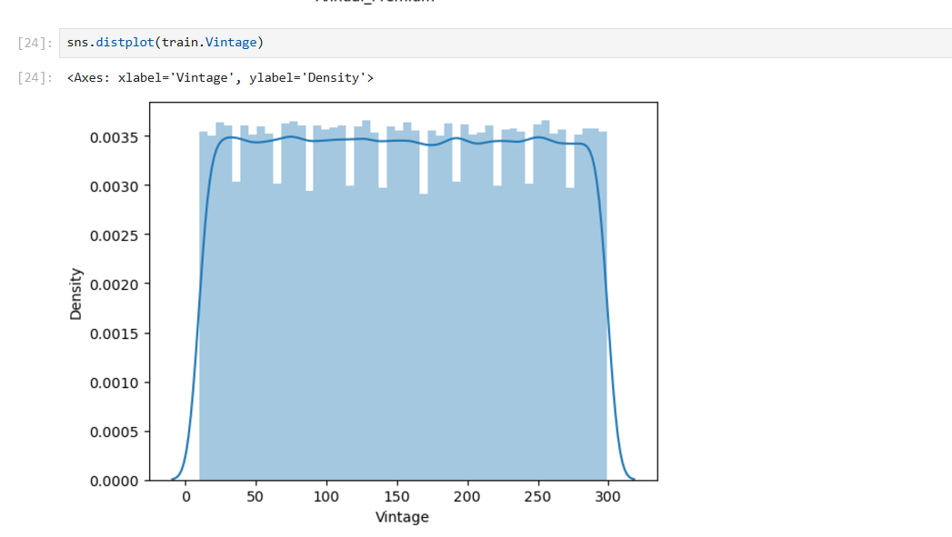
Vintage column

Slide 8
Data Preparation
Out of the 12 columns we considered only 11 columns (excluding ID) based on the Feature Importance analysis
To mitigate the imbalance we down sampled the data
To minimize the impact of outliers we applied scaling

Slide 9
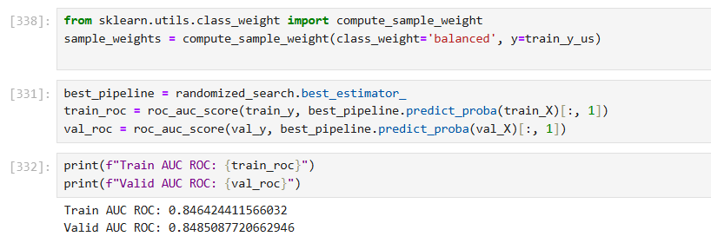
Techniques tried to increase the ROC score
Used both Grid Search and Random Search
Used StratifiedKFold with 10 splits
model_preprocess_polynomial_lasso_pipeline
cv= kfold was taking lot of time to run

Slide 10
Classification Analysis
Applied the following models and scores obtained
Model | ROC Score
Logistic Regression | 0.5000
Logistic Regression/Decision Tree Classifier | 0.784
Logistic Regression/Decision Tree Classifier/Stacking Classifier | 0.797
RandomForest Classifier | 0.797
AdaBoost Classifier | 0.504
XGBClassifier | 0.802
Polynomial Feature-Lasso model | 0.7976

Slide 11
Model | ROC Score
GradientBoosting Classifier | 0.801
Voting Classifier | 0.533
Logistic Regression, Decision Tree Classifier, XGB Classifier ,Stacking Classifier | 0.789
Logistic Regression, Decision Tree Classifier, XGB Classifier | 0.846
Logistic Regression, Decision Tree Classifier, XGB Classifier , RandomForestClassifier, GradientBoostingClassifier | 0.846

Slide 12
Conclusion
Out of the 12 models considered we are recommending the XGB model with Logistic Regression, Decision Tree Classifier, XGB Classifier for predicting the customer being interested in Vehicle Loan

Slide 13
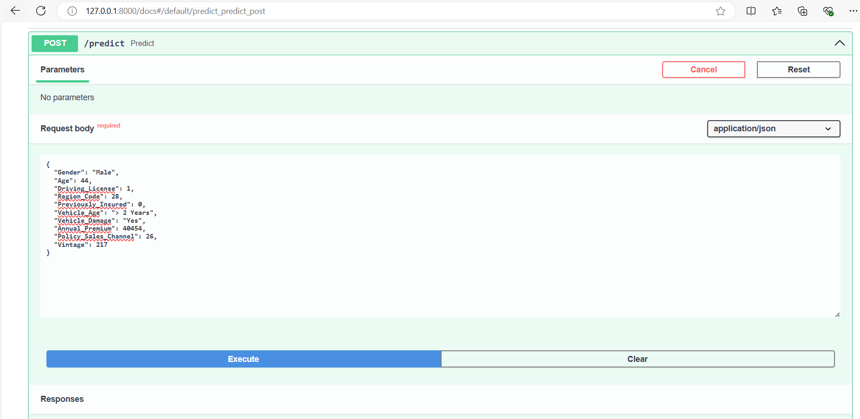
FAST API Local deployment

Slide 14
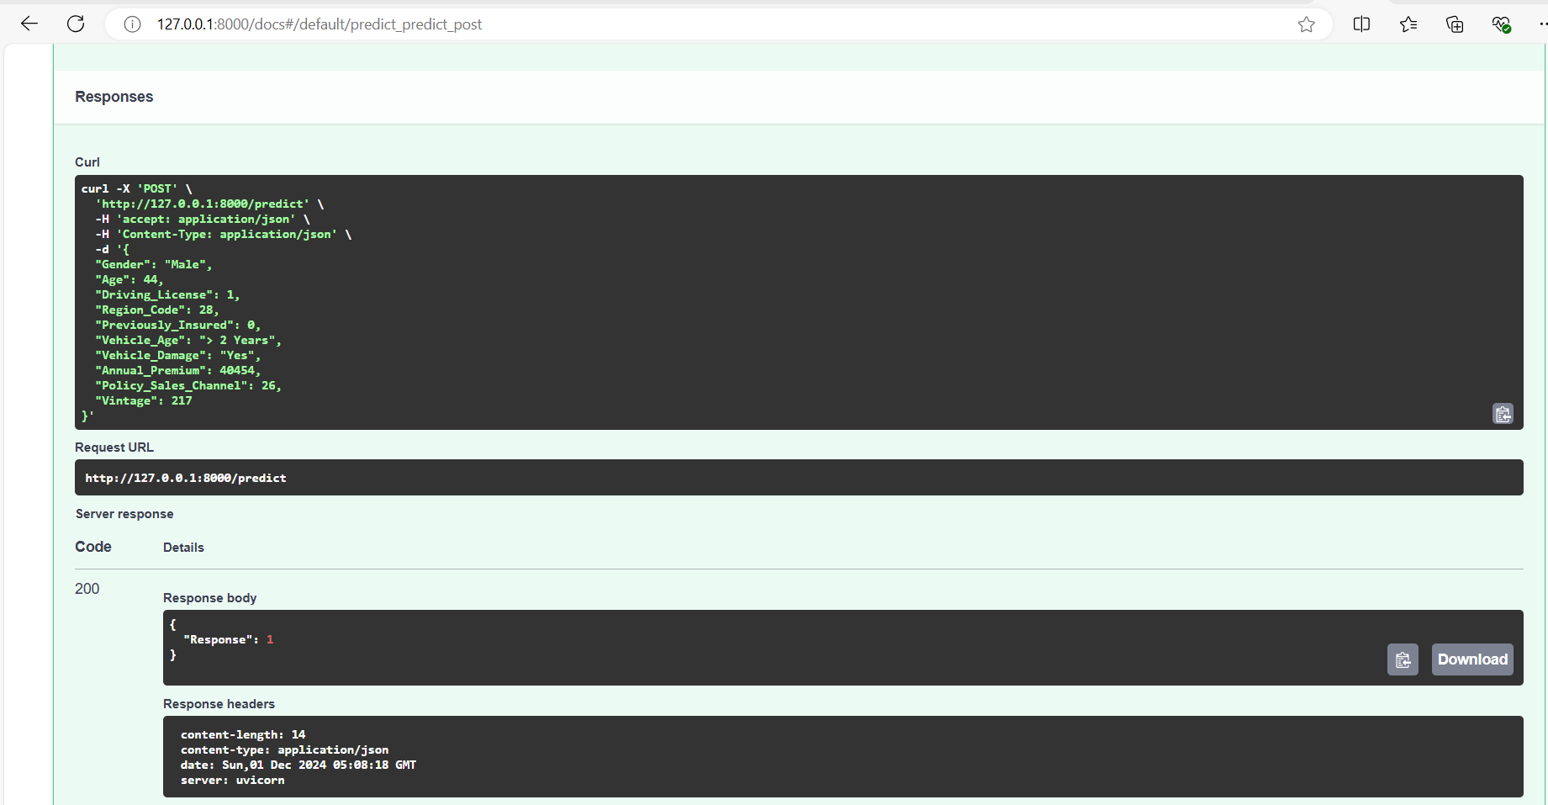

Slide 15
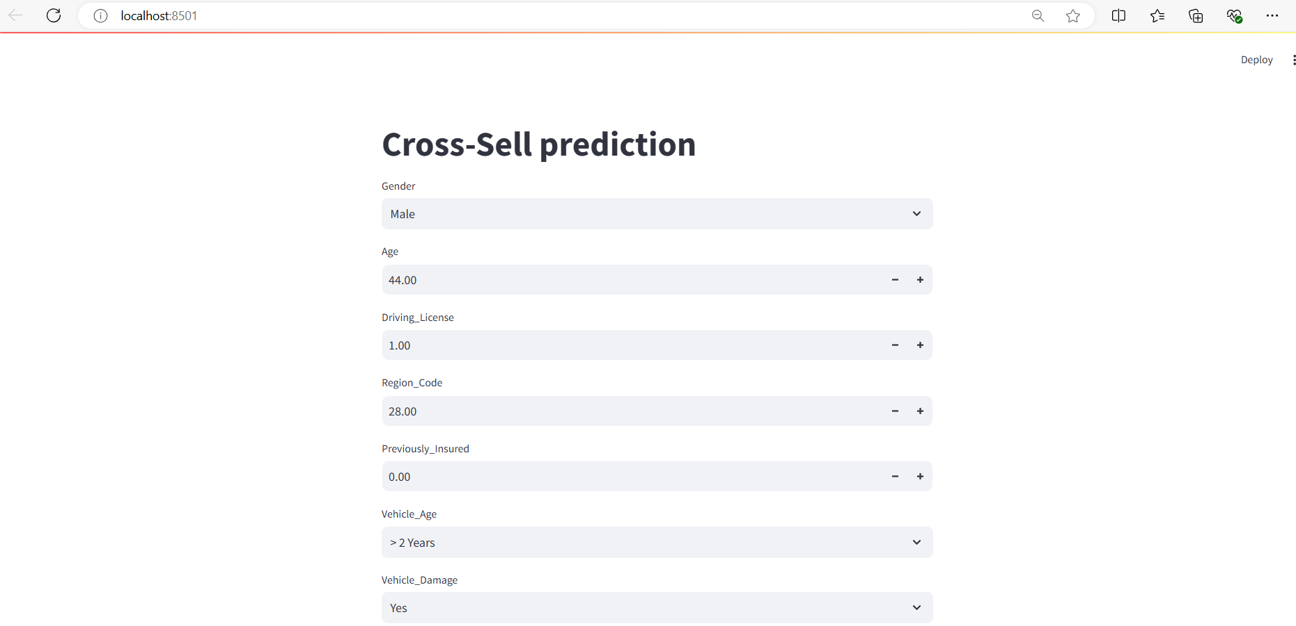
Web App Local Deployment

Slide 16
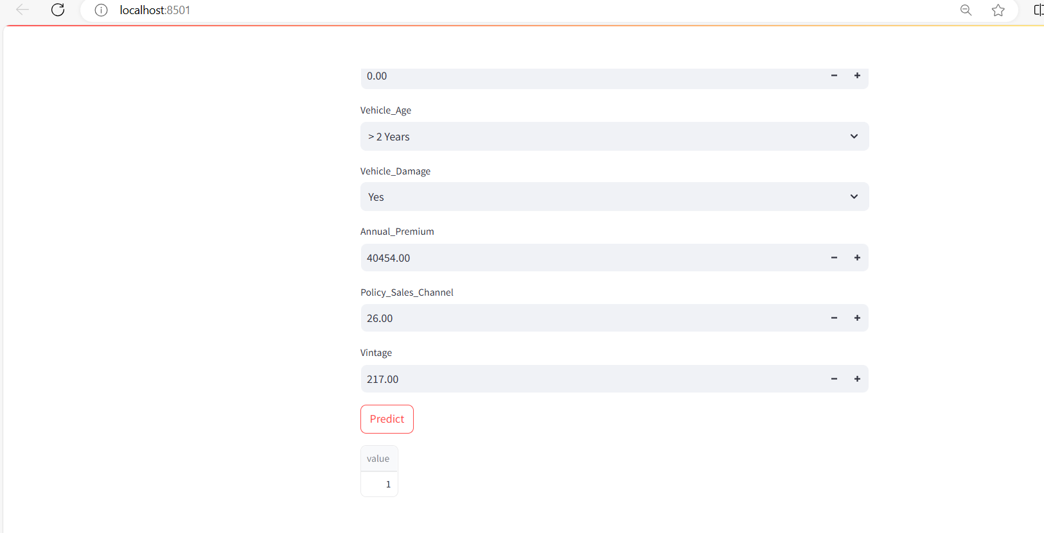

Slide 17
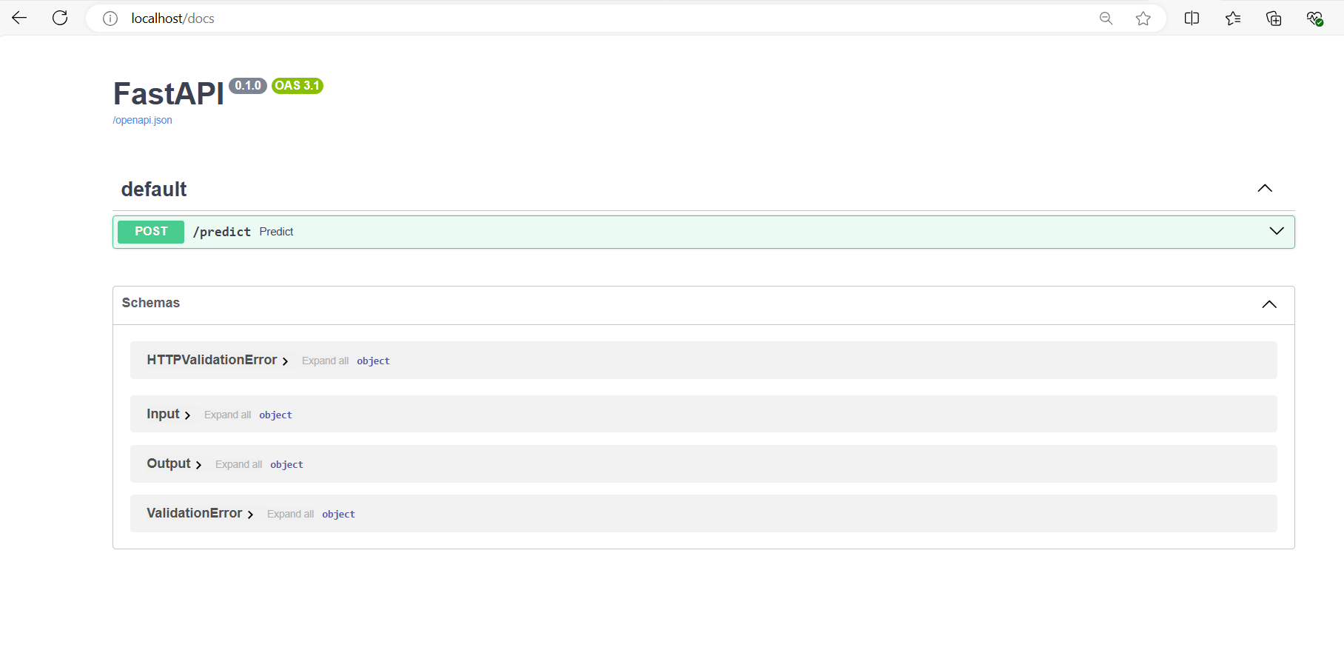
Docker deployment Local

Slide 18
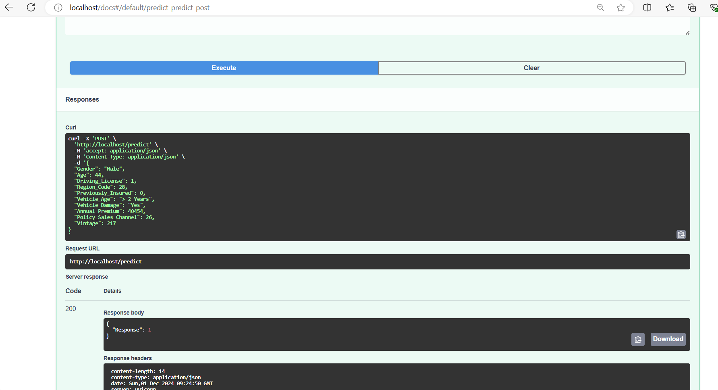

Slide 19
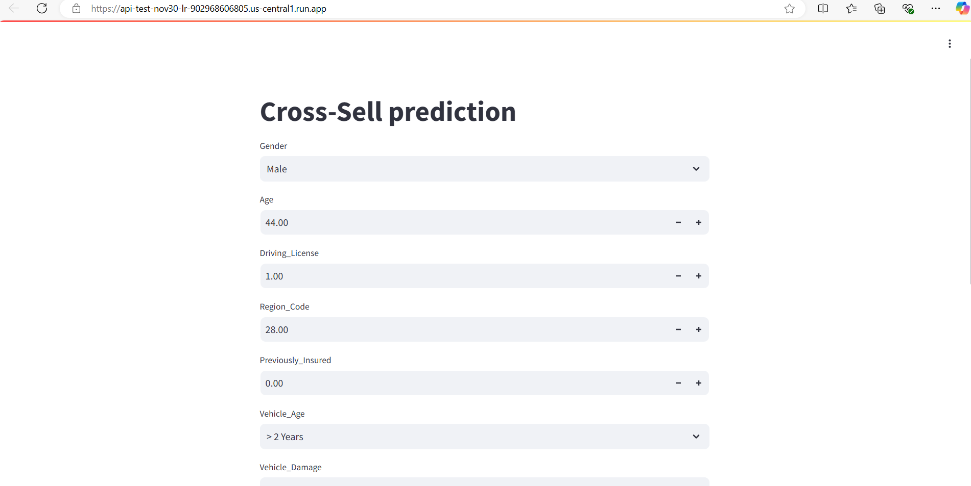
GCP Web View deployment screenshot

Slide 20
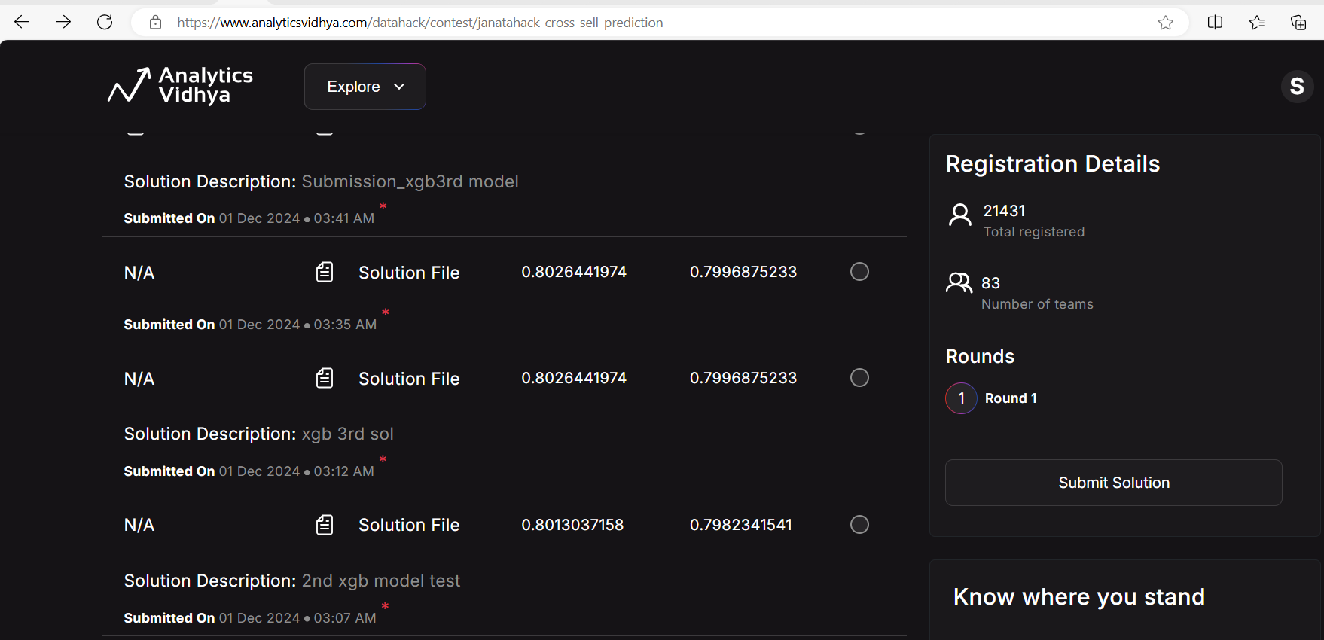
Analytics Vidhya

Slide 21
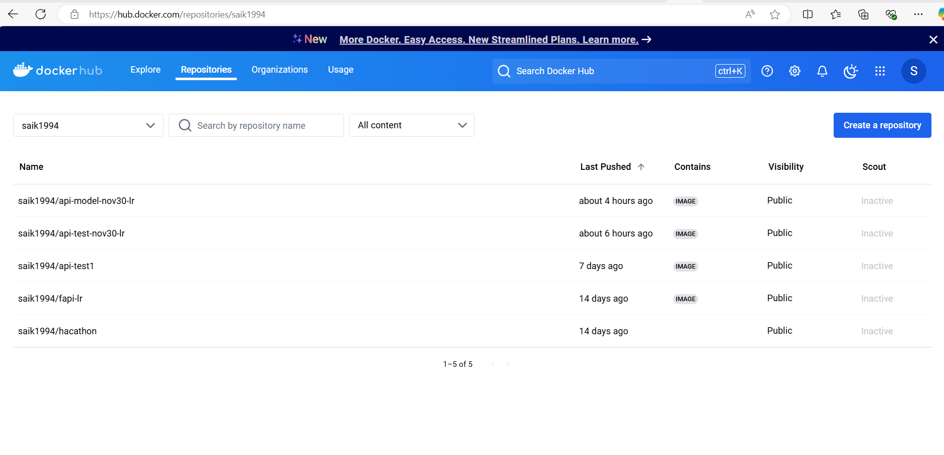
Docker hub

Slide 22
I have deployed both Model and Web view in GCP and AWS successfully and shared the links in the 2nd slide of this PPT

Slide 23
Commands used :
FastAPI - Swagger UI
Saikeerthanakumar/Nov30Hackathon2024
docker build -t api-test-nov30-lr:v1 .
docker tag api-test-nov30-lr:v1 saik1994/api-test-nov30-lr:v1
docker run -p 80:80 api-test-nov30-lr:v1
http://localhost:80
docker push saik1994/api-test-nov30-lr:v1
docker build -t api-model-nov30-lr:v1 .
docker tag api-model-nov30-lr:v1 saik1994/api-model-nov30-lr:v1
docker run -p 80:80 api-model-nov30-lr:v1
docker push saik1994/api-model-nov30-lr:v1
https://api-test-nov30-lr-902968606805.us-central1.run.app/

