Slide 1

MeetMind AI
Learning Block 1 — Generative AI Application
Submitted by MeetMind AI Project Team | Academic Project Submission
Department of [Department Name] · Academic Year: [Final / Pre-Final] – [20XX–20XX]
Guided by: Project Mentor

Slide 2
Navigation
Index
01
02
03
Introduction
Problem Statement & Objectives
Scope & Methodology
Overview of the application, its purpose, and key features
The real-world gap this project addresses and measurable goals
Project boundaries, target users, and end-to-end approach
04
05
Architecture & Implementation
Results, Challenges & Future
System design, technology stack, and integration details
UI walkthrough, limitations, conclusion, and roadmap

Slide 3

CHAPTER 1
Introduction
MeetMind AI is a Generative AI–powered web application designed to [one-line summary of what it does]. The application addresses a genuine, well-defined real-world need faced by [target user group], providing an intelligent, automated alternative to existing manual or rule-based approaches.
Role of GenAI
Generative AI drives grounded query answering, summarization, classification, and structured extraction at the core of the application, producing structured text and evidence-linked meeting intelligence outputs.
Key Features
The application offers 3–5 primary user-facing features including transcript intelligence, decision and action extraction, grounded meeting assistant, and reports, sharing, and follow-up.
Target Audience
Built for [specific user group] who require [specific capability], making their workflow faster, smarter, and more effective.

Slide 4
CHAPTER 2
Problem Statement
The Problem Today
Why GenAI is the Answer
Users currently face [specific inefficiency or difficulty] when attempting to [task]. Existing tools rely on [manual effort / rule-based logic], leading to [time delays / inaccuracies / high effort]. The gap between what users need and what current solutions offer is significant.
A Generative AI–based solution is uniquely suited to this problem because it can understand natural language input, reason over context, and generate nuanced, high-quality output at scale — something no rule-based system can replicate.
Time saved: Automation reduces effort from hours to seconds
Accuracy gained: AI-driven reasoning outperforms rigid rules
Outcome: Users receive a searchable, reviewable meeting record with clear next steps, transforming their workflow
Slow and error-prone manual workflows
Rigid rule-based tools that cannot adapt
High effort with inconsistent output quality

Slide 5
CHAPTER 3
Objectives
The following objectives are measurable and directly map to deliverables present in the finished application.
1
Build a Functional, Deployable Application
Develop a complete, working GenAI-based website or application that is accessible to end users without technical setup.
2
Select an Appropriate GenAI Model or API
Evaluate and integrate a Generative AI model or API — such as OpenAI-compatible provider through a server-side adapter, with a provider-safe demo mode — that is well-matched to the identified problem domain.
3
Design Effective Prompts and Inputs
Engineer structured prompts or input schemas that consistently yield accurate, relevant, and useful AI-generated responses.
4
Deliver an Intuitive User Interface
Design and implement a clean, accessible, and user-friendly frontend that requires no technical expertise to operate.
5
Evaluate Output Quality
Assess the accuracy, relevance, and overall quality of the AI-generated outputs through structured testing and user feedback.

Slide 6

CHAPTER 4
Project Scope
What Is Included
Current Limitations & Boundaries
Use Cases Covered
Target Users
The following are known boundaries of this version and are addressed in the Future Scope section.
[Specific problem domain and use case(s)] — clearly defined and implemented in this version.
teams that run recurring product, project, sprint, client, and management meetings with requirements including traceable evidence and secure, actionable follow-through.
Multilingual support is implemented through localization catalogs and configurable translation providers
Dependent on external API availability and rate limits
No dedicated mobile application in this release
Dataset or domain coverage is limited to authorized workspace meetings and the included Apollo demo dataset
Edge cases involving uncertain ownership, missing evidence, and provider outages are not yet handled
GenAI Features
Input / Output Types
Features powered by AI in this release: evidence-linked summaries, decision and action intelligence, meeting Q&A and search.
Accepts meeting recordings, transcripts, live captions, and natural-language questions and produces summaries, decisions, actions, risks, questions, reports, and grounded answers as output.

Slide 7
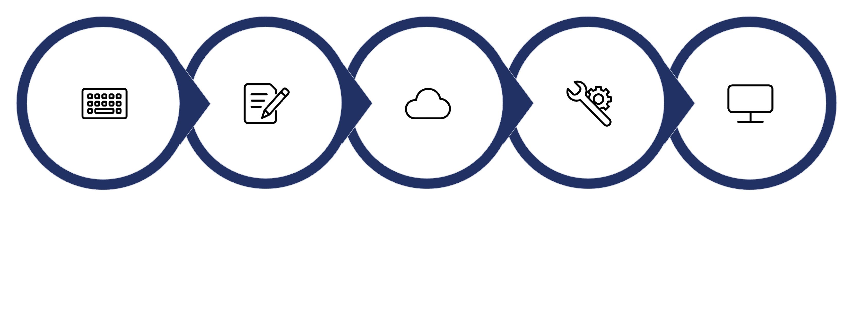
CHAPTER 5
Proposed System / Methodology
The application follows a structured end-to-end pipeline — from user input collection through AI processing to final output delivery.
Prompt Construction
GenAI Model API Call
Response Processing
Output Display
User Input
Step-by-Step Process
Key Design Decisions
User Input: The user provides [text prompt / form data / file upload] via the application interface.
Prompt Construction: The raw input is enriched with context, constraints, and formatting instructions to build an effective prompt.
API Call: The constructed prompt is sent to the a provider-independent AI adapter with a grounded demo provider and optional OpenAI provider via a secure authenticated request.
Processing: The model generates a response, which is parsed, validated, and post-processed as needed.
Output Display: The formatted result is rendered back to the user in a clear, readable, and actionable format.
Prompt templates are parameterised for consistency
Input sanitisation prevents injection or misuse
Fallback handling ensures graceful failure on API errors

Slide 8
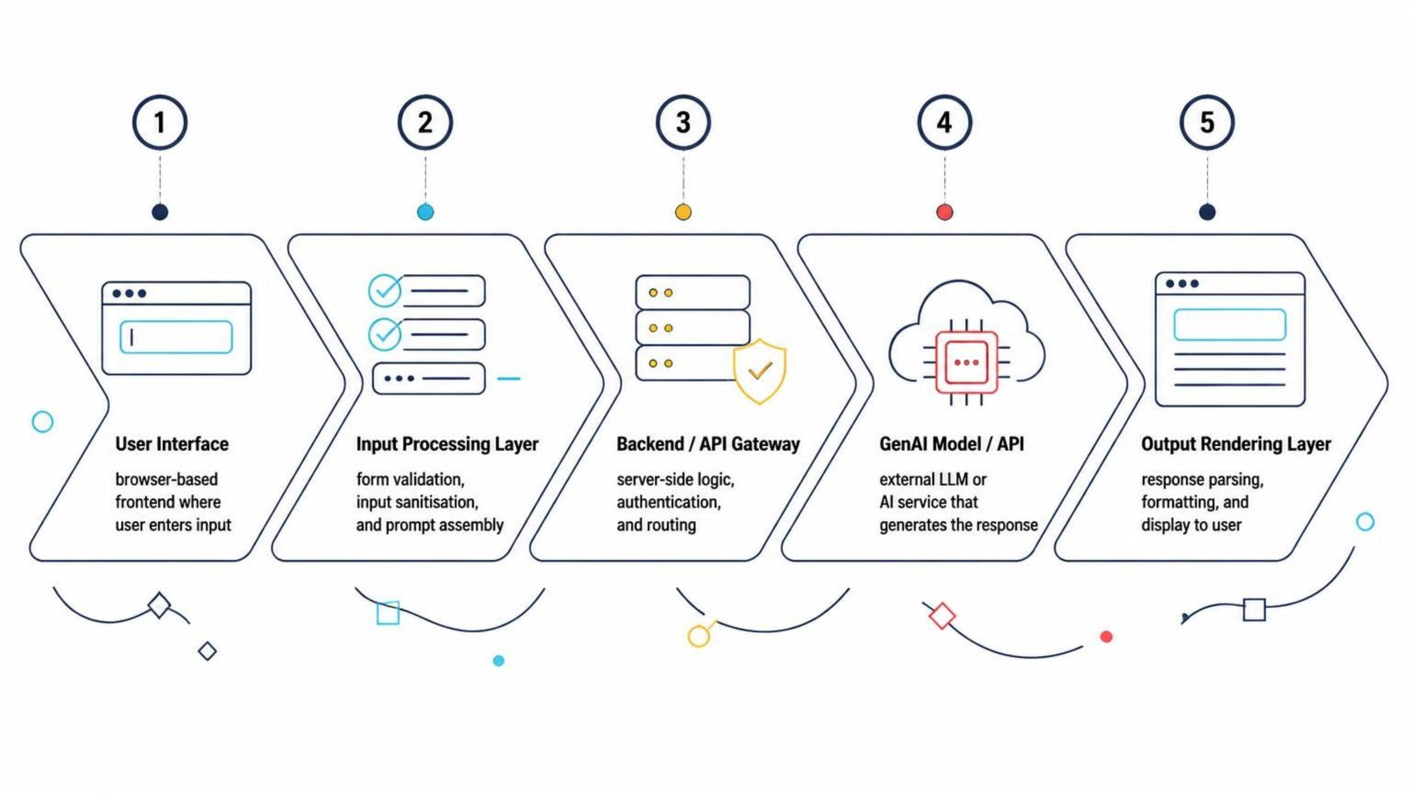
CHAPTER 6
System Architecture & Workflow
The architecture separates the React frontend, FastAPI backend, SQLAlchemy persistence, storage abstraction, and provider adapters. User requests are authenticated, scoped to authorized meetings, processed server-side, and returned with evidence references.
Frontend Layer
Backend & AI Layer
Users interact through a browser-based UI. All input is collected via forms or chat interfaces and validated before being forwarded to the backend.
The server constructs prompts, authenticates API calls to the GenAI service, processes the returned response, and delivers the final output to the frontend.

Slide 9
CHAPTER 7
Implementation
Technology Stack
Integration & Prompt Engineering
The GenAI model is integrated via authenticated REST API calls using the provider's official SDK. API keys are stored securely in environment variables and never exposed on the client side.
Prompts are constructed dynamically using a template system:
Frontend
Backend
[HTML / CSS / JavaScript / React / Vue] — UI design and user interaction layer.
[Python / Node.js / Flask / FastAPI / Express] — server-side logic and API routing.
system_prompt = "You are a helpful assistant that..."
user_input = request.form["query"]
final_prompt = f"{system_prompt}\nUser: {user_input}"
response = openai.chat.completions.create(
model="gpt-4",
messages=[{"role":"user","content":final_prompt}]
)
GenAI Model
[OpenAI GPT-4 / Gemini / Claude / other] API — core AI generation engine.
The response is parsed, sanitised, and rendered as HTML or structured JSON on the frontend.

Slide 10


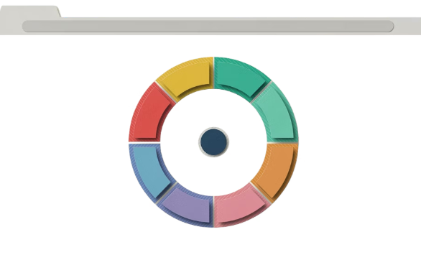


CHAPTER 8
User Interface & Application Screenshots
The following screens represent the complete user journey through the application — from landing on the home screen to receiving AI-generated results.
Home / Main Screen
Input / Prompt Screen
Processing / Loading State
AI-Generated Output
The application's landing page, showing navigation, a brief description of functionality, and the primary call-to-action to begin.
Users enter their query, upload a file, or fill in structured form fields. Input is validated before submission to the AI backend.
A loading indicator confirms the AI request is in progress, preventing repeated submissions and maintaining a smooth user experience.
The system displays the GenAI-generated response — formatted, readable, and ready for the user to act on or download.
Screens shown in this section should be captured from the running MeetMind AI application at the dashboard, meeting room, intelligence view, and assistant panel.

Slide 11
CHAPTER 9
Challenges & Limitations
Technical Challenges Faced
Current Limitations
Model Selection
API Dependency
Token & Cost Constraints
Evaluating and selecting the right GenAI model required testing multiple APIs for output quality, latency, and cost suitability.
The application requires continuous access to an external API. Downtime or rate-limiting directly impacts availability.
Token limits restrict the length of input and output. High API usage incurs cost, making large-scale deployment expensive without optimisation.
Prompt Engineering
Crafting reliable prompts that consistently produce accurate, well-formatted outputs required iterative refinement and extensive testing.
Unexpected AI Outputs
Security & Privacy
The model occasionally produced incomplete or off-topic responses. These were handled via output validation, retries, and fallback messages.
User-provided data is sent to a third-party API. Sensitive inputs must be flagged, and data handling policies must be clearly communicated.

Slide 12

CHAPTER 10
Conclusion
This project demonstrates a GenAI-powered meeting intelligence application for product, engineering, operations, and client-facing teams. MeetMind AI automates transcript analysis and follow-up preparation while preserving source evidence and refusing unsupported claims.
What Was Built
Impact & Output
A functional full-stack meeting intelligence web application featuring evidence-linked summaries, decision and action intelligence, and meeting Q&A and search, integrated with [GenAI model].
The system produces evidence-linked meeting intelligence that is reviewable, traceable, and actionable, saving users manual note-taking and follow-up effort compared to prior approaches.
Key Learnings
This project provided hands-on experience in prompt engineering, API integration, full-stack development, and AI output evaluation.

Slide 13
CHAPTER 11
Future Scope
The current implementation establishes a solid foundation. The following enhancements are planned or recommended for future iterations.
Multimodal Input Support
Model Fine-Tuning
Extend the system to accept image, audio, and video inputs using multimodal GenAI models such as GPT-4o or Gemini 1.5 Pro.
Fine-tune the base model on domain-specific datasets to improve output accuracy, relevance, and tone for meeting intelligence.
Multilingual Support
Production Deployment & Scaling
Add support for additional Indian and international languages to broaden the application's accessibility and user reach.
Deploy on a cloud platform (AWS / GCP / Azure) with proper load balancing, caching, and monitoring for real-world scale use.

Slide 14

CHAPTER 12
References
All sources consulted during the design, development, and evaluation of this project are listed below.
AI Model & API Documentation
Books & Articles
OpenAI API Documentation Official Documentation — [URL]
FastAPI Documentation — [URL]
React and Vite Documentation — [URL]
[Author], [Book Title], [Publisher], [Year].
[Author], "[Article Title]", [Publication], [Year].
Websites & Tutorials
Research Papers
[Tutorial / Website Name] — [URL]
[Tutorial / Website Name] — [URL]
[Author(s)], "[Paper Title]", [Journal / Conference], [Year].
[Author(s)], "[Paper Title]", [Journal / Conference], [Year].
GitHub Repositories
Datasets & External Resources
[Repository Name] — [GitHub URL]
[Repository Name] — [GitHub URL]
[Dataset Name] — [Source / URL]
[External Resource Name] — [Source / URL]
Use a consistent citation style (e.g., IEEE or APA) throughout this section. Replace all placeholders with actual sources used.

