Slide 1
Secure internship

Slide 2

UAV – MAV Link

Slide 3

Problem Statement:
MAV Link 2.0 lacks native encryption, allowing sensitive command-and-control messages to be transmitted in plaintext. This exposes UAV communications to eavesdropping and traffic analysis attacks. Furthermore, deployments that rely on shared symmetric keys remain vulnerable to key compromise, where the breach of a single node can jeopardize the security of the entire fleet.

Slide 4

WHY WE chose it:
It leads to:
Eavesdropping
Loss of Confidentiality
Man-in-the-Middle Attacks
Command Injection
Privacy Risks
Mission Failure
Safety Risks

Slide 5

Tools used:
PX4
Gazebo
Q Ground Control
MAV Proxy
Py MAV
Claude – Open Claw
Wireshark

Slide 6
Possible solutions:
MAV Link communication is allowed only after successful verification of a secondary authentication token.
A cryptographic hash-based authentication tag is generated and attached to each MAV Link packet to verify integrity and authenticity.
MAV Link messages are encrypted using an Affine Cipher where latitude and longitude values act as encryption parameters.
MAV Link packets are encrypted using the ChaCha20 stream cipher before transmission and decrypted by the receiver.

Slide 7
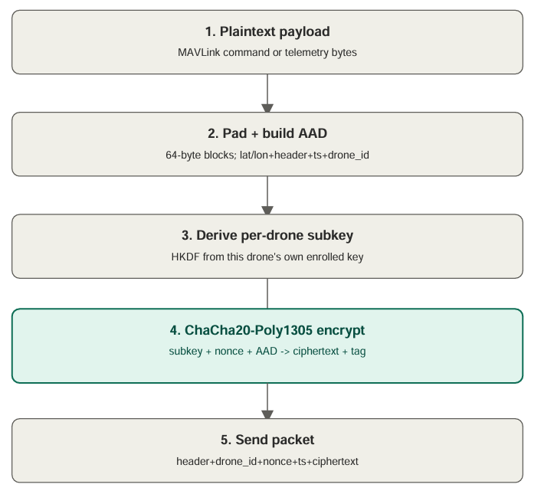
How the chacha20 works

Slide 8
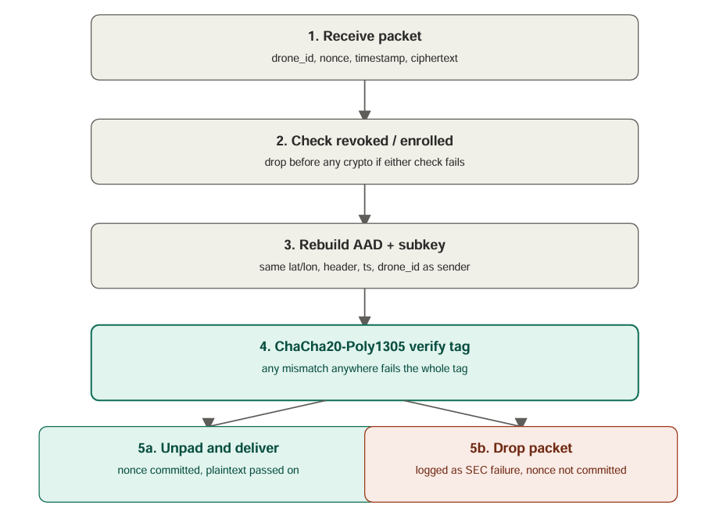

Slide 9
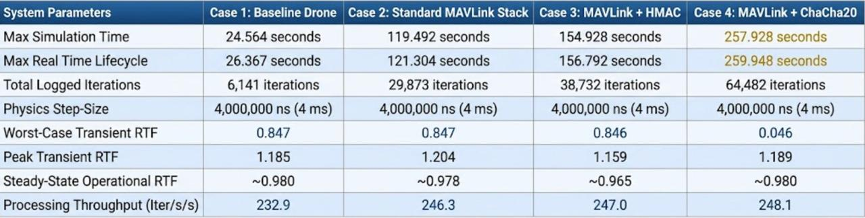
Comparison:

Slide 10
Chacha 20 – latest resource metrics
Max Simulation Time | 51.512 seconds
Max Real Time Lifecycle | 53.339 seconds
Total Logged Iterations | 12,878 iterations
Physics Step-Size | 4,000,000 ns (4 ms)
Worst-Case Transient RTF | 0.0023
Peak Transient RTF | 1.161
Steady-State Operational RTF | ~0.978
Processing Throughput | 241.4 iterations/s

Slide 11

Attacks launched:
Software attacks
MITM
Replay Attack
Eavesdropping
CLI Injection
Token Brute Force
Endpoint Compromise
Hardware attacks
RF Jamming
GPS Spoofing
Mixed
GPS Spoofing
Endpoint Compromise

Slide 12
Metrics recorded:
ASR | Percentage of attacks that succeeded.
ADR | Percentage of attacks detected by the defense.
FPR | Normal traffic incorrectly detected as an attack.
FNR | Attacks missed by the detection system.
PDR | Percentage of packets delivered successfully.
PLR | Percentage of packets lost.
Throughput | Data successfully transferred per second.

Slide 13
Single node with our encryption
Attack | ASR | ADR | FPR | FNR | PDR | PLR | Throughput/s
MITM (tamper ciphertext) | 0.0% | 100.0% | 0.4% | 0.0% | 97.0% | 3.0% | 20,500
Replay attack | 1.0% | 99.0% | 0.4% | 1.0% | 97.0% | 3.0% | 53,400
Eavesdropping | 0.0% | 0.0%* | 0.4% | 100.0%* | 97.0% | 3.0% | 55,900
GPS spoofing | 0.0% | 100.0% | 0.4% | 0.0% | 97.0% | 3.0% | 55,700
RF jamming | 100.0%** | 0.0% | 0.0% | 100.0% | 40.0% | 60.0% | 41,700
CLI / command injection | 0.0% | 100.0% | 0.4% | 0.0% | 97.0% | 3.0% | 69,000
ARM token brute force | 0.0% | 100.0% | 0.4% | 0.0% | 97.0% | 3.0% | 67,400
Endpoint compromise (key stolen) | 100.0%*** | 0.0% | 0.4% | 100.0% | 97.0% | 3.0% | 75,400

Slide 14
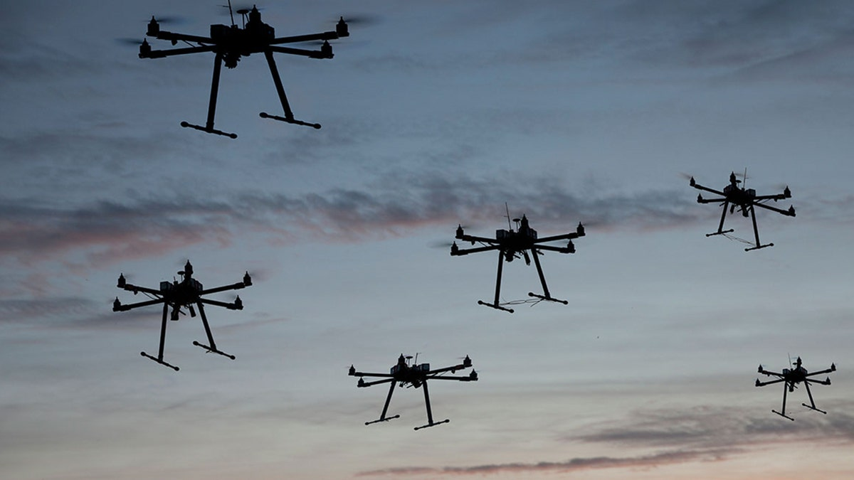
Swarm scenarios:

Slide 15
4 node swarm
Attack | ASR | ADR | FPR | FNR | PDR | PLR | Throughput/s
MITM | 0.0% | 100.0% | 0.3% | 0.0% | 98.2% | 1.8% | 26,000
Replay | 0.6% | 99.4% | 0.3% | 0.6% | 98.2% | 1.8% | 99,100
Eavesdropping | 0.0% | 0.0%* | 0.3% | 100.0%* | 98.2% | 1.8% | 112,600
GPS spoofing | 0.0% | 100.0% | 0.3% | 0.0% | 98.2% | 1.8% | 89,900
RF jamming | 100.0%** | 0.0% | 0.0% | 100.0% | 38.5% | 61.5% | 57,600
CLI injection | 0.0% | 100.0% | 0.3% | 0.0% | 98.2% | 1.8% | 78,700
Token brute force | 0.0% | 100.0% | 0.3% | 0.0% | 98.2% | 1.8% | 92,900
Endpoint compromise | 100.0%*** | 0.0% | 0.3% | 100.0% | 98.2% | 1.8% | 98,100

Slide 16
8 node swarm
Attack | ASR | ADR | FPR | FNR | PDR | PLR | Throughput/s
MITM | 0.0% | 100.0% | 0.2% | 0.0% | 98.6% | 1.4% | 65,200
Replay | 0.6% | 99.4% | 0.2% | 0.6% | 98.6% | 1.4% | 106,700
Eavesdropping | 0.0% | 0.0%* | 0.2% | 100.0%* | 98.6% | 1.4% | 104,800
GPS spoofing | 0.0% | 100.0% | 0.2% | 0.0% | 98.6% | 1.4% | 96,800
RF jamming | 100.0%** | 0.0% | 0.0% | 100.0% | 35.1% | 64.9% | 55,300
CLI injection | 0.0% | 100.0% | 0.2% | 0.0% | 98.6% | 1.4% | 83,300
Token brute force | 0.0% | 100.0% | 0.2% | 0.0% | 98.6% | 1.4% | 96,600
Endpoint compromise | 100.0%*** | 0.0% | 0.1% | 100.0% | 99.3% | 0.7% | 96,700

Slide 17
16 node swarm
Attack | ASR | ADR | FPR | FNR | PDR | PLR | Throughput/s
MITM | 0.0% | 100.0% | 0.2% | 0.0% | 98.4% | 1.6% | 90,000
Replay | 0.4% | 99.6% | 0.2% | 0.4% | 98.4% | 1.6% | 96,600
Eavesdropping | 0.0% | 0.0%* | 0.2% | 100.0%* | 98.4% | 1.6% | 116,900
GPS spoofing | 0.0% | 100.0% | 0.2% | 0.0% | 98.4% | 1.6% | 101,000
RF jamming | 100.0%** | 0.0% | 0.0% | 100.0% | 34.8% | 65.2% | 56,000
CLI injection | 0.0% | 100.0% | 0.2% | 0.0% | 98.4% | 1.6% | 92,900
Token brute force | 0.0% | 100.0% | 0.2% | 0.0% | 98.4% | 1.6% | 107,500
Endpoint compromise | 100.0%*** | 0.0% | 0.1% | 100.0% | 99.5% | 0.5% | 93,900

Slide 18
32 node swarm
Attack | ASR | ADR | FPR | FNR | PDR | PLR | Throughput/s
MITM | 0.0% | 100.0% | 0.2% | 0.0% | 98.7% | 1.3% | 78,900
Replay | 0.3% | 99.7% | 0.2% | 0.3% | 98.7% | 1.3% | 88,000
Eavesdropping | 0.0% | 0.0%* | 0.2% | 100.0%* | 98.7% | 1.3% | 109,100
GPS spoofing | 0.0% | 100.0% | 0.2% | 0.0% | 98.7% | 1.3% | 92,600
RF jamming | 100.0%** | 0.0% | 0.0% | 100.0% | 34.6% | 65.4% | 55,100
CLI injection | 0.0% | 100.0% | 0.2% | 0.0% | 98.7% | 1.3% | 96,600
Token brute force | 0.0% | 100.0% | 0.2% | 0.0% | 98.7% | 1.3% | 106,800
Endpoint compromise | 100.0%*** | 0.0% | 0.1% | 100.0% | 99.6% | 0.4% | 96,700

Slide 19
64 node swarm
Attack | ASR | ADR | FPR | FNR | PDR | PLR | Throughput/s
MITM | 0.0% | 100.0% | 0.2% | 0.0% | 98.8% | 1.2% | 88,300
Replay | 0.5% | 99.5% | 0.2% | 0.5% | 98.8% | 1.2% | 98,800
Eavesdropping | 0.0% | 0.0%* | 0.2% | 100.0%* | 98.8% | 1.2% | 115,800
GPS spoofing | 0.0% | 100.0% | 0.2% | 0.0% | 98.8% | 1.2% | 100,300
RF jamming | 100.0%** | 0.0% | 0.0% | 100.0% | 34.3% | 65.7% | 59,300
CLI injection | 0.0% | 100.0% | 0.2% | 0.0% | 98.8% | 1.2% | 99,300
Token brute force | 0.0% | 100.0% | 0.2% | 0.0% | 98.8% | 1.2% | 107,900
Endpoint compromise | 100.0%*** | 0.0% | 0.1% | 100.0% | 99.2% | 0.8% | 99,300

Slide 20
Unsolved vulnerabilities:
RF jamming:
ChaCha20-Poly1305 protects confidentiality and integrity of content, not availability of the radio channel. Jamming doesn't try to read or forge anything — it just raises the noise floor so legitimate packets never arrive intact. There's nothing for the AEAD tag check to catch because no packet ever gets that far. Fix requires frequency-hopping spread spectrum (FHSS), directional antennas, or redundant links not stronger crypto.
Endpoint compromise:
The attacker isn't breaking the cipher; they have the real 32-byte key (physically extracted). Every packet they craft passes the exact same AEAD tag check, GPS-as-AAD check, and HMAC token check that a legitimate drone's packets pass, because it's using the same trusted key. Cryptographically the proxy has no way to tell "real Drone 01" from "attacker holding Drone 01's key" that distinction lives outside the crypto.

Slide 21

If an attacker takes over one drone, the threat does not spread randomly.
Highest Risk: The One in Direct Communication with the Malicious Drone
Drones operating on the same localized communication channel or mesh link are forced to process its packets first. Because the rogue drone holds valid cryptographic keys, these immediate peers will blindly ingest the malicious data, making them highly susceptible to logical exploits, data poisoning, or command injection.
Medium Risk: The Nearby Neighbors
Swarms use localized collision-avoidance loops. Drones flying closest to the rogue drone are highly vulnerable to physical disruption. The malicious drone can suddenly veer off course or feed them fake proximity warnings, forcing them into erratic maneuvers that crash the drones or break the swarm's structural stability.
Comparatively Less Risk: The Busiest Drone
In large swarms, certain central drones handle a massive volume of routed traffic. If the malicious drone targets the busiest node with complex, validly encrypted data, it forces that central hub to exhaust its processing cycles decrypting junk traffic. This triggers a cascading bottleneck, causing massive packet loss for the entire fleet.

Slide 22

methods We used to Find the Compromised Drone
Behavioral Anomaly Detection:
We tracked the content of the messages. If a drone passes the ChaCha20-Poly1305 check but starts sending physically impossible telemetry, the system flags it as compromised.
Trust Scoring Systems:
Drones in the swarm constantly evaluate their peers. If Drone A claims it is at coordinates (X, Y), but Drones B and C visually see Drone A at coordinates (Z, W), they cross-reference the data, lower Drone A’s trust score, and report it to the Ground Control Station.
Network Flow & Throughput Spikes:
Your metrics track throughput/s. If a compromised drone begins scanning the network or flooding neighbors with junk data to exhaust them, a sudden, unexplained spike in its throughput metric will give away its location.

Slide 23
Prevention of infections of other Drones
Dynamic Key Revocation:
The server generates a key revocation broadcast. This tells all healthy drones to instantly delete the compromised drone's specific 32-byte key from their memory, permanently locking it out of the network.
Immediate Network Quarantine:
Neighboring drones dynamically alter their routing tables. They refuse to accept or forward any packets originating from the compromised drone's hardware ID, effectively dropping its packet delivery rate to zero.
Physical Failsafe Separation:
Automated swarm formation algorithms trigger a physical separation rule. Healthy drones are commanded to physically steer clear of the rogue drone’s last known airspace coordinates to prevent intentional mid-air collisions.

Slide 24
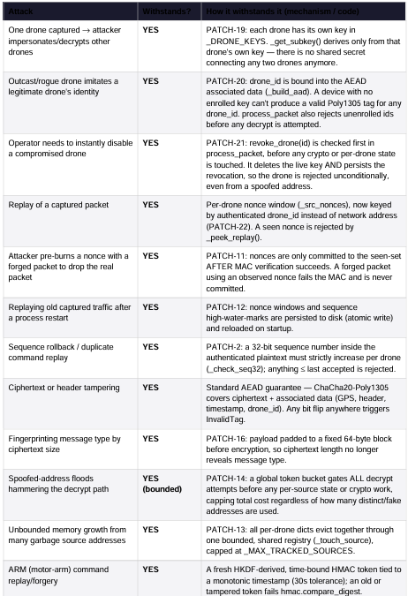

Slide 25
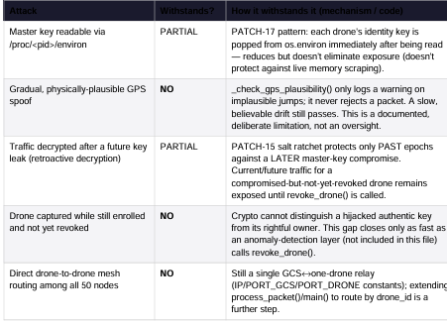

Slide 26
Residual Limits (Not Fixable by Code Alone)
Delayed Revocation: Captured drones with valid keys authenticate perfectly until the breach is actively detected and revoked.
Gradual Spoofing: GPS-AAD prevents sudden location jumps but remains vulnerable to slow, plausible spoofing.
Incomplete Forward Secrecy: The salt ratchet protects past epochs but does not provide true ephemeral-Diffie-Hellman perfect forward secrecy.
Relay Vulnerability: Because it uses a hop-by-hop relay, compromising the host exposes plaintext MAVLink traffic regardless of encryption strength.
1:1 Topology Limits: The system only supports single GCS-to-drone routing; handling multiple drones requires extending the packet-processing loop.
DDoS Susceptibility: Crypto-layer rate-limiting only saves CPU; it cannot prevent large network-layer volumetric floods.

Slide 27
Thank you

