Slide 1


Customer Loan Prediction Analysis
CMR TECHNICAL CAMPUS
UGC AUTONOMOUS
DEPARTMENT OF
COMPUTER SCIENCE AND ENGINEERING
TEAM MEMBERS:
B SRIHITHA 217R5A0502
P SAI KIRAN 207R1A0546
K SUNIL 207R1A0533
UNDER THE GUIDANCE OF
G VIJAY KUMAR
ASSISTANT PROFESSOR
CSE DEPARTMENT

Slide 2
CONSTITUENTS
Abstract
Existing system
Disadvantage
Proposed system
Advantages
Hardware and software requirements
Novelty of project
Architecture
System modules
UML diagrams
Sample Code
Results
Conclusion
Future scope
References
Git Hub Link

Slide 3
ABSTRACT
With the enhancement in banking sector, lots of people are applying for loans, but the bank has limited assets.
It has to grant them to people to limited people which will be a safer way, also typical.
Our project is implemented to reduce the risk factor behind selecting the safe person so as to save bank efforts and assets.
The main objective is to predict whether assigning loan to a particular person will be safe or not.
Big data analytics and machine learning help bank predict the likelihood of a borrower, enabling informed decision making.

Slide 4
EXISTING SYSTEM
Implementation of Machine Learning is complex part in terms of data analytics.
There are less systems in existence, which have implemented loan prediction using Machine learning. Even if used, they are not efficient.
Making the code to predict the future of outcomes from the customer is the challenging part.

Slide 5
DISADVANTAGES OF EXISTING SYSTEM
Complexity in analysing data
Challenges in prediction
Complex code consisting of multiple methods
Unfamiliar libraries

Slide 6
PROPOSED SYSTEM
Implementation of machine learning algorithms like random forest and vast & familiar python libraries to overcome the risks.
The data is collected from the client source by the user, based on payment history and loan recipients.
Comparing different machine learning algorithms, training the model, testing are the phases involved.
The trained model is then deployed to aid officers to make informed decisions on loan approvals.

Slide 7
ADVANTAGES OF PROPOSED SYSTEM
Reduced complexity in prediction
Accurate results
Familiar libraries reduce complexity of code
Less number of methods and modules

Slide 8
SYSTEM CONFIGURATION REQUIREMENTS
MINIMUM HARDWARE REQUIREMENTS
MINIMUM SOFTWARE REQUIREMENTS
Processor : i3
RAM : 8GB
Storage : 128GB SSD
Operating system :Windows 8
Programming language : Python
Any latest version browser (particularly chrome)

Slide 9
NOVELTY
Enhancing the machine learning implementation
Promoting automation of process and analysis, therefore reducing manual involvement.
Predicting accurate results for providing loans for the need and trusted borrowers.
Protecting the efforts made by banks and their assets.

Slide 10
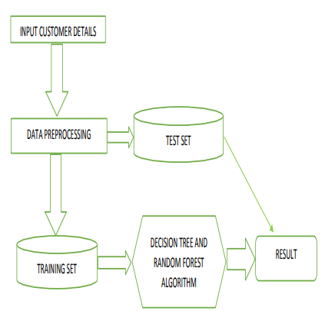
SYSTEM ARCHITECTURE

Slide 11
SYSTEM MODULES
Data description
Data analysis
Data preprocessing
Classification model

Slide 12
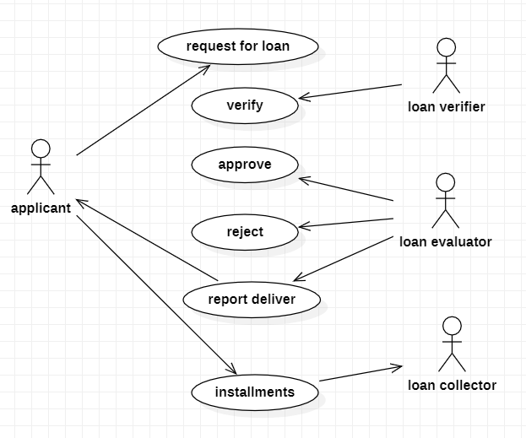
UML DIAGRAMS
1(a). Use case diagram
(for loan process)

Slide 13
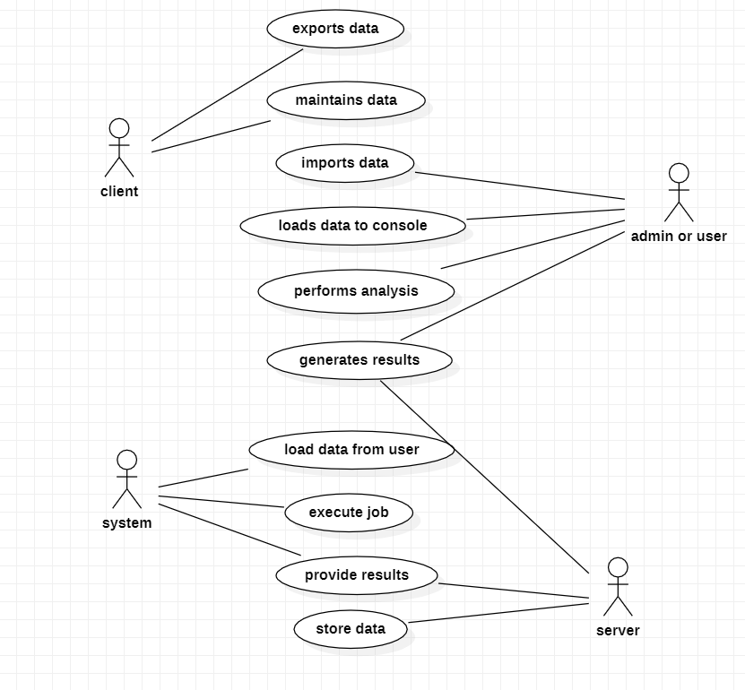
1 (b). Use case diagram
(for system function process)

Slide 14
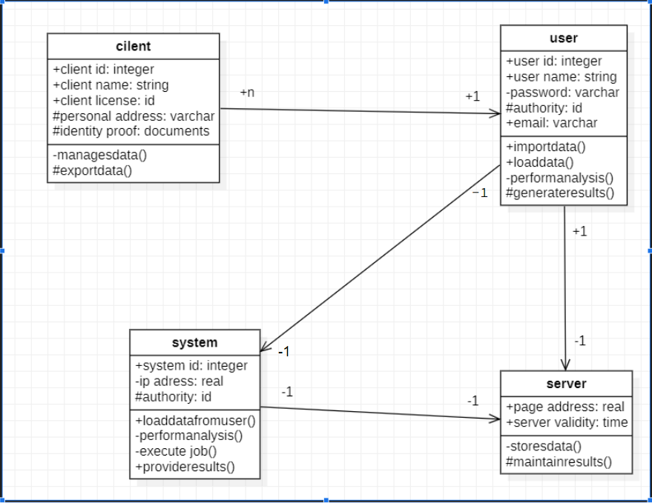
2. Class diagram

Slide 15
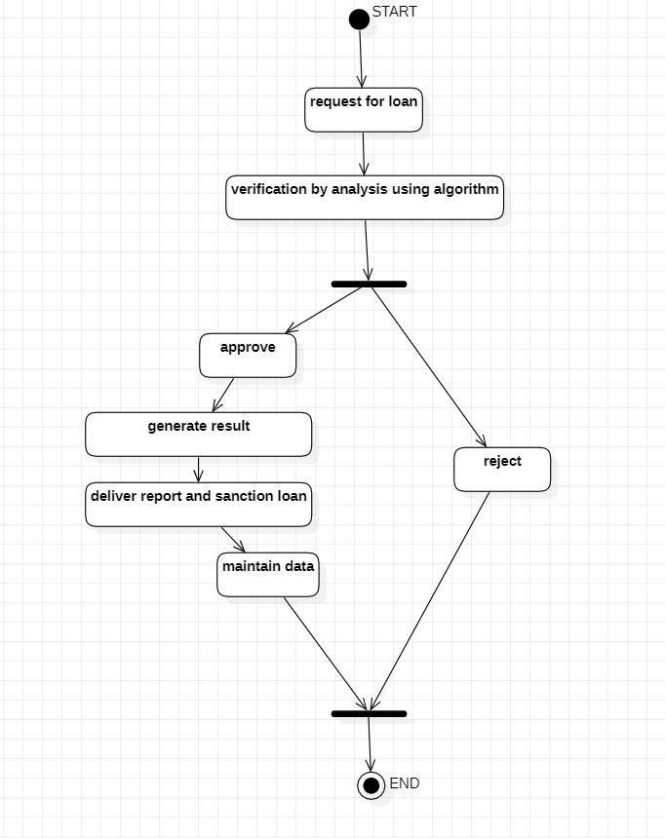
3. Activity diagram

Slide 16
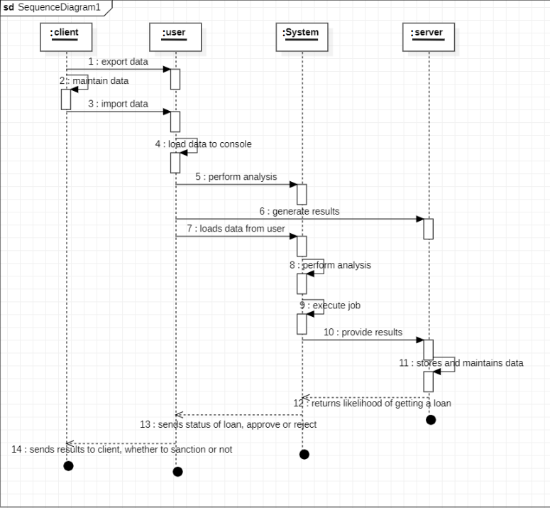
4. Sequence diagram

Slide 17
SAMPLE CODE
clp.py
import pandas as pd
import numpy as np
import matplotlib as plt df = pd.read_csv(r"D:\MINI PROJECT\A19_CUSTOMER LOAN PREDICTION ANALYSIS\Project14 clp\data.csv")
df.head(10)
df.tail(10)
df.describe()
df['Property_Area'].value_counts()
import matplotlib.pyplot as plt
df['ApplicantIncome'].hist(bins=50)
plt.show()
df.boxplot(column=‘ApplicantIncome’)
plt.show()
df.boxplot(column=‘ApplicantIncome’, by = 'Education')
plt.show()
df['LoanAmount'].hist(bins=50)
plt.show()
df.boxplot(column='LoanAmount')
plt.show()
temp1 = df['Credit_History'].value_counts(ascending=True)
temp2 = df.pivot_table(values='Loan_Status',index=['Credit_History'],aggfunc=lambda x: x.map({'Y':1,'N':0}).mean())

Slide 18
print('Frequency Table for Credit History:')
print(temp1) print('\nProbility of getting loan for each Credit History class:' )
print(temp2) import matplotlib.pyplot as plt
fig = plt.figure(figsize=(8,4))
ax1 = fig.add_subplot(121)
ax1.set_xlabel('Credit_History')
ax1.set_ylabel('Count of Applicants')
ax1.set_title("Applicants by Credit_History")
temp1.plot(kind='bar')
plt.show() ax2 = fig.add_subplot(122)
temp2.plot(kind = 'bar')
ax2.set_xlabel('Credit_History')
ax2.set_ylabel('Probability of getting loan')
ax2.set_title("Probability of getting loan by credit history/data.csv")
df.head(10)
df.describe()
df['Property_Area'].value_counts() temp1 = df['Credit_History'].value_counts(ascending=True)
temp2 = df.pivot_table(values='Loan_Status',index=['Credit_History'],aggfunc=lambda x: x.map({'Y':1,'N':0}).mean())
print('Frequency Table for Credit History:')
print(temp1) print('\nProbility of getting loan for each Credit History class:' )
print(temp2)

Slide 19
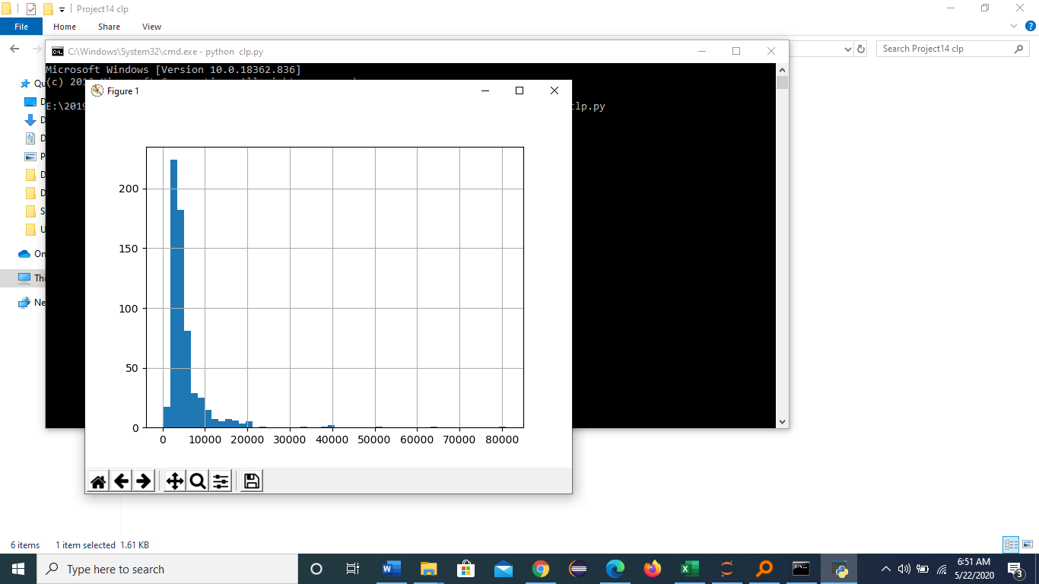
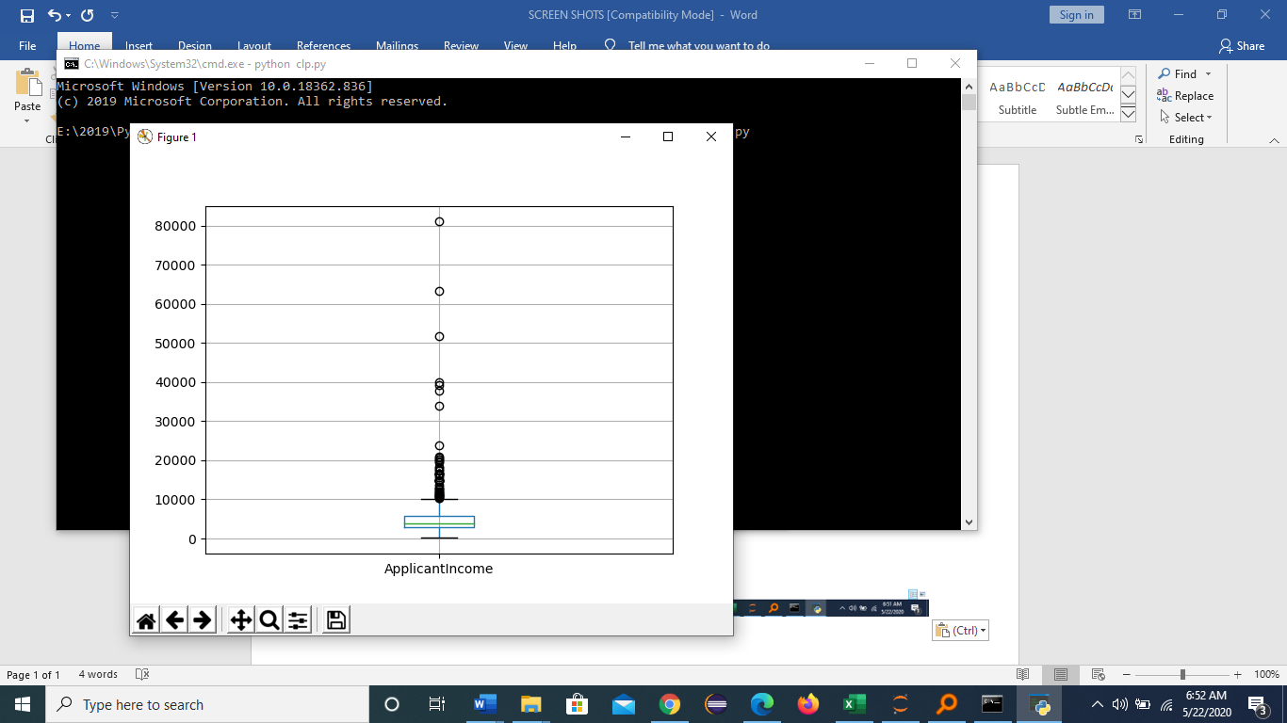
RESULTS
Customer Based On Salary
Customer income

Slide 20
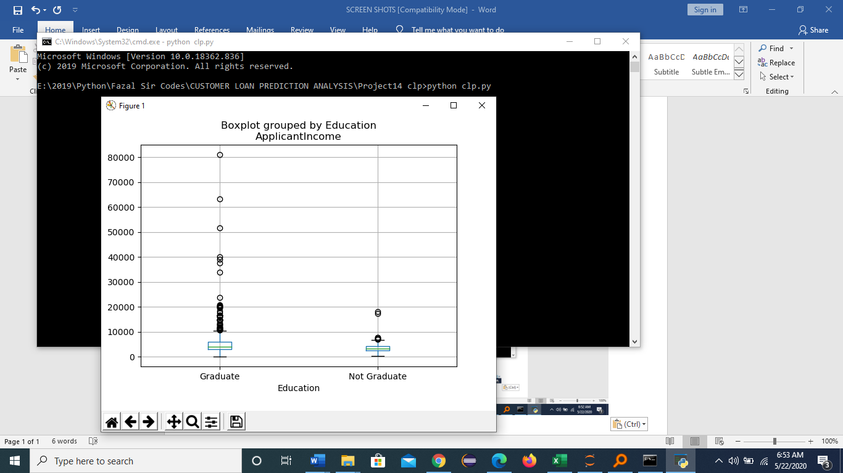
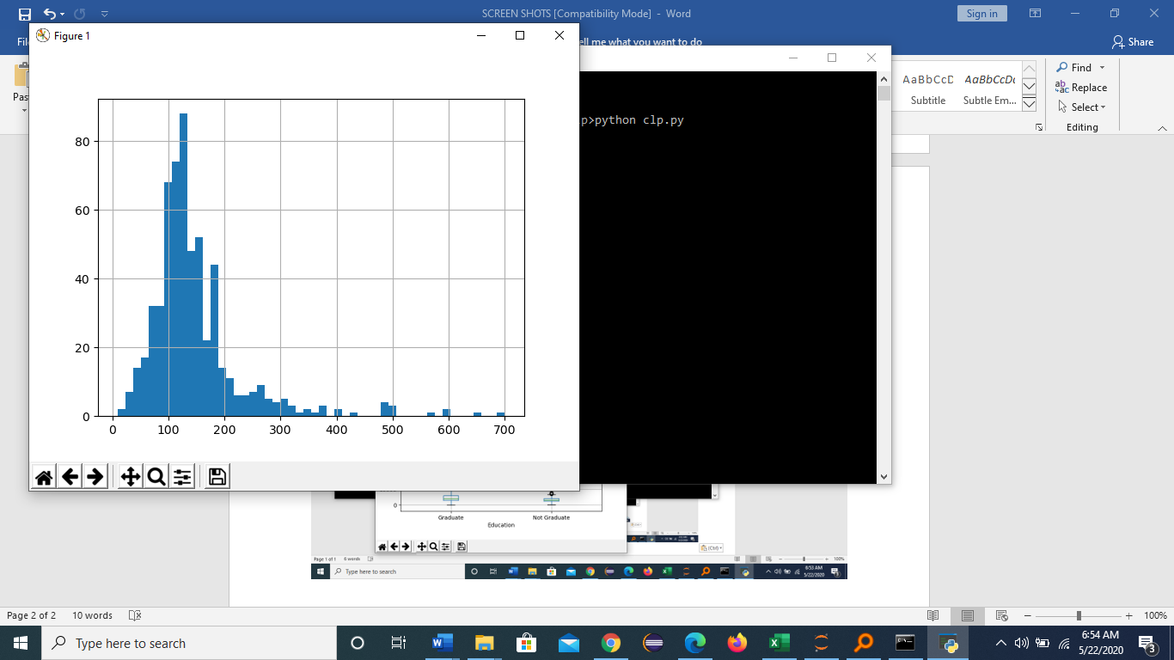
Customer Income By Education
Customer Score

Slide 21
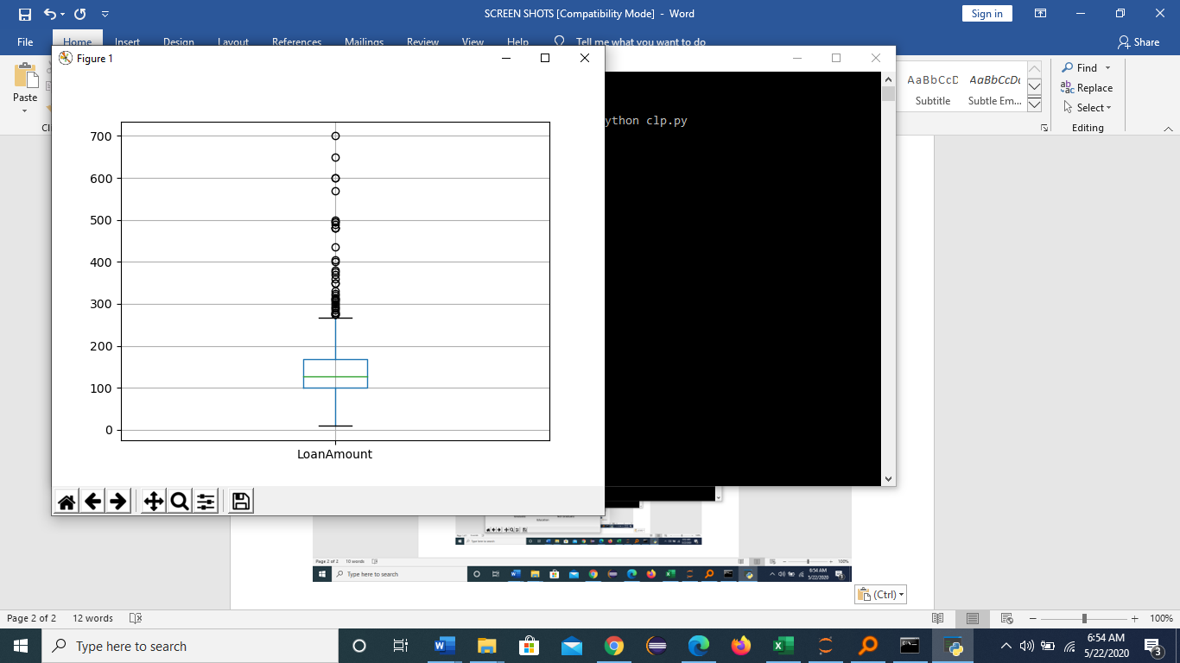
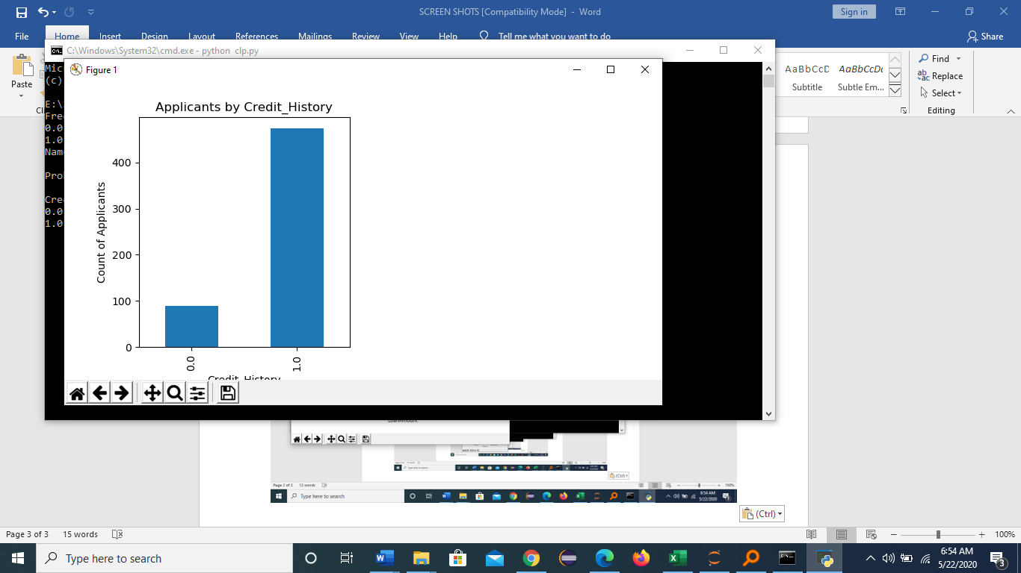
Customer Loan Amount
Customers Credit History

Slide 22
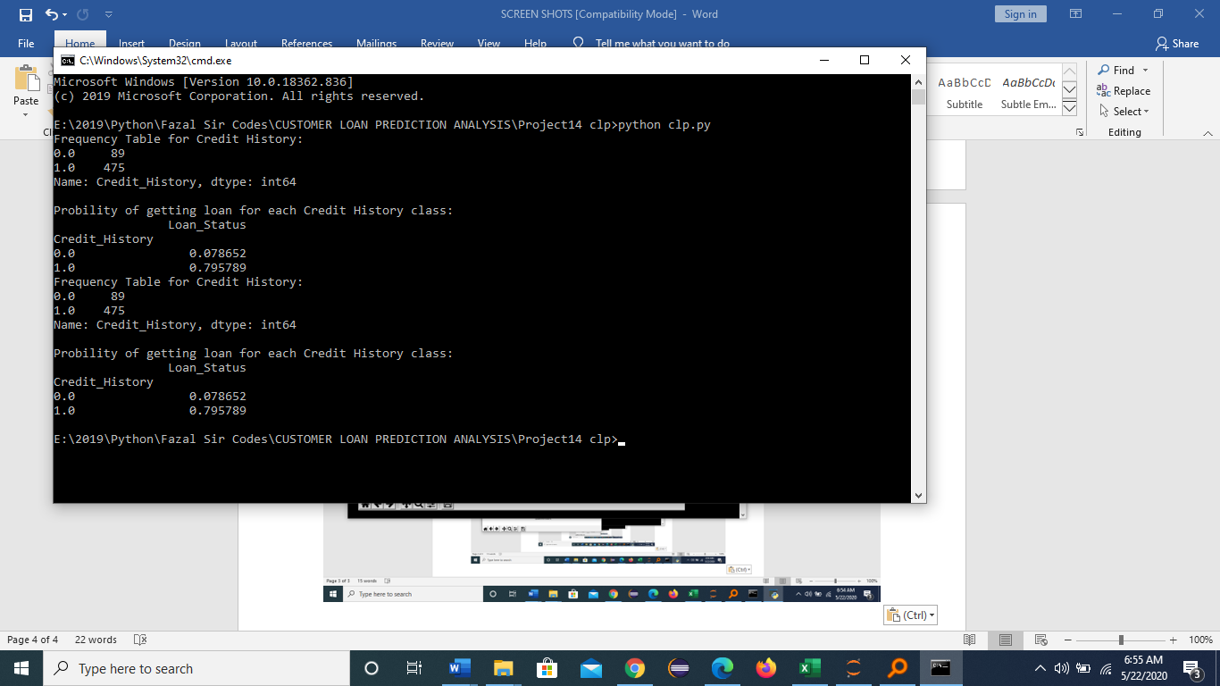
Credit History Of Getting Loan

Slide 23
CONCLUSION
The aim of this project is to analyse customer loan data and predict loan approval status. The data was cleaned and pre-processed, and various machine learning models were trained and tested. The results showed that the Random Forest Classifier performed the best, with a high accuracy and F1-score. Overall, the analysis suggests that factors such as credit history, income, and loan amount are important indicators of loan approval status. Based on this analysis, it can be concluded that the model has a good capability of predicting loan approval status for new customers.

Slide 24
FUTURE SCOPE
Looking ahead, working on predicting whether customers can get loans is a big deal. As technology gets better, we'll use smart predictions to figure out if someone can pay back a loan or not. This helps banks make safer choices when giving out loans. Following the rules and doing this responsibly is very important. We'll also see these prediction tools teaming up with new finance tech, making things faster and better. As computer skills improve, these predictions will become more accurate, like getting really good at guessing. Plus, making it easier for people to ask for a loan and get help with smart robots will be a cool part of this project. It's like using fancy tech to make banking fair and easy for everyone!

Slide 25
REFERNCES
1. S. Johnson, ”Internet changes everything: Revolutionizing public participation and access to government information through the Internet”, Administrative Law Review, Vol. 50, No. 2 (Spring 1998).
2. D. Chrysanthos. ”Strategic manipulation of internet opinion forums: Implications for consumers and firms.” Management Science 52.10 (2006): 1577-1593.
3. M. Wollmer, et al. ”Youtube movie reviews: Sentiment analysis in an audio-visual context.” Intelligent Systems, IEEE (2013).
4. J. Naughton, ”The internet: is it changing the way we think?”, The Gaurdian, Saturday 14 August 2010
5. G. Mishne and N. S. Glance, ”Predicting movie sales from blogger sentiment,” in AAAI 2006 Spring Symposium on Computational Approaches to Analyzing Weblogs, 2006.

Slide 26
Git Hub Link
https://github.com/Saikiran-287/Customer_loan_predictionanalysis

Slide 27
THANK
YOU

