Slide 1
Project-P1: Failed Banking Transaction Analysis

Slide 2
Project Overview
The "Failed Banking Transaction Analysis" project is an end-to-end data processing and analytics pipeline designed to analyze transaction failures across multiple bank branches using cloud-native technologies. The objective is to collect, clean, transform, and analyze transaction data in order to uncover operational issues, optimize infrastructure performance, and support decision-making through actionable insights.

Slide 3
Project Objectives
Upload
Upload CSVs to Cloud Storage.
Clean & combine
Clean & combine data using Dataproc.
Filter
Filter failed transactions.
Save
Save to Cloud SQL.
Analyze
Analyze using BigQuery.

Slide 4
Technology Stack
Google Cloud Storage(GCS)
Python
Google Dataproc with Pyspark
Cloud SQL(MySQL)
BigQuery with federated external connection
gsutil & gcloud CLI tools

Slide 5
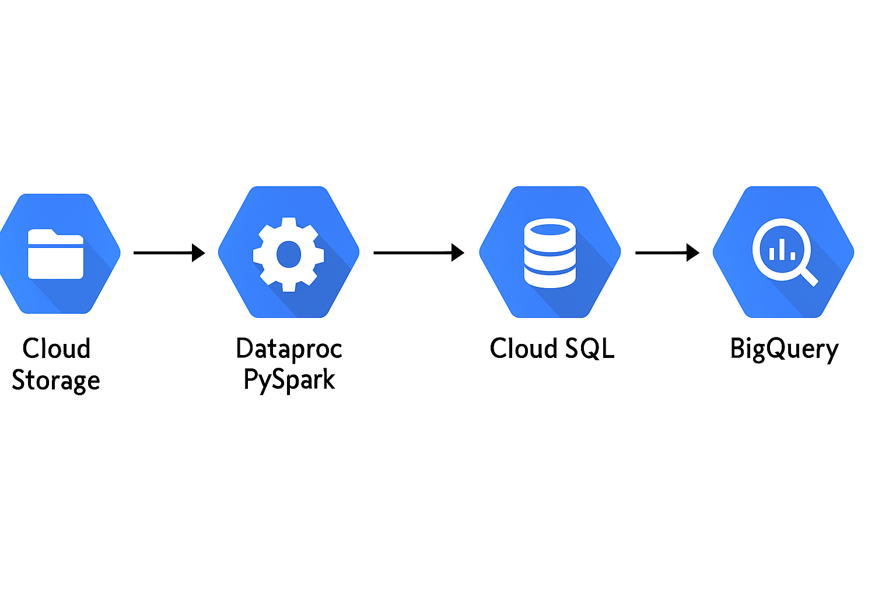
End-to-End Data Workflow for Failed Transaction Analysis

Slide 6
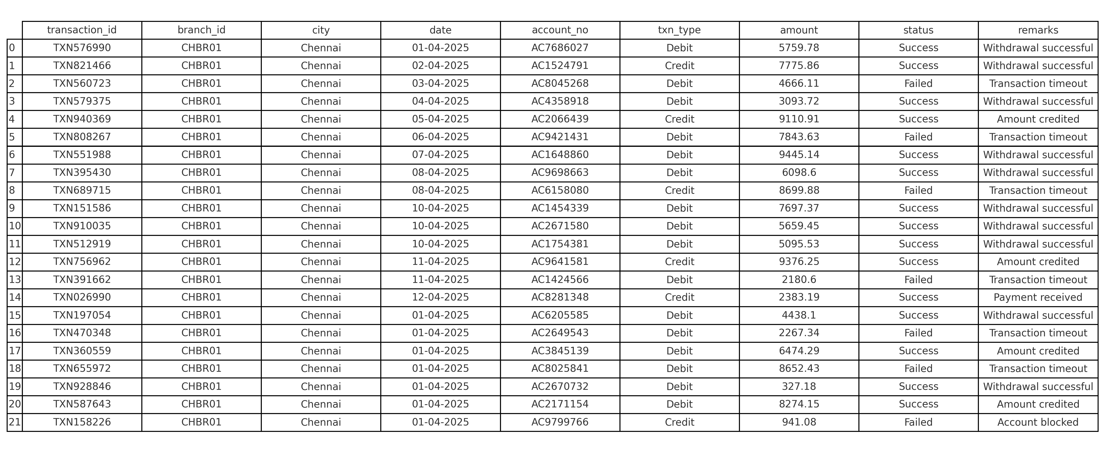
Sample csv data

Slide 7
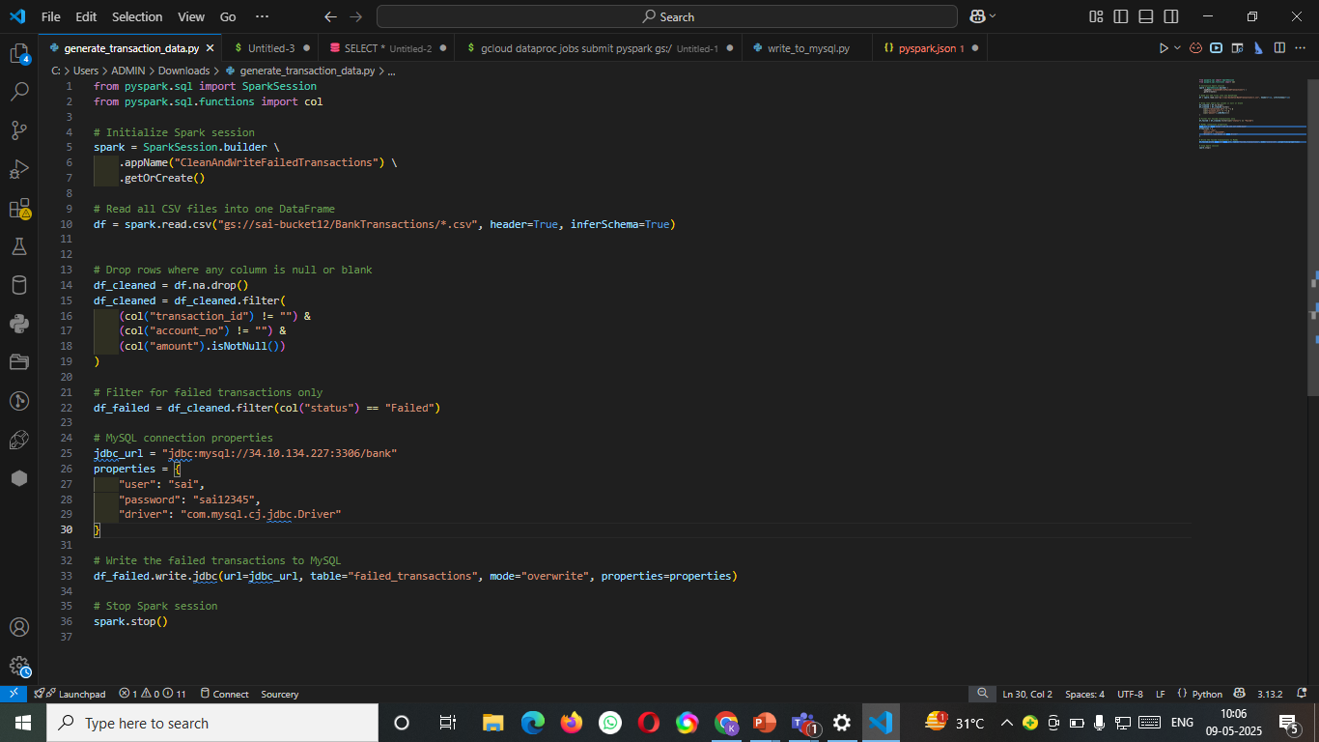
Python script code

Slide 8
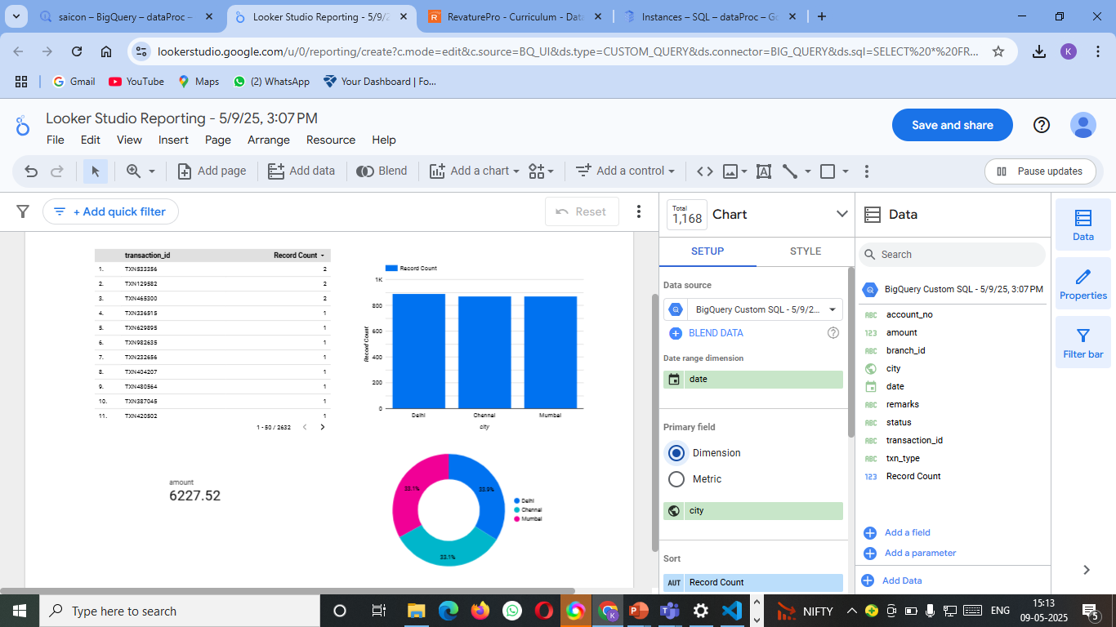
Output Visualization

Slide 9
Potential Use Cases
Automatically ingest and process failed banking transactions from multiple branches using GCP services
Clean and filter failure records with PySpark on Dataproc to ensure accurate analysis.
Store filtered data in Cloud SQL for centralized access and auditability.
Analyze failure trends using BigQuery to identify common issues and peak failure periods.
Enable banks to improve service reliability, customer satisfaction, and operational decision-making.

Slide 10
Conclusion
This project successfully demonstrates an end-to-end data analytics pipeline for identifying and analyzing failed banking transactions using Google Cloud Platform. By leveraging PySpark on Dataproc, Cloud Storage, Cloud SQL, and BigQuery, the system automates data ingestion, cleaning, filtering, and analysis. It provides valuable insights into transaction failures, helping banks improve operational efficiency, reduce downtime, and enhance customer experience. The solution is scalable, secure, and ready for real-time expansion—paving the way for data-driven decision-making in modern banking environments.

