Slide 1
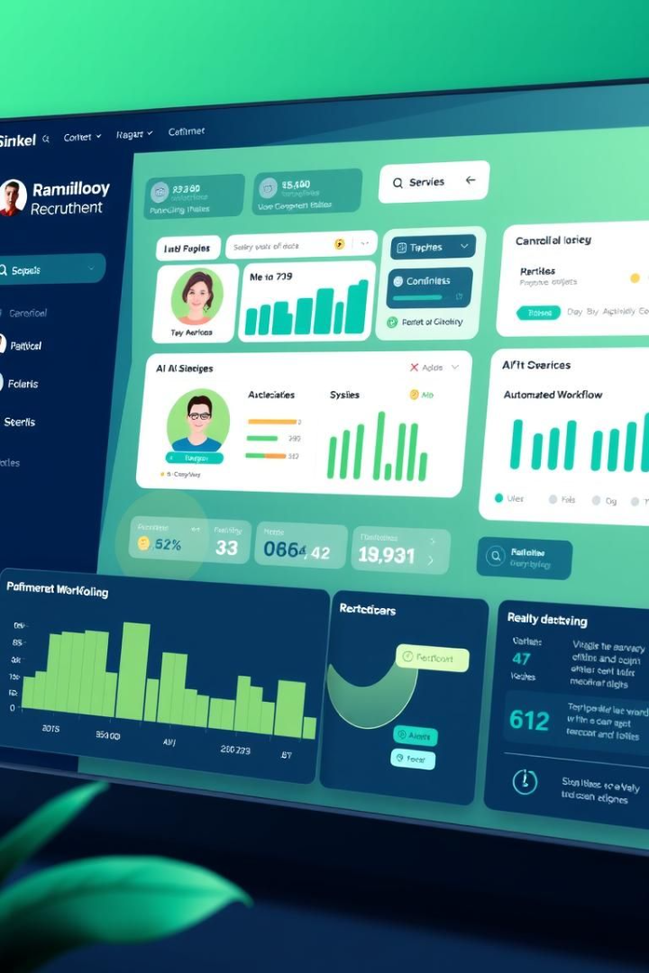

Solution Architecture: AI-Powered Recruitment System
This presentation provides an overview of the recruitment system's solution architecture, which leverages AI and automation to streamline the hiring process. The system integrates Streamlit for the frontend, Python for backend processing, and JSON for data storage. It features an agentic architecture that autonomously manages the hiring process, integrating AI-powered decision making with automated workflow management.
by Saikiran Paramkusham

Slide 2
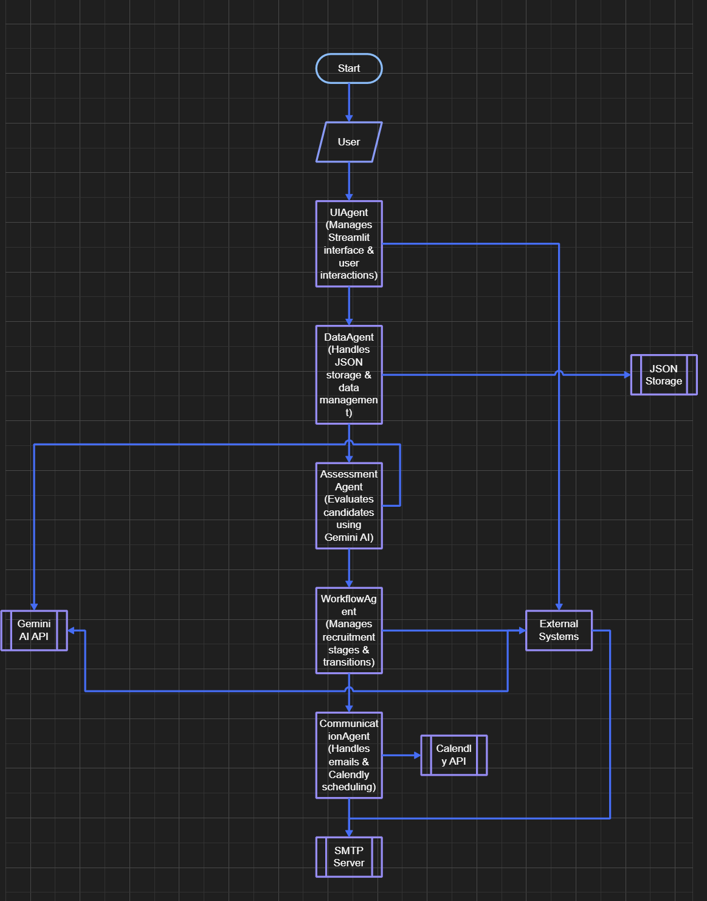
System Design Overview
Frontend (Streamlit UI)
Backend (Python)
The Streamlit UI offers an intuitive interface for users to engage with the recruitment system. It seamlessly connects with the Python backend to manage data processing and execute business logic.
The Python backend is responsible for data processing and implementing core business logic, utilizing JSON files for persistent data storage. It also orchestrates integrations with external services to facilitate email notifications, automate interview scheduling, and leverage AI for candidate assessments.
The system utilizes external services like SMTP for email notifications, Calendly API for interview scheduling, and Gemini AI for AI-driven candidate assessment. Security is maintained using environment variables for sensitive API keys, complemented by basic error handling for system resilience. The system is built on Python 3.8+ and requires several specific libraries.

Slide 3




AI/ML Components: Gemini AI Integration
Resume Analysis
Job Posting Matching
Extracts key information from resumes, parsing and structuring content using Natural Language Processing.
Compares candidate profiles with job requirements, identifying relevant skills and qualifications.
Candidate Scoring
Provides quantitative assessment (0-100), evaluating experience level and cultural fit.
The Gemini AI model (gemini-1.5-pro) is the core component for intelligent candidate assessment, providing advanced capabilities for analyzing resumes, matching candidates with job requirements, and generating comprehensive assessments. The AI system provides comprehensive capabilities for analyzing and evaluating candidates throughout the recruitment process.

Slide 4
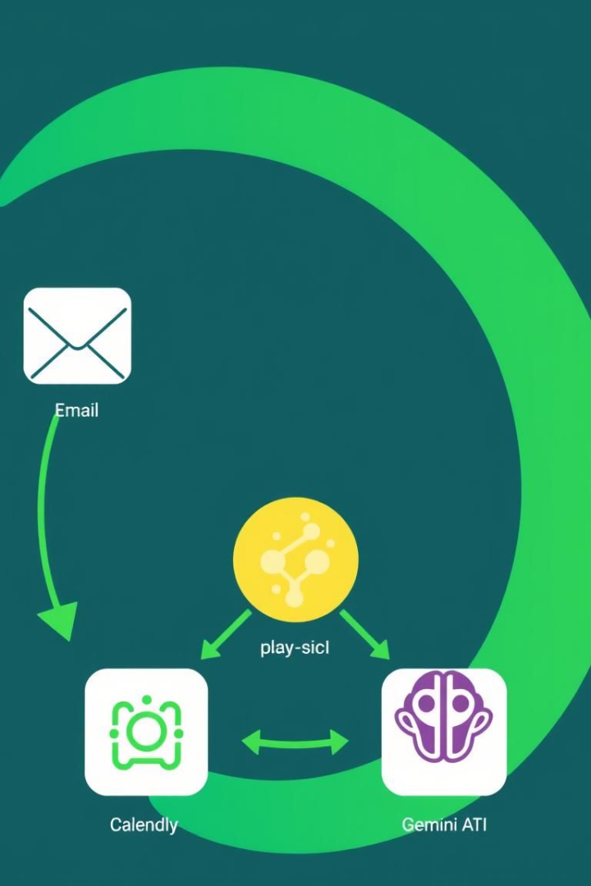



Integration Architecture: External Services
Email Service (SMTP)
Handles email delivery with HTML email templates and automated notifications for status updates.
Calendly API
Manages interview scheduling, calendar management, and availability checking for efficient meeting coordination.
Gemini AI API
Provides real-time assessment, batch processing, custom prompts, and response handling for AI outputs.
The system integrates with several external services to provide a complete recruitment solution. The system manages data flow between various components to ensure efficient processing and storage. Data synchronization maintains current state, handles bulk operations, and manages data consistency.

Slide 5





Data Flow: Agentic Workflow
Perception
Data collection and input from various sources.
Processing
AI assessment and analysis of candidate data.
Decision
Stage progression logic based on AI assessment.
Action
Communication and scheduling with candidates.
State
Data persistence and storage of candidate information.
This flow diagram shows how data moves through the system, from user interactions to final responses. Each step includes specific processes and validations to ensure accurate and efficient handling of recruitment tasks. The agentic workflow includes perception, processing, decision, action, and state management.

Slide 6

Security Considerations: Data Protection
Data Encryption
Access Control
File and network encryption to protect stored data and secure communication.
Role-based access and user authentication to manage permissions and track usage.
Compliance
Adherence to GDPR considerations, data privacy, and data retention policies.
The system implements comprehensive security measures to protect sensitive information. Environment variables are used for sensitive data, and secure API key storage is implemented. The system adheres to data protection regulations and best practices, including GDPR considerations and data privacy policies.

Slide 7






Technical Requirements: Infrastructure
Streamlit Framework
Creates UI components, manages state, and ensures custom styling consistency.
Python 3.x
Ensures version compatibility, performance optimization, and security updates.
Required Libraries
Includes pandas, requests, google-generativeai, python-dotenv, smtplib, and json.
The system requires specific technical infrastructure to operate effectively. It relies on various external services for functionality, including an SMTP server, Calendly account, and Gemini AI API access. The system requires Python 3.x, the Streamlit framework, and several required libraries.

Slide 8



Scalability Considerations: Future Growth
Modular Architecture
Component isolation for independent operation and easy updates.
Stateless Design
Efficient session management and load balancing for resource optimization.
Easy Integration
Plugin system and API extensions for extensible functionality.
The system is designed with scalability in mind to accommodate future growth. It features a modular architecture, stateless design, and easy integration of new features. The extensible data model allows for schema evolution, data migration, and version control. The architecture is designed to scale horizontally with modular components that can be independently scaled.

