Slide 1
MSc Project
(CMP060L050H)
Viva Presentation
Crop Recommendation System Using Machine Learning Based on NPK Soil Nutrients and
Weather Conditions
Student Name: SAI KIRAN REDDY KONDAM
Date:
Supervisor: Dr.Shekoufeh Rahimi
Second Marker:

Slide 2
Outline
Context​
Problematic statement​
Objectives ​
Methodology​
Project management​
Literature review​
Your contributions
Conclusion

Slide 3
Problem Statement - WHY
Precision Agriculture is a farming technique that makes use of data analysis of soil and environmental conditions to help make better decisions [1].
Agricultural sustainability, crop productivity and growth are directly linked to soil nutrients and weather factors.
The traditional selection of crops is largely based on farmers' experience and agricultural practice.
Resource wastage, diminished yield and lowered farm profitability arise from the use of inappropriate crop input signals [2].
Measurable soil and weather characteristics serve as the basis for intelligent crop recommendation with machine learning [3].
Notes:
The study is one of precision agriculture, in which machine learning is used to help decide on a crop based on quantifiable soil nutrients and weather conditions. Farmers are usually accustomed to managing traditional farming systems, which can lead to inadequate outcomes. An intelligent recommendation system can minimise the uncertainty, increase productivity, optimise the use of resources, and help the farmers make wise cultivation decisions.

Slide 4
Objective - WHAT
The aim is to develop, test and improve a soil-and-weather-based crop recommendation system for suitable crop selection.
Objectives
To investigate the relationship between soil and weather features and crop suitability within the selected dataset.
To identify the soil and weather features that contribute most significantly to crop recommendation decisions.
To prepare and analyse the dataset to establish a suitable foundation for crop recommendation modelling.
To develop a data-driven crop recommendation approach using soil and weather features.
To enhance the proposed crop recommendation approach through an appropriate improvement stage informed by the initial modelling outcomes.
To evaluate the effectiveness of the proposed crop recommendation approach using suitable performance measures.
To critically discuss the practical applicability, limitations and potential value of the proposed approach for agricultural decision support.
Notes:
The main goal was to create a trustworthy crop recommendation system with the use of machine learning. This study contributes engineered features, compares five algorithms under the same circumstances and evaluates the algorithms in several aspects, unlike some of the previous studies in the field which mainly focused on prediction accuracy.

Slide 5
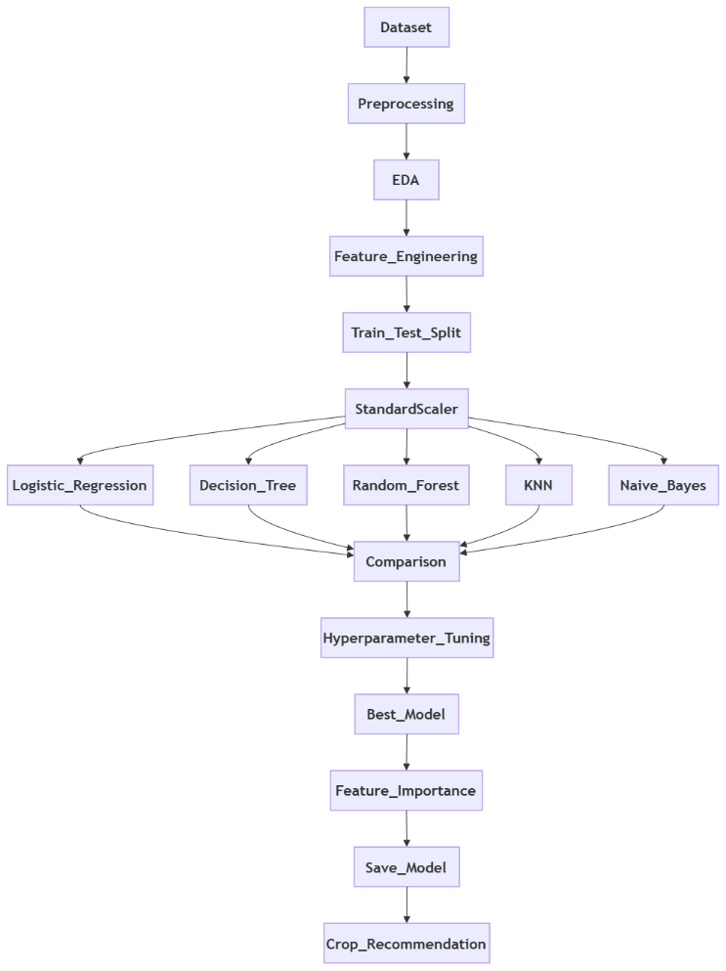
Methodology - HOW
Followed a machine learning process from collecting data to building and comparing models.
Constructed and examined a balanced dataset of 22,000 observations for 22 crop classes.
Designed 7 more features and pre-processed the features to enhance the learning performance of the model.
Developed and tested five algorithms of supervised machine learning under the same experimental conditions.
Finally, chose the best-performing model based on accuracy, Precision, Recall, F1-score and Cross-Validation.
Figure 1: Workflow
Notes:
In this research, the machine learning process was systematic. The first step was collecting the datasets followed by EDA to gain insight into the agricultural data. The data was split into training and test sets and feature engineering and data preprocessing were performed to improve the quality of the data. The same conditions were applied for training and testing five supervised machine learning algorithms. They were compared with various evaluation measures which then helped to choose the most accurate and reliable crop recommendation model which is Random Forest.

Slide 6
Project Management
Figure 2: Gantt Chart
Notes:
This Gantt chart illustrates the project timeline across eight weeks. The work progressed systematically through research, data preparation, exploratory data analysis, model development, evaluation, and documentation. All planned milestones were completed on schedule, ensuring a structured workflow and successful completion of the crop recommendation system.

Slide 7
Literature Review
Soil nutrients and weather conditions were found to significantly affect the crop suitability prediction in previous studies [4].
Machine learning algorithms can outperform traditional farming decisions by providing accurate and precise data-driven crop recommendations [5].
Data preprocessing and feature engineering greatly enhance the prediction accuracy and model reliability [6].
It is observed that ensemble models, especially Random Forest models, have invariably been of high performance in agricultural classification tasks.
Motivation for the study was a lack of comprehensive model comparison, interpretability and external validation in existing studies.
Notes:
The literature review showed that crop recommendation relies on soil nutrients as well as climatic conditions, and machine learning is better for crop recommendation than conventional methods. Past research has tended to study just a small number of algorithms and was largely evaluated in terms of accuracy. This study filled those gaps by adding new features and comparing the performance of five machine learning models under comparable conditions and further assessed the models using several performance metrics to build a reliable crop recommendation system.

Slide 8
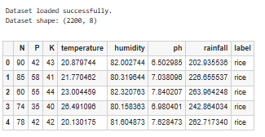
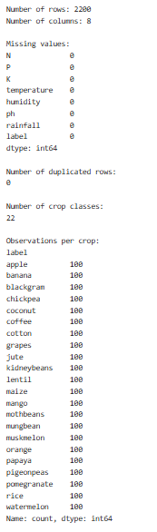
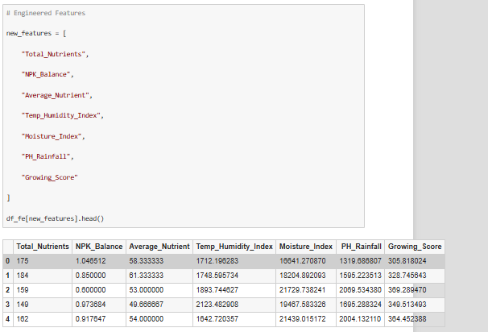
Data Preparation & Feature Engineering
Data Preparation
Successfully loaded the Crop Recommendation data with 2200 records and 8 variables.
Verified feature names and data types and dataset dimensions to validate dataset structure.
No missing data, no data duplication and high-quality input data were confirmed.
22 balanced crop classes were verified with 100 observations per crop class, for unbiased crop classification.
Conducted correlation and feature scaling before training machine learning models.
Feature Engineering
Total Nutrients = Combined Nitrogen, Phosphorus and Potassium values.
Average Nutrient = Average nutrient concentration (overall soil fertility).
NPK Balance = The ratio of nutrient balance in the soil.
Temperature–Humidity Index = Combined climatic interaction affecting crop growth.
Moisture Index = Rainfall x Humidity, thus partly representing the moisture available in the environment.
pH × Rainfall = Soil acidity × Rainfall conditions.
Growing Score = Integrated feature of temperature, humidity and rainfall suitability.
Figure 3: Dataset Overview
Figure 5:Feature Engineering
Figure 4: Handling Values
Notes:
The dataset was initially validated to correct its structure, names of features and data quality. There was no missing data and no duplicate records, and all 22 crop classes had equal observations for balanced data. Seven features were then created, including Total Nutrients, Moisture Index and Growing Score, that allows to reflect the hidden agronomic relationships that ultimately can be used to improve the predictive performance of the machine-learning models.

Slide 9
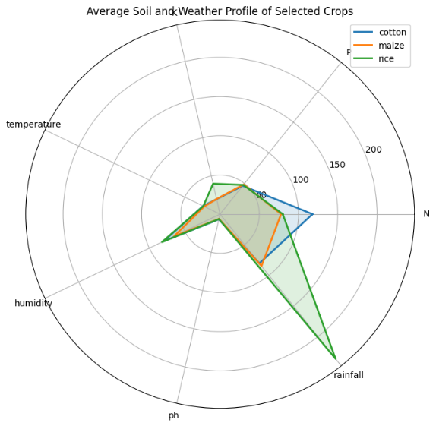
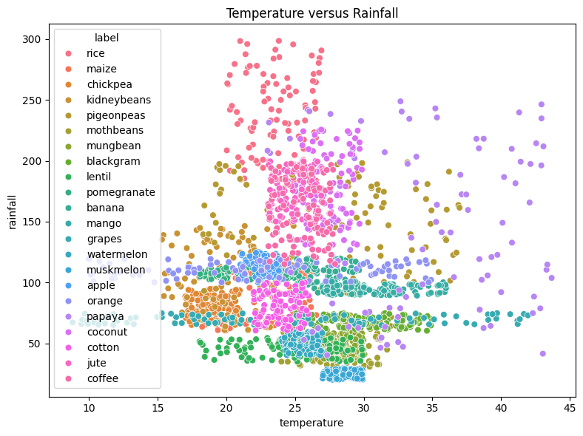
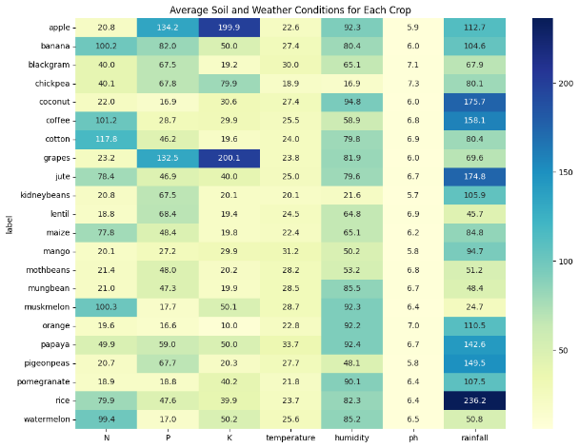
Exploratory Data Visualisations
Heatmap indicated soil nutrient and weather profiles were different between the 22 crop classes.
Using a scatter plot, the clustering patterns between temperature and rainfall of the crops were identified.
Average environmental conditions of rice, maize and cotton were compared using the radar chart.
Good agreement with the visual analysis was seen for nutrient and climatic requirements of crops.
The exploratory visualisations facilitated feature engineering and effective machine learning model development [7].
Figure 6: Radar Chart
Figure 7: Temperature vs Rainfall Scatter Plot
Figure 8: Average Soil and Weather Conditions Heatmap
Notes:
Before model development, Exploratory Data Analysis was used to understand the relationships of soil nutrients, weather conditions and crop classes. The heatmap indicated the different kinds of environmental requirements of each crop, and the scatter plot provided clustering and overlapping among the classes of crops. Selected crops were compared in the radar chart and substantial differences between the nutrient and climatic requirements of these crops were observed. These insights made feature engineering and using machine learning models for precise crop recommendation worthwhile.

Slide 10
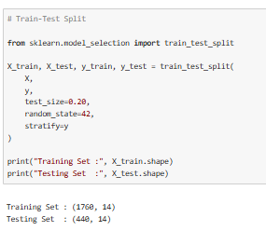
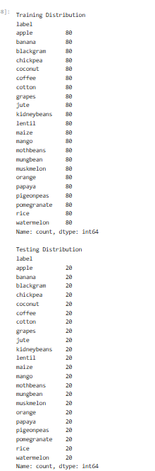
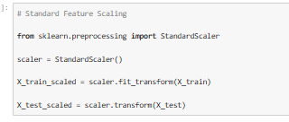
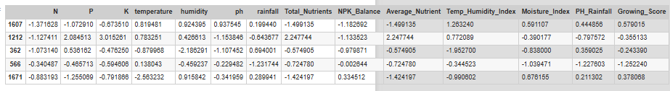
Practical Implementation
Machine Learning Implementation
Python libraries for data manipulation, visualisation and supervised machine learning were imported from external sources [8].
Using Stratified sampling, split the dataset into 80% training (1,760) and 20% testing (440).
The numerical features were standardised using the StandardScaler before training the model [9].
Built 5 supervised learning models with the same experimental set-up.
Compared the model performance and determined which model (crop recommendation algorithm) was best.
Python Libraries
Pandas – Data loading and preprocessing
NumPy – Numerical computations
Scikit-learn – Machine learning implementation
Matplotlib – Data visualisation
Seaborn – Statistical plots
Figure 9: Train-Test Split
Figure 11: StandardScaler
Figure 10: Training & Testing Distribution
Figure 12: Standardised Dataset Output
Notes:
Implementation was done in Python and scikit-learn. Once loaded, I pre-processed the data and after an 80-20 stratified train-test split, I maintained the balance of the crop distribution. Data leakage was avoided because StandardScaler was used only for the training data before applying the data transformation to both. Finally, five supervised machine learning algorithms were trained in the same way to make it possible to compare the predictive performance.

Slide 11
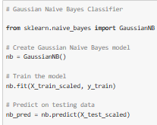
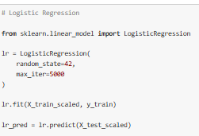
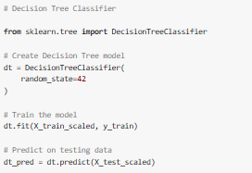
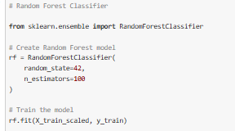
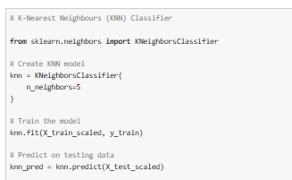
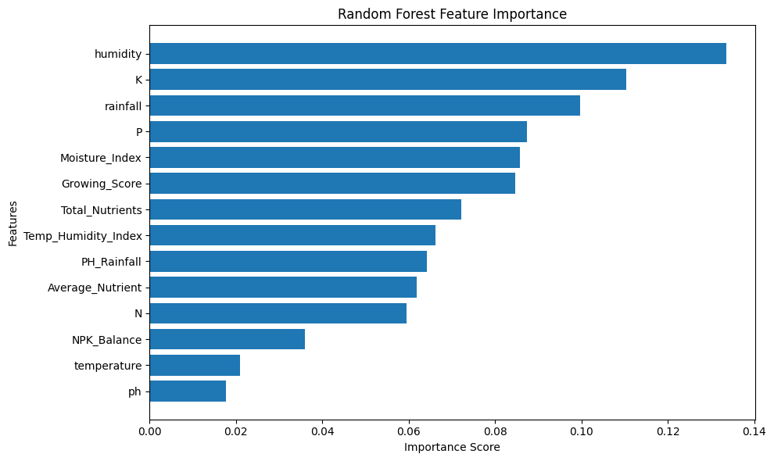
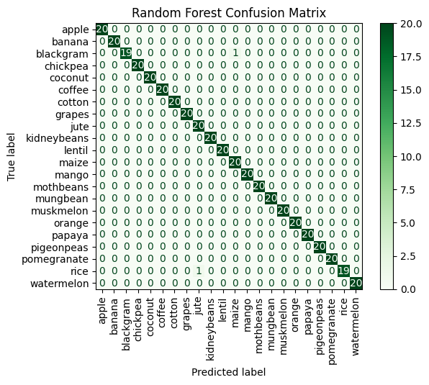
Model Evaluation
Model Performance Evaluation
Tested the same 5 supervised machine learning algorithms with the same training and test environments.
Evaluated models based on Accuracy, Precision, Recall, F1-Score, and Cross-Validation [10].
The classification errors obtained by Random Forest were the lowest and its predictive performance was obtained to be the highest.
Excellent classification was shown in the confusion matrix of the 22 crop categories.
The feature importance analysis was used to determine the most influential variables affecting the crop recommendation.
Figure 13: Model Implementation
Figure 14: Random Forest Feature Importance
Figure 15: Random Forest Confusion Matrix
Notes:
The same dataset and preprocessing pipeline were used to evaluate 5 supervised machine learning algorithms to ensure a fair comparison. Accuracy, Precision, Recall, F1-score, and cross-validation were used for evaluating the performance. Random Forest performed the best overall with higher predictive accuracy and the least misclassification. The confusion matrix also shows that a good classification has been achieved across all the crop classes, and the feature importance analysis shows that humidity, potassium, rainfall and phosphorus are the most important features for the recommendations.

Slide 12
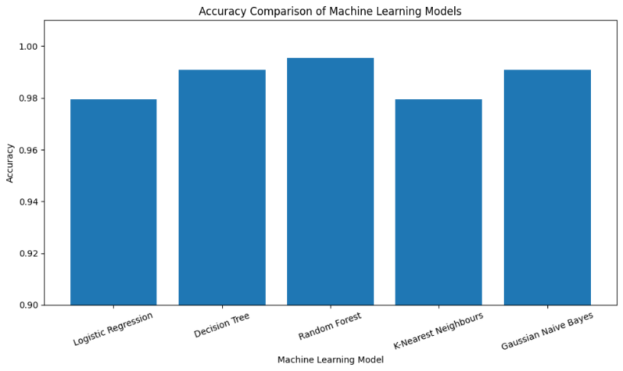
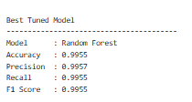
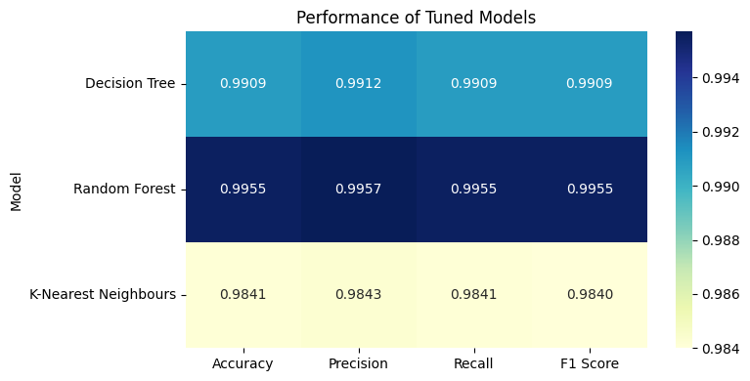
Model Comparison
Key Findings
Random Forest obtained the best results in terms of accuracy, precision, recall and F1-score of all models.
Competitive performance of Decision Tree and Gaussian Naïve Bayes with more than 99% accuracy was observed.
Logistic Regression and KNN also yielded good performance with a slightly lower predictive value.
The Random Forest model was found to be robust and have generalisation ability by comparative evaluation [11].
Random Forest was chosen as the final model for the recommendation based on precision agriculture applications.
Figure 16: Accuracy Comparison
Figure 17: Best Tuned Model
Figure 18: Performance Heatmap
Notes:
The comparative evaluation of all five supervised machine learning models is shown in this slide. Random Forest consistently performed the best in terms of accuracy, precision, recall and F1 scores, which is attributed to its superior predictive and generalisation performance. Decision Tree and Gaussian Naïve Bayes also achieved very good performance, but Random Forest gave the least number of classification errors and the best overall performance. These evaluation metrics were used along with cross-validation results to choose the final model for crop recommendation which is Random Forest.

Slide 13
Results, Contributions & Discussion
Key Results
Among the models tested, the Random Forest model had the highest performance of 99.55% accuracy.
With feature engineering, data was better represented, and overall prediction accuracy of the models was improved.
The most significant prediction features were found to be Humidity, Potassium, Rainfall and Phosphorus.
The proposed system was able to classify 22 crop classes based on soil and weather conditions.
For intelligent crop recommendation, machine learning proved to be very promising in precision agriculture.
Research Contributions
Constructed and evaluated five supervised machine learning algorithms with the same evaluation parameters.
Designed seven extra agricultural traits to capture concealed soil and weather conditions interactions.
Developed an entire end-to-end machine learning pipeline, from pre-processing to model evaluation, that is reproducible.
Performed comprehensive evaluation using Accuracy, Precision, Recall, F1-score and Cross-Validation.
Made a practical proposal to help farmers in the crop selection process using a Decision Support System.
Limitations & Discussion
Only 2200 observations were made and used as benchmarks, which results in a constrained ability to generalise to the real world.
No real-time sensor or satellite data or IoT data was used in model development.
External validation with respect to different regions, seasons and soil conditions was not done.
Factors beyond the scope of this investigation were economic, irrigation and soil texture.
The constructed system assists in decisions in farming and should not be interpreted as an alternative to expert agronomic advice.
Notes:
The objective of the project has also been accomplished and the machine learning-based crop recommendation system has been successfully developed. Random Forest achieved the best in terms of predictive performance, and feature engineering enhanced the overall effectiveness of the models used. The study proposes a reproducible machine learning framework and comparison of five algorithms. The model, however, can be constrained by a benchmark dataset, real-time data in agriculture, and no external validation. Therefore, the suggested system is to be viewed as a decision-support system, instead of a substitute for agricultural experts.

Slide 14
Conclusion & Future Work
Conclusion
Competently completed all research tasks using a systematic implementation and evaluation of the machine learning.
The ML approach successfully predicted crops that can be grown with the soil nutrients and weather.
Random Forest had the highest overall accuracy of 99.55% and was also the best generaliser.
The feature engineering enhanced the representation of data and boosted the prediction performance of the models.
The suggested system fulfils precision agriculture by helping farmers to make informed decisions regarding crops.
Future Work
Verify the model with more and geographically spread-out agricultural information.
Consider satellite images and remote sensing for better crop recommendations.
Add support for real-time monitoring and sensing of soil and environment using IoT sensors [12].
Create a user-friendly web/mobile app for practical deployment.
Use Explainable AI methods to enhance models' transparency [13].
Allow real-time recommendations by regularly collecting data and updating models.
Notes:
The objectives of this research were met by building and testing a machine learning approach for crop recommendation and this approach proved to be successful. The Random Forest model was found to be the best and most reliable model for the prediction of suitable crops based on soil and weather data. While the results are very promising, further research is needed into larger real-world data sets, integration with IoT, consideration of satellite data, explainable AI as well as generating a practical web/mobile based application for farmers.

Slide 15
References
[1] | K. Demestichas and E. Daskalakis, “Data Lifecycle Management in Precision Agriculture Supported by Information and Communication Technology,” Agronomy, vol. 10, no. 11, p. 1648, 2020.
[2] | F. Fuentes-Peñailillo, K. Gutter, R. Vega and G. Silva, “Transformative Technologies in Digital Agriculture: Leveraging Internet of Things, Remote Sensing, and Artificial Intelligence for Smart Crop Management,” Journal of Sensor and Actuator Networks, vol. 13, no. 4, p. 39, 2024.
[3] | M. Bouni, B. Hssina, K. Douzi and S. Douzi, “Integrated IoT Approaches for Crop Recommendation and Yield-Prediction Using Machine-Learning,” IoT, vol. 5, no. 4, pp. 634-649, 2024.
[4] | M. Haque, M. Arifuzzaman, M. Hoque and A. Alluqmani, “Modeling Climate Variability Impacts on Agricultural Productivity Using Integrated Regression and Transformer-Based Deep Learning,” Agronomy, vol. 16, no. 11, p. 1088, 2026.
[5] | E. Elbasi, C. Zaki, A. Topcu, W. Abdelbaki, A. Zreikat, E. Cina, A. Shdefat and L. Saker, “Crop Prediction Model Using Machine Learning Algorithms,” Applied Sciences, vol. 13, no. 16, p. 9288, 2023.
[6] | P. Koukaras and C. Tjortjis, “Data Preprocessing and Feature Engineering for Data Mining: Techniques, Tools, and Best Practices,” AI, vol. 6, no. 10, p. 257, 2025.
[7] | S. Tufail, H. Riggs, M. Tariq and A. Sarwat, “Advancements and Challenges in Machine Learning: A Comprehensive Review of Models, Libraries, Applications, and Algorithms,” Electronics, vol. 12, no. 8, p. 1789, 2023.
[8] | S. Hiremath, E. Shetty, A. Prakash, S. Sahoo, K. Patro, K. Rajesh and P. Pławiak, “A New Approach to Data Analysis Using Machine Learning for Cybersecurity,” Big Data and Cognitive Computing, vol. 7, no. 4, p. 176, 2023.
[9] | B. McShane, “An Extensive Guide to Scaling as a Method of Data-Preprocessing,” Medium, 2024. [Online]. Available: https://medium.com/@broganmcshane.code/an-extensive-guide-to-scaling-as-a-method-of-data-preprocessing-be88b8f861f0 . [Accessed 3rd August 2026].
[10] | Y. Zhang, H. Le, N. Lopez and K. Phan, “Comparative Study of Machine Learning Models for Textual Medical Note Classification,” Computers, vol. 15, no. 1, p. 7, 2025.
[11] | M. Kamal, B. Zhang, J. Cao, X. Zhang and J. Chang, “Comparative Study of Artificial Neural Network and Random Forest Model for Susceptibility Assessment of Landslides Induced by Earthquake in the Western Sichuan Plateau, China,” Sustainability, vol. 14, no. 21, p. 13739, 2022.
[12] | T. Kalaivani, T. Kamireddy and S. Govindakumar, “IoT-Enabled Soil and Crop Monitoring System Using Low-Cost Smart Sensors for Precision Agriculture,” The 12th International Electronic Conference on Sensors and Applications, p. 77, 2025.
[13] | I. Siachos and N. Karacapilidis, “Explainable Artificial Intelligence Methods to Enhance Transparency and Trust in Digital Deliberation Settings,” Future Internet, vol. 16, no. 7, p. 241, 2024.

