Slide 1
2026 TN Elections
Decoded
Built for AtliQ Media
An Interactive Election Analytics Platform
Built with Python · Streamlit · Plotly · Claude AI · ChatGPT · GitHub Copilot
📋 AtliQ Media Guidelines: All data sourced from Election Commission of India · For informational & journalistic purposes only · No causal claims made
234
107
85.1%
4,023
Constituencies
TVK Seats Won
Voter Turnout
Candidates
Saikiran Udayana · 2026

Slide 2
Tools & Technology Stack
Every layer of the stack, purposefully chosen
Python
Streamlit
Plotly
Data wrangling, analysis, scripting & automation
Interactive multi-page web dashboard framework
Rich interactive charts, Sankey diagrams & maps
Claude AI
ChatGPT
GitHub Copilot
Code generation, data insight & prompt engineering
Content drafting, slide logic & idea iteration
Inline code suggestions & boilerplate acceleration

Slide 3
Code Basics & Architecture
How the codebase is structured — clean, modular, and production-ready
📁 Project Structure
⚙️ Key Patterns
app.py ← Streamlit entry point
🗄 Data Pipeline
pages/
@st.cache_data decorator on all load functions — fast reloads with zero recompute
01_Results.py ← Full constituency results
02_MapView.py ← Choropleth district map
📊 Chart Factory
03_Regional.py ← Region-level analysis
utils/charts.py exports reusable Plotly functions — consistent styling across all pages
04_Flips.py ← Flip tracker + Sankey
05_VoteShare.py ← Vote % story
🔄 State Management
06_Margins.py ← Margin & reserved seats
st.session_state for filters (region, year, party) shared across chart components
data/
results_2026.csv ← ECI cleaned data
⬇️ CSV Downloads
results_2021.csv ← Baseline comparison
st.download_button on every analysis — journalists can export any filtered dataset
utils/
clean.py ← Data cleaning helpers
🗺 Choropleth Maps
charts.py ← Plotly chart factories
GeoJSON-based Plotly maps colored by alliance; hover tooltips show district seat counts

Slide 4
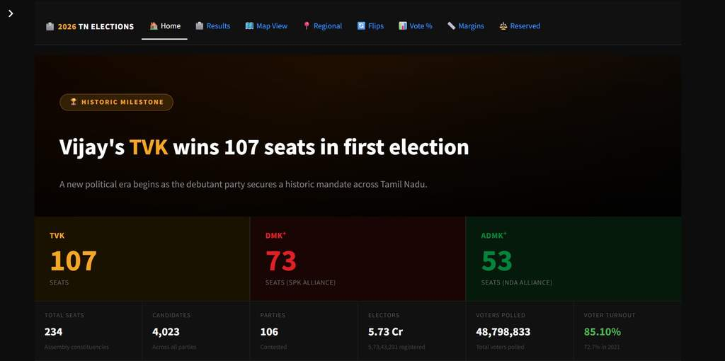
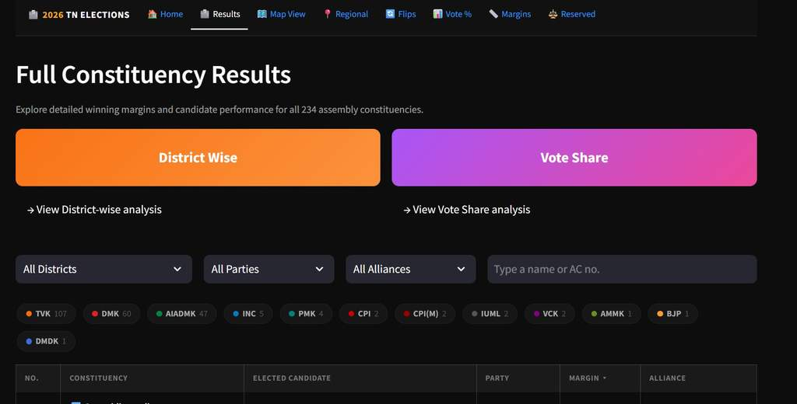
The Story
A historic election. A brand-new party. A data story waiting to be told.
Historic Debut
Massive Realignment
DMK Collapse
TVK — Vijay's party — won 107 of 234 seats in its very first election, becoming the single largest party in Tamil Nadu.
162 of 234 constituencies (69.2%) changed hands — the largest political churn Tamil Nadu has seen in decades.
DMK went from 133 seats in 2021 to just 60 standalone seats in 2026 — a loss of 73 seats in a single election cycle.

Slide 5
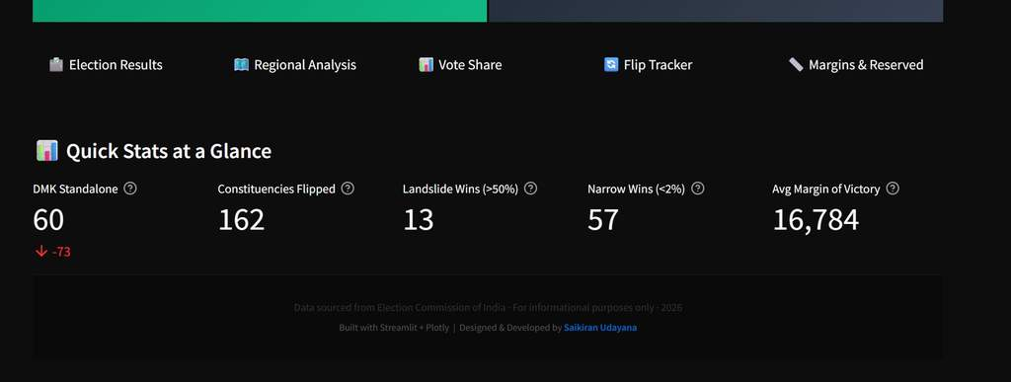
Dashboard Showcase
Home · Full Constituency Results
🏠 Home
Overview stats: 234 seats, 85.1% turnout, TVK 107 · SPK 73 · NDA 53
📋 Results
Searchable table: 234 constituencies, margins, candidates, parties, alliances with filter by district/party/alliance

Slide 6
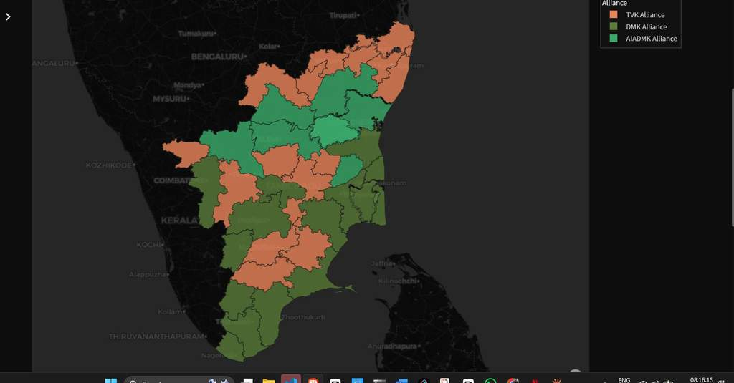
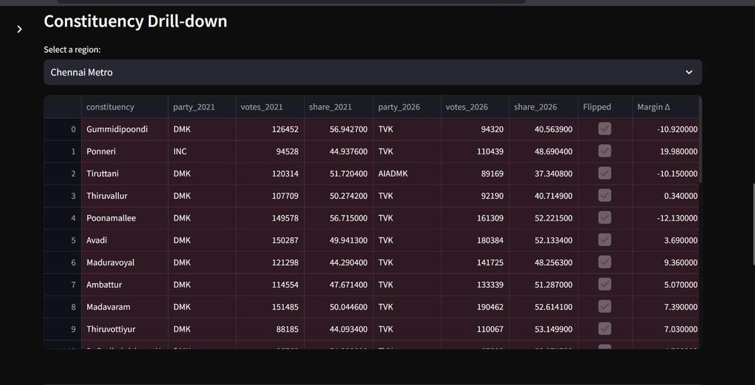
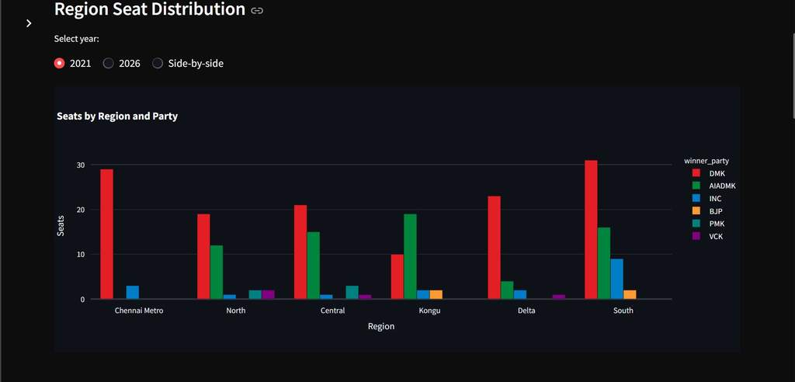
Dashboard Showcase
Map View · Regional Analysis
🗺️ Map View
📍 Regional Analysis
District choropleth — alliance dominance by color · 2021/2026/Side-by-side toggle
Region swing table + seat distribution bar charts across 6 regions

Slide 7
Regional Swing Summary
How every region voted — who gained, who lost
Region
Seats
Dom 2021
Dom 2026
TVK Wins
DMK Δ
ADMK Δ
Flips
Chennai Metro
32
DMK
TVK
25
-27
+1
30
North
37
DMK
TVK
15
-15
+3
27
Central
41
DMK
AIADMK
13
-13
0
26
Kongu
33
AIADMK
TVK
16
-1
-12
27
Delta
33
DMK
DMK
10
-9
0
15
South
58
DMK
TVK
28
-8
-11
37

Slide 8
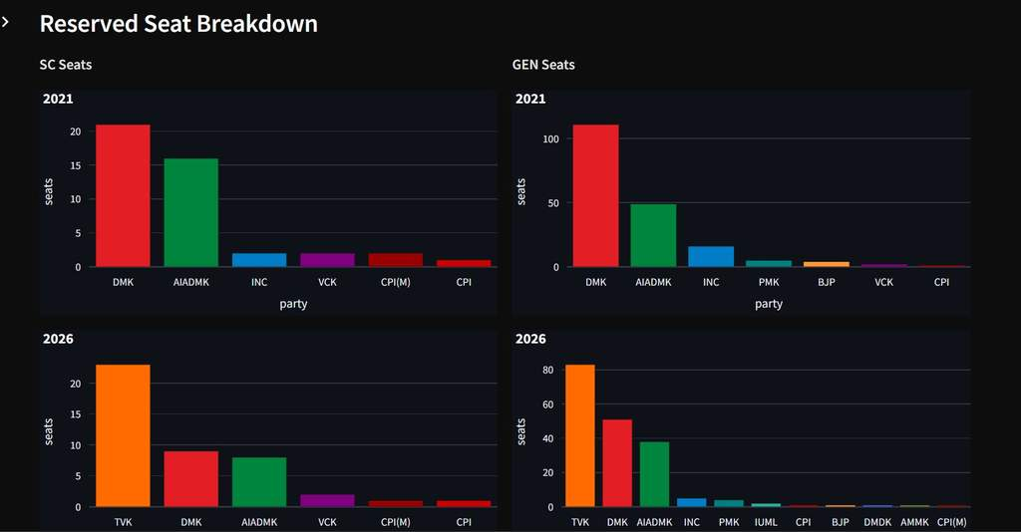
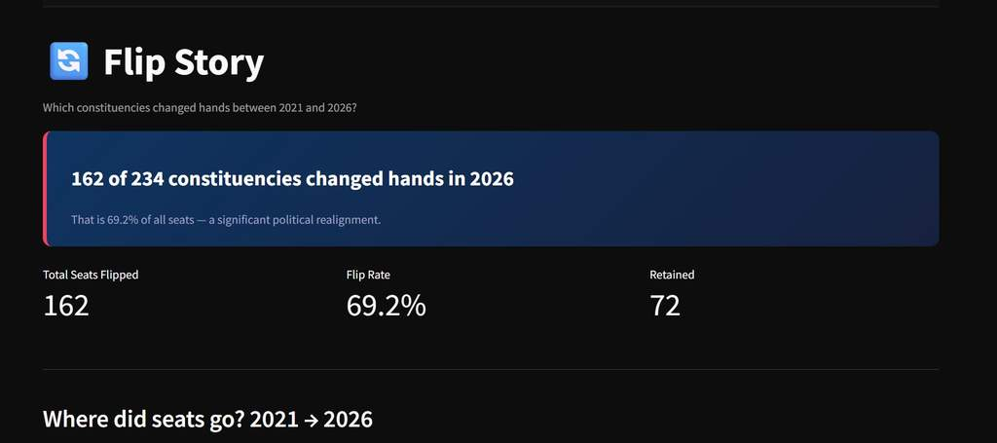
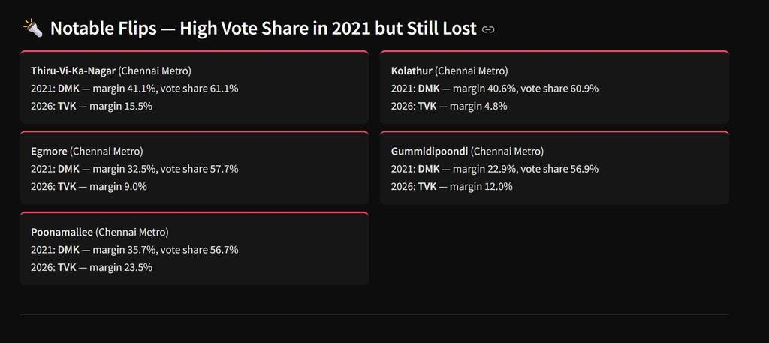
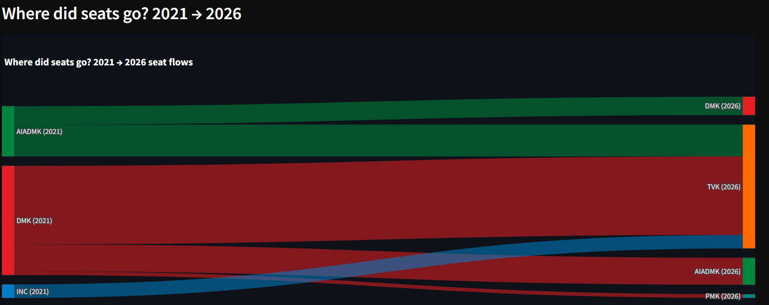
Dashboard Showcase
Constituency Flip Tracker

Slide 9
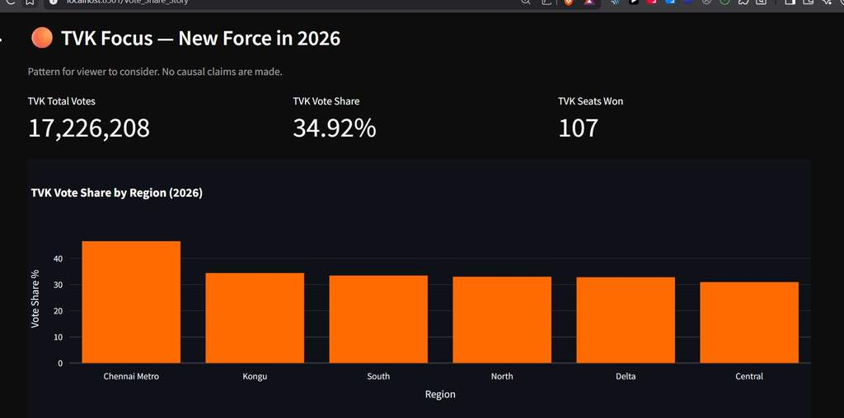
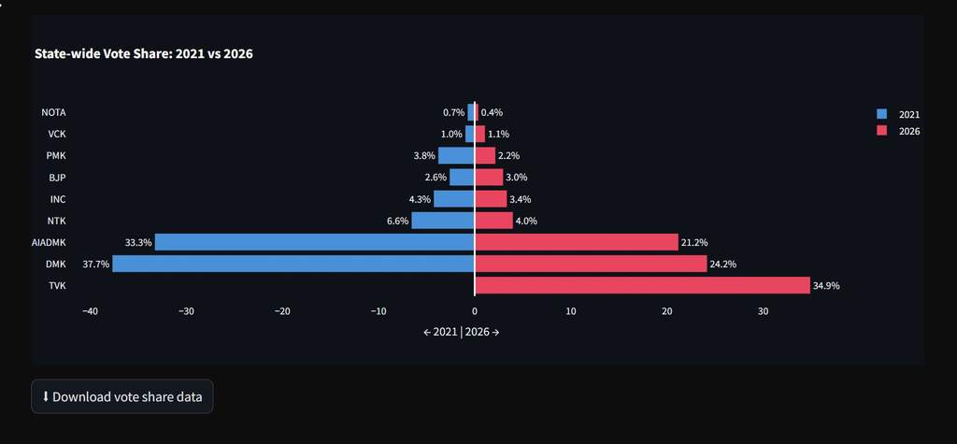
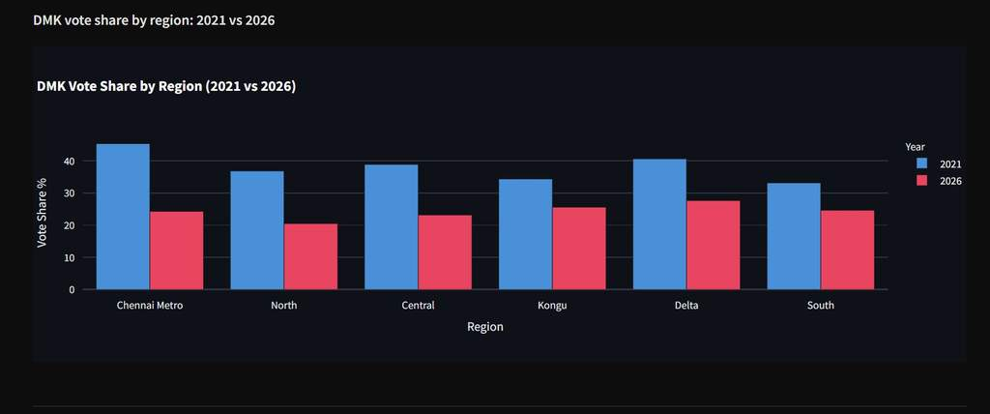
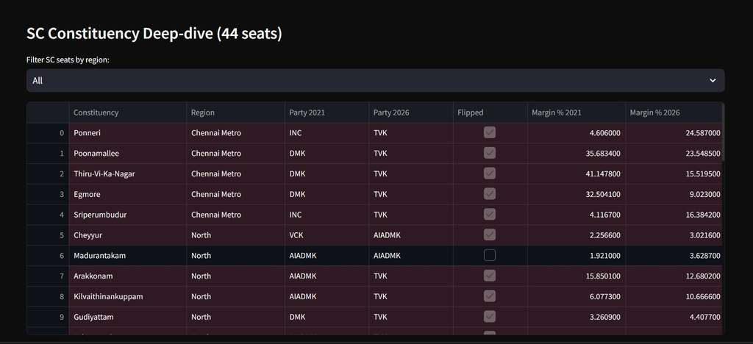
Dashboard Showcase
Vote Share Story

Slide 10
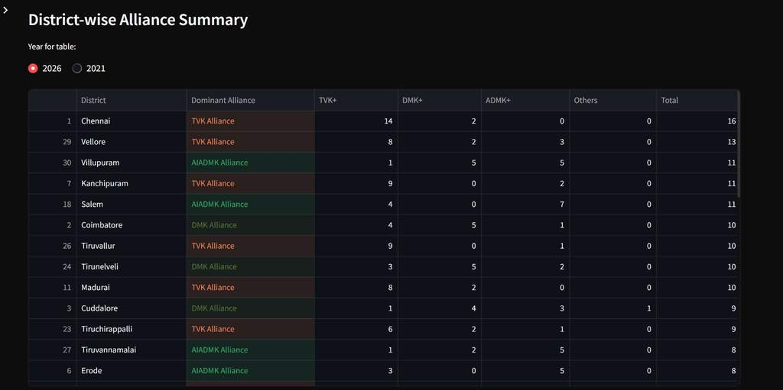
State-wide Vote Share Shift
TVK captures the votes that DMK and AIADMK lost
🆕 TVK
34.9%
2021: —
↓ DMK
24.2%
2021: 37.7%
↓ AIADMK
21.2%
2021: 33.3%
↓ NTK
4.0%
2021: 6.6%
↓ INC
3.4%
2021: 4.3%

Slide 11
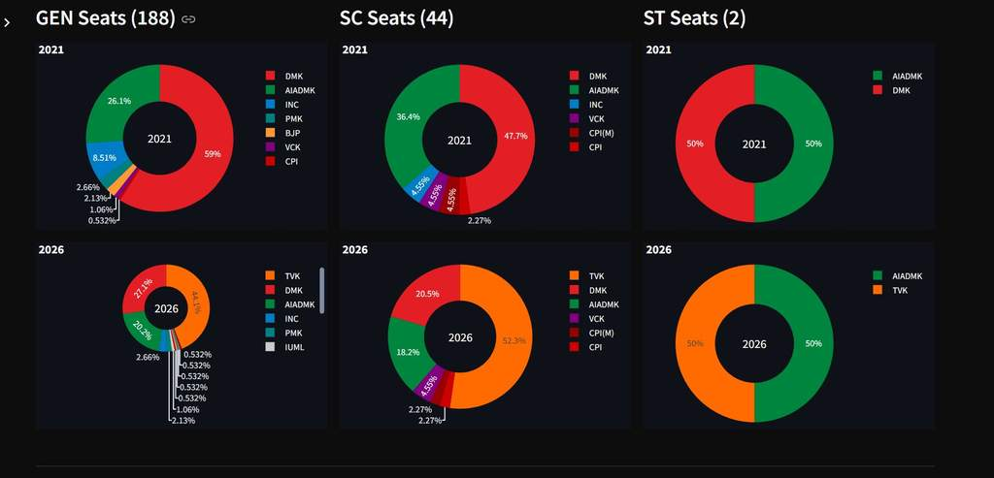
Dashboard Showcase
Margin of Victory · Reserved Seats Analysis
⚖️ Reserved Seats: GEN (188 seats, 69.1% flip) · SC (44 seats, 70.5% flip) · ST (2 seats, 50% flip) | Narrowest win: Tiruppattur — 1 vote margin

Slide 12
Key Insights from the Data
What the numbers reveal about Tamil Nadu's political shift
34.9%
162
150
1
TVK Vote Share
Seats Flipped
Narrow Wins
Smallest Margin
Debut — largest vote share
69.2% flip rate — historic
< 40% margin — ultra-competitive
Tiruppattur — 1 vote!
🔶 TVK — with 34.9% state-wide vote share and 17.2M votes — is the dominant political force entering Tamil Nadu legislature
🔶 DMK vote share fell from 37.7% in 2021 to 24.2% in 2026 across all 6 regions — sharpest decline in Chennai Metro (44% → 25%)
🔶 AIADMK vote share dropped from 33.3% to 21.2% — losing 12 percentage points state-wide
🔶 Win Category shift: Landslide wins fell from 70 to 13; Narrow wins (<40%) exploded from 13 to 150 — a far more competitive election

Slide 13
Thank You
Built with curiosity, data, and a little help from AI.
Data Source
Stack
AI Tools
Election Commission of India (ECI)
Streamlit · Plotly · Python
Claude · ChatGPT · Copilot
Saikiran Udayana · 2026 TN Elections Dashboard · Built for AtliQ Media · Data: ECI · For informational purposes only

