Slide 1
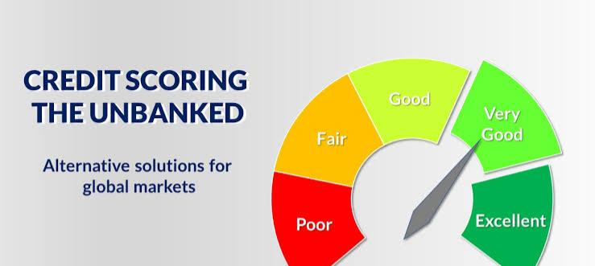

Slide 2
Problem Statement
A large portion of the global population remains unbanked or underbanked. Traditional credit scoring systems exclude people without formal credit history. Access to fair credit remains a challenge, especially in emerging markets.

Slide 3
Statistics
India: 22% of adults are unbanked (World Bank).
USA: 22% are unbanked or underbanked — reliant on payday loans/check cashing.

Slide 4
Stakeholders
Microfinance Institutions Fintech Companies Government and Development Agencies Unbanked and Underbanked Populations

Slide 5
Present Scenario
Individuals without formal credit records are invisible to financial systems.
Risk assessment is biased toward past financial behavior only.
Informal economies and gig workers are left out.

Slide 6
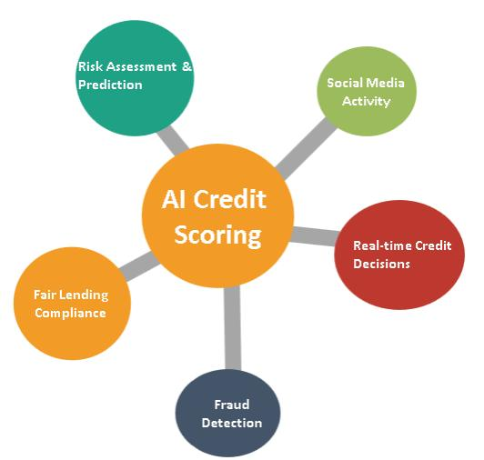
Proposed Solution – AI-Driven Alternative Credit Scoring
Mobile usage patterns
Social media behaviour
Utility and rent payments
E-commerce and transaction history
GPS and location data
Build credit profiles with behavioural and transactional data

Slide 7
Features
Explainable AI models for transparency
Real-time risk prediction engine
Adaptive learning from new data
Privacy-respecting data aggregation

Slide 8
