Slide 1



FEM-based Simulations of Bulk Micromachined Piezoresistive Pressure sensor
Division :Semiconductor process and microsystems group
Under Dr. S Santosh Kumar
CSIR – Central Electronics Engineering Research Institute (CEERI) , Pilani , Rajasthan , India
e-mail: santoshkumar.ceeri@gmail.com
BITS Pilani
Pilani Campus
Date: 18th Jan, 2023

Slide 2
Objectives and Scope of the project
To understand the working of MEMS-based Bulk Micromachined Piezoresistive Pressure Sensors, including a comprehensive literature review on the principles of piezoresistivity, diaphragm design, and fabrication techniques such as bulk micromachining.
To simulate a piezoresistive pressure sensor using FEM in COMSOL Multiphysics.
  To perform detailed structural analysis of the diaphragm, studying stress distribution, deflection patterns, and boundary conditions under applied pressure.
  To compare isotropic vs. orthotropic material properties of silicon (Young’s modulus, Poisson’s ratio, Shear modulus) and analyze their impact on simulation accuracy.
  To evaluate the effect of different meshing strategies, including custom ultra-fine meshing, on simulation accuracy and computational efficiency.
  To benchmark COMSOL results against MATLAB models
  To optimize the placement of the four piezoresistors on the diaphragm by performing parametric sweeps to maximize sensitivity and minimize non-linearity.
To design a high-performance piezoresistive pressure sensor for Deepsea Autonomous Underwater Vehicles (AUVs): 0–6000 m (600 bar)

Slide 3
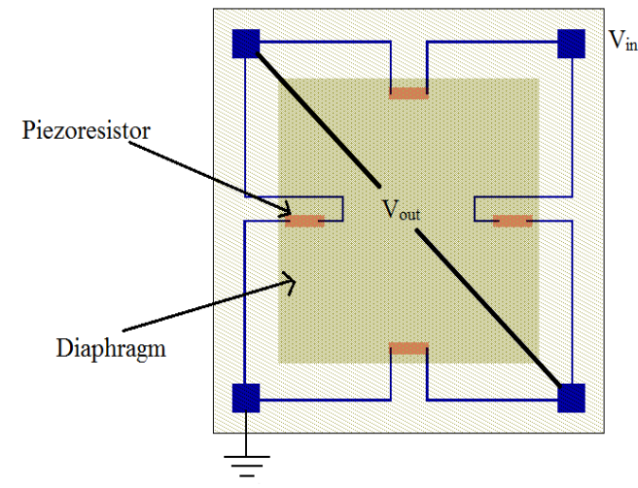
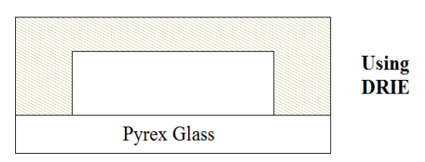
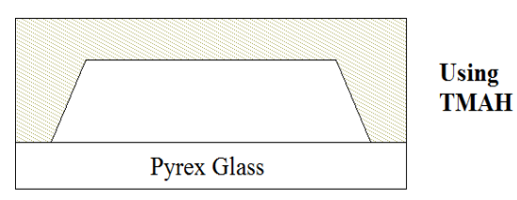
Working of Piezoresistive pressure sensor
Deep Reactive Ion Etching
Tetramethylammoniumhydroxide etching

Slide 4

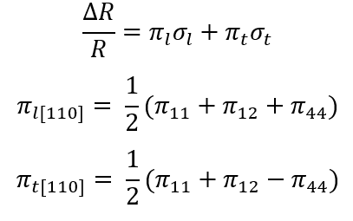
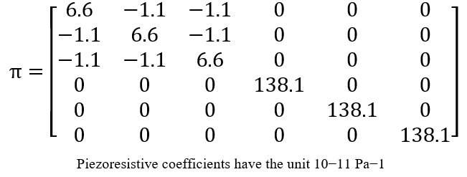
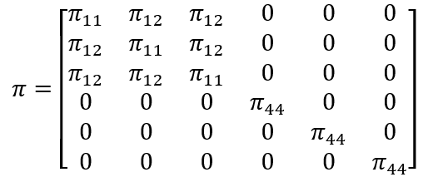
Working of Piezoresistive pressure sensor
Deep Reactive Ion Etching
tetramethylammonium hydroxide etching

Slide 5
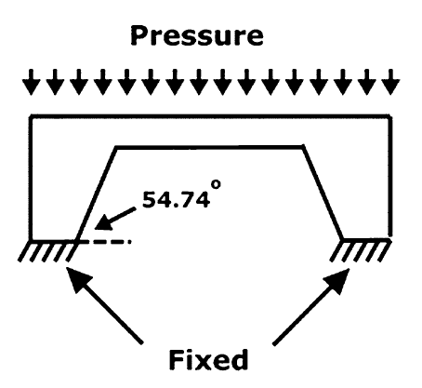
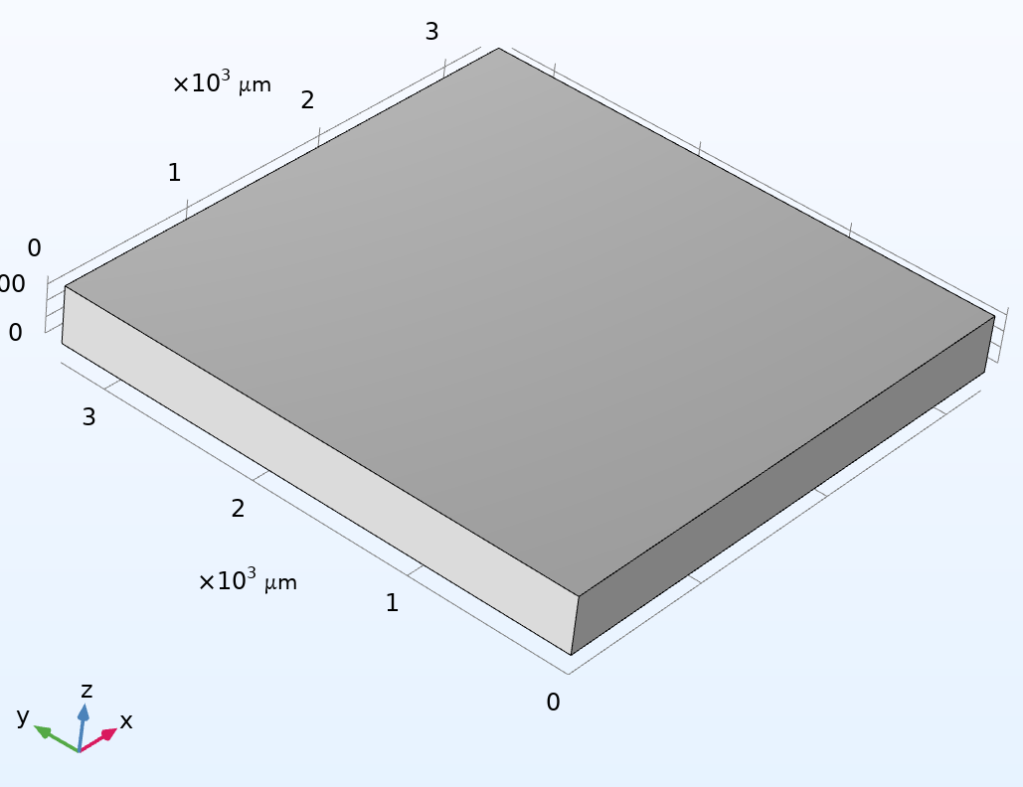
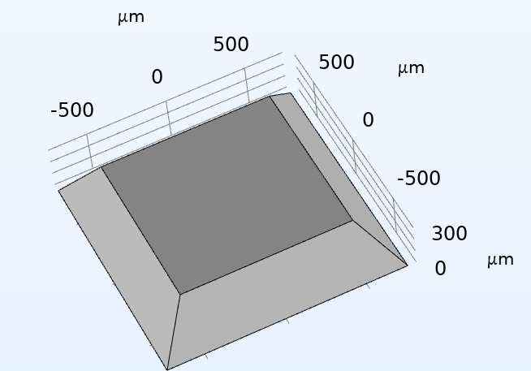
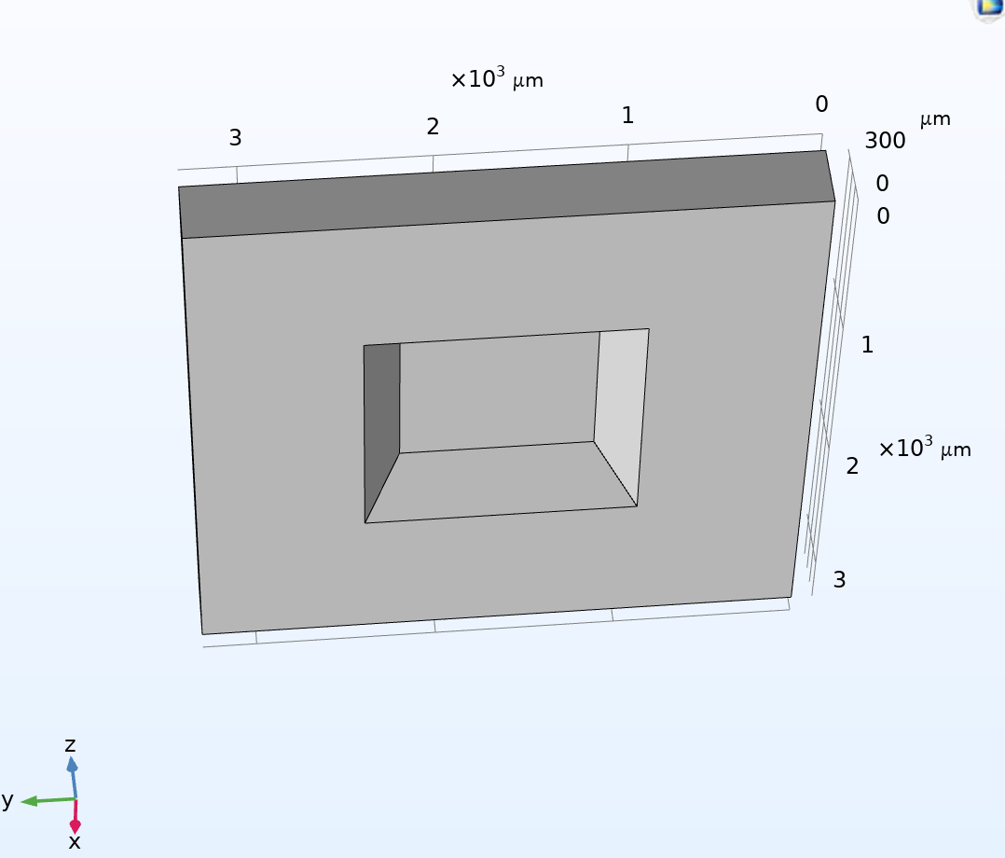
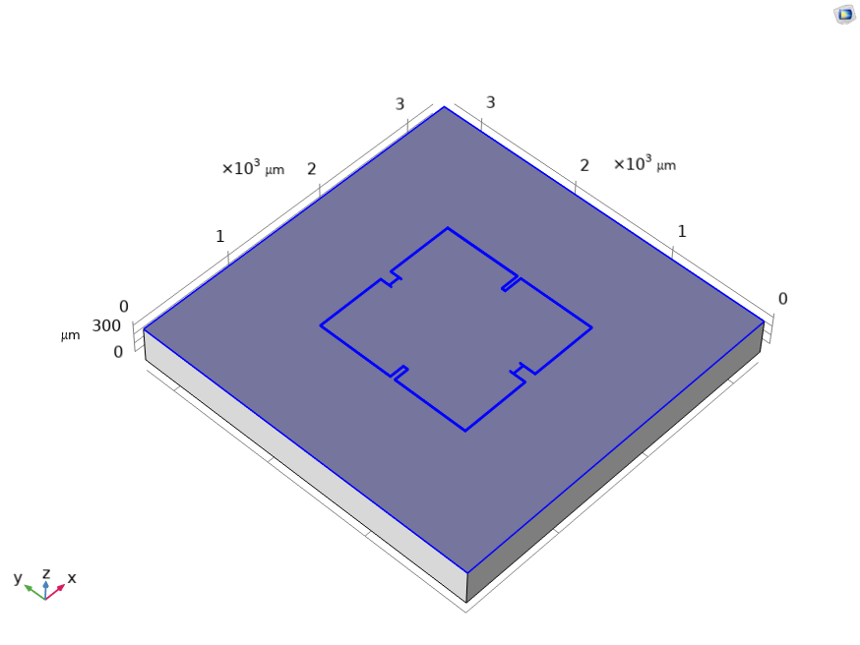
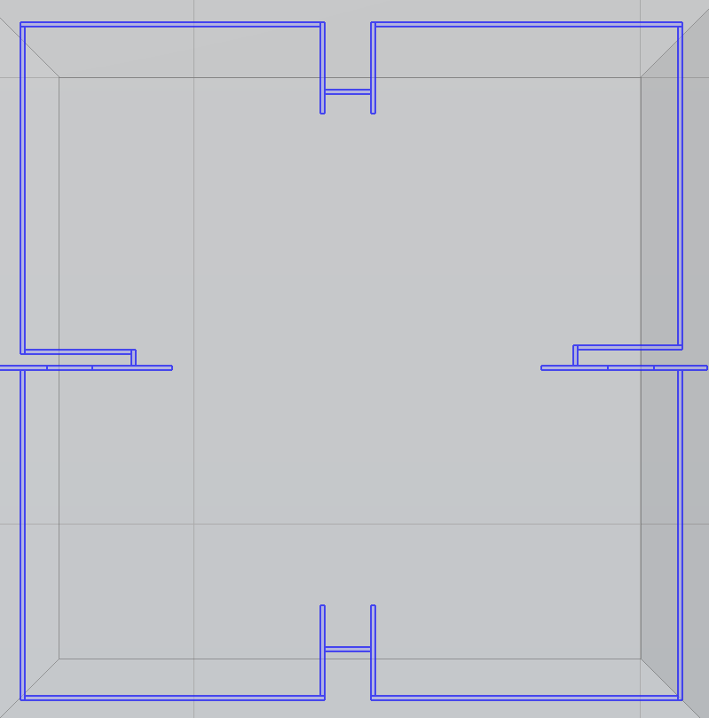
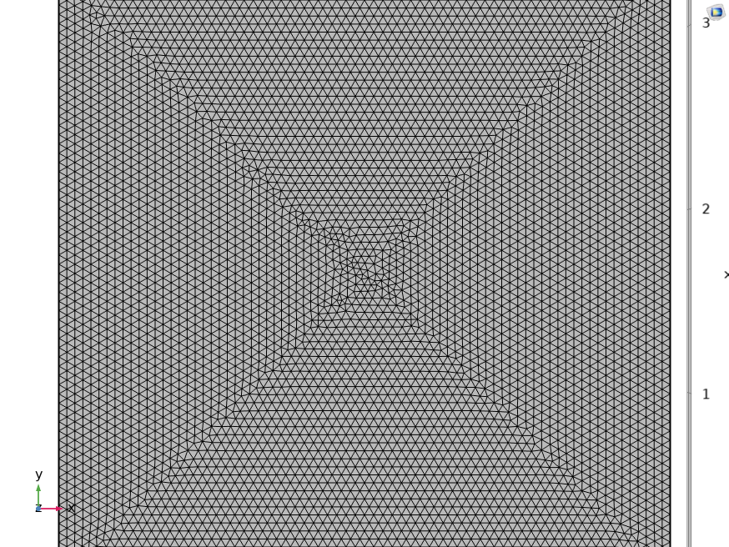
Designing the complete piezoresistive pressure sensor on COMSOL

Slide 6
Results for 1060um x 1060um diaphragm
Present work | Custom Ultra fine meshing in COMSOL | Max Deflection: 3.9576 um | Max Stress: 317MPa
Kumar & Pant , 2014 | Using CoventorWare | Max Deflection:3.93um | Max Stress: 312.86Mpa

Slide 7
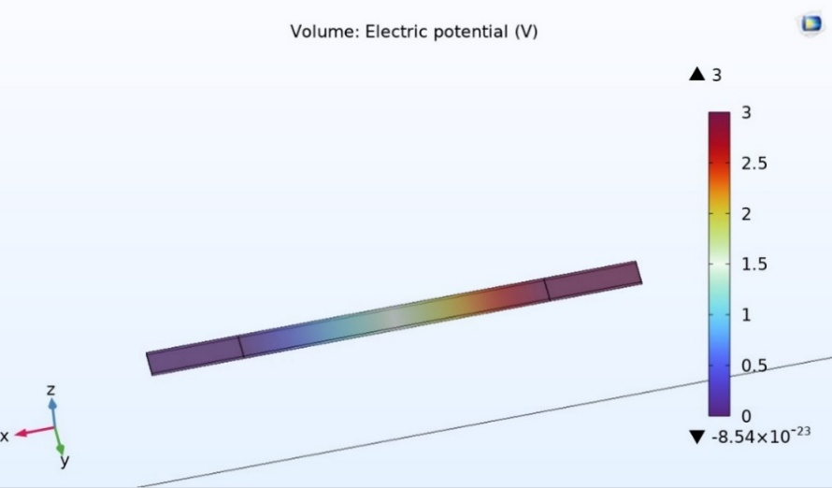
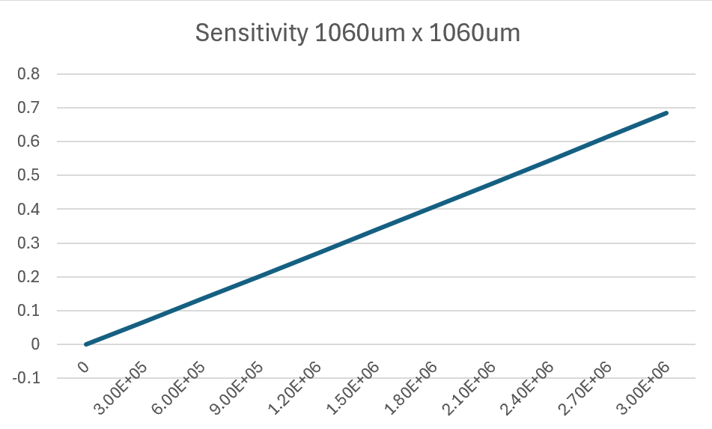

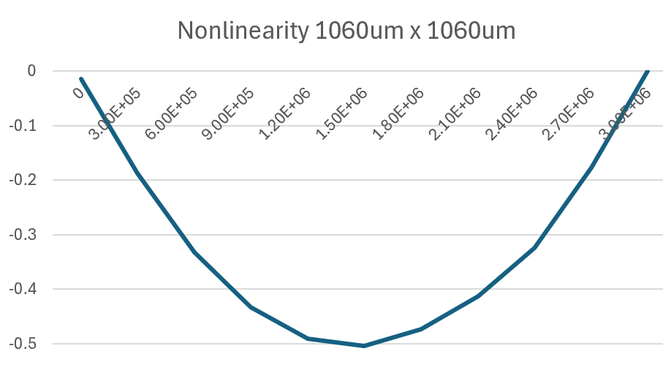
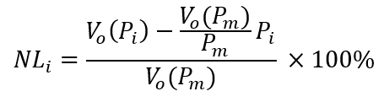
Results for 1060um x 1060um diaphragm

Slide 8
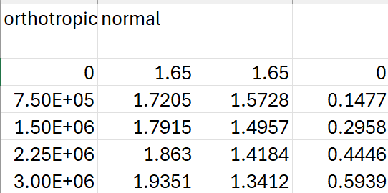
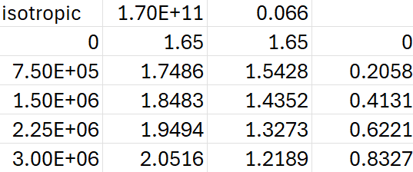
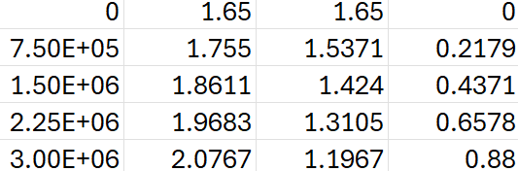
Results for 1280um x 1280um diaphragm
Journey followed :
Different Orthotropic Material Properties in all their respective axes
(Ex = Ey = 169GPa, Ez = 130GPa) (PRyz = 0.36, PRxy = 0.064, PRxz = 0.28)
(Gyz = Gxz = 79.6 GPa, Gxy = 50.9 GPa)
Isotropic Material Properties
Rotational Correction (45 degrees) + Orthotropic Properties
(E = 169.8 GPa, PR = 0.066)
(Ex = Ey = Ez = 130GPa)
(PRyz = PRxy = PRxz = 0.28)
(Gyz = Gxz = Gxy = 79.6 GPa)

Slide 9
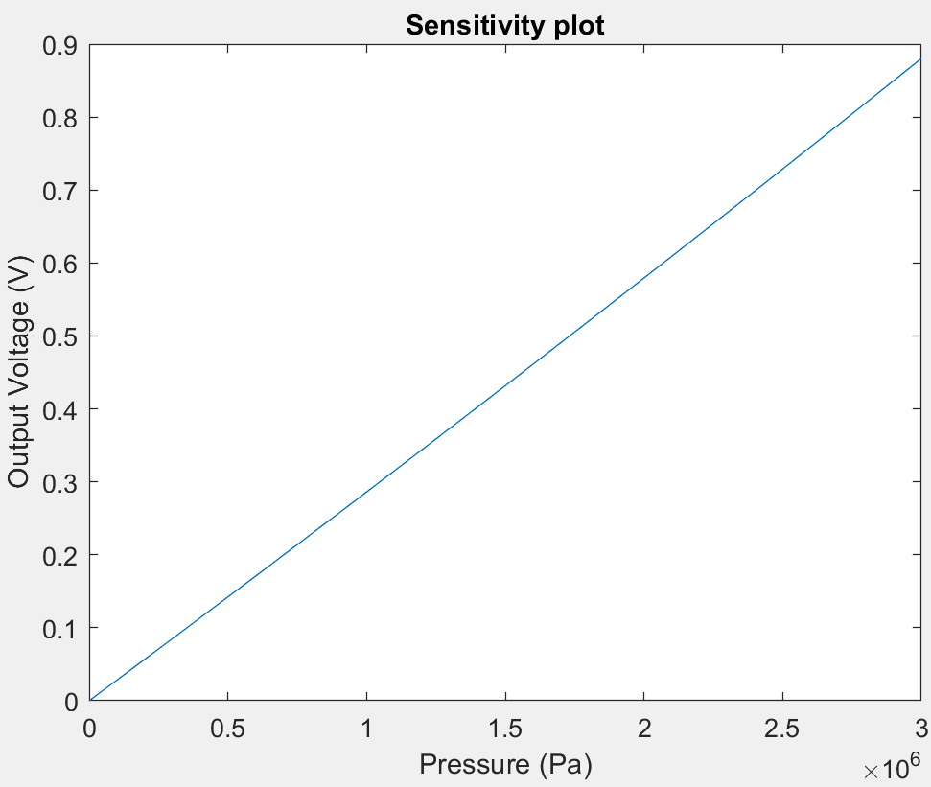
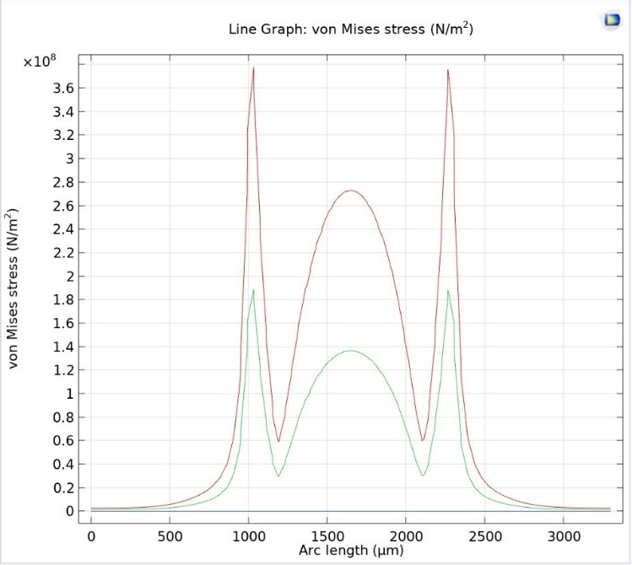
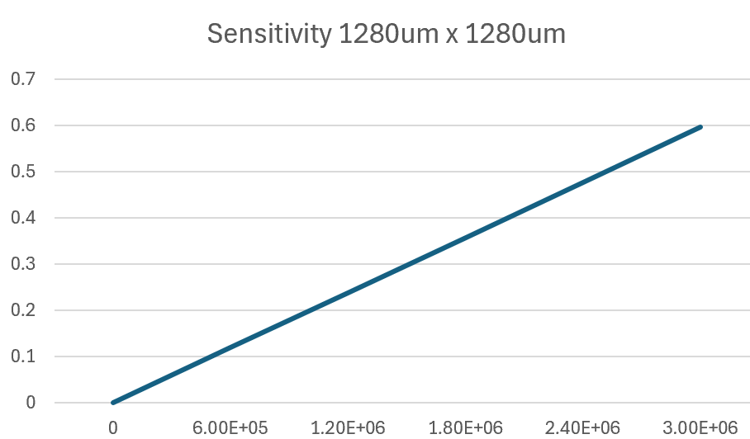
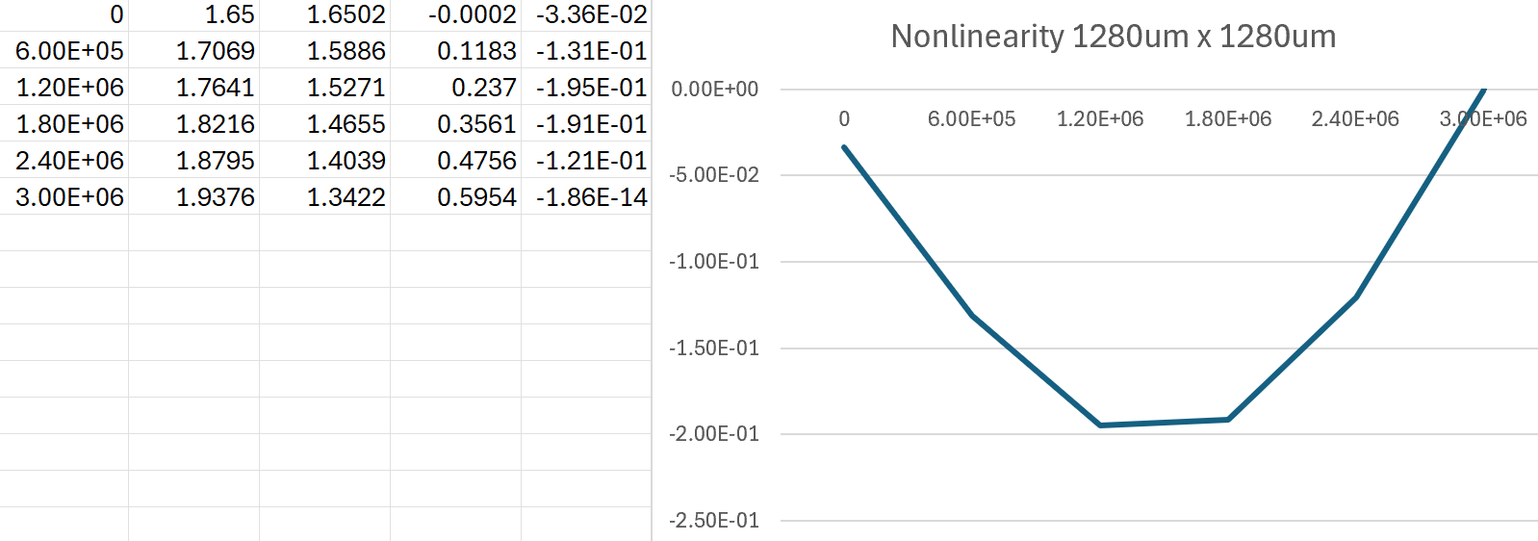
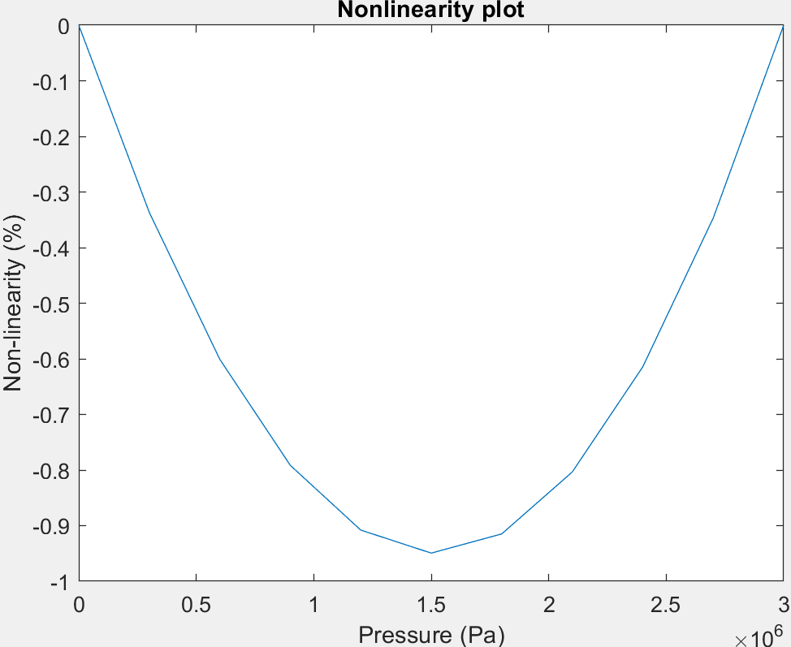
Results for 1280um x 1280um diaphragm
Custom Ultra Fine meshing for 0,1.5MPa, and 3MPa pressure

Slide 10
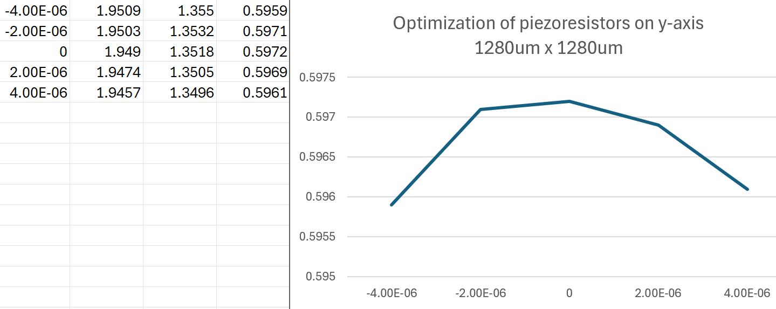
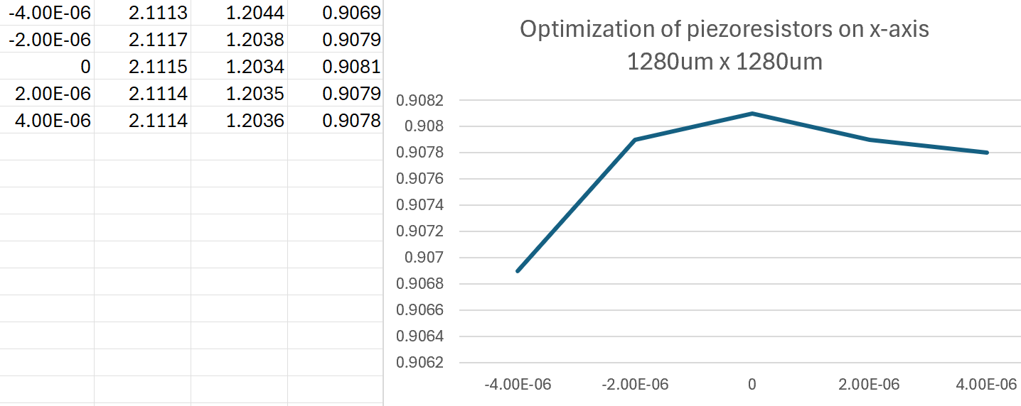
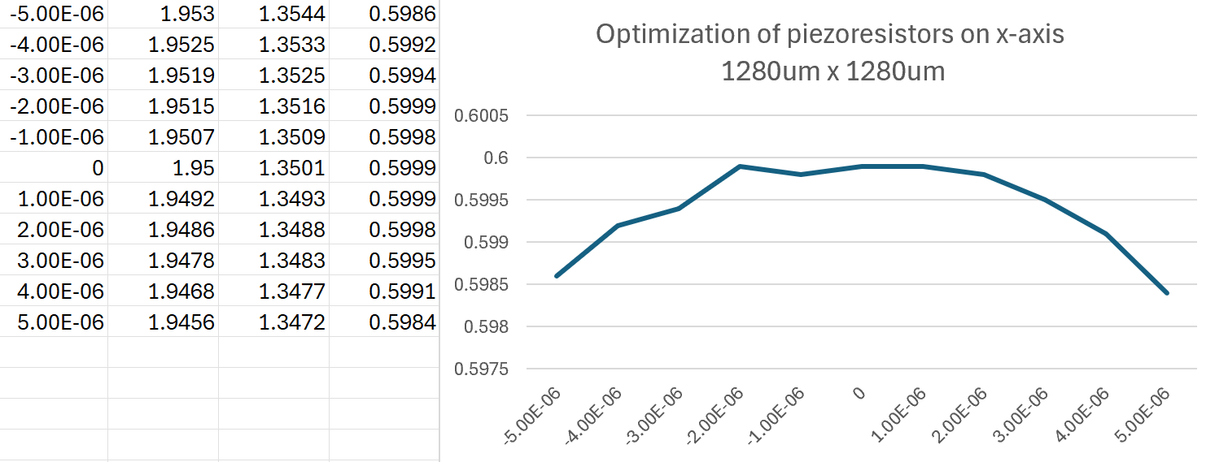
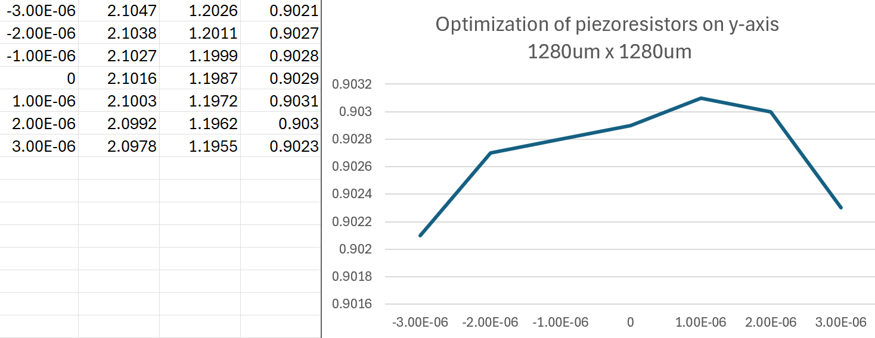
Results for 1280um x 1280um diaphragm
Wrong:
Right:

Slide 11
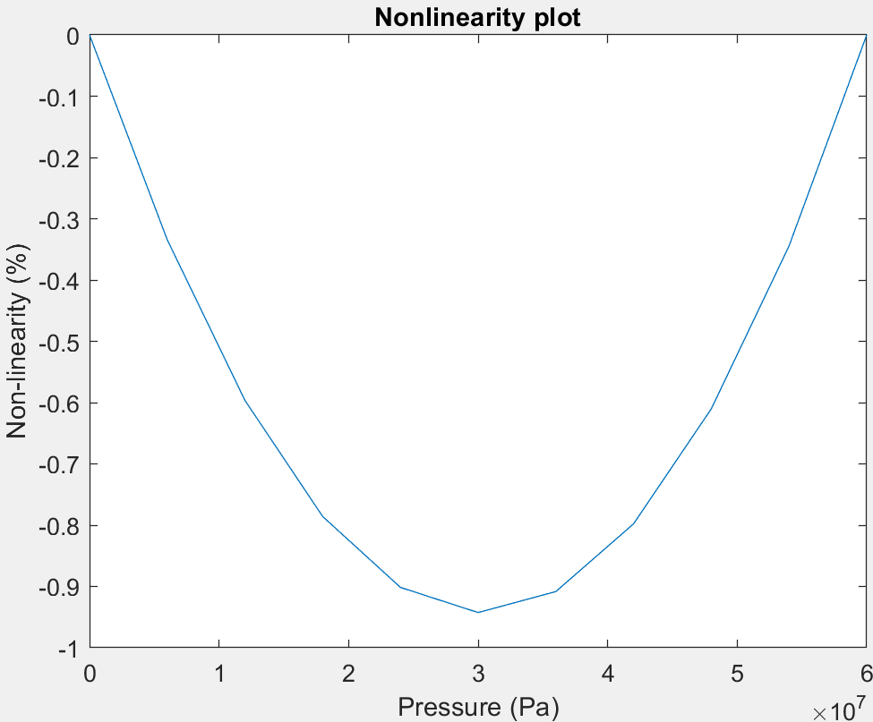
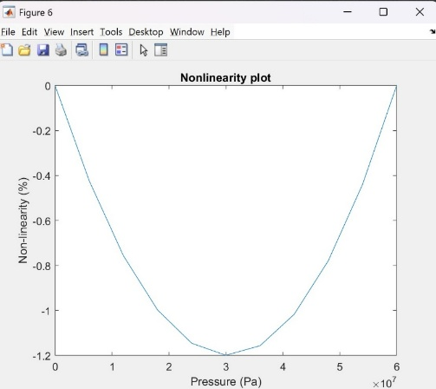
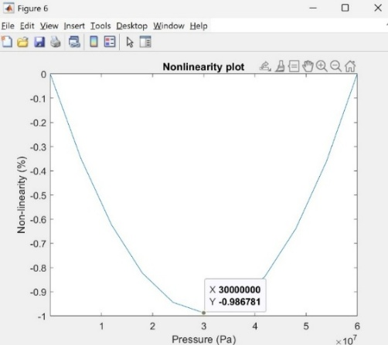
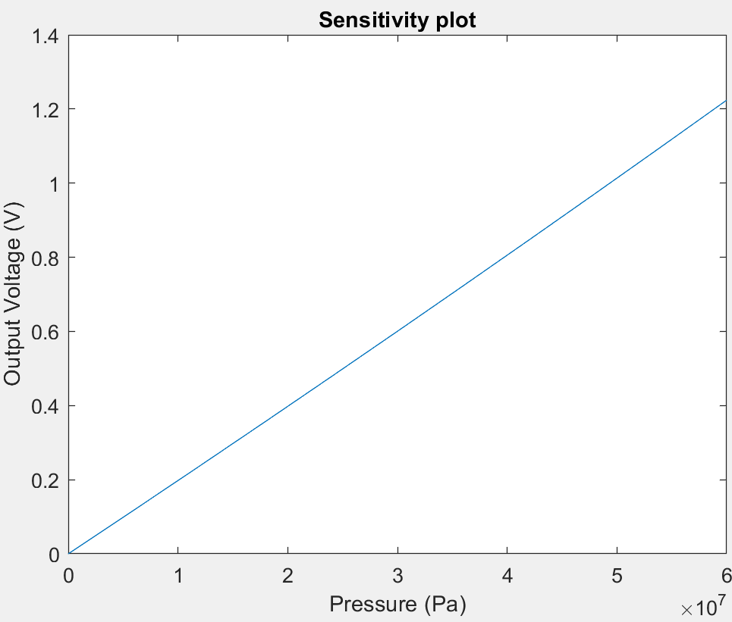
Results for AUV Application
Plate thickness = 200µm
Plate thickness = 220µm
Plate thickness = 225µm
1/5th thumb-rule has been followed, where the max deflection should be less than 1/5th of the diaphragm thickness.

Slide 12
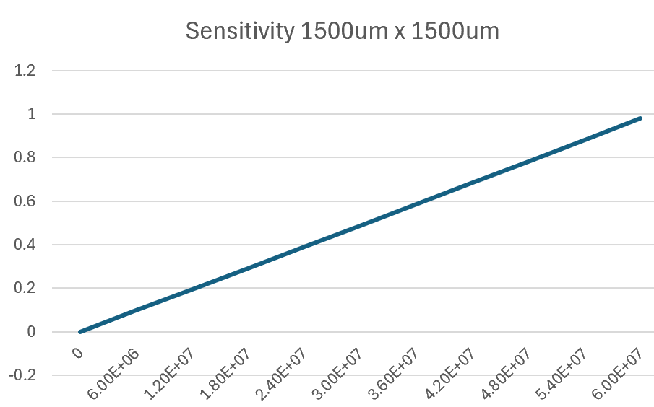
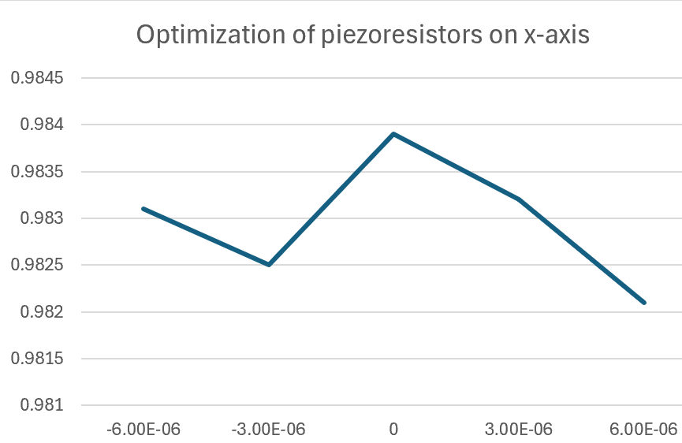
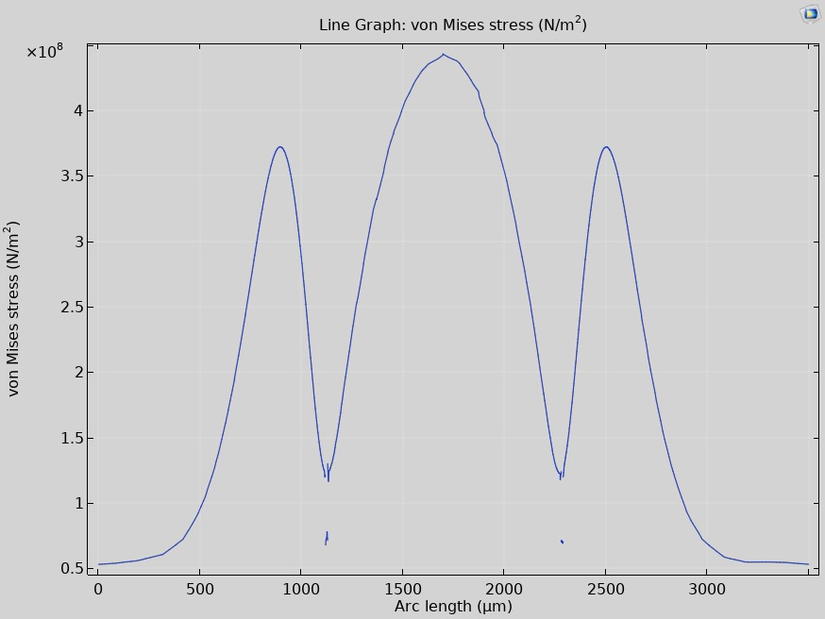
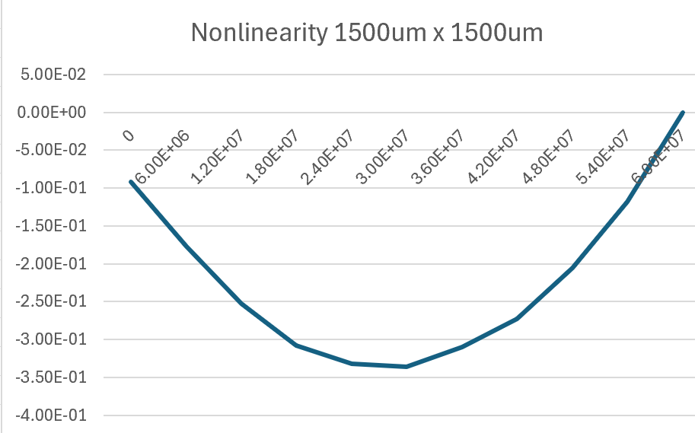
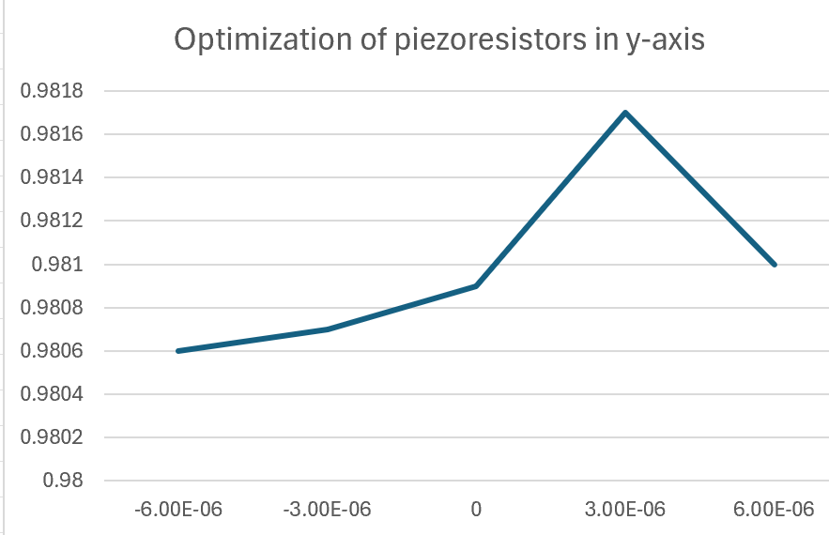
Results for AUV Application

Slide 13
Future Work
Integrate meander-shaped piezoresistors for improved stress concentration.
Explore double-diaphragm designs for AUV robustness.
Include temperature dependence modeling of piezoresistive coefficients.
Prototype and test using SOI wafers for high-temp / high-pressure environments.
Placing the piezoresistors closer to the center in the high stress region for the AUV Application.

Slide 14
References
Kumar SS, Pant BD (2012) Design of piezoresistive MEMS absolute pressure sensor. SPIE, UK 8549
Yazdi N, Ayazi F, Najafi K (1998) Micromachined inertial sensors. Proc IEEE 86(8):1640-1659
Peng CT, Lin JC, Lin CT, Chiang KN (2005) Performance and package effect of a novel piezoresistive pressure sensor fabricated by front-side etching technology. Sens Actuators A 119(1):28–37
Timoshenko S, Woinowsky-Krieger S (1959) Theory of plates and shells, 2nd edn. McGraw-Hill, New York
Eaton WP, Smith JH (1997) Micromachined pressure sensors: review and recent developments. Smart Mater Struct 6(5):530–539
Esashi M, Sugiyama S, Ikeda K, Wang Y, Miyashita H (1998) Vacuum-sealed silicon micromachined pressure sensors. Proc IEEE 86(8):1627–1639
Hopcroft, M. A., Nix, W. D., & Kenny, T. W. (2010). What is the Young’s modulus of silicon? Journal of Microelectromechanical Systems, 19(2), 229–238. https://doi.org/10.1109/JMEMS.2009.2039697
Kumar, S. S., & Pant, B. D. (2014). Design principles and considerations for the “ideal” silicon piezoresistive pressure sensor: A focused review. Microsystem Technologies, 20(7), 1213–1247. https://doi.org/10.1007/s00542-014-2215-7
Kumar, S. S., & Pant, B. D. (2015). Polysilicon thin film piezoresistive pressure microsensor: design, fabrication and characterization. Microsystem Technologies, 21(9), 1949–1958. https://doi.org/10.1007/s00542-014-2318-1

