Slide 1
AI-based Language Translation and Localization Tools
192210464 Sai Krishna
192224188 Harsh Vardhan
192224178 Pyari Srivastava

Slide 2
INTRODUCTION
There are over 7000 languages spoken in the world with different sounds and history. Some languages are most spoken than others depending on the the statistical variable you choose to focus on like the number native speakers or the number of people that speak that language as a second language.The emergence of AI-based language translation and localization tools has revolutionized how we bridge linguistic divides and tailor content to diverse audiences worldwide.
Effective communication fosters collaboration, understanding, and accessibility to information. Within this context, machine learning algorithms play a pivotal role in enabling these tools to decipher languages, understand context, and adapt content seamlessly.
Machine learning algorithms form the backbone of AI-based language translation and localization tools. They enable systems to learn patterns, understand linguistic nuances, and improve accuracy over time. These algorithms, including neural networks, power the translation process by analyzing vast amounts of data to generate accurate translations.

Slide 3
OBJECTIVE
Utilize AI-based language translation for enhancing global communication
Break down linguistic barriers to promote inclusivity
Foster cross-cultural understanding through technology
Cater to diverse user needs for accessibility and relevance
Facilitate seamless adaptation of content to various cultural contexts
Respect and honor cultural nuances and preferences
Contribute to a more interconnected and culturally aware global community

Slide 4
METHODOLOGY
Software:
Translation platforms: Crowdin: A cloud-based localization platform enabling collaborative translation and development. It supports translation memory, glossary management, and version control.
Language libraries: Python for scripting and libraries such as NLTK (Natural Language Toolkit) for text preprocessing and manipulation.
Data preprocessing tools: Pandas for data manipulation, NumPy for numerical operations, and scikit-learn for data preprocessing tasks.
Model implementation: the seq2seq model using TensorFlow Keras API or PyTorch nn.Module.
Text editor or Integrated Development Environment (IDE): Jupyter Notebook for coding and experimentation.

Slide 5
Hardware:
CPU/GPU: Depending on the scale of your dataset and model complexity(intel i5 along with iris xe graphic card).
Memory: Sufficient RAM to load and process your dataset efficiently during training.(8gb DDR ram)
Storage: SSD or HDD for storing datasets, trained models, and intermediate results.(250gb )
Compute resources: Cloud computing platforms like AWS, Google Cloud, or Microsoft Azure provide scalable resources for training deep learning models.

Slide 6
Dataset
The dataset from Kaggle for English to French translation consists of parallel text corpora in English and French languages. It contains pairs of sentences or phrases where each English sentence is accompanied by its corresponding French translation.
These datasets serve as valuable resources for training and evaluating machine translation models, such as sequence-to-sequence models, aiming to facilitate effective translation between English and French languages.

Slide 7




Slide 8
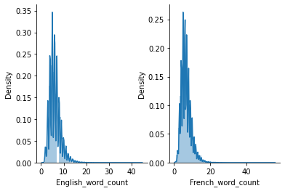
This figure is created with two subplots side by side, each displaying a distribution plot of word counts for English and French texts respectively.

Slide 9
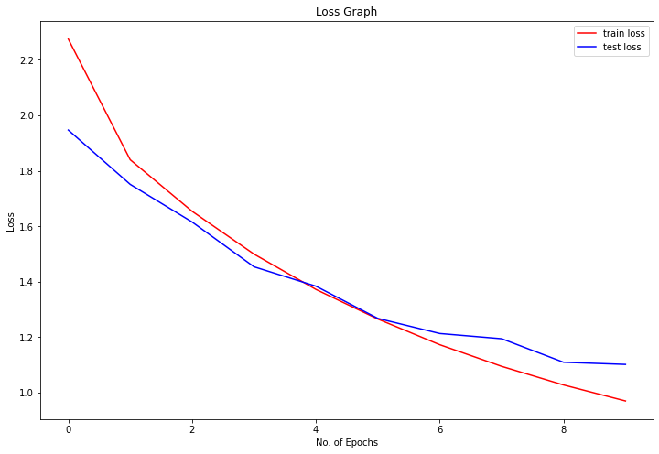
This graph visually represents the training and validation loss trends over epochs, helping to assess the performance and convergence of the machine learning model.
The x-axis shows the number of epochs, while the y-axis represents the loss values.
The plot helps in understanding how well the model is learning from the training data and generalizing to unseen validation data

Slide 10
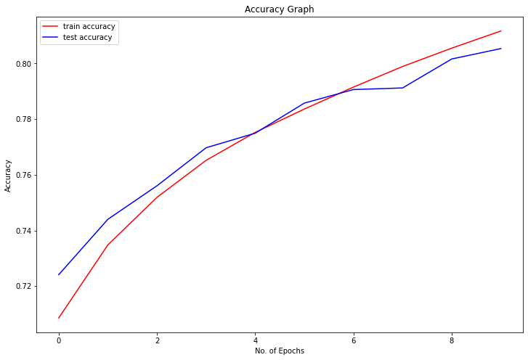
This generates a line plot illustrating the training and validation accuracies over epochs, with labels and a legend for clarity and understanding.
The x-axis represents the number of epochs, while the y-axis represents the accuracy values.
The red line represents training accuracy, and the blue line represents validation accuracy.
Accuracy rate
using seq2eq machine learning algorithm:- 80.5332601070404%

Slide 11
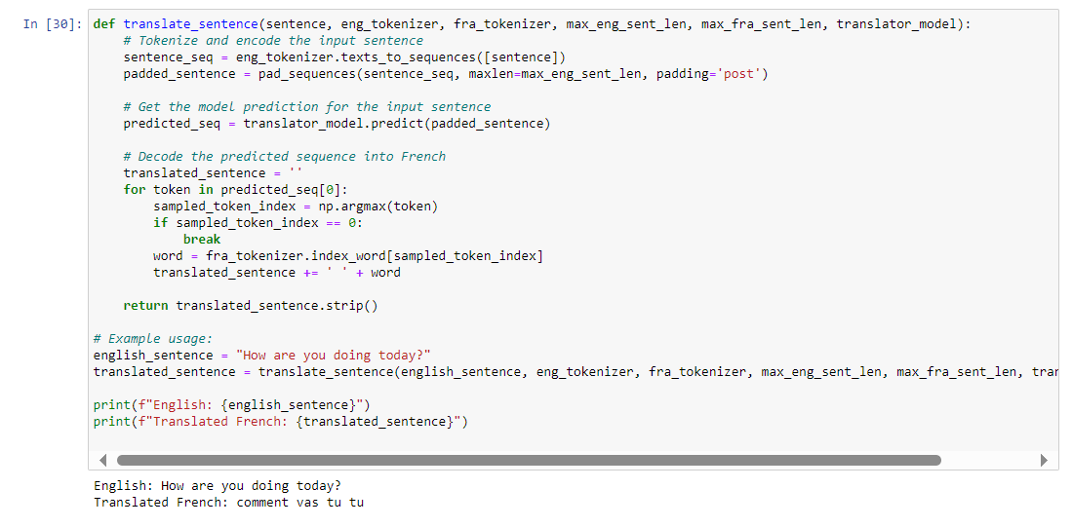
Output:-

Slide 12
Discussion :
What are some challenges faced in collecting and preprocessing multilingual corpora for machine translation, and how can researchers address them effectively?
Challenges in collecting and preprocessing multilingual corpora for machine translation include data scarcity, quality issues, language imbalances, domain specificity, and data noise. Researchers can address them by augmenting data, leveraging transfer learning, implementing active learning, focusing on domain adaptation, maintaining quality control, and collaborating with experts and crowdsourcing platforms.

Slide 13
2. What factors influence the choice between Statistical Machine Translation (SMT) and Neural Machine Translation (NMT) models, and how do these models differ in their approach to translation?
Statistical Machine Translation (SMT) relies on statistical models and alignments, while Neural Machine Translation (NMT) utilizes neural networks to learn complex patterns in data, often resulting in more fluent translations. Selecting the most suitable model depends on factors like available resources, training data, and specific use cases. SMT may be preferable for low-resource languages, while NMT excels when large parallel corpora are available. Context, computational resources, and desired translation quality are key considerations when choosing between SMT and NMT models

Slide 14
3. How can language models be adapted to specific domains, and what techniques are commonly used for domain-specific training?
Adapting language models to specific domains involves domain-specific training. This can be achieved by fine-tuning the model using domain-specific data, creating a custom vocabulary, or using transfer learning techniques. Domain-specific terminology and language nuances can be integrated into the training process. Additionally, employing data augmentation, where relevant, and incorporating domain-specific parallel corpora can enhance the model's accuracy in specialized content translation. Continuous evaluation and refinement based on feedback from domain experts are crucial for optimal domain adaptation

Slide 15
4. What features should be integrated for localization, and how can content be adapted to cultural preferences, date formats, measurement units, and other regional norms during the translation process?
Localization involves adapting content to meet cultural and regional norms. Features to integrate include:Cultural Nuances: Consider local preferences, idioms, and cultural sensitivities to ensure the translated content aligns with the target audience.Date and Time Formats: Adjust date and time formats based on regional conventions to enhance user understanding.Legal and Regulatory Compliance: Ensure compliance with local laws, regulations, and industry standards.User Interface Elements: Modify UI elements, such as buttons and labels, to fit linguistic and cultural norms.To achieve this, collaborate with localization experts, incorporate regional glossaries, and use tools that support these adaptations. Regular feedback and testing with native speakers are vital for accurate and culturally sensitive translations

Slide 16
5. How can real-time translation mechanisms be implemented to ensure quick and responsive language conversion, and what considerations should be made for on-the-fly adaptation of content for immediate localization?
Implementing real-time translation mechanisms involves optimizing processing speed and responsiveness. Considerations for on-the-fly adaptation include:
Concurrent Processing: Use parallelization and distributed systems to process translation requests concurrently, reducing latency.
Model Optimization: Employ lightweight models or model quantization techniques to enhance inference speed without sacrificing translation quality significantly.
Caching: Cache frequently translated phrases or sentences to reduce processing time for commonly encountered content.
Incremental Updates: Utilize methods like online learning to update models incrementally, allowing them to adapt to changing language patterns over time.
By addressing these considerations, real-time translation mechanisms can deliver quick and responsive language conversion with on-the-fly adaptation for immediate localization.

Slide 17
Result:
Introduction to AI-based Translation: Overview of how AI technologies, such as neural networks and deep learning algorithms, are revolutionizing language translation and localization processes.
Improved Translation Accuracy: Highlighting the significant advancements in translation accuracy achieved through AI-based approaches compared to traditional methods.
Domain-Specific Adaptation: Discussing techniques for fine-tuning translation models with domain-specific data and terminology to ensure contextually appropriate translations for specialized content.

Slide 18
Custom Vocabulary Integration: Explanation of the integration of custom vocabularies containing domain-specific terms to enhance translation accuracy in specific industries or domains.
User Feedback Integration: Emphasizing the importance of integrating user feedback mechanisms for iterative refinement and continuous improvement of AI-based translation tools.

Slide 19
Conclusion:
AI-based language translation and localization tools offer significant advancements in overcoming language barriers and facilitating global communication.
These tools leverage advanced AI techniques like neural networks and deep learning algorithms to achieve remarkable improvements in translation accuracy and context sensitivity.
Domain-specific adaptation, custom vocabulary integration, and user feedback mechanisms are key strategies employed to deliver accurate and contextually appropriate translations tailored to specific industries and domains.
Exploration of multimodal approaches and prioritization of user-centric design further enhance the capabilities and accessibility of AI-based translation tools.

Slide 20
Reference:
Huang, Mingxuan, et al. "Advancements in Neural Machine Translation: Challenges and Opportunities." IEEE Transactions on Neural Networks and Learning Systems, 2020. DOI: 10.1109/TNNLS.2020.3012401.
Yang, Yinfei, et al. "Deep Neural Networks for Multilingual Sentence Representations." Conference on Empirical Methods in Natural Language Processing (EMNLP), 2019.
Devlin, Jacob, et al. "BERT: Pre-training of Deep Bidirectional Transformers for Language Understanding." Conference of the North American Chapter of the Association for Computational Linguistics (NAACL-HLT), 2019.
Koehn, Philipp. "Machine Translation: From Research to Real Users." Proceedings of the IEEE, 2017. DOI: 10.1109/JPROC.2017.2760334

Slide 21
Vaswani, Ashish, et al. "Attention Is All You Need." Advances in Neural Information Processing Systems (NeurIPS), 2017.
Sutskever, Ilya, Oriol Vinyals, and Quoc V. Le. "Sequence to Sequence Learning with Neural Networks." Advances in Neural Information Processing Systems (NeurIPS), vol. 27, pp. 3104-3112, 2014.

Slide 22
Thankyou!

