Slide 1

The Byzantine Generals Problem
Boon Thau Loo
CS294-4

Slide 2
Overview
Motivation
Problem Definition
Impossibility?
Solutions (Oral and signed messages)
Practical Use?
Conclusions

Slide 3
Motivation
Coping with failures in computer systems
Failed component sends conflicting information to different parts of system.
Agreement in the presence of faults.
P2P Networks?
  Good nodes have to “agree to do the same thing”.
  Faulty nodes generate corrupted and misleading messages.
  Non-malicious: Software bugs, hardware failures, power failures
  Malicious reasons: Machine compromised.

Slide 4
Problem Definition
Generals = Computer Components
The abstract problem…
  Each division of Byzantine army is directed by its own general.
  There are n Generals, some of which are traitors.
  All armies are camped outside enemy castle, observing enemy.
  Communicate with each other by messengers.
  Requirements:
    G1: All loyal generals decide upon the same plan of action
    G2: A small number of traitors cannot cause the loyal generals to adopt a bad plan
  Note: We do not have to identify the traitors.

Slide 5
Naïve solution
i^{th} general sends v(i) to all other generals
To deal with two requirements:
  All generals combine their information v(1), v(2), .., v(n) in the same way
  Majority (v(1), v(2), …, v(n)), ignore minority traitors
Naïve solution does not work:
  Traitors may send different values to different generals.
  Loyal generals might get conflicting values from traitors
Requirement: Any two loyal generals must use the same value of v(i) to decide on same plan of action.

Slide 6
Reduction of General Problem
Insight: We can restrict ourselves to the problem of one general sending its order to others.
Byzantine Generals Problem (BGP):
  A commanding general (commander) must send an order to his n-1 lieutenants.
Interactive Consistency Conditions:
  IC1: All loyal lieutenants obey the same order.
  IC2: If the commanding general is loyal, then every loyal lieutenant obeys the order he sends.
Note: If General is loyal, IC2 => IC1.
Original problem: each general sends his value v(i) by using the above solution, with other generals acting as lieutenants.

Slide 7
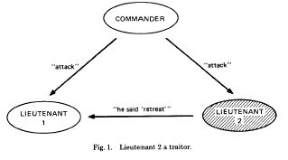
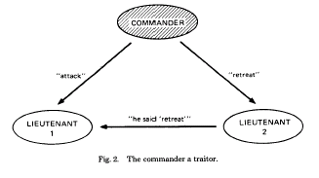
3-General Impossibly Example
3 generals, 1 traitor among them.
Two messages: Attack or Retreat
Shaded – Traitor
L1 sees (A,R). Who is the traitor? C or L2?
Fig 1: L1 has to attack to satisfy IC2.
Fig 2: L1 attacks, L2 retreats. IC1 violated.

Slide 8
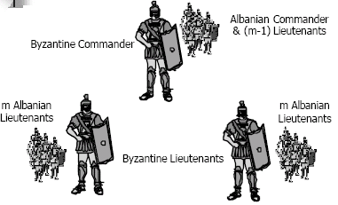
General Impossibility
In general, no solutions with fewer than 3m+1 generals can cope with m traitors.
Proof by contradiction.
  Assume there is a solution for 3m Albanians with m traitors.
  Reduce to 3-General problem.
- Solution to 3m problem => Solution to 3-General problem!!

Slide 9
Solution I – Oral Messages
If there are 3m+1 generals, solution allows up to m traitors.
Oral messages – the sending of content is entirely under the control of sender.
Assumptions on oral messages:
  A1 – Each message that is sent is delivered correctly.
  A2 – The receiver of a message knows who sent it.
  A3 – The absence of a message can be detected.
Assures:
  Traitors cannot interfere with communication as third party.
  Traitors cannot send fake messages
  Traitors cannot interfere by being silent.
Default order to “retreat” for silent traitor.

Slide 10
Oral Messages (Cont)
Algorithm OM(0)
  Commander send his value to every lieutenant.
  Each lieutenant (L) use the value received from commander, or RETREAT if no value is received.
Algorithm OM(m), m>0
  Commander sends his value to every Lieutenant (v_{i})
  Each Lieutenant acts as commander for OM(m-1) and sends v_{i} to the other n-2 lieutenants (or RETREAT)
  For each i, and each j<>i, let v_{j} be the value lieutenant i receives from lieutenant j in step (2) using OM(m-1). Lieutenant i uses the value majority (v₁, …, v_{n-1}).
  Why j<>i? “Trust myself more than what others said I said.”

Slide 11
Restate Algorithm
OM(M):
  Commander sends out command.
  Each lieutenant acts as commander in OM(m-1). Sends out command to other lieutenants.
  Use majority to compute value based on commands received by other lieutenants in OM(m-1)
Revisit Interactive Consistency goals:
  IC1: All loyal lieutenants obey the same command.
  IC2: If the commanding general is loyal, then every loyal lieutenant obeys the command he sends.

Slide 12
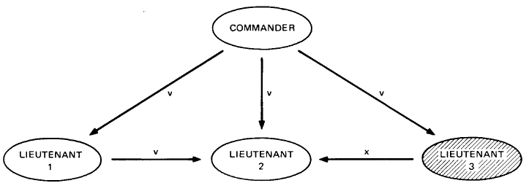
Example (n=4, m=1)
Algorithm OM(1): L3 is a traitor.
L1 and L2 both receive v,v,x. (IC1 is met.)
IC2 is met because L1 and L2 obeys C

Slide 13
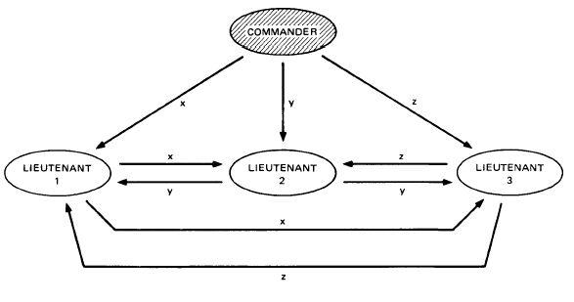
Example (n=4, m=1)
Algorithm OM(1): Commander is a traitor.
All lieutenants receive x,y,z. (IC1 is met).
IC2 is irrelevant since commander is a traitor.

Slide 14
Expensive Communication
OM(m) invokes n-1 OM(m-1)
OM(m-1) invokes n-2 OM(m-2)
OM(m-2) invokes n-3 OM(m-3)
…
OM(m-k) will be called (n-1)…(n-k) times
O(n^{m}) – Expensive!

Slide 15
Solution II: Signed messages
Previous algorithm allows a traitor to lie about the commander’s orders (command). We prevent that with signatures to simplify the problem.
By simplifying the problem, we can cope with any number of traitors as long as their maximum number (m) is known.
Additional Assumption A4:
  A loyal general’s signature cannot be forged.
  Anyone can verify authenticity of general’s signature.
Use a function choice(…) to obtain a single order
  choice(V) = v if v if the only elem. in V
  choice(V) = RETREAT if V is empty

Slide 16
Signed Messages (Cont)
Each lieutenant maintains a set V of properly signed orders received so far.
The commander sends a signed order to lieutenants
A lieutenant receives an order from someone (either from commander or other lieutenants),
  Verifies authenticity and puts it in V.
  If there are less than m distinct signatures on the order
    Augments orders with signature
    Relays messages to lieutenants who have not seen the order.
When lieutenant receives no new messages, and use choice(V) as the desired action.
If you want to protect against more traitors, increase m

Slide 17
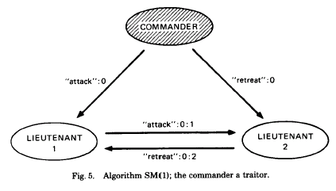
Algorithm’s Intuition
All loyal lieutenants compute the same set of V eventually, thus choice(V) is the same (IC1)
If the commander is loyal, the algorithm works because all loyal lieutenants will have the properly signed orders by round 1 (IC2)
What if the commander is not loyal?
V = “attack, retreat” => Commander is a traitor.

Slide 18
Missing Communication Paths
What if not all generals can reach all other generals directly?
P-regular graph – Each node has p regular neighbors.
3m-regular graph has minimum of 3m+1 nodes
Paper shows algorithm for variant of oral message algorithm – OM(m,p). Essentially same algorithm except that each lieutenant forwards orders to neighbors.
Proofs that OM(m,3m) solves BGP for at most m traitors.
I.e. if the communication graph is 3m-regular, and there are at most m traitors, the problem can still be solved.

Slide 19
Practical use of BGP?
What does it take for majority voting to work?
  Input synchronization (order from commander) of non-faulty (loyal) processors to produce same outputs (decisions). (IC1)
  If input unit (commander) is non-faulty (loyal),all non-faulty processes use the value it provides as input (IC2)
A1 – Every message sent by non-faulty process is delivered correctly.
  Failure of communication line cannot be distinguished from failure of nodes.
  OK because we still are tolerating m failures.
A2 – A processor can determine origin of message
  A4 makes this obsolete.

Slide 20
Practical Use of BGP (Cont..)
A3 – Absence of a message can be detected.
  Timeouts or synchronized clocks
A4 – Unforgeable signatures. Anyone can verify authenticity of signature
  Message signed by i = (M, Si(M))
  If i is not faulty, no one can generate Si(M). Faulty processor used for generating signatures?
  Given M and X, anyone can verify if X=Si(M)

Slide 21
Concluding thoughts
BGP solutions are expensive (communication overheads and signatures)
Use of redundancy and voting to achieve reliability. What if >1/3 nodes (processors) are faulty?
3m+1 replicas for m failures. Is that expensive?
Tradeoffs between reliability and performance (E.g. Oceanstore’s primary and secondary replicas)
How would you determine m in a practical system?

