Slide 1
Introduction to DBMS
CM Suvarna Varma
Assoc Prof
UNIT 1

Slide 2
Syllabus
UNIT-I: Introduction
Introduction to Database, Applications of Database, Purpose of Database, View of Data, Data Independence, Data Models, Users of Database, DBA, Query Processor, Storage Manager, Database Architecture

Slide 3
DATA
DATABASE (DB)
DATABASE MANAGEMENT SYSTEM (DBMS)

Slide 4
What is Data?
Data is collection of facts/figures which are stored in a computer memory.
Data are units of information collected through observation.
Data are raw bits and pieces of information with no content.
Data can be qualitative (numeric) or quantitative (descriptive)

Slide 5
What to do with the Data???
A data with content is called information.
3.8 million vaccines –covishield
4.2 million vaccines – covaxin shared to AP
Wisdom
Analysed & implemented
(Business Intelligence)
30% of Female (age group 18-45) , 3.80CRores
35% of male (age group 18-45) registered for vaccination 4.20Crores
Knowledge
Context analysed
(Data mining)
Information
Data with content
(DBMS)
E.g: Covid vaacination starts from 01/05/21
DATA
Raw Bits/ no content
E.g: 010521

Slide 6
Database
A collection of inter related data /information that is organized so that it can be easily accessed, managed & updated.
Most databases contain multiple tables which may include several fields.
E.g: A company database may have tables for products, employees, sales & financial records.
DATABASE

Slide 7
DBMS (Database management systems)
DB (database -> collection of data) + MS (management -> set of programs to store/retrieve the data)
It is a software which is used to manage the database.
A collection of inter related data & set of programs to store & access the data in a very easy & effective manner.

Slide 8
History of Data
Data – word discovered in 1640’s.
It was first used to mean “transmissible & storable computer information” in 1946.
“Data Processing” was first used in 1954
Latin word -> data is plural of Datum (single value)

Slide 9
History of database
1950-1960s: Punch cards, maganetic tapes to store data.
1960-1970s: Hard disks came in this era , Data structures(lists, trees), (N/w, hierarchial models)
1970- Edgar Codd – RDBMS
1970-1980s: R-prototype led to IBMs first relational database –SQL/DS , Ingress, oracle, rdbms
1990s – Oodatabases, SQL, WWW.
2000s – Semi structured data XML , opemsource-MySQL , Datamining
Later 2000s – parallel data – mapreduce(big data) , NO SQL
2010’s : support to NoSQL , cyber security, risks

Slide 10
Database
Applications
USERS
C
DBMS
C++
Java
store
retrieve

Slide 11
Applications of Database
Banking: Customer Information, Accounts, Loans, Banking Transactions, Forex
Personal Dept
BANKING DATABASE
DBMS
Loan Dept
Acct Dept
Foreign Exchnage Dept

Slide 12
More Applications
Airlines: Reservations and scheduled information.
Universities: Student information, course registration, grades
Sales: customer, product, purchase information.
Telecommunication: Call records, data usage,monthly bills, maintain balance.
Social media: user records, connection between users,posts, ratings
Online-retailers: sales records, orders, tracking, search, best items recommendation.
Online advertisements: keep history, product suggestion,new articles, make online purchase.
Human Resource: Employees,salaries,payroll,benefits,pay checks.
Manufacturing: Supply chain,tracking production,inventories in warehouse,order for items.

Slide 13
Data Characteristics
1.Structured & described data: definition, type, format, relationship of data {meta data} [ metadata : data about the data]
2.Seperation of data & application: Application s/w doesn’t need any knowledge of physical storage of data. It only comm with DBMS s/w
3.Data integrity: Maintain quality,reliability of data & protection from unauthorized users.
4.Transaction: Bundle of actions within database to bring it from one consistent state to new consistent state.
5.Data Persistence: DBMS maintains all data for long period of time(one stored cant be lost)

Slide 14
Purpose of Database systems contd..file vs dbms
The main purpose of database systems is to manage the data, especially with the client-server environment.
File systems also used to store & retrieve data but it has got its disadvantages: DBMS helps with this:
Data storage (less space, remove redundant data, huge volume of data store)
Data retrieve(fast retrieval)
Metadata

Slide 15
File system Vs DBMS
1. Data Redundancy & inconsistency : In files, multiple file formats & duplicate info in different files..[no redundancy & inconsistency in dbms]
2. Difficulty in accessing data: write new program to carry a new task.[not required in dbms]
3. Data isolation: multiple files & formats [ access –location of file, dbms doesn’t need location]
4.Integrity problems(constraints) become part of code & adding new constraint is hard ( adding constraints is easy)
5.Atomocity of updates: failures might leave inconsistent state with partial update, no concurrency acces [ concurrent & consistent in dbms]
6.Security problems: security not guaranteed in files [dbms provides role based security]

Slide 16
Types of data (stored)
1.User data: table of data , columns fileds, rows records.
2. Metadata: description, structure of database, (no of tables, no of fileds,table name, field name) (DDL)
3.Application data: stores structure of queries,reports,other applic components.
4.Hardware: secondary storage devices like magnetic tapes, hard disks, DVD, optical disk, etc.(stored with help of i/p devices)
5.software: Bridge between user and database operation ( SIDU –DML)

Slide 17
Types of databases
Traditional databases – TDB ---- Text, numbers
Multimedia databases – MDB ----Speech, Image, Voice
Global Information System – GIS ---- Images / Maps
Real time databases –RTDB – Ongoing transactions
Datawarehouse – DW – Historical data

Slide 18
Types of users
Users are the persons who need information from the database.
1. Database Administrator (DBA)
2.Database Designer [ ER , Normalization]
3. Application Programmer [ queries – SQL]
4.End users

Slide 19
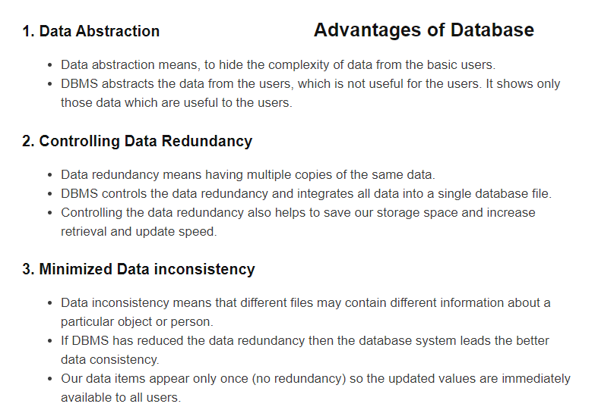

Slide 20
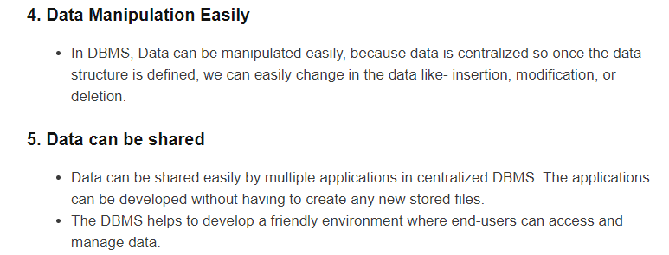
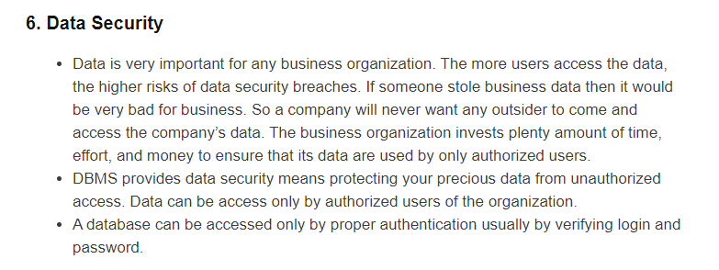

Slide 21
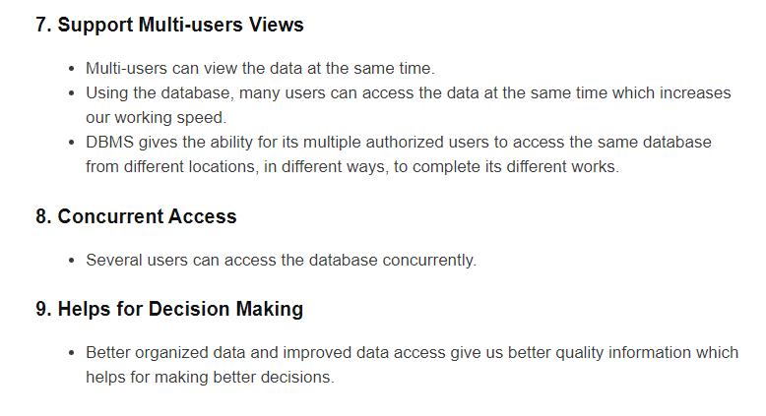

Slide 22
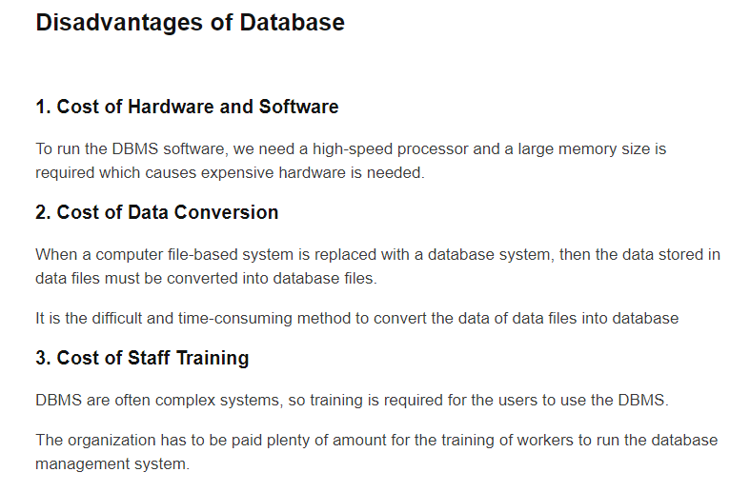

Slide 23
4. Danger of Over fill
Small & simple application for single user of database system is not advisable
5. Complexity
Several users access dbms and is quite complex & costly affair.
6.Low efficiency
Continuous multiuse slows down the system.

Slide 24
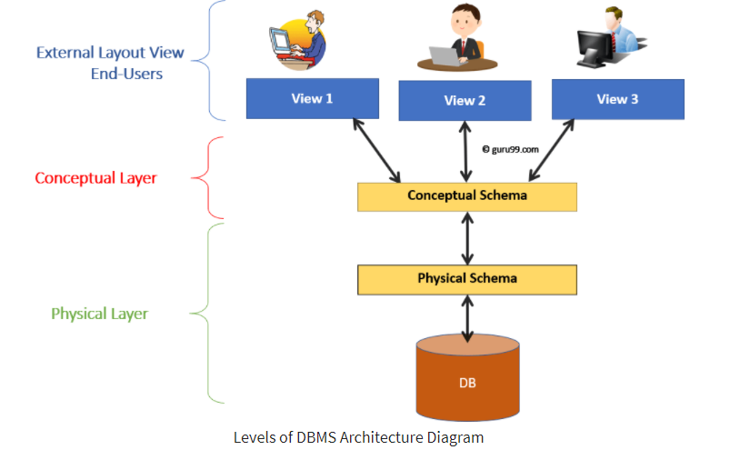
Views of Data ( 3-tier architecture)
mapping

Slide 25
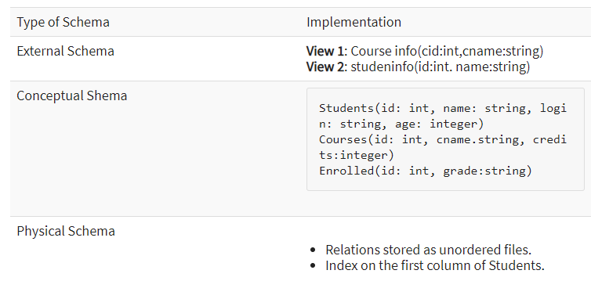
The three schema architecture defines view of data at three levels. Level
1. Physical level(internal level)
2.Logical level(conceptual level)
3. View level(external level)

Slide 26
Physical Level: Close to physical storage of data, stored in the form of bits with physical address on secondary storage devices. Its highest form of viewing is a File format (stored datatypes).
Conceptual Level: structure of database for a group of users. Information to build relevant extended records & hides internal details of lower level
External level: data viewd by individual end user. A segment of data is required by particular user of group and hides rest of database from the other user groups.

Slide 27
Data independence
Data Independence is the property of DBMS that helps you to change the Database schema at one level of a database system without requiring to change the schema at the next higher level.
Two levels of data independence are 1) Physical and 2) Logical
Physical data independence helps you to separate conceptual levels from the internal/physical levels
Logical Data Independence is the ability to change the conceptual scheme without changing
When compared to Physical Data independence, it is challenging to achieve logical data independence
Data Independence Helps you to improve the quality of the data

Slide 28
LDI: It describes Which data to stored in database, and relationships among the data in database E.g: Entities, relationships, attributes, integrity, security
Logical Schema
Logical Data independence ( LDI)
Physical Schema
Physical Data independence ( PDI)
The data at one layer doesn’t affect the data at another level, the data is independent but mapped to each other.
PDI: It describes How data to stored in database, and data structure & organization in database E.g: Indexes, hasing, different file storage devices, merge, sort

Slide 29
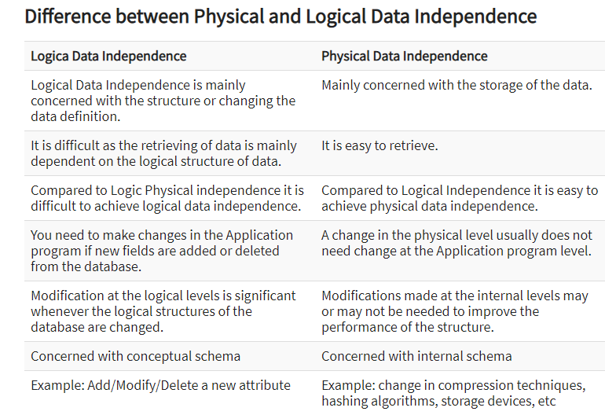

Slide 30
Relation system
The data is collected by the user in the form of tables.
Create new applications, collected data from old tables & derive new tables.
SQL – 1970s-80s Oracle 9i from oracle corporation
And DB2 version from IBM
Object oriented 1980s-90s Informix

Slide 31
Facultyname | Salary | Telephone
Anand | 45000 | 9000012385
Uma | 18000 | 9123458901
Raja | 24000 | 9789647647
Rani | 40000 | 9876876474
SELECT * FROM Faculty WHERE salary > 40,000;
Facultyname | Salary | Telephone
Anand | 45000 | 9000012385

Slide 32
Client-Server System
USER
The purpose of database system is to support the development & execution of database applications. The database system having simple two parts: backend , frontend
Server – backend [ DBMs s/w DDL, DML, DCL,etc]
Set of clients – front end [Applications on top of DBMS]
User written applications : c, C++, java
Vendor provided applications: Tools (Data Mining, Data visualisation tools)
APPLICATION PROGRAM
Client /
Frontend
DBMS
Server /
Backend
DATABASE

Slide 33
Server
Network
Client
Client
Client-Server System

Slide 34
Data models
1. hierarchial model
2. Network model
3.ER model
4.Relational model
5.object oriented model
6. Semi structured model
A data model is an abstract model that organizes elements of data and standardizes how they relate to one another and to the properties of real-world entities

Slide 35
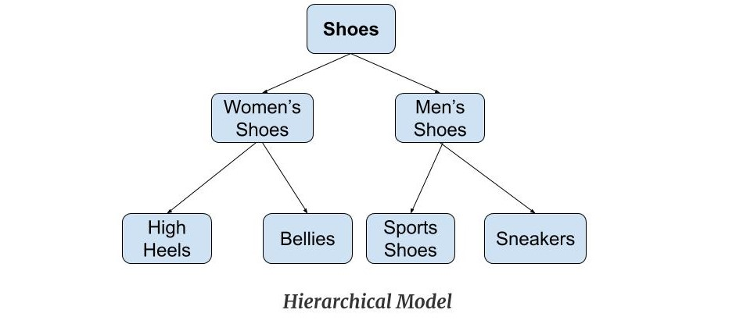
Hierarchial data model

Slide 36
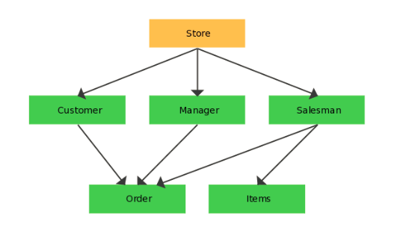
Network data model

Slide 37
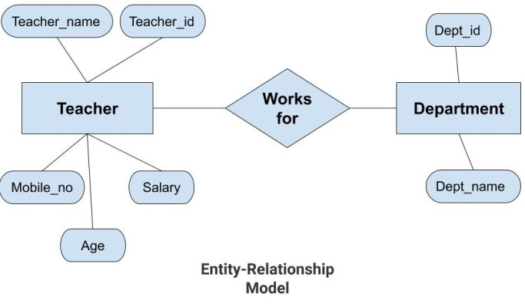
ER Model

Slide 38
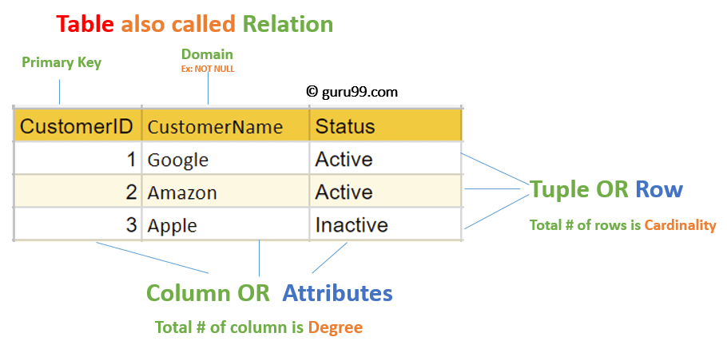
Relational model

Slide 39
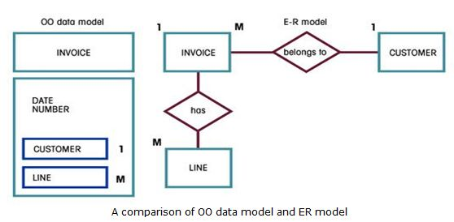
Object oriented data model

Slide 40
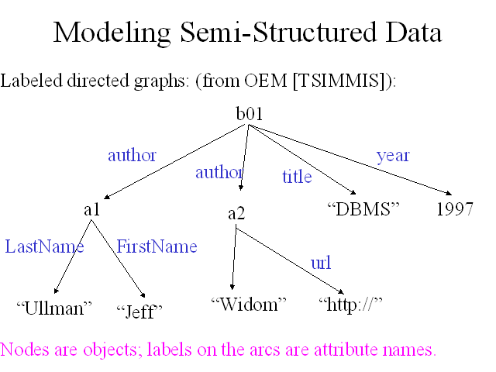
Semi structured data model

Slide 41
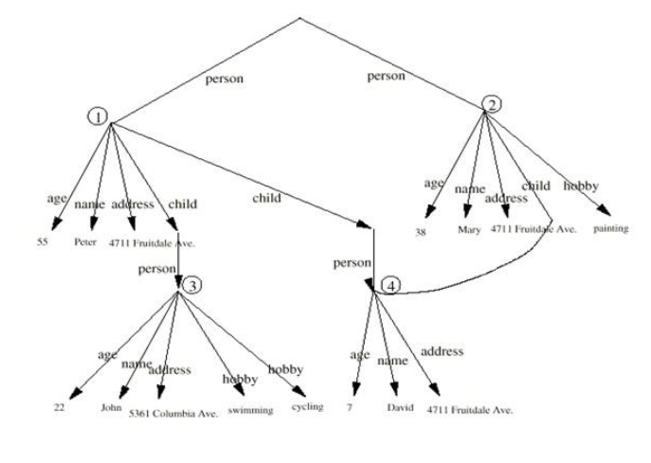

Slide 42
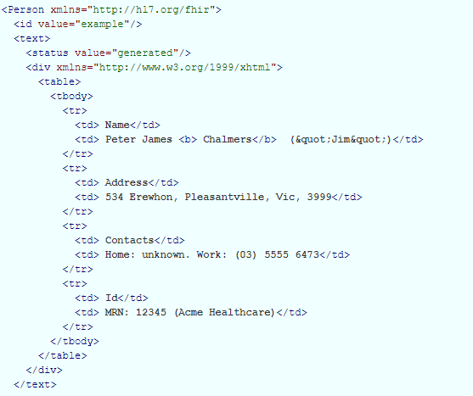
xml

