Slide 1
The Entity-Relationship Model
CM Suvarna Varma
Assoc Prof
UNIT-II PART 1/3
DBMS

Slide 2
Syllabus
UNIT-II: Conceptual Design & Relational Query Languages
Conceptual Design of Database using ER Model, Notations, Types of attributes, Relation, Mapping Constraints, Features of ER Diagram, Weak Entity Set, Examples of Conceptual Design
Relational Algebra: Selection, Projection, Set Operations, Rename, Cartesian-Product, Join, Outer Join, Examples
Relational Calculus: Tuple Relational Calculus and Domain Relational Calculus ,Safety Expressions

Slide 3
Steps in developing a database
Data model
Move from informal description of what user wants to Precise description of what can be implemented in a DBMS in the form of a design.
Requirements analysis →
Conceptual Database design → ER diagram
Logical Database design →
Schema refinement →
Physical Database design
Applications and security

Slide 4
Conceptual design: (ER Model is used at this stage.)
What are the entities and relationships in the enterprise?
What information about these entities and relationships should we store in the database?
What are the integrity constraints or business rules that hold?
A database `schema’ in the ER Model can be represented pictorially (ER diagrams).
Can map an ER diagram into a relational schema.
Notes:
2

Slide 5
ER Model
Entity
Attribute
Relationship
STRONG /
WEAK ENTITY
KEY Attribute
Composite attribute
Multivalued attribute
Derived attribute
One-one
One-many
Many-many
Many-one
Total/partial

Slide 6
Notations
Entity
Weak entity
Derived
Attribute
Attribute
Attribute
Multi valued attribute
Primary Key attribute
Relationship
Weak Relationship

Slide 7
Relationship
One - one
1
Generalization
1
Relationship
Many - one
ISA
m
1
Relationship
One - many
Specialization
1
m
ISA
Relationship
Many - Many
m
m

Slide 8
ER Model Basics
Relation : Representing the data in a relational model is called a relation.
Relation Schema: It describes fields for table, the schema specifies relation name, name of each field, domain of each field.
E.g: Student (Sid: int, Sname: string, Branch: string);

Slide 9
ER Model Basics
name
ssn
lot
Employees
Entity: Real-world object distinguishable from other objects. It is an object which has some existence & existence is either physical or conceptual.
An entity is described using a set of attributes. Each attribute has a domain.
Domain: The domain of a database is the set of all allowable values or the attributes of the database.
E.g: Gender (male, female, others)
Entity Set: A collection of similar entities. E.g., all employees.
All entities in an entity set have the same set of attributes. (Until we consider ISA hierarchies, anyway!)
Each entity set has a key.
Notes:
3
The slides for this text are organized into several modules. Each lecture contains about enough material for a 1.25 hour class period. (The time estimate is very approximate--it will vary with the instructor, and lectures also differ in length; so use this as a rough guideline.) This covers Lectures 1 and 2 (of 6) in Module (5).
Module (1): Introduction (DBMS, Relational Model)
Module (2): Storage and File Organizations (Disks, Buffering, Indexes)
Module (3): Database Concepts (Relational Queries, DDL/ICs, Views and Security)
Module (4): Relational Implementation (Query Evaluation, Optimization)
Module (5): Database Design (ER Model, Normalization, Physical Design, Tuning)
Module (6): Transaction Processing (Concurrency Control, Recovery)
Module (7): Advanced Topics

Slide 10
Degree of a relation : the no.of fields or attributes in a relation is called the degree of the relation.
Cardinality of a relation : The no.of tuples in a relation is called the cardinality.
E.g: Student table
Id | Name | Address
1 | Siva | london
2 | Ravi | illinois
3 | Mary | delhi
4 | Pooja | colombo
Degree = 3
Cardinality = 4

Slide 11
Relationship: the association among the entity is called relationship.
Relationship set: The collection of relationships is called Relationship set.
An n-ary relationship set R relates n entity sets E1 ... En; each relationship in R involves entities e1 E1, ..., en En
Same entity set could participate in different relationship sets, or in different “roles” in same set.
Attributes:The property of an entity is called attribute.
E.g: Student is an entity with attributes Id, name, Address (above slide)

Slide 12
Types of attributes
1. Simple/Atomic attribute: An attribute which is not divisible is called simple attribute. E.g: Sid
2. Composite Attribute: An attribute which can be divisible into parts is called composite attribute. E.g: Name ( Fname + Lname)
3. Single valued Attribute: An attribute having single value. E.g: Age
4. Multivalued Attribute: Attribute having multiple values. E.g: phno, address.
5. Stored Attribute: An attribute which is used for deriving a new attribute. E.g: DOB
6. Derived Attribute: an attribute which is derived from another attribute. E.g: Age

Slide 13
ER diagram –Person entity
Person(aadhar_no, name, phno, age)
Fname
Name
LName
Aadhar_no
PERSON
Age
Phno

Slide 14
Degree of a Relationship
The degree of a relationship is the number of entities associated in the relationship.
Binary and ternary relationships are special cases where the degree is 2 and 3, respectively.
An n-ary relationship is the general form for any degree n.

Slide 15
Unary Relationship
name
ssn
lot
Employees
super-visor
subor-dinate
Reports_To
A unary relationship is when both participants in the relationship are the same entity, e.g: Employees is entity & Relationship is Reports_to
It is also called Recursive relationship because, the same entity may participate in a relationship itself.

Slide 16
Binary relationship
since
name
dname
ssn
lot
did
budget
Employees
Works_In
Departments
A binary relationship is when two entities participate and is the most common relationship degree
e.g: Employees, departments are entities and Works_in is common relationship
Note: the attribute of relationship is called descriptive attribute

Slide 17
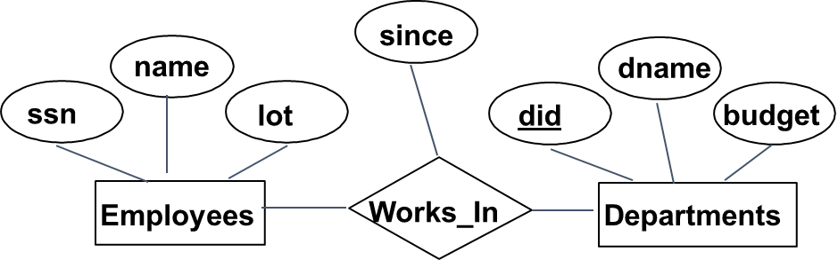
Ternary Relationship
Projects
Pid
Pname
loc
Ternary relationship is when three entities participate in the relationship.
E.g: Employees, departments & projects are entities that share a common relationship “works_in”

Slide 18
Strong & weak entities
Strong entity set: An entity set having sufficient attributes to form a primary key is called Strong entity set
Weak entity set: An entity set is not having sufficient attributes to form a primary key is called weak entity set.
SUPPLIER
SUPPLY

Slide 19
Convert Ternary relationship to binary relationship
Qty
Sname
Pname
SUPPLY
SUPPLIER
PROJECT
Given Ternary relationship with entities supplier , project and part and relationship is supply and all are string Entities and strong relationship. The query will also be strict and sometimes misleads the original purpose.
Therefore , it is good to avoid such mislead and redundant rows which might occur due to ternary and convert them to binary, even if the relations get weaker.
Pno
PART

Slide 20
contd
Qty
Sname
Pname
SUPPLIER
PROJECT
SS
SUPPLY
SPj
To convert Ter- bin:
Replace relation with weak entity and form every two relations with its respective weak relationship
Pno
SPa
PART

Slide 21
ER diagram for company to keep track of employee phones
Employee
Works_In
Company
Uses
Phones
Provides

Slide 22
Constraints
1. Key Constraints: Primary key, Foreign key , super key , candidate key
2. Mapping constraints : cardinalities with these possible ways:
One-one , One –many , many –one & many-many
3. Participation Constraints : total / Partial participation

Slide 23
Key constraints
Minimal set of attributes which uniquely identify an instance of a entity
Many candidate keys choose one to be a primary keys
SSN vs Name … key must be unique

Slide 24
key
KEY
PRIMARY KEY
SUPER KEY
Candidate KEY
FOREIGN KEY

Slide 25
STUDENT
Sid | Sname | Address | Deptid
S001 | Mary | London | 1
S002 | John | Rome | 1
S003 | Mary | Ohio | 3
S004 | Robert | Delhi | 5
S005 | Samuel | Beijing | 4
DEPARTMENT
DeptId | Dname
1 | IT
2 | CSE
3 | ME
4 | ECE

Slide 26
Primary Key:
It’s the first key which is used to identify one & only one instance of an entity uniquely.
An entity can have multiple keys but only one primary key.
E.g: Sid in Student Student(Sid)
Deptid in Department Department(Deptid)

Slide 27
Super Key
A set of attributes which can uniquely identify a tuple
Super key is a superset of candidate key
E.g: 1.Sid
2.Sid,Sname
3.Sid, Address
4.Sid,sname,address
5.Sid,sname,address,deptid
6.Sid,deptid
7.Sid,sname,deptid
8.sid,address,deptid
9.sname,address
10.sname,address,deptid

Slide 28
Candidate key
A candidate key is an attribute or asset of attributes which can uniquely identify a tuple.
The remaining attributes except for primary key are considered as a candidate key.
The candidate key is also a minimal superkey & as strong as a primary key.
E,g: Student( Sname,address)
Note: Canddiate key also called alternate key (mostly composite style)

Slide 29
Foreign key
The colun of table which is used to point to primary key of another table
An attribute of relation which is a primary key is being refernced to another relation, the reference attribute is called foreign key.
E.g: Student (Deptid)

Slide 30
Mapping Constraints
since
name
dname
In contrast, each dept has at most one manager, according to the key constraint on Manages.
* arrow indicates that given a dept it uniquely determines the Manages relationship in which it appears
ssn
lot
did
budget
Employees
Manages
*
Departments
*
1-to-1
1-to Many
Many-to-1
Many-to-Many
Notes:
6

Slide 31
Weak Entities
A weak entity can be identified uniquely only by considering the primary key of another (owner) entity.
Owner entity set and weak entity set must participate in a one-to-many relationship set (one owner, many weak entities).
Weak entity set must have total participation in this identifying relationship set.
name
ssn
lot
cost
pname
age
Employees
Policy
Dependents
Notes:
10

Slide 32
One-one mapping
B
C
R
E1
E2
In One-one mapping, E1 entity is associate with atmost one entity in E2 ands an Entity E2 is associated with atmost one entity in E1

Slide 33
Many-one mapping
B
C
R
E1
E2
In Many-one mapping, E1 entity is associated with any no.of entities in E2 ands an Entity E2 is associated with atmost one entity in E1

Slide 34
One-Many mapping
B
C
R
E1
E2
In One-Many mapping, E1 entity is associate with atmost one entity in E2 ands an Entity E2 is associated with any no.of entities in E1

Slide 35
Many-Many mapping
B
C
R
E1
E2
In Many-many mapping, E1 entity is associated with with any no.of entities in E2 ands an Entity E2 is associated with with any no.of entities in E1

Slide 36
Mapping Constraints
Study
Student
m
1
College
1
has
Person
1
Passport
1
Placed
Customer
m
Order
m
Study
Student
m
Project

Slide 37
Married to
Female
1
1
Male
invent
Scientist
1
m
Invention
Assign
Employee
m
m
task
Enroll
Student
m
1
Course

Slide 38
Study_in
Student
College
Placed
Customer
Order
Teaches
Student
Teacher
LoAN
Installment

Slide 39
Participation Constraints
Does every department have a manager?
If so, this is a participation constraint: the participation of Departments in Manages is said to be total (vs. partial).
Every Department entity must appear in an instance of the relationship Works_In (have an employee) and every Employee must be in a Department
Both Employees and Departments participate totally in Works_In
name
name
dname
since
dname
ssn
did
did
budget
lot
budget
Employees
Manages
Departments
Works_In
since
Notes:
8

Slide 40
ISA (`is a’) Hierarchies
As in C++, attributes can be inherited.
If we declare A ISA B, every A entity is also considered to be a B entity.
Upwards is generalization. Down is specialization
Notes:
12

Slide 41
Employee
Person
IS A
Is A
Tester
Developer
student
Patient
Specialization
Generalization
Bottom up
Top down

Slide 42
Generalization
Account
IS A
savings
Current
Specialization

Slide 43
More examples
Student , teacher grouped to Person - ? B-Up , Gen
Employee to Tester, developer .- ? T-Down , Spec
Vehicle to car, bus , truck ? T-Down , Spec
Technician , engineer, Accountant to employee? B-Up, Gen
Animal to monkey, lion, goat? T-Down , Spec

Slide 44
Constraints in ISA relation
Overlap constraints: Can Joe be an Hourly_Emps as well as a Contract_Emps entity? (Allowed/disallowed)
Covering constraints: Does every Employees entity also have to be an Hourly_Emps or a Contract_Emps entity? (Yes/no)
Reasons for using ISA:
To add descriptive attributes specific to a subclass.
To identify entitities that participate in a relationship.

Slide 45
name
ssn
lot
Person
name
IS A
ssn
lot
Studen_id
course
Employees
Student
hourly_wages
hours_worked
ISA
contractid
Hourly_Emps
Contract_Emps

Slide 46
Aggregation
name
ssn
lot
Employees
Used when we have to model a relationship involving (entitity sets and) a relationship set.
Monitors
until
started_on
since
dname
pid
pbudget
did
budget
Projects
Sponsors
Departments
Aggregation allows us to treat a relationship set as an entity set for purposes of participation in (other) relationships.
Note: aggregate Mostly higher order
Notes:
2

Slide 47
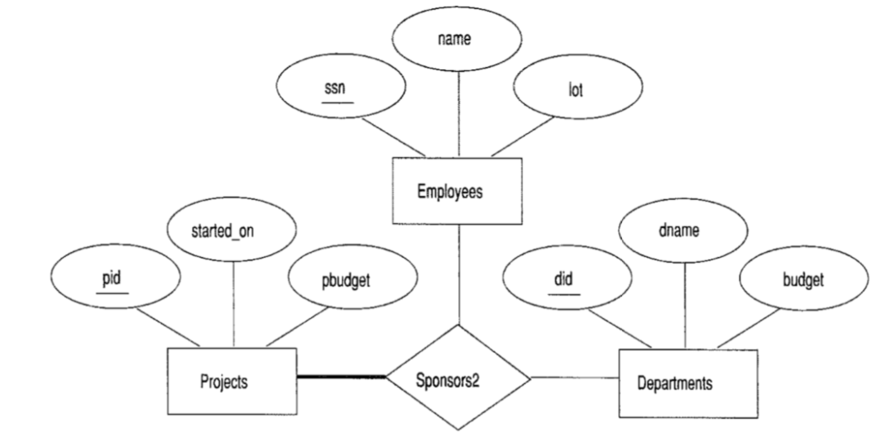
Ternary Relationship

Slide 48
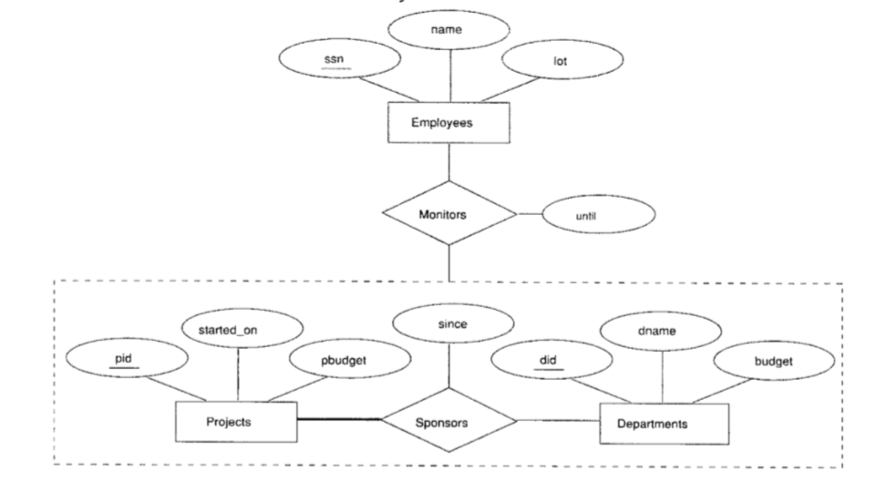
Aggregation

Slide 49
Conceptual Design Using the ER Model
Design choices:
Should a concept be modeled as an entity or an attribute?
Should a concept be modeled as an entity or a relationship?
Identifying relationships: Binary or ternary? Aggregation?
Constraints in the ER Model:
A lot of data semantics can (and should) be captured.
But some constraints cannot be captured in ER diagrams.
Notes:
3

Slide 50
Entity vs. Attribute
Should address be an attribute of Employees or an entity (connected to Employees by a relationship)?
Depends upon the use we want to make of address information, and the semantics of the data:
If we have several addresses per employee, address must be an entity (since attributes cannot be set-valued).
If the structure (city, street, etc.) is important, e.g., we want to retrieve employees in a given city, address must be modeled as an entity (since attribute values are atomic).

Slide 51
Entity vs. Attribute (Contd.)
from
to
name
dname
Works_In4 does not allow an employee to work in a department for two or more periods.
Similar to the problem of wanting to record several addresses for an employee: We want to record several values of the descriptive attributes for each instance of this relationship. Accomplished by introducing new entity set, Duration.
ssn
lot
did
budget
Employees
Works_In4
Departments
name
dname
ssn
lot
did
budget
Employees
Works_In4
Departments
from
Duration
to
Notes:
5

Slide 52
Entity vs. Relationship
since
dbudget
name
dname
ssn
lot
did
budget
Employees
Manages2
Departments
ER diagram OK if a manager gets a separate discretionary budget for each dept.
What if a manager gets a discretionary budget that covers all managed depts?
Redundancy: dbudget stored for each dept managed by manager.
Misleading: Suggests dbudget associated with department-mgr combination.
Notes:
6

Slide 53
This fixes the problem!
name
ssn
lot
since
dname
Employees
did
budget
Manages2
Departments
ISA
Managers
dbudget

Slide 54
Binary vs. Ternary Relationships
name
ssn
lot
pname
age
Employees
Covers
Dependents
Bad design
Policies
policyid
cost
If each policy is owned by just 1 employee, and each dependent is tied to the covering policy, first diagram is inaccurate.
What are the additional constraints do we need?
Notes:
7

Slide 55
Better design
name
pname
age
ssn
lot
Dependents
Employees
Purchaser
Beneficiary
Policies
policyid
cost
Key constraint
Total participation of policies in purchaser relationship

Slide 56
Binary vs. Ternary Relationships (Contd.)
Previous example illustrated a case when two binary relationships were better than one ternary relationship.
An example in the other direction: a ternary relation Contracts relates entity sets Parts, Departments and Suppliers, and has descriptive attribute qty. No combination of binary relationships is an adequate substitute:
S “can-supply” P, D “needs” P, and D “deals-with” S does not imply that D has agreed to buy P from S.
How do we record qty?
Notes:
9

Slide 57
Summary of Conceptual Design
Conceptual design follows requirements analysis,
Yields a high-level description of data to be stored
ER model popular for conceptual design
Constructs are expressive, close to the way people think about their applications.
Basic constructs: entities, relationships, and attributes (of entities and relationships).
Some additional constructs: weak entities, ISA hierarchies, and aggregation.
Note: There are many variations on ER model.
Notes:
11

Slide 58
Summary of ER (Contd.)
Several kinds of integrity constraints can be expressed in the ER model: key constraints, participation constraints, and overlap/covering constraints for ISA hierarchies. Some foreign key constraints are also implicit in the definition of a relationship set.
Some constraints (notably, functional dependencies) cannot be expressed in the ER model.
Constraints play an important role in determining the best database design for an enterprise.
Notes:
12

Slide 59
Summary of ER (Contd.)
ER design is subjective. There are often many ways to model a given scenario! Analyzing alternatives can be tricky, especially for a large enterprise. Common choices include:
Entity vs. attribute, entity vs. relationship, binary or n-ary relationship, whether or not to use ISA hierarchies, and whether or not to use aggregation.
Ensuring good database design: resulting relational schema should be analyzed and refined further. FD information and normalization techniques are especially useful.
Notes:
13

