Slide 1
Relation algebra
CM Suvarna Varma
Assoc Prof
VVIT
UNIT 2- Part 2/3
DBMS

Slide 2
Syllabus
UNIT-II: Conceptual Design & Relational Query Languages
Conceptual Design of Database using ER Model, Notations, Types of attributes, Relation, Mapping Constraints, Features of ER Diagram, Weak Entity Set, Examples of Conceptual Design
Relational Algebra: Selection, Projection, Set Operations, Rename, Cartesian-Product, Join, Outer Join, Examples
Relational Calculus: Tuple Relational Calculus and Domain Relational Calculus ,Safety Expressions

Slide 3
What is the Relational Algebra?
•✸ A collection of operations each acting on one or two relations and producing one relation as result, and
✸ A language for combining those operations •
The algebra has played a central role in the relational model: algebraic operations characterize high-level set-at-a-time access
• The algebra in practice :
✸ it was never a real user language (calculus-based languages and SQL are simpler)
✸ its semantics is clear and a de facto standard
✸ a precise syntax for the algebra is more complicated than its semantics

Slide 4
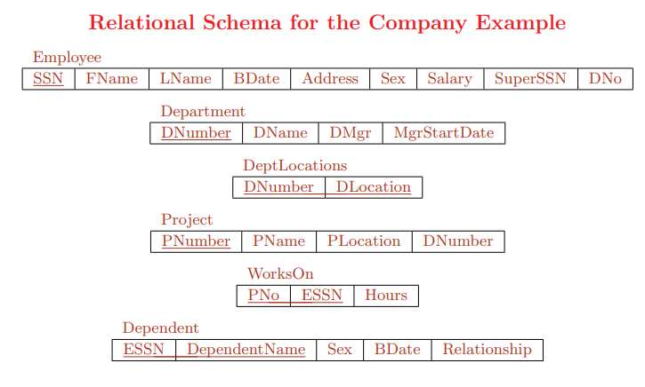

Slide 5
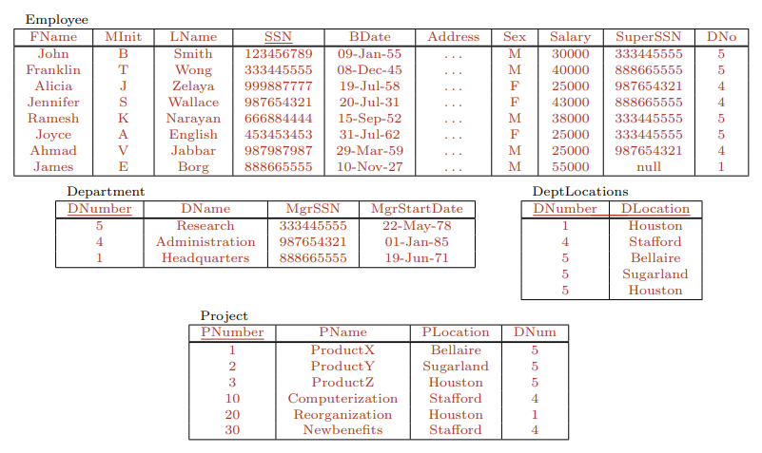

Slide 6
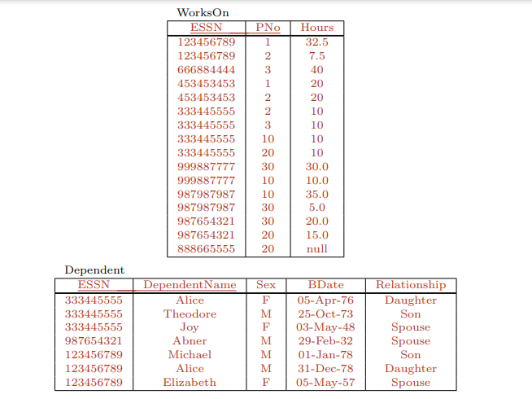

Slide 7
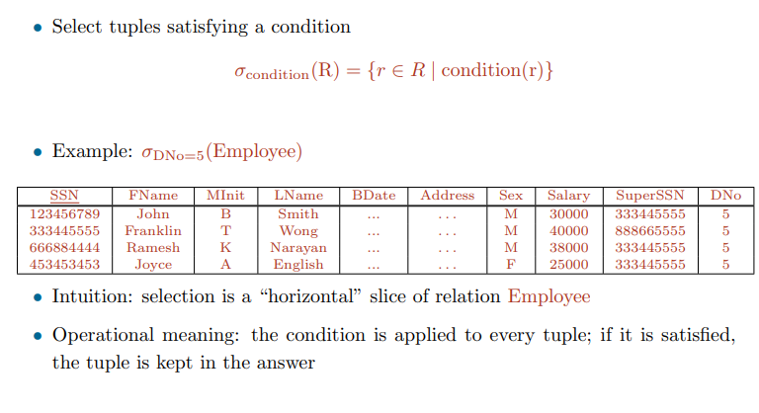
Select or restriction ( σ )

Slide 8
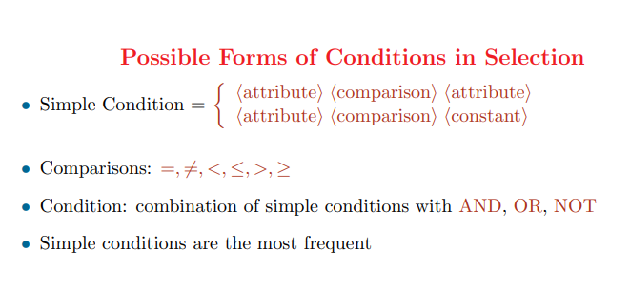

Slide 9
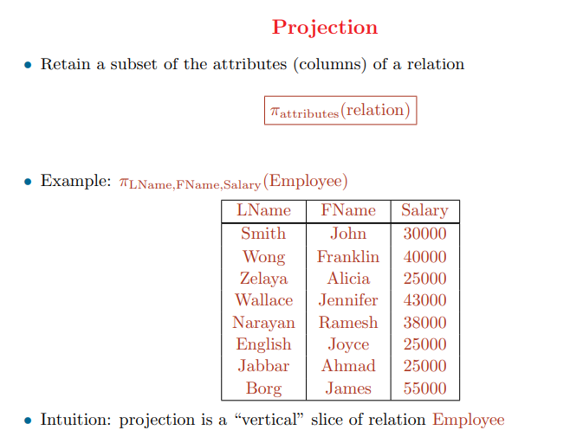

Slide 10
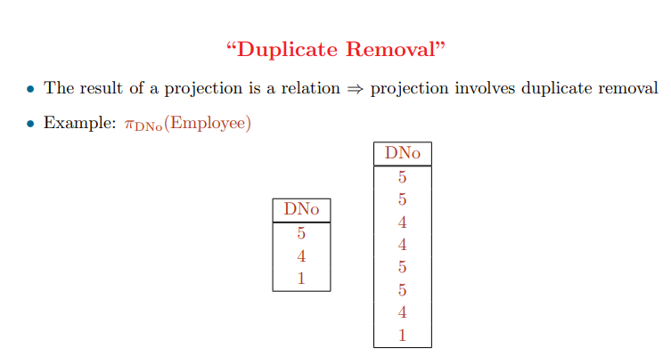

Slide 11
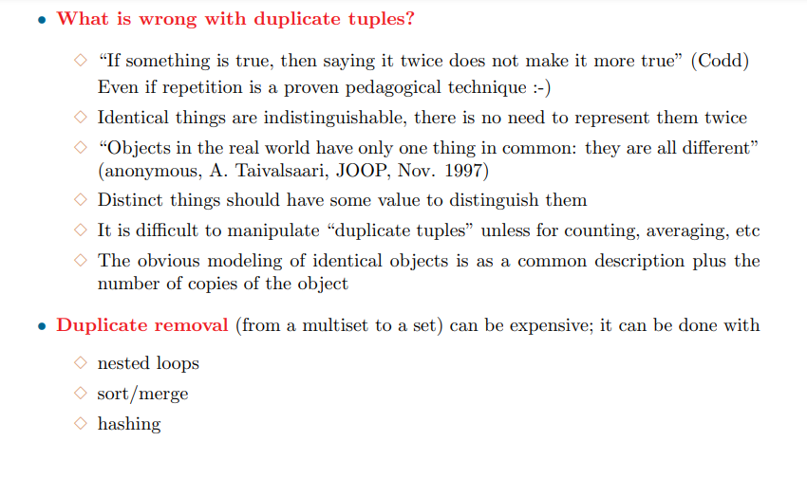

Slide 12
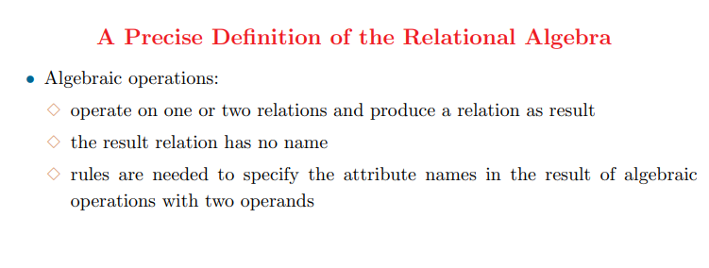

Slide 13
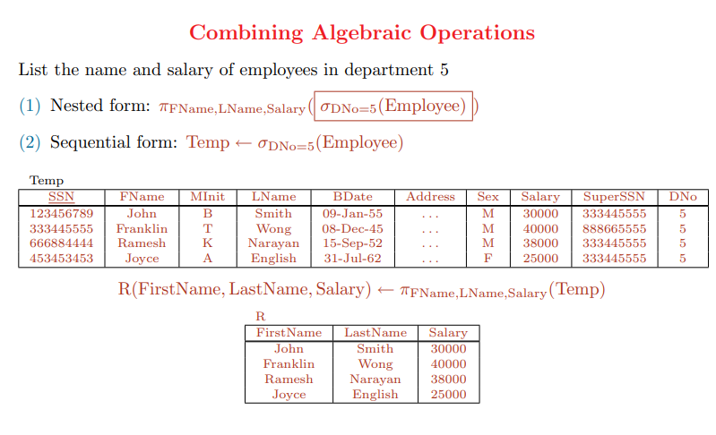

Slide 14
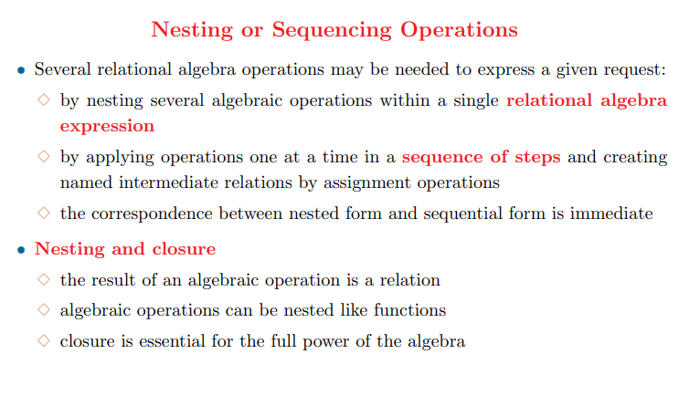

Slide 15
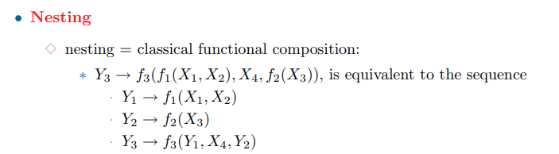

Slide 16
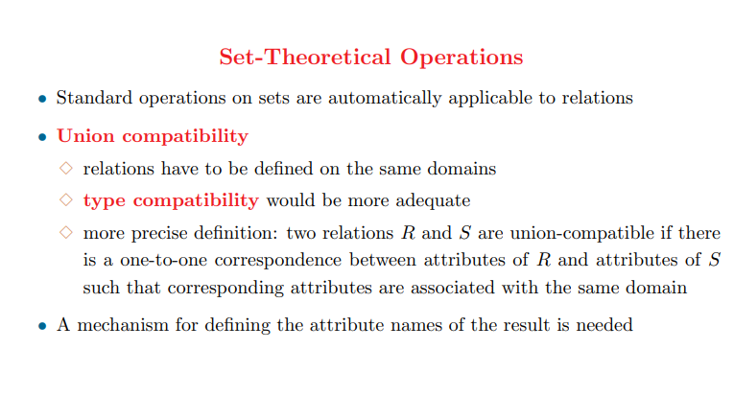

Slide 17
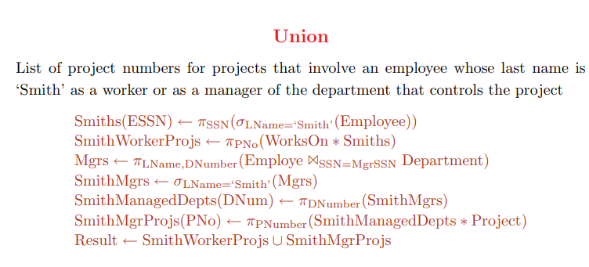

Slide 18
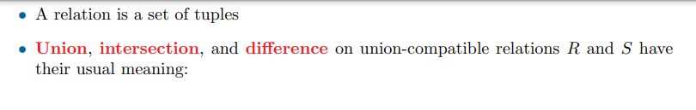
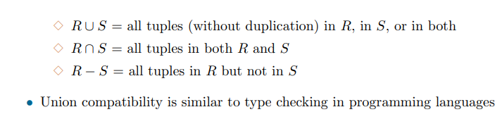

Slide 19
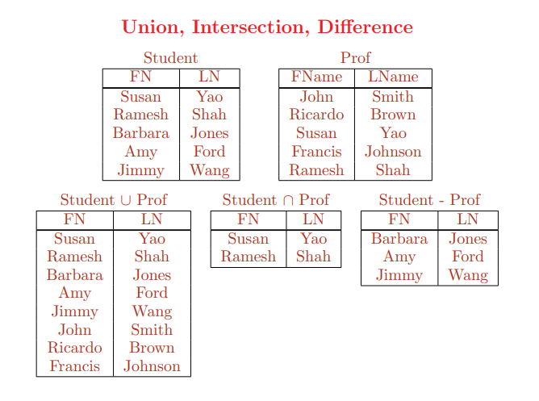

Slide 20
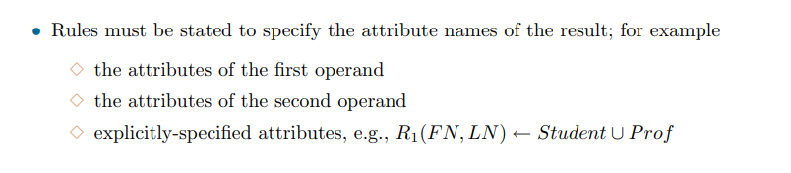

Slide 21
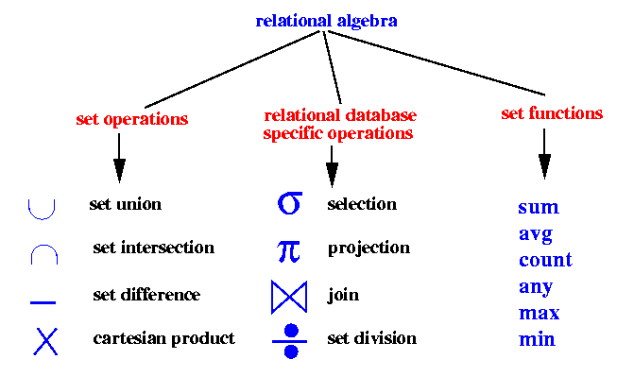

Rename

Slide 22
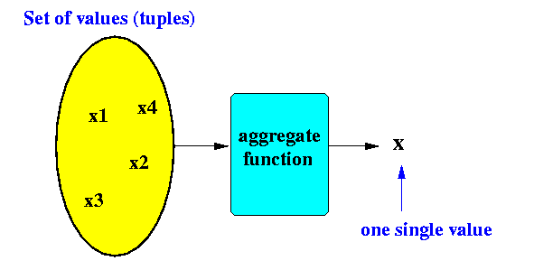
Set functions operates on a set of values and computes one single output value.
They are used to formulate "group conditions" - conditions on a set of tuples.
Aggregate or Set Functions
Aggregate or Set functions are introduced to relational algebra to increase its expressive
power.
An aggregate function operates on a set of values (tuples) and computes one single value as
output.

Slide 23
The Set Functions in Relational Algebra
sum(): computes the sum of all values in the (numeric) set
avg(): computes the average of all values in the (numeric) set
max(): finds the maximum value of all values in the set
min(): finds the minimum value of all values in the set
any(): returns TRUE if set is not empty, otherwise (i.e., empty set), returns FALSE
count(): returns the cardinaility (number of elements) in the set
Forming groups using attribute values
Set functions must be applied to a group/set of value(The set may contain zero or one value, it is nevertheless a set )

Slide 24
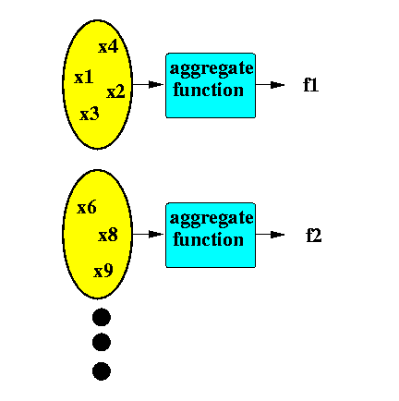
The SAME (set) function is usually applied to multiple sets/groups :
For each group , the set function will produce EXACTLY one output value(Therefore, since there are multiple groups , you will get multiple values or a group/set of values )

Slide 25
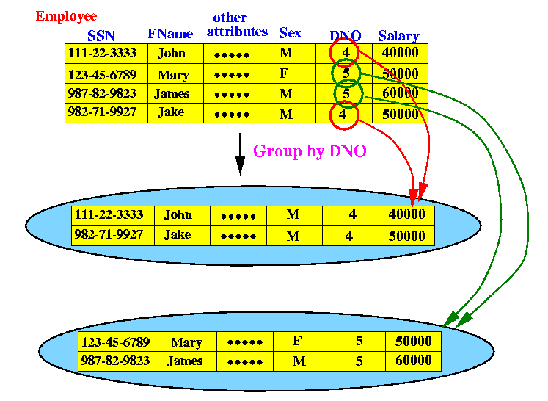
Groups are formed based on common values in one or more attributes
Example: grouping employee tuples based on their dno attribute:

Slide 26
Set functions used on groups formed on attribute values
We saw that tuples in a relation can be grouped based on one or more attribute values
One or more set functions can now be applied to these groups
Example:
Find the average salary for each department
Steps:
We must first form groups of employee tuples based on their DNO attribute
(grouped by department number)
And then compute the average Salary :

Slide 27
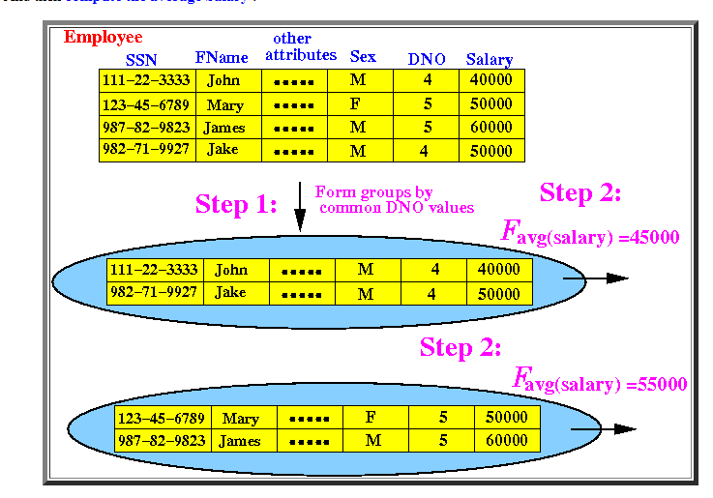
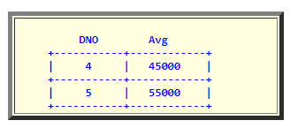

Slide 28
Example:
Compare (find) the average salary for male and female employees
We must first form groups of employee tuples based on their "sex" attribute
And then compute the average Salary :

Slide 29
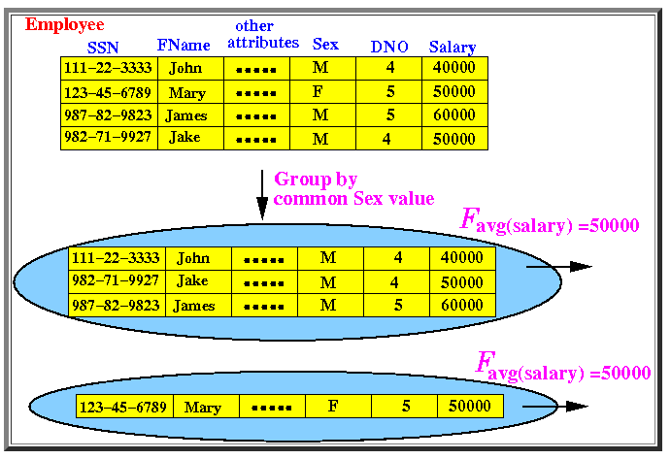
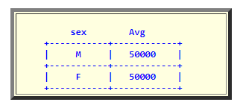

Slide 30
Forming groups using multiple attributes
You can form groups using more than one attributesIn that case, you will have "finer" (more smaller) groups.]
Example:
Find the average salary of males and females for each department
We must first form groups of employee tuples based on their DNO and sex attributes (grouped by department number and sex)
And then compute the average Salary :

Slide 31
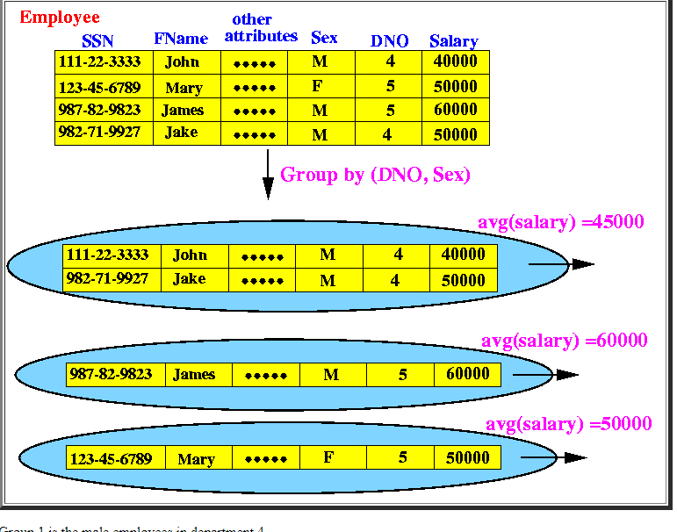
Group 1
is the male employees in deptt 4
Group 2
is the male employees in dept5
Group 3
is the female employees in dept5

Slide 32
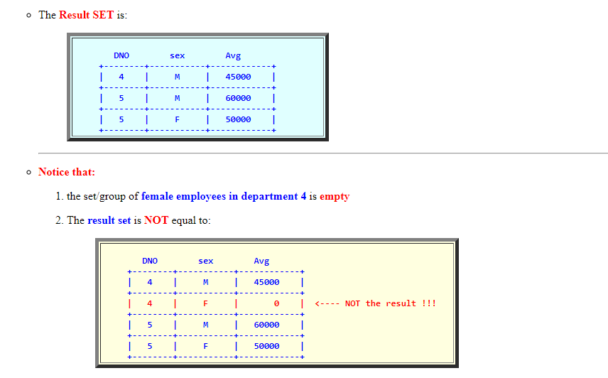

Slide 33
Applying multiple (set) functions
You can apply more than one (set) function on the groups
Each set function will produce one value for each group
So, you will get a "vector" (or array) of function values
Example:
Find the average salary and average number of employees for males and females
for each department
We must first form groups of employee tuples based on their DNO and sex attributes
(grouped by department number and sex)
And then compute average Salary and count the SSN of employees:

Slide 34
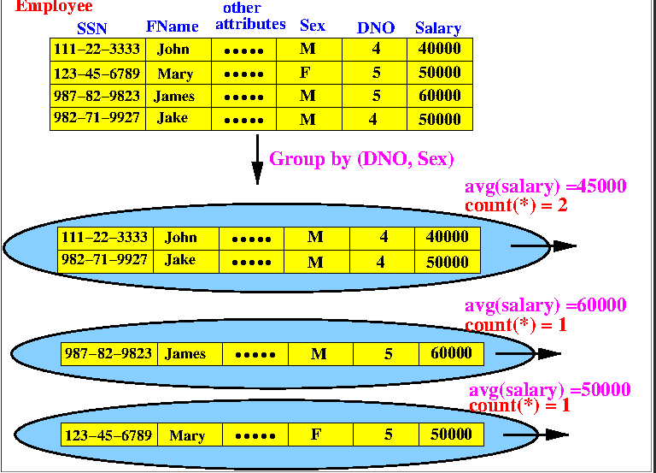
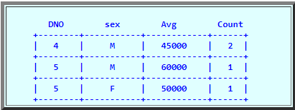

Slide 35
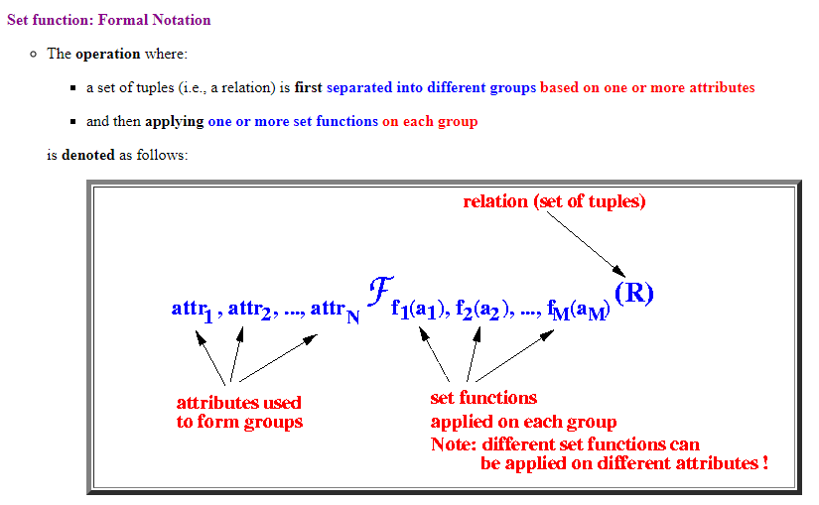
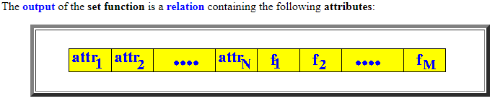

Slide 36
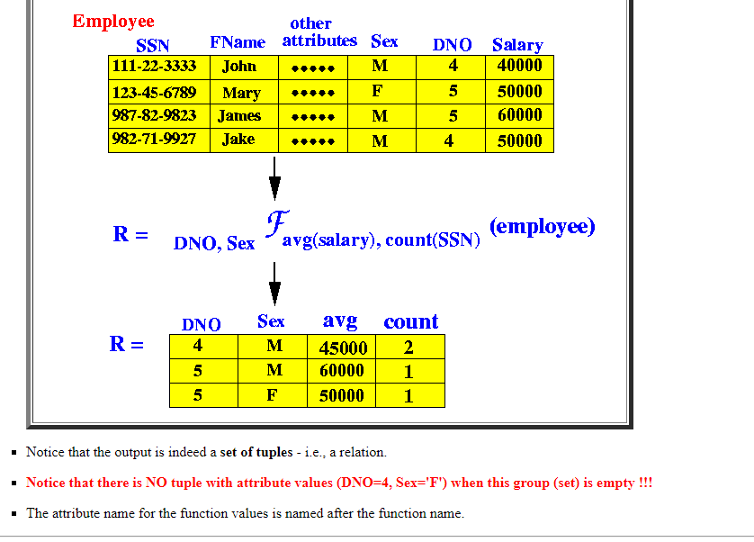
The content (i.e., tuples ) of the relation consists of:
all distinct values of the grouping attributes attr₁, attr₂, ..., attr_{N}.
and the function values f₁(a₁), f₂(a₂), ..., f_{M}(a_{M}) on the corresponding group

Slide 37
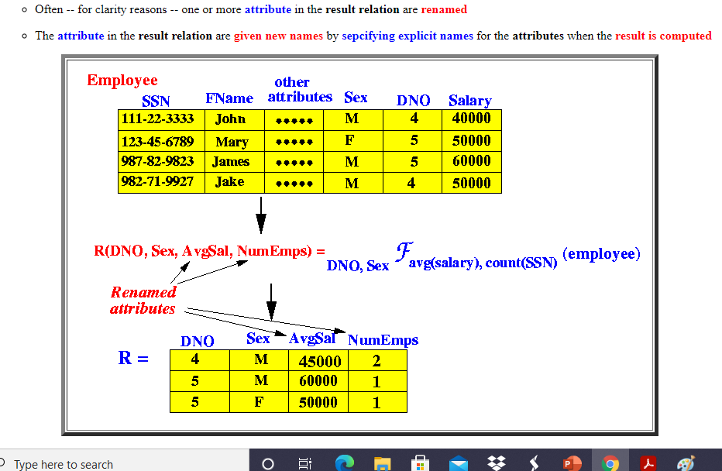

Slide 38
Although the result set will consist of ONE single tuple (row) , the output of the set function is still a relation It is a relation with one single tuple in it !!!
Applying (set) functions without any grouping attributes
When there are no grouping attributes specified in a set function, then the set function is
applied on ONE group that consists of all tuples of the relation
(i.e., all tuples in the relation are in one single group).
The most important fact to remember in this case is:

Slide 39
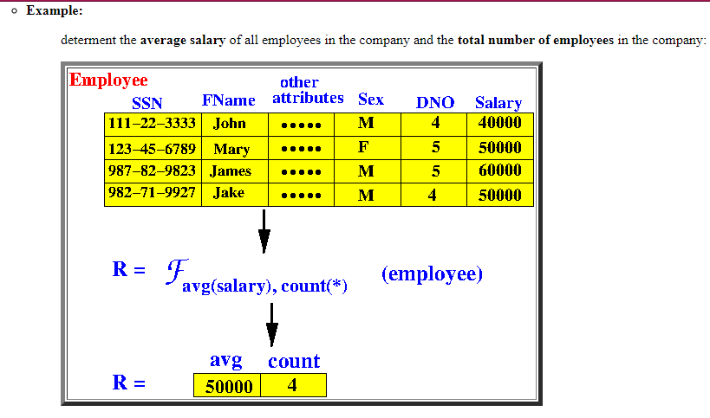

Slide 40
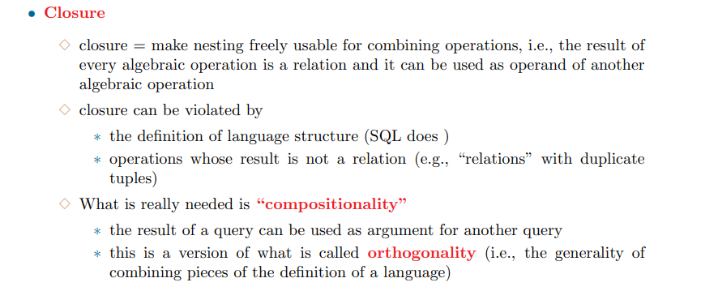

Slide 41
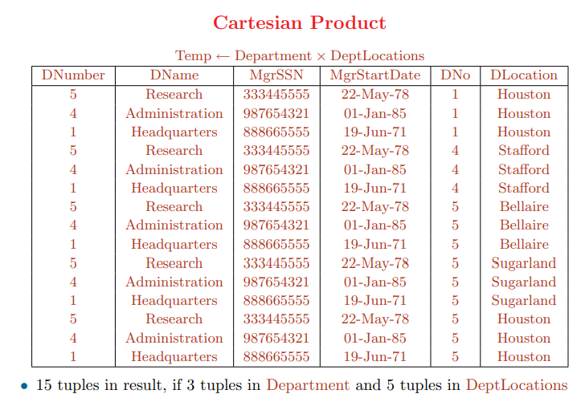

Slide 42
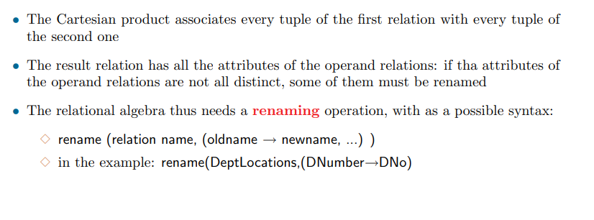

Slide 43
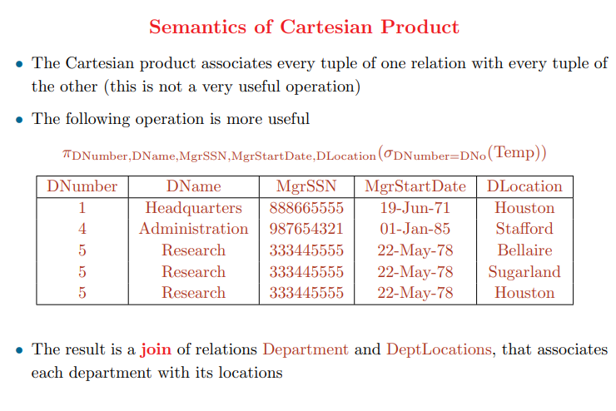

Slide 44
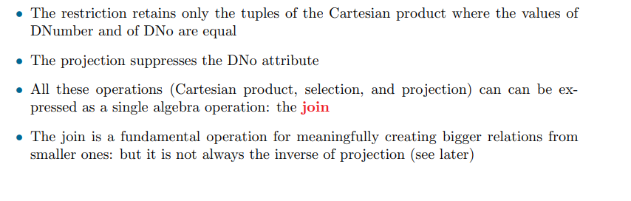

Slide 45
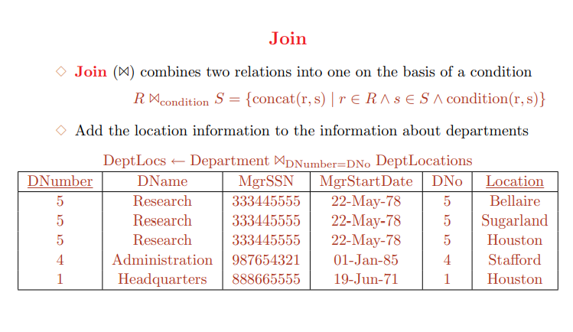

Slide 46
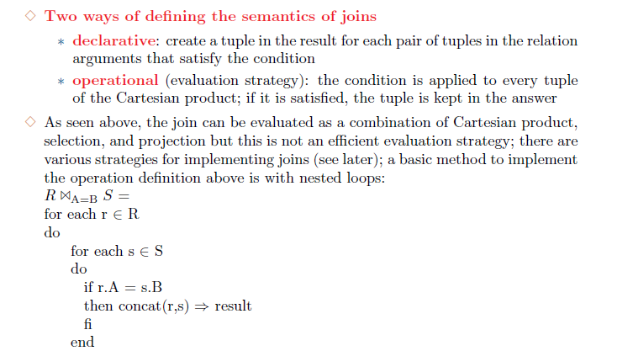

Slide 47
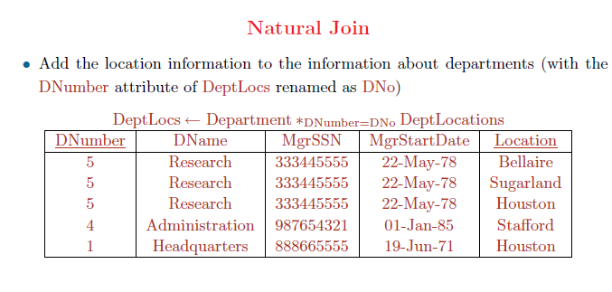

Slide 48
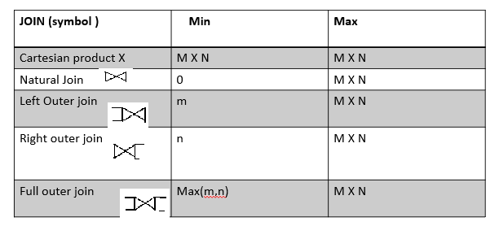
Types of join
Natural join
Outer join (left outer, right outer, full outer joins)

Slide 49

Cartesian Product
A | B
1 | a
2 | c
C | D
1 | b
3 | d
A | B | C | D
1 | a | 1 | d
1 | a | 3 | d
2 | c | 1 | b
2 | c | 3 | d

Slide 50

Natural Outer join
A | B
1 | a
2 | c
C | D
1 | b
3 | d
A | B | C | D
1 | a | 1 | d

Slide 51

Left Outer join
A | B
1 | a
2 | c
C | D
1 | b
3 | d
A | B | C | D
1 | a | 1 | d
2 | c | Null | Null

Slide 52

Right Outer join
A | B
1 | a
2 | c
C | D
1 | b
3 | d
A | B | C | D
1 | a | 1 | d
Null | Null | 3 | d

Slide 53

Full Outer join
A | B
1 | a
2 | c
C | D
1 | b
3 | d
A | B | C | D
1 | a | 1 | d
2 | c | Null | Null
Null | Null | 3 | d

Slide 54
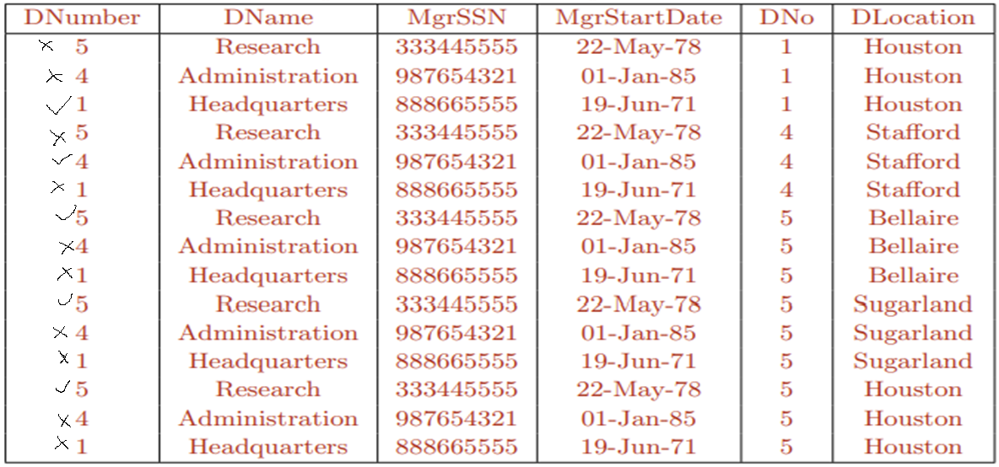

Slide 55
Outer join
5 Rows
DNumber | DName | MgrSSN | MgrStartDate | DNo | DLocation
1 | Headquarters | 888665555 | 19-jun-71 | 1 | Houston
4 | Administration | 987654321 | 01-jan-85 | 4 | Stafford
5 | Research | 333445555 | 22-May-78 | 5 | Bellaire
5 | Research | 333445555 | 22-May-78 | 5 | SugarLand
5 | Research | 333445555 | 22-May-78 | 5 | Houston

Slide 56
Left Outer join
5 Rows + 3 rows = 8 rows
DNumber | DName | MgrSSN | MgrStartDate | DNo | DLocation
1 | Headquarters | 888665555 | 19-jun-71 | 1 | Houston
4 | Administration | 987654321 | 01-jan-85 | 4 | Stafford
5 | Research | 333445555 | 22-May-78 | 5 | Bellaire
5 | Research | 333445555 | 22-May-78 | 5 | SugarLand
5 | Research | 333445555 | 22-May-78 | 5 | Houston
5 | Research | 333445555 | 22-May-78 | Null | Null
4 | Administration | 987654321 | 01-jan-85 | Null | Null
1 | Headquarters | 888665555 | 19-jun-71 | Null | Null

Slide 57
Right Outer join
5 Rows + 5 rows = 10 rows
DNumber | DName | MgrSSN | MgrStartDate | DNo | DLocation
1 | Headquarters | 888665555 | 19-jun-71 | 1 | Houston
4 | Administration | 987654321 | 01-jan-85 | 4 | Stafford
5 | Research | 333445555 | 22-May-78 | 5 | Bellaire
5 | Research | 333445555 | 22-May-78 | 5 | SugarLand
5 | Research | 333445555 | 22-May-78 | 5 | Houston
Null | Null | Null | Null | 1 | Houston
Null | Null | Null | Null | 4 | Stafford
Null | Null | Null | Null | 5 | Bellaire
Null | Null | Null | Null | 5 | SugarLand
Null | Null | Null | Null | 5 | Houston

Slide 58
Full Outer join
5 Rows + 3 rows + 5 rows = 13 rows
DNumber | DName | MgrSSN | MgrStartDate | DNo | DLocation
1 | Headquarters | 888665555 | 19-jun-71 | 1 | Houston
4 | Administration | 987654321 | 01-jan-85 | 4 | Stafford
5 | Research | 333445555 | 22-May-78 | 5 | Bellaire
5 | Research | 333445555 | 22-May-78 | 5 | SugarLand
5 | Research | 333445555 | 22-May-78 | 5 | Houston
5 | Research | 333445555 | 22-May-78 | Null | Null
4 | Administration | 987654321 | 01-jan-85 | Null | Null
1 | Headquarters | 888665555 | 19-jun-71 | Null | Null
Null | Null | Null | Null | 1 | Houston
Null | Null | Null | Null | 4 | Stafford
Null | Null | Null | Null | 5 | Bellaire
Null | Null | Null | Null | 5 | SugarLand
Null | Null | Null | Null | 5 | Houston

Slide 59
Division Operation
r  s
Suited to queries that include the phrase “for all”.
Let r and s be relations on schemas R and S respectively where
R = (A₁, …, A_{m}, B₁, …, B_{n})
S = (B₁, …, B_{n})
The result of r ÷ s is a relation on schema
R – S = (A₁, …, A_{m})
r ÷ s = { t | t ∈ ∏ _{R-S}(r) ∧ ∀ u ∈ s ( tu ∈ r ) }

Slide 60
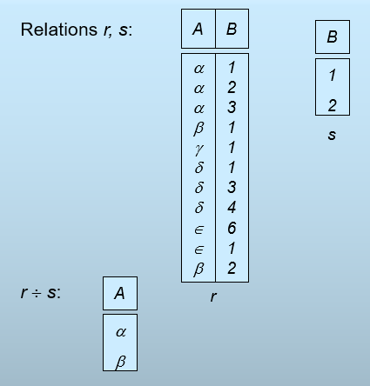
Division Operation – Example

Slide 61
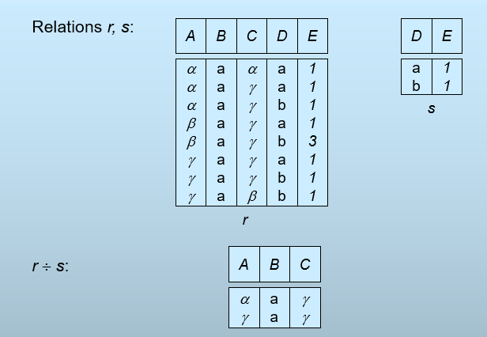
One more example:

Slide 62
Division Operation
Property
Let q – r ÷ s
Then q is the largest relation satisfying q x s ⊆ r
Definition in terms of the basic algebra operation Let r(R) and s(S) be relations, and let S ⊆ R
r ÷ s = ∏_{R-S} (r) –∏_{R-S} ( (∏_{R-S} (r) x s) – ∏_{R-S,S}(r))
To see why
∏_{R-S,S}(r) simply reorders attributes of r
∏_{R-S}(∏_{R-S} (r) x s) – ∏_{R-S,S}(r)) gives those tuples t in ∏_{R-S} (r) such that for some tuple u ∈ s, tu ∉ r.

Slide 63
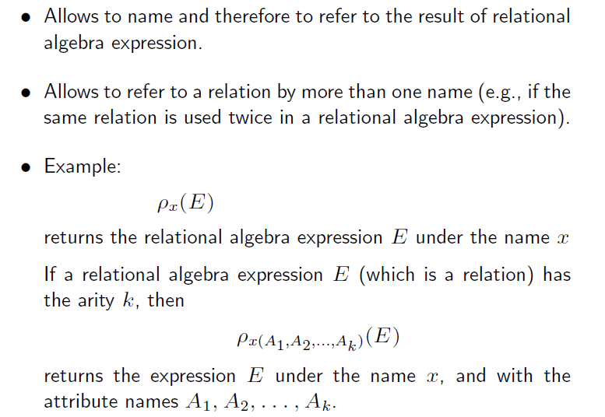
Rename
renames attribute(s) and relation

Slide 64
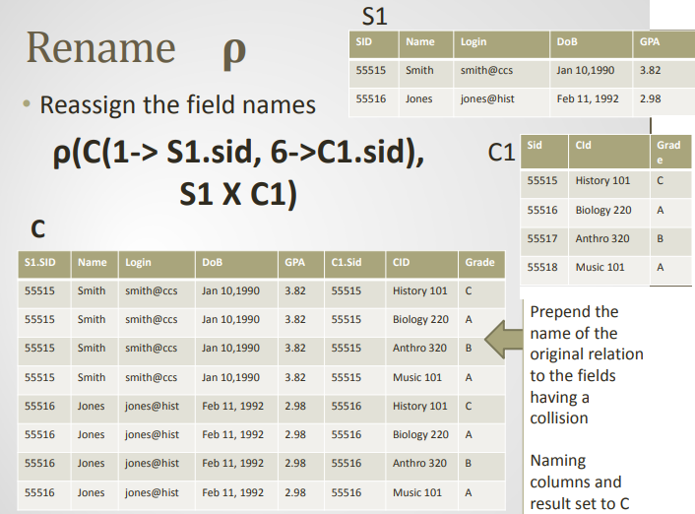

Slide 65
Null Values
It is possible for tuples to have a null value, denoted by null, for some of their attributes
null signifies an unknown value or that a value does not exist.
The result of any arithmetic expression involving null is null.
Aggregate functions simply ignore null values
Is an arbitrary decision. Could have returned null as result instead.
We follow the semantics of SQL in its handling of null values
For duplicate elimination and grouping, null is treated like any other value, and two nulls are assumed to be the same
Alternative: assume each null is different from each other
Both are arbitrary decisions, so we simply follow SQL

Slide 66
Null Values
Comparisons with null values return the special truth value unknown
If false was used instead of unknown, then not (A < 5) would not be equivalent to A >= 5
Three-valued logic using the truth value unknown:
OR: (unknown or true) = true, (unknown or false) = unknown (unknown or unknown) = unknown
AND: (true and unknown) = unknown, (false and unknown) = false, (unknown and unknown) = unknown
NOT: (not unknown) = unknown
In SQL “P is unknown” evaluates to true if predicate P evaluates to unknown
Result of select predicate is treated as false if it evaluates to unknown

Slide 67
Modification of the Database
The content of the database may be modified using the following operations:
Deletion
Insertion
Updating
All these operations are expressed using the assignment operator.

Slide 68
Deletion
A delete request is expressed similarly to a query, except instead of displaying tuples to the user, the selected tuples are removed from the database.
Can delete only whole tuples; cannot delete values on only particular attributes
A deletion is expressed in relational algebra by:
r ← r – E
where r is a relation and E is a relational algebra query.

Slide 69
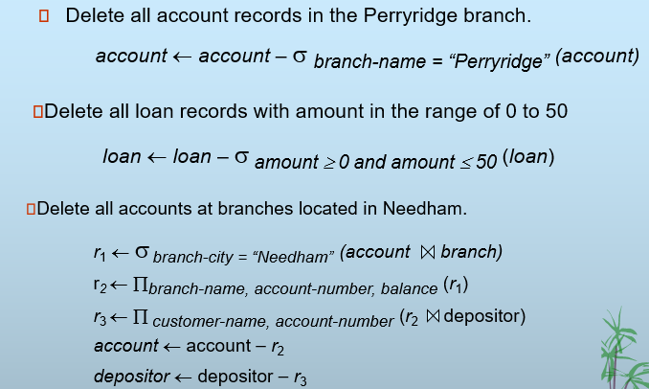
Delete examples

Slide 70
Insertion
To insert data into a relation, we either:
specify a tuple to be inserted
write a query whose result is a set of tuples to be inserted
in relational algebra, an insertion is expressed by:
r ← r ∪ E
where r is a relation and E is a relational algebra expression.
The insertion of a single tuple is expressed by letting E be a constant relation containing one tuple.

Slide 71

Insertion examples

Slide 72
Updating
A mechanism to change a value in a tuple without changing all values in the tuple
Use the generalized projection operator to do this task
r ← ∏ _{F1, F2, …, FI,} (r)
Each F_{i} is either
the ith attribute of r, if the ith attribute is not updated, or,
if the attribute is to be updated F_{i} is an expression, involving only constants and the attributes of r, which gives the new value for the attribute

Slide 73

Update examples

Slide 74

Views

Slide 75
View Definition
A view is defined using the create view statement which has the form
create view v as <query expression>
where <query expression> is any legal relational algebra query expression. The view name is represented by v.
Once a view is defined, the view name can be used to refer to the virtual relation that the view generates.
View definition is not the same as creating a new relation by evaluating the query expression
Rather, a view definition causes the saving of an expression; the expression is substituted into queries using the view.

Slide 76

View Examples

Slide 77
Updates Through View
Database modifications expressed as views must be translated to modifications of the actual relations in the database.
Consider the person who needs to see all loan data in the loan relation except amount. The view given to the person, branch-loan, is defined as:
create view branch-loan as
∏_{branch-name, loan-number} (loan)
Since we allow a view name to appear wherever a relation name is allowed, the person may write:
branch-loan ← branch-loan ∪ {(“Perryridge”, L-37)}

Slide 78
The previous insertion must be represented by an insertion into the actual relation loan from which the view branch-loan is constructed.
An insertion into loan requires a value for amount. The insertion can be dealt with by either.
rejecting the insertion and returning an error message to the user.
inserting a tuple (“L-37”, “Perryridge”, null) into the loan relation
Some updates through views are impossible to translate into database relation updates
create view v as σ_{branch-name = “Perryridge”} (account))
v ← v ∪ (L-99, Downtown, 23)
Others cannot be translated uniquely
all-customer ← all-customer ∪ {(“Perryridge”, “John”)}
Have to choose loan or account, and create a new loan/account number!

Slide 79
Views Defined Using Other Views
One view may be used in the expression defining another view
A view relation v₁ is said to depend directly on a view relation v₂ if v₂ is used in the expression defining v₁
A view relation v₁ is said to depend on view relation v₂ if either v₁ depends directly to v₂ or there is a path of dependencies from v₁ to v₂
A view relation v is said to be recursive if it depends on itself.

Slide 80
View Expansion
A way to define the meaning of views defined in terms of other views.
Let view v₁ be defined by an expression e₁ that may itself contain uses of view relations.
View expansion of an expression repeats the following replacement step:
repeat Find any view relation v_{i} in e₁ Replace the view relation v_{i} by the expression defining v_{i} until no more view relations are present in e₁
As long as the view definitions are not recursive, this loop will terminate

Slide 81
More Example Queries

Slide 82


Slide 83


Slide 84


Slide 85
Precedence of Relational Operators
•1. [ σ, π, ρ] (highest).
•2. [ Χ, ⋈, ÷]
•3. ∩
•4. [ ∪, — ]

