Slide 1
Relational Calculus
CM Suvarna Varma
Assoc Prof
VVIT
UNIT 2- Part 3/3
DBMS

Slide 2
Syllabus
UNIT-II: Conceptual Design & Relational Query Languages
Conceptual Design of Database using ER Model, Notations, Types of attributes, Relation, Mapping Constraints, Features of ER Diagram, Weak Entity Set, Examples of Conceptual Design
Relational Algebra: Selection, Projection, Set Operations, Rename, Cartesian-Product, Join, Outer Join, Examples
Relational Calculus: Tuple Relational Calculus and Domain Relational Calculus ,Safety Expressions

Slide 3
Relational Calculus
Relational calculus query specifies what is to be retrieved rather than how to retrieve it. (No description of how to evaluate a query.)
In first-order logic (or predicate calculus), predicate is a truth-valued function with arguments.
When we substitute values for the arguments, function yields an expression, called a proposition, which can be either true or false.
Relational calculus is non-procedural query language.*declarative language

Slide 4
Relational Calculus
Relational calculus gives description about the query to get the result (unlike relational algebra gives a method to get result)
If predicate contains a variable (e.g. ‘x is a member of staff’), there must be a range for x.
When we substitute some values of this range for x, proposition may be true; for other values, it may be false.
When applied to databases, relational calculus has forms: tuple and domain.

Slide 5
Relational calculus applied to database
When applied to database, we get two types of relational calculus.
1. Tuple Relational Calculus (TRC)
Proposed by codd in 1972
Works on tuples(rows) E.g: SQL (structured query language)
2. Domain Relational calculus (DRC)
Proposed by Lacroix & pirotte in 1977
Works on domain of attributes (columns) E.g: QBE ( Query by Example)

Slide 6
Tuple Relational Calculus
Interested in finding tuples for which a predicate is true. Based on use of tuple variables.
Tuple variable is a variable that ‘ranges over’ a named relation: i.e., variable whose only permitted values are tuples of the relation.
Specify range of a tuple variable S as the Staff relation as:
Staff(S)
To find set of all tuples S such that P(S) is true:
{S | P(S)}

Slide 7
Tuple Relational Calculus - Example
To find details of all staff earning more than £10,000:
{S | Staff(S) ∧ S.salary > 10000}
To find a particular attribute, such as salary, write:
{S.salary | Staff(S) ∧ S.salary > 10000}

Slide 8
Tuple Relational Calculus
Can use two quantifiers to tell how many instances the predicate applies to:
Existential quantifier ∃ (‘there exists’)
Universal quantifier ∀ (‘for all’)
Tuple variables qualified by ∀ or ∃ are called bound variables, otherwise called free variables.

Slide 9
Tuple Relational Calculus
Existential quantifier used in formulae that must be true for at least one instance, such as:
Staff(S) ∧ (∃B)(Branch(B) ∧
(B.branchNo = S.branchNo) ∧ B.city = ‘London’)
Means ‘There exists a Branch tuple with same branchNo as the branchNo of the current Staff tuple, S, and is located in London’.

Slide 10
Tuple Relational Calculus
Universal quantifier is used in statements about every instance, such as:
(∀B) (B.city ≠ ‘Paris’)
Means ‘For all Branch tuples, the address is not in Paris’.
Can also use ~(∃B) (B.city = ‘Paris’) which means ‘There are no branches with an address in Paris’.

Slide 11
Tuple Relational Calculus
Formulae should be unambiguous and make sense.
A (well-formed) formula is made out of atoms:
R(S_{i}), where S_{i} is a tuple variable and R is a relation
S_{i}.a₁ θ S_{j}.a₂
S_{i}.a₁ θ c
Can recursively build up formulae from atoms:
An atom is a formula
If F₁ and F₂ are formulae, so are their conjunction, F₁ ∧ F₂; disjunction, F₁ ∨ F₂; and negation, ~F₁
If F is a formula with free variable X, then (∃X)(F) and (∀X)(F) are also formulae.

Slide 12
Example - Tuple Relational Calculus
List the names of all managers who earn more than £25,000.
{S.fName, S.lName | Staff(S) ∧
S.position = ‘Manager’ ∧ S.salary > 25000}
List the staff who manage properties for rent in Glasgow.
{S | Staff(S) ∧ (∃P) (PropertyForRent(P) ∧ (P.staffNo = S.staffNo) ∧ P.city = ‘Glasgow’)}

Slide 13
Example - Tuple Relational Calculus
List the names of staff who currently do not manage any properties.
{S.fName, S.lName | Staff(S) ∧ (~(∃P) (PropertyForRent(P)∧(S.staffNo = P.staffNo)))}
Or
{S.fName, S.lName | Staff(S) ∧ ((∀P) (~PropertyForRent(P) ∨
~(S.staffNo = P.staffNo)))}

Slide 14
Example - Tuple Relational Calculus
List the names of clients who have viewed a property for rent in Glasgow.
{C.fName, C.lName | Client(C) ∧ ((∃V)(∃P)
(Viewing(V) ∧ PropertyForRent(P) ∧
(C.clientNo = V.clientNo) ∧
(V.propertyNo=P.propertyNo) ∧
P.city =‘Glasgow’))}

Slide 15
Tuple Relational Calculus (unsafe query)
Expressions can generate an infinite set. For example:
{S | ~Staff(S)}
To avoid this, add restriction that all values in result must be values in the domain of the expression.

Slide 16
Domain Relational Calculus
Uses variables that take values from domains instead of tuples of relations.
If F(d₁, d₂, . . . , d_{n}) stands for a formula composed of atoms and d₁, d₂, . . . , d_{n} represent domain variables, then:
{d₁, d₂, . . . , d_{n} | F(d₁, d₂, . . . , d_{n})}
is a general domain relational calculus expression.
Pearson Education © 2009

Slide 17
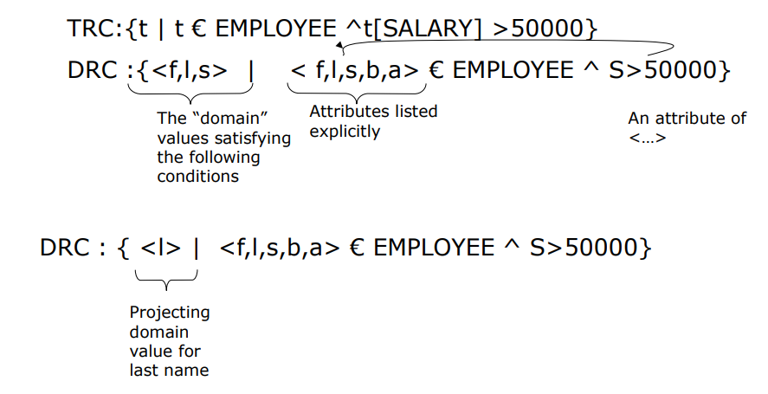

Slide 18
Example - Domain Relational Calculus
Find the names of all managers who earn more than £25,000.
{fN, lN | (∃sN, posn, sex, DOB, sal, bN)
(Staff (sN, fN, lN, posn, sex, DOB, sal, bN) ∧
posn = ‘Manager’ ∧ sal > 25000)}
Pearson Education © 2009

Slide 19
Example - Domain Relational Calculus
List the staff who manage properties for rent in Glasgow.
{sN, fN, lN, posn, sex, DOB, sal, bN |
(∃sN1,cty)(Staff(sN,fN,lN,posn,sex,DOB,sal,bN) ∧
PropertyForRent(pN, st, cty, pc, typ, rms,
rnt, oN, sN1, bN1) ∧
(sN=sN1) ∧ cty=‘Glasgow’)}
Pearson Education © 2009

Slide 20
Example - Domain Relational Calculus
List the names of staff who currently do not manage any properties for rent.
{fN, lN | (∃sN)
(Staff(sN,fN,lN,posn,sex,DOB,sal,bN) ∧
(~(∃sN1) (PropertyForRent(pN, st, cty, pc, typ,
rms, rnt, oN, sN1, bN1) ∧ (sN=sN1))))}
Pearson Education © 2009

Slide 21
Example - Domain Relational Calculus
List the names of clients who have viewed a property for rent in Glasgow.
{fN, lN | (∃cN, cN1, pN, pN1, cty)
(Client(cN, fN, lN,tel, pT, mR) ∧
Viewing(cN1, pN1, dt, cmt) ∧
PropertyForRent(pN, st, cty, pc, typ,
rms, rnt,oN, sN, bN) ∧
(cN = cN1) ∧ (pN = pN1) ∧ cty = ‘Glasgow’)}
Pearson Education © 2009

Slide 22
Domain Relational Calculus
When restricted to safe expressions, domain relational calculus is equivalent to tuple relational calculus restricted to safe expressions, which is equivalent to relational algebra.
TRC(se) = DRC (se) = Rel-Algebra
Means every relational algebra expression has an equivalent relational calculus expression, and vice versa.
Pearson Education © 2009

Slide 23
Other Languages
Transform-oriented languages are non-procedural languages that use relations to transform input data into required outputs (e.g. SQL).
Graphical languages provide user with picture of the structure of the relation. User fills in example of what is wanted and system returns required data in that format (e.g. QBE).
Pearson Education © 2009

Slide 24
Tuple Relational Calculus (Memory tips)
{ A | F(A) }
A is a tuple variable and is the answer if it satisfies the formula F(A)
A is a tuple of relation F
A is a free variable
E.g: { S | S € Sailors }

Slide 25
Tuple Relational Calculus *contd
Syntax for TRC Queries:
1. Atomic formula : a) R € Rel E.g: S € Sailor
b) R.a op S.b E.g: B.branchNo = S.branchNo c)R.a op Constant (or) Constant op R.a
E.g: B.city=‘Paris’

Slide 26
Tuple Relational Calculus :contd
2. P, ¬ P , P V Q , P ^ Q, P => Q
e.g: {S | S € Sailors }
{S | ¬ S.position = ‘Manager’}
{S | S.position = ‘Manager’ ∧ S.salary > 25000}
{S | S.position = ‘Manager’ V S.salary > 25000}
{S | S.position = ‘Manager’ => S.salary > 25000}

Slide 27
Tuple Relational Calculus contd
3. ∃ R P(R) where R is a tuple variable.
E.g: ∃ S [S € Sailors ]
4. ∀ R P(R)
E.g: ∀ S [S € Sailors ]

Slide 28
Tuple Relational Calculus
Example: Find the names and ages of sailors with a ratying abobve 7 ?
{ s.name, s.age |S€ Sailors ^ S.rating > 7 } x
Here S is a free variable
{ T | ∃ S( S€ Sailors S.rating > 7 ) ^ T.name = S.name ^ T.age = s.age }

Slide 29
Safe query
Unsafe query { s | s sailors }
Define concept called domain of the query: {all tables which are mentioned in the query}
Domain { Sailors only} or { sailors & reserves}
Relation between Domain of query and your output.
For eg: o/p results subset or equal to that table.
T | there exists sailors and there exists reserves and r.sid = s.sid, and r.bid=7 and t.name=s.name
Output must come from one of the tables of query and restricted. Here domain is Sailors U Reserves.

Slide 30
