Slide 1
PL/SQL
CM Suvarna Varma
Assoc Prof
VVIT
Unit 3 part 2/2

Slide 2
syllabus
SQL Commands: DDL, DML, TCL, DCL
Types of Constraints (Primary, Alternate, Not Null, Check, Foreign),
Basic form of SQL query, joins, outer joins, set operations, group operations,
various types of queries,
PL/SQL (Cursor, Procedures, Functions, Packages, Triggers…)

Slide 3
PL/SQL
PL/SQL stands for Procedural Language/SQL.
PL/SQL extends SQL by adding control Structures found in other procedural language.
PL/SQL combines the flexibility of SQL with Powerful feature of 3rd
generation Language.
The procedural construct and database access Are present in PL/SQL.
PL/SQL can be used in both in database in Oracle Server and in Client side application development tools.
It was developed by Oracle Corporation in the early 90's to enhance the capabilities of SQL.
PL/SQL is one of three key programming languages embedded in the Oracle Database, along with SQL itself and Java.

Slide 4
notable facts about PL/SQL −
PL/SQL is a completely portable, high-performance transaction-processing language.
PL/SQL provides a built-in, interpreted and OS independent programming environment.
PL/SQL can also directly be called from the command-line SQL*Plus interface.
Direct call can also be made from external programming language calls to database.
PL/SQL's general syntax is based on that of ADA and Pascal programming language.
Apart from Oracle, PL/SQL is available in TimesTen in-memory database and IBM DB2.

Slide 5
Features of PL/SQL
PL/SQL has the following features −
PL/SQL is tightly integrated with SQL.
It offers extensive error checking.
It offers numerous data types.
It offers a variety of programming structures.
It supports structured programming through functions and procedures.
It supports object-oriented programming.
It Contains new libraries of built in packages.
Allows the calling of external functions and procedures.
with PL/SQL , an multiple sql statements can be processed in a single command line statement.

Slide 6
Advantages of PL/SQL
PL/SQL supports both static and dynamic SQL. Static SQL supports DML operations and transaction control from PL/SQL block.
In Dynamic SQL, SQL allows embedding DDL statements in PL/SQL blocks.
PL/SQL allows sending an entire block of statements to the database at one time. This reduces network traffic and provides high performance for the applications.
PL/SQL gives high productivity to programmers as it can query, transform, and update data in a database.
PL/SQL saves time on design and debugging by strong features, such as exception handling, encapsulation, data hiding, and object-oriented data types.
Applications written in PL/SQL are fully portable.
PL/SQL provides high security level.
PL/SQL provides access to predefined SQL packages.
PL/SQL provides support for Object-Oriented Programming.
PL/SQL provides support for developing Web Applications and Server Pages.

Slide 7
PL/SQL Program units
PL/SQL block
Function
Package
Package body
Procedure
Trigger
Type
Type body

Slide 8
PL/SQL BLOCK
PL/SQL is a block-structured language, means that the PL/SQL programs are divided and written in logical blocks of code. Each block consists of three sub-parts −
It consists of three sections:
A declaration of variables, constants, cursors and exceptions which is optional.
A section of executable statements.
A section of exception handlers, which is optional
The text of an Oracle Forms trigger is an anonymous PL/SQL block.
Every PL/SQL statement ends with a semicolon (;).
PL/SQL blocks can be nested within other PL/SQL blocks using BEGIN and END.

Slide 9
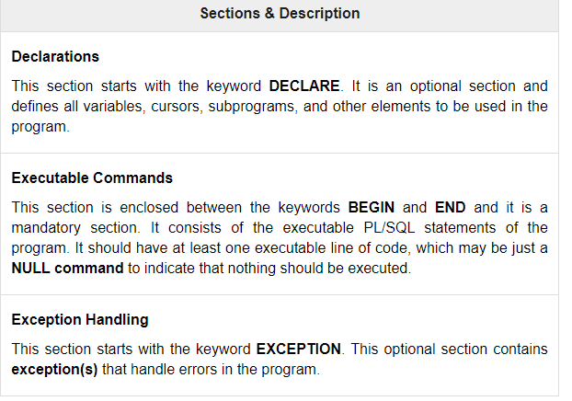

Slide 10
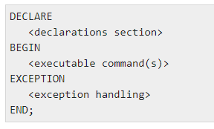
Basic structure of PL/sQL

Slide 11
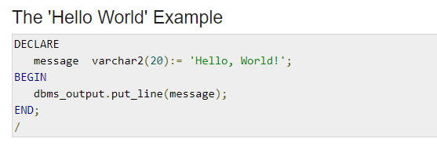

Example
OUTPUT:

Slide 12
PRINT
DBMS_OUTPUT.PUT_LINE ()
It is a pre-defined package that prints the message inside the parenthesis

Slide 13
The PL/SQL Identifiers
PL/SQL identifiers are constants, variables, exceptions, procedures, cursors, and reserved words. The identifiers consist of a letter optionally followed by more letters, numerals, dollar signs, underscores, and number signs and should not exceed 30 characters.
By default, identifiers are not case-sensitive. So you can use integer or INTEGER to represent a numeric value. You cannot use a reserved keyword as an identifier.

Slide 14
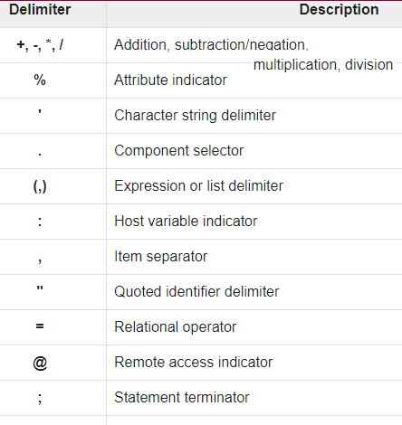
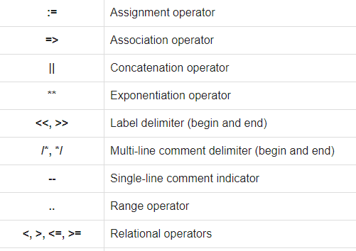

Slide 15
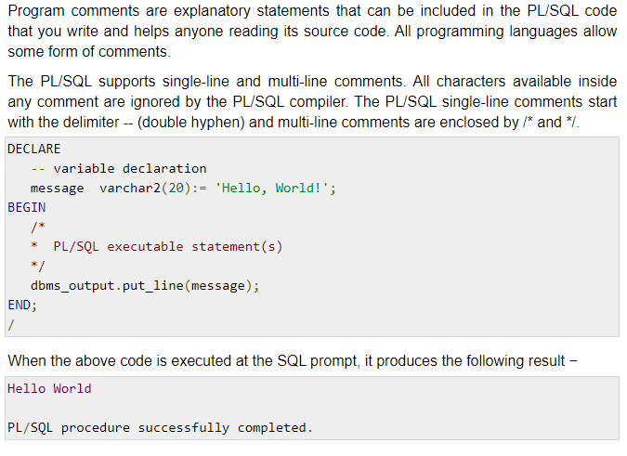
PL/SQL Comments

Slide 16
PL/SQL Datatypes
Scalar Types
BINARY_INTEGER ,DEC,DECIMAL,DOUBLE ,,PRECISION,FLOAT,INT,INTEGER,NATURAL,
NATURALN,NUMBER, NUMERIC, PLS_INTEGER,POSITIVE,POSITIVEN,REAL,SIGNTYPE,
SMALLINT,CHAR,CHARACTER,LONG,LONG RAW,NCHAR,NVARCHAR2,RAW,ROWID,STRING,
VARCHAR,VARCHAR2,
Composite Types
TABLE, VARRAY, RECORD
LOB Types
BFILE, BLOB, CLOB, NCLOB
Reference Types
REF CURSOR
BOOLEAN, DATE

Slide 17
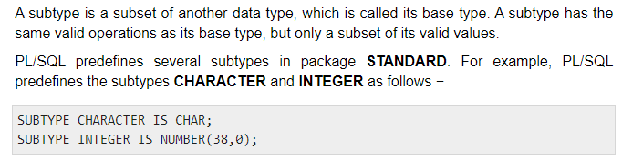
Subtype – in a datatype

Slide 18

PL/SQL User-Defined Subtypes
A subtype is a subset of another data type, which is called its base type. A subtype has the same valid operations as its base type, but only a subset of its valid values.
PL/SQL predefines several subtypes in package STANDARD.
For example, PL/SQL predefines the subtypes CHARACTER and INTEGER as follows −

Slide 19
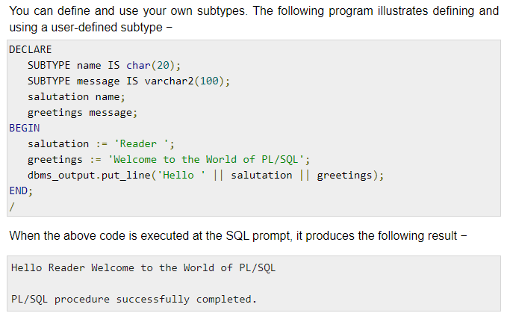

Slide 20
Variable Declaration in PL/SQL
PL/SQL variables must be declared in the declaration section or in a package as a global variable. When you declare a variable, PL/SQL allocates memory for the variable's value and the storage location is identified by the variable name.
The syntax for declaring a variable is −

Slide 21
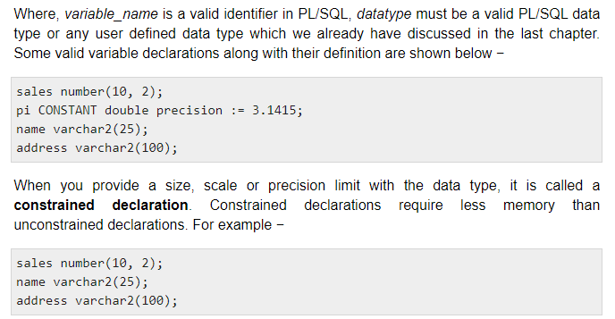

Slide 22
Initializing Variables in PL/SQL
Whenever you declare a variable, PL/SQL assigns it a default value of NULL. If you want to initialize a variable with a value other than the NULL value, you can do so during the declaration, using either of the following −
The DEFAULT keyword
The assignment operator

Slide 23

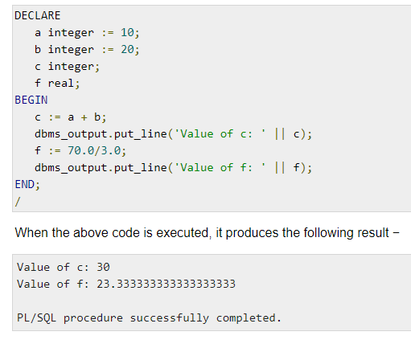
NULL
DEFAULT
ASSIGNMENT

Slide 24
Variable scope
PL/SQL allows the nesting of blocks, i.e., each program block may contain another inner block. If a variable is declared within an inner block, it is not accessible to the outer block. However, if a variable is declared and accessible to an outer block, it is also accessible to all nested inner blocks. There are two types of variable scope −
Local variables − Variables declared in an inner block and not accessible to outer blocks.
Global variables − Variables declared in the outermost block or a package.

Slide 25
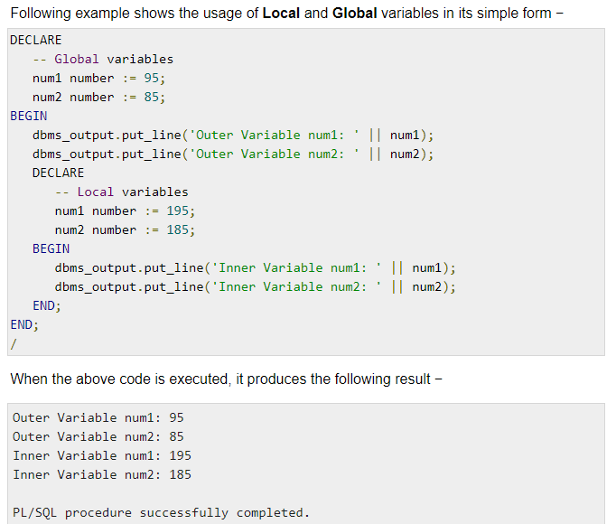

Slide 26
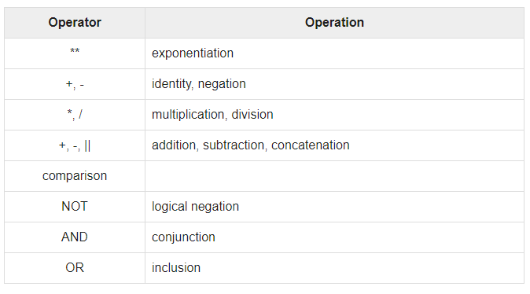
Operator Precedence

Slide 27
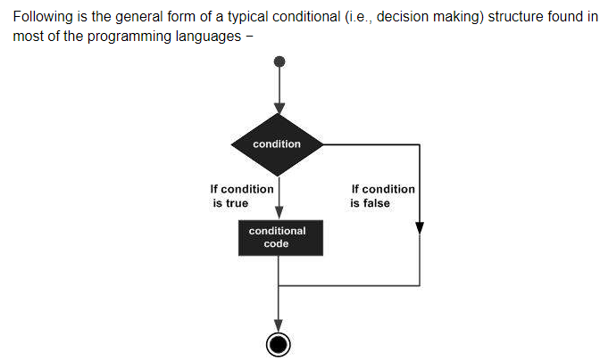
Conditions

Slide 28
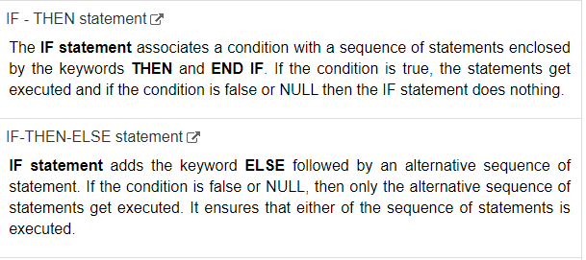
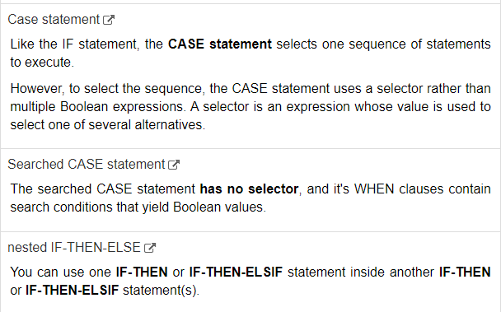

Slide 29
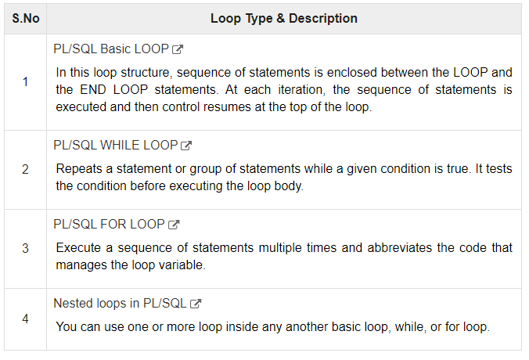

Slide 30
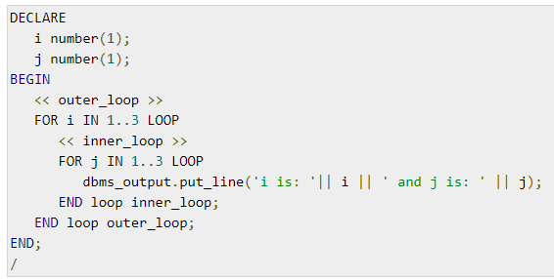
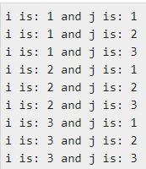
PL/SQL loops can be labeled. The label should be enclosed by double angle brackets (<< and >>) and appear at the beginning of the LOOP statement. The label name can also appear at the end of the LOOP statement. You may use the label in the EXIT statement to exit from the loop.

Slide 31
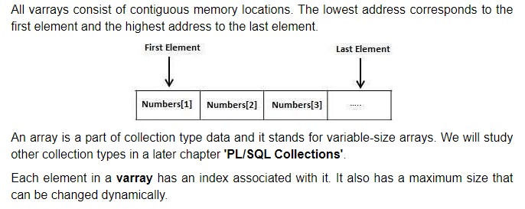
V-Array
The PL/SQL programming language provides a data structure called the VARRAY, which can store a fixed-size sequential collection of elements of the same type. A varray is used to store an ordered collection of data, however it is often better to think of an array as a collection of variables of the same type.
All varrays consist of contiguous memory locations. The lowest address corresponds to the first element and the highest address to the last element.

Slide 32
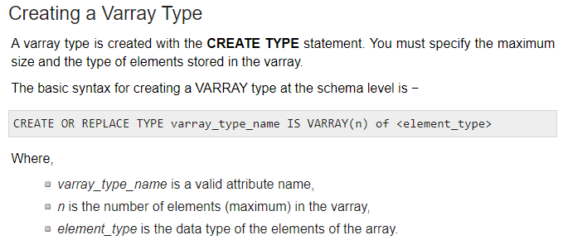
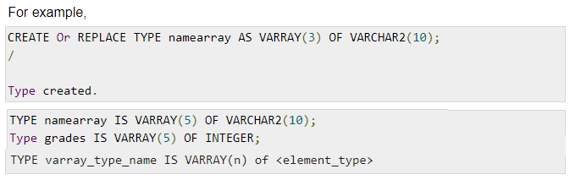

Slide 33
Procedures
A subprogram is a program unit/module that performs a particular task. These subprograms are combined to form larger programs.
This is basically called the 'Modular design'. A subprogram can be invoked by another subprogram or program which is called the calling program.
A subprogram can be created −
At the schema level
Inside a package
Inside a PL/SQL block

Slide 34
Procedures
At the schema level, subprogram is a standalone subprogram. It is created with the CREATE PROCEDURE or the CREATE FUNCTION statement. It is stored in the database and can be deleted with the DROP PROCEDURE or DROP FUNCTION statement.
A subprogram created inside a package is a packaged subprogram. It is stored in the database and can be deleted only when the package is deleted with the DROP PACKAGE statement. We will discuss packages in the chapter 'PL/SQL - Packages'.

Slide 35
Procedures & functions
PL/SQL subprograms are named PL/SQL blocks that can be invoked with a set of parameters. PL/SQL provides two kinds of subprograms −
Functions − These subprograms return a single value; mainly used to compute and return a value.
Procedures − These subprograms do not return a value directly; mainly used to perform an action.

Slide 36
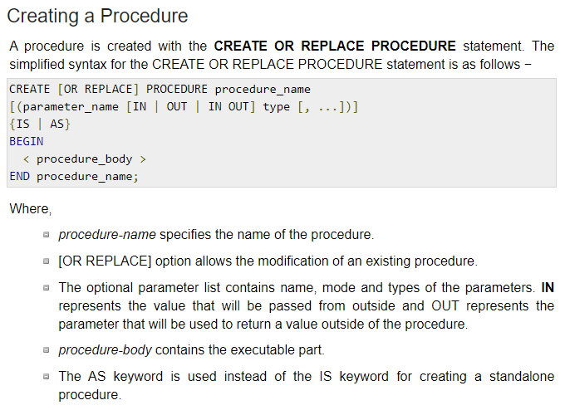

Slide 37
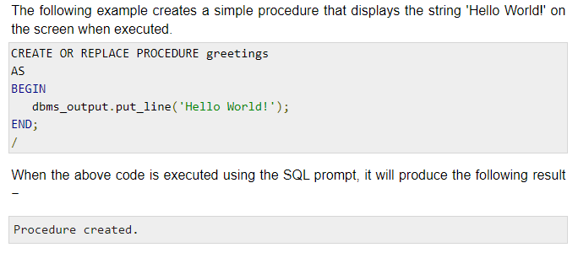
Example: Procedure

Slide 38
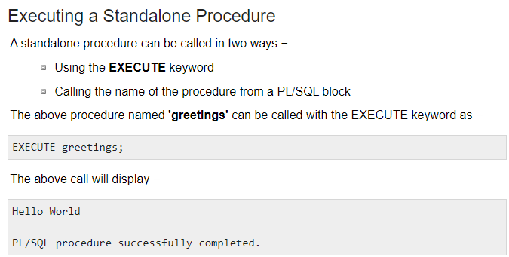
To execute a Procedure:

Slide 39
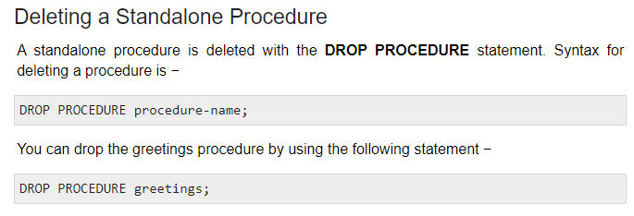

Slide 40
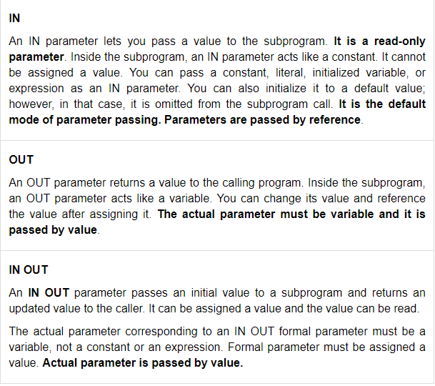
PROCARGS.SQL

Slide 41
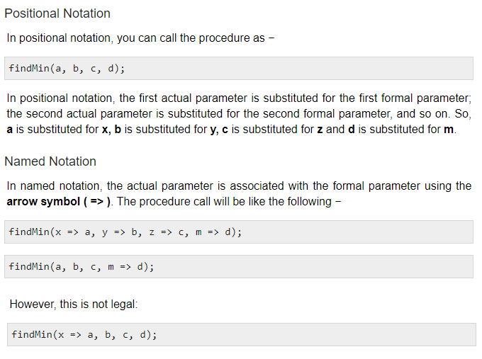

Slide 42
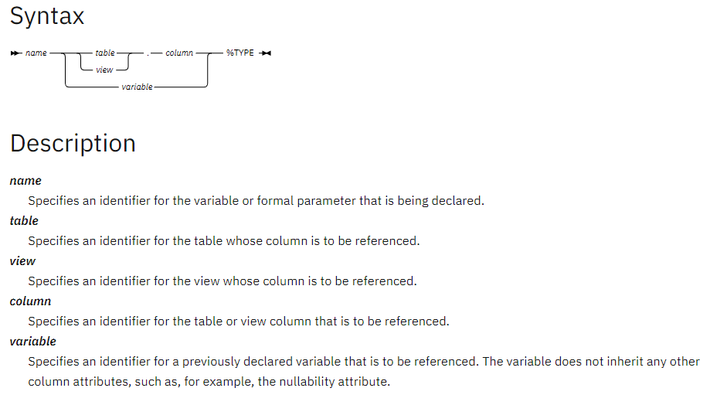

Slide 43
ATTRIBUTES
ATTRIBUTES Allow us to refer to data types and objects from the database.
PL/SQL variables and Constants can have attributes.
The main advantage of using Attributes is even if you Change the data definition, you don’t need to change in the application.
%TYPE
It is used when declaring variables that refer to the database columns.
Using %TYPE to declare variable has two advantages.
First, you need not know the exact datatype of variable.
Second, if the database definition of variable changes, the datatype of variable changes accordingly at run time.

Slide 44
%ROWTYPE
The %ROWTYPE attribute provides a record type that represents a row in a table (or view).
The record can store an entire row of data selected from the table or fetched from a cursor or strongly typed cursor variable.

Slide 45
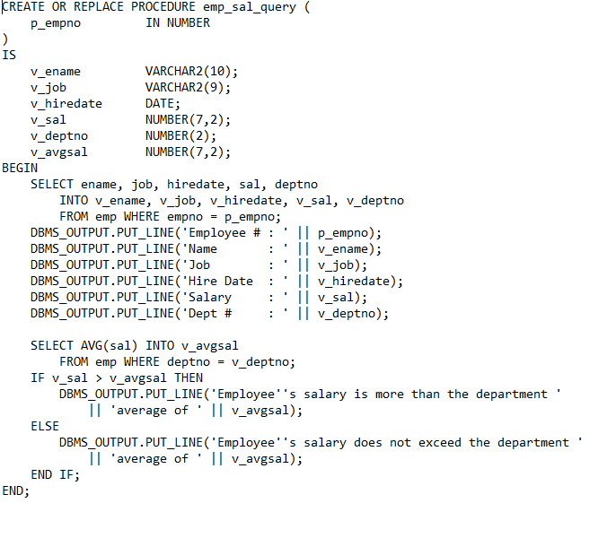
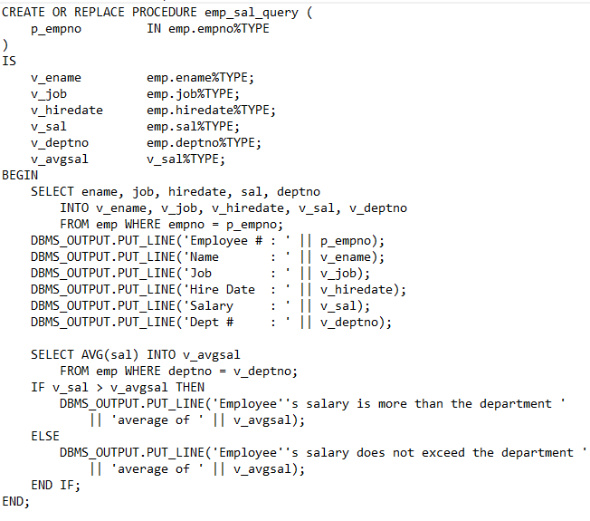

Slide 46
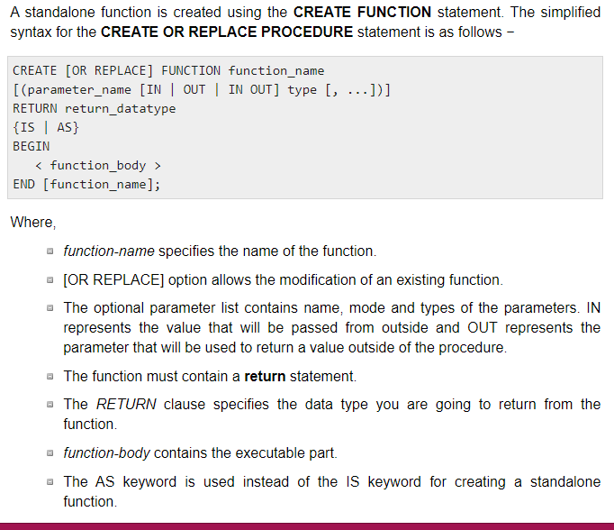
FUNCTIONS

Slide 47
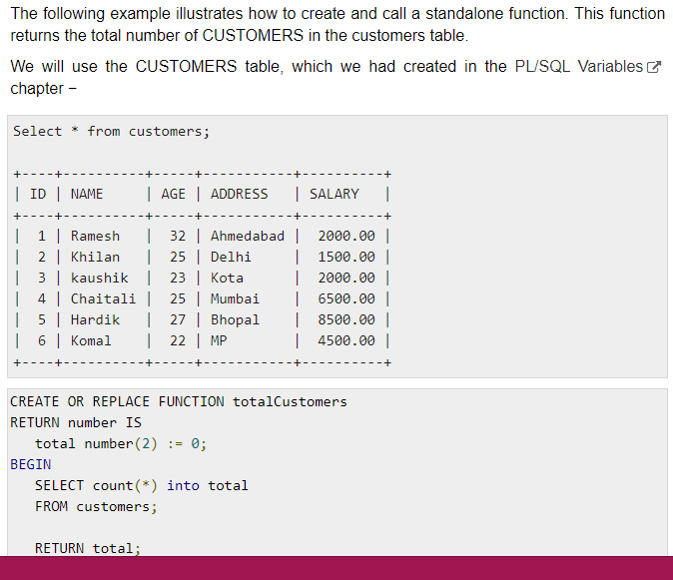

Slide 48
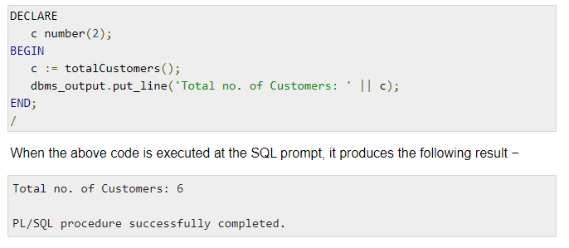
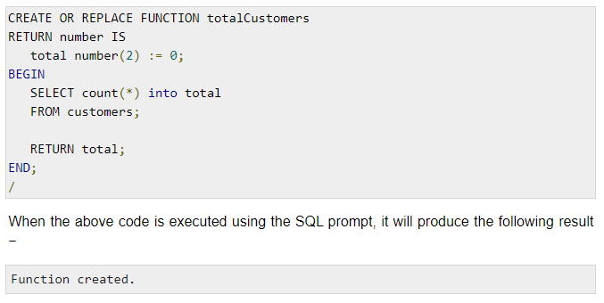
Calling function

Slide 49
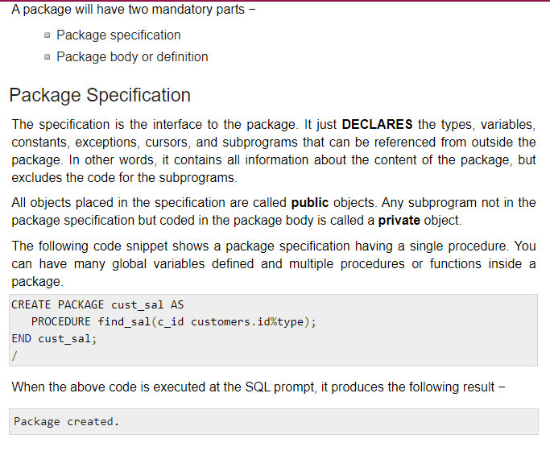
Package

Slide 50
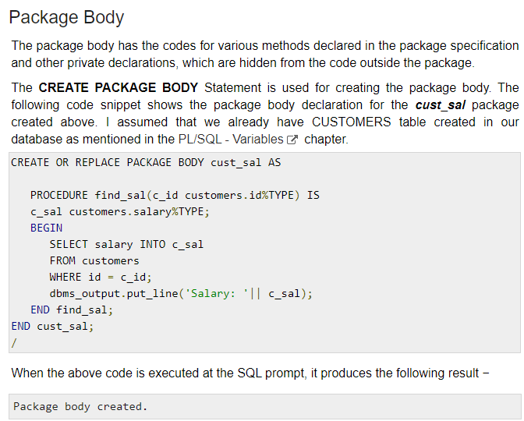

Slide 51
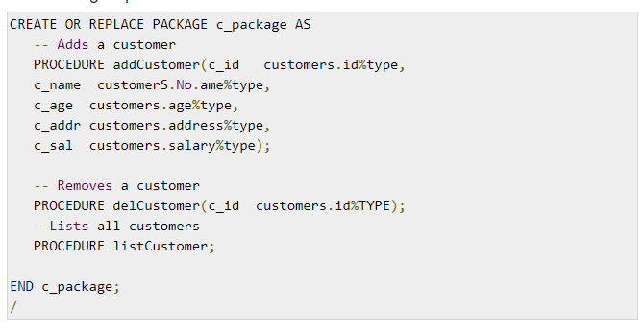

Slide 52
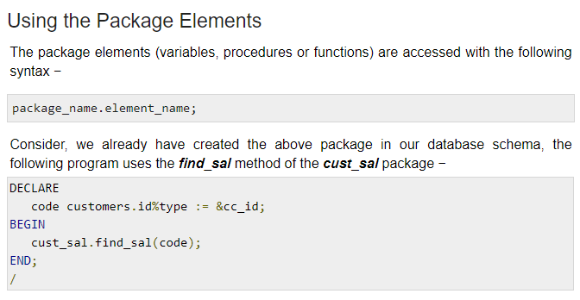

Slide 53
Cursors
A cursor is a pointer to this context area. PL/SQL controls the context area through a cursor.
A cursor holds the rows (one or more) returned by a SQL statement.
The set of rows the cursor holds is referred to as the active set.
You can name a cursor so that it could be referred to in a program to fetch and process the rows returned by the SQL statement, one at a time.
There are two types of cursors −
Implicit cursors
Explicit cursors

Slide 54
Implicit Cursors
Implicit cursors are automatically created by Oracle whenever an SQL statement is executed, when there is no explicit cursor for the statement. Programmers cannot control the implicit cursors and the information in it.
Whenever a DML statement (INSERT, UPDATE and DELETE) is issued, an implicit cursor is associated with this statement. For INSERT operations, the cursor holds the data that needs to be inserted. For UPDATE and DELETE operations, the cursor identifies the rows that would be affected.

Slide 55
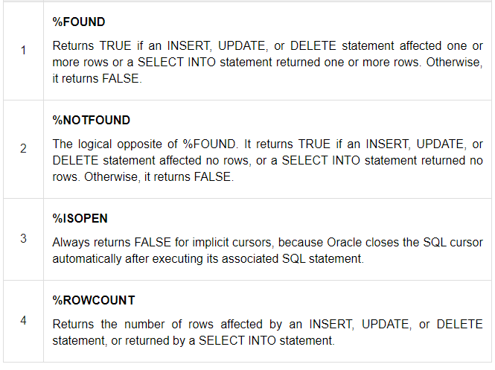

Slide 56
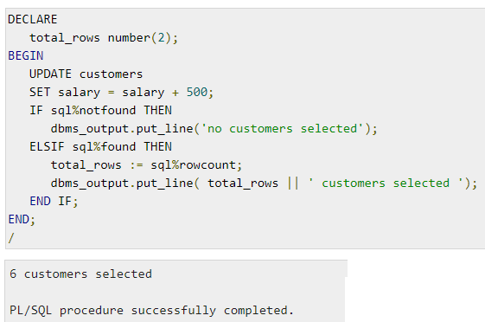

Slide 57
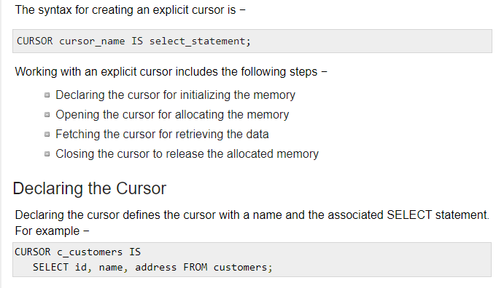
Explicit cursors

Slide 58
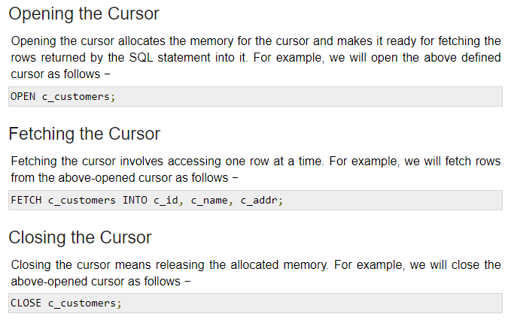

Slide 59
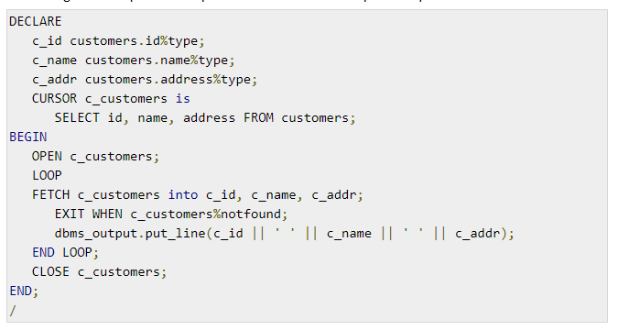
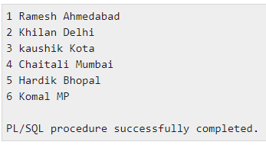

Slide 60
Triggers
Triggers are stored programs, which are automatically executed or fired when some events occur. Triggers are, in fact, written to be executed in response to any of the following events −
A database manipulation (DML) statement (DELETE, INSERT, or UPDATE)
A database definition (DDL) statement (CREATE, ALTER, or DROP).
A database operation (SERVERERROR, LOGON, LOGOFF, STARTUP, or SHUTDOWN).
Triggers can be defined on the table, view, schema, or database with which the event is associated.

Slide 61
Benefits of Triggers
Triggers can be written for the following purposes −
Generating some derived column values automatically
Enforcing referential integrity
Event logging and storing information on table access
Auditing
Synchronous replication of tables
Imposing security authorizations
Preventing invalid transactions

Slide 62
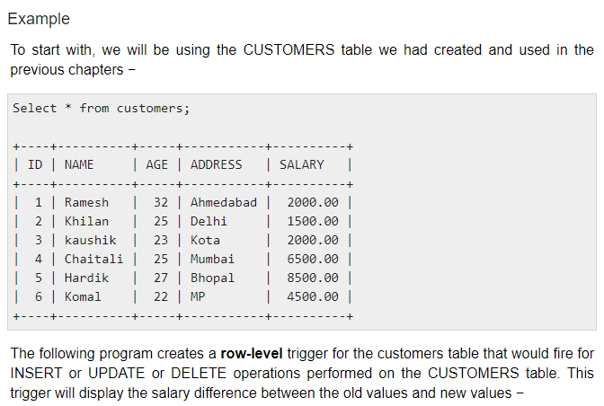

Slide 63
Ref table: Customer table
CREATE TABLE CUSTOMERS( ID INT NOT NULL, NAME VARCHAR (20) NOT NULL,
AGE INT NOT NULL, ADDRESS CHAR (25), SALARY DECIMAL (18, 2), PRIMARY KEY (ID) );
INSERT INTO CUSTOMERS (ID,NAME,AGE,ADDRESS,SALARY) VALUES (1, 'Ramesh', 32, 'Ahmedabad', 2000.00 );
INSERT INTO CUSTOMERS (ID,NAME,AGE,ADDRESS,SALARY) VALUES (2, 'Khilan', 25, 'Delhi', 1500.00 );
INSERT INTO CUSTOMERS (ID,NAME,AGE,ADDRESS,SALARY) VALUES (3, 'kaushik', 23, 'Kota', 2000.00 );
INSERT INTO CUSTOMERS (ID,NAME,AGE,ADDRESS,SALARY) VALUES (4, 'Chaitali', 25, 'Mumbai', 6500.00 );
INSERT INTO CUSTOMERS (ID,NAME,AGE,ADDRESS,SALARY) VALUES (5, 'Hardik', 27, 'Bhopal', 8500.00 );
INSERT INTO CUSTOMERS (ID,NAME,AGE,ADDRESS,SALARY) VALUES (6, 'Komal', 22, 'MP', 4500.00 );

Slide 64
CREATE [OR REPLACE ] TRIGGER trigger_name
{BEFORE | AFTER | INSTEAD OF }
{INSERT [OR] | UPDATE [OR] | DELETE}
[OF col_name] ON table_name
[REFERENCING OLD AS o NEW AS n]
[FOR EACH ROW] WHEN (condition)
DECLARE Declaration-statements
BEGIN Executable-statements
EXCEPTION Exception-handling-statements
END;

Slide 65
Where,
CREATE [OR REPLACE] TRIGGER trigger_name − Creates or replaces an existing trigger with the trigger_name.
{BEFORE | AFTER | INSTEAD OF} − This specifies when the trigger will be executed. The INSTEAD OF clause is used for creating trigger on a view.
{INSERT [OR] | UPDATE [OR] | DELETE} − This specifies the DML operation.
[OF col_name] − This specifies the column name that will be updated.
[ON table_name] − This specifies the name of the table associated with the trigger.
[REFERENCING OLD AS o NEW AS n] − This allows you to refer new and old values for various DML statements, such as INSERT, UPDATE, and DELETE.
[FOR EACH ROW] − This specifies a row-level trigger, i.e., the trigger will be executed for each row being affected. Otherwise the trigger will execute just once when the SQL statement is executed, which is called a table level trigger.
WHEN (condition) − This provides a condition for rows for which the trigger would fire. This clause is valid only for row-level triggers.

Slide 66
Trigger program
CREATE OR REPLACE TRIGGER display_salary_changes
BEFORE DELETE OR INSERT OR UPDATE ON customers
FOR EACH ROW
WHEN (NEW.ID > 0)
DECLARE
sal_diff number;
BEGIN
sal_diff := :NEW.salary - :OLD.salary;
dbms_output.put_line('Old salary: ' || :OLD.salary);
dbms_output.put_line('New salary: ' || :NEW.salary);
dbms_output.put_line('Salary difference: ' || sal_diff);
END;
/

Slide 67
CREATE OR REPLACE TRIGGER display_salary_afterchanges
AFTER DELETE OR INSERT OR UPDATE ON customers
FOR EACH ROW
WHEN (NEW.ID > 0)
DECLARE
sal_diff number;
BEGIN
sal_diff := :NEW.salary - :OLD.salary;
dbms_output.put_line('Old salary: ' || :OLD.salary);
dbms_output.put_line('New salary: ' || :NEW.salary);
dbms_output.put_line('Salary difference: ' || sal_diff);
END;
/

Slide 68
The trigger “Display_salary_change” triggers for update, insert or delete operations of customer table as below:
INSERT INTO CUSTOMERS (ID,NAME,AGE,ADDRESS,SALARY)
VALUES (7, 'Kriti', 22, 'HP', 7500.00 );
When a record is created in the CUSTOMERS table, the above create trigger,
display_salary_changes will be fired and it will display the following result −
Old salary:
New salary: 7500
Salary difference:
UPDATE customers SET salary = salary + 500 WHERE id = 2;
Old salary: 1500
New salary: 2000
Salary difference: 500
DELETE FROM customers WHERE id = 2;

Slide 69
EXCEPTION HANDLING
PL/SQL supports programmers to catch such conditions using EXCEPTION block in the program and an appropriate action is taken against the error condition. There are two types of exceptions −
System-defined exceptions (Pre-defined)
User-defined exceptions

Slide 70
Exception Types
1. Predefined Exceptions
An internal exception is raised implicitly whenever your PL/SQL program violates an Oracle rule or exceeds a system-dependent limit. Every Oracle error has a number, but exceptions must be handled by name.
So, PL/SQL predefines some common Oracle errors as exceptions. For example, PL/SQL raises the predefined exception NO_DATA_FOUND if a SELECT INTO statement returns no rows.

Slide 71
2. User – Defined exceptions
User – defined exception must be defined and explicitly raised by the user
EXCEPTION_INIT
A named exception can be associated with a particular oracle error. This can be used to trap the error specifically.
PRAGMA EXCEPTION_INIT(exception name, Oracle_error_number);
The pragma EXCEPTION_INIT associates an exception name with an Oracle, error number. That allows you to refer to any internal exception by name and to write a specific handler

Slide 72
RAISE_APPLICATION_ERROR
The procedure raise_application_error lets you issue user-defined error messages from stored subprograms.
That way, you can report errors to your application and avoid returning unhandled exceptions.
To call raise_application_error, you use the syntax
raise_application_error(error_number, message[, {TRUE | FALSE}]);
where error_number is a negative integer in the range -20000 .. -20999 and message is a character string up to 2048 bytes long

Slide 73
Using SQLCODE and SQLERRM
For internal exceptions, SQLCODE returns the number of the Oracle error. The number that SQLCODE returns is negative unless the Oracle error is no data found, in which case SQLCODE returns +100.
SQLERRM returns the corresponding error message. The message begins with the Oracle error code.
Unhandled Exceptions
PL/SQL returns an unhandled exception error to the host environment, which determines the outcome.
When Others
It is used when all exception are to be trapped.

Slide 74
Exception syntax
DECLARE <declarations section>
BEGIN <executable command(s)>
EXCEPTION <exception handling goes here > WHEN exception1 THEN
exception1-handling-statements WHEN exception2 THEN
exception2-handling-statements WHEN exception3 THEN
exception3-handling-statements ........ WHEN others THEN
exception3-handling-statements
END;

Slide 75
Program
DECLARE c_id customers.id%type := 8;
c_name customerS.Name%type;
c_addr customers.address%type;
BEGIN
SELECT name, address INTO c_name, c_addr
FROM customers WHERE id = c_id;
DBMS_OUTPUT.PUT_LINE ('Name: '|| c_name);
DBMS_OUTPUT.PUT_LINE ('Address: ' || c_addr);
EXCEPTION WHEN no_data_found THEN
dbms_output.put_line('No such customer!’);
WHEN others THEN dbms_output.put_line('Error!’);
END;
/

