Slide 1
SQL
CM Suvarna Varma
Assoc Prof
Unit 3
PART 1/2

Slide 2
syllabus
SQL Commands: DDL, DML, TCL, DCL
Types of Constraints (Primary, Alternate, Not Null, Check, Foreign),
Basic form of SQL query, joins, outer joins, set operations, group operations,
various types of queries,
PL/SQL (Cursor, Procedures, Functions, Packages, Triggers…)

Slide 3
SQL
SQL (Structured Query Language) is a standardized programming language that's used to manage relational databases and perform various operations on the data in them.
... Also known as SQL databases, relational systems comprise a set of tables containing data in rows and columns.

Slide 4
History of SQL
The language, Structured English Query Language (SEQUEL) was developed by IBM Corporation, Inc., to use Codd's model.
Raymond Boyce and Donald Chamberlin developed SQL at IBM in the early 1970s. It was created for getting access and modifying data held in databases.
Initially, it was called SEQUEL (Structured English Query Language) but later needed to change its name because another business claimed that name as a trademark
SEQUEL later became SQL (still pronounced "sequel").
In 1979, Relational Software, Inc. (now Oracle) introduced the first commercially available implementation of SQL.

Slide 5
SolarWinds Database Performance Analyzer
DbVisualizer
ManageEngine Applications Manager
Altibase
Oracle RDBMS
IBM DB2
Microsoft SQL Server
SAP Sybase ASE
Teradata
ADABAS
MySQL
FileMaker
Microsoft Access
Informix
SQLite
16. PostgresSQL
17.AmazonRDS
18.MongoDB
19.Redis
20.CouchDB
21.Neo4j
22.OrientDB
23.Couchbase
24.Toad
25.phpMyAdmin
26.SQL Developer
27.Seqel PRO
28.Robomongo
29.Hadoop HDFS
30.Cloudera
31.MariaDB
32.Informix Dynamic Server
33.4D (4th Dimension)

Slide 6
Free Databases
Best Free Database Software:
MySQL.
Microsoft SQL.
PostgreSQL.
Teradata Database.
SAP HANA, Express Edition.
MongoDB.
CouchDB.
DynamoDB.

Slide 7
SQL Commands
DDL - Data Definition Language [ Create, Drop, alter, rename, Truncate]
DML -Data Manipulation language [ Select, Insert, Update, Delete]
DCL -Data Control Language [ Grant, Revoke]
TCL -Transaction control Language [ Commit, rollback , savepoint]

Slide 8
DDL
CREATE TABLE or ALTER TABLE belong to the DDL.
DDL is about "metadata".
DDL includes commands such as CREATE, ALTER, and DROP statements.
DDL are used to CREATE, ALTER, OR DROP the database objects (Table, Views, Users).
Data Definition Language (DDL) is used in different statements :
CREATE - to create objects in the database
ALTER - alters the structure of the database
DROP - delete objects from the database
TRUNCATE - remove all records from a table, including all spaces allocated for the records are removed
COMMENT - add comments to the data dictionary
RENAME - rename an object

Slide 9
CREATE TABLE
Syntax:
CREATE TABLE table_name(
Col_name1 datatype(),
Col_name2 datatype(),…
Col_namen datatype(),
);
E.g: CREATE TABLE DDLTest
( id int, DDL_Type varchar(50), DDL_Value int
);

Slide 10
ALTER TABLE -add
Syntax:
ALTER TABLE table_name
ADD Col_name datatype()...;
E,g: ALTER TABLE DDLTest
ADD COLUMN DDL_Example varchar(50);

Slide 11
ALTER TABLE - modify
Syntax:
ALTER TABLE table_name
MODIFY (fieldname datatype()...);
E.g: ALTER TABLE DDLTest
MODIFY DDL_Example BIGINT;

Slide 12
Decribe & Drop table
Syntax:
DESCRIBE TABLE NAME;
E,g: Describe DDLTest;
Syntax:
DROP TABLE NAME;
E,g: Drop DDLTest;

Slide 13
Rename
Syntax:
RENAME table table_name new table_name;
E,g: RENAME table DDLTest DDLTest1;

Slide 14
CREATE WITH KEYS
CREATE TABLE CUSTOMERS( ID INT NOT NULL,
NAME VARCHAR (20) NOT NULL,
AGE INT NOT NULL, ADDRESS CHAR (25) ,
SALARY DECIMAL (18, 2),
PRIMARY KEY (ID) );

Slide 15
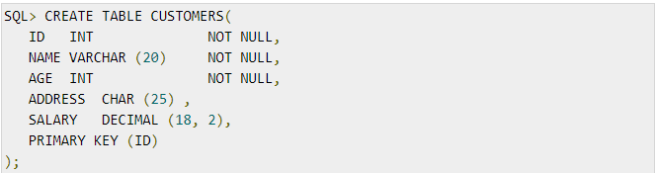
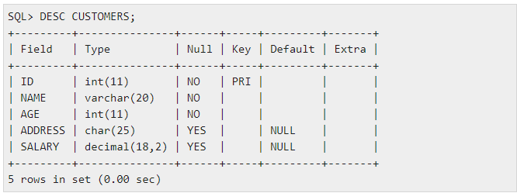

Slide 16
DML
Data Manipulation Language (DML) statements are used for managing data within schema objects DML deals with data manipulation, and therefore includes most common SQL statements such as SELECT, INSERT, etc.
DML allows adding / modifying / deleting data itself.
DML is used to manipulate the existing data in the database objects (insert, select, update, delete).
DML Commands (SIDU)
1. SELECT
2. INSERT
3.DELETE
4.UPDATE

Slide 17
INSERT
Syntax:
INSERT INTO Table_Name VALUES();
[can add multiple values at single time]
[can use the order or specific insert values]
E.g:
INSERT INTO DDLTest (id, DDL_Type, DDL_Value) VALUES (2, 'DML', 123 , ‘ashsg’),
(3, 'DCL', 123, ‘ghgd’);

Slide 18
Insert with field names included
Insert without field names
INSERT INTO CUSTOMERS VALUES (1, 'Ramesh', 32, 'Ahmedabad', 2000.00 ),
(2, 'Khilan', 25, 'Delhi', 1500.00 ),
(3, 'kaushik', 23, 'Kota', 2000.00 ),
(4, 'Chaitali', 25, 'Mumbai', 6500.00 ),
(5, 'Hardik', 27, 'Bhopal', 8500.00 ),
(6, 'Komal', 22, 'MP', 4500.00 );
Insert without field names and multiple values at same time

Slide 19
Insert multiple rows in single query;
INSERT INTO CUSTOMERS VALUES (1, 'Ramesh', 32, 'Ahmedabad', 2000.00 ),
(2, 'Khilan', 25, 'Delhi', 1500.00 ),
(3, 'kaushik', 23, 'Kota', 2000.00 ),
(4, 'Chaitali', 25, 'Mumbai', 6500.00 ),
(5, 'Hardik', 27, 'Bhopal', 8500.00 ),
(6, 'Komal', 22, 'MP', 4500.00 );

Slide 20
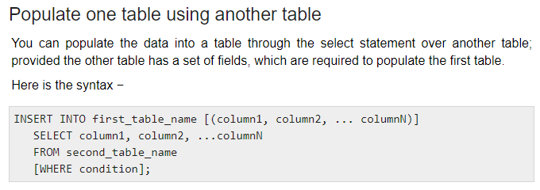
Insert using another table

Slide 21
SELECT
SELECT * FROM <table_name>;
E,g: SELECT * FROM DDLTest;

Slide 22
UPDATE
Syntax:
UPDATE <table name> set (to_calculation);
E,g: UPDATE ddlTest SET DDL_Value = 555 WHERE DDL_Type = 'DML';

Slide 23
DELETE
Syntax:
DELETE FROM <table_name>;
E.g: DELETE FROM DDLTest
Where id = 2 ;

Slide 24
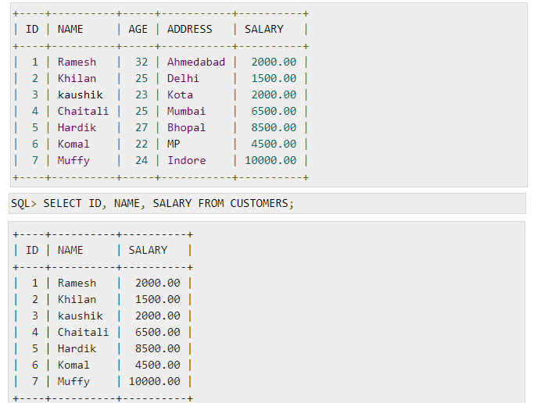

Slide 25
DCL
DCL is the abstract of Data Control Language.
Data Control Language includes commands such as GRANT, and is concerned with rights, permissions, and other controls of the database system.
DCL is used to grant/revoke permissions on databases and their contents.
DCL is simple, but MySQL permissions are a bit complex.
DCL is about security.
DCL is used to control the database transaction.
DCL statements allow you to control who has access to a specific object in your database.
1. GRANT
2. REVOKE

Slide 26
GRANT
Syntax :
Statement permissions:
GRANT { ALL | statement [ ,...n ] } TO security_account [ ,...n ]
Normally, a database administrator first uses CREATE USER to create an account, then GRANT to define its privileges and characteristics.

Slide 27
GRANT
CREATE USER vatsa@'localhost' IDENTIFIED BY 'mypass';
GRANT ALL ON MY_TABLE TO vatsa@'localhost';
GRANT SELECT ON Users TO vatsa@'localhost';

Slide 28
REVOKE
The REVOKE statement enables system administrators and to revoke (back permission) the privileges from MySQL accounts.
Syntax:
REVOKE
priv_type [(column_list)] [, priv_type [(column_list)]] ... ON [object_type] priv_level FROM user [, user] ...
REVOKE ALL PRIVILEGES, GRANT OPTION FROM user [, user] ...
E,g: REVOKE INSERT ON *.* FROM 'vatsa'@'localhost’;

Slide 29
TCL
TCL commands deal with the transaction within the database.
Examples of TCL commands:
COMMIT– commits a Transaction.
ROLLBACK– rollbacks a transaction in case of any error occurs.
SAVEPOINT–sets a savepoint within a transaction.
SET TRANSACTION–specify characteristics for the transaction.

Slide 30
COmmit
Syntax:
The COMMIT command is the transactional command used to save changes invoked by a transaction to the database.
The COMMIT command is the transactional command used to save changes invoked by a transaction to the database. The COMMIT command saves all the transactions to the database since the last COMMIT or ROLLBACK command.
Syntax:
COMMIT;

Slide 31
Rollback
The ROLLBACK command is the transactional command used to undo transactions that have not already been saved to the database. This command can only be used to undo transactions since the last COMMIT or ROLLBACK command was issued.
Syntax:
Rollback;

Slide 32
SAVEPOINT
A SAVEPOINT is a point in a transaction when you can roll the transaction back to a certain point without rolling back the entire transaction.
The syntax for a SAVEPOINT command is as shown below.
SAVEPOINT SAVEPOINT_NAME;
This command serves only in the creation of a SAVEPOINT among all the transactional statements. The ROLLBACK command is used to undo a group of transactions.
The syntax for rolling back to a SAVEPOINT is as shown below.
ROLLBACK TO SAVEPOINT_NAME;

Slide 33
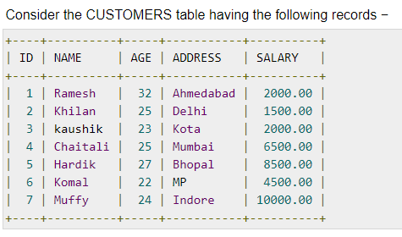

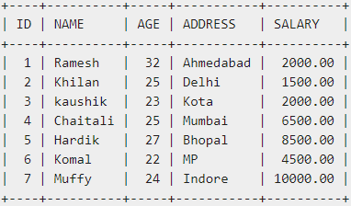
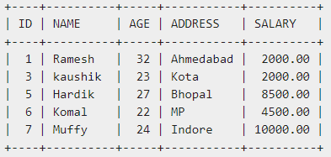


Slide 34
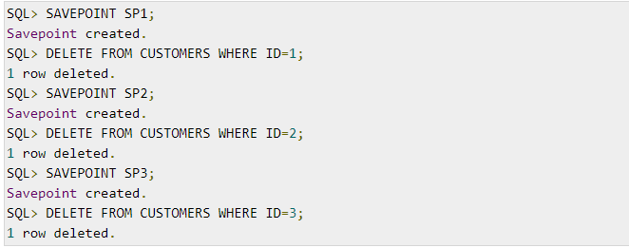

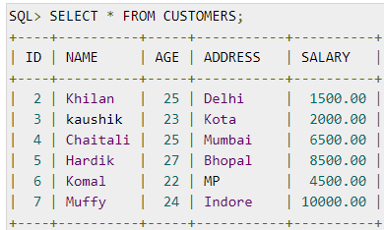
Savepoint

Slide 35
SQL Functions
Queries to facilitate acquaintance of Built-In Functions, String Functions, Numeric
Functions, Date Functions and Conversion Functions.
SQL FUNCTIONS:
SQL Functions are used to perform m calculations on data. Manipulate output from groups of rows. It can also format date members for display. It can also used for modifying individual data items. SQL function sometimes takes arguments and always returns value.
There are two distinct types of functions:
1. Single Row functions
2. Multiple Row functions

Slide 36
Single Row functions
Single row functions operate on single rows only and return one result per row.
The different type single row functions are
1. Character functions
2. Number Functions
3. Date functions.
4. Conversion Function
5. General Function

Slide 37
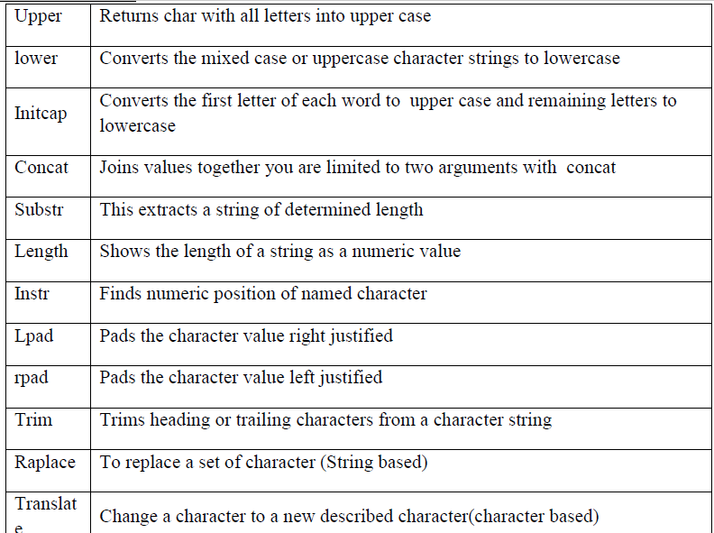
Character functions

Slide 38
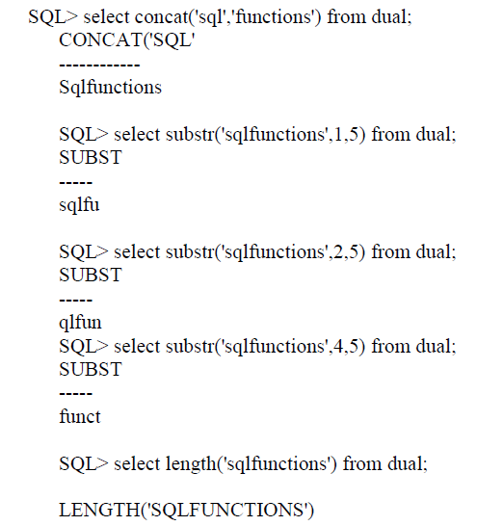
Examples

Slide 39
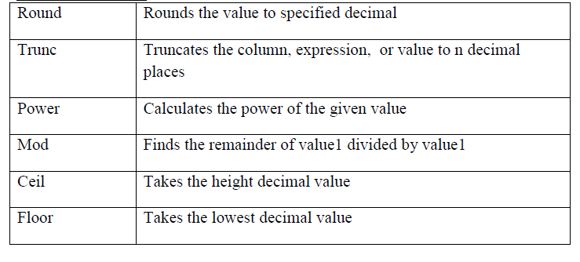
Number Functions

Slide 40
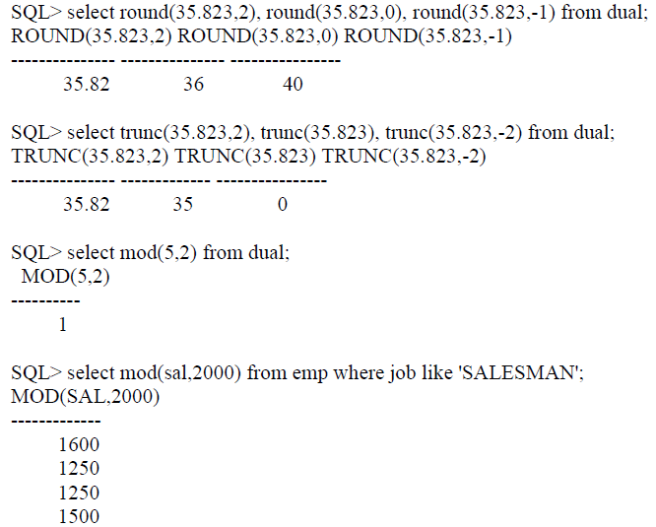
Examples

Slide 41
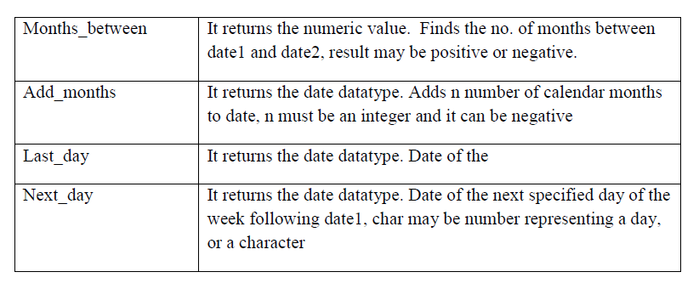
Date Functions

Slide 42
DATE
SYSDATE is a pseudo column that returns the current date and time. When we select sysdate it will display in a dummy table called DUAL.
Oracle date range between 1st jan 4712 BC and 31st Dec 4712 AD.

Slide 43
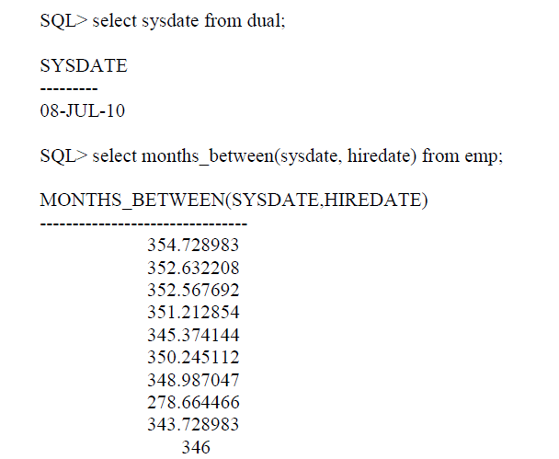
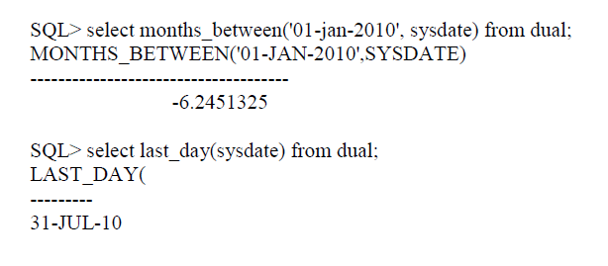
Examples

Slide 44
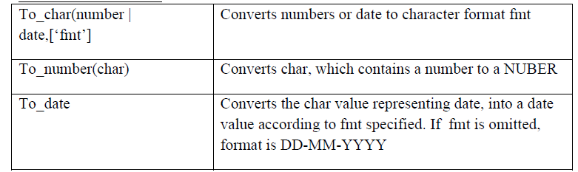
Conversion Functions

Slide 45
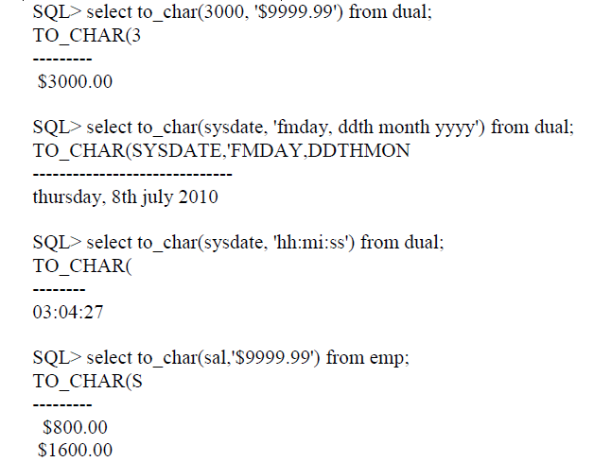
Examples

Slide 46
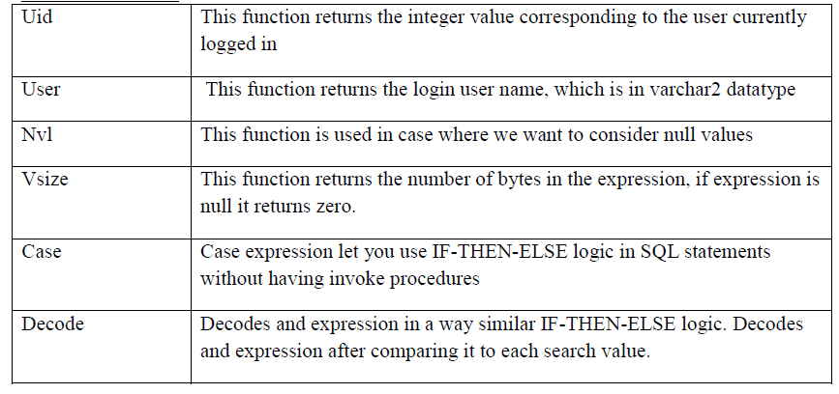
General Functions

Slide 47
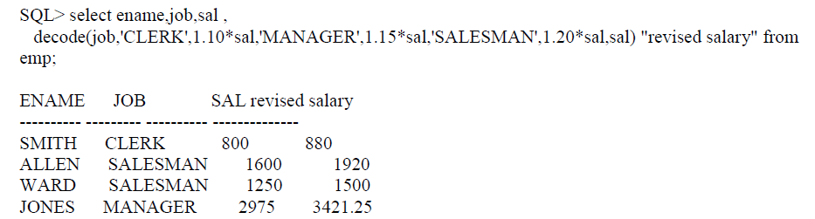
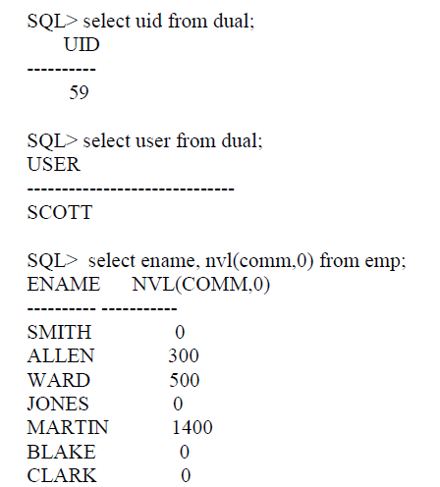
Examples

Slide 48
MULTIPLE ROW FUNCTIONS
Multi row function is also called as a group function or Aggregate function.
Group function operate on a set of rows to give one result per group.

Slide 49
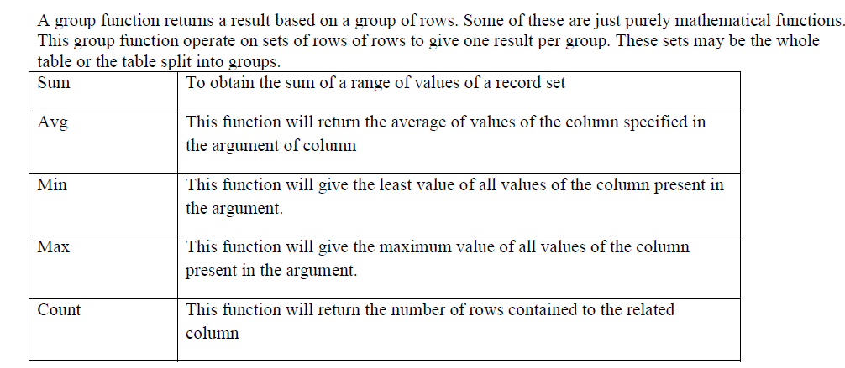
GROUP

Slide 50
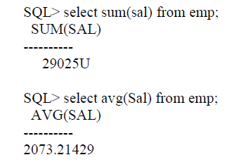
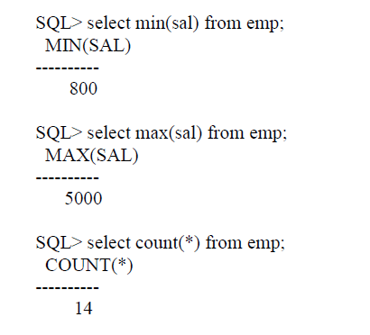
Examples

Slide 51
SQL Operators
Arithmetic operators: add + , sub - , mul *, div / , mod %
Comparison operators:=, != , <, >, <=, >=
Logical operators: ALL , AND, ANY, BETWEEN, EXISTS, IN , LIKE, NOT, OR, IS NULL, UNIQUE.

Slide 52
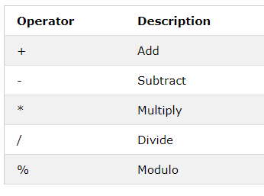
Arithmetic operators

Slide 53
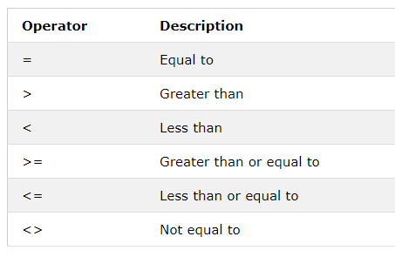
Comparison operators

Slide 54
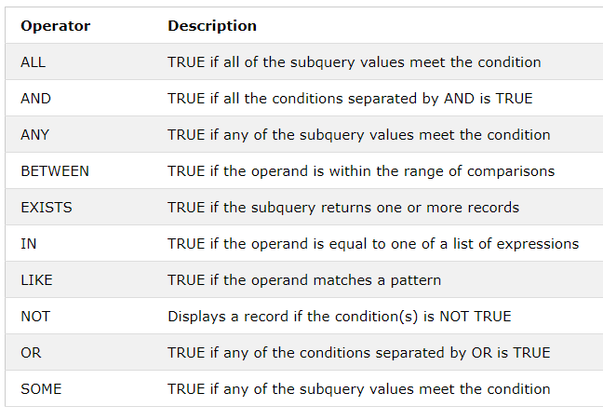
Logical operators

Slide 55
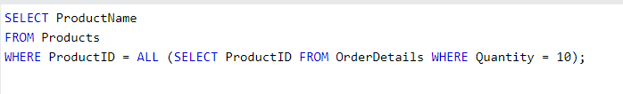




Examples

Slide 56





Slide 57
SQL Constraints
SQL Constraints are rules used to limit the type of data that can go into a table, to maintain the accuracy and integrity of the data inside table.
Constraints can be divided into the following two types,
Column level constraints: Limits only column data.
Table level constraints: Limits whole table data.

Slide 58
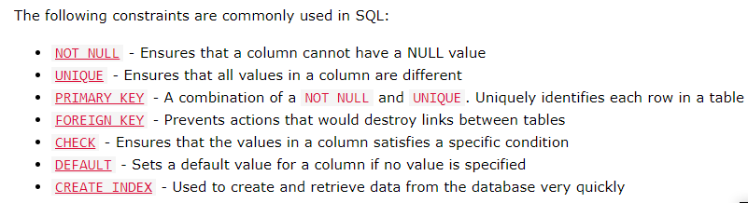

Slide 59
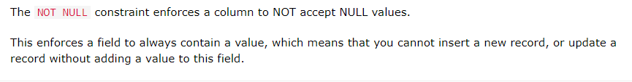
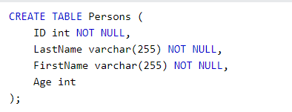
NOT NULL

Slide 60
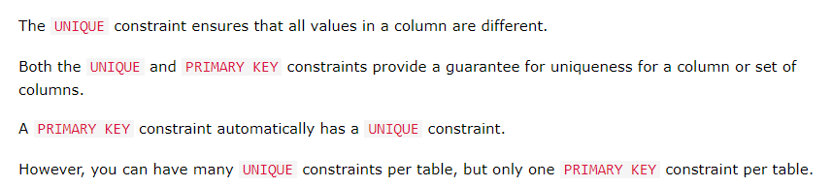
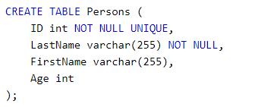
UNIQUE

Slide 61
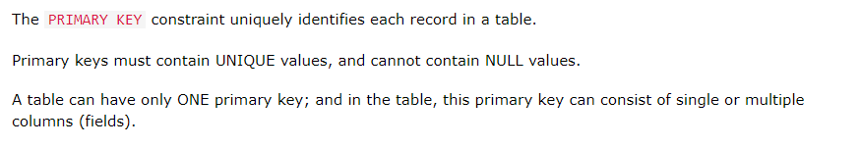
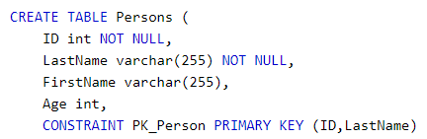
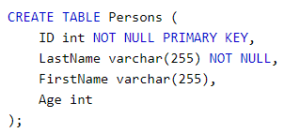
Primary key

Slide 62





Slide 63
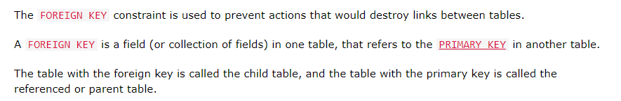
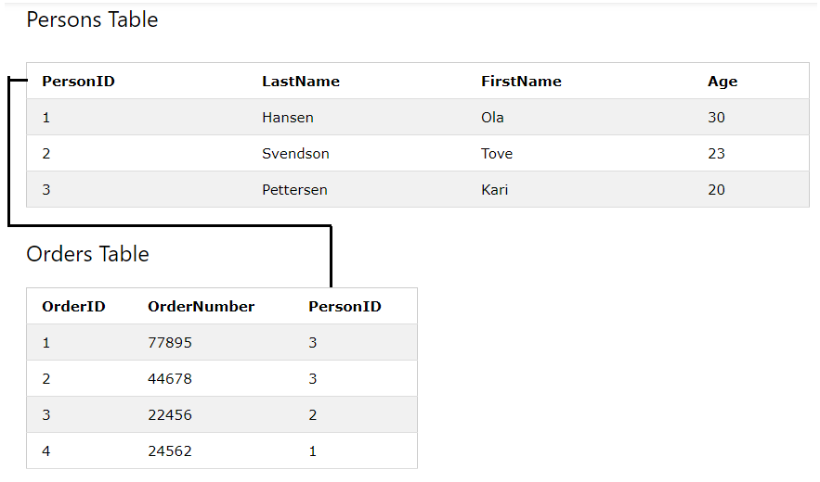
Foreign key

Slide 64
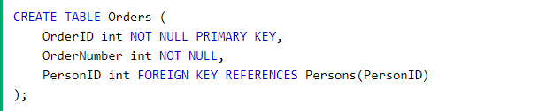
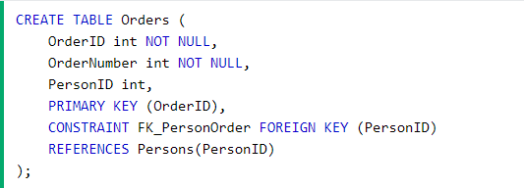

Slide 65
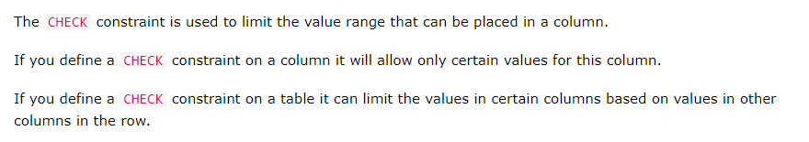
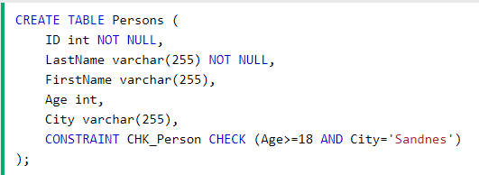
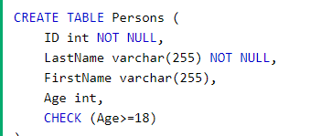
CHECK

Slide 66

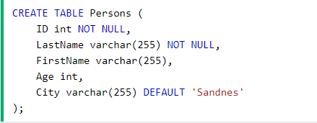
DEFAULT

Slide 67
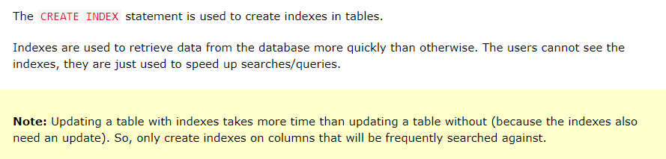
Index

Slide 68


Slide 69
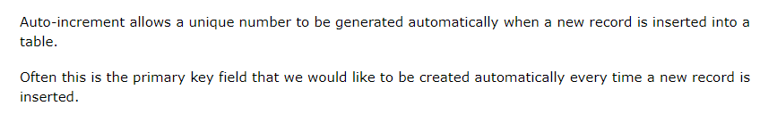
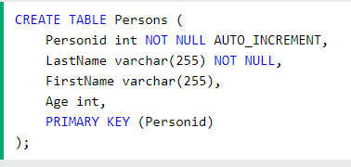

Auto increment

Slide 70
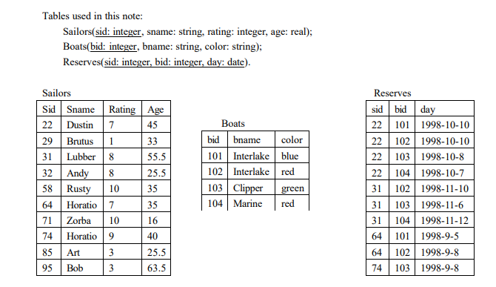

Slide 71
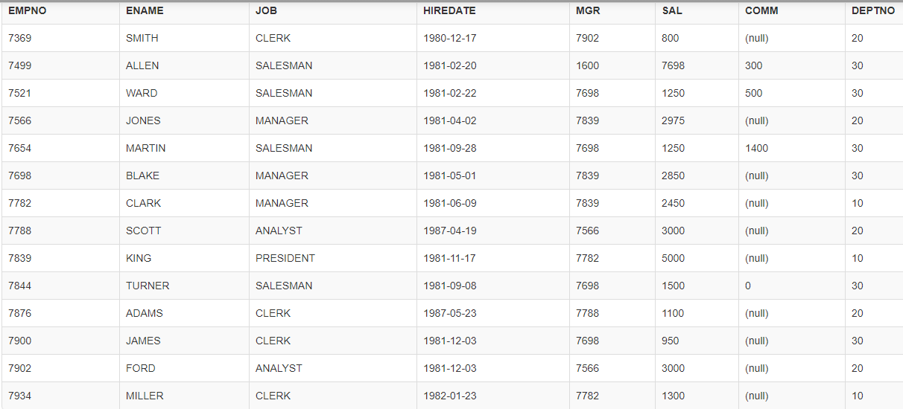

Slide 72
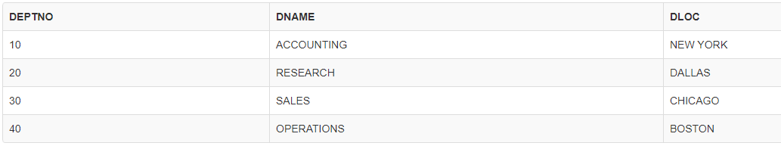

Slide 73

Order by
All Customer names are displayed in ascending order

Slide 74


GROUP BY

Slide 75




Slide 76
SQL GROUP BY - Having
Syntax:
SELECT statements... GROUP BY column_name1[,column_name2,...] [HAVING condition];
HERE
"SELECT statements..." is the standard SQL SELECT command query.
"GROUP BY column_name1" is the clause that performs the grouping based on
column_name1.
"[,column_name2,...]" is optional; represents other column names when the
grouping is done on more than one column.
"[HAVING condition]" is optional; it is used to restrict the rows affected by the GROUP BY
clause. It is similar to the WHERE clause.

Slide 77



Group by Example

Slide 78


Slide 79

Example- Group by having

Slide 80



Slide 81



Slide 82


Slide 83


Slide 84


Slide 85


Slide 86


Slide 87


Slide 88


Slide 89


Slide 90


Slide 91


Slide 92


Slide 93


Slide 94


Slide 95


Slide 96




