Slide 1
Database Design
CM Suvarna Varma
Assoc Prof
VVIT
UNIT 4 part 1/2

Slide 2
syllabus
Database Design: Normalization, Purpose of Normalization, Functional Dependency, Closure,
1NF, 2NF, 3NF, BCNF,
MVFD, 4NF, Join Dependency, 5NF
Why NoSQL?, Importance of NoSQL

Slide 3
Importance of Database Design
A well-designed database is imperative in guaranteeing information consistency, eliminating redundant data, efficiently executing queries, and improving the performance of the database. ...
A good database design also allows you to easily access and retrieve data whenever needed.

Slide 4
Informal Design Guidelines for Relational Databases
What is relational database design?
The grouping of attributes to form "good" relation schemas
Two levels of relation schemas
The logical "user view" level
The storage "base relation" level
Design is concerned mainly with base relations
What are the criteria for "good" base relations?

Slide 5
Informal Design Guidelines for Relational Databases
Guideline 1:
Informally, each tuple in a relation should represent one entity or relationship instance. (Applies to individual relations and their attributes).
Attributes of different entities (EMPLOYEEs, DEPARTMENTs, PROJECTs) should not be mixed in the same relation
Only foreign keys should be used to refer to other entities
Entity and relationship attributes should be kept apart as much as possible.
Bottom Line: Design a schema that can be explained easily relation by relation. The semantics of attributes should be easy to interpret.

Slide 6
BAD DESIGN
EmpId | Ename | Addr | DeptId | Deptname | Pid | Pname | Sal | comm | age
E0001 | Sam | delhi | D002 | English | P1 | abc | 10k | 0 | 32
E0002 | Mary | jaipur | D004 | Computers | P2 | xyz | 20k | 100 | 23
E0003 | deepa | AP | D006 | Physics | P3 |  |  | 300 | 25
E0004 | sreenu | MP |  | Chemistry | P2 | xyz | 30k | 500 | 45
E0005 | iqbal | UP | D002 | English | P4 | qrs | 10k | 1000
E0006 | zara | bihar | D001 | Maths | P5 | www | 20k | 200 | 21
E0007 | sunita |  | D003 | Phy.Education | P1 | abc | 15k | 100 | 31
E0008 | amit | Kerala | D005 | Social | P6 | zzz | 25k | 120 | 28

Slide 7
Design GuidelineS ….
GUIDELINE 2:
Design a schema that does not suffer from the insertion, deletion and update anomalies.
If there are any anomalies present, then note them so that applications can be made to take them into account.
GUIDELINE 3: [ NULL VALUES IN TUPLES]
Relations should be designed such that their tuples will have as few NULL values as possible
Attributes that are NULL frequently could be placed in separate relations (with the primary key)
Reasons for nulls: Attribute not applicable or invalid
Attribute value unknown (may exist)
Value known to exist, but unavailable

Slide 8
Design Guidelines…
Bad designs for a relational database may result in erroneous results for certain JOIN operations
The "lossless join" property is used to guarantee meaningful results for join operations
GUIDELINE 4: [ spurious tuples - Avoid at any cost ]
The relations should be designed to satisfy the lossless join condition.
No spurious tuples should be generated by doing a natural-join of any relations.
There are two important properties of decompositions:
Non-additive or losslessness of the corresponding join
Preservation of the functional dependencies.
Note that:
Property (a) is extremely important and cannot be sacrificed.
Property (b) is less stringent and may be sacrificed.

Slide 9
Schema Refinement
The purpose of Schema refinement is used for a refinement
approach based on decompositions. Redundant storage of information (i.e. duplication of
data) is main cause of problem. This redundancy is eliminated by decompose the relation.
How do we do that ????
1. Avoid redundancies wrt storage and manipulating anamolies using decomposition
2. Decomposing the tables using functional dependencies & normal forms

Slide 10
Anamolies
Mixing attributes of multiple entities may cause problems
Information is stored redundantly
Wastes storage
Causes problems with update anomalies
Insertion anomalies
Deletion anomalies
Modification anomalies

Slide 11
EXAMPLE OF ANOMALIES
Consider the relation:
EMP_PROJ ( Emp#, Proj#, Ename, Pname, No_hours)
Update Anomaly
Changing the name of project number P1 from “Billing” to “Customer-Accounting” may cause this update to be made for all 100 employees working on project P1
Insert Anomaly
Cannot insert a project unless an employee is assigned to .
Inversely- Cannot insert an employee unless he/she is assigned to a project.

Slide 12
EXAMPLE OF ANOMALIES
Delete Anomaly
When a project is deleted, it will result in deleting all the employees who work on that project. Alternately, if an employee is the sole employee on a project, deleting that employee would result in deleting the corresponding project.
Design a schema that does not suffer from the insertion, deletion and update anomalies.

Slide 13
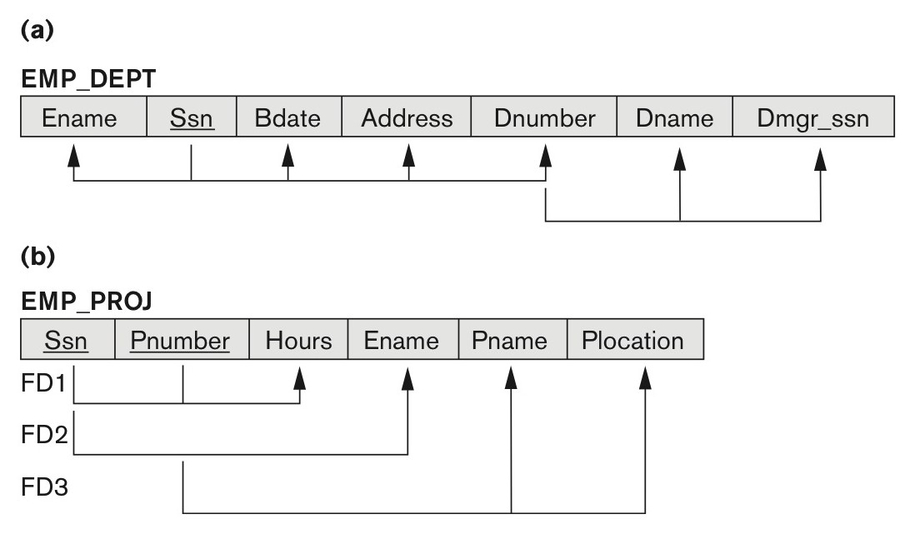
Two relation schemas suffering from update anomalies. (a) EMP_DEPT and (b) EMP_PROJ.

Slide 14
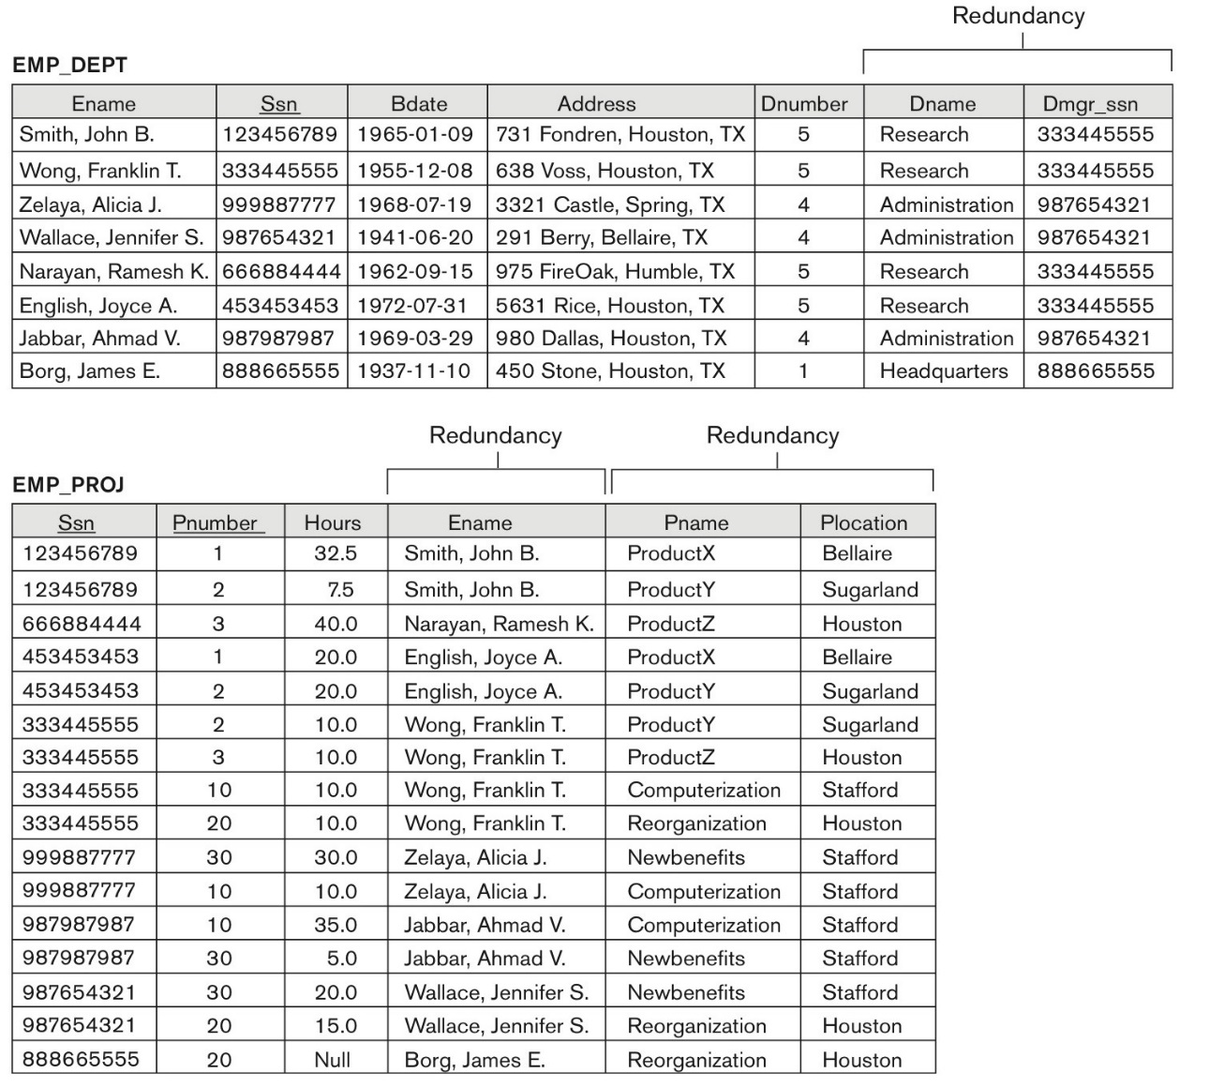

Slide 15
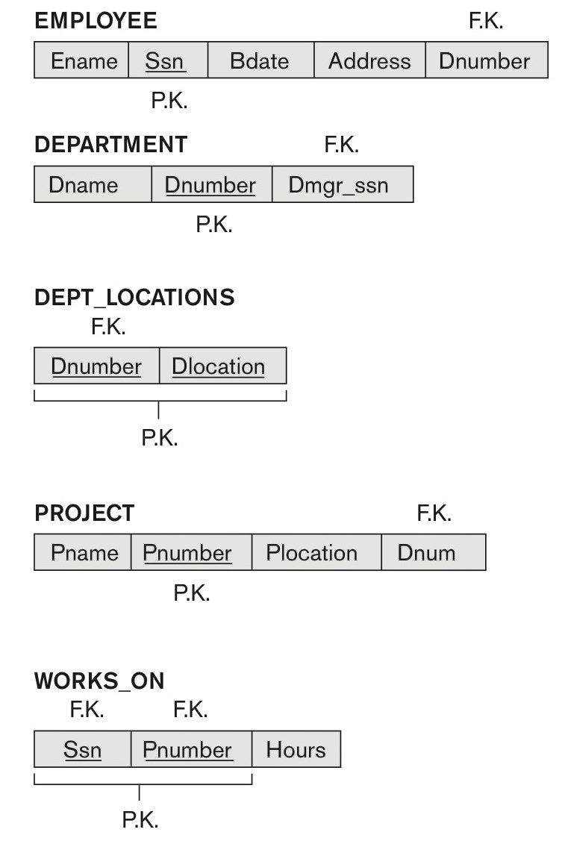
Relations

Slide 16
2. Functional Dependencies
Functional dependencies (FDs)
Are used to specify formal measures of the "goodness" of relational designs
And keys are used to define normal forms for relations
Are constraints that are derived from the meaning and interrelationships of the data attributes
A set of attributes X functionally determines a set of attributes Y if the value of X determines a unique value for Y

Slide 17
2.1 Defining Functional Dependencies
X  Y holds if whenever two tuples have the same value for X, they must have the same value for Y
For any two tuples t1 and t2 in any relation instance r(R): If t1[X]=t2[X], then t1[Y]=t2[Y]
X  Y in R specifies a constraint on all relation instances r(R)
Written as X  Y; can be displayed graphically on a relation schema as in Figures. ( denoted by the arrow: ).
FDs are derived from the real-world constraints on the attributes

Slide 18
Examples of FD constraints (1)
Social security number determines employee name
SSN  ENAME
Project number determines project name and location
PNUMBER  {PNAME, PLOCATION}
Employee ssn and project number determines the hours per week that the employee works on the project
{SSN, PNUMBER}  HOURS

Slide 19
Examples of FD constraints (2)
An FD is a property of the attributes in the schema R
The constraint must hold on every relation instance r(R)
If K is a key of R, then K functionally determines all attributes in R
(since we never have two distinct tuples with t1[K]=t2[K])

Slide 20
Defining FDs from instances
Note that in order to define the FDs, we need to understand the meaning of the attributes involved and the relationship between them.
An FD is a property of the attributes in the schema R
Given the instance (population) of a relation, all we can conclude is that an FD may exist between certain attributes.
What we can definitely conclude is – that certain FDs do not exist because there are tuples that show a violation of those dependencies.

Slide 21
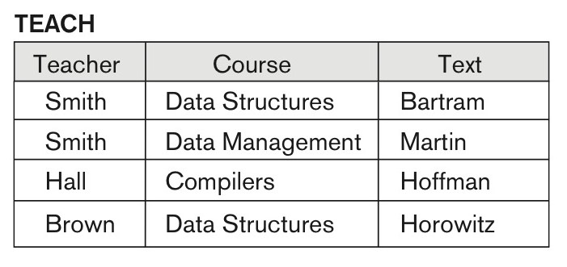
Ruling Out FDs
Note that given the state of the TEACH relation, we can say that the FD: Text → Course may exist. However, the FDs Teacher → Course, Teacher → Text and
Couse → Text are ruled out.
Fig 1:
Teach relation

Slide 22
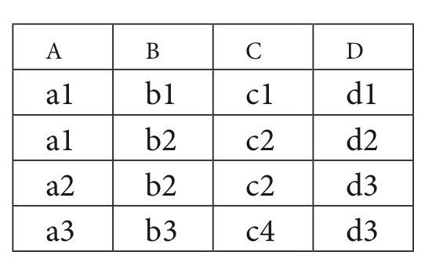
What FDs may exist?
A relation R(A, B, C, D) with its extension.
Which FDs may exist in this relation?
Fig 2:
R(ABCD)

Slide 23
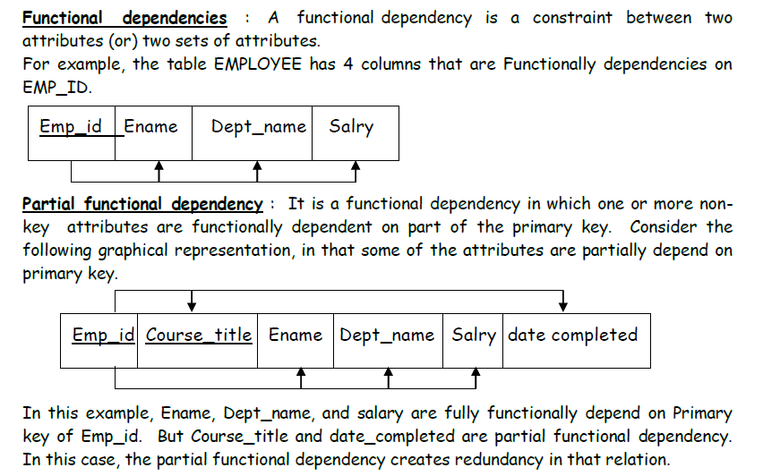

Slide 24
3 Normal Forms Based on Primary Keys
3.1 Normalization of Relations
3.2 Practical Use of Normal Forms
3.3 Definitions of Keys and Attributes Participating in Keys
3.4 First Normal Form
3.5 Second Normal Form
3.6 Third Normal Form
3.7 Boyce codd Normal Form

Slide 25
3.1 Normalization of Relations (1)
Normalization:
The process of decomposing unsatisfactory "bad" relations by breaking up their attributes into smaller relations
Normal form:
Condition using keys and FDs of a relation to certify whether a relation schema is in a particular normal form

Slide 26
Normalization of Relations (2)
2NF, 3NF, BCNF
based on keys and FDs of a relation schema
4NF
based on keys, multi-valued dependencies : MVDs;
5NF
based on keys, join dependencies : JDs
Additional properties may be needed to ensure a good relational design (lossless join, dependency preservation)

Slide 27
3.2 Practical Use of Normal Forms
Normalization is carried out in practice so that the resulting designs are of high quality and meet the desirable properties
The practical utility of these normal forms becomes questionable when the constraints on which they are based are hard to understand or to detect
The database designers need not normalize to the highest possible normal form
(usually up to 3NF and BCNF. 4NF rarely used in practice.)
Denormalization:
The process of storing the join of higher normal form relations as a base relation—which is in a lower normal form

Slide 28
3.3 Definitions of Keys and Attributes Participating in Keys (1)
A superkey of a relation schema R = {A1, A2, ...., An} is a set of attributes S subset-of R with the property that no two tuples t1 and t2 in any legal relation state r of R will have t1[S] = t2[S]
A key K is a superkey with the additional property that removal of any attribute from K will cause K not to be a superkey any more.

Slide 29
Definitions of Keys and Attributes Participating in Keys (2)
If a relation schema has more than one key, each is called a candidate key.
One of the candidate keys is arbitrarily designated to be the primary key, and the others are called secondary keys.
A Prime attribute must be a member of some candidate key
A Nonprime attribute is not a prime attribute—that is, it is not a member of any candidate key.

Slide 30
First Normal Form
Disallows
composite attributes
multivalued attributes
nested relations; attributes whose values for an individual tuple are non-atomic
Considered to be part of the definition of a relation
Most RDBMSs allow only those relations to be defined that are in First Normal Form

Slide 31
FIRST NORMAL FORM – 1 NF
We say that a relation schema R is in first normal form (1NF) if the domains of all attributes of R are atomic.
A domain is atomic if elements of the domain are considered to be indivisible units.

Slide 32
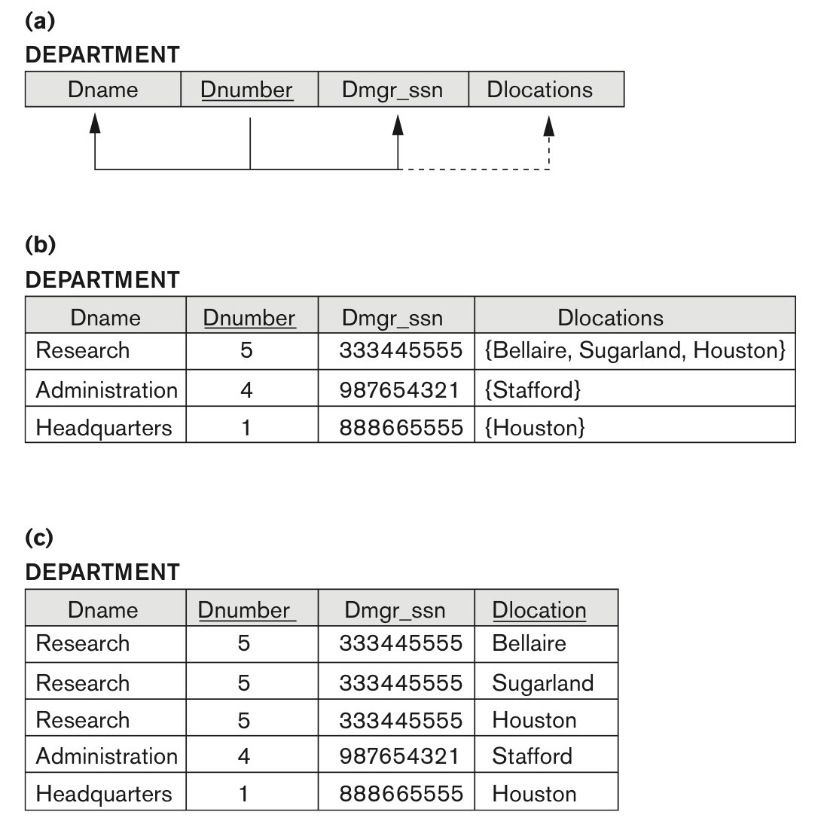
Normalization into 1NF
Fig3: Normalization into 1NF. (a) A relation schema that is not in 1NF. (b) Sample state of relation DEPARTMENT. (c) 1NF version of the same relation with redundancy.

Slide 33
Normalization into 1NF
Above Example:Fig 3b) Consider a table Department with attributes (DNAME, DNUMBER,DMGRSSN,DLOCATIONS)
Their FD’s DNUMBER →DNAME
DNUMBER →DMGRSSN
DNUMBER →DLOCATIONS
The 1NF fails due to the FD “DNUMBER →DLOCATIONS”
Fig c) is in 1 NF and doesn’t fail the definition

Slide 34

Normalizing nested relations into 1NF
Fig 4:Normalizing nested relations into 1NF. (a) Schema of the EMP_PROJ relation with a nested relation attribute PROJS. (b) Sample extension of the EMP_PROJ relation showing nested relations within each tuple. (c) Decomposition of EMP_PROJ into relations EMP_PROJ1 and EMP_PROJ2 by propagating the primary key.

Slide 35
3.5 Second Normal Form
Uses the concepts of FDs, primary key
Definitions
Prime attribute: An attribute that is member of the primary key K
Full functional dependency: a FD Y -> Z where removal of any attribute from Y means the FD does not hold any more
Examples:
{SSN, PNUMBER} -> HOURS is a full FD since neither SSN -> HOURS nor PNUMBER -> HOURS hold
{SSN, PNUMBER} -> ENAME is not a full FD (it is called a partial dependency ) since SSN -> ENAME also holds

Slide 36
Second Normal Form – 2 NF
A relation schema R is in second normal form (2NF) if every non-key attribute A in R is fully functionally dependent on the primary key
A relation schema R is in second normal form (2NF) if every non-key attribute A in R is not partially functionally dependent on the primary key
R can be decomposed into 2NF relations via the process of 2NF normalization or “second normalization”
It must be in 1 NF
Holds the definition as said before

Slide 37
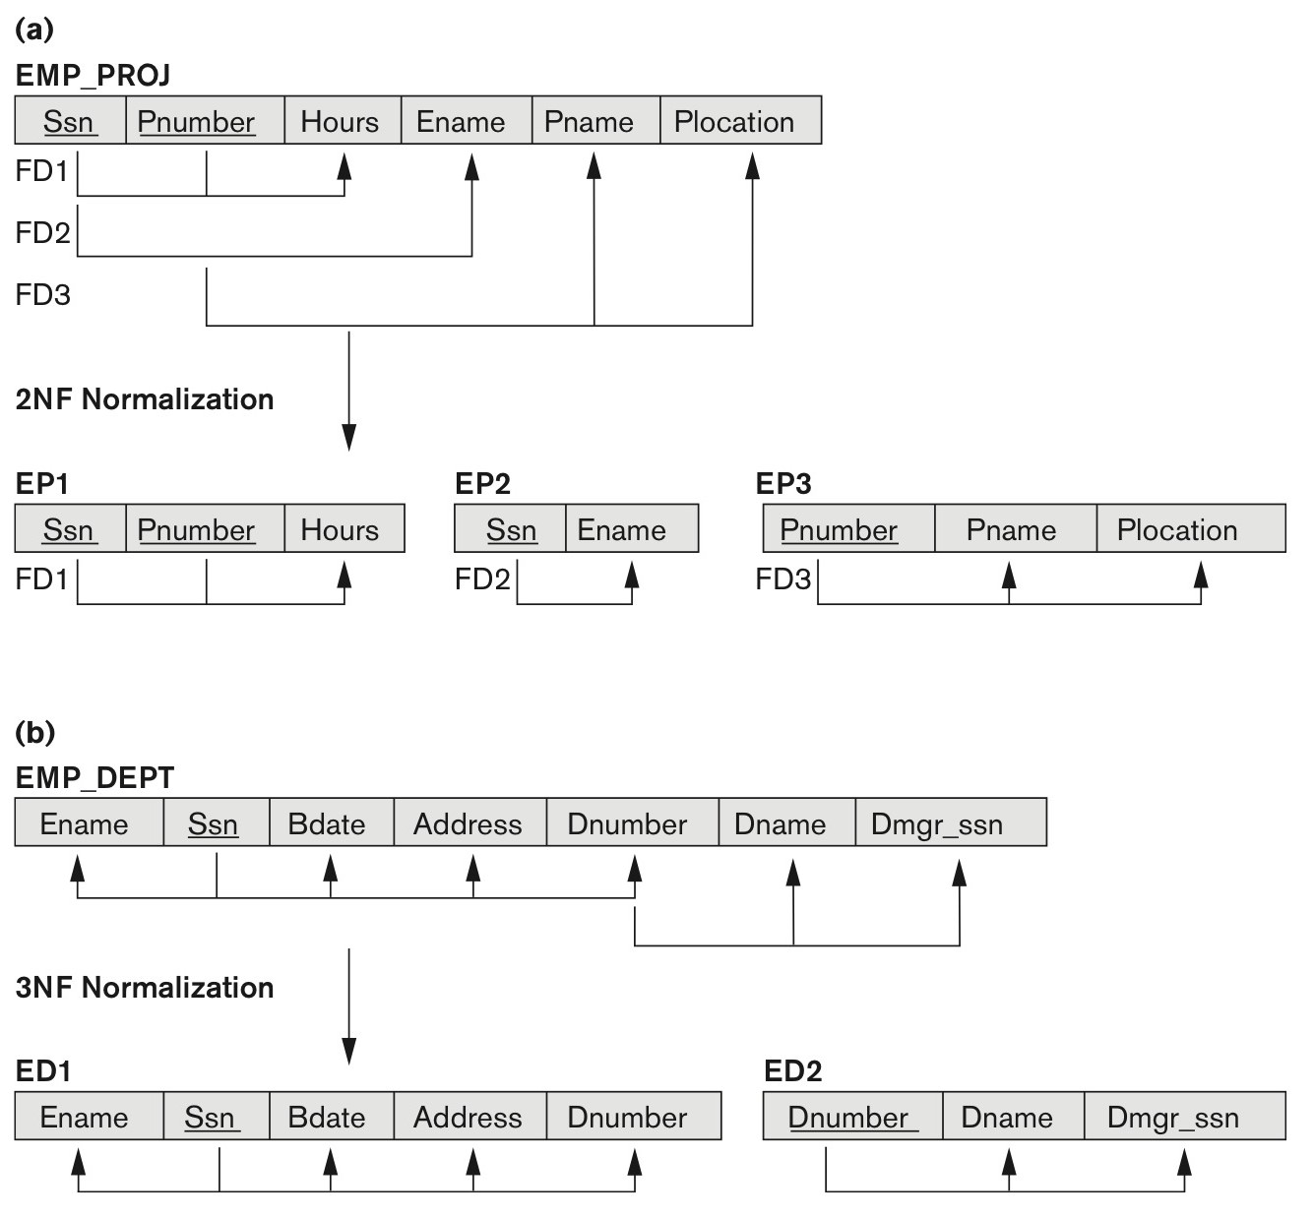
Normalizing into 2NF and 3NF
Fig 5:Normalizing into 2NF and 3NF. (a) Normalizing EMP_PROJ into 2NF relations. (b) Normalizing EMP_DEPT into 3NF relations.

Slide 38
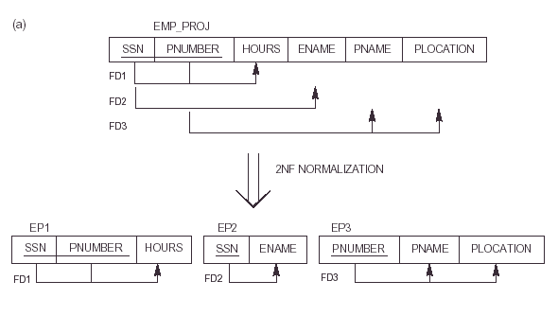
Fig 5a

Slide 39
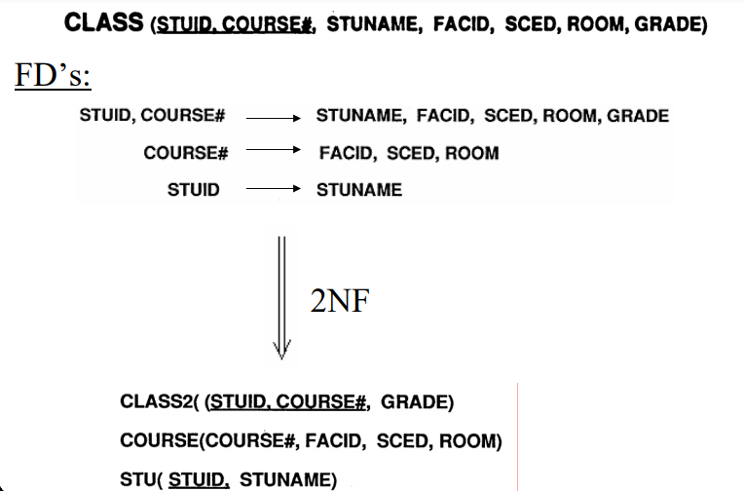

Slide 40
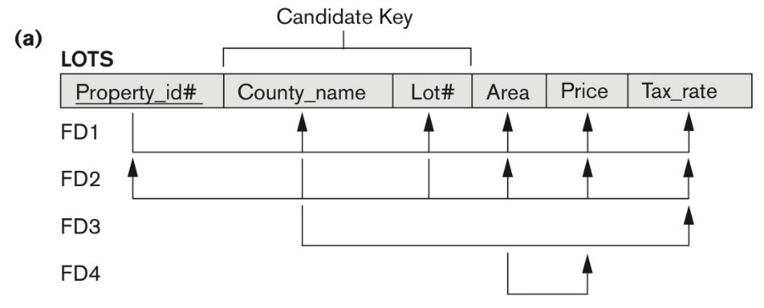
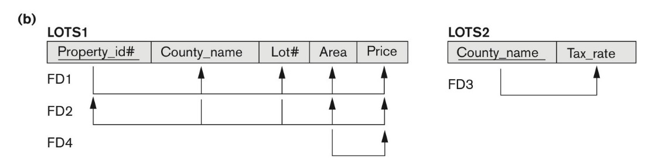
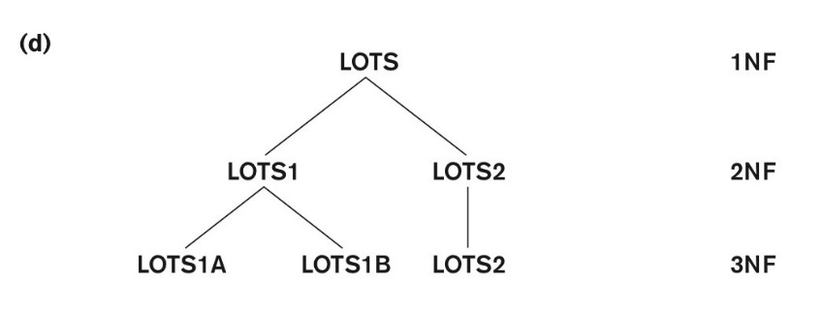
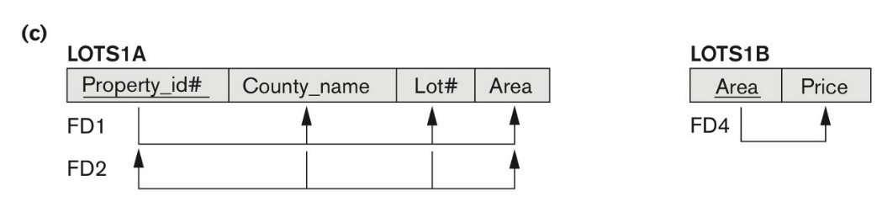
Normalization into 2NF and 3NF
Fig6Normalization into 2NF and 3NF. (a) The LOTS relation with its functional dependencies FD1 through FD4.
(b) Decomposing into the 2NF relations LOTS1 and LOTS2. (c) Decomposing LOTS1 into the 3NF relations LOTS1A and LOTS1B. (d) Progressive normalization of LOTS into a 3NF design.

Slide 41
3.6 Third Normal Form
Definition:
Transitive functional dependency: a FD X -> Z that can be derived from two FDs X -> Y and Y -> Z
Examples:
SSN -> DMGRSSN is a transitive FD
Since SSN -> DNUMBER and DNUMBER -> DMGRSSN hold
SSN -> ENAME is non-transitive
Since there is no set of attributes X where SSN -> X and X -> ENAME

Slide 42
Third Normal Form - 3 NF
A relation schema R is in third normal form (3NF) if it is in 2NF and no non-prime attribute A in R is transitively dependent on the primary key
R can be decomposed into 3NF relations via the process of 3NF normalization
It must be in 2NF
It must hold Transitive functional dependency – if there is a set of atribute Z that are neither a primary or candidate key and both
X → Z and Y → Z holds.
NOTE:
In X -> Y and Y -> Z, with X as the primary key, we consider this a problem only if Y is not a candidate key.
When Y is a candidate key, there is no problem with the transitive dependency .
E.g., Consider EMP (SSN, Emp#, Salary ).
Here, SSN -> Emp# -> Salary and Emp# is a candidate key.

Slide 43
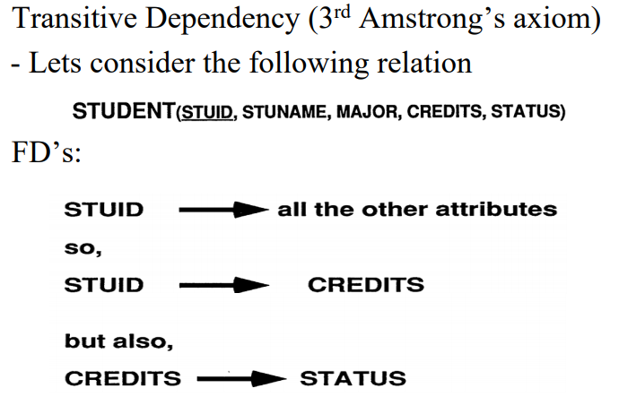

Slide 44
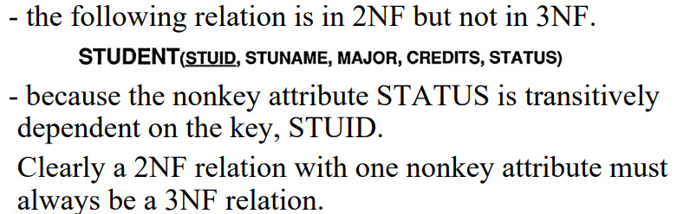
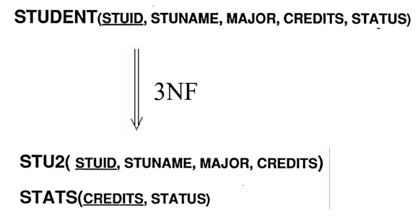

Slide 45
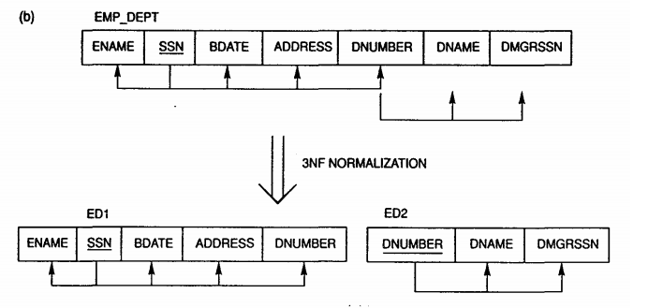

Slide 46
Normal Forms Defined Informally
1st normal form
All attributes depend on the key
2nd normal form
All attributes depend on the whole key
3rd normal form
All attributes depend on nothing but the key

Slide 47
3.7 Boyce CODD NORMAL FORM
Boyce Codd Normal Form
A relation schema R is in Boyce-Codd Normal Form (BCNF) if whenever an FD X → A holds in R, then X is a superkey of R
The steps are :
Find the candidate keys
Check if all the FD satisfies the definition.

Slide 48
Boyce CODD NORMAL FORM - BCNF
Each normal form is strictly stronger than the previous one:
Every 2NF relation is in 1NF
Every 3NF relation is in 2NF
Every BCNF relation is in 3NF ( not viceversa)
There exist relations that are in 3NF but not in BCNF
The goal is to have each relation in BCNF (or 3NF)

Slide 49
BCNF
Example #1 : ABCD AB → CD
The candidate key is only one, that is AB.
Fortunately that AB is also our left hand side FD (AB → CD), so the relation is in BCNF.

Slide 50
BCNF
Example #2:
ABCDE AB → CD E → A D → A
Candidate key : BE.
Unfortunately, all the left hand side FDs does not include BE, so the relation is not in BCNF.

Slide 51
Difference between BCNF and 3NF
Third Normal Form (3NF) is a bit more relaxed form compared to BCNF. Let’s see the definition:
A relation is in 3NF if for every non-trivial FD X → A, X is a superkey or A is part of some key for R.
Once again, it doesn’t help much until we see the example. So let’s go back to our previous examples.

Slide 52

Difference between BCNF and 3NF
Example #1 : ABCD AB → CD
The steps are the same with checking for BCNF.
Candidate key is AB, and
Our only FD’s left hand side is equal to that candidate key, so it is in 3NF.
Honestly, you don’t need to check for 3NF for the first example, because all relation that is in BCNF is also in 3NF.

Slide 53
Difference between BCNF and 3NF
Example #2 : ABCDE AB → CD E → A D → A
Candidate key : BE.
Let’s check the FDs one by one:
E → A : this is not ok, because E is not a candidate key, and A is not part of BE.

Slide 54
Difference between BCNF and 3NF
Example #3: ABCD ABC → D D → A
Let’s check this relation for both BCNF and 3NF.
BCNF check:
Candidate keys : ABC and BCD.
Check the FDs:
ABC → D : ABC is a candidate key.
D → A : D is not a candidate key, so it is not in BCNF.

Slide 55
Difference between BCNF and 3NF
Example #3: ABCD ABC → D D → A
3NF check:
Candidate keys : ABC and BCD.
Check the FDs:
ABC → D : ABC is a candidate key.
D → A : D is not a candidate key, BUT A is part of candidate key (ABC), so it is ok.
Since both are okay, this relation is 3NF.
That’s all there is in regards to determining whether a database relation is in BCNF or 3NF, it’s not that confusing at it appears to after all.

Slide 56
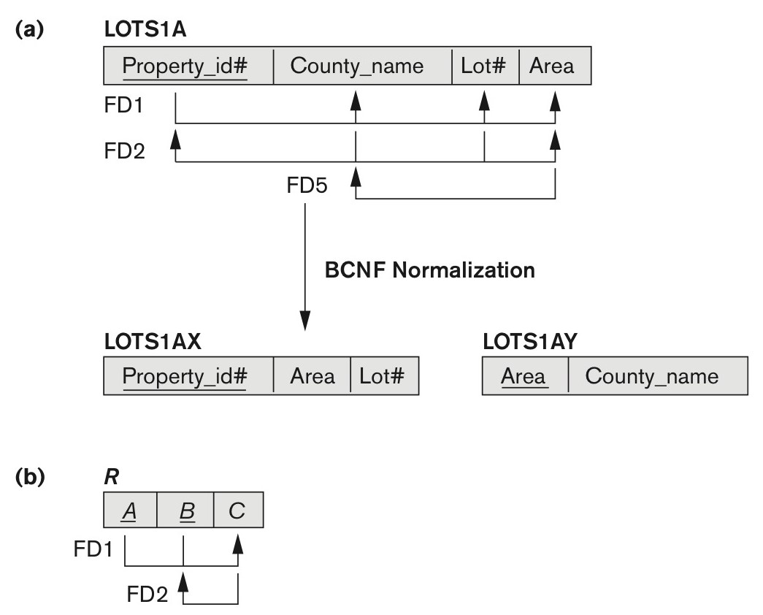
Boyce-Codd normal form
Figure 14.13
Boyce-Codd normal form. (a) BCNF normalization of LOTS1A with the functional dependency FD2 being lost in the decomposition. (b) A schematic relation with FDs; it is in 3NF, but not in BCNF due to the f.d. C → B.

Slide 57

A relation TEACH that is in 3NF but not in BCNF

Slide 58
Achieving the BCNF by Decomposition (
Two FDs exist in the relation TEACH:
fd1: { student, course} -> instructor
fd2: instructor -> course
{student, course} is a candidate key for this relation and that the dependencies shown follow the pattern in Figure 14.13 (b).
So this relation is in 3NF but not in BCNF
A relation NOT in BCNF should be decomposed so as to meet this property, while possibly forgoing the preservation of all functional dependencies in the decomposed relations.
(See Algorithm 15.3)

Slide 59
Achieving the BCNF by Decomposition (2)
Three possible decompositions for relation TEACH
D1: {student, instructor} and {student, course}
D2: {course, instructor } and {course, student}
D3: {instructor, course } and {instructor, student} ✓
All three decompositions will lose fd1.
We have to settle for sacrificing the functional dependency preservation. But we cannot sacrifice the non-additivity property after decomposition.
Out of the above three, only the 3rd decomposition will not generate spurious tuples after join.(and hence has the non-additivity property).
A test to determine whether a binary decomposition (decomposition into two relations) is non-additive (lossless) is discussed under Property NJB on the next slide. We then show how the third decomposition above meets the property.

Slide 60
Test for checking non-additivity of Binary Relational Decompositions
Testing Binary Decompositions for Lossless Join (Non-additive Join) Property
Binary Decomposition: Decomposition of a relation R into two relations.
PROPERTY NJB (non-additive join test for binary decompositions): A decomposition D = {R1, R2} of R has the lossless join property with respect to a set of functional dependencies F on R if and only if either
The f.d. ((R1 ∩ R2)  (R1- R2)) is in F⁺, or
The f.d. ((R1 ∩ R2)  (R2 - R1)) is in F⁺.

Slide 61
Test for checking non-additivity of Binary Relational Decompositions
If you apply the NJB test to the 3 decompositions of the TEACH relation:
D1 gives Student  Instructor or Student  Course, none of which is true.
D2 gives Course  Instructor or Course  Student, none of which is true.
However, in D3 we get Instructor  Course or Instructor  Student.
Since Instructor  Course is indeed true, the NJB property is satisfied and D3 is determined as a non-additive (good) decomposition.

Slide 62
General Procedure for achieving BCNF when a relation fails BCNF
Here we make use the algorithm :
Let R be the relation not in BCNF, let X be a subset-of R, and let X → A be the FD that causes a violation of BCNF. Then R may be decomposed into two relations:
(i) R –A and (ii) X υ A.
If either R –A or X υ A. is not in BCNF, repeat the process.
Note that the f.d. that violated BCNF in TEACH was Instructor →Course. Hence its BCNF decomposition would be :
(TEACH – COURSE) and (Instructor υ Course), which gives
the relations: (Instructor, Student) and (Instructor, Course) that we obtained before in decomposition D3.

Slide 63
5. Multivalued Dependencies and Fourth Normal Form
Definition:
A multivalued dependency (MVD) X —>> Y specified on relation schema R, where X and Y are both subsets of R, specifies the following constraint on any relation state r of R: If two tuples t₁ and t₂ exist in r such that t₁[X] = t₂[X], then two tuples t₃ and t₄ should also exist in r with the following properties, where we use Z to denote (R 2 (X υ Y)):
t₃[X] = t₄[X] = t₁[X] = t₂[X].
t₃[Y] = t₁[Y] and t₄[Y] = t₂[Y].
t₃[Z] = t₂[Z] and t₄[Z] = t₁[Z].
An MVD X —>> Y in R is called a trivial MVD if (a) Y is a subset of X, or (b) X υ Y = R.

Slide 64
Multivalued Dependencies and Fourth Normal Form
Definition:
A relation schema R is in 4NF with respect to a set of dependencies F (that includes functional dependencies and multivalued dependencies) if, for every nontrivial multivalued dependency X —>> Y in F⁺, X is a superkey for R.
Note: F⁺ is the (complete) set of all dependencies (functional or multivalued) that will hold in every relation state r of R that satisfies F. It is also called the closure of F.

Slide 65

4NF - Example
Primary Key -> { student_ID, Subject, Activity }
Many students → same subject [ e.g music]
Many students → same activity [ e.g: swimming]
Violates 4NF

Slide 66


4NF
{ student_ID,Activity }
{ student_ID,Subject }

Slide 67
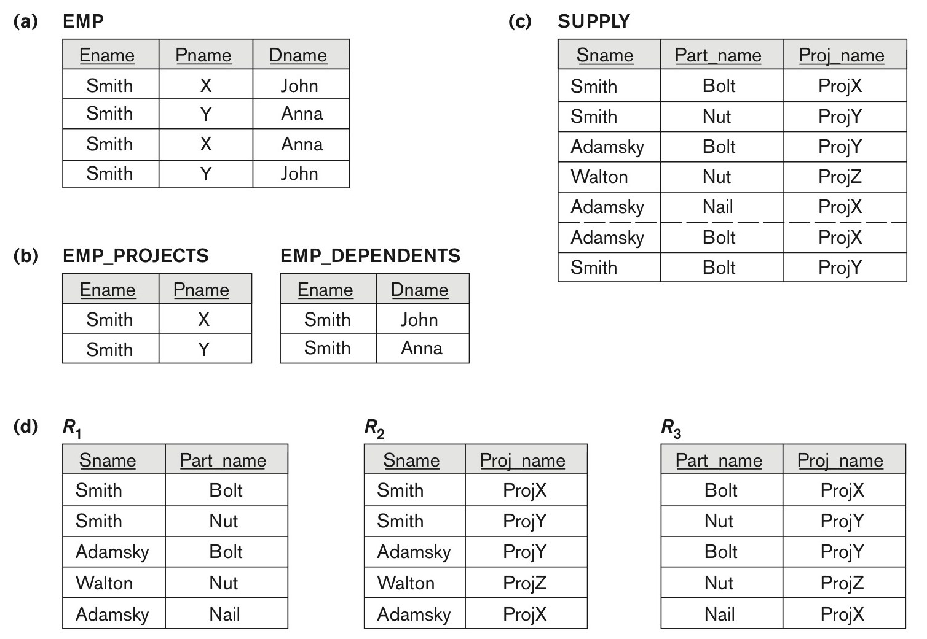
Fourth and fifth normal forms.
Figure 14.15
Fourth and fifth normal forms. (a) The EMP relation with two MVDs: Ename –>> Pname and Ename –>> Dname. (b) Decomposing the EMP relation into two 4NF relations EMP_PROJECTS and EMP_DEPENDENTS. (c) The relation SUPPLY with no MVDs is in 4NF but not in 5NF if it has the JD(R1, R2, R3). (d) Decomposing the relation SUPPLY into the 5NF relations R1, R2, R3.

Slide 68
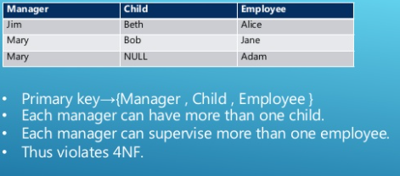
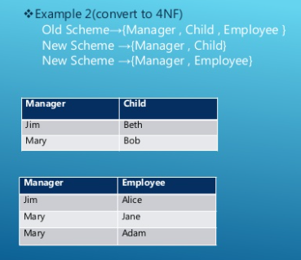
example 2:

Slide 69
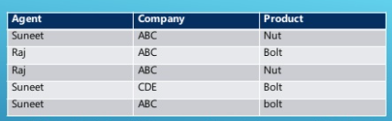
4 nf ?
The table is ___________

Slide 70
6. Join Dependencies and Fifth Normal Form
Definition:
A join dependency (JD), denoted by JD(R₁, R₂, ..., R_{n}), specified on relation schema R, specifies a constraint on the states r of R.
The constraint states that every legal state r of R should have a non-additive join decomposition into R₁, R₂, ..., R_{n}; that is, for every such r we have
* (π_{R1}(r), π_{R2}(r), ..., π_{Rn}(r)) = r
Note: an MVD is a special case of a JD where n = 2.
A join dependency JD(R₁, R₂, ..., R_{n}), specified on relation schema R, is a trivial JD if one of the relation schemas R_{i} in JD(R₁, R₂, ..., R_{n}) is equal to R.

Slide 71
Join Dependencies and Fifth Normal Form (2)
Definition:
A relation schema R is in fifth normal form (5NF) (or Project-Join Normal Form (PJNF)) with respect to a set F of functional, multivalued, and join dependencies if,
for every nontrivial join dependency JD(R₁, R₂, ..., R_{n}) in F⁺ (that is, implied by F),
every R_{i} is a superkey of R.
Discovering join dependencies in practical databases with hundreds of relations is next to impossible. Therefore, 5NF is rarely used in practice.

Slide 72
Chapter Summary
Informal Design Guidelines for Relational Databases
Functional Dependencies (FDs)
Normal Forms (1NF, 2NF, 3NF)Based on Primary Keys
BCNF (Boyce-Codd Normal Form)
Fourth and Fifth Normal Forms

Slide 73
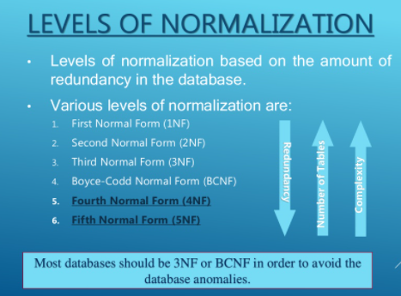

Slide 74
GATE
1. R(ABCDE) , FD={ AC-> E, C->D, D-> A }
Key?
2. R(ABCDE) , F={ AC->E, B-> D , E->A}
Is it in 2NF?
Make it to 2 Nf?

Slide 75
solved
1) In R(ABCDE) fd1: AC->E , fd2: C->D , fd3: D->A
“B” is not used in FDs , so the key must be attached with B
Find key covering with R1(ACDE), A -> A,E
C->C,D,E & A (transitive c->d, d->a => c->a)
D-> D, A, E
Therefore, C is the key for R1(ACDE)
And BC is the key for R(ABCDE)

Slide 76
SOLVED
2. R(ABCDE) , F={ AC->E, B-> D , E->A}
Find key: A-> A, E B->B,D C->C,E,A => BC -> BDCEA
Therefore BC is the key.
R( BC, A, D, E)
Fd1: AC->E, fd2: B->D , Fd3: E->A
A D E -> non keys
A must be ffd on BC , x 2NF
R1( BC, A, E) fd1,fd3 , R2( B,D) fd2
R1 is still not in 2 NF
R1(BC) , R3( ACE) in 2 NF
R( BC, A, D, E)

Slide 77
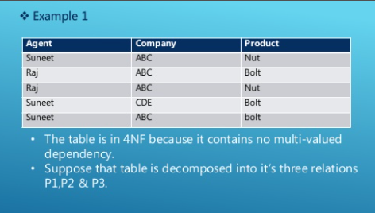

Slide 78
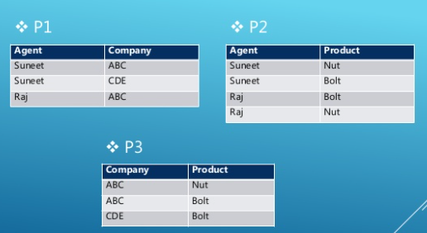

Slide 79
