Slide 1
Transaction management
CM Suvarna Varma
Assoc Prof
UNIT 5 Part 1/3

Slide 2
Syllabus
UNIT-V: Transaction, Data Recovery & Storage Management (12 hrs)
Transaction Management: ACID Properties of Transactions, Conflict & View serializability, Lock based protocols, Time Stamp based protocol, Thomas Write Rule, Validation Based Protocol, Deadlock detection, Deadlock avoidance, Deadlock prevention: wait-die and wound-wait
Recovery Management: Types of failures, ideal storage, Log, Log records, log based recovery techniques, Shadow Paging, ARIES
File Organization & Indexing: Types of File Organizations, Primary Indexing, Secondary Indexing, Multi-level Indexing, Hash Indexing, Tree Indexing

Slide 3
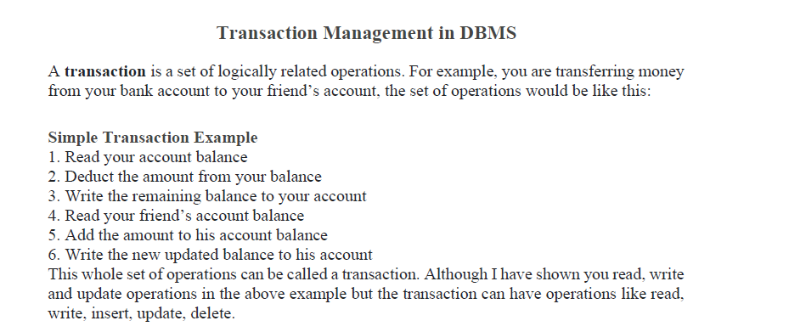

Slide 4


Slide 5
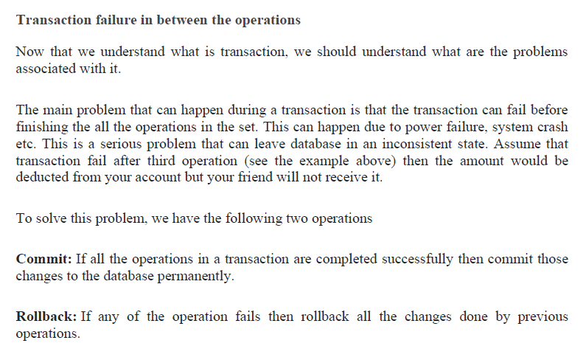

Slide 6


Slide 7
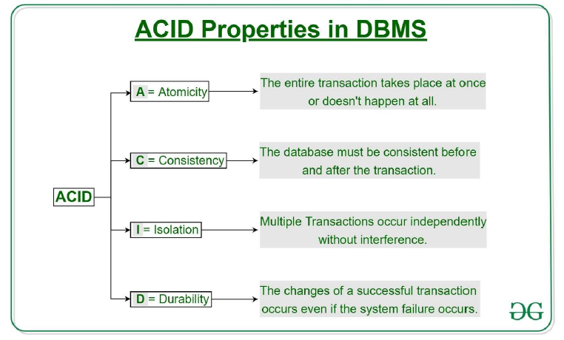

Slide 8
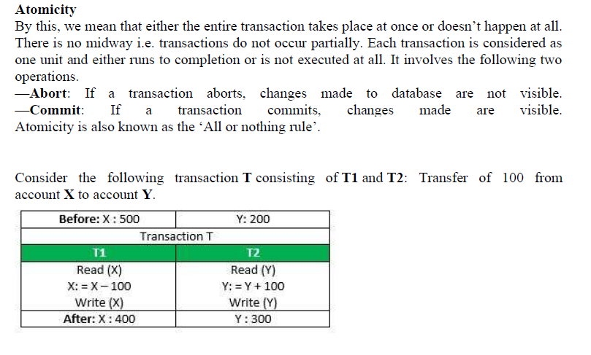

Slide 9
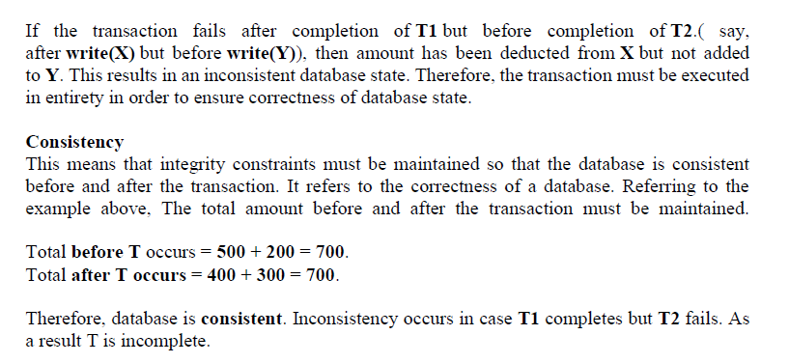

Slide 10
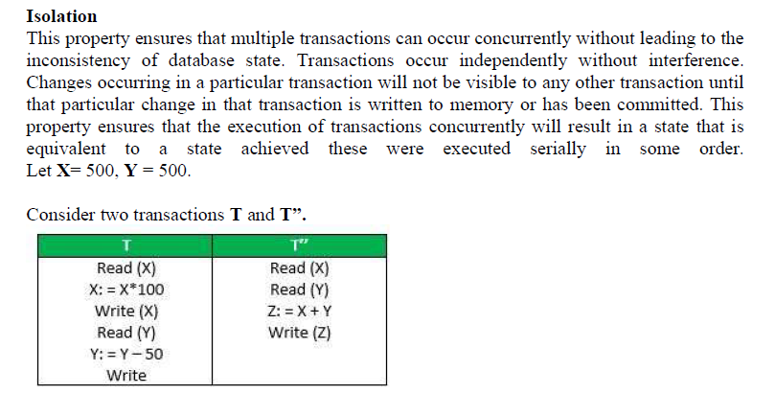

Slide 11


Slide 12


Slide 13
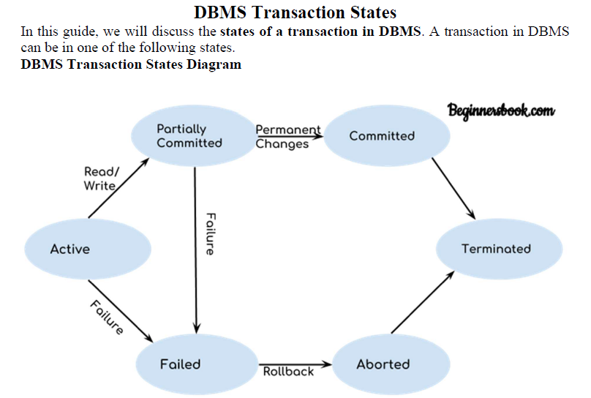

Slide 14
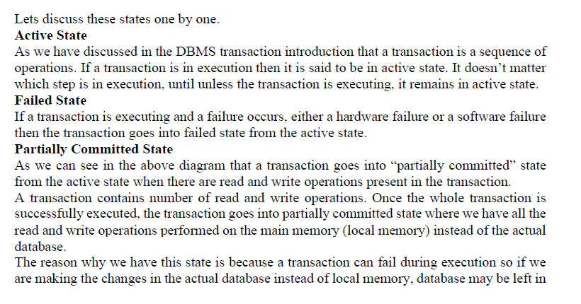

Slide 15
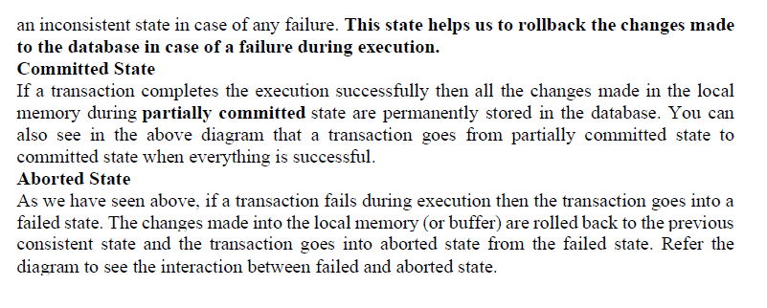

Slide 16
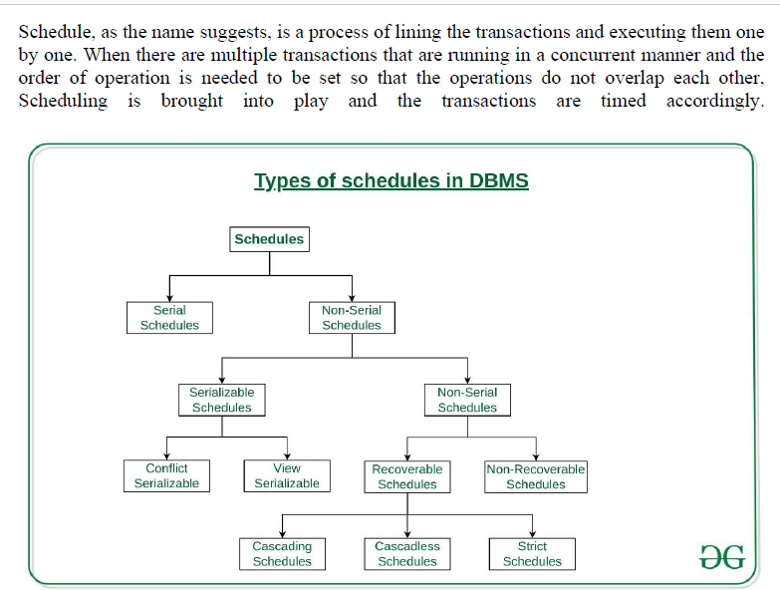

Slide 17


Slide 18
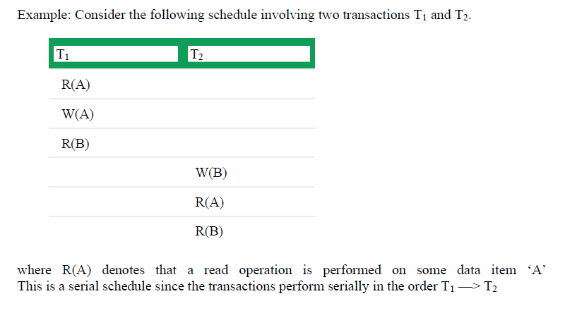

Slide 19
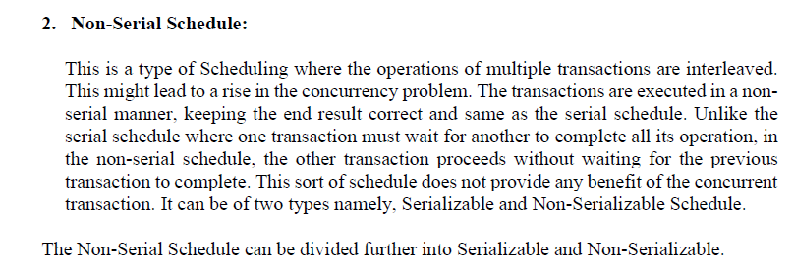

Slide 20
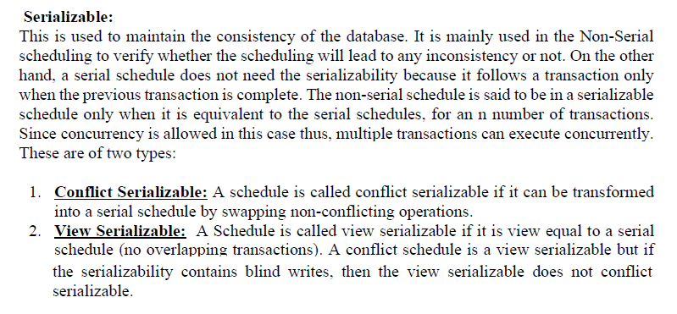

Slide 21


Slide 22
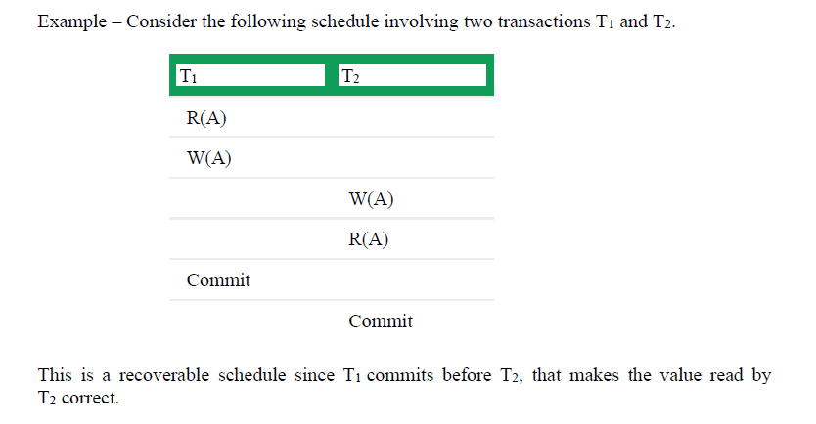

Slide 23
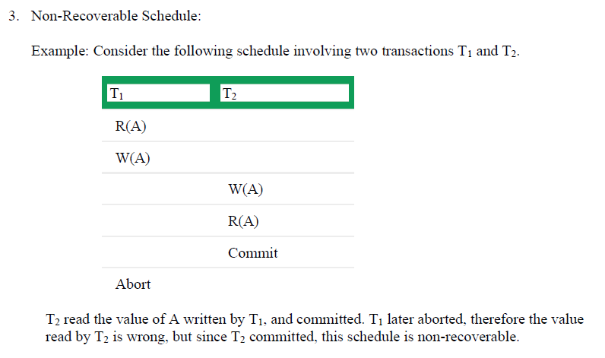

Slide 24
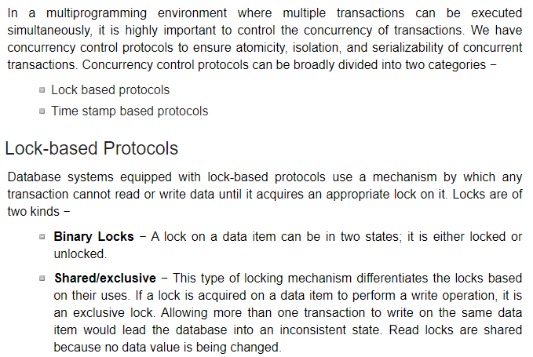

Slide 25
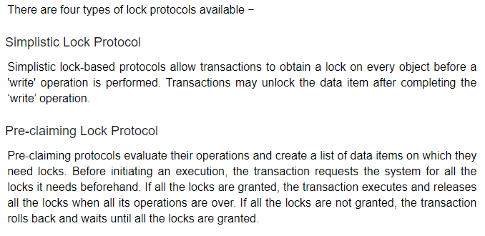
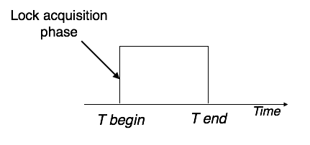

Slide 26
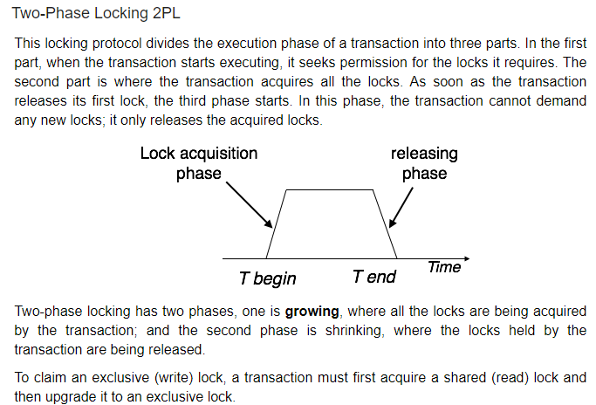

Slide 27
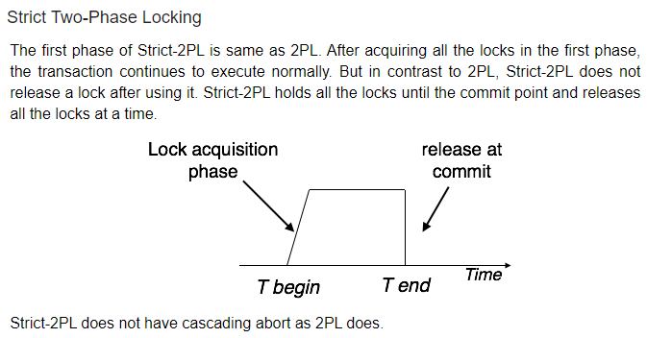

Slide 28
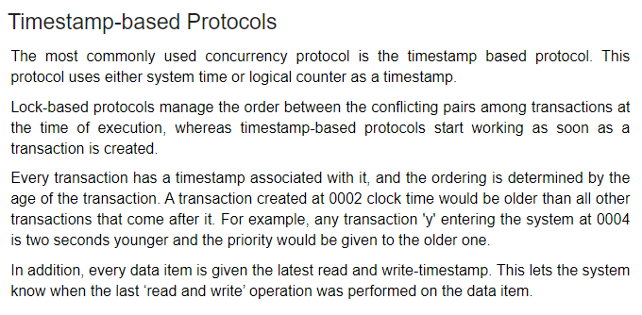

Slide 29
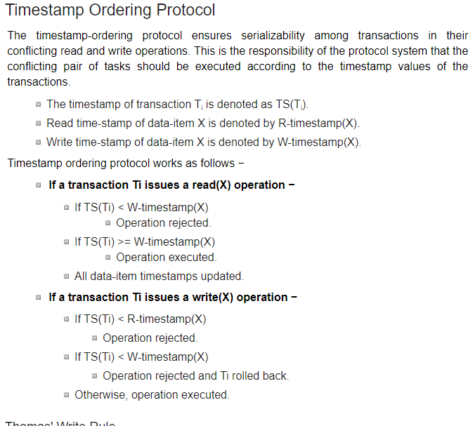

Slide 30
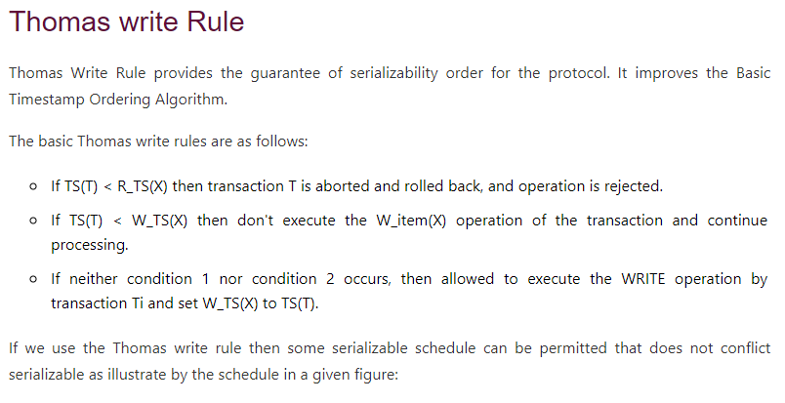

Slide 31
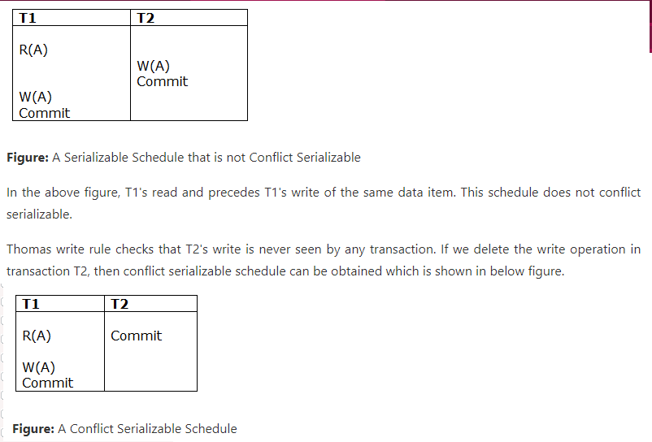

Slide 32
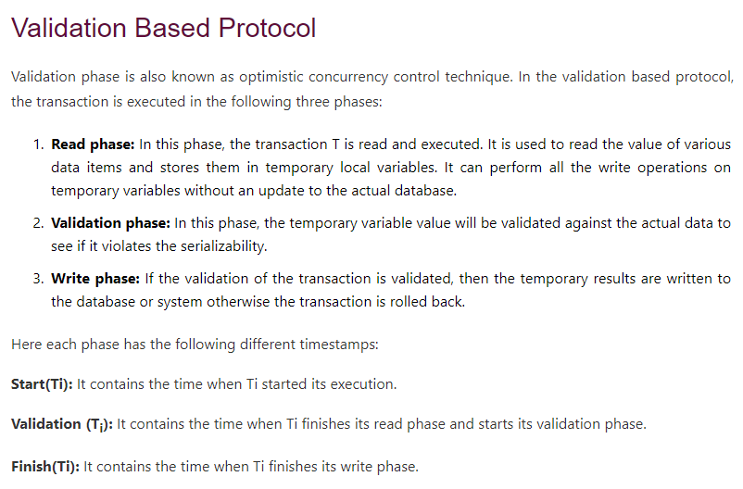

Slide 33
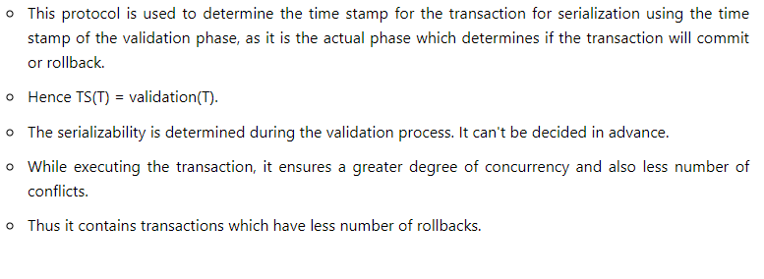

Slide 34
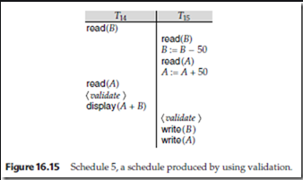

Slide 35
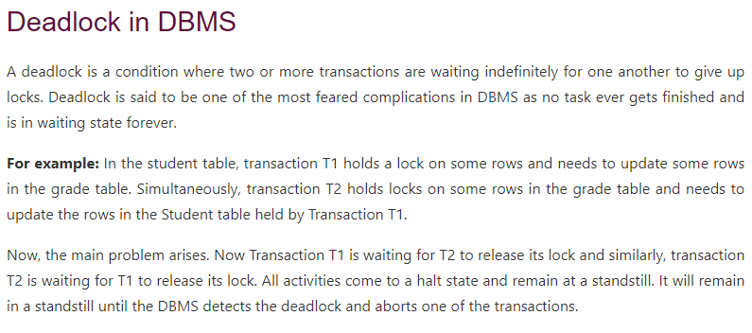

Slide 36
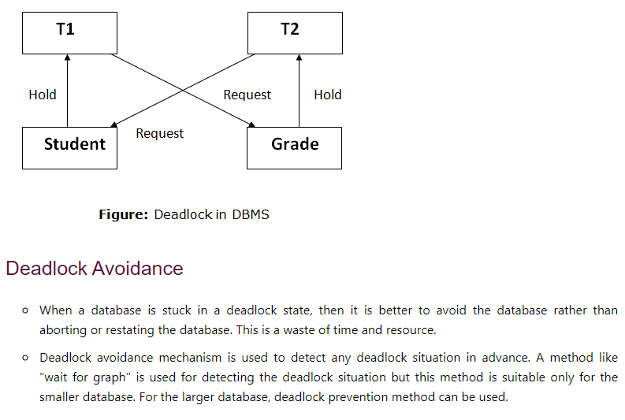

Slide 37
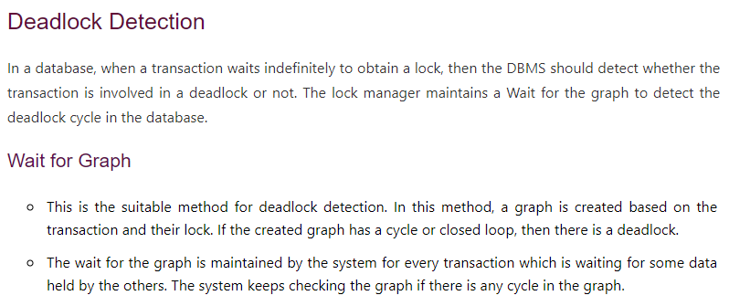

Slide 38
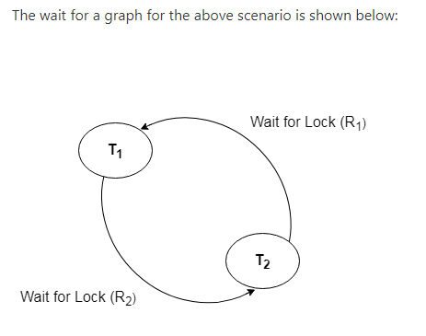

Slide 39
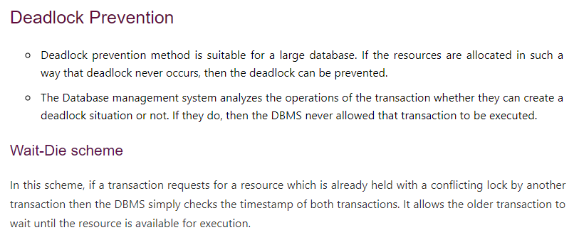

Slide 40
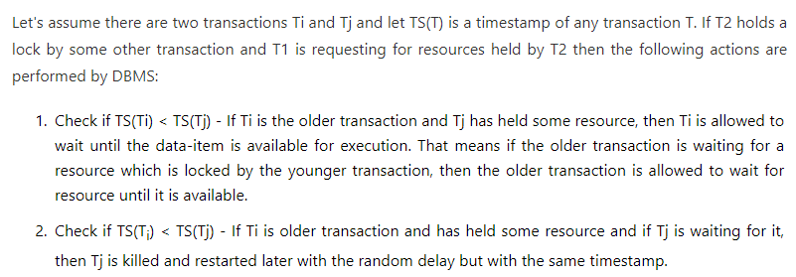

Slide 41


