Slide 1
File Organization & Indexing
CM Suvarna Varma
Assoc Prof
UNIT 5 Part 3/3

Slide 2
Syllabus
UNIT-V: Transaction, Data Recovery & Storage Management (12 hrs)
Transaction Management: ACID Properties of Transactions, Conflict & View serializability, Lock based protocols, Time Stamp based protocol, Thomas Write Rule, Validation Based Protocol, Deadlock detection, Deadlock avoidance, Deadlock prevention: wait-die and wound-wait
Recovery Management: Types of failures, ideal storage, Log, Log records, log based recovery techniques, Shadow Paging, ARIES
File Organization & Indexing: Types of File Organizations, Primary Indexing, Secondary Indexing, Multi-level Indexing, Hash Indexing, Tree Indexing

Slide 3
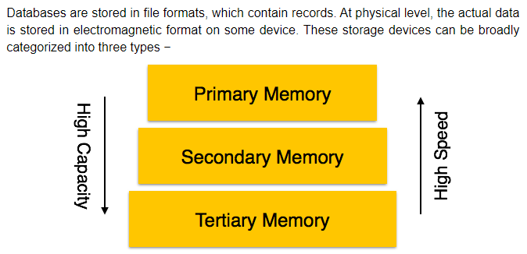

Slide 4
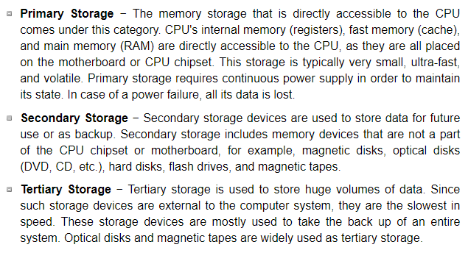

Slide 5
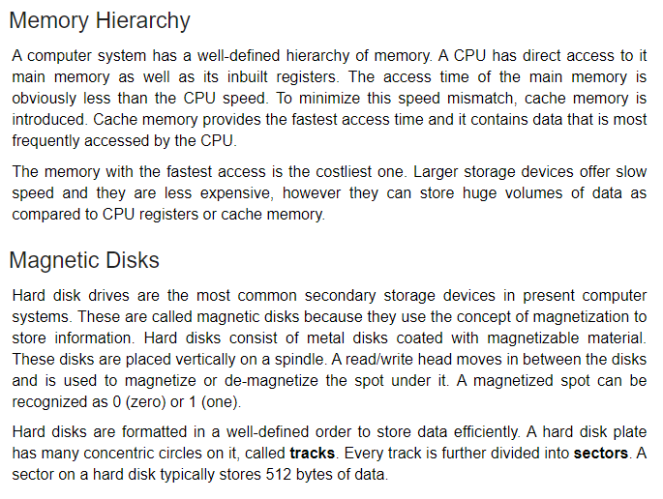

Slide 6
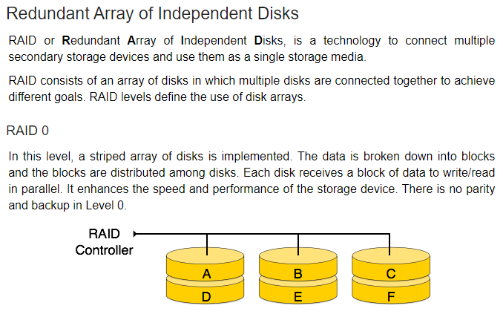

Slide 7
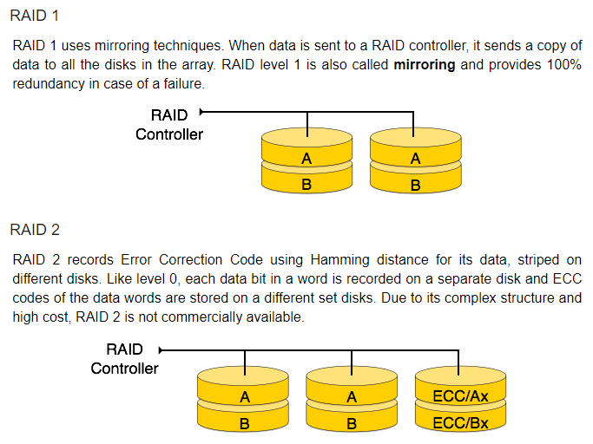

Slide 8
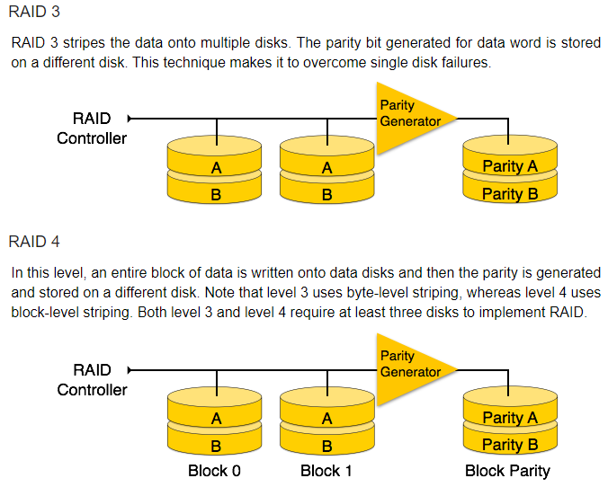

Slide 9
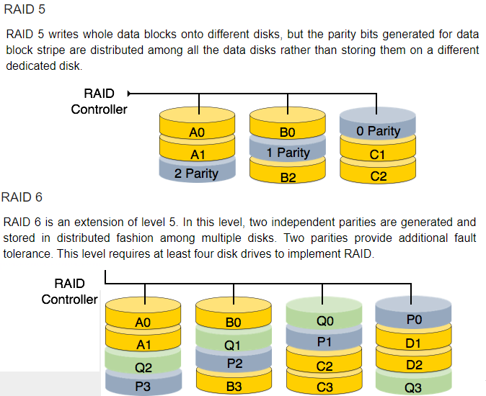

Slide 10
ABOVE STORAGE CONCEPT IS ONLY FOR UNDERSTANDING STORAGE STRUCTURES.
(NOT FOR SYLLABUS )

Slide 11
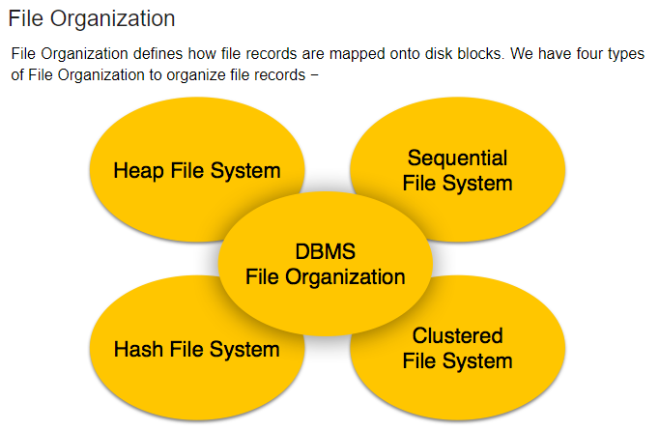

Slide 12
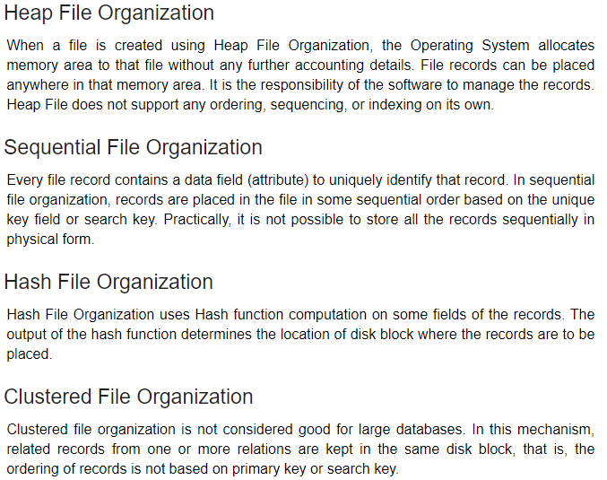

Slide 13
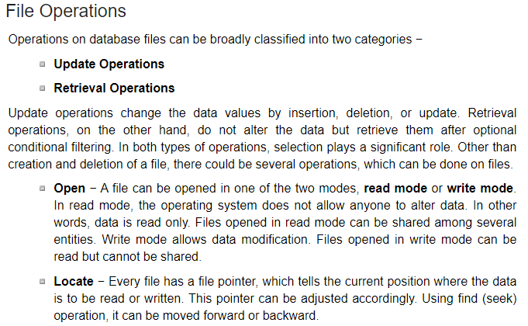

Slide 14
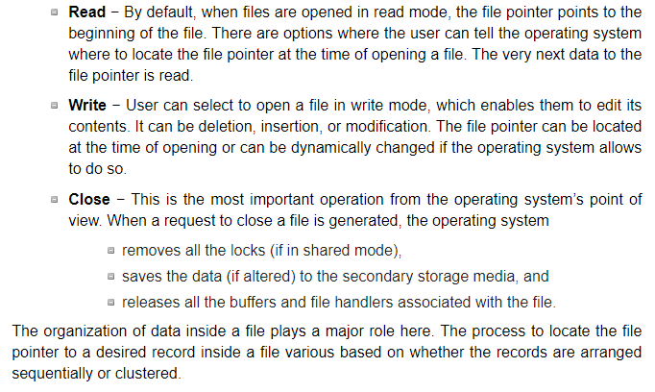

Slide 15
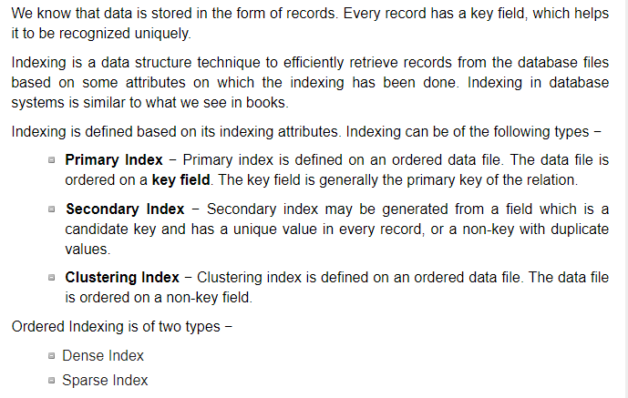

Slide 16
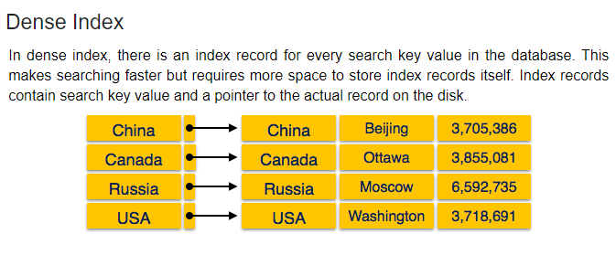

Slide 17
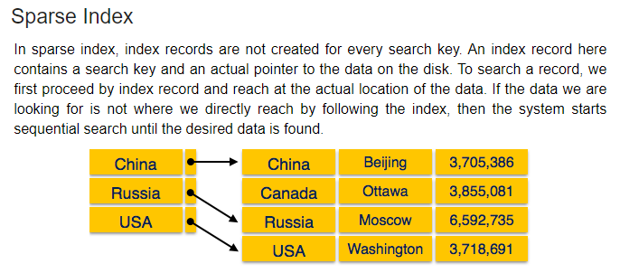

Slide 18
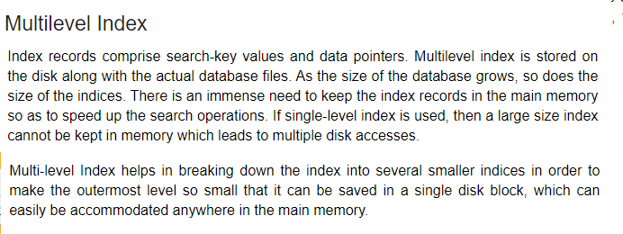

Slide 19
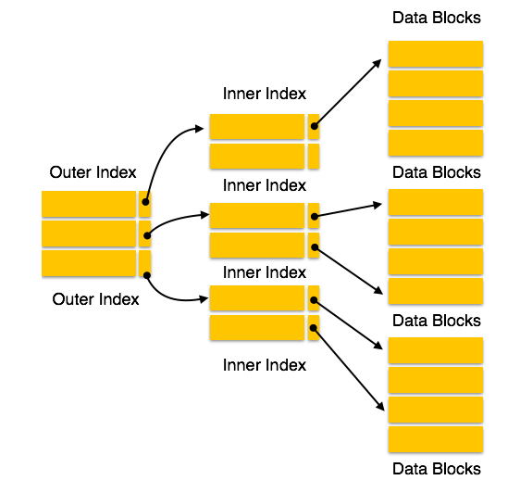
Multilevel indexing

Slide 20
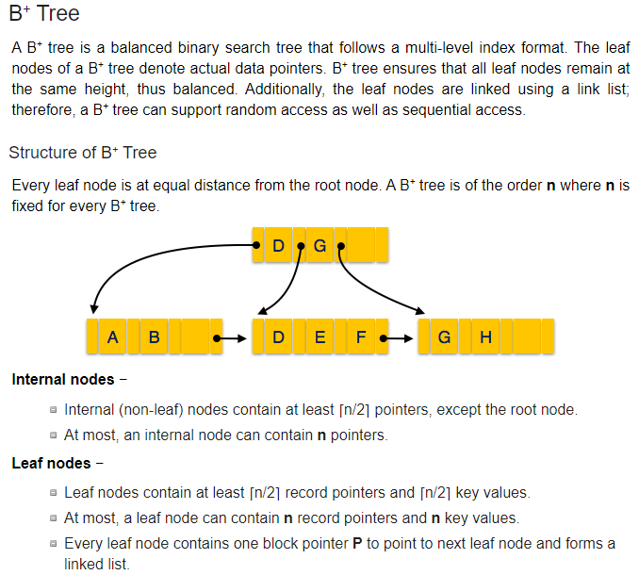
Tree Indexing

Slide 21
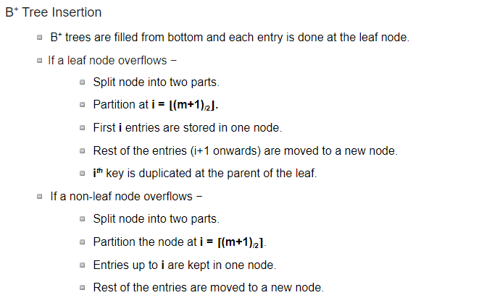

Slide 22
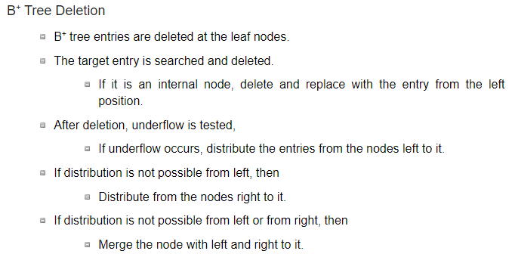
Note:
B+ Tree explained in ADS

Slide 23
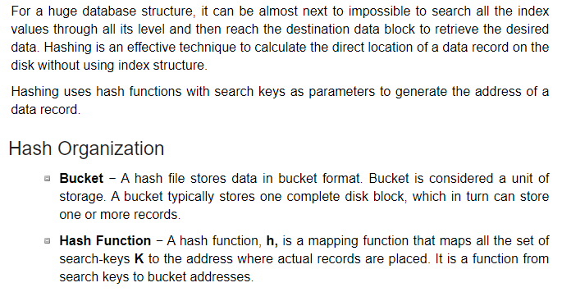

Slide 24
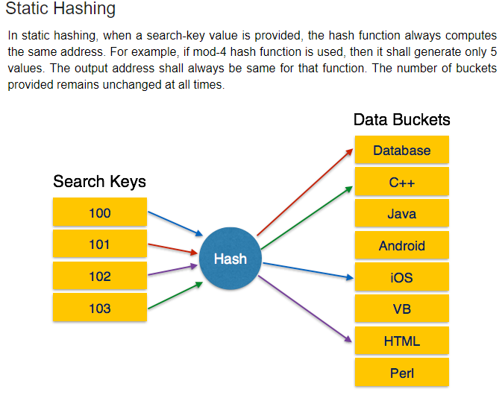

Slide 25
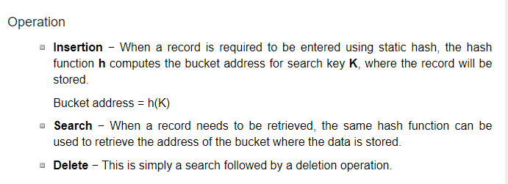

Slide 26
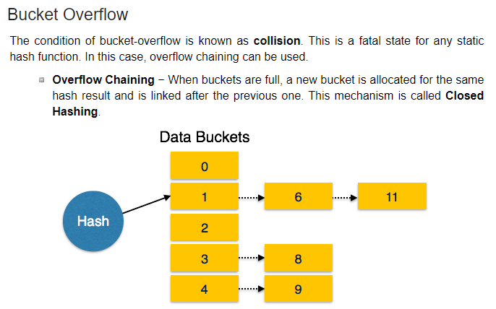

Slide 27
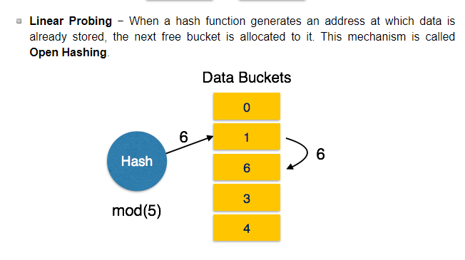

Slide 28
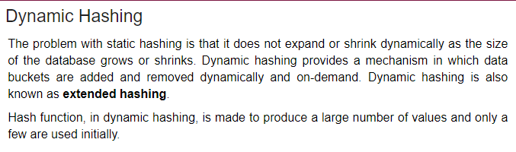
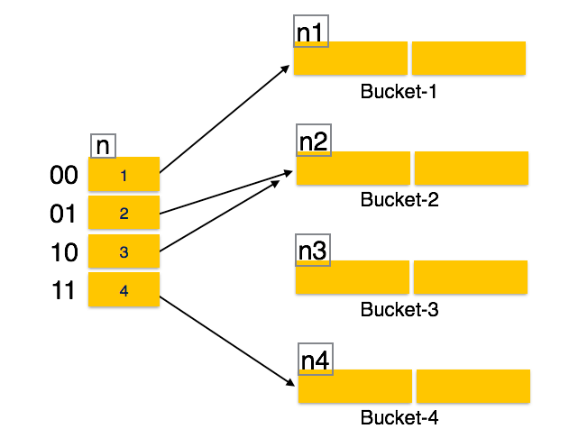

Slide 29
