Slide 1
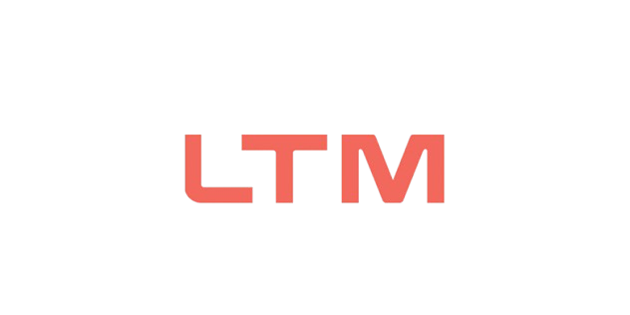

M.Tech Program
Advanced Industry Integrated Programs
Jointly offered by University and LTIMindTree
Project Title
Agentic AI Multi-Agent Architecture for Automated Fake News Verification & Explainable Trust Assessment
Team Member
VINOTH KANNA S
CRESCENT 2025-27
Knowledge partner | Implementation partner

Slide 2

RAG for Secure Enterprise Document Intelligence Using Role-Based Access Control (RBAC)
Introduction
Fake news spreads rapidly through social media and digital platforms.
Traditional fact-checking is slow and difficult to scale.
Existing AI models often give results without clear reasoning.
This project uses Agentic AI to verify claims, collect evidence, and provide an explainable trust score.

Slide 3
RAG for Secure Enterprise Document Intelligence Using Role-Based Access Control (RBAC)
Objective
Build a Multi-Agent System – Use Claim Extraction Agent, Evidence Retrieval Agent, Source Credibility Agent, Cross-Reference Agent, and Verdict Agent for automated fact-checking.
Verify Claims – Analyze evidence and source credibility through cross-checking.
Generate Trust Scores – Provide explainable trust scores with confidence levels.
Reduce Bias & Ensure Auditability – Use self-checking and maintain an evidence trail.

Slide 4
RAG for Secure Enterprise Document Intelligence Using Role-Based Access Control (RBAC)
Scope
Document ingestion, chunking, and embedding generation.
RBAC across 9 roles, 7 departments, 4 confidentiality tiers.
Secure authentication with salted password hashing.
LLM-based generation with a non-LLM extractive fallback.

Slide 5
RAG for Secure Enterprise Document Intelligence Using Role-Based Access Control (RBAC)
Literature Review
No. | Paper Title | Authors | Year | Conference / Journal | Relevance
1 | Retrieval Augmented Generation Based Explainable Fact-Checking Using Knowledge Graphs | Authors listed in IEEE Xplore | 2025 | IEEE International Conference on Recent Advances in Computing and Systems (REACS) | Uses RAG + Knowledge Graphs for evidence-based and explainable fact-checking.
2 | Fact-Checking With Contextual Narratives: Leveraging Retrieval-Augmented LLMs for Social Media Analysis | Authors listed in IEEE Xplore | 2026 | IEEE Transactions on Computational Social Systems | Uses RAG, LLMs and agent-based evidence refinement for multimodal misinformation verification.
3 | Multi-agent systems and credibility-based advanced scoring mechanism in fact-checking | Yihan Dong, Takayuki Ito | 2026 | Scientific Reports | Proposes multi-agent fact-checking and credibility-based scoring, closely matching your multi-agent trust-score approach.

Slide 6
RAG for Secure Enterprise Document Intelligence Using Role-Based Access Control (RBAC)
Summary of Literature
RAG-Based Fact-Checking (2025): Improves fake news verification by retrieving relevant evidence and providing explainable results
RAG with LLMs (2026): Combines retrieval and language models to improve factual accuracy and evidence-based verification.
Multi-Agent Fact-Checking (2026): Uses multiple specialized agents and credibility scoring to improve verification reliability.
Research Gap: Existing methods focus mainly on individual techniques; this project combines multi-agent verification, evidence retrieval, credibility assessment, and explainable trust scoring.

Slide 7
RAG for Secure Enterprise Document Intelligence Using Role-Based Access Control (RBAC)
Additional Information
Tech stack used in prototype: Python, FastAPI (backend), HTML/JS (frontend), Groq (free-tier LLM inference), Tavily (web search/evidence retrieval).
Key design principle: Transparent, documented scoring weights instead of a black-box fusion model — every score component is traceable.
Novel handling of uncertainty: Claims with no available evidence are labeled "developing" rather than falsely "unverifiable" or "false," avoiding overconfident errors for breaking news.
Evaluation approach: Can be benchmarked against labeled datasets (LIAR, FEVER, MultiFC) and compared against human fact-checker agreement rates.

Slide 8
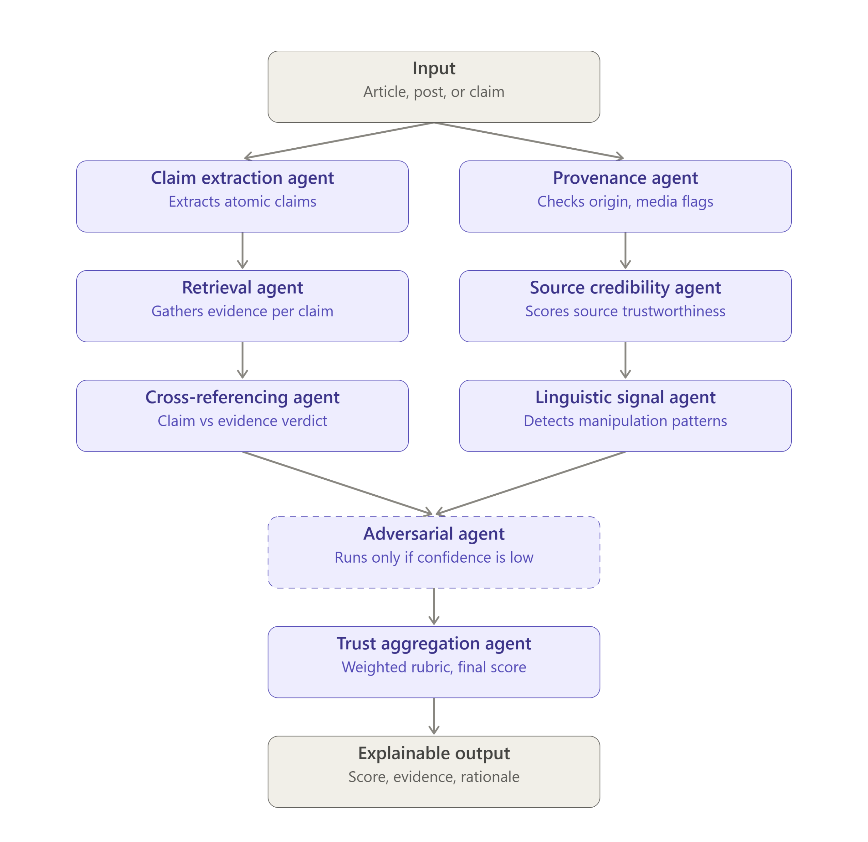
RAG for Secure Enterprise Document Intelligence Using Role-Based Access Control (RBAC)
Flowchart

Slide 9
RAG for Secure Enterprise Document Intelligence Using Role-Based Access Control (RBAC)
Modules to cover
Module Name | Subtopic
Claim Extraction Module | Parsing input into atomic, checkable claims; separating fact from opinion; detecting implicit/misleading framing
Context & Provenance Module | Tracing content origin, publisher history, reverse-image/video matching, manipulation detection
Evidence Retrieval Module | Querying search engines and fact-check databases per claim; retrieving both supporting and contradicting evidence
Source Credibility Module | Scoring sources on accuracy track record, editorial transparency, and domain reputation
Cross-Referencing Module | Comparing claims against evidence; classifying support/contradict/unverifiable; detecting logical fallacies
Linguistic & Behavioral Signal Module | Detecting emotional manipulation, clickbait, false urgency as supplementary risk indicators
Adversarial Review Module | Devil's-advocate agent that challenges the draft conclusion to surface weak reasoning
Trust Aggregation Module | Combining all signals via a transparent weighted rubric into a final trust score with confidence interval
Explainability & Reporting Module | Generating human-readable rationale, evidence citations, and audit trail for every verdict

