Slide 1
ORCA_TOP 32nm — Place & Route
Physical Design (PLACE AND ROUTE) Implementation using ICC2
Presented By
K.K.SAI KUMAR

Slide 2
CONTENTS
Introduction to Pnr
Orca_Top Project
Introduction to Orca_top
Input Preparation
Floorplan & powerplan
Placement
CTS
Routing

Slide 3
Introduction to PnR
PnR means the logical netlist is converted into a physical layout (GDSII) by placing cells and routing connections.
Inputs to PnR
Netlist (from synthesis)
Constraints (SDC)
Technology file (e.g., 32nm)
LEF/DEF files
Standard cell libraries
Power intent (UPF/CPF)
PnR Flow
Floorplanning
Power Planning
Placement
Clock Tree Synthesis (CTS)
Routing

Slide 4
Introduction to Orca_top
“ORCA top project includes design inputs like Logical Libraries, Physical Libraries ,modes (functional & scan), technology node, clock definitions, routing layers, voltage domains, and scan/IO setup required before starting PnR. ”
Modes
In orca top we have 2 modes (func, scan)
Functional mode(func) Normal working logic
Example: ALU, controller, memory logic
Scan mode (scan)Used for testing the chip
Flip-flops connected in scan chains
Technology node (32nm)
This tells how small the transistors are32nm = transistor Size
Smaller node →faster✔️ less power✔️ more density✔️

Slide 5
Clocks Clock controls timing of the chip Synchronizes all operations
Key things: Clock period, Skew (difference in arrival time) ,and Latency
Routing Layers These are metal layers(Metal1, Metal2, Metal3…Metal9) used for routing
Lower layers → local routing
Higher layers → global routing
Voltage Areas:
Different parts of chip use different voltages – VDD,VSS,VDDH
Scan Flop:
Used for testing and helps detect manufacturing defects
Implemented as scan chains
Logical Libraries:
HVT,LVT,SVT
HVT (High Threshold Voltage) → Lower leakage power, slower speed
LVT (Low Threshold Voltage) → Higher speed, higher leakage power
SVT (Standard Threshold Voltage) → Balanced trade-off between speed and leakage

Slide 6
Input Preparation
Library Setup / Import
Types of libraries:
Technology file (.tf) → layer info, rules
Logical libraries (.lib / .db) → timing, power
Physical libraries (LEF / Milkyway / NDM) → cell layout
TLU+ files → RC extraction data
2 . Create Design Library
Create working library (Milkyway / NDM and .tf)
Ex: create_lib -technology saed32nm_1p9m_mw.tf {workspace/pdlab1}ORCA_TOP.ndm
3 . Read Netlist
Import your synthesized design
Ex: read_verilog design.v
4. Link Design
Connect netlist with libraries
Ex : link_block
5. Read Constraints (SDC)
Timing constraints are very important before placement
Ex : read_sdc design.sdc
6. Unified power format (UPF)
Ex : load_upf ORCA_TOP_design.upf

Slide 7
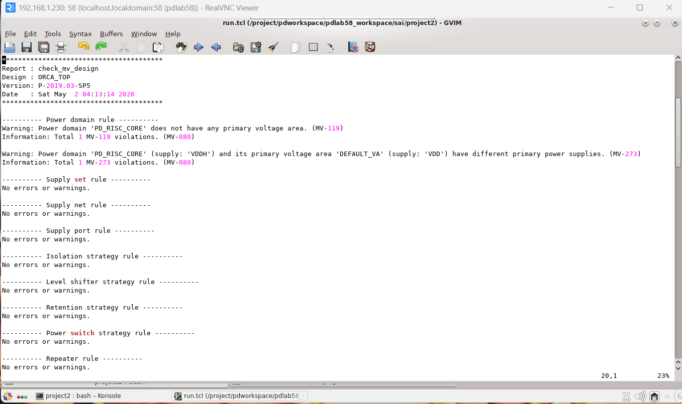
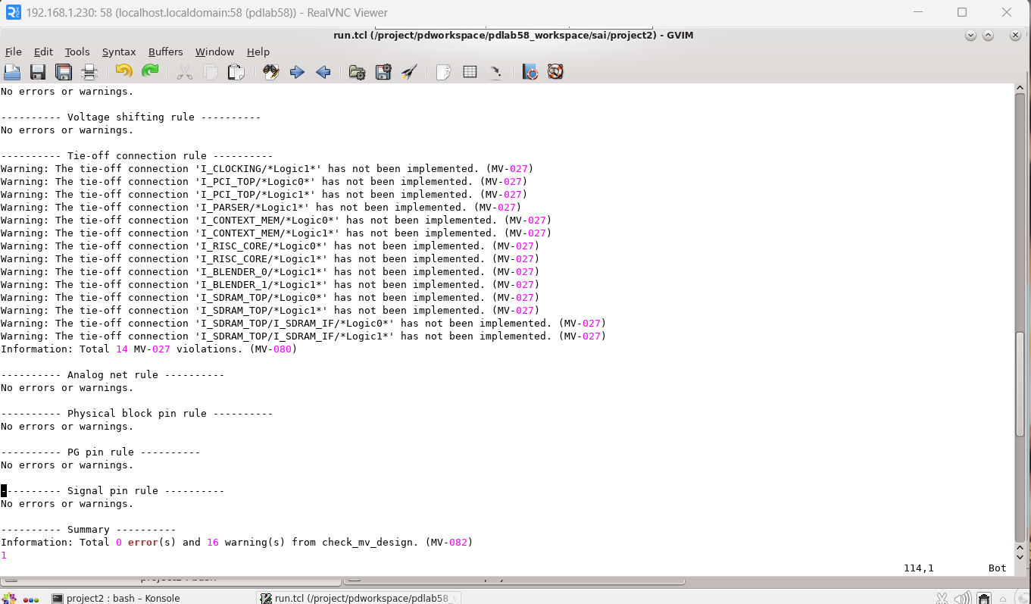
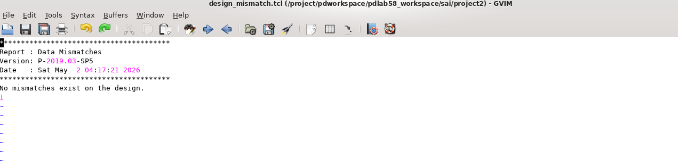
Checks Before floorplan :
Check mv design and Design mismatch

Slide 8
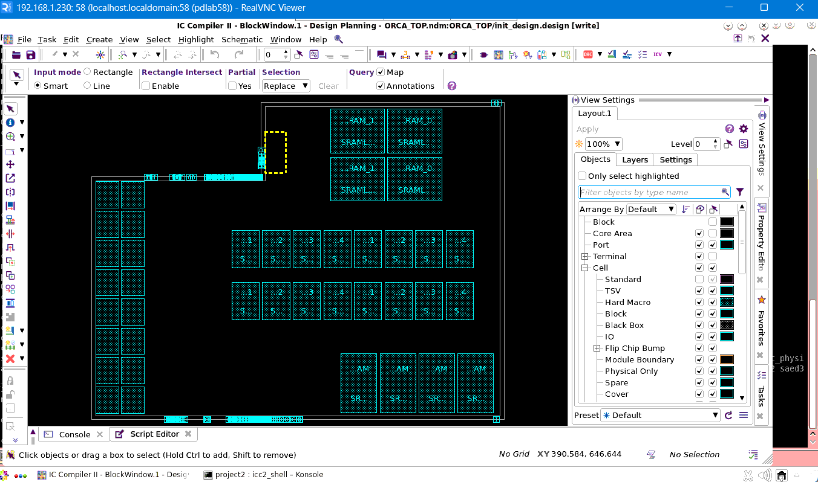
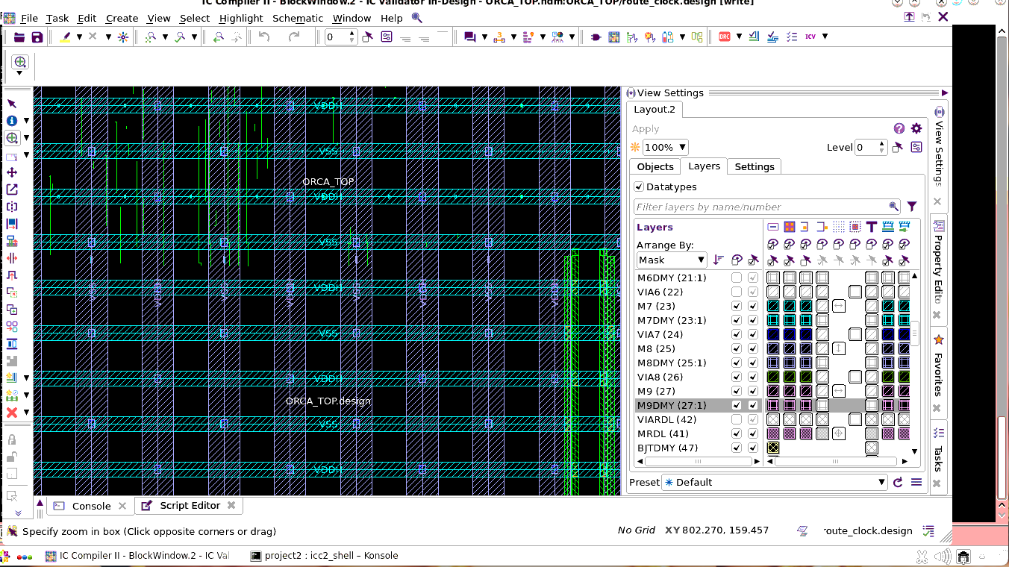
Floorplan and powerplan
Define chip/core area and Placing the macros (memories, IPs)as per macro guidelines and Define IO placement and Create voltage areas
Floorplanning is the process of defining the physical layout of the chip — the core area, I/O ring, macros, and blockages — before placing standard cells.
Power planning ensures the delivery of power (VDD) and High drain Supply voltage (VDDH) and ground (VSS) across the chip to avoid IR drop and electromigration.

Slide 9
Checks:
Check legality
Check pg missing vias
Check pg connectivity –check_std_cell_pins none
Check pg drc
Errors
Macro Overlap
Use spacing between macros
Use partial blockages
Pg Missing vias
insert vias
Re-run PG Routing or via fill
pg connectivity- Floating wires
Add missing Connections
Re-Run power routing

Slide 10
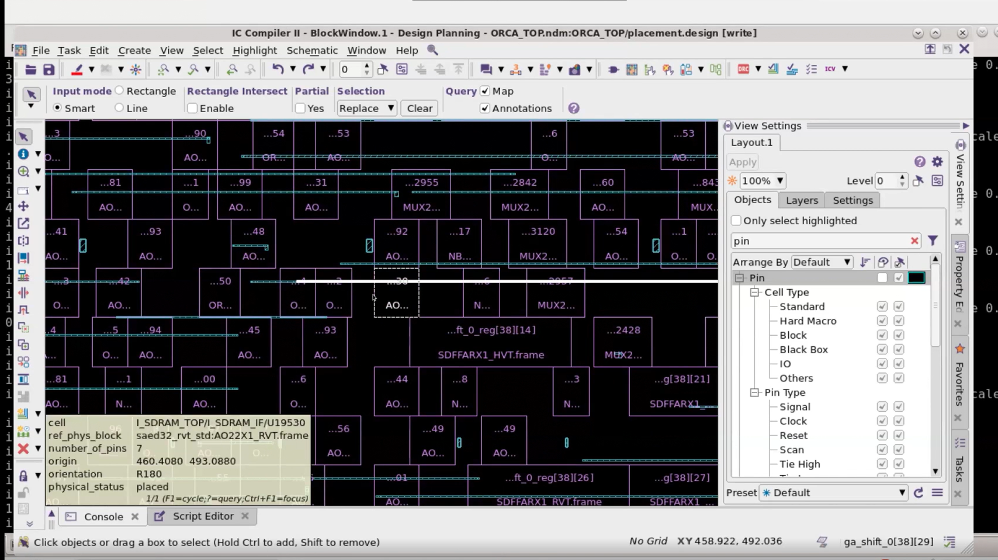
placement
Placement is the process of assigning physical locations and placing the standard cells, and physical-only cells (like endcaps, well taps, decaps) within the chip’s floorplan.

Slide 11
Checks:
check_legality
check_mv_design
report_global_timing
report_utilization
report_design -summary
report_congestion -rerun_global_router true
report_threshold_voltage_groups -nosplit
report_constraints -all_violators
Errors:
MV design
Add level Shifters
Check UPF/Voltage domains
Legality issues
Run legalization
Fix placement constraints

Slide 12
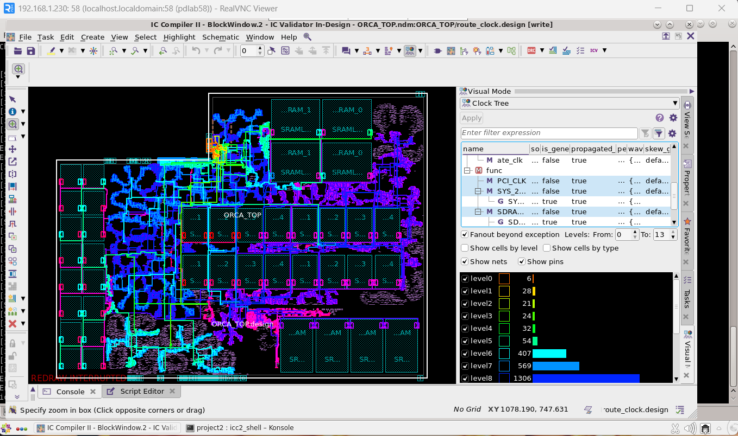
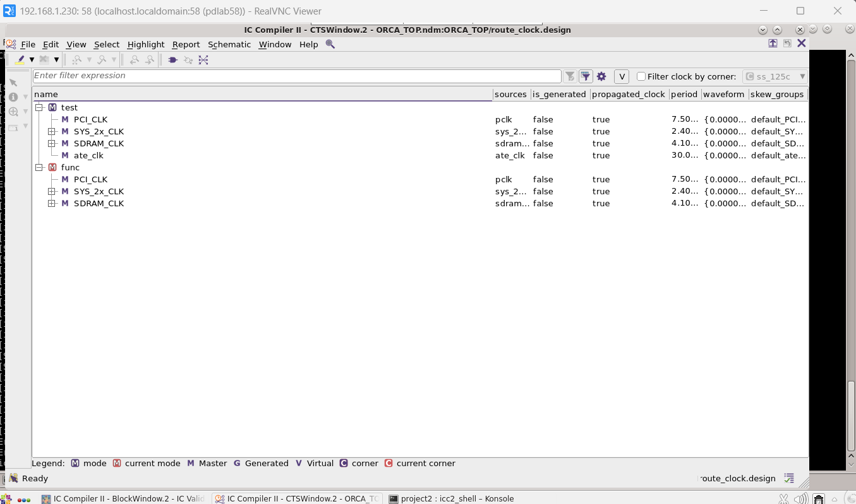
Cts (clock tree synthesis)
CTS stands for Clock Tree Synthesis. It is the process of building a balanced clock distribution network that delivers the clock signal from the source (PLL or clock pad) to all sequential elements (flip-flops, latches) with minimal skew and controlled insertion delay.

Slide 13
PRE CHECKS CTS Stage
report_clocks
report_clocks -groups
report_clock_qor -mode func
report_clock_qor -mode test
report_ports -verbose [get_ports *clk]
Post CTS Checks
report_clock_qor
report_clock_qor -type area
report_constraints -all_violators
Errors:
Max Cap Violations
Insert more clock buffers
Use high drive strength cells

Slide 14
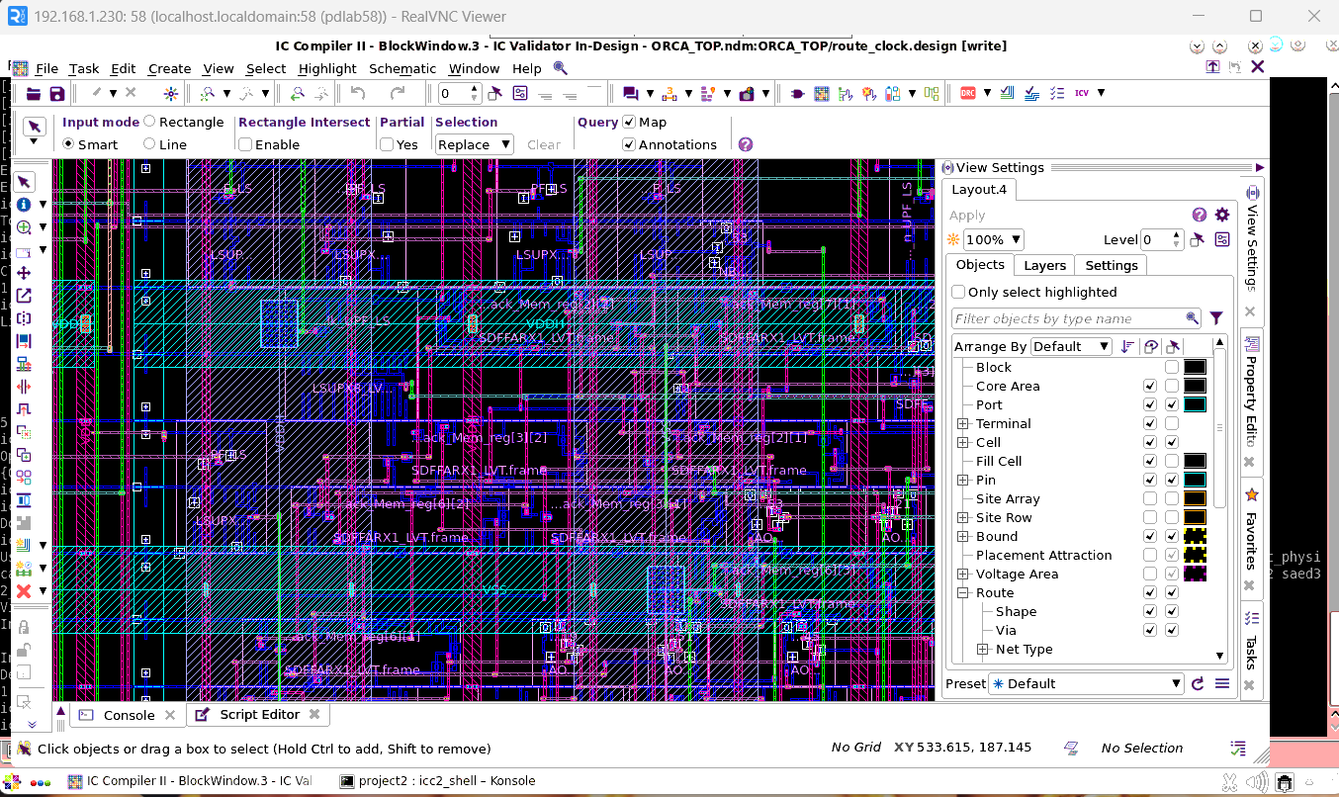
Routing
Routing is the process of creating physical interconnections (wires) between placed cells, macros, and I/O pins according to the netlist, while meeting timing, power, and design rule constraints. It transforms logical connectivity into manufacturable wiring patterns.

Slide 15
Checks after Routing :
check_routes
check_lvs
check_legality
check_mv_design
report_global_timing
report_utilization
report_design -summary
report_threshold_voltage_groups –nosplit
Errors:
DRC Violations – Re-route the specific Nets
Zroute Errors
Short errors – Two different nets get connected
Open errors – Nets is partially routed or disconnected
Routing Congestion
Increase Routing layers
Adjusting routing guides

