Slide 1
The Essentials of Physical Design (RTL to GDSII)
Transforming Logic into Silicon
Presented By
K.K.SAI KUMAR

Slide 2
Contents
Introduction to PD
Physical Design flow overview
Synopsys EDA Tool overview
Raven Wrapper Project overview
Floorplanning
powerplanning
Placement
CTS
Routing
Filler Insertion

Slide 3
INTRODUCTION TO PD
Physical design is the stage in the VLSI (Very Large Scale Integration) design flow where the abstract logical circuit (netlist) is transformed into a geometrical layout (GDSII)that can be fabricated on silicon.
Logical design → Blueprint (schematics, netlist).
Physical design → Actual construction (placement of transistors, wires, blocks).
The Goal: To ensure the chip meets PPA targets:
* Power: Minimize leakage and switching power.
* Performance: Meet timing requirements (Setup/Hold).
* Area: Minimize the silicon footprint to reduce cost.
Tools Used- EDA Tools like Synopsys ICC2, Cadence Innovus, Mentor Graphics Calibre. - These are automate placement, routing, and verification.

Slide 4
Physical Design flow overview
The RTL-to-GDSII
Physical Design Flow(Synopsys ICC2 Based)
Design Initialization
* Inputs: Verilog Netlist, SDC (Constraints), UPF (Power), Libraries (NDM/DB).
* Floorplanning
* Defining chip boundary, I/O pin placement, and Macro (SRAM) placement.
* Power Planning
* Creating the VDD/VSS mesh, rings, and stripes to minimize IR Drop.
* Placement
* Standard cell positioning and timing-driven optimization.
* Clock Tree Synthesis (CTS)
* Clock distribution, skew balancing, and buffer insertion.
* Routing
* Global and Detailed routing of all signal nets.
* Physical Verification & Sign-off
* DRC, LVS, and STA (Static Timing Analysis).

Slide 5
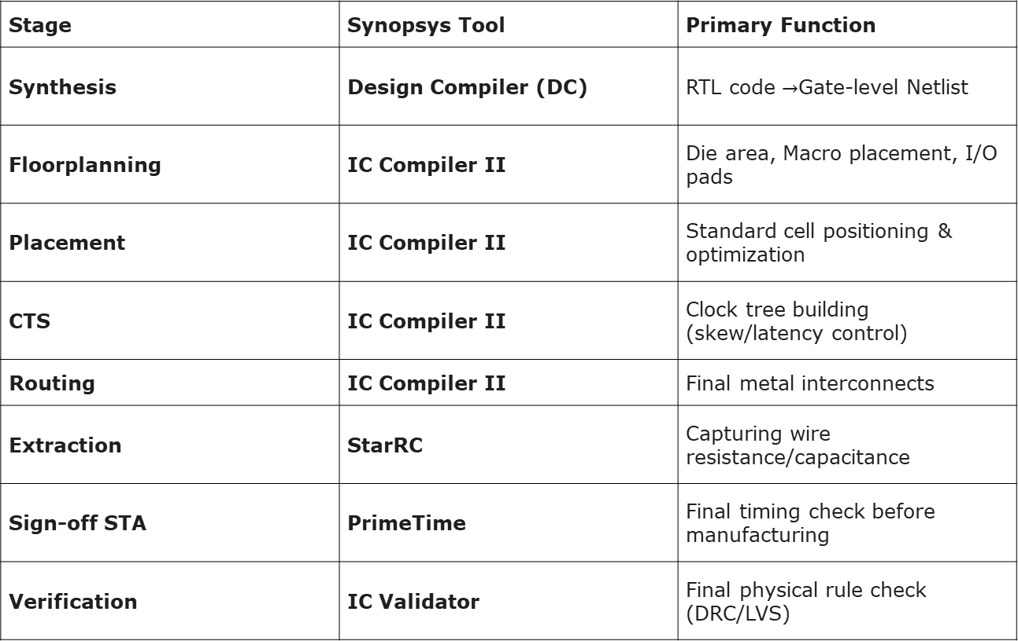
Synopsys EDA Tool overview
Stage | Synopsys Tool | Primary Function
Synthesis | Design Compiler (DC) | RTL code $→$Gate-level Netlist
Floorplanning | IC Compiler II | Die area, Macro placement, I/O pads
Placement | IC Compiler II | Standard cell positioning & optimization
CTS | IC Compiler II | Clock tree building (skew/latency control)
Routing | IC Compiler II | Final metal interconnects
Extraction | StarRC | Capturing wire resistance/capacitance
Sign-off STA | PrimeTime | Final timing check before manufacturing
Verification | IC Validator | Final physical rule check (DRC/LVS)

Slide 6
Raven Wrapper Project overview
Raven_wrapper is a design block for synthesis, place-and-route, and testing- Ensures compatibility with 45nm technology and multi-clocks.
Mode (func) → This suggests the wrapper is configured in functional mode (normal operation), as opposed to test/debug modes.-
Tech (45nm) → The design is targeted for a 45 nanometer technology node. This defines transistor size, power, and performance characteristics.-
Clocks (3 clocks) → The design uses three separate clock domains. Multiple clocks are common in complex chips to handle different subsystems.-
10 (Layers) → Likely refers to 10 metal layers available in the process technology for routing interconnects.
The Voltages → VDD & VSS
The Physical Cell → Filler Cell

Slide 7
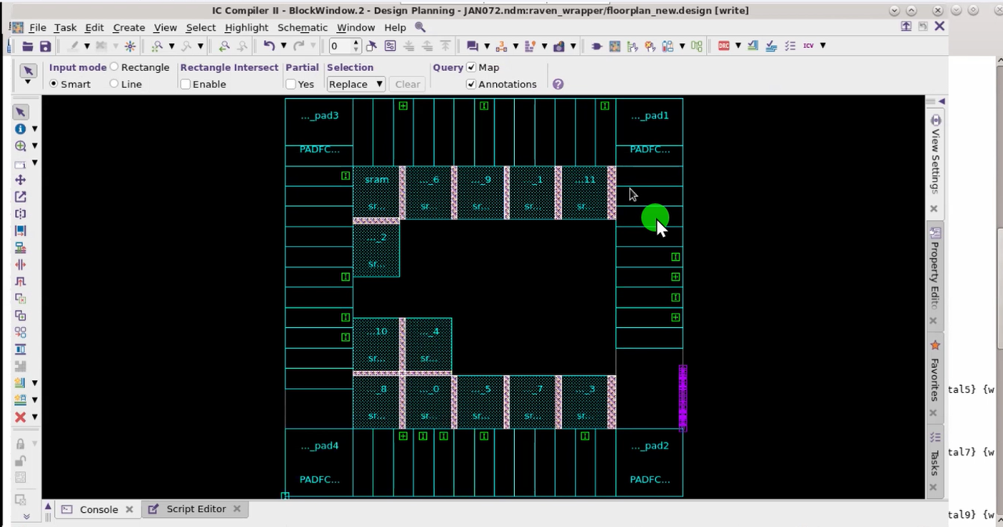
FLOOR PLANNING
Inputs for floorplanning
Netlist (.v) → Logical connectivity of the design.
Technology file (.techlef) → Process-specific rules.
Timing libraries (.lib) → Timing characteristics of cells.
Physical libraries (.lef) → Cell dimensions and layout info.
Constraints (.sdc) → Timing and design constraints.
TLU+ → Parasitic information for RC extraction.

Slide 8
FLOOR PLANNING
CHECKS
Die/Core Area Size
Macro placement
I/O pad placement
Errors
Placement Congestion
Orientation of macros
Misalignment of macros

Slide 9
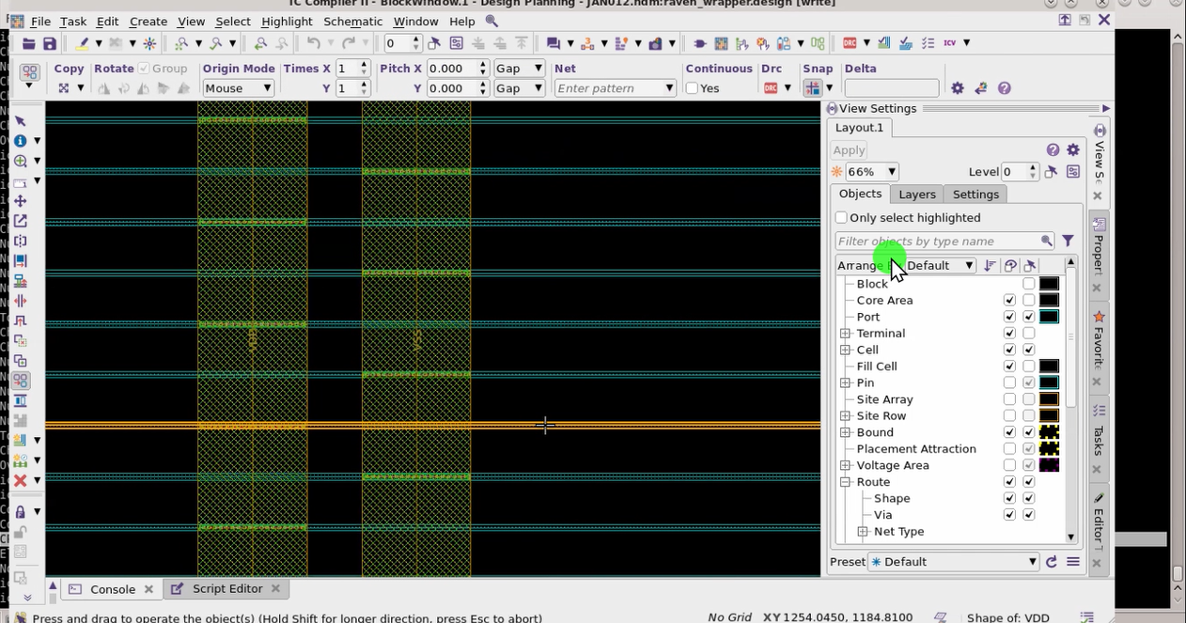
POWER PLANNING
Creating the VDD/VSS mesh, rings, and stripes to minimize IR Drop.
Power Mesh: Horizontal and Vertical stripes using higher metal layers. Connecting VDD and VSS pins of standard cells to the mesh.
Checks:
Check pg missing vias
Check pg drc
Check pg connectivity

Slide 10
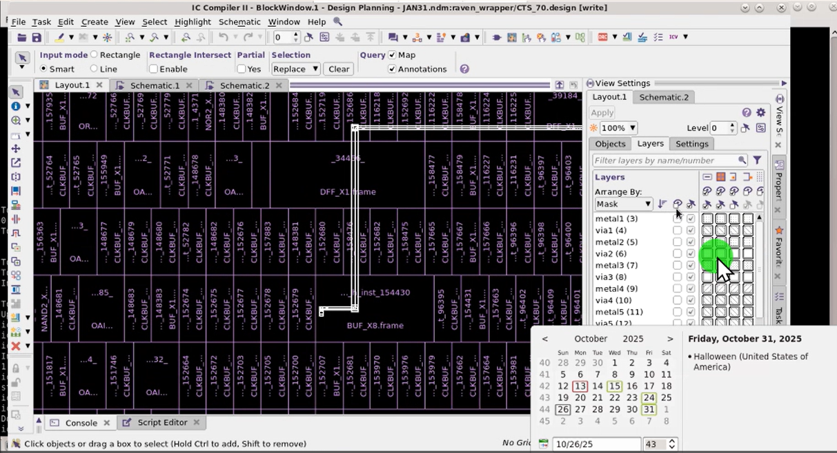
PLACEMENT
Place the standard cells inside the core area
Timing Analysis/congestion Analysis
Legaliazation of standard cell
QOR(Quality of Results) → Area,Power,Timing
Optimaztion

Slide 11
Checks after placement
Timing – check the setup timing
Congestion- cell density,Pin density
Legality issues
Utilization
Area
MV Violations
DRV – Max Capictance,Max Fan out,Max Transistion

Slide 12
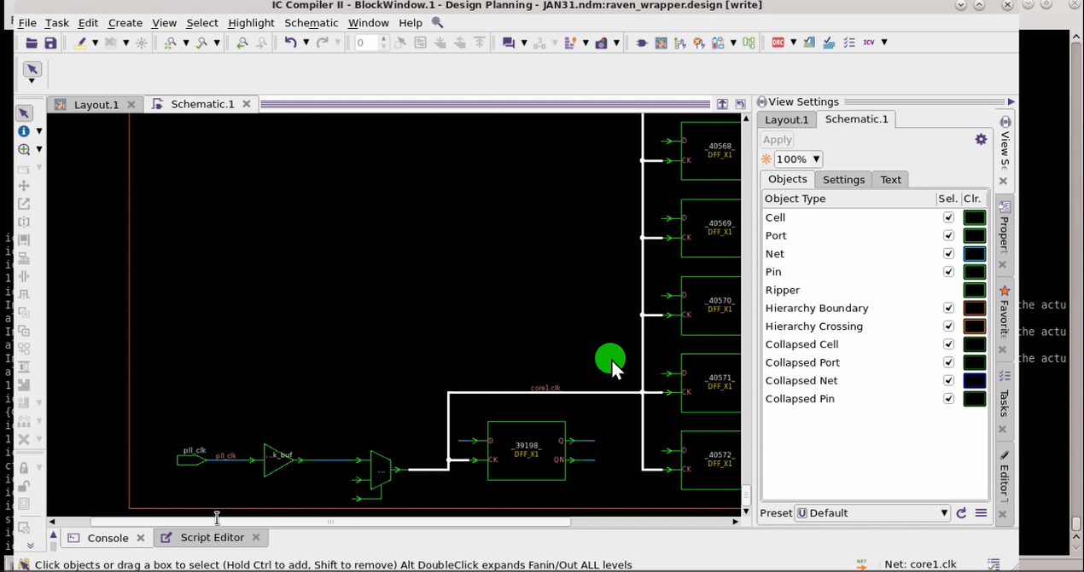
CTS(CLOCK TREE SYNTHESIS)
Clock Tree Synthesis (CTS) is the most critical stage in physical design. It is the process of distributing the clock signal from a single entry point (the clock pin) to every sequential element (flip-flops and registers) in the chip.

Slide 13
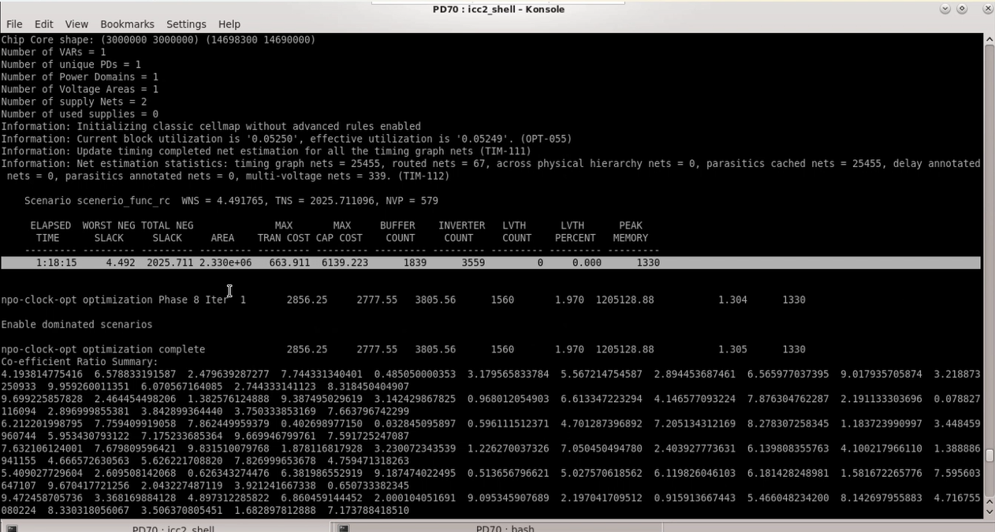
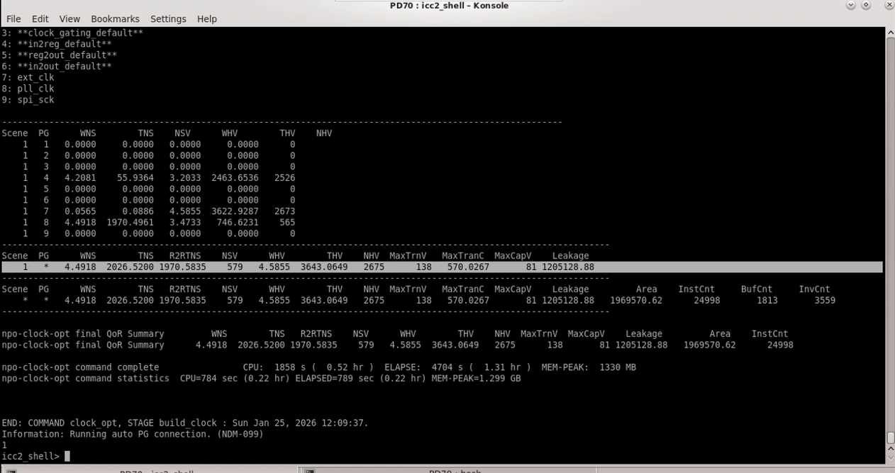
Checks After CTS
Report Clock QOR
Report Global Routing
s

Slide 14
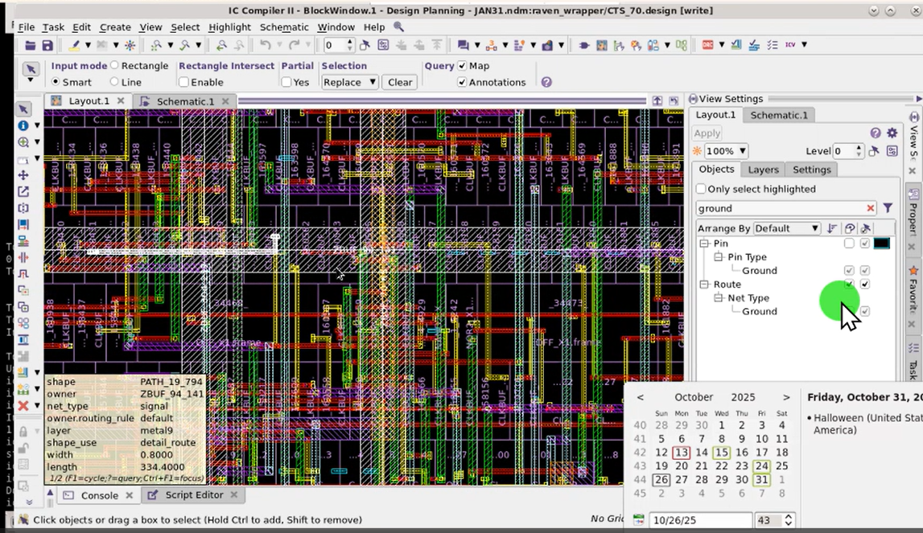
ROUTING
Routing is the stage where the tool creates the actual physical connections (metal wires) between the placed cells. After CTS, "placed" a design with a balanced clock.

Slide 15
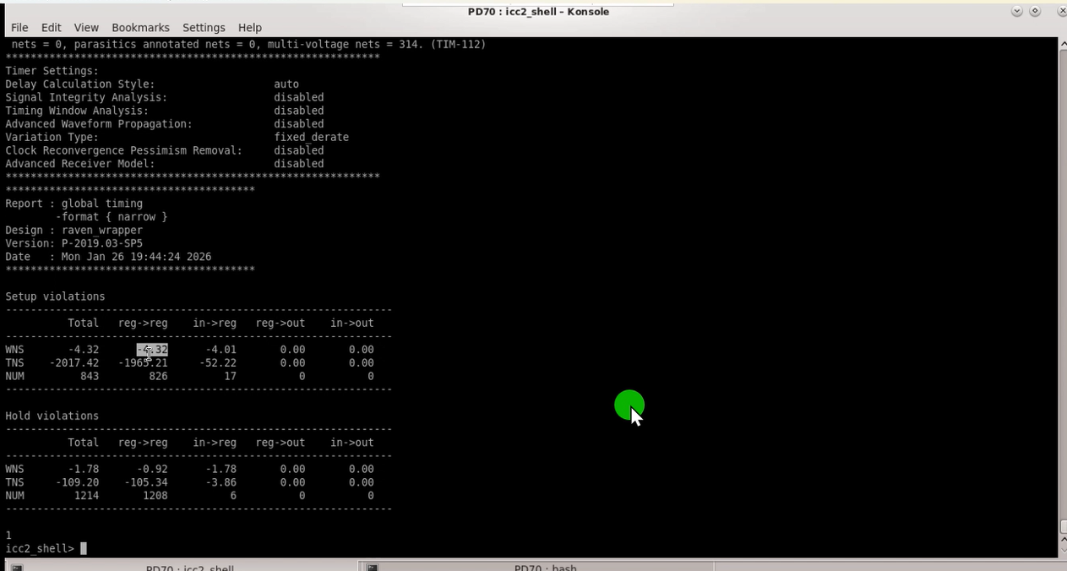
Checks After Routing
Check Routes
Check LVS
Check Global Timing
Report Utilization
Report Area
Report Design

Slide 16
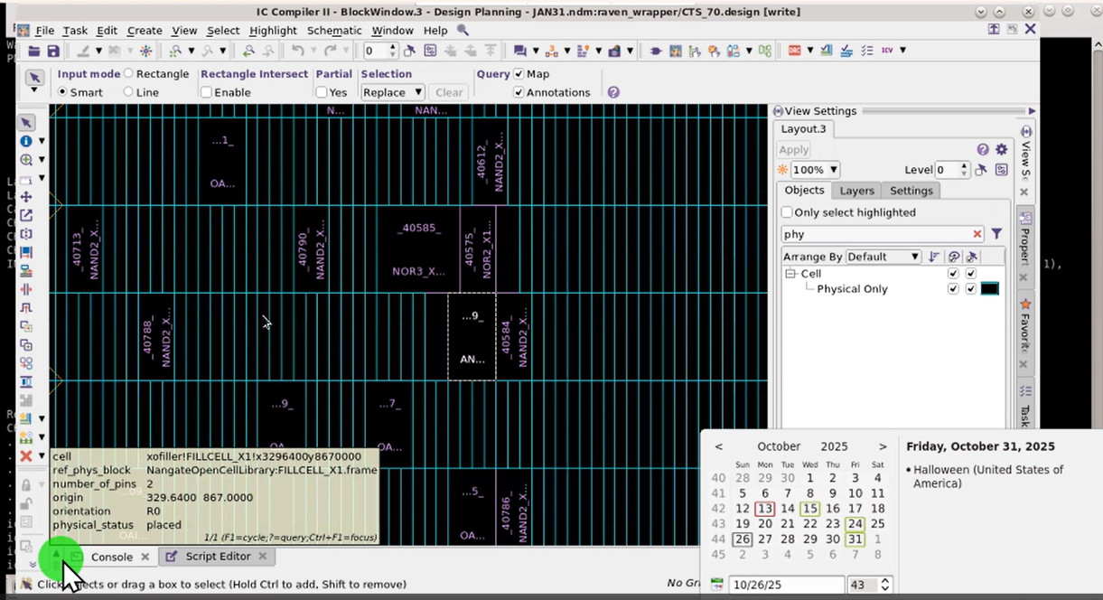
FILLER INSERTION
Filler Cells are non-functional cells that contain only the power and ground rails and the N-well/P-well layers. We insert them during the final stages of the design (usually after routing and before sign-off) to "fill" the empty gaps between standard cells.

