Slide 1

OPTIMIZING SMART GRID PERFORMANCE WITH DEEP LEARNING MODELS
Team Members:
Supervised By
Sri. V.A.G. Raju, M.Tech
Asst. Professor
IT Department
BHYRI ROHIT KUMAR (21A51A1210)
SANJEEVU SAI KUMAR (21A51A1204)
PUJARI SRAVYA (21A51A1252)
IPPILI BHANU PRAKASH (21A51A1229)
April 2025

Slide 2

Agenda
Abstract
Introduction
Literature Review
Methodology
Results
Conclusion

Slide 3
ABSTRACT
The smart grid is a cutting-edge power system idea that balances communication and electricity in system networks. It gives producers, operators, and consumers access to real-time information. The need to effectively manage electricity distribution to different consuming domains, including homes, businesses, industries, and smart cities, is growing. In this regard, dynamic power demand must be met by a stable smart grid system. Because there are so many affecting factors, predicting the stability of the smart grid is still difficult. Participation from producers and consumers is crucial since determining their level of involvement can help maintain grid stability. In this study, we suggest a deep learning model for smart grid stability prediction that is based on Gated Recurrent Units (GRU). Other conventional machine learning and deep learning classifiers. Such as Recurrent Neural Networks (RNN), Long Short-Term Memory (LSTM), and Artificial Neural Networks (ANN), are contrasted with the outcomes of the suggested GRU model. With a 97.45% accuracy rate, our suggested GRU model outperforms previous models in predicting the stability of the smart grid.
Keywords: Smart Grid Dataset, Decision tree Classifier, Logistic regression, Artificial Neural Networks, recurrent Neural Networks, Recurrent Neural Networks, Long Short-Term Memory, Gated Recurrent Units.

Slide 4
INTRODUCTION
A smart grid is a modernized electrical grid system that uses digital technology, communication networks, sensors, and automation to efficiently manage the generation, distribution, and consumption of electricity.
Unlike traditional power grids, smart grids enable two-way communication between power providers and consumers, allowing for real-time monitoring, quick detection of faults, and automated responses to changes in electricity demand. This advanced system supports the integration of renewable energy sources such as solar and wind, improving energy efficiency and reducing environmental impact.
Smart grids also provide detailed energy usage data, helping consumers manage their electricity consumption and reduce costs. Overall, the smart grid enhances reliability, promotes sustainable energy use, and ensures a more secure and resilient power infrastructure.

Slide 5
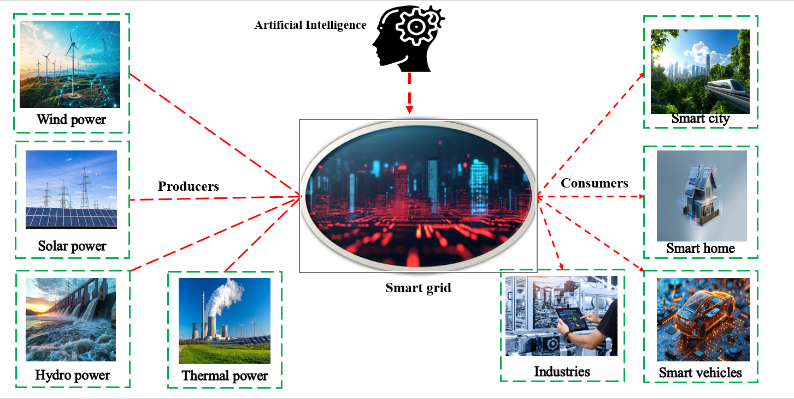
How Smart Grid Works

Slide 6
PROBLEM STATEMENT
Smart Grids sometimes struggle to manage the flow of power between power generators (like solar, wind, and thermal energy sources) and power consumers (such as smart cities, smart homes, etc.). These issues can lead to damage to electrical transformers and disruptions in power supply for end users. To solve this problem, we are trying to integrate advanced technologies like deep learning. By using deep learning models, we aim to reduce power-related damages and ensure a balanced and efficient power flow between power generators and consumers.

Slide 7
LITERATURE SURVEY
Author | Applied Algorithm | Dataset | They obtained Accuracy | Achieved
Anish Jindal et al., (2016) | Decision Tree classifier | Eletrical grid theft detection dataset | 90% | 84.95%
Ali Kashif Bashir et al., (2020) | Logistic Regression Classifier | Smart Grid Dataset | 80.90% | 82.05%
Swetha et al., (2023) | Artificial Neural Networks | Smart Grid Dataset | 93% | 96.39%
Shihab Hamad Khaleefah et al., (2024) | Long Short-term Memory (LSTM) | Smart Grid Dataset | 93.23% | 95.05%

Slide 8
METHODOLOGY
Dataset Overview
The dataset used in this study is “Smart Grid Stability Dataset” , firstly contributed by Vadim Arzamasov and made available through the University of California(UCI). This dataset which consists of 12 features, 2 dependent variables and an aggregate of 10,000 data points. The primary ideal of the dataset is to assess grid stability grounded on these features and classify the grid as either stable or unstable. Below is a breakdown of features.
Dataset Information
Number of Instances | 10,000
Independent Variables | 12
Dependent Variables | 2
Associated Task | Classification

Slide 9
Feature description used in the dataset
Feature Name | Feature Description
'tau1' to 'tau4 | The reaction time of each network participant, a real value within the range 0.5 to 10 ('tau1' corresponds to the supplier node, 'tau2' to 'tau4' to the consumer nodes)
'p1' to 'p4' | Nominal power produced (positive) or consumed (negative) by each network participant, a real value within the range -2.0 to -0.5 for consumers ('p2' to 'p4'). As the total power consumed equals the total power generated, p1 (supplier node) = - (p2 + p3 + p4)
'g1' to 'g4 | Price elasticity coefficient for each network participant, a real value within the range 0.05 to 1.00 ('g1' corresponds to the supplier node, 'g2' to 'g4' to the consumer nodes; 'g' stands for 'gamma')
'stabf' | A categorical (binary) label ('stable' or 'unstable')

Slide 10
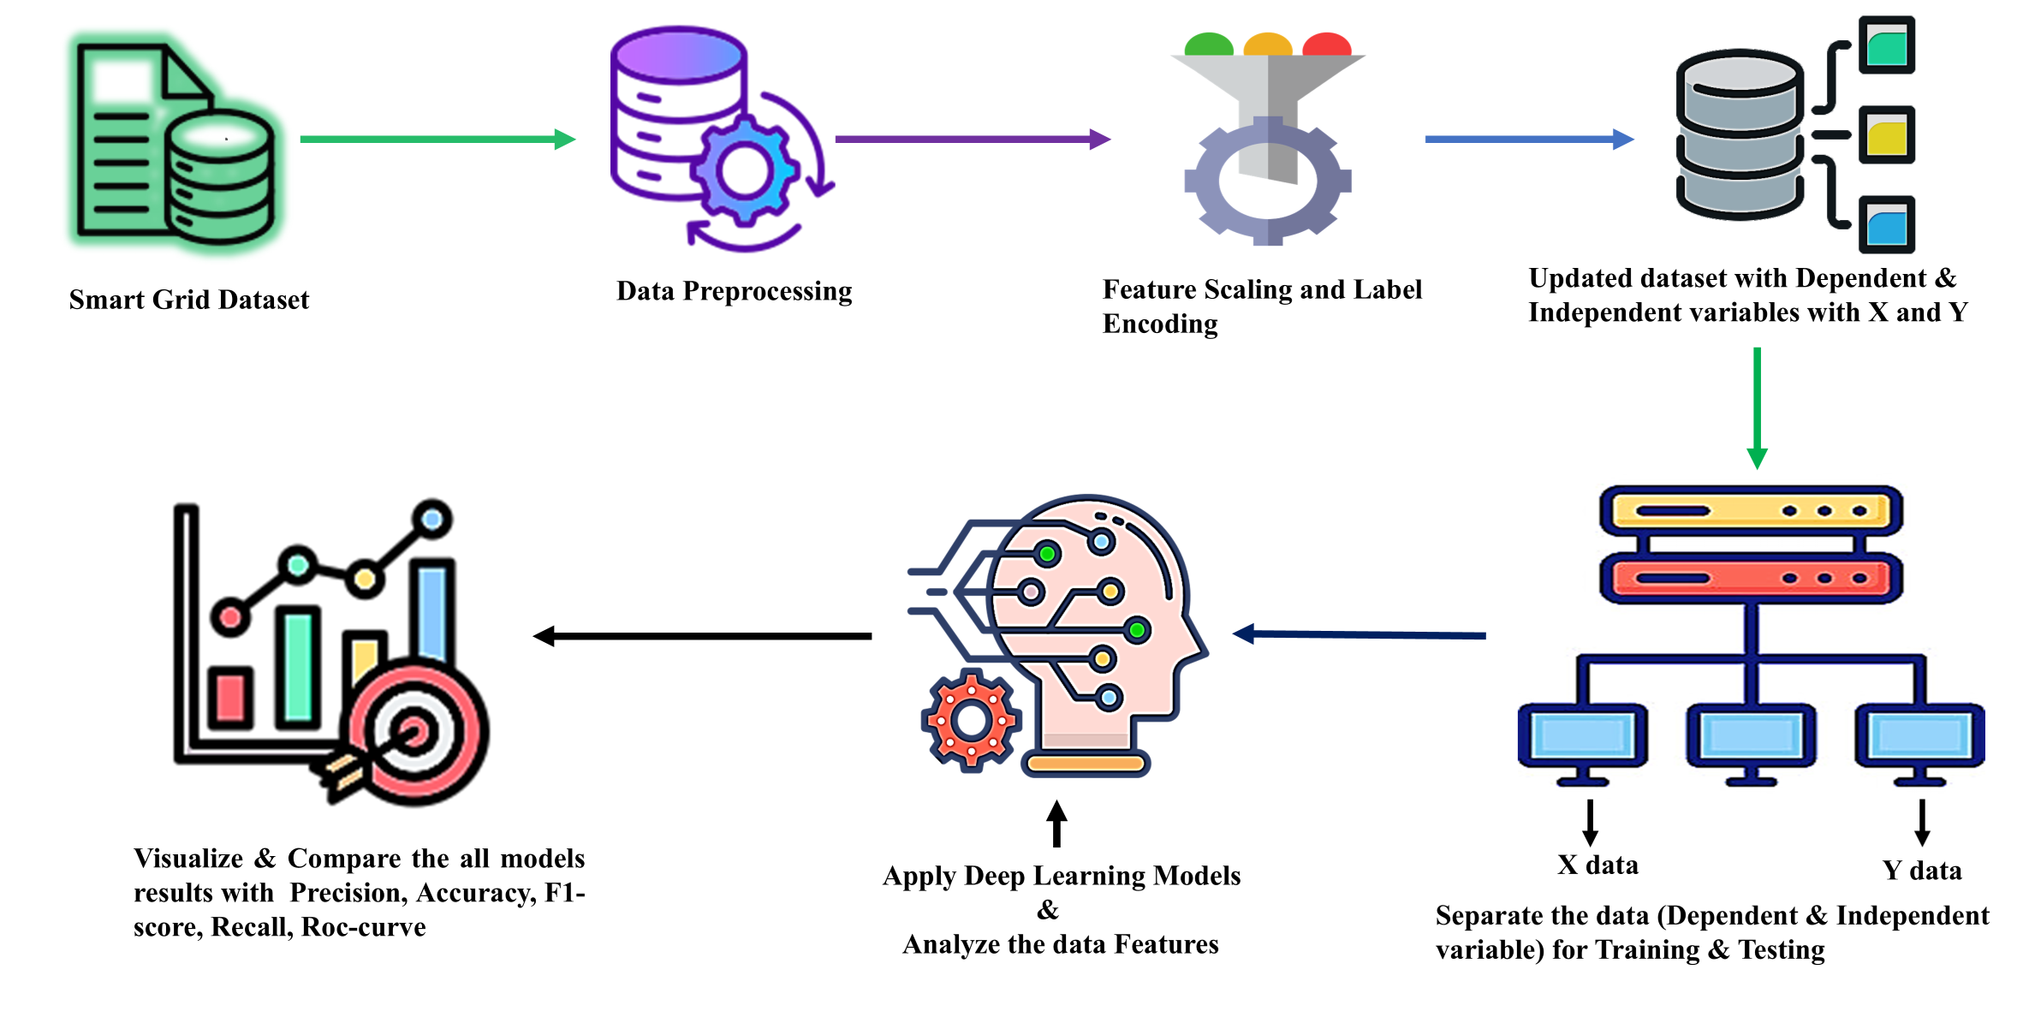
Steps Involved in Working with Datasets for Deep Learning

Slide 11
Applied Algorithms
Decision Tree Classifier
A decision tree classifier splits the dataset into subsets using feature-based conditions, forming a tree-like structure.Each internal node represents a decision on a feature, and each leaf node represents a class label.It’s simple, interpretable, and useful for both classification and regression tasks.
Logistic Regression
Logistic regression is a statistical method used for binary or multi-class classification.It calculates the probability of an outcome using the logistic (sigmoid) function applied to a linear combination of input features.Despite its name, it is used for classification, not regression.
Artificial Neural Network
An ANN is a computational model inspired by the human brain, consisting of input, hidden, and output layers of interconnected neurons.Each connection has a weight, and neurons apply activation functions to learn complex patterns in data.ANNs are widely used in image recognition, NLP, and predictive analytics.

Slide 12
Recurrent Neural Network
RNNs are a type of neural network designed for sequential data, where outputs from previous steps are fed as inputs to current steps.This memory-like feature allows RNNs to capture temporal or sequential dependencies.They are commonly used in tasks like language modeling, speech recognition, and time-series forecasting.
Long Short-Term Memory
LSTM is an advanced RNN architecture that solves the problem of long-term dependency using memory cells and gates (input, forget, and output).It can learn when to remember or forget information, making it powerful for long sequences.LSTMs are used in applications like machine translation, music generation, and video analysis.
Gated Recurrent Unit
GRU is a streamlined version of LSTM that combines the input and forget gates into a single update gate. It simplifies the architecture while maintaining performance in handling sequence data. GRUs are faster to train and often perform comparably to LSTMs on many tasks like text and speech processing.

Slide 13
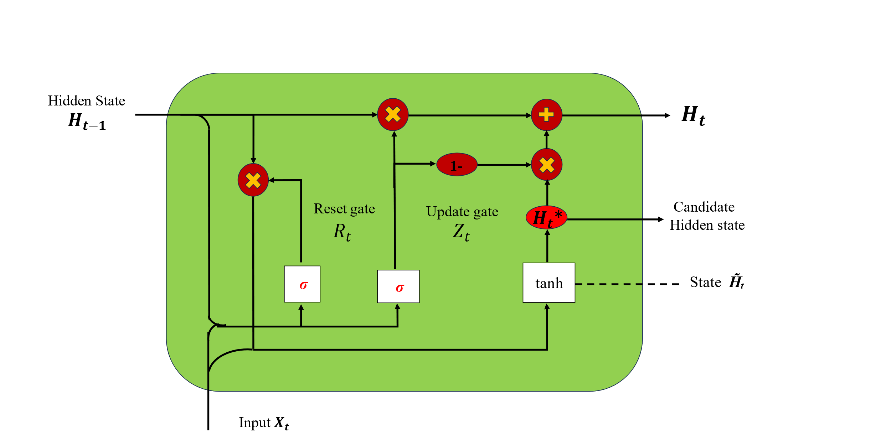
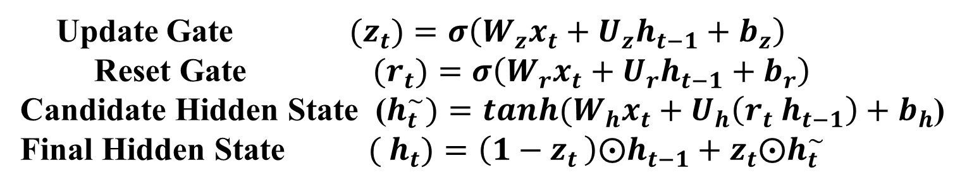
Proposed Algorithm
GRU Architecture
Gated Recurrent Unit (GRU) is a type of recurrent neural network (RNN) as a simpler alternative to Long Short-Term Memory (LSTM) networks. Like LSTM, GRU can process sequential data such as text, speech, and time-series data.
Update Gate${(z}_{t})=σ\left(W_{z}x_{t}+U_{z}h_{t−1}+b_{z}\right)$
Reset Gate ${ (r}_{t})=σ\left(W_{r}x_{t}+U_{r}h_{t−1}+b_{r}\right)$
Candidate Hidden State ($h_{t}^{\sim })=tanh(W_{h}x_{t}+U_{h}\left(r_{t} h_{t−1}\right)+{ b}_{h}$)
Final Hidden State ${( h}_{t})=\left(1−z_{t }\right)⨀h_{t−1}+z_{t}⨀h_{t}^{\sim }$

Slide 14
GRU Model Parameters
Model Parameters | Values
No. of GRU Layers | 2
GRU Units (Layer 1) GRU Units (Layer 2) | 128 64
Learning Rate | 0.003
Optimizer | RMSprop
No.of epochs | 30
Batch Size | 32
Dense Units (Layer 1) Dense Units (Output Layer ) | 64 1
Dense Activation (Layer 1) Dense Activation (Output Layer) | Relu,Tanh Sigmoid
Dropout Rate (Layer 1 and Layer 2) | 0.2
Metrics | accuracy

Slide 15
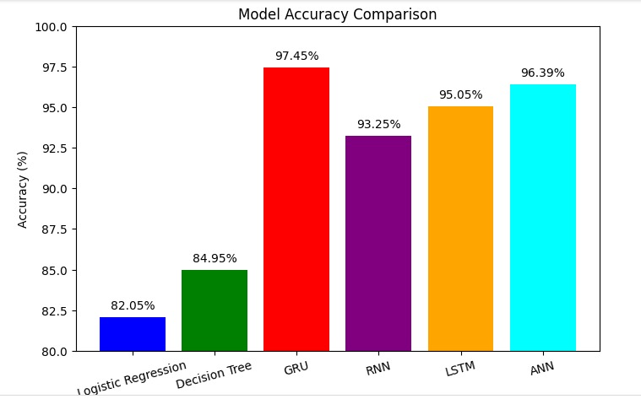
RESULTS
Models | Accuracy | Precision | Recall | F1-score | ROC
Decision Tree | 0.8495 | 0.85 | 0.84 | 0.84 | 0.832
Logistic Regression | 0.8205 | 0.81 | 0.82 | 0.80 | 0.792
ANN | 0.9639 | 0.96 | 0.96 | 0.96 | 0.995
RNN | 0.9325 | 0.93 | 0.93 | 0.93 | 0.986
LSTM | 0.9505 | 0.97 | 0.96 | 0.96 | 0.941
GRU | 0.9745 | 0.97 | 0.97 | 0.97 | 0.996

Slide 16
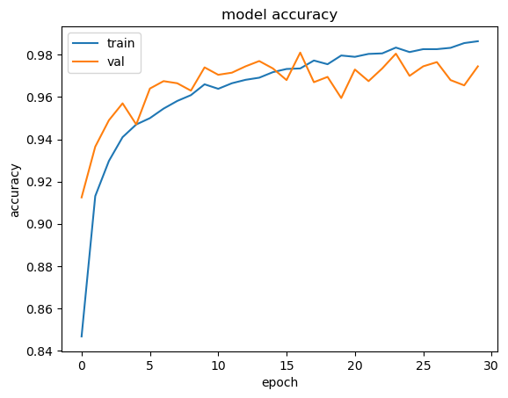
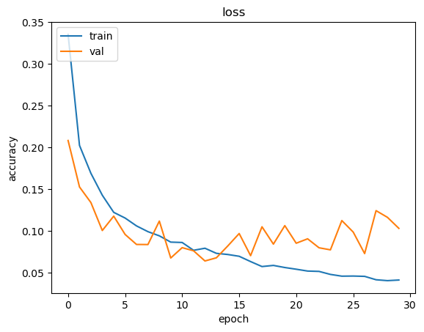
GRU Model Accuracy & Loss

Slide 17
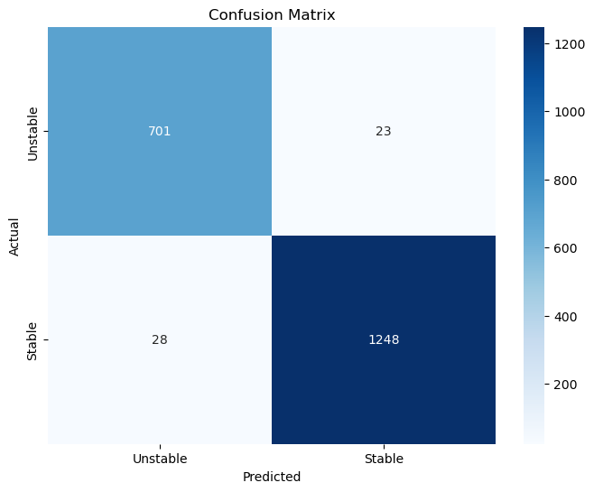
Confusion Matrix of GRU Model

Slide 18
CONCLUSION
The capacity of GRU, LSTM, RNN, ANN, Decision Tree, Logistic Regression to categorize data extracted from a smart grid dataset in order to forecast grid stability was investigated in this study. In order to improve the forecast of smart power grid stability, we then suggest a GRU model. Both user-consumed energy and smart grid-generated energy were included in the test simulation data. The accuracy of the GRU model is 97.45%, while its loss is only 10.33%. Additionally, 97% precision, 97% recall, and 97% F1-Score are attained with the GRU model. However, the accuracy of the LSTM, RNN, ANN, Decision Tree classifier, and Logistic Regression models is 96.39%, 93.25%, 96.39%, 84.35%, and 81.60%, respectively. The model with the highest accuracy among the examined models was determined to be the most appropriate for predicting the stability of smart grids. The findings demonstrate how deep learning approaches can enhance grid stability evaluation, which is crucial for effective power distribution in contemporary energy systems. To improve real-time prediction ability, future research can concentrate on refining these models even more and adding more affecting variables.

Slide 19
REFERENCES
Eltigani, D. and Masri, S., 2015. Challenges of integrating renewable energy sources to smart grids: A review. Renewable and Sustainable Energy Reviews, 52, pp.770-780.
Singh, A.K., Singh, R. and Pal, B.C., 2014. Stability analysis of networked control in smart grids. IEEE Transactions on Smart Grid, 6(1), pp.381-390.
Mishra, M., Patnaik, B., Biswal, M., Hasan, S. and Bansal, R.C., 2022. A systematic review on DC-microgrid protection and grounding techniques: Issues, challenges and future perspective. Applied Energy, 313, p.118810.
Dewangan, F., Biswal, M., Patnaik, B., Hasan, S. and Mishra, M., 2022. Smart grid stability prediction using genetic algorithm-based extreme learning machine. In Electric Power Systems Resiliency (pp. 149-163). Academic Press.
Mishra, M., Nayak, J., Naik, B. and Patnaik, B., 2022. Enhanced Memetic Algorithm Based Extreme Learning Machine Model for Smart Grid Stability Prediction. International Transactions on Electrical Energy Systems, 2022.
Arzamasov, V., Böhm, K. and Jochem, P., 2018, October. Towards concise models of grid stability. In 2018 IEEE international conference on communications, control, and computing technologies for smart grids (SmartGridComm) (pp. 1-6). IEEE.

Slide 20
THANK YOU

