Slide 1

A Mini Project Presentation on Student Performance Prediction Using Machine Learning by
G.SaiRam (23RS5A0506)
D.Saikumar (23RS5A0505)
E.Vishnuvardhan (22RS1A0519)
D.Srija (22RS1A0518)
Y.Jyoshika (22RS1A0524)
Under the Guidance Of
Dr.T.Venugopal Prinicipal of CSE
Project Co-Ordinator
G.Sravan Kumar Professor & Head of CSE
Department of Computer Science Engineering
Jawaharlal Nehru Technological University Hyderabad
College of Engineering Rajanna Sircilla

Slide 2
Problem Statement
Student performance is affected by multiple factors (attendance, study time, socio-economic background).
Traditional evaluation methods rely on exams, assignments, and teacher feedback, which may not be sufficient for early detection.
Lack of a predictive approach results in late interventions, reducing the chances of improvement.
A data-driven system can predict student success and suggest timely corrective measures.

Slide 3
Real World Example
Universities & Schools: Use predictive analytics to identify students at risk of failing and provide extra support.
Online Learning Platforms: Platforms like Coursera and Udemy analyze student engagement to suggest personalized courses.
Government Initiatives: Some countries use predictive models to allocate educational resources effectively.

Slide 4
Introduction
Education is essential for societal progress, but ensuring student success remains a challenge.
With the rise of technology, machine learning can analyze vast amounts of student data.
A predictive model can offer insights into student behavior, performance, and areas requiring improvement.
The project focuses on leveraging AI to enhance academic success rates.

Slide 5
Literature Review
2025 – Sharma et al.: "A Comparative Analysis of Tree-Based Models for Student Performance Prediction." Found LightGBM slightly outperformed Random Forest, emphasizing feature selection.
2024 – Banerjee et al.: "Hybrid Stacking for Academic Performance Forecasting." Achieved R² of 0.91 with a stacked ensemble model, showing superior generalization.
2023 – Prasad et al.: Developed a hybrid ensemble system for Indian college students. Achieved over 89% accuracy combining multiple tree-based algorithms.
2022 – Nandhini & Deepa: Conducted a comparative analysis of deep learning vs. traditional ML models. Random Forest remained competitive on smaller, structured educational datasets.

Slide 6
Abstract
This project develops a machine learning model to predict student performance.
It considers multiple attributes such as:
- Attendance
- Study time
- Socio-economic factors
- Parental education
The system will help educators identify at-risk students early and take corrective actions.

Slide 7
Existing System
Current student performance evaluation methods include:
- Periodic tests and assignments
- Teacher feedback
- Parent-teacher meetings
Challenges of the current system:
- No early warning mechanism
- Intervention is often delayed
- Difficult to analyze multiple factors influencing performance

Slide 8
Proposed System
Key Features:
- Predicts student performance based on historical and real-time data.
- Identifies key influencing factors.
- Generates early warning signals for struggling students.
- Helps in designing personalized study plans.
Advantages:
- Timely interventions
- Data-driven decision-making
- Improved student success rates

Slide 9
Hardware Requirement
Processor: Intel Core i5 or higher
RAM: 8GB or higher (Recommended: 16GB for larger datasets)
Storage: Minimum 256GB SSD

Slide 10
Software Requirements
Programming Language: Python
Development Environments: Jupyter Notebook, Google Colab
Libraries Required:
- Scikit-learn (Machine Learning)
- Pandas (Data Processing)
- NumPy (Numerical Computing)
- Matplotlib & Seaborn (Data Visualization)
Operating System: Windows, Linux, or macOS

Slide 11
Methodology
Dataset Description
Data Preprocessing
Feature Selection and Encoding
Model Building
Model Evaluation
Visualization and Interpretation

Slide 12
Dataset Description
Source: Student academic data from multiple institutions.
Features (Independent Variables)Included:
- Demographics: School, gender, age
- Family Background: Parental education, job status, family support.
- Academic Details: Study time, past failures, attendance records.
- Behavioral Aspects: Participation in extracurricular activities, internet
access, health status.
Shape: 395 rows and 33 columns
Target Variable (dependent Variables): Final Grade (G3).
Dataset URL:https://www.kaggle.com/datasets/janiobachmann/math-students

Slide 13
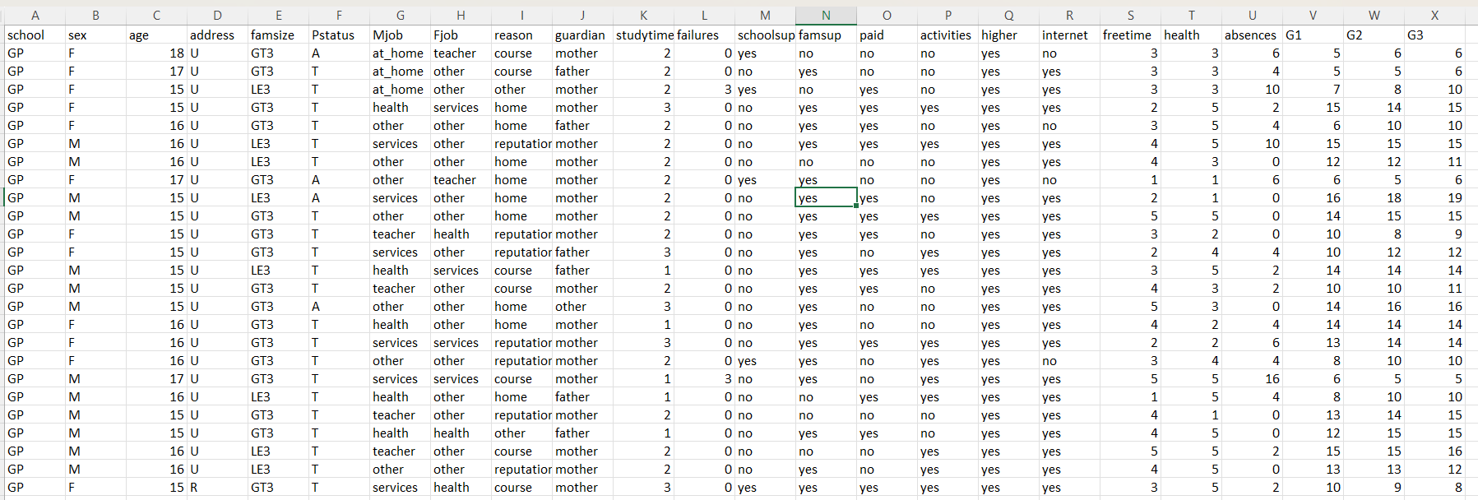
Dataset Csv File

Slide 14
Data Preprocessing
Handling Categorical Variables: Converted text-based categories (e.g., gender, school) into numerical format using Label Encoding.
Data Cleaning : Missing values are eliminated, ensuring the data is clean and ready for processing.
Feature-Target Separation: Separated independent variables (features) from the dependent variable (G3 - student performance).
Train-Test Split: Divided the dataset into an 80:20 ratio for training and testing, respectively. Ensuring model learns effectively and is evaluated on unseen data .

Slide 15
Feature Selection and Encoding
Feature Selection: LabelEncoder from sklearn Library is used to convert non-numeric categorical attributes into numerical format.
Encoding: All the Features are checked for relevance by examining the relationship between encoded data and target.
Based on this analysis, all features are used as an input for our model,

Slide 16
Model Building
Algorithms Used:
Linear Regression – Identifies linear relationships between input features and final grade (G3).
Random Forest Regressor – Captures complex, non-linear interactions using an ensemble of decision trees.
Training:
Models trained on 80% of the data (training set).
Hyperparameter tuning performed to enhance prediction accuracy and reduce overfitting.
Objective:
Predict students' final performance (G3) using academic and demographic features.

Slide 17
Model Evaluation
Evaluation Metrics:
Mean Absolute Error (MAE): Measures average prediction error. (The average difference between predicted and actual values.)
Mean Squared Error (MSE): Penalizes larger errors more heavily by squaring them. (The average of squared differences between predictions and actual values)
R² Score: Indicates how well the model explains variance in student performance (G3).(higher the better)
Testing:
Models evaluated on the 20% test set to assess generalization performance.
Outcome:
Random Forest outperformed Linear Regression on all metrics, showing better capability in handling complex patterns in educational data.

Slide 18
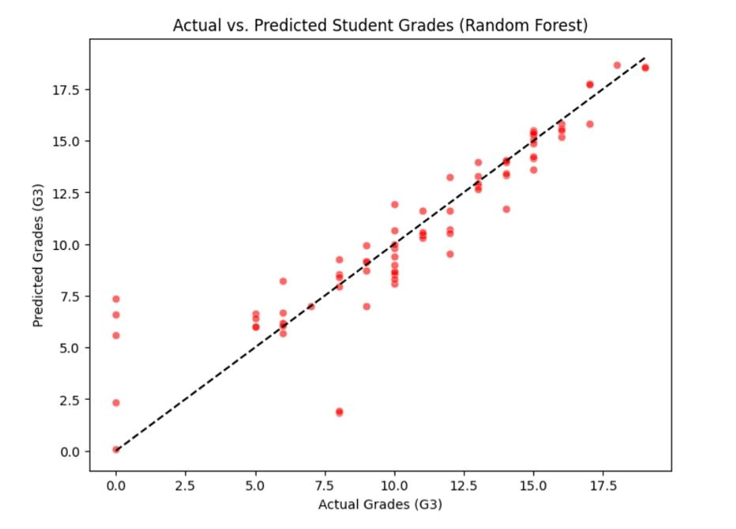
Visualization and Interpretation

Slide 19
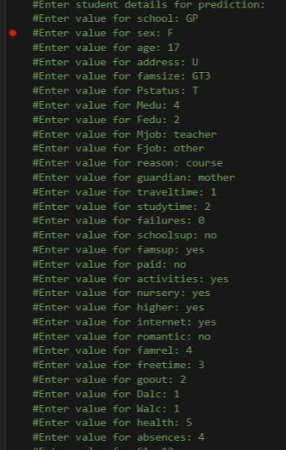

Manual Prediction
Final Manual Prediction Result

Slide 20
References
E. Alhazmi and A. Sheneamer, “Early Predicting of Students’ Performance in Higher Education,” IEEE Access, vol. 11, pp. 27579–27591, 2023. [Online]. Available: https://ieeexplore.ieee.org/document/10169421
Q. Hu and H. Rangwala, “Academic Performance Estimation with Attention-based Graph Convolutional Networks,” arXiv preprint, arXiv:2001.00632, 2019. [Online]. Available: https://arxiv.org/abs/2001.00632
S. Garg and R. Verma, “Prediction of Student Performance Using Machine Learning Techniques,” 2022 7th International Conference on Communication and Electronics Systems (ICCES), pp. 872–877, 2022. [Online]. Available: https://ieeexplore.ieee.org/document/9874521

Slide 21
Conclusion
- Predictive analytics can help educators identify struggling students early.
- Machine learning models offer deeper insights into academic performance trends.
- The system enables data-driven decision-making for improving student success rates.
- Future enhancements include integrating real-time feedback from teachers and parents.

Slide 22
THANK YOU

