Slide 1

FACE RECOGNITION SYSTEM
AI PROJECT
Presented By :
LEELA LAHARI U22CS106
HARSHA HEMANTH U22CS107
SAI KUMAR U22CS124
VAMSHI KOUSHIK U22CS087
APOORVA U22CS117
APRIL 2024
NIT SURAT
*
Notes:
*
Chandra prakash
RAMAN LAB

Slide 2
TABLE OF CONTENTS
Problem statement
Objectives
assumptions
Agent introduction
Ai module used
Working video
My learning
NIT SURAT
*

Slide 3
Problem statement
Face recognition: Identifying or verifying individuals from digital images or video frames.
Significance: widely used in security ,surveillance ,access control,authentication.
Challenges:
- Variations in lighting, pose, expression, occlusion, and aging.
- Need for robust algorithms to handle diverse conditions.
Summary:
- Develop algorithms and systems for accurate face recognition.
- Address challenges related to variability, privacy, and ethics.
*

Slide 4
OBJECTIVES
Face detection.
Face labelling.
Face recognition.
NIT SURAT

Slide 5
ASSUMPTIONS
  Assumed only one prominent face per image for simplicity.if there are multiple faces then dominating face will be detected.
  Assumed a small dataset for training due to resource constraints
  Assumed consistent image quality and resolution across training.
  Assumed a static environment with minimal changes in facial appearance.
  Only trained faces will be detected.
NIT SURAT
*

Slide 6
AGENT INTRODUCTION
PEAS (Performance measure, Environment, Actuators, Sensors):
  Performance Measure: Accuracy of face recognition, speed of detection and recognition.
  Environment: Digital images containing human faces.
  Actuators: Detection and recognition algorithms, display of results.
  Sensors: Input of digital images for processing.
1. Data-Driven Agent: The LBPH face recognition system learns facial patterns from training data, enabling it to recognize faces accurately.
2. Learning and Recognition: Trained on facial images, the agent identifies individuals in new images or video frames by comparing them to learned features, without predefined recognition rules.
NIT SURAT
*

Slide 7
AI MODULE USED
Module 1 : introduction to AI : CV2, NUMPY,OS.
Module 8: Learning from Examples: LBPH (Local Binary Patterns Histograms), using examples of faces to learn discriminative features and patterns for recognition.
Module 9: AI Applications and Ethics: data privacy, surveillance, bias in facial recognition algorithms.
NIT SURAT

Slide 8
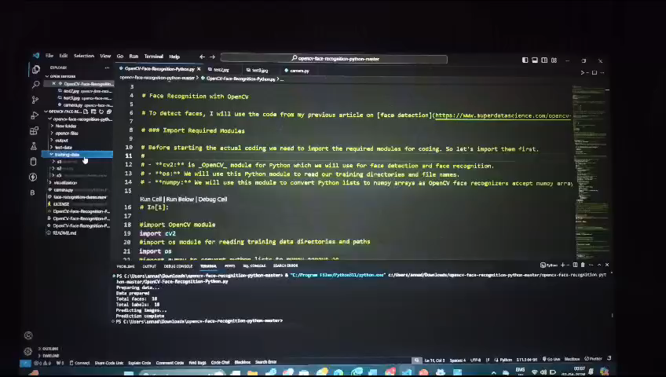
WORKING VIDEO
NIT SURAT

Slide 9
MY LEARNING
Challenges Faced: Data Preparation , Parameter Tuning , Debugging
New Skills Acquired: Face Detection and Recognition , Data Preprocessing , Algorithm Understanding , Project Management
Future Improvements: Performance Optimization , Dataset Expansion , User Interface Enhancement , Integration with Deep Learning , Error Handling and Logging
NIT SURAT

Slide 10
THANK YOU

