Slide 1
GDP-I Week-7 Progress
Team Members:
Kopparthi Sai Dinesh,
Chepuri Tagore Charith,
Emani Aasrita,
Dasari Vamshika,
Maddela Tejaswi,
Veldanda Sailaxmi

Slide 2
Contents
Work Completed in Previous Week
Work Completed in Present Week
Contribution
Next Steps

Slide 3
Work Completed in Previous Week
Created 5 new interactive wireframes and Implemented navigations within the wireframes.
Started research into development environment set-up.

Slide 4
Work Completed in Present Week
Defined system architecture for the project.
Set-up a collaborative git repository for the project.

Slide 5



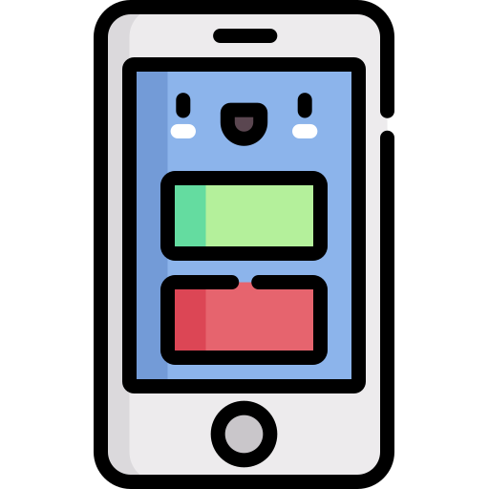
Work Completed in Present Week – System Architecture
Frontend
Backend
Authentication
Server
Database
User Interface

Slide 6
Work Completed in Present Week
Tools and Technologies:
User Authentication:
Firebase Authentication: A popular authentication service by Google that provides secure user sign-ins.
User Interface:
XML Layout: To define the structure and appearance of UI components within Android app screens.
Server:
Node.js: Backend frameworks for server development.
Database:
Firebase Realtime Database, SQLite: Database for server-based data.
Data Parsing:
Java: CSV parsing using libraries like Apache Commons CSV.
Python: Built-in ‘csv’ module.

Slide 7
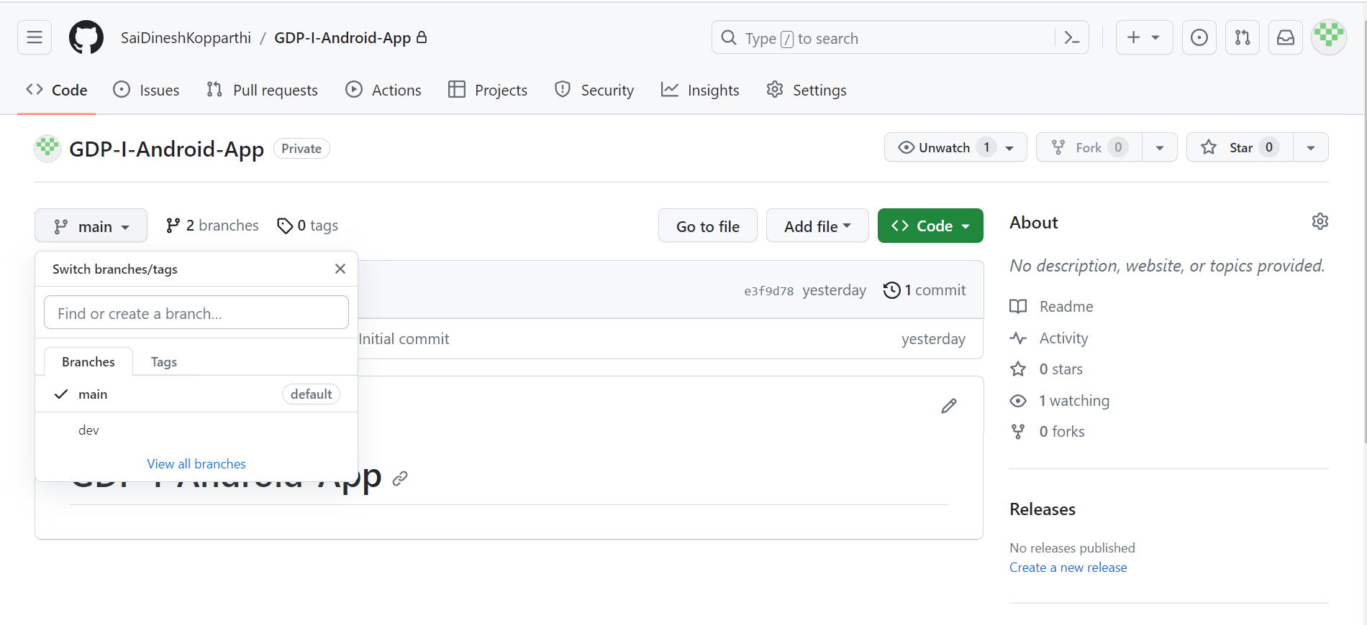
Work Completed in Present Week – Git Repository
Branch ‘main’ : Source code hosting.
Branch ‘dev’: Branch for development.

Slide 8
Contribution
Team Member | Tasks
Veldanda Sailaxmi | Defining the system architecture for the application.
Emani Aasrita | Defining the system architecture for the application.
Maddela Tejaswi | Research into tools and technologies for the application.
Dasari Vamshika | Research into tools and technologies for the application.
Chepuri Tagore Charith | Research into tools and technologies and develop environment.
Kopparthi Sai Dinesh | Setting up of git repository and implementing required branch settings.

Slide 9
Next steps
Research into detailed technology stack required for each component of the project.
Continuing with the set-up of the development environment.
Find out the perfect configurations required for the creation of android project.

Slide 10
THANK YOU

