Slide 1
GDP – I ANDROID APPLICATION
Team Members
Kopparthi Sai Dinesh,
Chepuri Tagore Charith,
Emani Aasrita,
Dasari Vamshika,
Maddela Tejaswi,
Veldanda Sailaxmi

Slide 2
Introduction to Week 4
In Week 4, our focus was on critical tasks that laid the foundation for our project. Here's a summary of our objectives:
Creating wireframes for the login screen and department screen.
Gaining proficiency in using Figma, our chosen design tool.
Engaging in collaborative discussions to brainstorm and refine our wireframe designs.

Slide 3
Learning Figma
This week, we invested time in learning how to use Figma, a powerful design tool. We took the following steps to familiarize ourselves with Figma:
Utilized online tutorials and resources to understand Figma's capabilities.
Explored the Figma interface and key features.
Practiced creating basic shapes, elements, and layouts in Figma.
Key Takeaways:
Figma is a versatile and user-friendly design tool.
We now have a solid foundation to create wireframes and design elements efficiently.

Slide 4
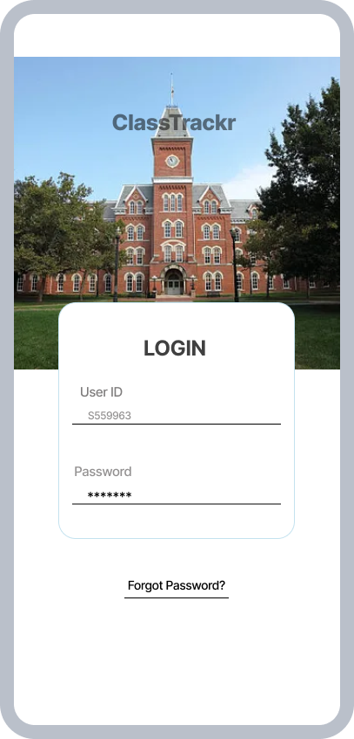
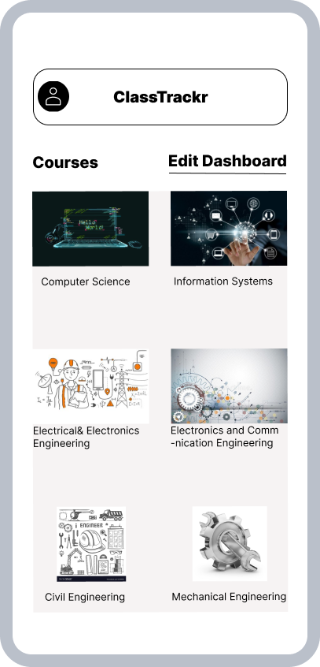
Wireframe Designs
The initial wireframe designs for the login screen and department screen:

Slide 5
Wireframe Designs
Design Considerations:
Login Screen:
The screen contains two text fields that take User ID and password.
It also contains a link which lets the user reset their password, in case they forget it.
Department Screen:
The Screen contains on top an option to view user profile and logout of application.
It also contains the list of departments in a materialistic way.

Slide 6
Conclusion and Next Steps
In conclusion, Week 4 marked significant progress in our project:
Successful creation of wireframes for key screens.
Attainment of foundational Figma skills.
Looking ahead to Week 5:
Continuing with the wireframes design for remaining screens and making further modifications to already created login and department screens based on collective feedback within the team.

