Slide 1
GDP-I Week-12 Progress
Team Members:
Kopparthi Sai Dinesh,
Chepuri Tagore Charith,
Emani Aasrita,
Dasari Vamshika,
Maddela Tejaswi,
Veldanda Sailaxmi
1

Slide 2
Contents
Work Completed in Previous Week
Work Completed in Present Week
Contribution
Next Steps
2

Slide 3
Work Completed in Previous Week
Re-Creation of project due to configuration issues.
Creation of constrained XML layout for login screen
Working on integrating our app with firebase.
3

Slide 4
Work Completed in Present Week
Implementing java file for the Login Screen.
Developing XML Layout for the Department Screen.
Continued with the research for development tools and technology
4

Slide 5
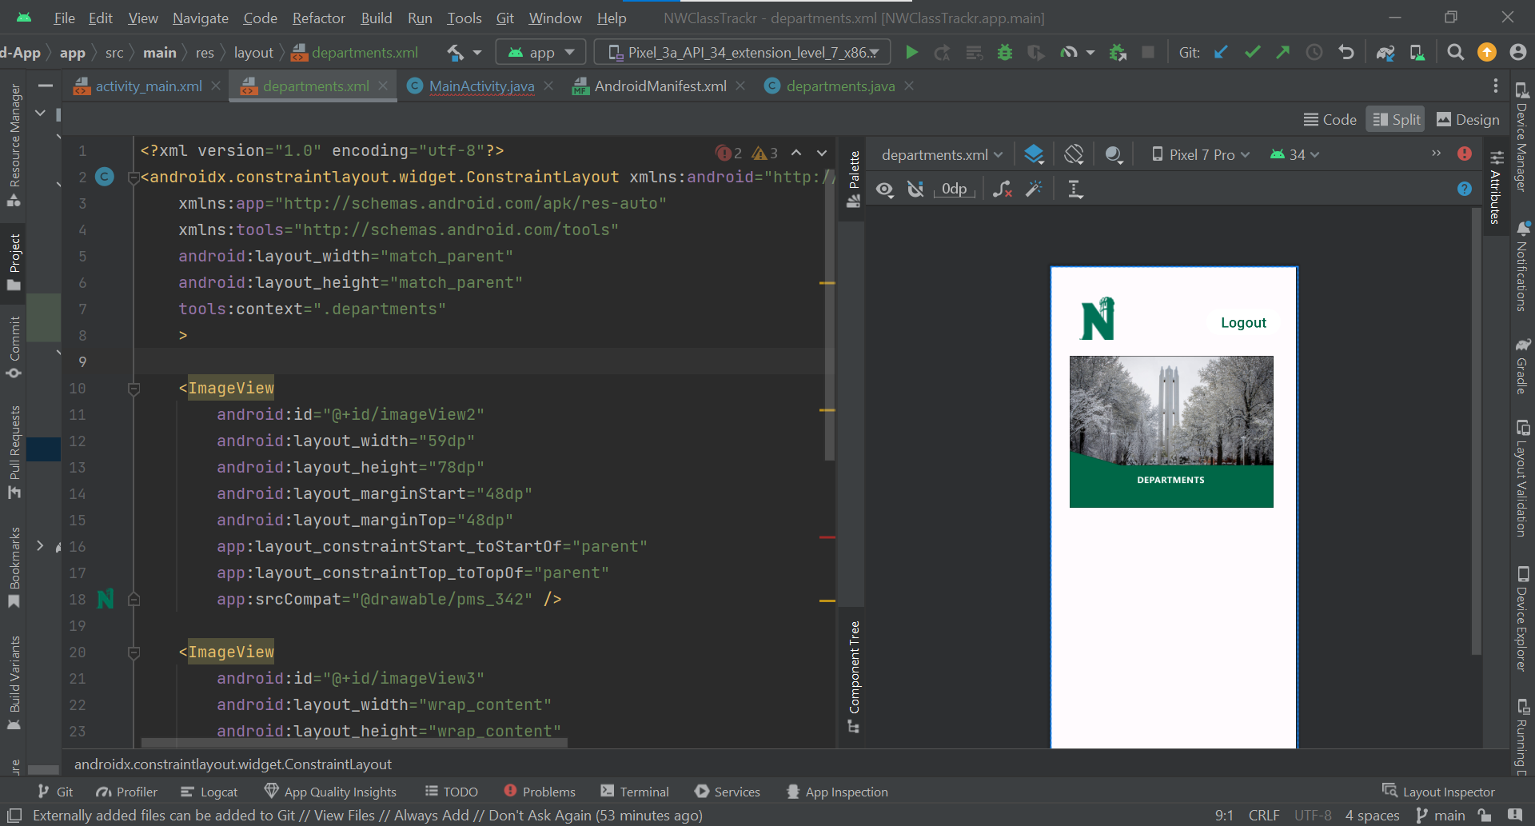
Work Completed in Present Week – Departments Layout
Design View for the departments Screen
XML code for the departments screen
5

Slide 6
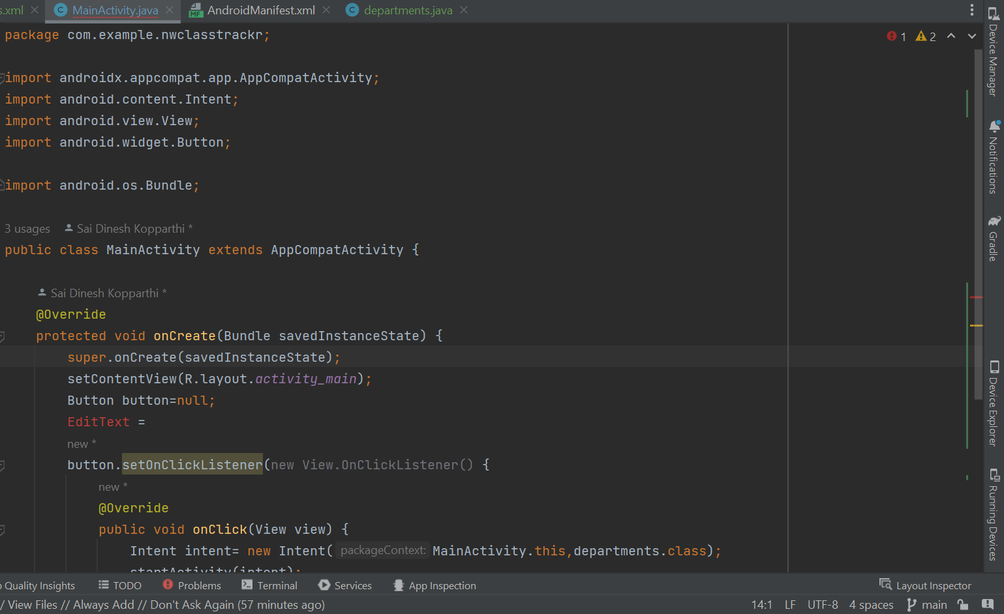
Work Completed in Present Week
Code to initiate Navigation from Login screen to Departments Screen
6

Slide 7
Contribution
Team Member | Tasks
Veldanda Sailaxmi | Java Code for navigation – login to departments
Emani Aasrita | Creating XML Layout for departments Screen
Maddela Tejaswi | Creating XML Layout for departments Screen
Dasari Vamshika | Creating XML Layout for departments Screen
Chepuri Tagore Charith | Java Code for navigation – login to departments
Kopparthi Sai Dinesh | Java Code for navigation – login to departments. Research in to tools and technologies for project
7

Slide 8
Next steps
Completing XML Layout for the Department Screen.
Creating java file for the Department Screen.
Continuing with the research for development tools and technology
8

Slide 9
THANK YOU

