Slide 1
Protocols 44643 mobile Computing – iOS
Instructor: Dr. Chandra Mouli
Northwest Missouri State University

Slide 2
Table of contents
Introduction
Creating and adopting protocols
Properties and methods
Protocol names as types
Protocol composition
Optional properties and methods
Delegation
Conclusion

Slide 3
Introduction
A protocol is an outline, or contract, of behavior that a type can implement.
It’s only a blueprint of methods and properties.
Any type can adopt a protocol to gain extra functionality to perform a task or set of tasks.
Adopting a protocol means agreeing to the contract it defines.
In Swift, classes, enums and structs can adopt protocols.
Type that adopts a protocol and implements its defined behavior is said to conform to the protocol.
Syntax:
protocol TestProtocol{
// properties, methods, etc.
}

Slide 4

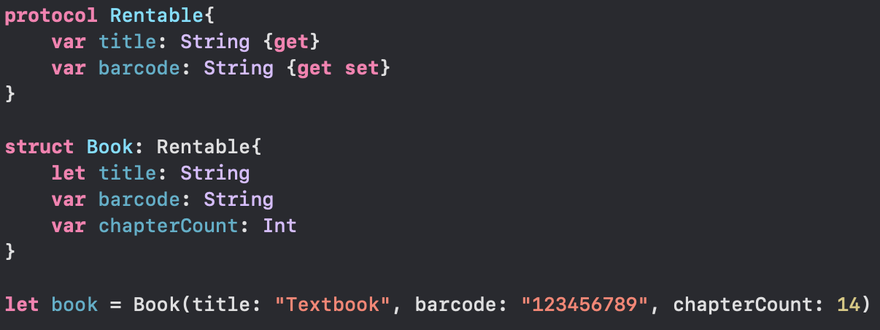
Creating and adopting protocols
To adopt a protocol, use same syntax as we do for a class inheriting from a superclass.
If a class inherits from a superclass and need to conform to a protocol, list superclass first and then protocol second.
Of course, a class can inherit from only one superclass, but can implement one or more protocols.
class SomeClass: SuperClassOfSomeClass, ProtocolOne, ProtocolTwo, …{
}

Slide 5
properties
Property requirements are always introduced with var keyword inside a protocol.
var barcode: String {get set} // both gettable (read) and settable (write)
A property with {get set} cannot be implemented as a constant. However, a property with {get} can be implemented in the conforming type as read-write.
In struct Book,
var title: String // OK
let barcode: String // NOT OK
Conforming types can have more beyond the defined implementation.
var chapterCount: Int
Type properties are defined with class keyword.
While implementing, use static keyword for a struct or enum, and class keyword for classes.

Slide 6
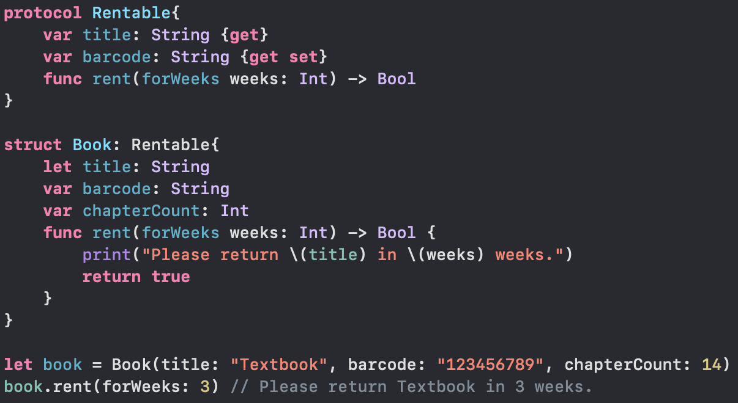
Methods
Define methods – name of the method, list of parameters, and return type.
No body i.e., no braces for methods.
Use mutating keyword for a method in a protocol if it mutates a type’s properties (valid for classes as well).
Like type properties, class keyword for classes, and static keyword for structs and enums.
Define initializers inside a protocol and implement them using required keyword in the conforming type.

Slide 7
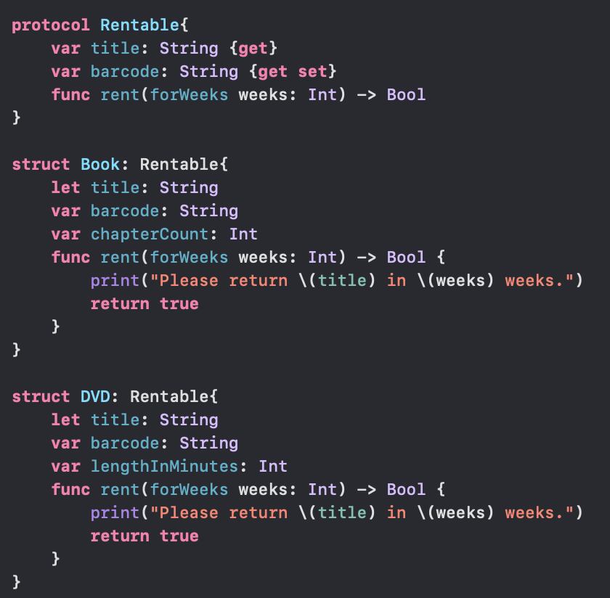
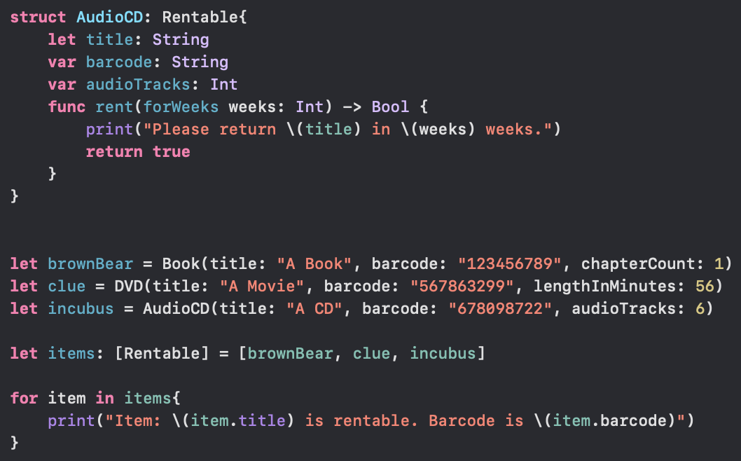
Protocol names as types

Slide 8
Protocol composition
In functions, if a parameter’s argument is an instance that conformed to multiple protocols and function body’s accessed properties or methods from multiple protocols, we use protocol composition to define the parameter type properly. For this, use protocol keyword.
func someMethod(composedProperty: protocol<ProtocolOne, ProtocolTwo>){}

Slide 9
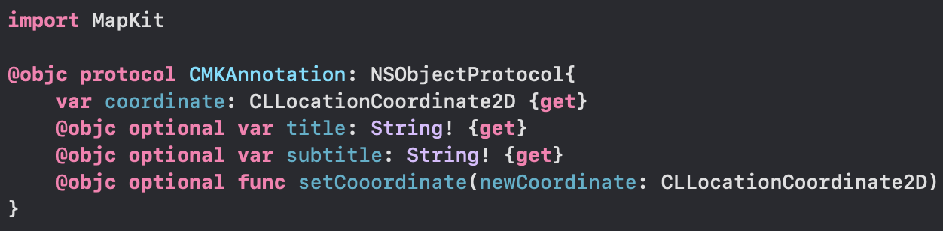
Optional properties and methods
Not the same as Optional type.
Inside a protocol, an optional property or method means that the conforming type is not required to implement that property or method, but it could.

Slide 10
delegation
A way to implement blind structured communication between a View and its Controller.
Controller
delegate
data source
View

Slide 11
Delegation mechanism
How it works:
A View declares a delegation protocol (i.e., what the View wants the Controller to do for it), for example, UITableView declares a UITableViewDelegate protocol.
The View’s API has a weak delegate property whose type is that delegation protocol.
weak open var delegate: UITableViewDelegate?
The View uses the delegate property to get/do things it can’t own or control on its own.
The Controller declares that it implements the protocol.
class ViewController: UIViewController, UITableViewDelegate {}
The Controller sets self as the delegate of the View by setting the property in step 2 above.
someTableView.delegate = self
The Controller implements (properties and methods) the protocol.

Slide 12
Conclusion
A protocol is only a blueprint of methods and properties.
In Swift, classes, enums and structs can adopt protocols.
A conforming type must implement all the non-optional properties and methods of a protocol.
A delegate means “an object that acts on behalf of, or in coordination with, another object when that object encounters an event in a program.”

Slide 13
Reference
Miller, B. J. (2014). Sams Teach yourself Swift in 24 hours. Pearson Education.
https://www.youtube.com/watch?v=d83KZk816lk

Slide 14
Protocols 44643 mobile Computing – iOS
Instructor: Dr. Chandra Mouli
Northwest Missouri State University

