Slide 1
Strings AND Characters 44643 Mobile Computing - iOS
Instructor: Dr. Chandra Mouli
Northwest Missouri State University

Slide 2
Table of contents
Introduction
String Literals
Initializing an Empty String
String Mutability
Strings Are Value Types
Working with Characters
Concatenating Strings and Characters
String Interpolation
Unicode
Counting Characters
Accessing and Modifying a String
Substrings
Comparing Strings
Conclusion

Slide 3
Introduction
A string is a series of characters, such as "hello, world" or "albatross".
Swift strings are represented by the String type. The contents of a String can be accessed in various ways, including as a collection of Character values.
The syntax for string creation and manipulation is lightweight and readable.
A string literal is a sequence of characters surrounded by double quotation marks (").

Slide 4
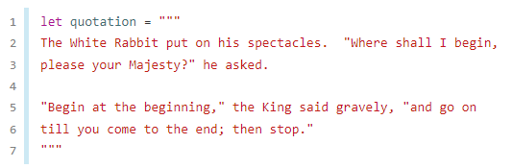
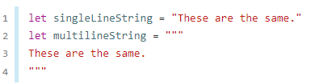
Multiline string Literals
If you need a string that spans several lines, use a multiline string literal—a sequence of characters surrounded by three double quotation marks.
The string begins on the first line after the opening quotation marks (""") and ends on the line before the closing quotation marks.
no line breaks and same output when printed

Slide 5

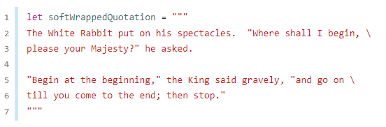
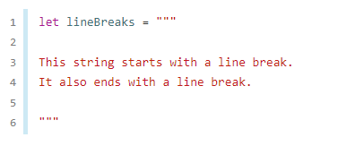
Multiline string Literals
If you want to use line breaks to make your source code easier to read, but you don’t want the line breaks to be part of the string’s value, write a backslash (\) at the end of those lines.
To make a multiline string literal that begins or ends with a line feed, write a blank line as the first or last line.

Slide 6
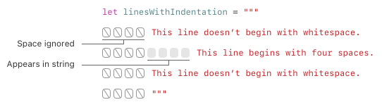
Multiline string Literals
A multiline string can be indented to match the surrounding code. The whitespace before the closing quotation marks (""") tells Swift what whitespace to ignore before all of the other lines.
However, if you write whitespace at the beginning of a line in addition to what’s before the closing quotation marks, that whitespace is included.

Slide 7
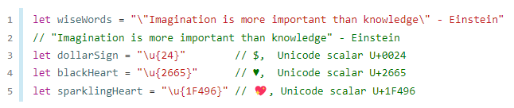
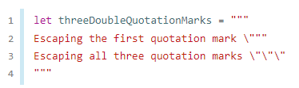
Special Characters in String Literals
String literals can include the following special characters:
The escaped special characters \0 (null character), \\ (backslash), \t (horizontal tab), \n (line feed), \r (carriage return), \" (double quotation mark) and \' (single quotation mark).
An arbitrary Unicode scalar value, written as \u{n}, where n is a 1–8 digit hexadecimal number.

Slide 8

Extended String Delimiters
You can place a string literal within extended delimiters to include special characters in a string without invoking their effect.
Examples:
#"Line 1\nLine 2"# prints the line feed escape sequence (\n) rather than printing the string across two lines.
To break the line, you can use #"Line 1\#nLine 2"#
Similarly, ###"Line1\###nLine2"### also breaks the line.
You can use extended delimiters to include the text """ in a multiline string, overriding the default behavior that ends the literal.

Slide 9
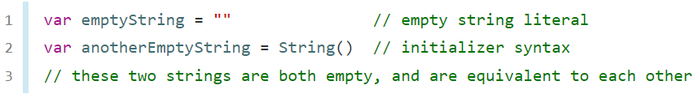
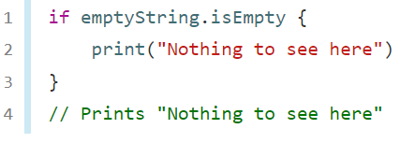
Initializing an Empty String
To create an empty String, either assign an empty string literal to a variable, or initialize a new String instance with initializer syntax.
To find out whether a String value is empty by checking its Boolean isEmpty property.

Slide 10
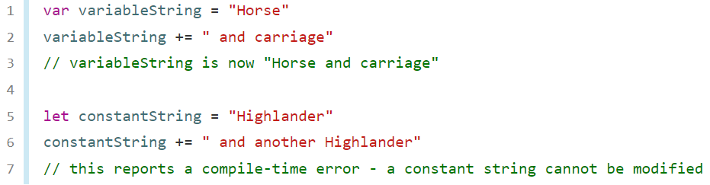
String Mutability
To indicate whether a particular String can be modified (or mutated) by assigning it to a variable (in which case it can be modified), or to a constant (in which case it can’t be modified).

Slide 11
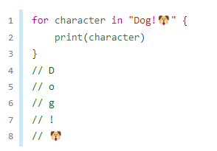
Strings Are Value Types
Swift’s String type is a value type. If you create a new String value, that String value is copied when it’s passed to a function or method, or when it’s assigned to a constant or variable.
Working with Characters:

Slide 12
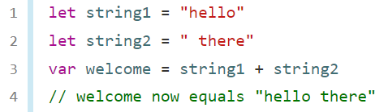
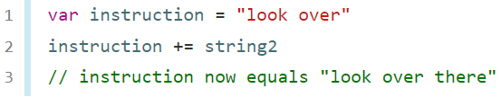
Concatenating Strings and Characters
String values can be added together (or concatenated) with the addition operator (+) to create a new String value.
We can also append a String value to an existing String variable with the addition assignment operator (+=).

Slide 13
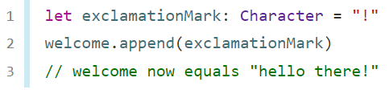
Concatenating Strings and Characters Cont’d...
Append a Character value to a String variable with the String types append() method.
We can’t append a String or Character to an existing Character variable, because a Character value must contain a single character only.

Slide 14
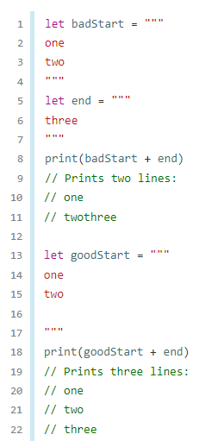
Concatenating Strings and Characters Cont’d...
Multiline strings concatenation.

Slide 15
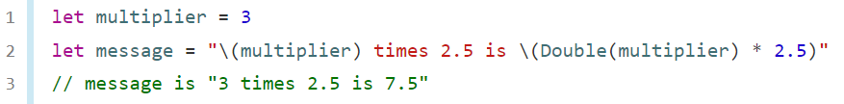
String Interpolation
String interpolation is a way to construct a new String value from a mix of constants, variables, literals, and expressions by including their values inside a string literal.
Each item that you insert into the string literal is wrapped in a pair of parentheses, prefixed by a backslash (\).
The expressions you write inside parentheses within an interpolated string can’t contain an unescaped backslash (\), a carriage return, or a line feed. However, they can contain other string literals.

Slide 16
Unicode
Unicode is an international standard for encoding, representing, and processing text in different writing systems.
Swift’s String and Character types are fully Unicode-compliant.
Swift’s native String type is built from Unicode scalar values. A Unicode scalar value is a unique 21-bit number for a character or modifier.
U+0061 for LATIN SMALL LETTER A ("a")
U+1F425 for FRONT-FACING BABY CHICK ("🐥")

Slide 17

Unicode cont’d…
Extended grapheme clusters are a flexible way to represent many complex script characters as a single Character value.

Slide 18
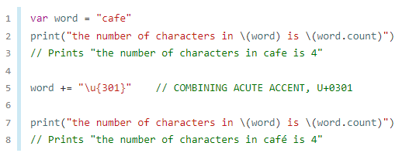
Counting characters
Use the count property of the string.

Slide 19
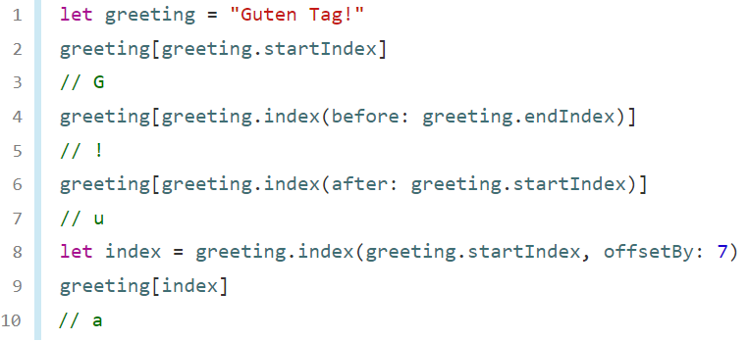
Accessing and Modifying a String
Each String value has an associated index type, String.Index, which corresponds to the position of each Character in the string.
Swift strings are not indexed by integer values.
Use the startIndex property to access the position of the first Character of a String. The endIndex property is the position after the last character in a String.
You access the indices before and after a given index using the index(before:) and index(after:) methods of String.
To access an index farther away from the given index, you can use the index(_:offsetBy:)

Slide 20
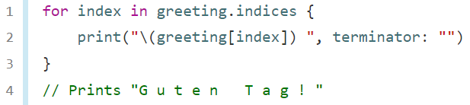
Accessing and Modifying a String Cont’d...
Attempting to access an index outside of a string’s range or a Character at an index outside of a string’s range will trigger a runtime error.
Use the indices property to access all of the indices of individual characters in a string.
It is possible to use the startIndex and endIndex properties and the index(before:), index(after:), and index(_:offsetBy:) methods on any type that conforms to the Collection protocol.
String, Array, Dictionary, Set

Slide 21
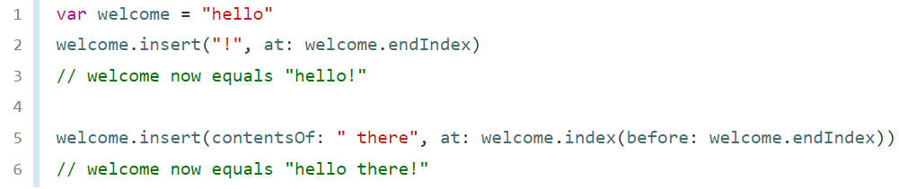
Accessing and Modifying a String Cont’d...
To insert a single character into a string at a specified index, use the insert(_:at:) method, and to insert the contents of another string at a specified index, use the insert(contentsOf:at:) method.

Slide 22
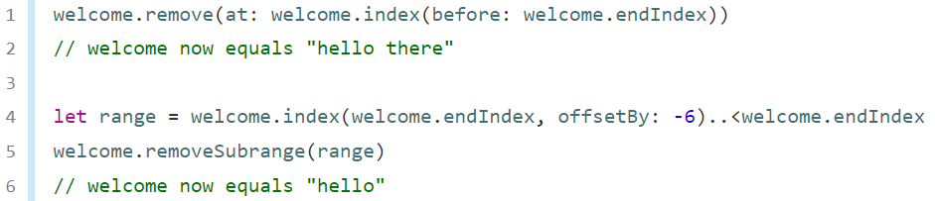
Accessing and Modifying a String Cont’d...
To remove a single character from a string at a specified index, use the remove(at:) method, and to remove a substring at a specified range, use the removeSubrange(_:) method.
Use the insert(_:at:), insert(contentsOf:at:), remove(at:), and removeSubrange(_:) methods on any type that conforms to the RangeReplaceableCollection protocol.
String, Array, Dictionary, Set

Slide 23
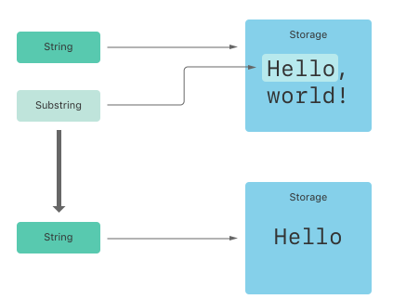
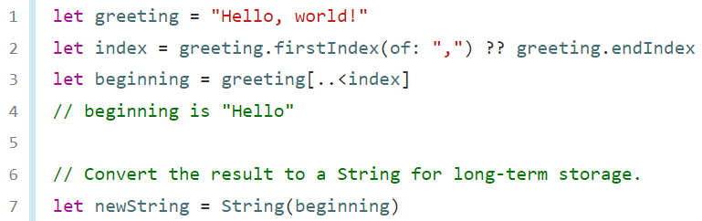
Substrings
When you get a substring from a string, the result is an instance of Substring, not another string.
Substrings in Swift have most of the same methods as strings, which means you can work with substrings the same way you work with strings.
beginning is a substring of greeting, it reuses the memory that greeting uses.

Slide 24
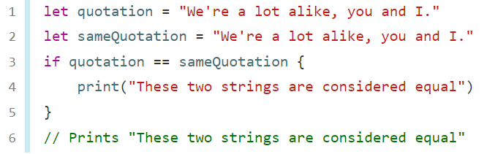
Comparing Strings
String and character equality is checked with the “equal to” operator (==) and the “not equal to” operator (!=).

Slide 25
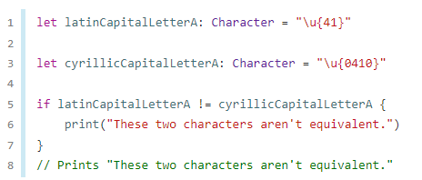
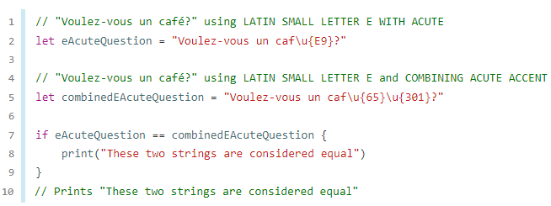
Comparing Strings cont’d…
Two String values (or two Character values) are considered equal if their extended grapheme clusters are canonically equivalent.

Slide 26
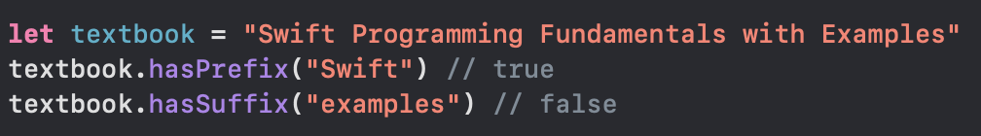
Prefix and Suffix Equality
To check whether a string has a particular string prefix or suffix, call the string’s hasPrefix(_:) and hasSuffix(_:) methods, both of which take a single argument of type String and return a Boolean value.

Slide 27
Conclusion
A string is a series of characters, such as "hello, world" or "albatross".
The syntax for string creation and manipulation is lightweight and readable, with a string literal syntax that’s similar to C.
Despite this simplicity of syntax, Swift’s String type is a fast, modern string implementation.
Every string is composed of encoding-independent Unicode characters, and provides support for accessing those characters in various Unicode representations.

Slide 28
Reference
https://www.swift.org/documentation/#swift-language

Slide 29
Strings AND Characters 44643 Mobile Computing - iOS
Instructor: Dr. Chandra Mouli
Northwest Missouri State University

