Slide 1
Closures in swift 44643 mobile Computing – iOS
Instructor: Dr. Chandra Mouli
Northwest Missouri State University

Slide 2
Table of contents
Introduction
Structure of closure expressions
Type inference
Shorthand syntax for arguments
Trailing closure syntax
Operator functions
Functions as return types and arguments
Closure capture values
Closures as reference types
Functional programming
Higher-order functions
Map, filter, and reduce
Conclusion

Slide 3
Introduction
Closures are discrete bundles of functionality that can be used in your application to accomplish specific tasks. (Anonymous functions)
A function is a named closure.
Compared to functions, they have a more compact and lightweight syntax.
Global functions – named closures but do not capture any values from a containing context.
Nested functions - named closures and can capture values from a containing function.
Closures – do not have a name but can capture values from a containing context.
The act of capturing outside values and references to be used inside a closure is called closing, hence the name closure.

Slide 4

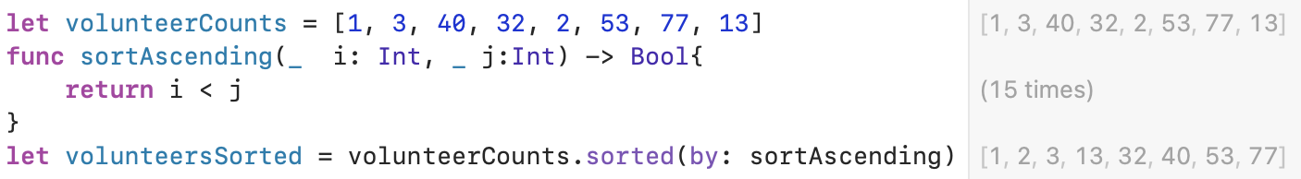
Example

Slide 5
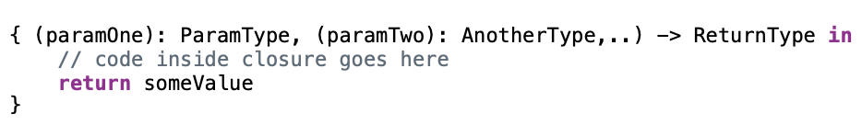
Structure of closure expressions

Slide 6
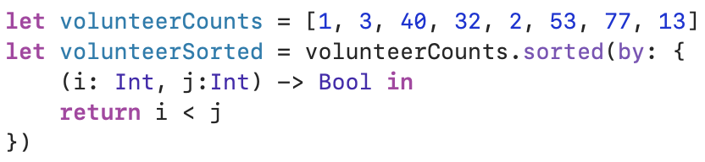
Example

Slide 7
Type inference
Previous code is a little verbose. Closures can take advantage of Swift’s type inference system.

Slide 8
Shorthand syntax for arguments
The compiler know sorted(by:) takes a closure.
Closure itself take two parameters that are of the same type as the items in the array.
Incidentally, for a closure with more than two arguments use $2, $3, and so on.

Slide 9

Trailing closure syntax
“Brevity is the soul of wit.”
If a closure is passed to a function’s final argument, it can be written inline, outside of and after the function’s parenthesis.

Slide 10

Operator functions
Some closure expressions in Swift require a Boolean return value, such as with sorting.
Using operator functions, we can reduce a final parameter to just an operator, such as < or > for sorting.

Slide 11
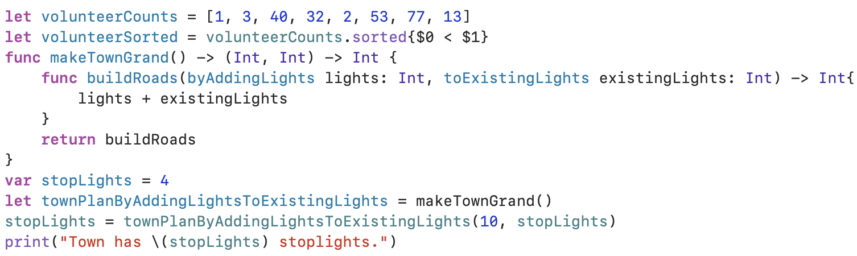
Functions as return types
Output?
Town has 14 stoplights.

Slide 12
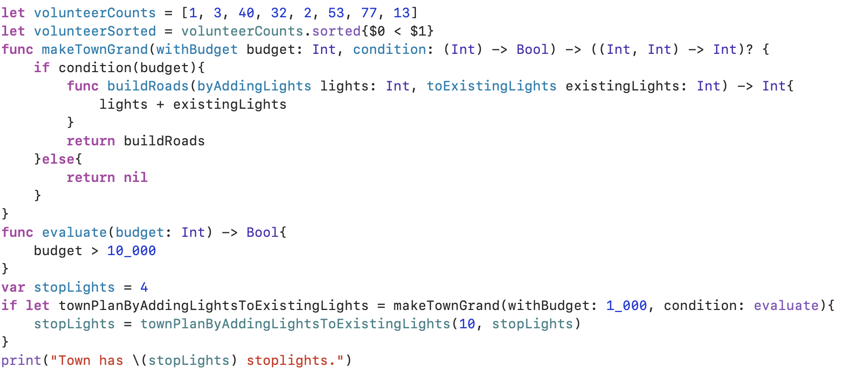
Functions as arguments
Functions can serve as arguments to other functions.
Now, invoke makeTownGrand with budget 10_500

Slide 13
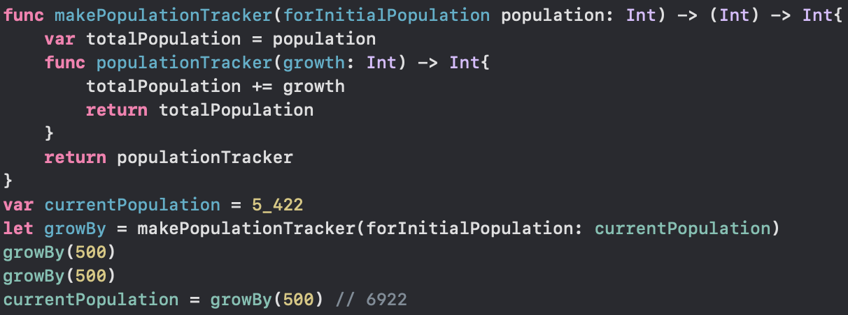
Closures capture values
Closures and functions can keep track of internal information encapsulated by a variable defined in their enclosing scope.

Slide 14
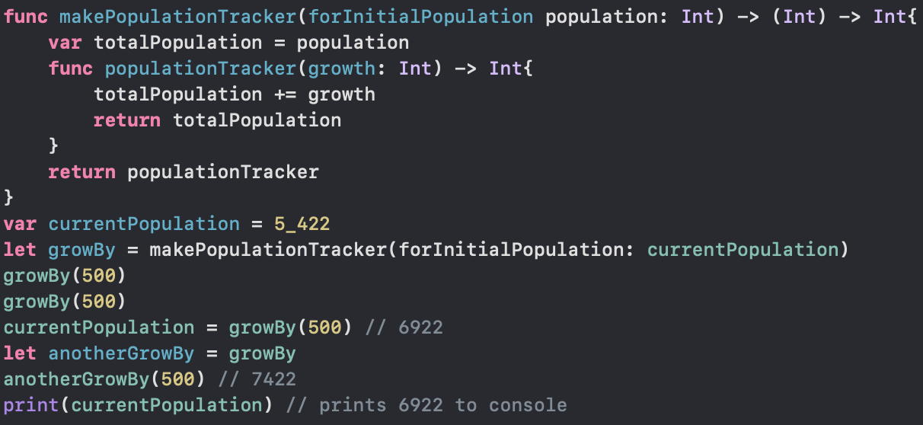
Closures are reference types
Assigning a function to a constant or variable makes that constant or variable to point to the function.
Distinct copy of that function is not created.

Slide 15
Functional programming
First-class functions - functions can be returned from and passed as arguments to other functions, can be stored in variables, etc.; they are just like any other type.
E.g., Int, String, etc.
Pure functions – functions have no side effects; functions, given the same input, always return the same output and do not modify other states elsewhere in the program.
E.g., sin, cos, etc.
Immutability – mutability is de-emphasized as it is more difficult to reason about data whose values can change.
E.g., let keyword
Strong typing – a strong type system increases the runtime safety of the code because the guarantees of the language’s type system are checked at compile time.
Swift supports all of these approaches.

Slide 16
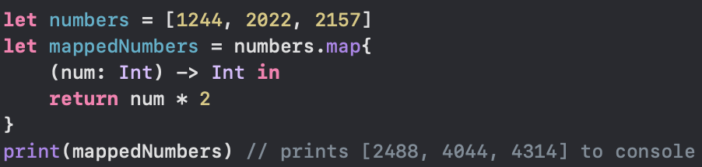
Higher-order functions
They take at least one function as input.
E.g., sorted(by:)
Map – Map function is used to transform contents of a collection (e.g., Array).

Slide 17
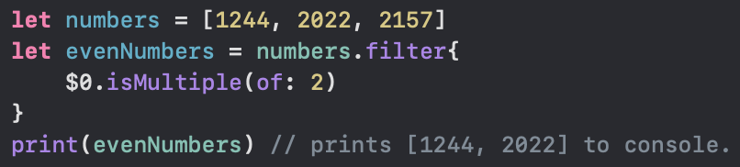
Higher-order functions
Filter – It’s purpose is to filter group of elements based upon some criteria.

Slide 18
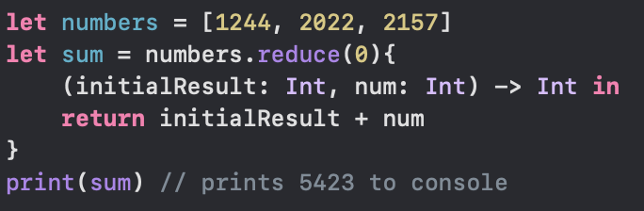
Higher-order functions
Reduce – It’s job is to reduce values in a collection to a single value that is returned from the function.

Slide 19
Conclusion
Closures are a powerful feature, enabling us to send a closure as an argument to a function and drastically reduce the amount of code needed to not only complete the task but also clearly describe what the code should be doing in the closure expression.
Five key features, namely, type inference, implicit returns, shorthand argument names, trailing closures, and operator functions.

Slide 20
References
Mathias, M., & Gallagher, J. (2016). Swift Programming: The Big Nerd Ranch Guide. Pearson Technology Group.
Miller, B. J. (2014). Sams Teach yourself Swift in 24 hours. Pearson Education.

Slide 21
Closures in swift 44643 mobile Computing – iOS
Instructor: Dr. Chandra Mouli
Northwest Missouri State University

