Slide 1
Structs and classes 44643 mobile Computing – iOS
Instructor: Dr. Chandra Mouli
Northwest Missouri State University

Slide 2
Table of contents
Introduction
Structs
Classes
Inheritance
Preventing overriding
Type methods
Conclusion

Slide 3
Introduction
Structures (aka structs) and classes are the pillars on which you build your applications.
A struct is a type that groups a set of related chunks of data together in memory.
Use structs when there is a need to group data together under common type.
A struct encapsulates its data within a single type and placing its definition in its own file provides a convenient location to find its implementation.

Slide 4
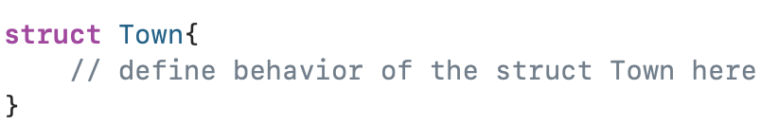
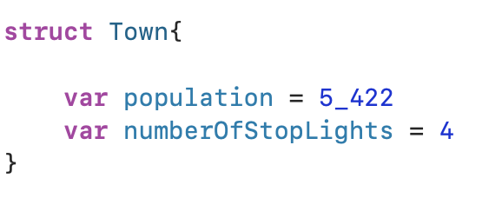
Structs
To declare a structure, use struct keyword.
Variables or constants can be added as properties.

Slide 5
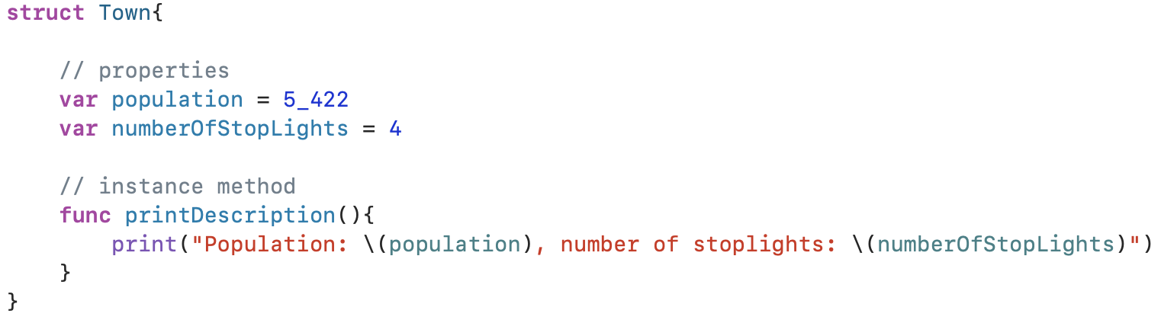
structs
To create an instance of struct Town, use its default initializer.
Instance methods can be invoked using myTown instance, for example, myTown.printDescription()

Slide 6
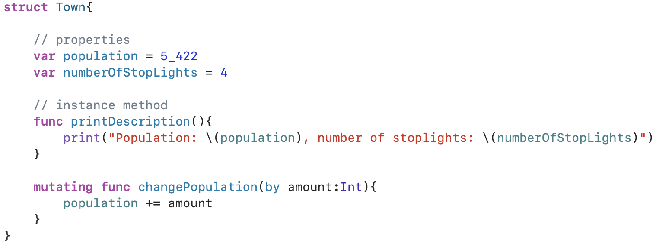

structs
Mutating methods are functions inside a struct that change the struct’s properties. Structs and enums are value types and require the “mutating” keyword on methods that change value of an instance’s properties.
If an instance method on a struct changes any of the struct’s properties, it must be marked as mutating.

Slide 7
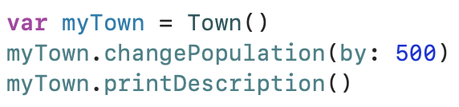
structs
What’s the output?
Population: 5922, number of stoplights: 4

Slide 8
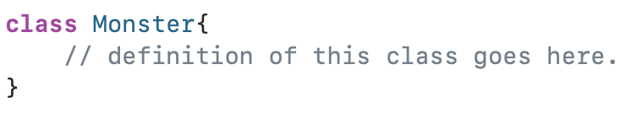
classes
Like structs, classes are used to model related data under a common type.
Declaration is done using the class keyword.

Slide 9
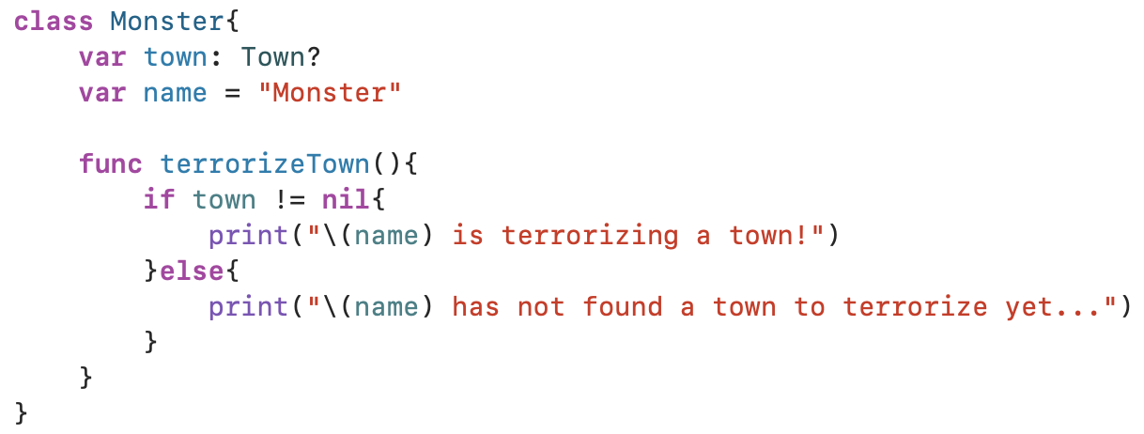
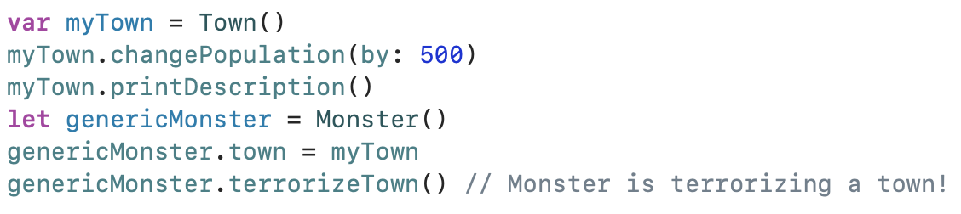
classes
Monster class | Outside the Monster class

Slide 10
inheritance
Inheritance is a relationship in which one class, a subclass, is defined in terms of another, a superclass.
The subclass inherits the properties and methods of its superclass.
Structs do not have inheritance.

Slide 11

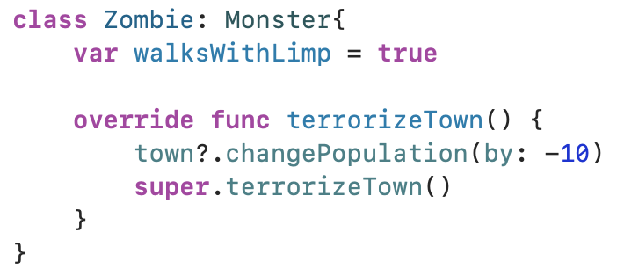
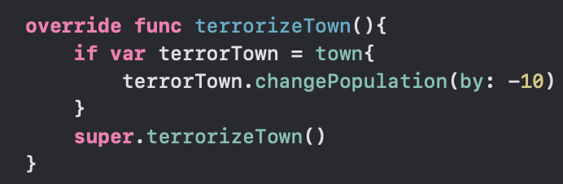
Inheritance
A Zombie subclass.
super.terrorizeTown()
Used super to call Monster class’s implementation of terrorizeTown()
super is invoked to borrow or override functionality from a superclass.
Question: Why optional chaining, why not optional binding?
Answer: With optional binding, any changes made on the terrorTown will not be reflected in the Zombie instance’s town property.
Notes:
The value semantics of struct means that the terrorTown instance will not be the same as the town instance.
Value types are always copied when you pass them around in the code.

Slide 12
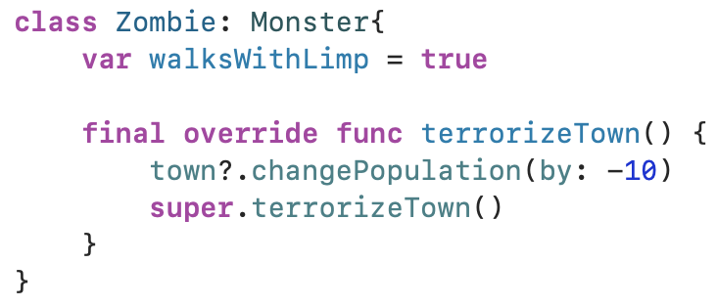
Preventing overriding
All subclasses of Zombie should terrorize their towns in the exact same way.
Add the final keyword to the function terrorizeTown() in Zombie class.
Can be applied to properties as well.

Slide 13
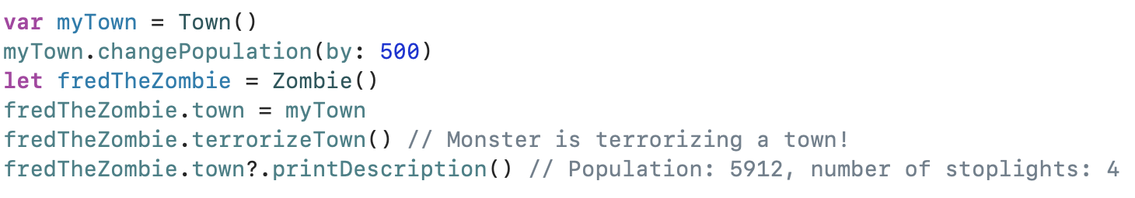
Example

Slide 14
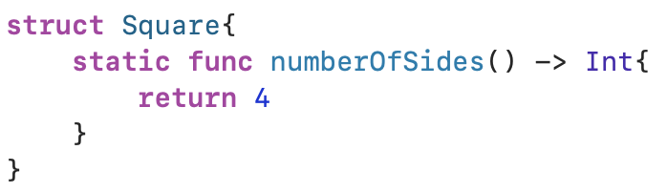
Type methods
For structs, use static keyword.
Usage:

Slide 15
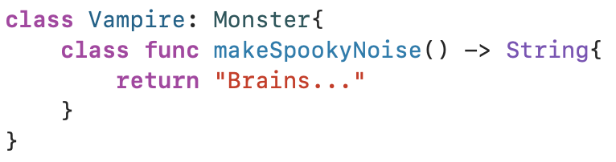
Type methods
For classes, use class keyword.
Usage:
What if the class method should not be overridden by subclasses?
Use static keyword instead of class.
Use final class instead of just class.

Slide 16
Access control
Access Level | Description | Visible to… | Subclassable within…
open | Entities are visible and subclassable to all files in the module as well as those that import the module. | Defining module and importing modules | Defining module and importing modules
public | Entities are visible to all files in the module and those that import the module. | Defining module and importing modules | Defining module
internal (the default) | Entities are visible to all files in the module. | Defining module | Defining module
fileprivate | Entities are visible only within their defining source file. | Defining file | Defining file
private | Entities are visible only within their defining scope. | scope | scope

Slide 17
Conclusion
Structs and classes provide important mechanisms to model the things what developers wish to represent in their code.
If a type is needed to be passed by value, use a struct. Doing so will ensure that the type is copied when assigned or passed into a function’s argument.
If type does not need to support subclasses inheriting from it, then use a struct. Structs do not support inheritance, and so they cannot be subclassed.
If the behavior to be represented in a type is relatively straightforward and encompasses a few simple values, consider starting out with a struct. It can always be changed to a class later.
Use a class in all other cases.

Slide 18
Reference
Mathias, M., & Gallagher, J. (2016). Swift Programming: The Big Nerd Ranch Guide. Pearson Technology Group.

Slide 19
Structs and classes 44643 mobile Computing – iOS
Instructor: Dr. Chandra Mouli
Northwest Missouri State University

